Slide 1
FEMALE REPRODUCTIVE ANATOMY& PHYSIOLOGY

Slide 2
Objectives: by the end of this session, students will be able to:
Identify parts of female reproductive system.
Discuss functions of each part.
Recognize female sex hormones.
Practice breast self examination.
Express understanding of menstrual cycle.

Slide 3
Introduction
This information is important because it will raise your level of awareness and understanding about your physical body.
It is imperative that you learn the changes you can expect to experience from menarche to menopause as you live with your female reproductive system

Slide 4
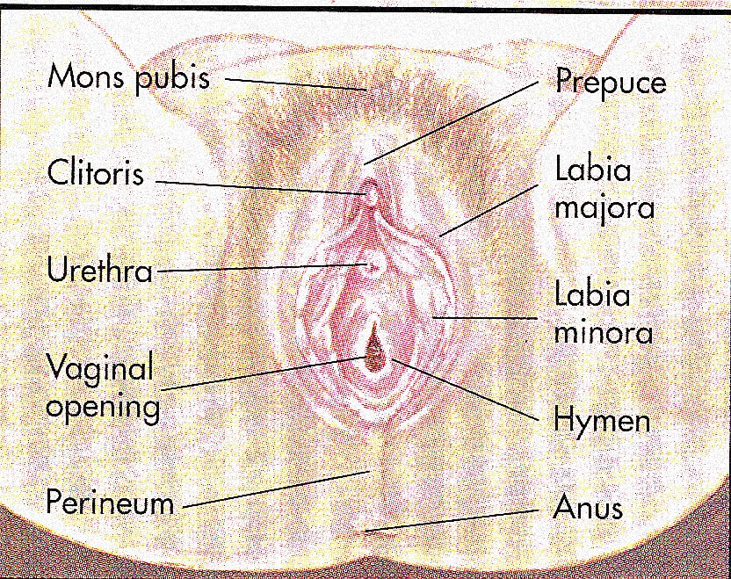

Slide 5
CLITORIS
Highly sensitive organ composed of nerves, blood vessels, and erectile tissue
Located under the prepuce
It is made up of a shaft and a glans
Becomes engorged with blood during sexual stimulation
Key to sexual pleasure for most women
Urethral opening is located directly below clitoris

Slide 6

VAGINAL OPENING
INTROITUS
Opening may be covered by a thin sheath called the hymen
Using the presence of an intact hymen for determining virginity is erroneous
Some women are born without hymens
The hymen can be perforated by many different events

Slide 7
INTERNAL GENITALIA
The internal genitalia consists of the:
Vagina
Cervix
Uterus
Fallopian Tubes
Ovaries

Slide 8
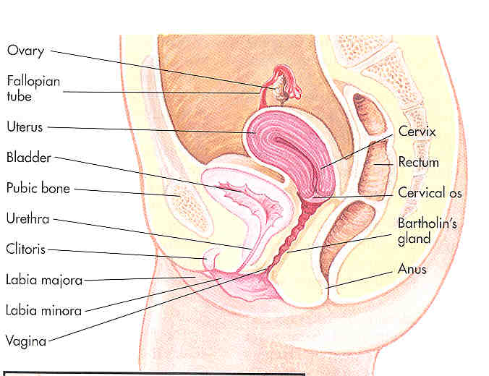

Slide 9
VAGINA
The vagina connects the cervix to the external genitals
It is located between the bladder and rectum
It functions :
As a passageway for the menstrual flow
For uterine secretions to pass down through the introitus
As the birth canal during labor
With the help of two Bartholin’s glands becomes lubricated during SI

Slide 10
CERVIX
The cervix connects the uterus to the vagina
The cervical opening to the vagina is small
This acts as a safety precaution against foreign bodies entering the uterus
During childbirth, the cervix dilates to accommodate the passage of the fetus
This dilation is a sign that labor has begun

Slide 11
UTERUS
Commonly referred to as the womb
A pear shaped organ about the size of a clenched fist
It is made up of the endometrium, myometrium and perimetrium
Consists of blood-enriched tissue that sloughs off each month during menstrual cycle
The powerful muscles of the uterus expand to accommodate a growing fetus and push it through the birth canal

Slide 12
FALLOPIAN TUBES
Serve as a pathway for the ovum to the uterus
Are the site of fertilization by the male sperm
Often referred to as the oviducts or uterine tubes
Fertilized egg takes approximately 6 to 10 days to travel through the fallopian tube to implant in the uterine lining

Slide 13
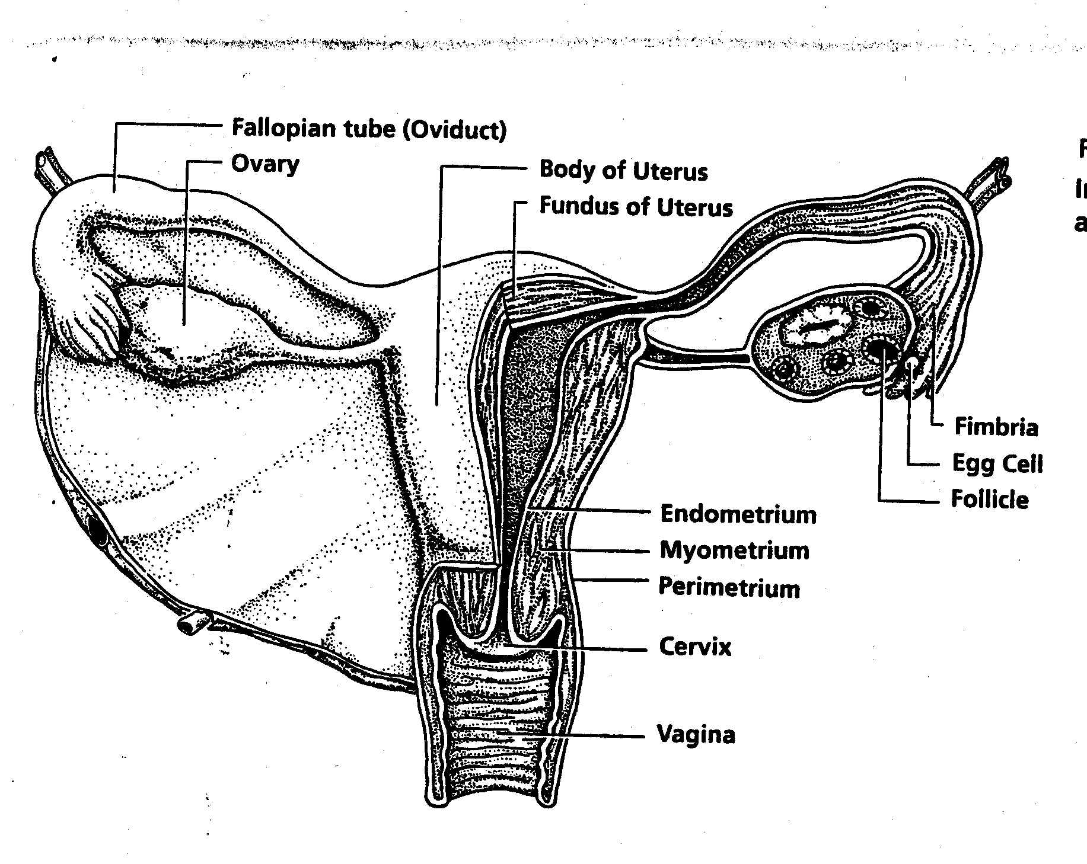

Slide 14

OVARIES
The female gonads or sex glands
They develop and expel an ovum each month
A woman is born with approximately 400,000 immature eggs called follicles
During a lifetime a woman release @ 400 to 500 fully matured eggs for fertilization
The follicles in the ovaries produce the female sex hormones, progesterone and estrogen
These hormones prepare the uterus for implantation of the fertilized egg

Slide 15
BREASTS
Organs of sexual arousal
Contain mammary glands
Consist of connective tissue that serves as support
Each breast contain 15-25 clusters called lobes
Each lobule is connected by ducts that open into the nipples
The nipples are made up of erectile tissue
The pigmented around the nipples are called the areola
Breast size is determined primarily by heredity
Size also depends on the existing fat and glandular tissue
Breasts may exhibit cyclical changes, including increased swelling and tenderness prior to menstruation
Benign breast changes refer to fibrocystic disease
Lumps or masses that are noncancerous

Slide 16
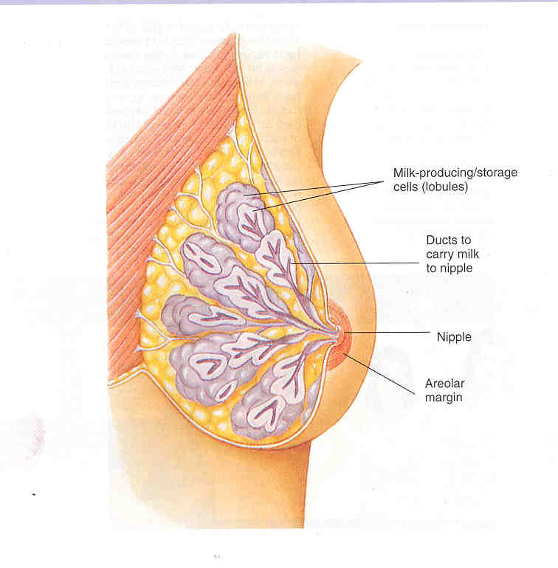

Slide 17
BREAST SELF-EXAMINATION
Women need to examine their breasts monthly BSE
This is a proactive approach to detect possible breast cancer
A supplement to clinical exams and mammography
Best time for a BSE is a week after menstruation

Slide 18
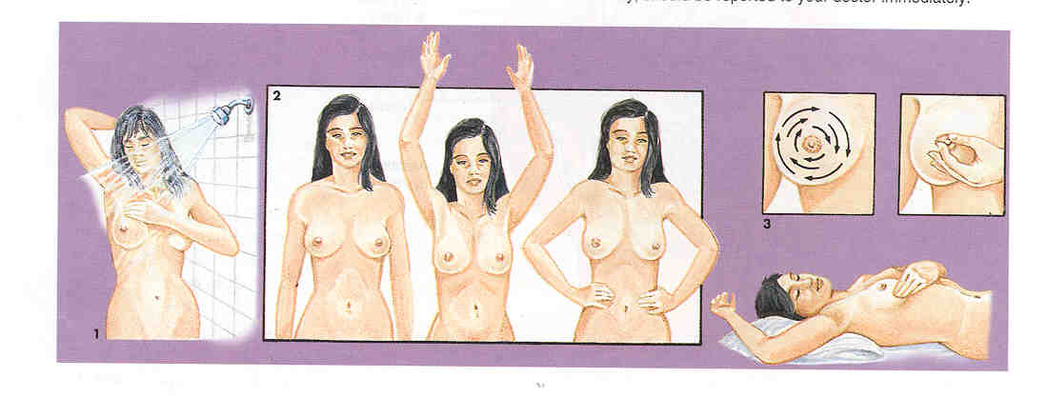
BREAST SELF EXAM

Slide 19
MENSTRUATION
Menarche, the onset of menstruation signals the bodily changes that transform a female body
Average age is 12.8 y
Amount of bleeding varies from woman to woman
Expulsion of blood clots
Blood color can vary from bright red to dark maroon
Usually occurs every 25 to 32 days
Women can experience fluid retention, cramping, mood swings, weight gain, breast tenderness, diarrhea, and constipation

Slide 20
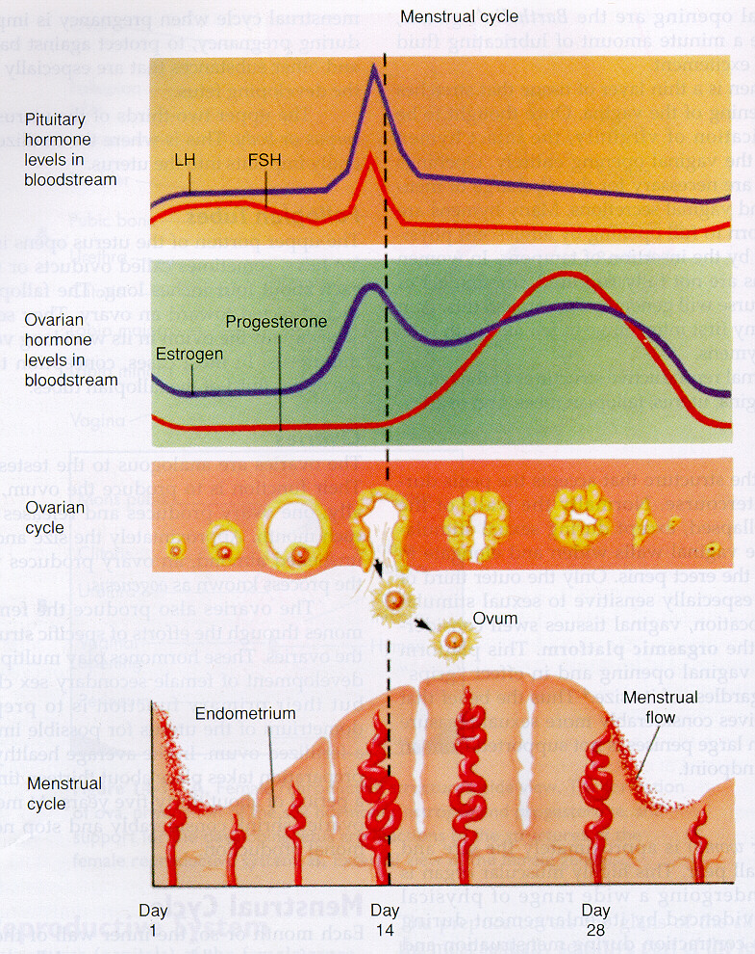

Slide 21
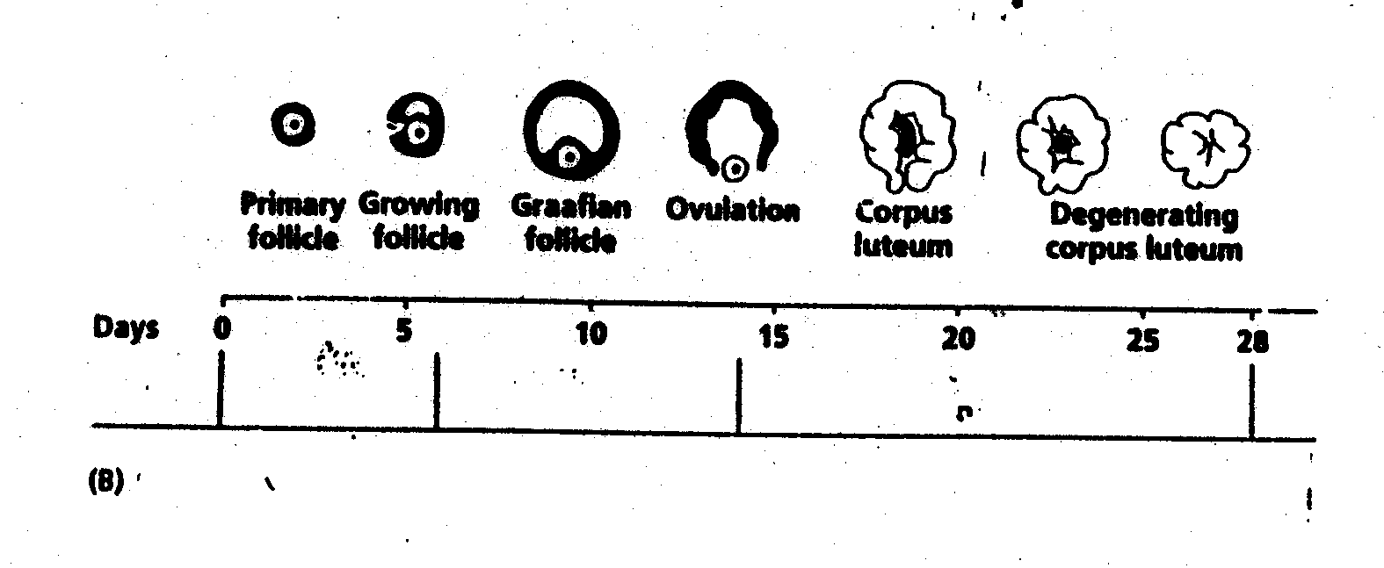
FOLLICLE DEVELOPMENT

Slide 22
SEX HORMONES
Follicle stimulating hormone FSH
Luteinizing hormone LH-signals ovulation
Estrogen- produced throughout the menstrual cycle
Progesterone-produced during second half of cycle
Contributes to thickening of the endometrium which is shed during menstrual phase if fertilization does not take place
Both FSH and LH are produced in the pituitary gland
Both estrogen and progesterone are produced by the follicles in the ovaries

Slide 23
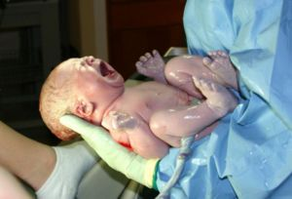
Thank you

