Slide 1
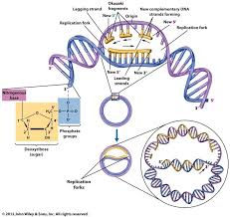
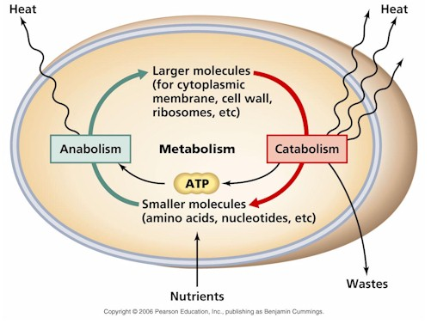
Bacterial Metabolism and Genetics
Notes:
Bacteria are usually used to study the metabolic reactions that occur within the cell. Why?
Because they’re inexpensive to maintain in the lab, take up little space, reproduce quickly, their metabolic reactions are easily observable.
Metabolic reactions in microbes are similar to those that occur in cells of the human body

Slide 2
Bacteria are usually used to study the metabolic reactions that occur within the cell. Why?
Because they’re inexpensive to maintain in the lab,
take up little space,
reproduce quickly,
their metabolic reactions are easily observable.
Metabolic reactions in microbes are similar to those that occur in cells of the human body

Slide 3
Metabolism

Slide 4
Bacterial Metabolism
Metabolism:
All the chemical reactions (metabolic reactions) that occur within any cell.
*Countless chemical reactions take place in cells and are responsible for all the actions of organisms.
*Metabolic reactions are regulated by metabolic enzymes.
Notes:
Countless chemical reactions take place in cells and are responsible for all the actions of organisms.
Metabolic reactions are regulated by metabolic enzymes.

Slide 5
Bacterial Metabolism
Metabolic reactions are categorized into:
Catabolic reactions (Catabolism)
degradative reactions
Breaking down the large molecules into smaller molecules and energy is released.
B) Anabolic reactions (Anabolism)
biosynthetic reactions
Assembly (biosynthesis) of smaller molecules into larger molecules and energy is used.
Most of the energy that released during catabolic reactions is used in anabolic reactions, and some use in growth, reproduction, movement..etc
Table 7-2, page 106
Notes:
Catabolism involve breaking the chemical bonds between the molecules so energy is released, celled “degradative reactions”
Anabolism involve formation of bonds which require energy, called “biosynthetic reactions”
Most of the energy that released during catabolic reactions is used in anabolic reactions, and some use in growth, reproduction, movement..etc

Slide 6
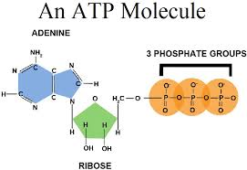
Bacterial Metabolism
Adenosine triphosphate (ATP):
Energy-storing molecules within a cell.
ATP molecules are used to transfer energy from catabolic reactions to the anabolic reactions
ATP is energy-carrying molecules
Transfer energy from energy-yielding molecules to an energy-requiring molecules
Notes:
ATP is energy-carrying molecules
Transfer energy from energy-yielding molecules to an energy-requiring molecules

Slide 7
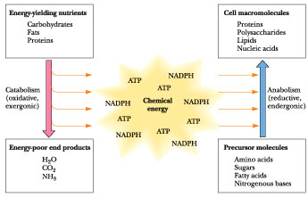

Slide 8
Catabolism
Glucose molecules can be catabolized by different methods:
Aerobic respiration
Anaerobic respiration
Fermentation
Method of catabolism depends on type of organisms
Notes:
Glucose is the favorite food “nutrient” of cells.
Method of catabolism depends on type of organisms

Slide 9
Aerobic respiration
it’s the most efficient way to extract energy from glucose.
It requires oxygen (aerobic conditions)
It involves:
          Glycolysis
          Kerbs Cycle
          Electron transport chain (ETC)

Slide 10
Aerobic respiration
Glycolysis:
Glucose>> Pyruvic acid + 2 ATP molecules
**Oxygen doesn’t participate in this phase.
2) Kerbs cycle: enter Kerbs cycle then broke
Pyruvic acid>> Acetyl-CoA>> Oxaloacetate + 2 ATP molecules
Notes:
In glycolysis, glucose is broken down into pyruvic acid and produces very little energy>> 2 ATP molecules
In glycolysis oxygen doesn’t participate in this phase.
In Kerbs cycle, pyruvic acid converted into Acetyl-CoA which enter the Kerbs cycle and broken dowm into Oxaloacetate>> 2 ATP molecules

Slide 11
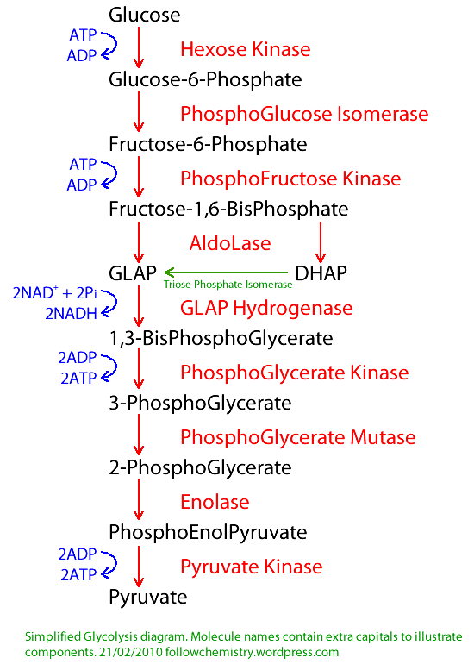

Slide 12
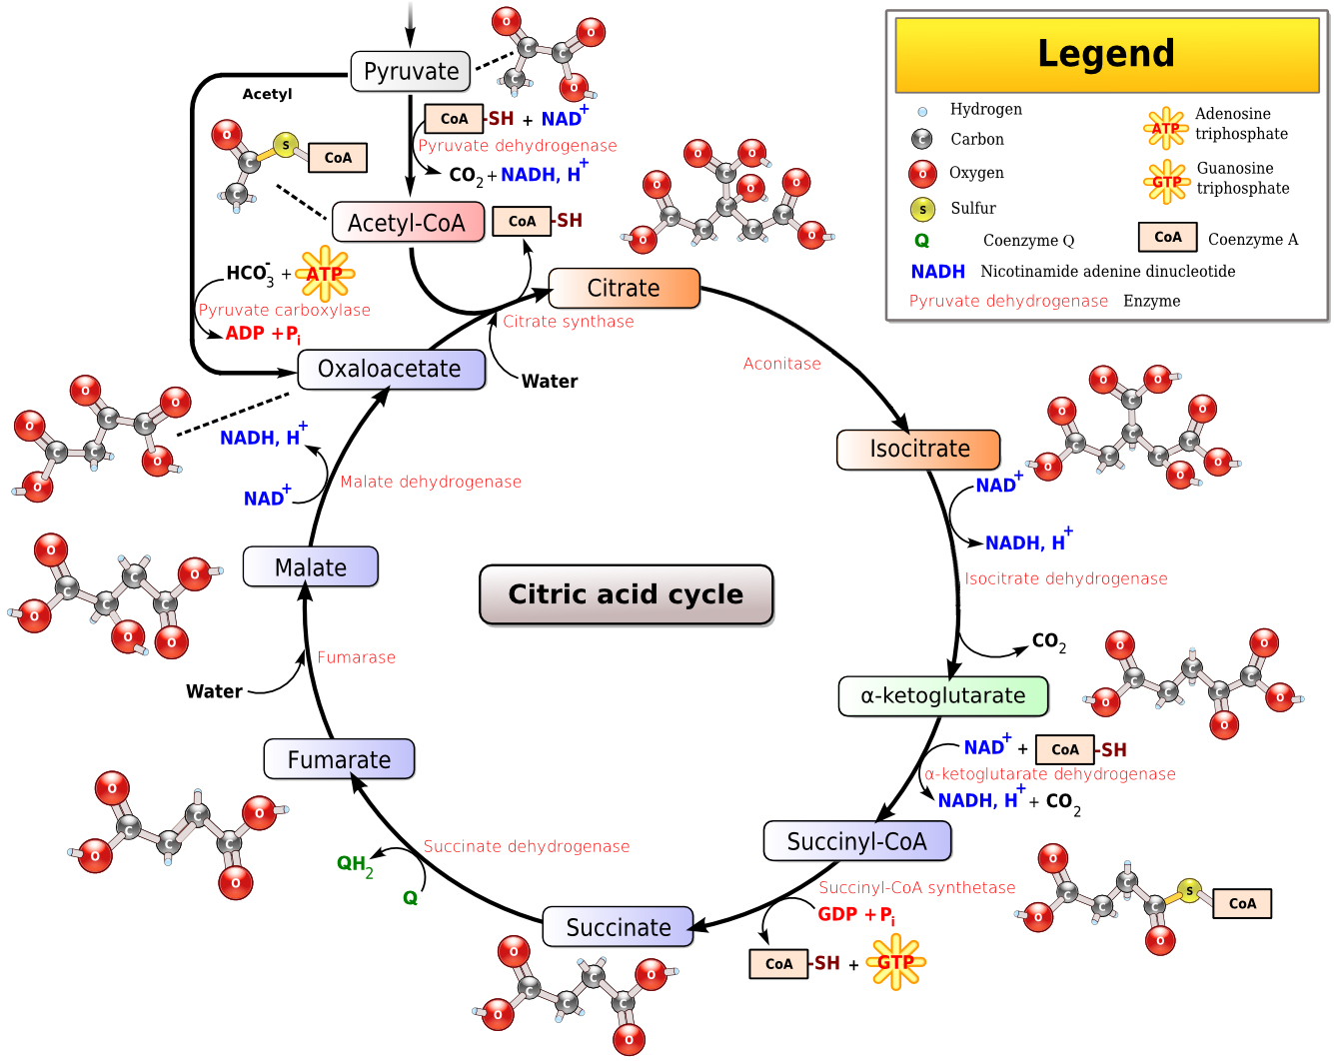

Slide 13
Aerobic respiration
3) Electron transport chain (ETC):
It’s Oxidation-reduction reactions.
NADH & FADH2 are oxidized>> loss electron and release energy (ATP)
The electrons are transferred from one compound to another and finally given to the oxygen (final electron acceptor).
Oxygen is the final electron acceptor resulting in formation of water
During the ETC>> 32 ATP molecules are produced in prokaryotic cells, 34 ATP in eukaryotic cells
Notes:
NADH & FADH2 are products producing during Kerbs cycle and enter to the ETC
Oxygen is the final electron acceptor resulting in formation of water

Slide 14
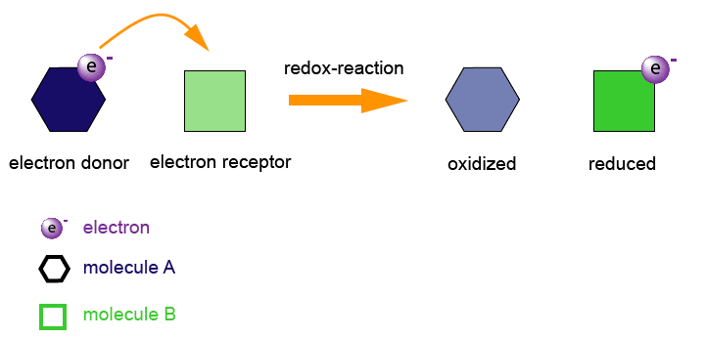
Oxidation-reduction reactions:
Electrons are transferred from one compound to another.
Oxidation reaction:
Loss of an electron.
Reduction reaction:
Gain of an electron

Slide 15
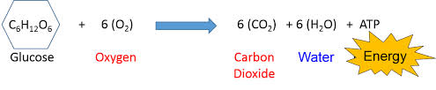
Aerobic respiration
Catabolism of 1 glucose molecule by aerobic respiration produces:
36 ATP molecules in prokaryotic
38 ATP molecules in eukaryotic
Table 7-3, page 110

Slide 16
Fermentation
Oxygen doesn’t participate (anaerobic condition).
It involves:
          Glycolysis
          Convert pyruvic acid into an end product
Catabolism of 1 glucose molecule by fermentation produces 2 ATP molecules.

Slide 17
Fermentation
The end product depends on the organism that make the fermentation.
Some end products of fermentation have industrial applications while some have harmful effects.
Ex:
Certain yeasts convert pyruvic acid to ethanol, these yeasts used to make wine
Lactic acid bacteria convert pyruvic acid to lactic acid, these bacteria used to make cheese, yogurt
Streptococcus spp. (oral bacteria) convert pyruvic acid to lactic acid>> eat teeth enamel>> cause teeth decay

Slide 18
Anabolism
Examples of anabolic reactions:
Linking a.a molecules >> protein
Linking nucleotides molecules >> N.A
These reactions require energy.
Anabolic reactions are categorized according to the source of energy to:
Photosynthesis>>
biosynthesis small molecule to larger molecule using sun light energy
Chemosynthesis>>
biosynthesis small molecule to larger molecule using chemical energy

Slide 19
Define the following terms:
Phototrophs
Chemotrophs
Autotrophs
Heterotrophs
Photoautotrophs
Photoheterotrophs
Chemoautotrophs
Chemoheterotrophs

Slide 20
Genetics

Slide 21
Genetics
Genetics: study of heredity
Nucleic acids (NA): include DNA and RNA, they are large molecules made from nucleotides.
Gene: it’s a segment of DNA, and it’s the fundamental unit of heredity that carry the information needed for protein synthesis.
Chromosome: located inside the nucleus and it’s made up of DNA coiled around proteins called histones
In the nucleus of each cell, the DNA molecule is packaged into thread-like structures called chromosomes.
The organism can’t produce a particular protein unless it has the gene that codes for this protein
Notes:
In the nucleus of each cell, the DNA molecule is packaged into thread-like structures called chromosomes.
The organism can’t produce a particular protein unless it has the gene that codes for this protein

Slide 22
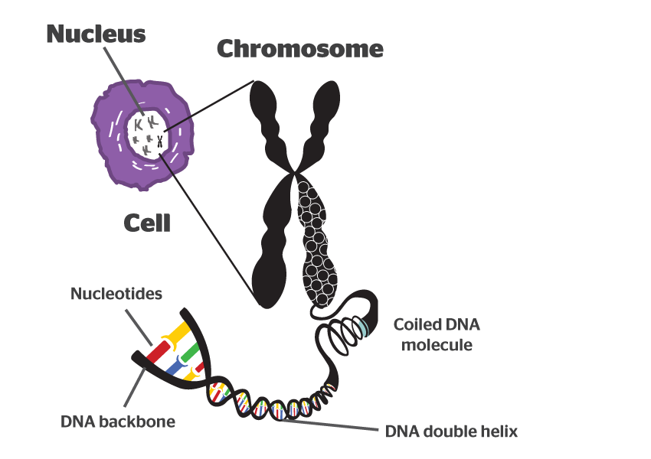

Slide 23
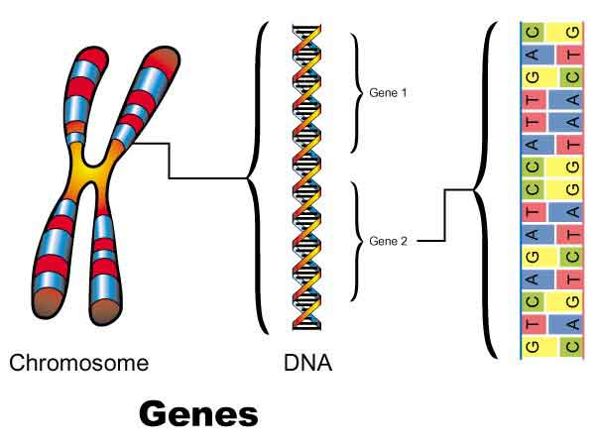

Slide 24
Bacterial Genetics
Bacterial Genome: collection of genes
Chromosome
B. Plasmids
Notes:
Genome: collection of genes

Slide 25
Bacterial Genetics
Bacterial chromosome:
Contain circular, ds DNA molecule
Bacterial DNA contain about 4000 genes

Slide 26
Bacterial Genetics
B. Plasmids:
They are extra-chromosomal DNA (circular, ds DNA), and very small in size.
Located in the cytoplasm and capable of self- replication.
Could be more that one copy / cell.
Some plasmids contain many genes, others only few.
Not essential for growth.
Can carry several characters: virulence, resistance to AB, toxin production .. etc.
Notes:
Smaller than the chromosome
Not essential for growth so some cells have it and some don’t

Slide 27
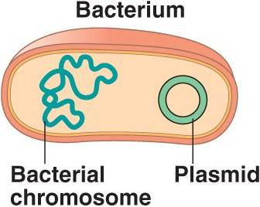

Slide 28
Bacterial Gene Transfer
Vertical gene transfer:
Occurs during reproduction, between generation of cells.
B. Horizontal gene transfer:
Transfer of genes between cells of the same generation. Leads to acquire new genetic information
Can be done by: conjugation, transduction, transformation
Notes:
Vertical gene transfer>> chromosome, plasmids

Slide 29
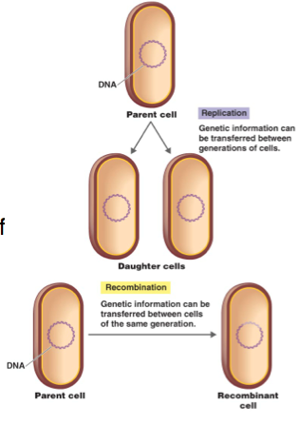
Vertical gene transfer

Slide 30
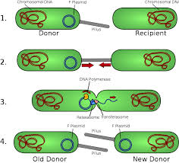
Horizontal gene transfer
(conjugation: bridge-like connection between two cells)

Slide 31
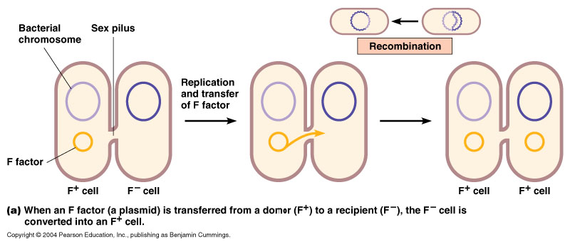
Bacterial Gene Transfer
Conjugation:
Is the transfer of genetic material between bacterial cells by direct cell-to-cell contact, or by a bridge-like connection between two cells
Direct cell to cell contact

Slide 32
Bacterial Gene Transfer
Transduction:
Transfer of genetic material from one bacterium to another by virus after bacteriophage infection.
Transformation:
Transfer of genetic material from one bacterium to another by transfer naked DNA from a donor cell to recipient cell, followed by recombination in the recipient chromosome.

Slide 33
Mutation
During bacterial reproduction (binary fission) an accidental alteration in the gene can be happen (mutation) and leads to alters the gene product.
Mutation is spontaneous and rare (1 mutation/ million cell division)
The mutant gene is transmitted to the new generation cells
Mutation can be: beneficial, harmful, or silent.
Mutation rate can be increased by using some physical or chemical agents (mutagens) that affect the chromosome.
Notes:
Bacteria can acquire new genetic information by horizontal gene transfer and by mutation (vertical gene transfer)

Slide 34
Bacteria can acquire new genetic information by
- horizontal gene transfer
- and mutation (vertical gene transfer)

Slide 35
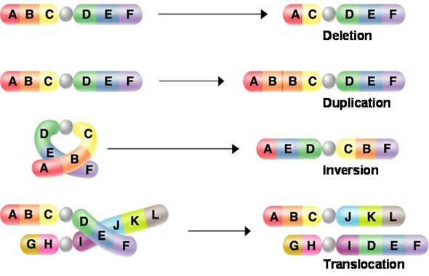
Mutation

