Slide 1
Laminar Flow Cabinets
Sterile Products Lab PHT 434

Slide 2
Definition
Laminar flow cabinets are a carefully enclosed bench designed to:
Prevent contamination of biological samples, or any particle sensitive device.
Protect the product, operator, and/or environment.
Laminar flow: An airflow moving in a single direction and in parallel layers at constant velocity from the beginning to the end of a straight line vector.
HEPA filters: High Efficiency Particulate Air: remove at least 99.97% of airborne particles 0.3 µm in diameter.

Slide 3
Laminar Flow Cabinets
Theory:
Unidirectional air moving at a fixed velocity along parallel lines (laminar flow) was demonstrated to reduce turbulence and aid in the capture and removal of airborne contaminants from the air stream.
Use of the HEPA filter provides a particulate-free work environment.
Mode of Action:
Air is drawn through a HEPA filter and blown in a very smooth, laminar flow towards the user.

Slide 4
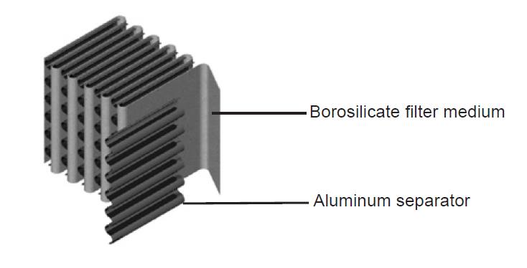
HEPA filters:
Constructed of:
paper-thin sheets of borosilicate medium
pleated to increase surface area
affixed to a frame.
Aluminum separators are added to:
prevent pleats from collapsing in air stream
provide a path for airflow.

Slide 5
Types of Laminar Flow Cabinets
A- Biological Safety Cabinets (BSCs):
Class I (Low risk operations)
Class II (Moderate risk operations)
Type A
Type B
Class III ((High risk operations)
B- Clean Benches:
Horizontal Laminar Flow
Vertical Laminar Flow

Slide 6
Biological Safety Cabinets (BSCs)
BSCs are designed to provide
personnel,
environmental and
product protection
Most BSCs use high efficiency particulate air (HEPA) filters in the exhaust and supply systems. The exception is a Class I BSC which does not have HEPA filtered supply air.

Slide 7
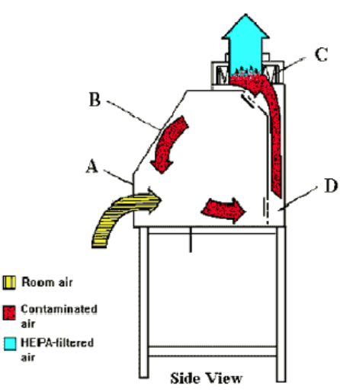
BSCs class I
Personnel & Environmental protection.
No product protection.
It is like a fume hood, but has a HEPA filter in exhaust system to protect environment.
Uses:
enclose equipment, e.g.:
centrifuges
harvesting equipment
small fermenters
procedures with potential to generate aerosols, e.g.:
animals cages dumping
culture aeration
tissue homogenation.

Slide 8
BSCs class II
provide personnel, environmental and product protection
Uses:
provide the microbe-free work environment necessary for cell culture propagation
formulation of nonvolatile antineoplastic or chemotherapeutic drugs
Types:
Type A
Type B

Slide 9
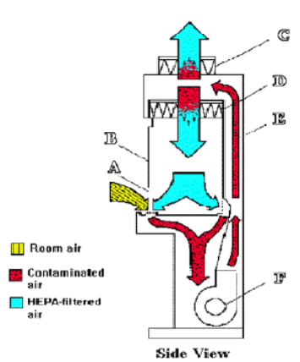
BSCs class II Type A
Exhaust air re-circulated to the laboratory.
Not to be used for work involving volatile toxic chemicals

Slide 10
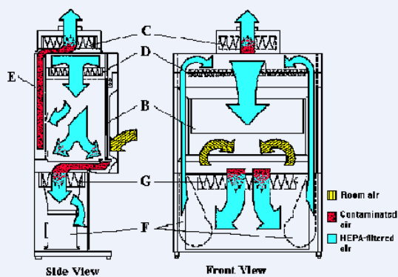
BSCs class II Type B
Two HEPA filters for supply and exhaust.
Exhaust air must be discharged to outdoors via a hard connection.
HEPA filters are effective at trapping particulates (e.g. infectious agents) but do not capture volatile chemicals or gases.
Uses: in volatile, toxic chemicals, but amounts must be limited.

Slide 11
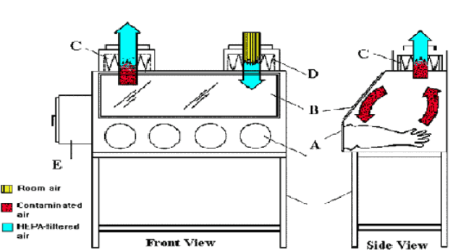
BSCs class III
Two HEPA filters for supply and exhaust.
Maximum protection for environment and worker
discharge to the outdoors
Uses:
Working with highly infectious microbiological agents
conduction of hazardous operations

Slide 12
BSCs Surface Decontamination
All containers and equipment should be surface decontaminated and removed from the cabinet when work is completed.
At the end of the work day, the final surface decontamination of the cabinet should include a wipe-down of the work surface, the cabinet’s sides and back and the interior of the glass.
If necessary, the cabinet should also be monitored for radioactivity and decontaminated when necessary.
Any splatter onto items within the cabinet, as well as the cabinet interior, should be immediately cleaned up with a towel dampened with an appropriate decontaminating solution

Slide 13
BSCs Gas Decontamination
The most common decontamination method uses:
Formaldehyde gas
Hydrogen peroxide vapor
Chlorine dioxide gas

Slide 14
Ultraviolet Lamps in BSCs
If installed, UV lamps must be cleaned weekly to remove any dust and dirt that may block the germicidal effectiveness of the ultraviolet light.
The lamps should be checked weekly with a UV meter to ensure that the appropriate intensity of UV light is being emitted

Slide 15
Clean Benches
Provide product protection
They can be used for certain clean activities, such as the dust-free assembly of sterile equipment (in hospital pharmacies for preparation of intravenous solutions).
These benches should never be used for the manipulation of potentially infectious or toxic materials.
Two types:
Horizontal Laminar Flow
Vertical Laminar Flow

Slide 16
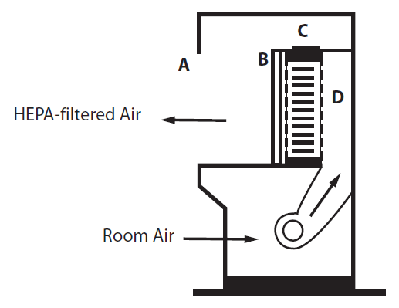
Horizontal Laminar Flow
Horizontal laminar flow “clean benches” are not BSCs.
These pieces of equipment discharge HEPA-filtered air from the back of the cabinet across the work surface and toward the user.

Slide 17
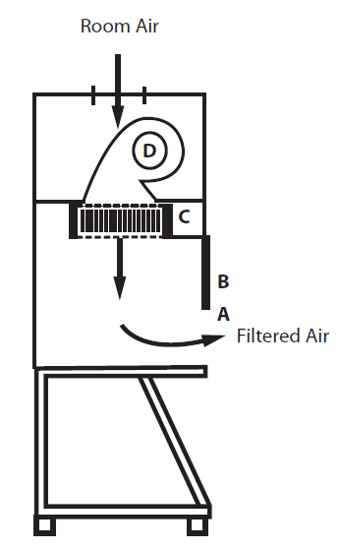
Vertical Laminar Flow
Vertical laminar flow clean benches also are not BSCs.
While these units generally have a sash, the air is usually discharged into the room under the sash, resulting in the same potential problems presented by the horizontal laminar flow clean benches.
These benches should never be used for the manipulation of potentially infectious or toxic materials.

