Slide 1

Fundamentals of Organic Chemistry
CHEM 108
King Saud University
College of Science, Chemistry Department
CHAPTER 5. ALDEHYDES & KETONES
CHEM 108

Slide 2
Aldehydes & Ketones
Common Classes of Carbonyl Compounds
General Formula | Class | General Formula | Class
 | Aldehydes |  | Ketones
 | Acid Chlorides |  | Carboxylic acids
 | Amides |  | Esters

Slide 3
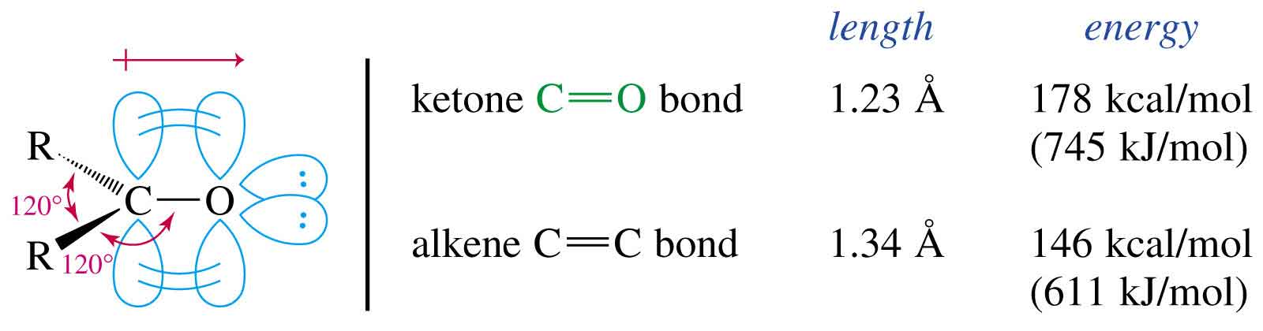
Aldehydes & Ketones
Carbon is sp² hybridized.
C=O bond is shorter, stronger, and more polar than C=C bond in alkenes.

Slide 4
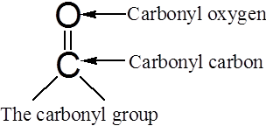
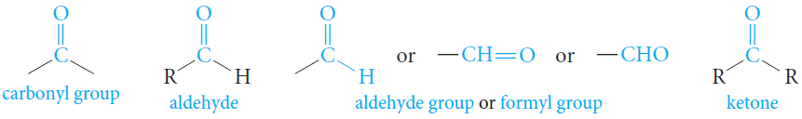
Structure of Aldehydes and Ketones
Aldehydes and ketones are characterized by the presence of the carbonyl group.
Aldehydes have at least one hydrogen atom attached to the carbonyl carbon atom.
The remaining group may be another hydrogen atom or any aliphatic or aromatic organic group.
The -CH=O group characteristic of aldehydes is often called a formyl group.
In ketones, the carbonyl carbon atom is connected to two other carbon atoms.

Slide 5
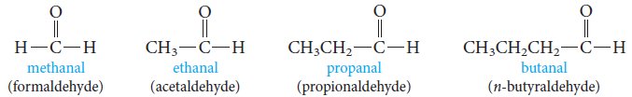
Nomenclature of Aldehydes
IUPAC System
Aliphatic aldehydes are named by dropping the suffix -e from the name of the hydrocarbon that has the same carbon skeleton as the aldehyde and replacing it with the suffix -al.
Alkane - e+ al = Alkanal

Slide 6
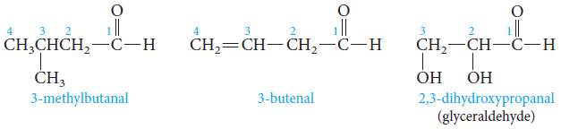
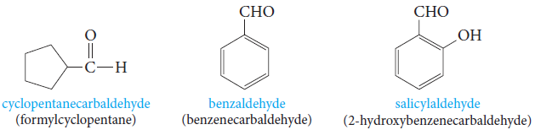
Nomenclature of Aldehydes
IUPAC System
Substituted aldehydes, we number the chain starting with the aldehyde carbon.
-CH=O group is assigned the number 1 position.
Aldehyde group has priority over a double bond or hydroxyl group.
Cyclic aldehydes, the suffix –carbaldehyde is used.

Slide 7
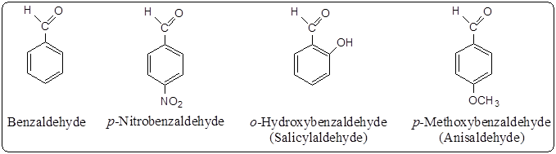
Nomenclature of Aldehydes
IUPAC System
Aromatic aldehydes are usually designated as derivatives of the simplest aromatic aldehyde, benzaldehyde.

Slide 8
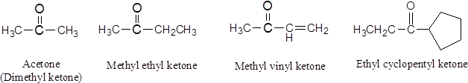
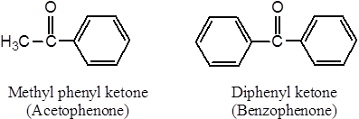
Nomenclature of Aldehydes
Common Names
Common names of ketones are formed by adding the word ketone to the names of the alkyl or aryl groups attached to the carbonyl carbon. Alkyl ketone.
In still other cases, traditional names are used.

Slide 9
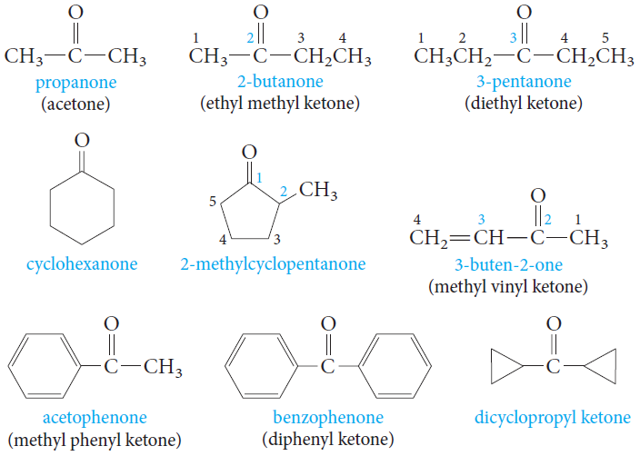
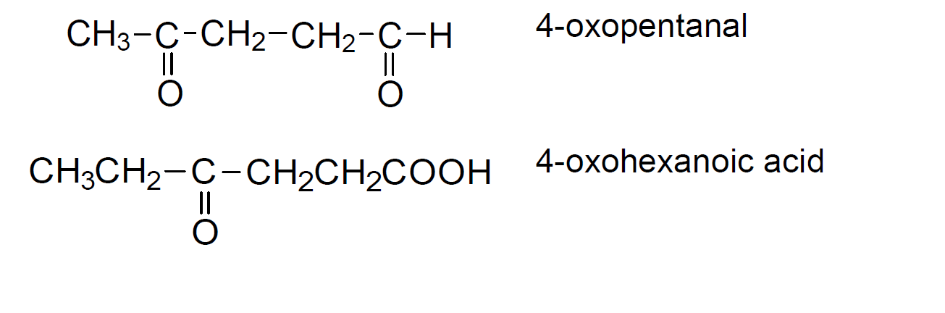
Nomenclature of Ketones
IUPAC System
In the IUPAC system, the ending for ketones is -one.
The chain is numbered so that the carbonyl carbon has the lowest possible number.
For cyclic ketones, numbering always starts from the C=O group.
The prefix "oxo" is used when the ketone is not the principal functional group.

Slide 10
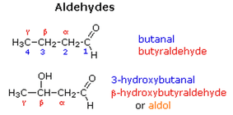
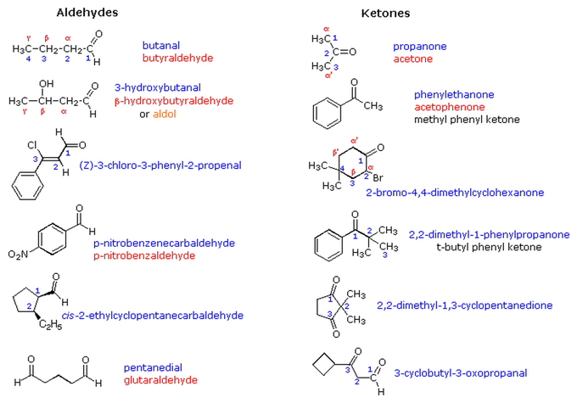
Nomenclature of Aldehydes Ketones
NOTES
In common names carbon atoms near the carbonyl group are often designated by Greek letters.
The atom adjacent to the function is alpha (α), the next removed is beta (β) and so on. Since ketones have two sets of neighboring atoms, one set is labeled α, β etc., and the other α', β' etc.
The functional group priority order in nomenclature system is as following:
Acid and derivatives >aldehyde> ketone> alcoho > amine > alkene > alkyne > ether

Slide 11
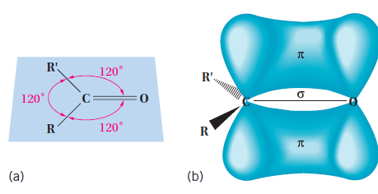
The Carbonyl Group
The structure and properties of the carbonyl group.
The carbon–oxygen double bond consists of a sigma bond and a pi bond.
The carbon atom is sp²-hybridized. The three atoms attached to the carbonyl carbon lie in a plane with bond angles of 120°.
The pi bond is formed by overlap of a p orbital on carbon with an oxygen p orbital.
There are also two unshared electron pairs on the oxygen atom.
The C=O bond distance is 1.24A, shorter than the C-O distance in alcohols and ethers (1.43A) .

Slide 12
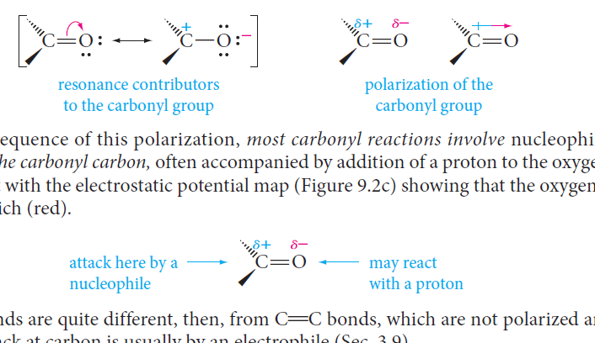
The Carbonyl Group
Oxygen is much more electronegative than carbon. Therefore, the electrons in the C=O bond are attracted to the oxygen, producing a highly polarized bond.
As a consequence of this polarization, most carbonyl reactions involve nucleophilic attack at the carbonyl carbon, often accompanied by addition of a proton to the oxygen (electron rich).

Slide 13

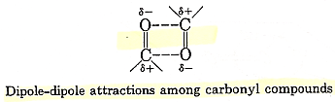
Physical Properties of Aldehydes and Ketones
Boiling Points
Carbonyl compounds boil at higher temperatures than hydrocarbons, but at lower temperatures than alcohols of comparable molecular weight.
This is due to the intermolecular forces of attraction, called dipole-dipole interactions, which is stronger than van der Waals attractions but not as strong as hydrogen bonds.

Slide 14
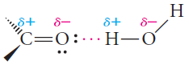
Physical Properties of Aldehydes and Ketones
Solubility
Carbonyl compounds as aldehydes and ketones have a C=O bond, but no O-H bond, cannot form hydrogen bonds with themselves.
The polarity of the carbonyl group also affects the solubility properties of aldehydes and ketones.
Carbonyl compounds with low molecular weights are soluble in water as they can form hydrogen bonds with O-H or N-H compounds.

Slide 15
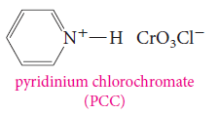
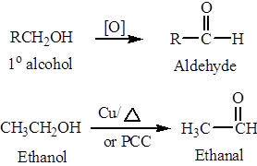
Preparation of
Aldehydes and Ketones
1) Oxidation of Primary and Secondary Alcohols
Chromium reagents, such as pyridinium chlorochromate (PCC), are commonly used in the laboratory.
Oxidation of primary alcohols, under controlled conditions, yields aldehydes.

Slide 16
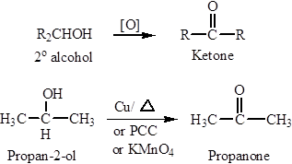
Preparation of
Aldehydes and Ketones
1) Oxidation of Primary and Secondary Alcohols
Oxidation of secondary alcohols yields ketones.

Slide 17
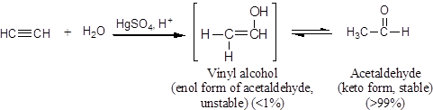
Preparation of
Aldehydes and Ketones
2) Hydration of Alkynes
Hydration of acetylene yields acetaldehyde (catalyzed by acid and mercuric).

Slide 18
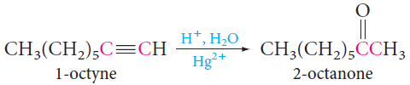
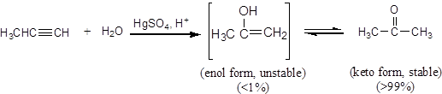
Preparation of
Aldehydes and Ketones
2) Hydration of Alkynes
Hydration of terminal alkynes EXCEPT acetylene yields ketones (catalyzed by acid and mercuric).

Slide 19
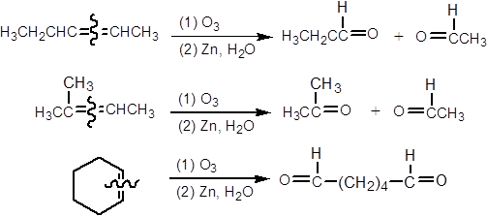
Preparation of
Aldehydes and Ketones
3) Ozonolysis of Alkenes
Product (aldehyde or ketone) depends on the structure of alkene.

Slide 20
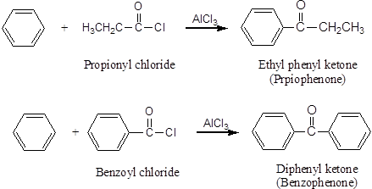
Preparation of
Aldehydes and Ketones
4) Friedel-Crafts Acylation
Preparing ketones that contain an aromatic ring.

Slide 21
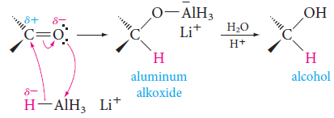
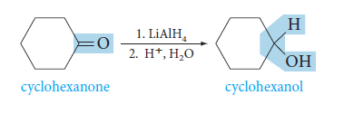
Reactions of
Aldehydes and Ketones
A) Reduction of Carbonyl Compounds
Aldehydes and ketones are easily reduced to primary and secondary alcohols, respectively.
The most common metal hydrides used to reduce carbonyl compounds are lithium aluminum hydride (LiAlH₄) and sodium borohydride (NaBH₄).
Example:

Slide 22
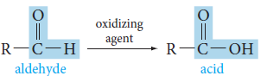
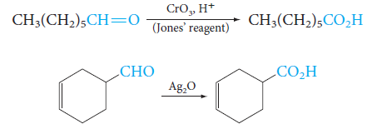
Reactions of
Aldehydes and Ketones
B) Oxidation of Carbonyl Compounds
Oxidation of aldehydes gives a carboxylic acid with the same number of carbon atoms.
Because the reaction occurs easily, many oxidizing agents, such as KMnO₄, CrO₃, Ag₂O and peracids will work.
Example:

Slide 23
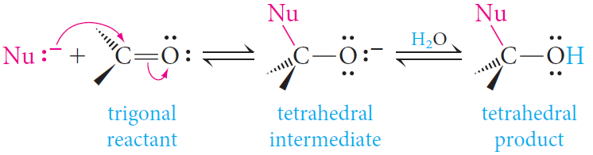
Reactions of
Aldehydes and Ketones
C) Nucleophilic Addition Reactions
Nucleophiles attack the carbon atom of a carbon-oxygen double bond because that carbon has a partial positive charge.
The overall reaction involves addition of a nucleophile and a proton across the pi bond of the carbonyl group (when carried out in alcohol or water).

Slide 24
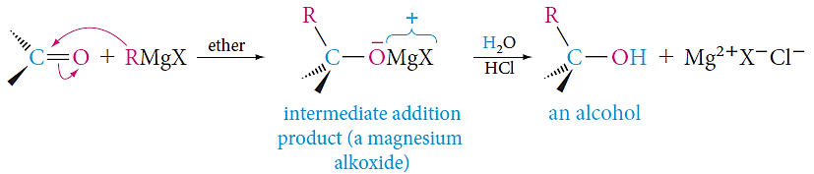
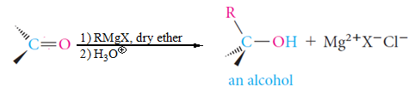
Reactions of
Aldehydes and Ketones
C) Nucleophilic Addition Reactions
1) Addition of Grignard Reagents: Formation of Alcohols
Grignard reagents act as carbon nucleophiles toward carbonyl compounds.
The reaction of a Grignard reagent with a carbonyl compound provides a useful route to alcohols.
The type of carbonyl compound chosen determines the class of alcohol produced.

Slide 25
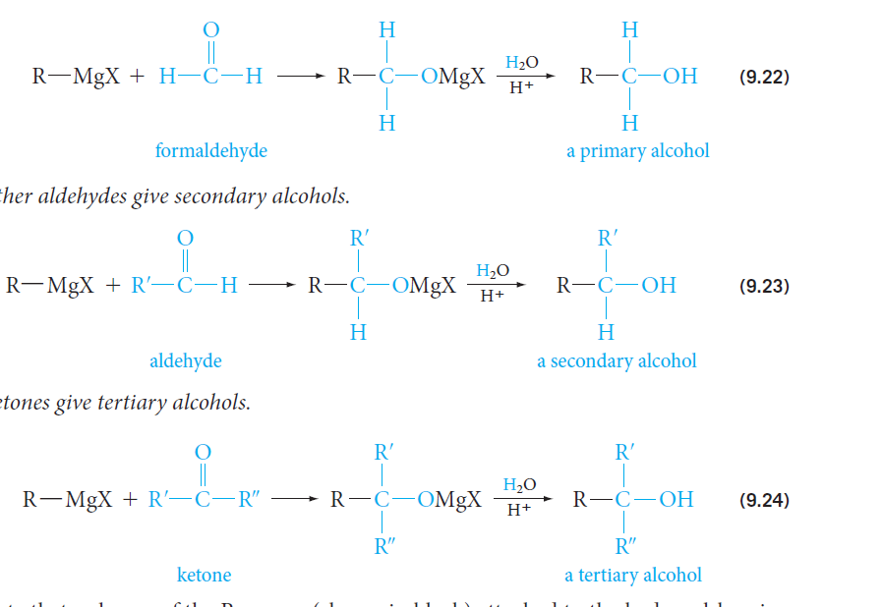
Reactions of
Aldehydes and Ketones
C) Nucleophilic Addition Reactions
1) Addition of Grignard Reagents: Formation of Alcohols
Formaldehyde gives primary alcohols.
Other aldehydes give secondary alcohols
Ketones give tertiary alcohols.

Slide 26
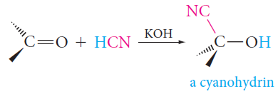
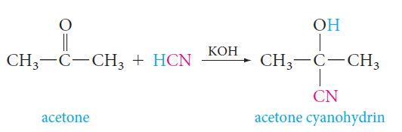
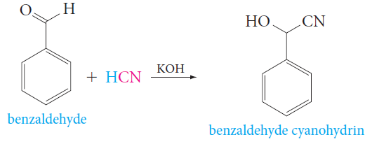
Reactions of
Aldehydes and Ketones
C) Nucleophilic Addition Reactions
2) Addition of Hydrogen Cyanide: Formation of Cyanohydrins
Hydrogen cyanide adds to the carbonyl group of aldehydes and ketones to form cyanohydrins, compounds with a hydroxyl and a cyano group attached to the same carbon.
Example

Slide 27
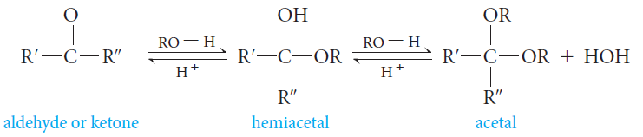
Reactions of
Aldehydes and Ketones
C) Nucleophilic Addition Reactions
3) Addition of Alcohols: Formation of Hemiacetals and Acetals
Alcohols add to the C=O bond, the OR group becoming attached to the carbon and the proton becoming attached to the oxygen.
Aldehydes and ketones react with alcohols to form, first, hemiacetals and then, if excess alcohol is present, acetals.

Slide 28
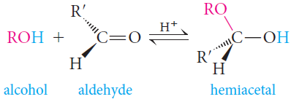
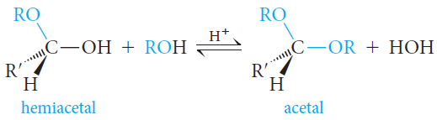
Reactions of
Aldehydes and Ketones
C) Nucleophilic Addition Reactions
3) Addition of Alcohols: Formation of Hemiacetals and Acetals
Hemiacetals; it contains both alcohol and ether functional groups on the same carbon atom.
Acetals have two ether functions at the same carbon atom.

Slide 29
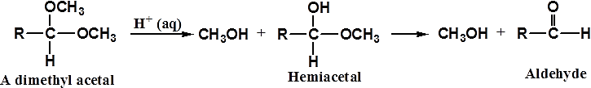
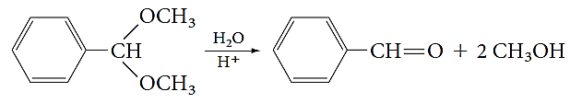
Reactions of
Aldehydes and Ketones
C) Nucleophilic Addition Reactions
3) Addition of Alcohols: Formation of Hemiacetals and Acetals
The reverse of acetal formation, called acetal hydrolysis.
Acetal can be hydrolyzed to its aldehyde or ketone and alcohol components by treatment with excess water in the presence of an acid catalyst.

Slide 30

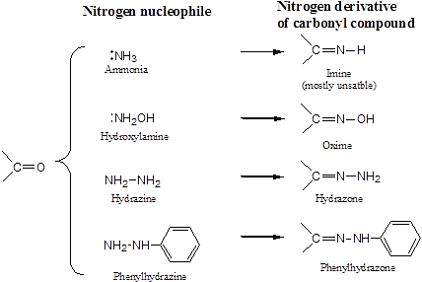
Reactions of
Aldehydes and Ketones
C) Nucleophilic Addition Reactions
4) Addition of Ammonia and Ammonia Derivatives
The addition of nitrogen nucleophile, such as ammonia(NH₃) and substituted ammonia (NH₂-Y).

