Slide 1
Chapter#8 General Procedures

Slide 2
Devices for Modularity
  Visual Basic has two ways for breaking problems into smaller pieces:
  Sub procedures
  Function procedures

Slide 3

General Form of Sub Procedure

Slide 4
Calling a Sub Procedure
The statement that invokes /calls a Sub procedure is referred to as a calling statement.
A calling statement looks like this:
ProcedureName(arg1, arg2,..., argN)

Slide 5
Naming Sub Procedures
The rules for naming Sub procedures are the same as the rules for naming variables.

Slide 6
Passing Values
DisplaySum( 2, 3 )
Sub DisplaySum(ByVal num1 As Double, ByVal num2 _
As Double)
Dim z As Double
z = num1 + num2
TextBox1.Text= "The sum of " & num1 &
" and " & num2 & " is " & z & "."
End Sub
In the Sub procedure, 2 will be stored in num1 and 3 will be stored in num2

Slide 7
Arguments and Parameters
Sum(2, 3)
Sub DisplaySum(ByVal num1 As Double, ByVal num2 _
As Double)
arguments
parameters
displayed automatically

Slide 8
Several Calling Statements
DisplaySum(2, 3)
DisplaySum(4, 6)
DisplaySum(7, 8)
Output:
The sum of 2 and 3 is 5.
The sum of 4 and 6 is 10
The sum of 7 and 8 is 15.

Slide 9
Passing Strings and Numbers
Demo("CA", 38)
Sub Demo(ByVal state As String, ByVal pop _
As Double)
TextBox1.Text = state & " has population " & pop & " million."
End Sub
Note: The statement Demo(38, "CA") would not be valid. The types of the arguments must be in the same order as the types of the parameters.

Slide 10
Variables and Expressions as Arguments
Dim s As String = "CA"
Dim p As Double = 19
Demo(s, 2 * p)
Sub Demo(ByVal state As String, ByVal pop As Double)
TextBox1.Text = state &" has population " & pop & "million."
End Sub
Note: The argument names need not match the parameter names. For instance, s versus state.

Slide 11
Sub Procedure Having No Parameters
Sub DescribeTask()
TextBox1.Clear()
msgbox("This program displays the name and population of a state.")
End Sub

Slide 12
Sub Procedure Calling Another Sub Procedure
Private Sub btnDisplay_Click(...) Handles _ btnDisplay.Click
Demo("CA", 37)
End Sub
Sub Demo(ByVal state As String, ByVal pop _
As Double)
DescribeTask()
TextBox1.Text = state &" has population " & pop & "million."
End Sub

Slide 13
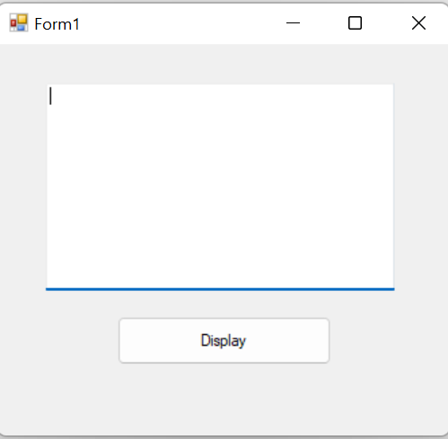
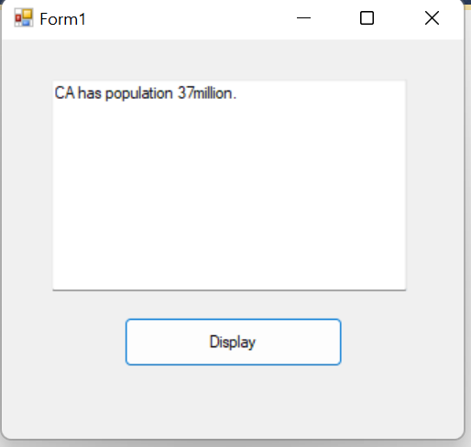
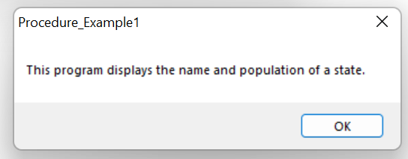





Output

Slide 14
ByVal and ByRef
Parameters in Sub procedure headers are proceeded by ByVal or ByRef
ByVal stands for By Value
ByRef stands for By Reference

Slide 15
Passing by Value
When a variable argument is passed to a ByVal parameter, just the value of the argument is passed.
After the Sub procedure ends, the variable has its original value.

Slide 16
Example
Public Sub btnOne_Click (...) Handles _btnOne.Click
Dim n As Double = 4
Triple(n)
txtBox1.Text = “n = “ & n
End Sub
Sub Triple(ByVal num As Double)
num = 3 * num
txtBox2.Text = “num = “ & num
End Sub
Output:
num = 12
n = 4
Argument name (n) is different than parameter name (num)
Memory (RAM):
12
4
num
n

Slide 17
Passing by Reference
When a variable argument is passed to a ByRef parameter, the parameter is given the same memory location as the argument.
After the Sub procedure terminates, the variable has the value of the parameter.

Slide 18
Example
Public Sub btnOne_Click (...) Handles _
btnOne.Click
Dim n As Double = 4
Triple(n)
txtBox2.Text = “2. n = “ & n
End Sub
Sub Triple(ByRef num As Double)
num = 3 * num
txtBox1.Text = “1. num = “ & num
End Sub
Output:
1. num = 12
2. n = 12
Argument name (n) is the same as parameter name (num)
Memory (RAM):
4 12
X
n num

Slide 19
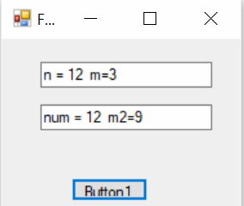
Public Class Form1
Private Sub Button1_Click(ByVal sender As System.Object, ByVal e As System.EventArgs) Handles Button1.Click
Dim n As Double = 4
Dim m As Double = 3
Triple(n, m)
TextBox1.Text = "n = " & n & " m=" & m
End Sub
Sub Triple(ByRef num As Double, ByVal m2 As Double)
num = 3 * num
m2 = 3 * m2
TextBox2.Text = "num = " & num & " m2=" & m2
End Sub
End Class

Slide 20
Most Common Use of ByRef: Get Input (Read Input)
Sub InputData(ByRef wage As Double,
ByRef hrs As Double)
wage = txtWage.Text
hrs = txtHours.Text
End Sub

Slide 21
Function Procedures
User-Defined Functions Having One Parameter
User-Defined Functions Having Several Parameters
User-Defined Functions Having No Parameters
User-Defined Boolean-Valued Functions

Slide 22
Some Built-In Functions
Function: Int
Example: Int(2.6) is 2
Input: number
Output: number
Function: Math.Round
Example: Math.Round(1.23, 1) is 1.2
Input: number, number
Output: number

Slide 23
Some Built-In Functions (continued)
Function: FormatPercent
Example: FormatPercent(0.12, 2) is 12.00%
Input: number, number
Output: string
Function: FormatNumber
Example: FormatNumber(12.62, 1) is 12.6
Input: number, number
Output: string

Slide 24
Function Procedures
Function procedures (aka user-defined functions) always return one value
Syntax:
Function FunctionName(ByVal var1 As Type1,
ByVal var2 As Type2,
...) As ReturnDataType
statement(s)
Return expression
End Function

Slide 25
Example With One Parameter
Function FtoC(ByVal t As Double) As Double
'Convert Fahrenheit temp to Celsius
Return (5 / 9) * (t - 32)
End Function

Slide 26

Header of the FtoC Function Procedure

Slide 27
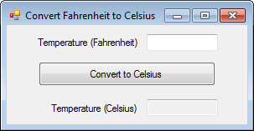
Example 1: Form
txtTempF
txtTempC

Slide 28
Example 1: Code Using Function
Private Sub Convert _Click(...) Handles btnCnvrt.Click
Dim fTemp, cTemp As Double
fTemp = txtTempF.Text
cTemp = FtoC(fTemp)
txtTempC.Text = cTemp
End Sub
Function FtoC(ByVal t As Double) As Double
Return (5 / 9) * (t - 32)
End Function

Slide 29
Example 1: Code Without Using Function
Private Sub btnConvert_Click(...) _Handles btnConvert.Click
Dim fTemp, cTemp As Double
fTemp = txtTempF.Text
cTemp = (5 / 9) * (fTemp - 32)
txtTempC.Text = cTemp
End Sub

Slide 30
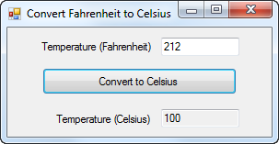
Example 1: Output

Slide 31
User-Defined Function Having Several Parameters
Function Pay(ByVal wage As Double,
ByVal hrs As Double) As Double
Dim amt As Double ‘ Total amount of salary
Select Case hrs
Case Is <= 40
amt = wage * hrs
Case Is > 40
‘the wage (salary/hour) increases 50% per every extra hour (extra hours >40)
amt = wage * 40 +(0.5 * wage * (hrs – 40))
End Select
Return amt
End Function

Slide 32
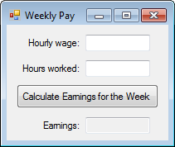
Example 3: Form
txtWage
txtHours
txtEarnings

Slide 33
Example 3: Partial Code
Private Sub btnCalculate_Click(...) _
Handles btnCalculate.Click
Dim hourlyWage, hoursWorkded As Double
hourlyWage = txtWage.Text
hoursWorked = txtHours.Text
txtEarnings.Text = Pay(hourlyWage, hoursWorked)
End Sub
Function call

Slide 34
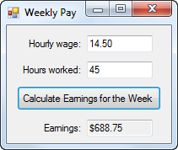
Example 3: Output

Slide 35
User-Defined Function Having No Parameters
Function CostOfItem() As Double
Dim price As Double = txtPrice.Text
Dim quantity As Integer =txtQuantity.Text
Dim cost = price * quantity
Return cost
End Function

Slide 36
User-Defined Boolean-Valued Function
Function isEven (ByVal x As Integer) As Boolean
if x Mod 2 =0 Then
return True
else
return false
end if
End function

Slide 37
Functions vs. Sub procedures
Both can perform similar tasks
Both can call other procedures
Use a function when you want to return one and only one value

