Slide 1
Industrial Mycology

Slide 2
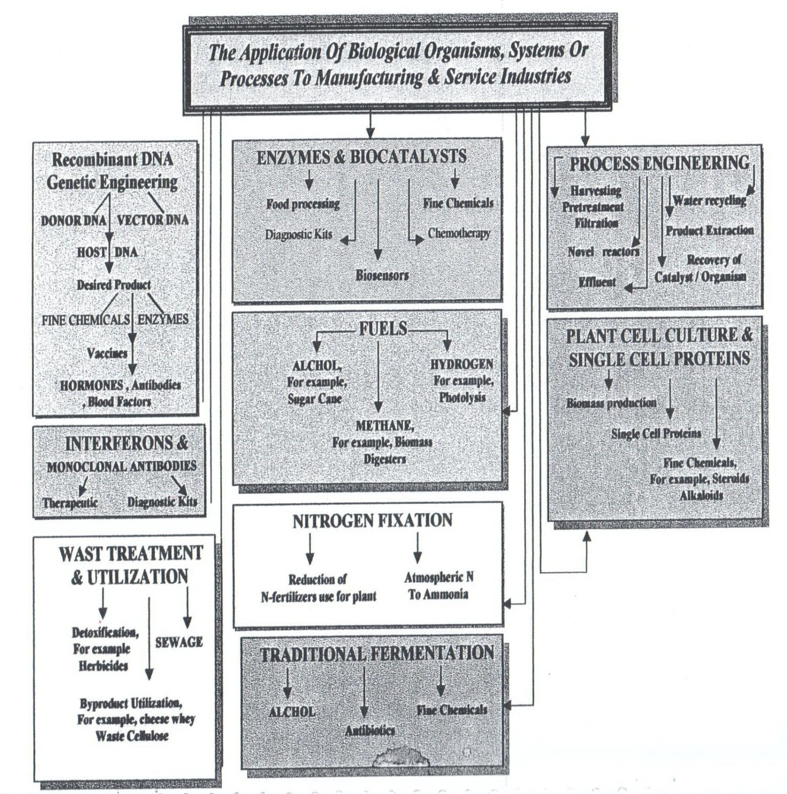

Slide 3
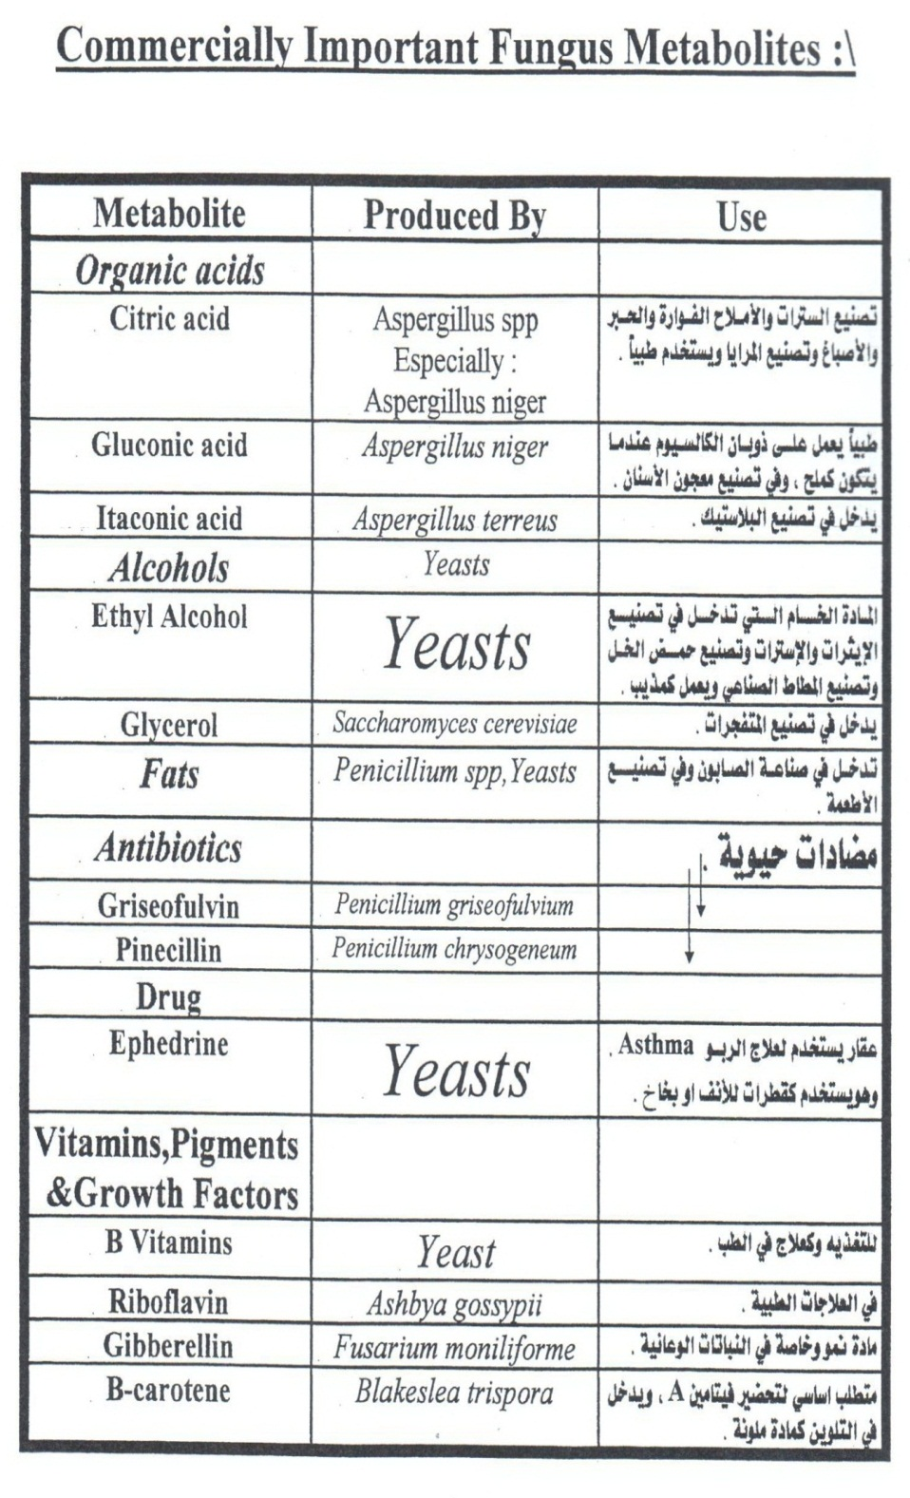

Slide 4
