Slide 1
Qualitative tests of Carbohydrates-II-
BCH302 [Practical]

Slide 2
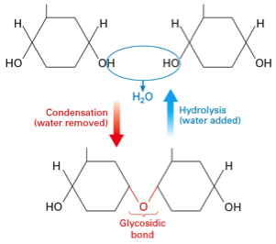
Complex carbohydrate:
Complex sugars consist of more than one unit of monosaccharide, it could be:
Disaccharides: contain two monosaccharide units.
Oligosaccharides: contain 3-9 monosaccharide units.
Polysaccharides: can contain more than 9 monosaccharide units.
Complex carbohydrates can be broken down into smaller sugar units through a process known as hydrolysis.

Slide 3
Polysaccharides :
Polysaccharides can either be :
homopolymeric (same repeating monosaccharide unit).
heteropolymeric (mixture of monosaccharaides).
Plants and animals store glucose in the form of very large polysaccharide glucose homopolymers.
The glucose homopolymer present in plants to store glucose is called starch.
While the glucose homopolymer present in animal cells is called glycogen.

Slide 4
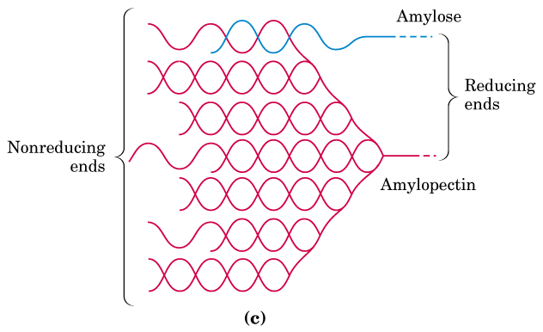
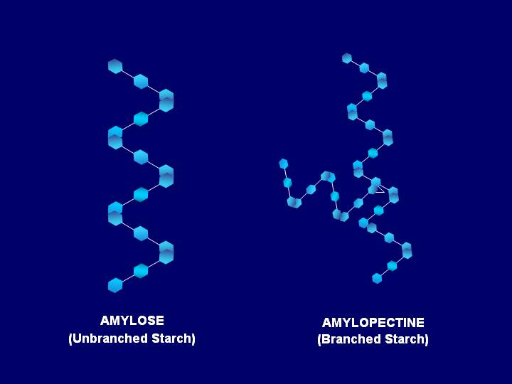
Starch:
Starch consists of two forms: amylose and amylopectin.
➔ Amylose is a Linear helical polymer of glucose linked by α-1,4 glycosidic bonds (100units).
➔Amylopectin is a Branched polymer containing glucose linked by α-1,4 glycosidic bonds, branch points has α-1,6 glycosidic bonds, (100,000 units).
Notes:
If alpha-form of monosaccharides involves in glycosidic linkage, it is known as alpha-glycosidic linkage which can be represented by the position of carbon atoms involve in bond formation.

Slide 5
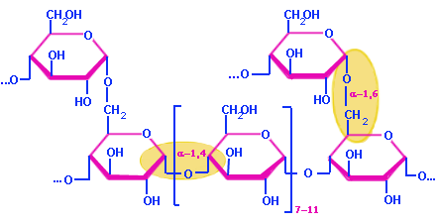
Amylose
Amylopectin

Slide 6
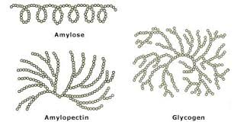
Glycogen:
Glycogen, is a branched polysacharide of D-glucose which contains both α(1→4) and α(1→6) is similar in structure to amylopectin.
➔ But glycogen has more α(1→6) branches.
Notes:
If alpha-form of monosaccharides involves in glycosidic linkage, it is known as alpha-glycosidic linkage which can be represented by the position of carbon atoms involve in bond formation.

Slide 7
Practical part

Slide 8
Qualitative tests of complex carbohydrates
Sucrose hydrolysis Test.
The Iodine/Potassium Iodide Test: for polysaccharides.
Hydrolysis of Starch.
1
2
3

Slide 9
Experiment 1 : Sucrose hydrolysis Test
This test is used to convert sucrose (non-reducing disaccharide) to glucose and fructose (reducing monosaccharides).
Objective:
To identify the products of hydrolysis of sucrose (disaccharide).
Principle:
Sucrose is a non-reducing disaccharide so it does not reduce the Cu++ solution (Bendict's and Fehling's test) because the glycosidic bond is formed between the two hemiacetal bonds.
So there is no free aldehydic or ketonic group to give positive reducing properties.
When glycosidic bond hydrolysed (in the presence of acid) to glucose + fructose (which are reducing sugars) are then able to give positive reducing test.
Notes:
Heating only can’t brake the glycosidic bond, there is should be an acid to act on.
Sucrose is non-reducing :
http://upload.wikimedia.org/wikipedia/commons/1/1c/Reducing_or_non_reducing_sugar.jpg

Slide 10
Non-reducing disaccharide
-ve result with benedict
Reducing monosaccharides
+ve result with benedict

Slide 11
Experiment 1 : Sucrose hydrolysis Test
Method:
Set up two tubes, add to each one 4ml of a sucrose solution, label the tube: (Sucrose with HCL, Sucrose without HCl)
To only one tube add 7 drops of concentrated hydrochloric acid (HCl). CARFULLY
Heat both tubes in boiling water bath for 15 minutes.
Add 15 drops of concentrated NaOH to each tube (why?).
From the tube containing HCl take 2ml in two tube to do Benedict's test and Seliwanoff's test, label the tube (Benedict +HCl) and (Seliwanoff +HCl)
Add 2 ml of Benedict's reagent and 2.5 ml of Seliwanoff's reagent .WHAT do expect?
From the tube which contain only sucrose take 2 ml to do Benedict's test only (add 2 ml of Benedict's reagent). WHAT do expect?
Results:
Sucrose without HCL | Sucrose with HCL
Benedict's test | Seliwanoff's test | Benedict's test

Slide 12
Sucrose + HCl
(+) Seliwanoff’s test
Sucrose + HCl
(+) Benedict’s test
Sucrose only
(-) Benedict’s test

Slide 13
Experiment 2 : The Iodine/Potassium Iodide Test
Objective:
This test used to distinguish between polysaccharides and mono or oligosaccharides.
To detect the presence of starch in a sample.
Principle:
Starch forms deeply blue color complex with iodine.
Starch contains α- amylose, a helical saccharide polymer and amylopectin. Iodine forms a large complex with α-amylose helix.
This complex absorbs light and reflects the blue light only.
Simple oligosaccharides and mono saccharides do not form this complex.
Note:
Other polysaccharides like glycogen may give other colors (red).
Notes:
Heating only can’t brake the glycosidic bond, there is should be an acid to act on.
Sucrose is non-reducing :
http://upload.wikimedia.org/wikipedia/commons/1/1c/Reducing_or_non_reducing_sugar.jpg

Slide 14
Experiment 2 : The Iodine/Potassium Iodide Test
Method:
Label two tubes A and B.
In tube A: add 2ml of starch and 2drops of iodine solution and one ml of water. Shake it well
A positive test is indicated by the formation of a blue-black complex.
Take a half of the tube A and heat it in boiling water bath for 3 min compare between the two tubes and write your observation. WHAT do expect?
In tube B: : add 2ml of glucose and 2drops of iodine solution. Record your results.
Results:
Observation | Tube
 | (Starch + Iodine) without heating
 | (Starch + Iodine) after heating
 | (Glucose+ Iodine)

Slide 15
Heating
Glucose + iodine
(-ve)
Starch + iodine
(+ve)
Starch + iodine

Slide 16
Experiment 3 : Hydrolysis of Starch
This experiment illustrates the conversion of starch (non-reducing sugar) to glucose (reducing sugar) by the action of hydrochloric acid at boiling point. The longer the starch is exposed to the acid the further hydrolysis proceeds.
Objective:
To establish the effect of concentrated HCl on a glycosidic bond in starch.
Principle:
Although starch has free hemiacetal in the terminal glucose residue, it has no reducing properties, because the percentage between the free residues is very low in comparison to the whole molecule.
Heating starch solution in acid medium hydrolysis the glycosidic bonds giving many free glucose residues ➔These glucose molecules give reducing properties to the hydrolysis product.
Notes:
Heating only can’t brake the glycosidic bond, there is should be an acid to act on.
Sucrose is non-reducing :
http://upload.wikimedia.org/wikipedia/commons/1/1c/Reducing_or_non_reducing_sugar.jpg

Slide 17
Non-reducing
Hydrolysis of glycosidic bond (HCl+heating)
Reducing

Slide 18
Experiment 3 : Hydrolysis of Starch
Method:
Two ml of starch in large tube.
Add 15 drops of Hydrochloric acid, heated in boiling water bath for 10 mints. then cold solution .
Add 25 drops of sodium hydroxide to become basic.
Divided in two tube (A,B)
In tube (A) add 1 ml of iodine solution and note the result. WHAT do expect?
In tube (B) add 1 ml of Benedict reagent, mix and heated for 3 mint and record result. WHAT do expect?
Results:
Starch with HCL
Iodine test | Benedict's test

Slide 19
Starch with HCL
[After heating]
[-ve] Iodine test
[+] Benedict's test

