Slide 1

CHEM 344 (REQUIRED COURSE)
ORGANIC REACTION MECHANISM
FOR CHEMISTRY’ STUDENTS, COLLEGE OF SCIENCE
Pre-requisites Course; CHEM 241
Credit Hours: 2(2+0)
Prof. Mohamed El-Newehy
Chemistry Department, College of Science, King Saud University
https://faculty.ksu.edu.sa/en/melnewehy
Prof. Zainab Almarhoon
Chemistry Department, College of Science, King Saud University
https://faculty.ksu.edu.sa/en/zalmarhoon

Slide 2
Addition to the Carbonyl Group
Nucleophilic Addition Reactions

Slide 3
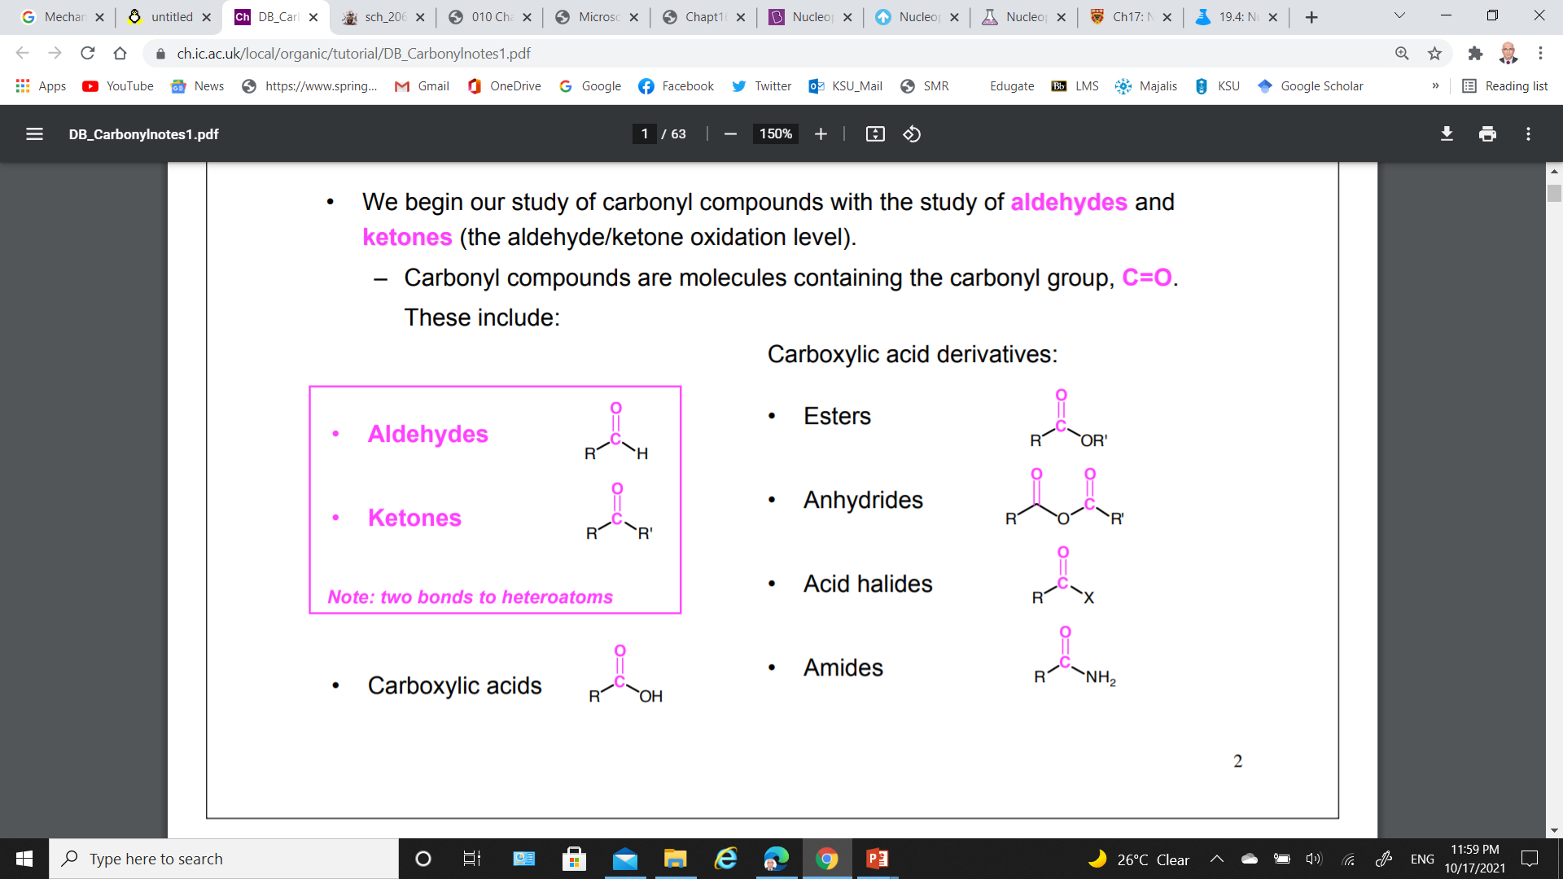
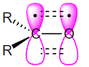
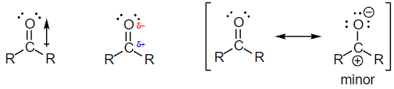
Carbonyl Compounds
Carbonyl compounds are molecules that containing the carbonyl group, C=O.
Carbonyl carbons are sp² hybridized;
Three sp² orbitals (from R groups: C or H) forming three sigma bonds.
and sp² hybrid orbital from oxygen.
Unhybridized 2p orbital forms π bond by overlapping with a 2p orbital from O.
The carbon-oxygen double bond is polar (O is more electronegative than C).
The oxygen is holding a partial negative charge and the carbonyl carbon with a partial positive charge;
The carbon is electron-poor (an electrophile): it attacks by an electron-rich nucleophilic group.

Slide 4
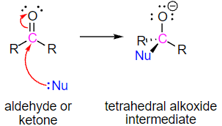
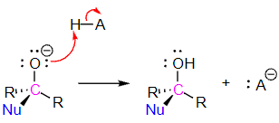
Nucleophilic Addition to Carbonyl Group; A Nucleophile
General mechanism
Step 1;
The nucleophile forms a bond with the electrophilic carbonyl carbon.
This causes the rehybridization of the carbonyl carbon from sp² to sp³.
Electrons in the π bond are pushed up to the electronegative oxygen atom forming a tetrahedral alkoxide intermediate.
Step 2;
The alkoxide is protonated by the addition of an acid to form an alcohol.
Nucleophilic Addition Reactions of Aldehydes and Ketones, leads to an alcohol product.

Slide 5
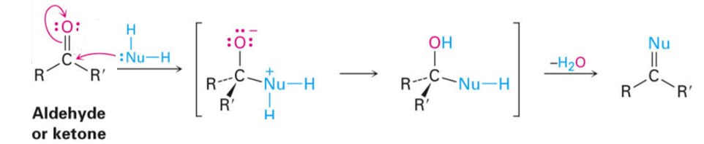
Nucleophilic Addition to Carbonyl Group; A Neutral Nucleophile
General mechanism
The presence of an additional hydrogen atom in the nucleophile allows for the removal of carbonyl oxygen to be completely as water and a C=Nu bond to be formed.
Nucleophilic Addition Reactions of Aldehydes and Ketones, leads to the product with a C= Nu bund.

Slide 6
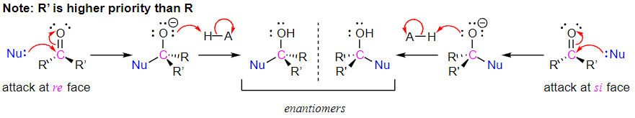
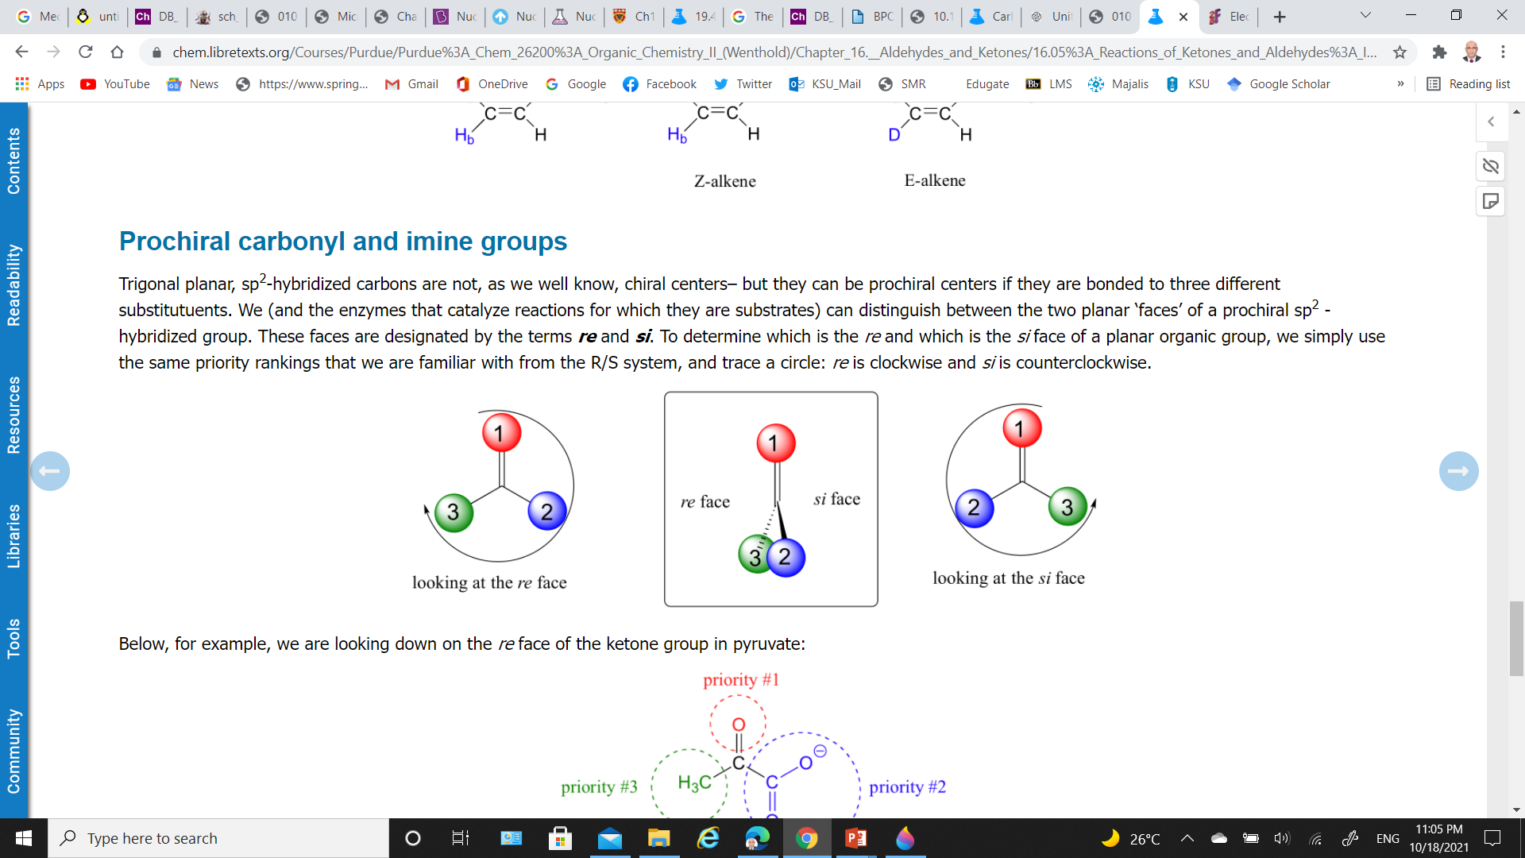
Nucleophilic Addition to Carbonyl Group; Stereochemistry
If the two R groups are not equivalent;
A chiral center is created upon addition of the nucleophile.
Reactions of this type often result in a 50:50 racemic mixture of stereoisomers.
NOTE:
A ‘prochiral' carbon is refereed to carbon that can be converted to a chiral center by changing only one of the attached groups.
A prochiral
Carbonyl carbon.
Faces are designated by the terms re (clockwise) and si (counterclockwise).

Slide 7
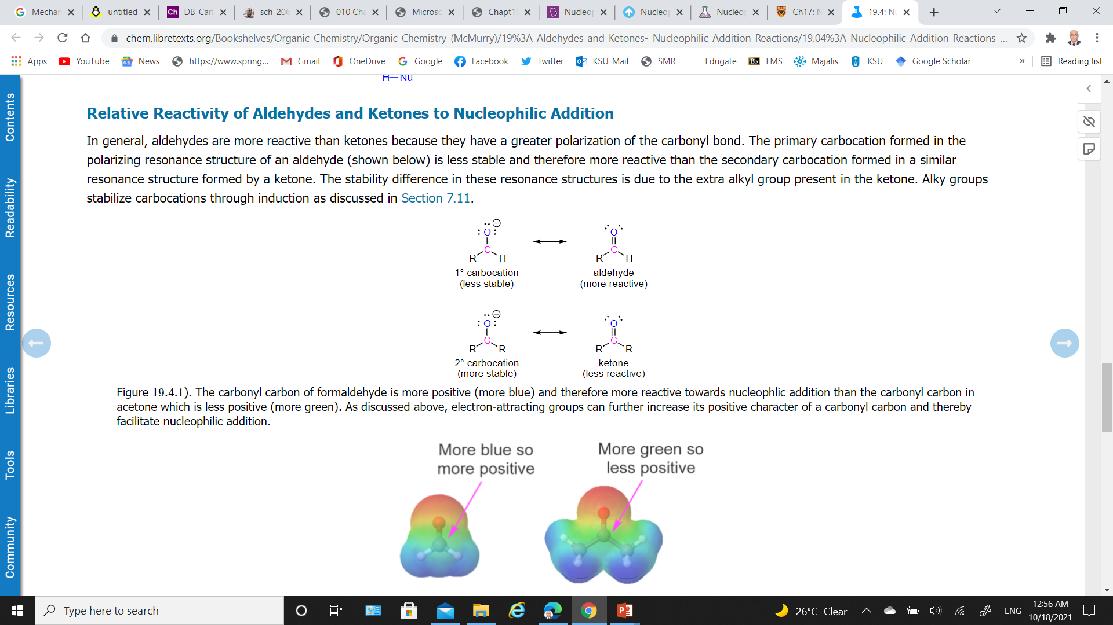
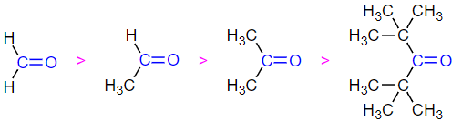
Relative Reactivity of Aldehydes and Ketones Towards Nucleophilic Addition
Aldehydes are more reactive than ketones because
1) Electrophilicity of Aldehydes and Ketones
The primary carbocation formed in the polarizing resonance structure of an aldehyde is less stable and therefore more reactive.
The secondary carbocation formed in a similar resonance structure formed by a ketone more stable and therefore less reactive due to the extra alkyl group present in the ketone.
2) Steric Hindrance Effect
The transition state of the rate determining step for formation of the tetrahedral intermediate is less sterically crowded, lower in energy, and more kinetically favorable for an aldehyde than a ketone.
more reactive
Least reactive

Slide 8
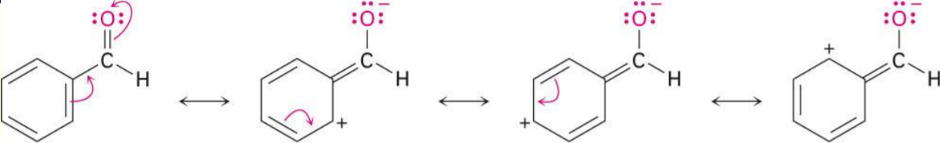
Relative Reactivity of Aldehydes and Ketones Towards Nucleophilic Addition
Aromatic aldehydes are less reactive than aliphatic aldehydes
Electron-donating resonance effect of aromatic ring makes C=O less reactive electrophile than the carbonyl group of an aliphatic aldehyde.

Slide 9
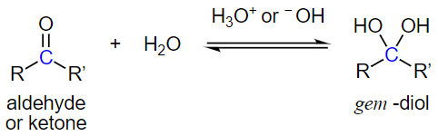
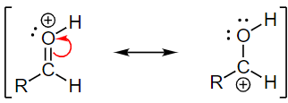
Nucleophilic Addition of H₂O; Hydration
Water adds rapidly to the carbonyl group of aldehydes and ketones establishing a reversible equilibrium with a hydrate (geminal-diol, gem-diol, or 1,1-diol).
In most cases the resulting gem-diol is unstable and cannot be isolated.
General mechanism
The rate is usually slow under neutral condition.
The rate can be significantly increased through the addition of an acid or base as a catalyst.
Basic conditions speed up the reaction because hydroxide is a better nucleophile than water.
Acidic conditions speed up the reaction because the carbonyl becomes protonated.
Protonation increases the polarity of the carbonyl bond which increase the partial positive charge on the carbon making it more electrophilic.

Slide 10
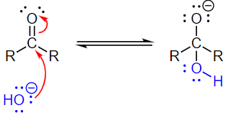
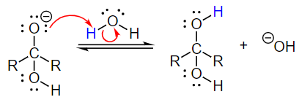
Nucleophilic Addition of H₂O; Hydration
General mechanism
Basic conditions
The negatively charged hydroxide forms a single bond with the electrophilic carbonyl carbon.
This pushes the two electrons of the pi bond onto the electronegative oxygen forming an alkoxide ion intermediate.
Water acts as an acid and protonates the alkoxide ion to form a neutral hydrate while also regenerating hydroxide.

Slide 11
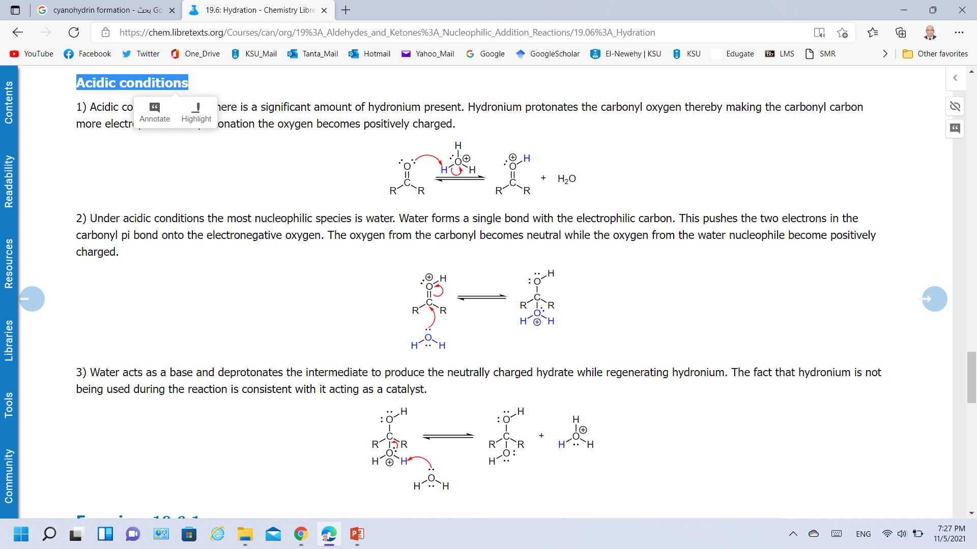
Nucleophilic Addition of H₂O; Hydration
General mechanism
Acidic conditions
Hydronium protonates the carbonyl oxygen thereby making the carbonyl carbon more electrophilic.
Water forms a single bond with the electrophilic carbon. This pushes the two electrons in the carbonyl pi bond onto the electronegative oxygen.
Water acts as a base and deprotonates the intermediate to produce the neutrally charged hydrate while regenerating hydronium.

Slide 12
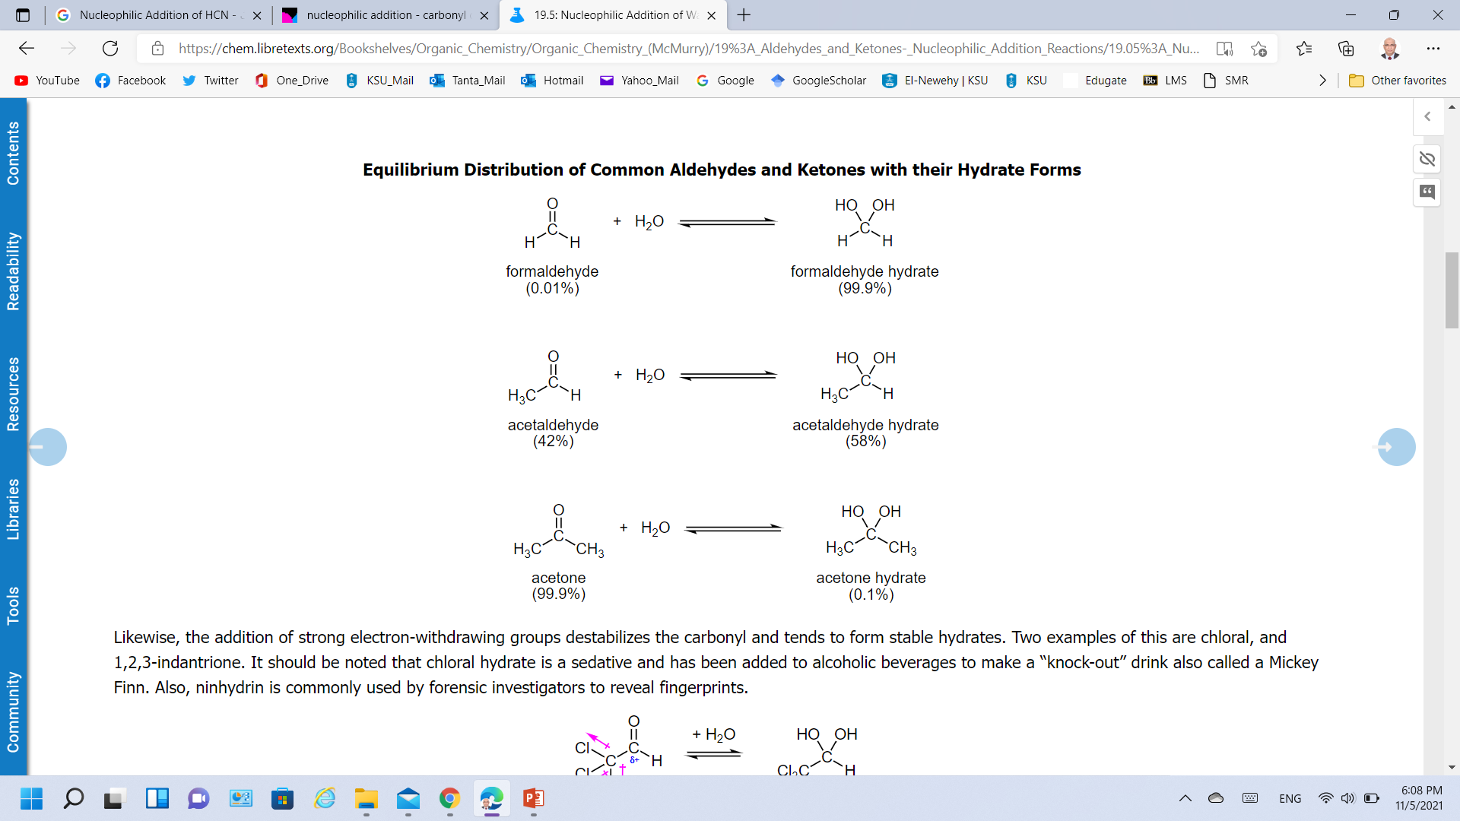
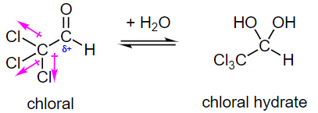
Nucleophilic Addition of H₂O; Hydration
Factors Affecting the Hydrate Equilibrium
The addition of electron donating alkyl groups stabilized the partial positive charge on the carbonyl carbon and decreases the amount of gem-diol product at equilibrium.
Formaldehyde favors hydrate formation.
The addition of strong electron-withdrawing groups destabilizes the carbonyl and tends to form stable hydrates.

Slide 13
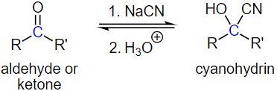
Nucleophilic Addition of HCN; Cyanohydrin Formation
Hydrogen cyanide (HC≡N), adds reversibly to aldehydes and many ketones forming hydroxyalkanenitrile adducts (cyanohydrins) (R₂C(OH)CN).
Cyanohydrin formation is favored for aldehydes, and unhindered cyclic and methyl ketones.
HCN is created in situ by adding a strong acid to a mixture of sodium cyanide and the carbonyl compound,
Cyanohydrin formation is base-catalyzed reaction.
Hydrogen cyanide is a weak acid (pK_{a} = 9.25), and a small amount of a strong base activates hydrogen cyanide by converting it to cyanide ion (-C≡N, carbon nucleophile).
In the absence of base, the reaction does not proceed or is at best very slow.

Slide 14
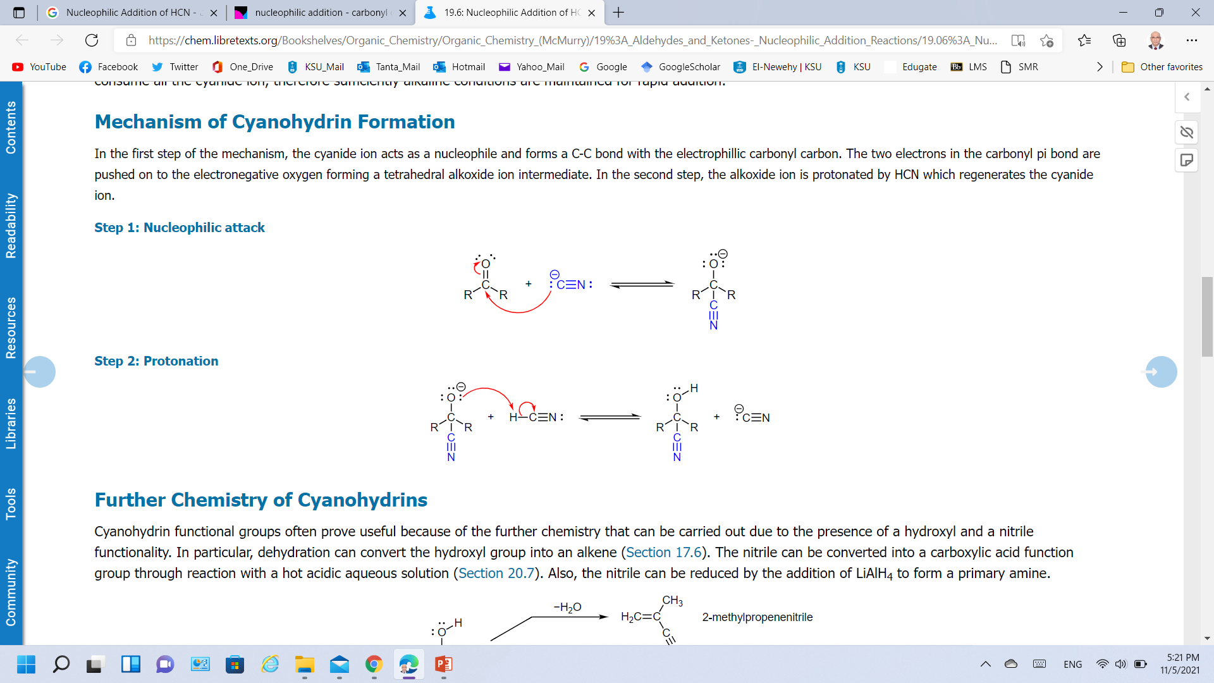
Nucleophilic Addition of HCN; Cyanohydrin Formation
Mechanism
Step 1: Nucleophilic attack
The cyanide ion acts as a nucleophile and forms a C-C bond with the electrophilic carbonyl carbon.
The two electrons in the carbonyl pi bond are pushed on to the electronegative oxygen forming a tetrahedral alkoxide ion intermediate.
Step 2: Protonation
The alkoxide ion is protonated by HCN which regenerates the cyanide ion.

Slide 15
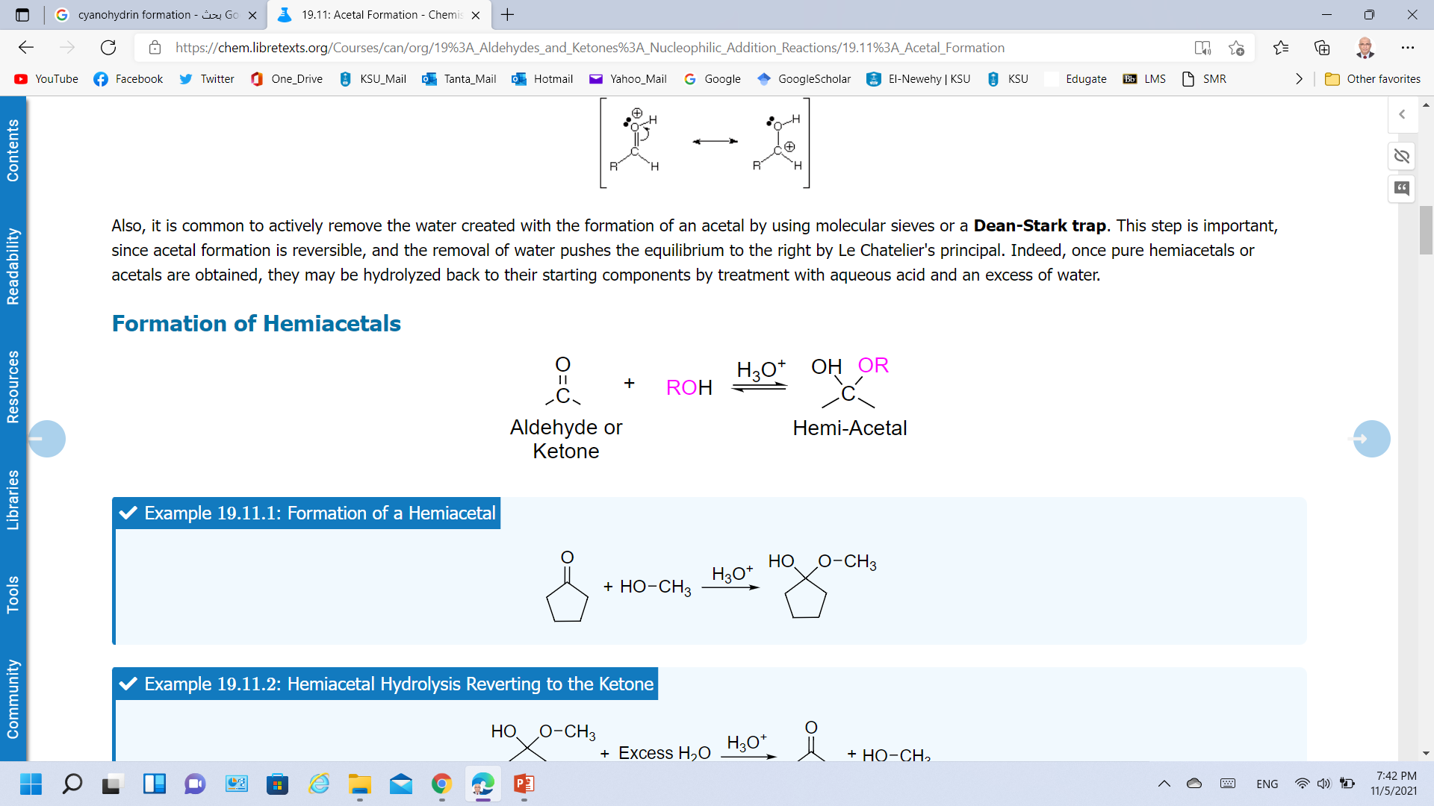
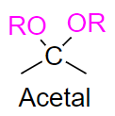
Nucleophilic Addition of ROH; Acetal Formation
Addition of one equivalent of an alcohol to aldehydes and ketones, in the presence of an acid catalyst, form a hydroxy ether called a hemiacetal (R₂COHOR').
This reaction can continue by adding another equivalent of an alcohol to form a diether called an acetal R₂C(OR')₂.
+

Slide 16
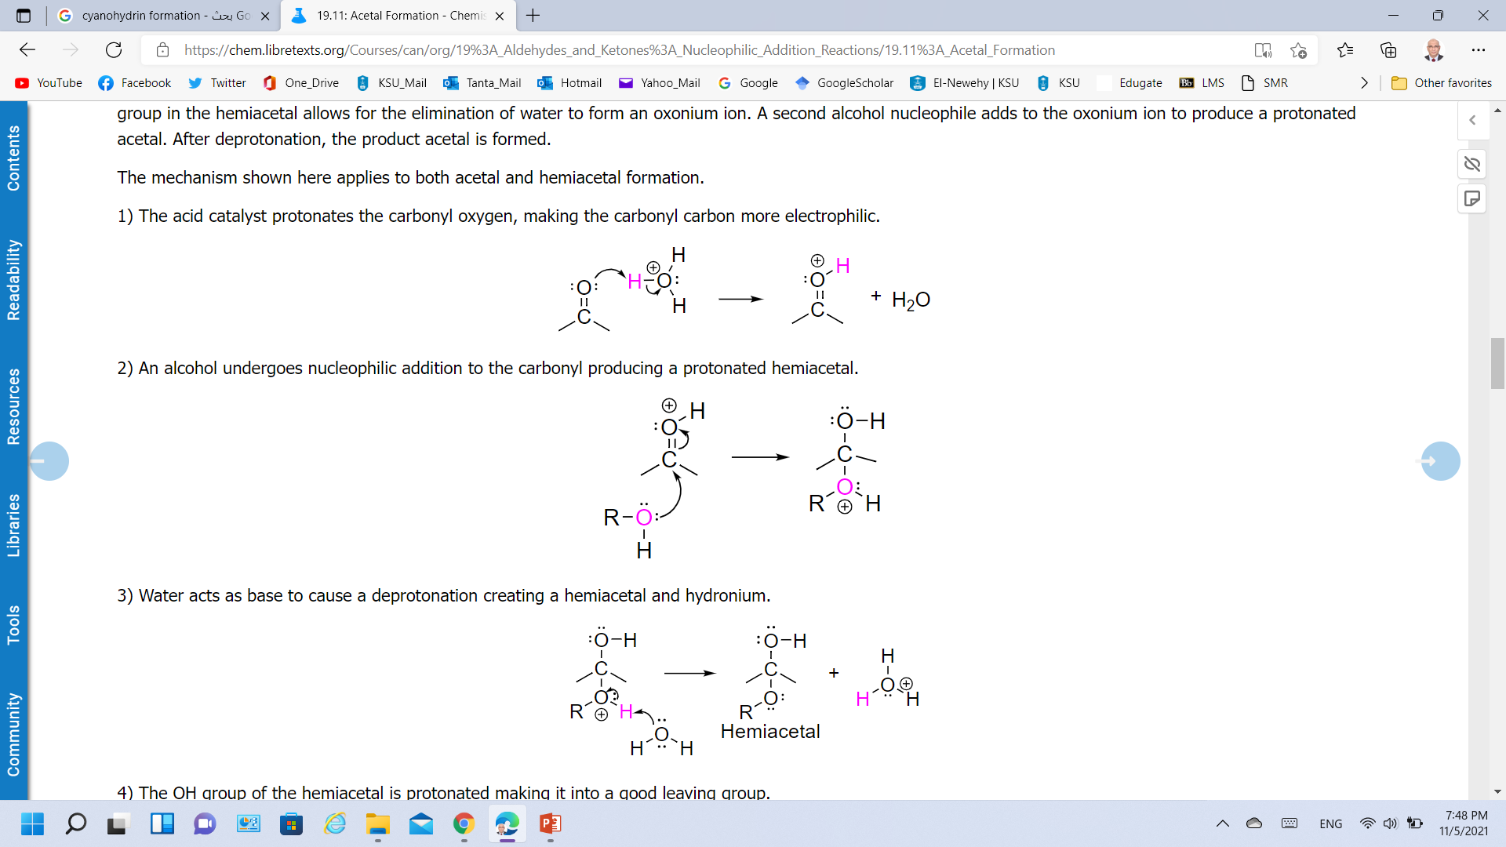
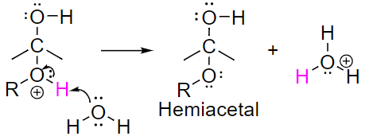
Nucleophilic Addition of ROH; Acetal Formation
Mechanism
Step 1: Protonation
The acid catalyst protonates the carbonyl oxygen, making the carbonyl carbon more electrophilic.
Step 2: Nucleophilic attack
An alcohol undergoes nucleophilic addition to the carbonyl producing a protonated hemiacetal.
Step 3: Deprotonation
Water acts as base to cause a deprotonation creating a hemiacetal and hydronium.

Slide 17
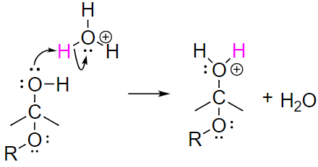
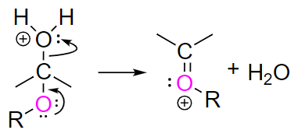
Nucleophilic Addition of ROH; Acetal Formation
Mechanism
Step 4: Protonation
The OH group of the hemiacetal is protonated making it into a good leaving group.
Step 5: Elimination of Water
Lone pair electrons on the ether oxygen reforms the C=O bond causing the elimination of water and producing an oxonium ion.

Slide 18
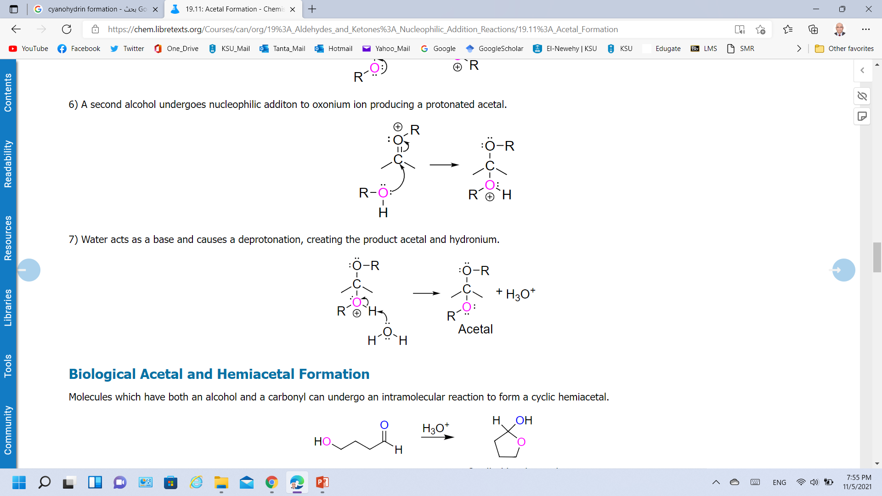
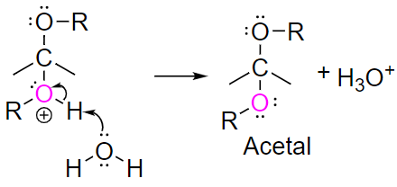
Nucleophilic Addition of ROH; Acetal Formation
Mechanism
Step 6: Nucleophilic Attack
Lone pair electrons on the ether oxygen reforms the C=O bond causing the elimination of water and producing an oxonium ion.
Step 7: Deprotonation
Water acts as a base and causes a deprotonation, creating the product acetal and hydronium.

Slide 19
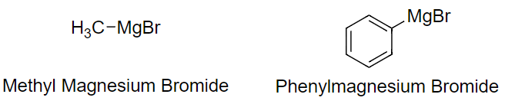
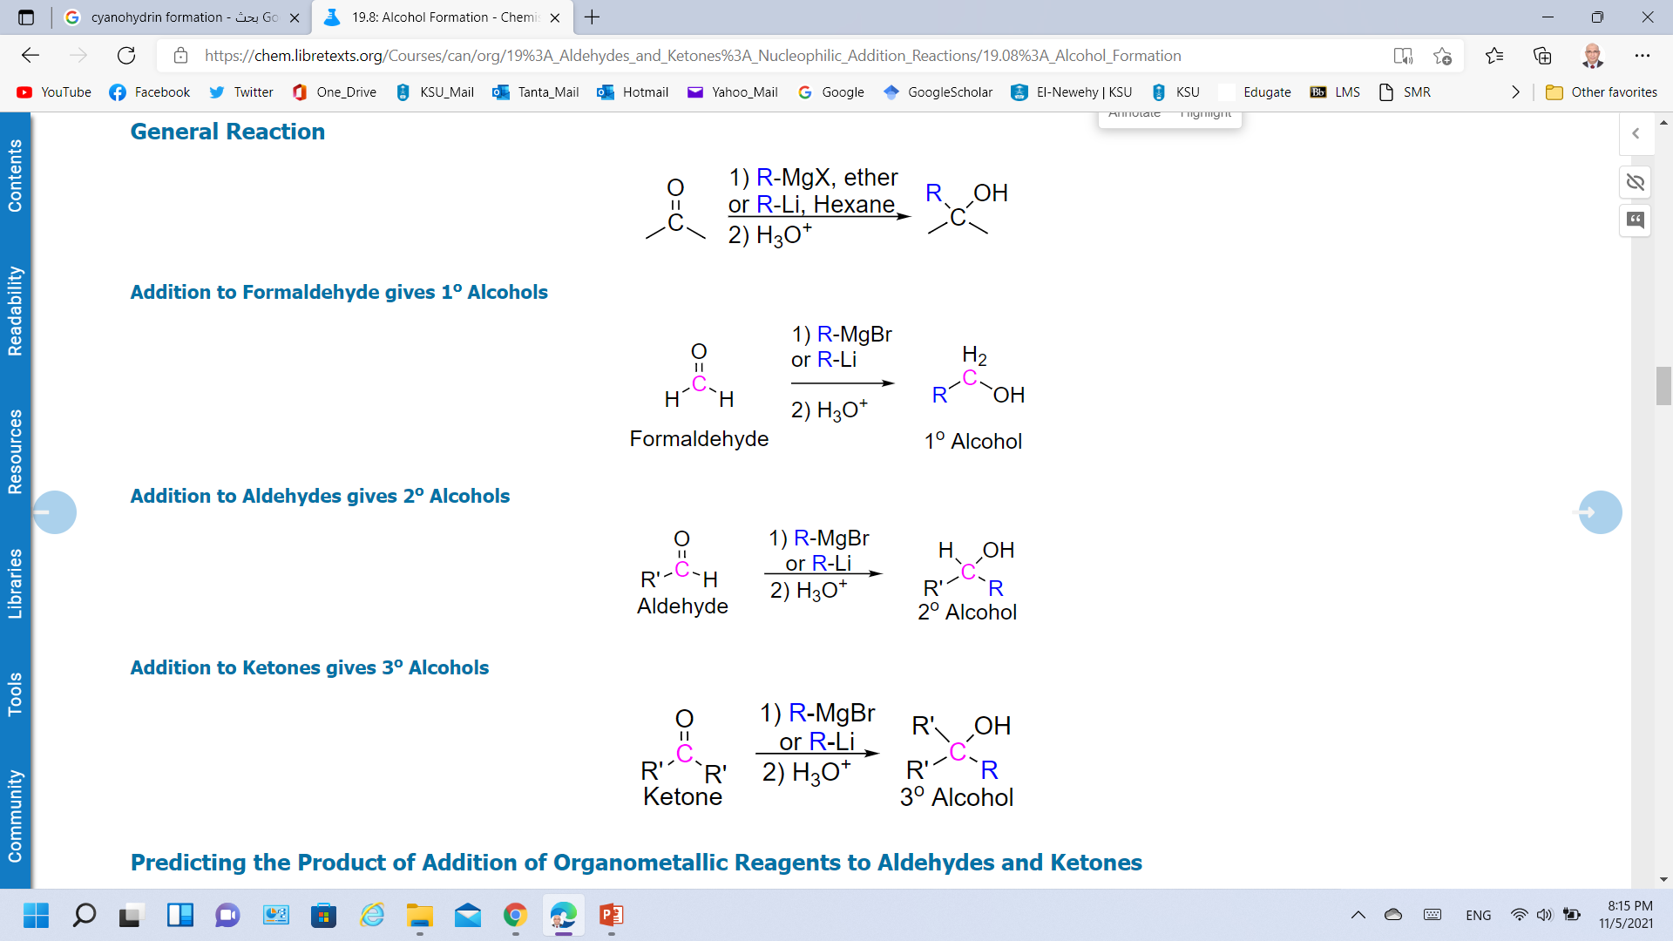
Nucleophilic Addition of RMgX; Organometallic Reactions
Magnesium metal reduce the carbon-halogen bonds of alkyl halides to form Grignard reagents as powerful bases.
The carbon bonds to the metal and has characteristics like a carbanion (R:⁻) nucleophile.
An alkoxide ion intermediate is formed which becomes an alcohol with subsequent protonation with an acid.

Slide 20
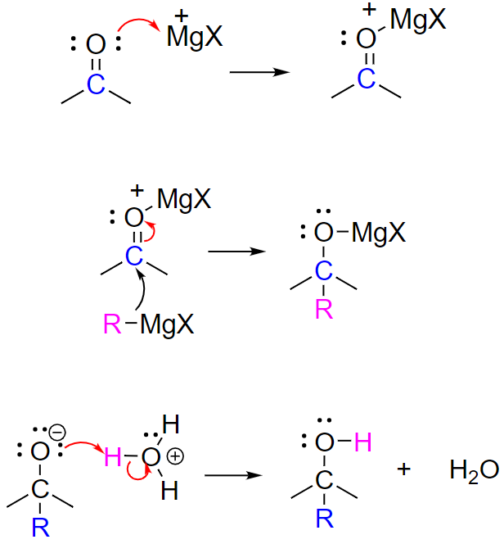
Nucleophilic Addition of RMgX to Aldehydes and Ketones
Mechanism
Step 1: Lewis's acid-base formation
The mechanism starts with the formation of an acid-base complex between ⁺MgX (acts as a Lewis acid) and the carbonyl oxygen.
Step 2: Nucleophilic attack
The carbanion nucleophile from the Grignard reagent adds to the electrophilic carbon of the acid-base complex forming a C-C bond forming a tetrahedral magnesium alkoxide intermediate. .
Step 3: Protonation
The alkoxide intermediate is converted to an alcohol through addition of an acidic aqueous solution.

Slide 21
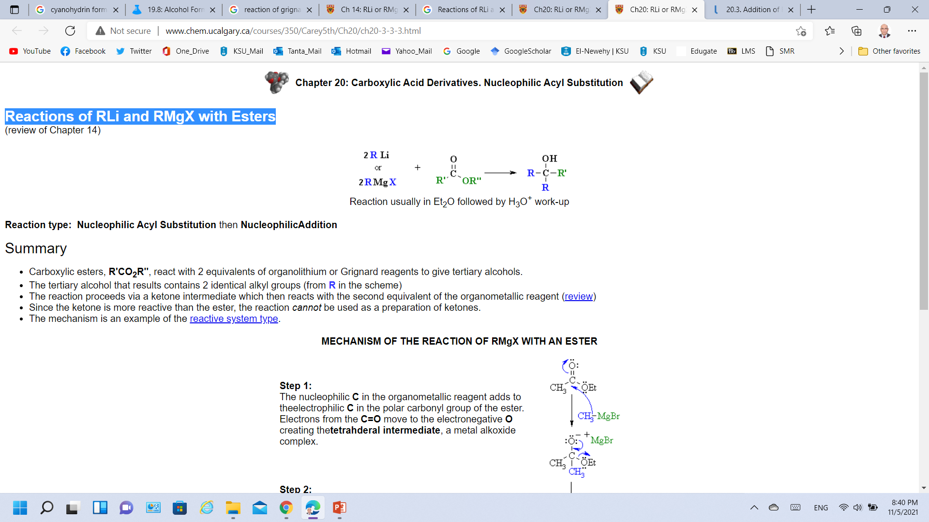
Nucleophilic Addition of RMgX to Esters
Grignard reagents are powerful bases and cannot be used as nucleophiles on compounds, which contain acidic hydrogens.
Grignard reagents will act as a base and deprotonate the acidic hydrogen rather than act as a nucleophile and attack the carbonyl.

Slide 22
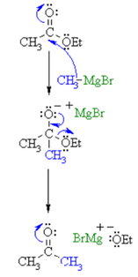
Nucleophilic Addition of RMgX to Esters
Mechanism
Step 1:
The nucleophilic C in the organometallic reagent adds to the electrophilic C in the polar carbonyl group of the ester.
Electrons from the C=O move to the electronegative O creating the tetrahedral intermediate, a metal alkoxide complex.
Step 2:
The tetrahedral intermediate collapses and displaces the alcohol portion of the ester as a leaving group, in the form of the alkoxide, RO⁻.
This produces a ketone as an intermediate.

Slide 23
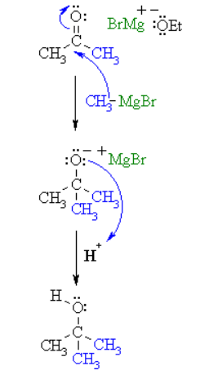
Nucleophilic Addition of RMgX to Esters
Mechanism
Step 3:
The nucleophilic C in the organometallic reagent adds to the electrophilic C in the polar carbonyl group of the ketone.
Electrons from the C=O move to the electronegative O creating an intermediate metal alkoxide complex.
Step 4:
This is the work-up step, a simple acid/base reaction. Protonation of the alkoxide oxygen creates the alcohol product from the intermediate complex.

Slide 24
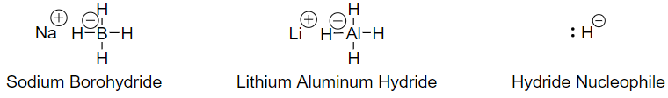
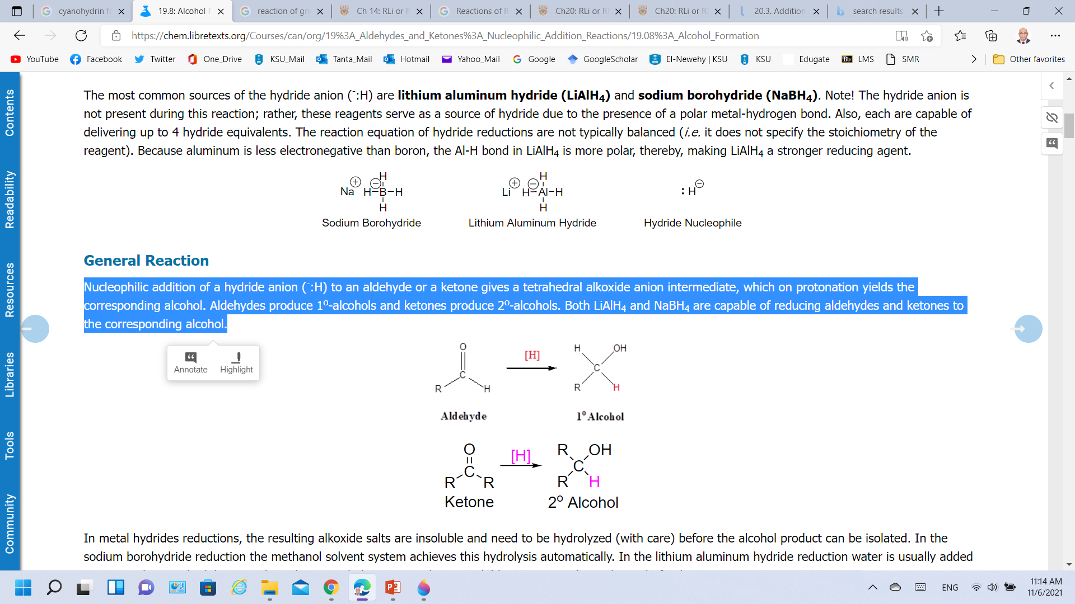
Reduction of Carbonyls to Alcohols Using Metal Hydrides
Hydrogen (e.g., hydride ion) can be used as a nucleophile if it is bonded to a metal.
The most common sources of the hydride anion (⁻:H) are lithium aluminum hydride (LiAlH₄) and sodium borohydride (NaBH₄).
Nucleophilic addition of a hydride anion (⁻:H) to an aldehyde produce 1º alcohols and ketones produce 2º-alcohols.

Slide 25
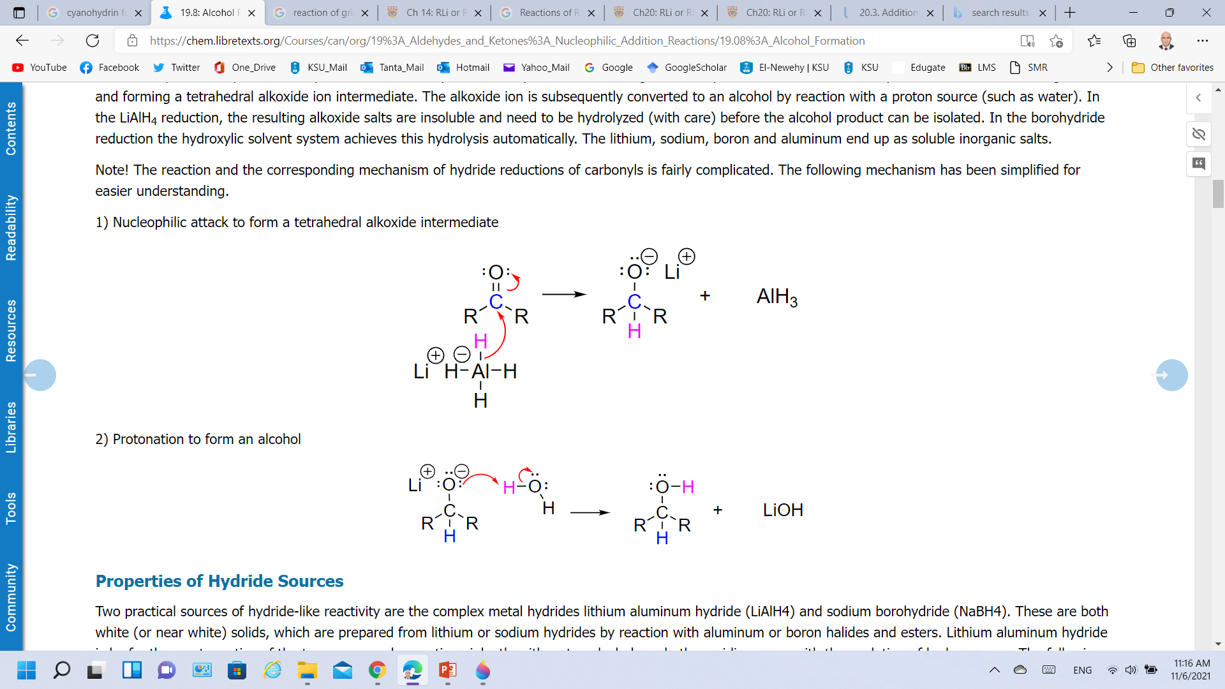
Reduction of Carbonyls to Alcohols Using Metal Hydrides
Mechanism
The hydride anion undergoes nucleophilic addition to the carbonyl carbon to form a C-H single bond and forming a tetrahedral alkoxide ion intermediate, which on protonation yields the corresponding alcohol.
Step 1: Nucleophilic attack to form a tetrahedral alkoxide intermediate
Step 2: Protonation to form an alcohol

Slide 26
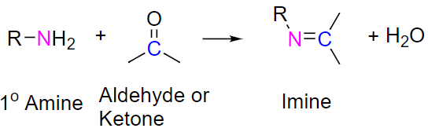
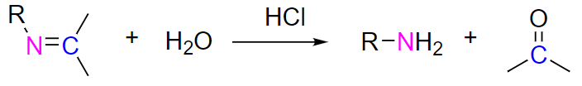
Reaction with Primary Amines to form Imines
The reaction of aldehydes and ketones with ammonia or 1º-amines forms imine derivatives (Schiff bases; compounds having a C=N function).
Water is eliminated in the reaction.
Imines can be hydrolyzed back to the corresponding 1o amine under acidic conditions.

Slide 27
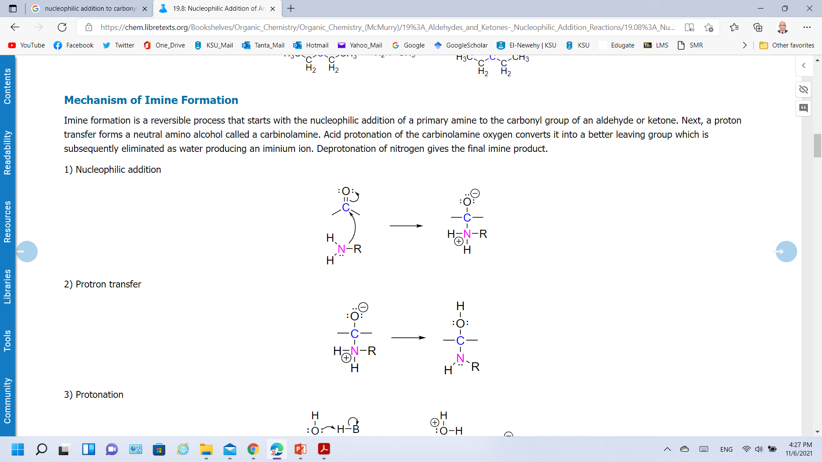
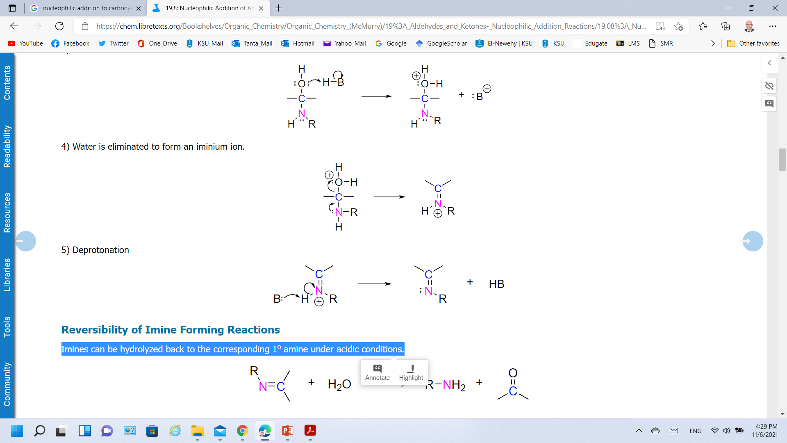
Reaction with Primary Amines to form Imines
Mechanism
Step 1: Nucleophilic addition
Nucleophilic addition of a primary amine to the carbonyl group of an aldehyde or ketone
Step 2: Proton transfer
A proton transfer forms a neutral amino alcohol called a carbinolamine
Step 3: Protonation
Acid protonation of the carbinolamine oxygen converts it into a better leaving group

Slide 28
Reaction with Primary Amines to form Imines
Mechanism
Step 4: Water is eliminated to form an iminium ion.
Better leaving group which is subsequently eliminated as water producing an iminium ion.
Step 5: Protonation
Deprotonation of nitrogen gives the final imine product.

Slide 29
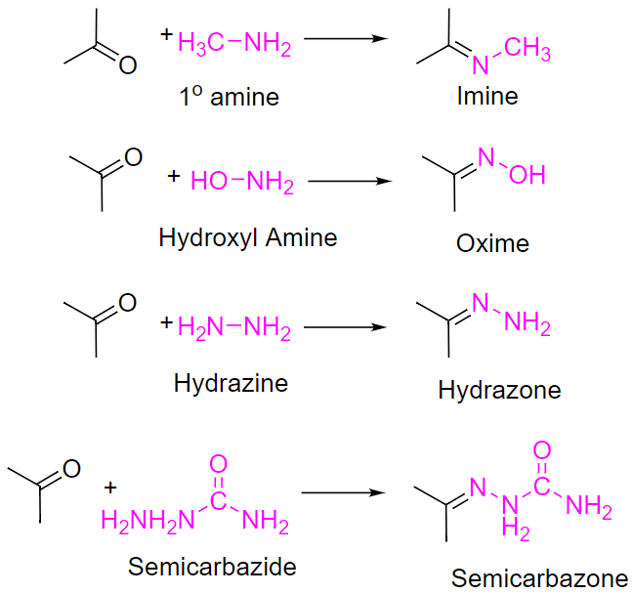
Reactions Involving other Reagents of the type Y-NH₂

Slide 30
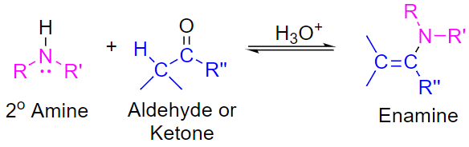
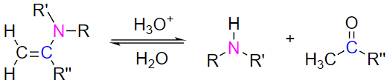
Reaction with Secondary Amines to form Enamines
Aldehydes and ketones react with 2º-amines to give products known as enamines (alkene + amine).
These are acid-catalyzed reversible reactions in which water is lost.
Reversibility of Enamines

Slide 31
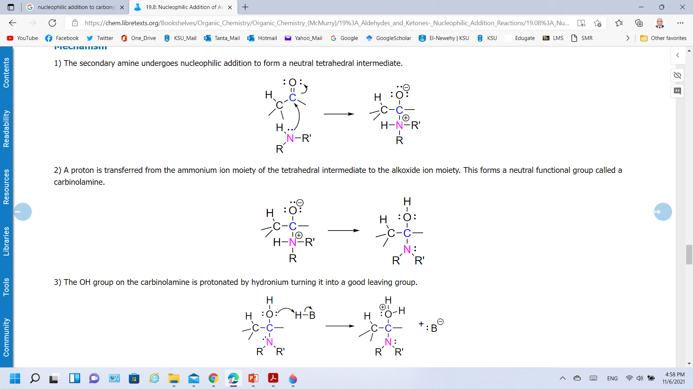
Reaction with Secondary Amines to form Enamines
Mechanism
Step 1: Nucleophilic addition
Nucleophilic addition of secondary amine to form a neutral tetrahedral intermediate.
Step 2: A proton transfer
A proton is transferred from the ammonium ion moiety of the tetrahedral intermediate to the alkoxide ion moiety to form a neutral functional group called a carbinolamine.
Step 3: Protonation
The OH group on the carbinolamine is protonated by hydronium turning it into a good leaving group.

Slide 32
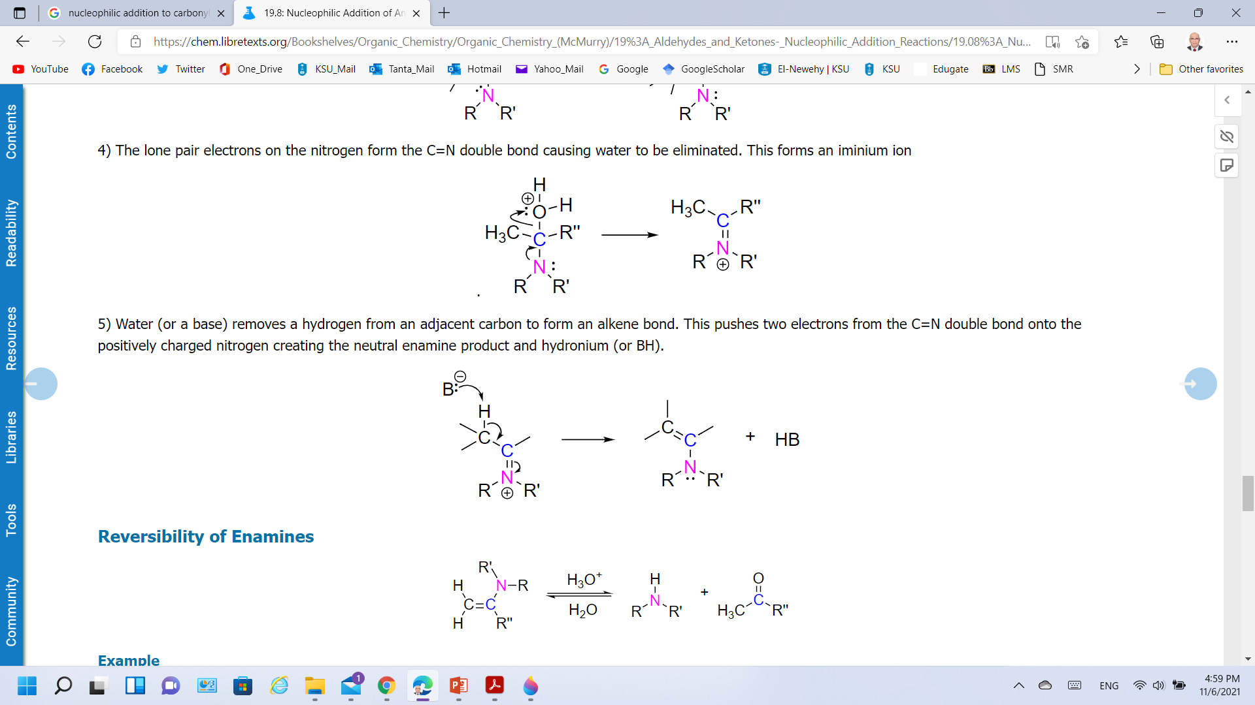
Reaction with Secondary Amines to form Enamines
Mechanism
Step 4: Water is eliminated to form an iminium ion.
The lone pair electrons on the nitrogen form the C=N double bond causing water to be eliminated. This forms an iminium ion
Step 5: Protonation
Water (or a base) removes a hydrogen from an adjacent carbon to form an alkene bond (C=N double bond into C=C bond) creating the neutral enamine product and hydronium (or BH).

Slide 33
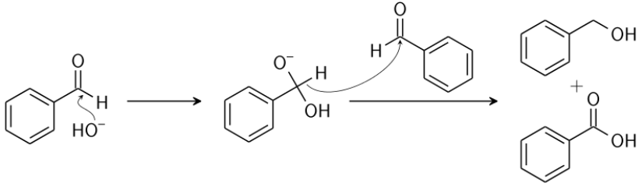
Cannizzaro Reaction
In the presence of concentrated alkali, aldehydes containing no α-hydrogens undergo self oxidation & reduction (Redox) reaction to yield a mixture of an alcohol & a salt of carboxylic acid.
The oxidation product is a salt of a carboxylic acid, and the reduction product is an alcohol.

Slide 34
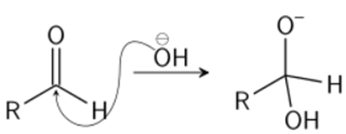
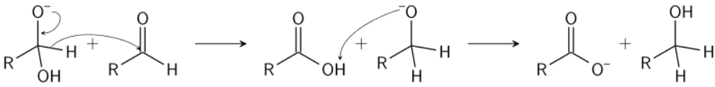
Cannizzaro Reaction
Mechanism
Nucleophilic addition of hydroxide to carbonyl group forming a tetrahedral intermediate.
Hydride transfer from the resulting tetrahedral intermediate to attack another carbonyl.
In the final step of the reaction, the acid and alkoxide ions formed exchange a proton.

Slide 35
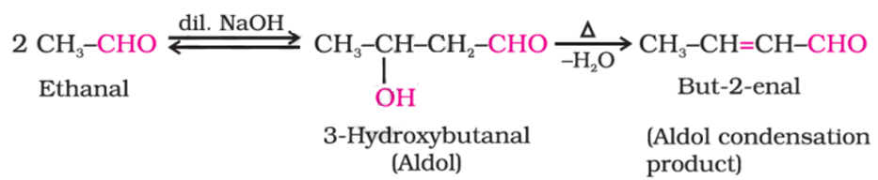
Aldol condensation
Aldehydes and ketones having at least one α-hydrogen undergo a reaction in the presence of dilute alkali as catalyst
It involves the nucleophilic addition of a ketone enolate to an aldehyde to form a β-hydroxy ketone, or "aldol" (aldehyde + alcohol),

Slide 36

Aldol condensation
Mechanism
The first part of this reaction is an aldol reaction,
The second part a dehydration-an elimination reaction (Involves removal of a water molecule or an alcohol molecule).

Slide 37

Conjugate Addition Reactions; α, β-Unsaturated Carbonyl Compounds
α,β-Unsaturated carbonyl compounds;
These compounds undergo further reactions at the C=C bond, which are not found in the reactions of simple alkene compounds.
Nucleophilic addition to the C=C bond can occur: why?
A resonance-stabilized enolate intermediate is formed.
The overall observed reaction is the net addition to the double bond.

Slide 38



Conjugate Addition Reactions; α, β-Unsaturated Carbonyl Compounds
Conjugate Addition vs. Carbonyl Group Reactions
Thermodynamics: Which reaction product is more stable?
C=O bonds are stronger than C=C bonds.
The conjugate addition product is more stable and is thermodynamically favored.
Kinetics: which reaction is faster?
The addition to the carbonyl carbon proceeds faster (because the carbonyl carbon is a stronger Lewis acid than the C=C carbon)
The carbonyl addition reaction usually proceeds faster.

