Slide 1

CHEM 342 (REQUIRED COURSE)
POLYMERS AND PETROCHEMICALS
FOR CHEMISTRY’ STUDENTS, COLLEGE OF SCIENCE
Pre-requisites Course; CHEM 241
Credit Hours: 2(2+0)
Prof. Mohamed El-Newehy
Chemistry Department, College of Science, King Saud University
http://fac.ksu.edu.sa/melnewehy/home

Slide 2
Polymer Reactions and Modification

Slide 3
Reactions of Synthetic Polymers
Polymer can be chemically modified to improve some property, such as biocompatibility, fire retardancy, or adhesion, or to provide specific functional groups for ion-exchange or other applications.
Example;
Bromination is sometimes used to impart fire retardancy to some polymers.
Poly(vinyl chloride) can be chlorinated after polymerization to increase its softening temperature or to improve its ability to blend with other polymers.
Important commercial polymers can be produced only by the chemical modification of a precursor polymer.
Examples;
Poly(vinyl alcohol), poly(vinyl butyral), cellulose derivatives such as cellulose acetate and cellulose nitrate, and polyphosphazenes—an interesting group of inorganic polymers.

Slide 4
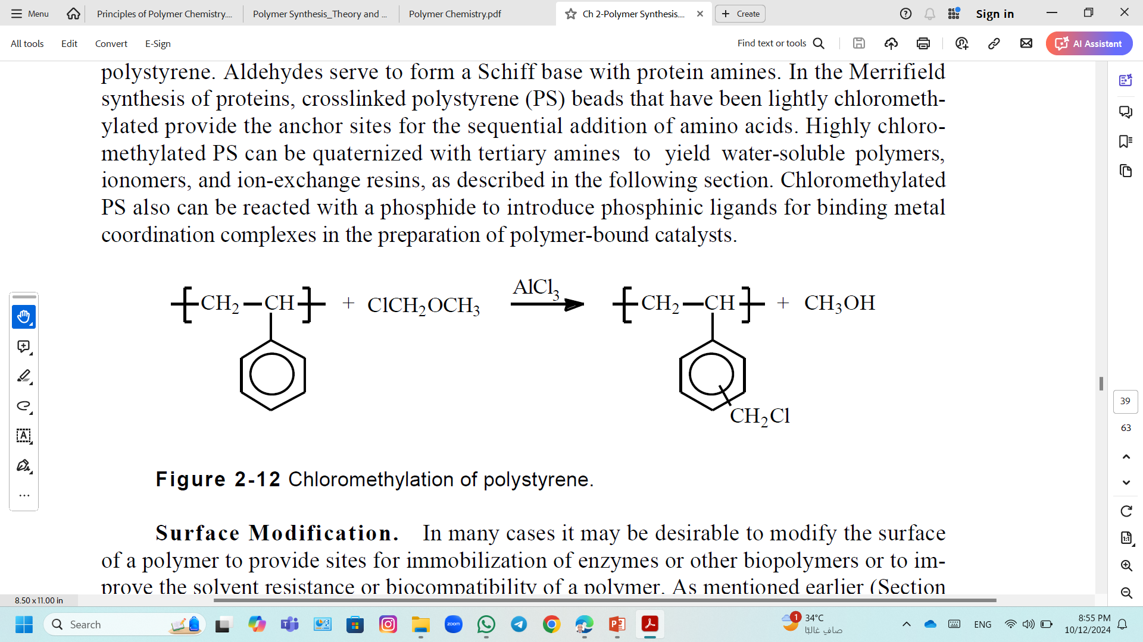
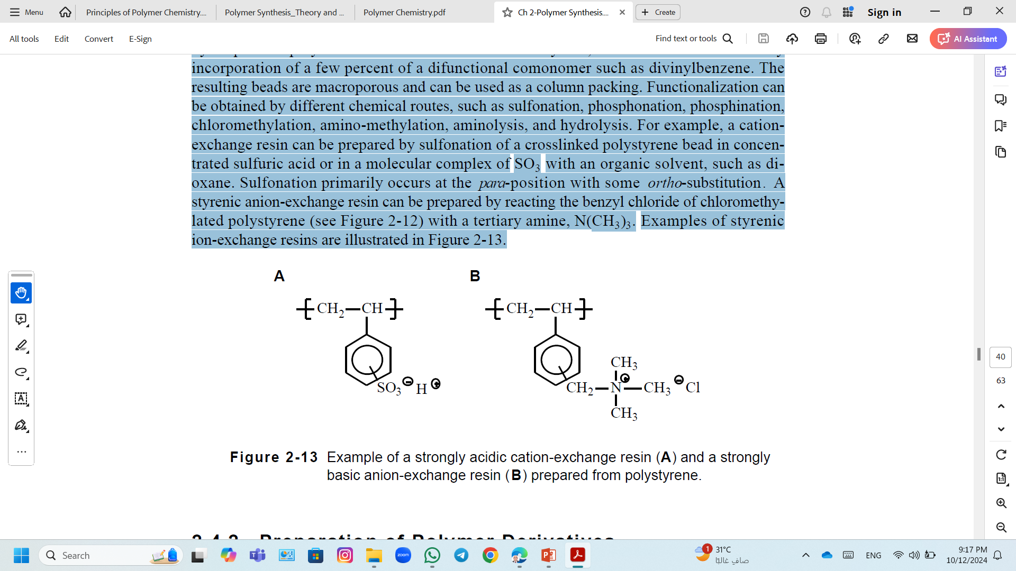
Chemical Modification; Chloromethylation
Chloromethylation of polystyrene, by reacting with a chloromethyl ether in the presence of a Friedel-Crafts catalyst like aluminum chloride, AlCl₃, can be used to introduce functionality such as aldehyde or carboxylic acid groups in polystyrene.
Highly chloromethylated PS can be quaternized with tertiary amines to yield water-soluble polymers, ionomers, and ion-exchange resins.
Chloromethylation of polystyrene.
A strongly basic anion-exchange resin prepared from polystyrene.

Slide 5
Chemical Modification; Ion-Exchange Resins
Cation-exchange resins possess a fixed negative charge and exchange cations such as Ca²⁺, Na⁺, and H⁺.
Anion-exchange resins possess a positive charge on the functional group or are positively charged during the ion-exchange reaction during which anions such as HCO₃–, SO₄–, and OH– are exchanged.
Most ion-exchange resins are prepared by suspension polymerization of monomers such as styrene.
Example;
Crosslinked polystyrene can be obtained by incorporation of a few percent of a difunctional comonomer such as divinylbenzene.
The resulting beads are macroporous and can be used as a column packing.
Functionalization can be obtained by different chemical routes, such as sulfonation, chloromethylation, amino-methylation, aminolysis, and hydrolysis.

Slide 6
Chemical Modification; Ion-Exchange Resins
Example; Sulfonation of A Crosslinked Polystyrene Bead
A cation exchange resin can be prepared by sulfonation of a crosslinked polystyrene bead in concentrated sulfuric acid with an organic solvent, such as dioxane.
Sulfonation primarily occurs at the para-position with some ortho-substitution.
A strongly acidic cation-exchange resin prepared from polystyrene.
Example;
A styrenic anion-exchange resin can be prepared by reacting the benzyl chloride of chloromethylated polystyrene with a tertiary amine, N(CH₃)₃.
A strongly basic anion-exchange resin prepared from polystyrene.

Slide 7
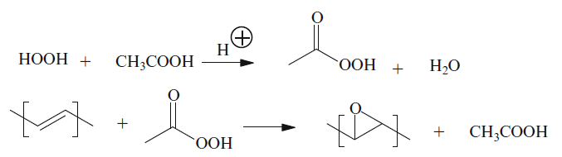
Chemical Modification; Epoxidation Reactions
These addition reactions of unsaturated polymers, like liquid polybutadiene, developed into preparations of useful commercial materials.
Hydrogen peroxide or peracetic acid is used in the presence of organic acids or their heavy metal salts.

Slide 8
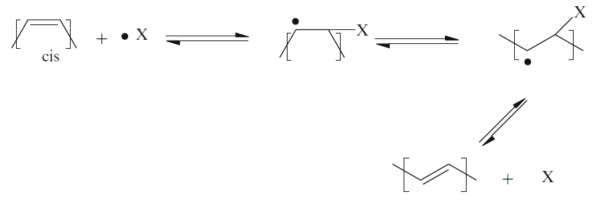
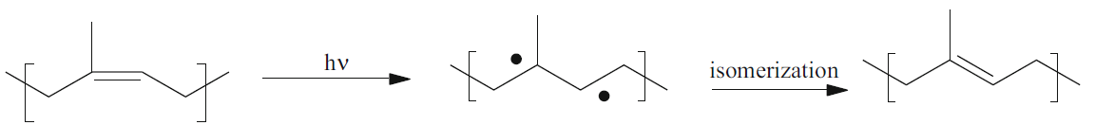
Chemical Modification; Isomerization Reactions
The isomerization of cis-polybutadiene can be carried out by
When light is used, the free-radical reaction requires photoinitiators.
The mechanism involves freely rotating transitory free-radicals on the polymer backbone.
The new configurations are trans because they are more thermodynamically stable.
where, X• represents a free-radical fragment from a photoinitiator.
With gamma radiation, there is no need for any additives.
Example; When 1,4-polyisoprene films are irradiated with light, cis–trans isomerization occur.

Slide 9
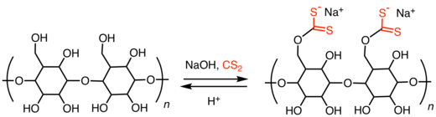
Preparation of Polymer Derivatives; Cellulose
The rigid chain of cellulose is strongly hydrogen bonded and highly crystalline.
Cellulose is essentially insoluble and infusible (degrades before melting), and therefore fibers and films can be obtained only by chemically modifying cellulose.
Regeneration process; Cellulose fiber (rayon) or film (cellophane) can be obtained by the viscose process.
In this process, The alkali cellulose is first reacted with carbon disulfide to form cellulose xanthate, which is soluble in a caustic solution.
Cellulose xanthate is then converted back to cellulose (regeneration) by treatment with aqueous sulfuric acid.
[C₆H₅(OH)₄−ONa]_{n} + nCS₂ → [C₆H₅(OH)₄−OCS₂Na]_{n}
[C₆H₅(OH)₄−OCS₂Na]_{2n} + nH₂SO₄ → [C₆H₅(OH)₄−OH]_{2n} + 2nCS₂ + nNa₂SO₄

Slide 10
Preparation of Polymer Derivatives; Cellulose
Various soluble cellulose derivatives can be obtained by chemical modification of the hydroxyl groups.
Cellulose acetate,
It can be obtained by reacting cellulose with glacial acetic acid in the presence of acetic anhydride and traces of sulfuric acid in refluxing methylene chloride.
Cellulose triacetate (CTA); If all the hydroxyl groups are reacted, which can be wet spun into fiber (acetate) from a methylene chloride–alcohol solvent mixture.
Cellulose diacetate; It can be obtained by partially hydrolysis of cellulose triacetate in which two (secondary) of the three hydroxyl groups in each anhydro glucose unit remain acetylated.
In commercial grades of cellulose acetate, about 65% to 75% of all available hydroxyl groups remain acetylated.
This polymer is amorphous and highly soluble in many solvents including acetone, from which it can be dry spun.

Slide 11
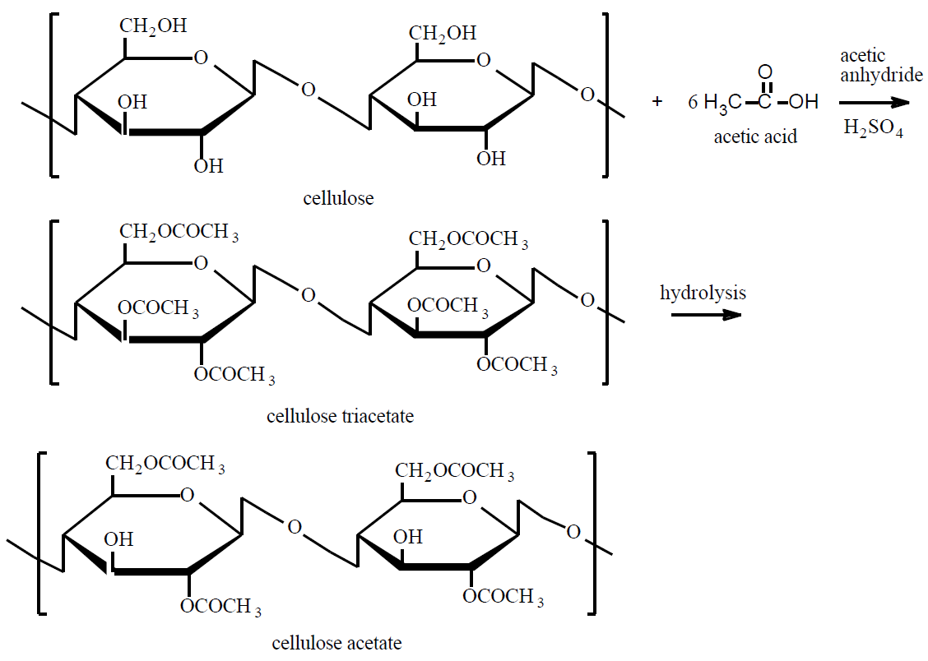
Preparation of Polymer Derivatives; Cellulose
Preparation of cellulose acetate from cellulose.
For simplicity, lone hydrogen atoms on the cellulose repeating units are omitted.

Slide 12
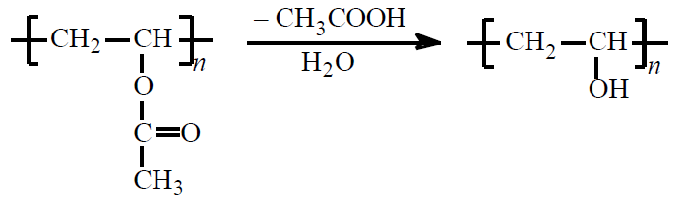
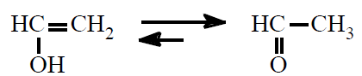
Preparation of Polymer Derivatives; Poly(vinyl alcohol)
Poly(vinyl alcohol) (PVA) is obtained by the direct hydrolysis (or catalyzed alcoholysis) of poly(vinyl acetate) (PVAC):
Poly(vinyl acetate) is produced by free-radical emulsion or suspension polymerization.
Poly(vinyl acetate) has a low glass-transition temperature (29C) and finds some applications as an adhesive.
Poly(vinyl alcohol), which is used as a stabilizing agent in emulsion polymerizations and as a thickening and gelling agent, cannot be polymerized directly because its monomer, vinyl alcohol, is isomeric with acetaldehyde

Slide 13
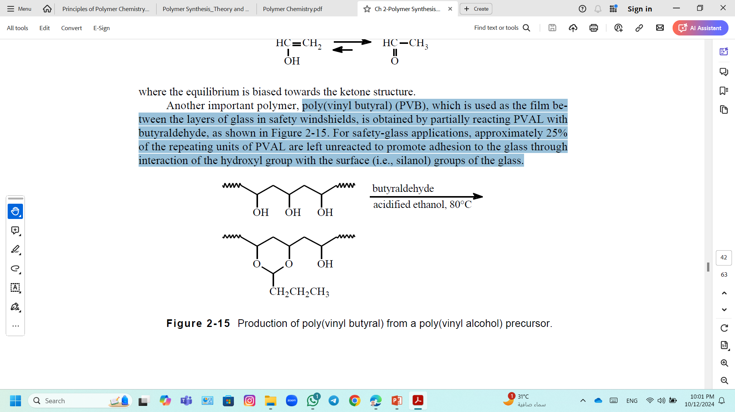
Preparation of Polymer Derivatives; Poly(vinyl butyral)
Poly(vinyl butyral) (PVB), which is used as the film between the layers of glass in safety windshields, is obtained by partially reacting PVA with butyraldehyde.
For safety-glass applications, approximately 25% of the repeating units of PVA are left unreacted to promote adhesion to the glass through interaction of the hydroxyl group with the surface (i.e., silanol) groups of the glass.
Production of poly(vinyl butyral) from a poly(vinyl alcohol) precursor.

