Slide 1

Chemistry Department, College of Science, King Saud University
CHEM 241
Organic Chemistry II
FOR CHEMISTRY’ STUDENTS, COLLEGE OF SCIENCE
PRE-REQUISITES COURSE; CHEM 240
CREDIT HOURS; 2 (2+0)
Amines Based on NCERT

Slide 2
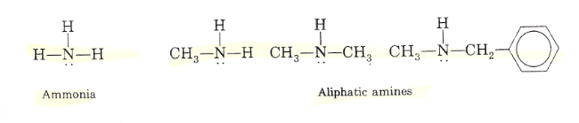
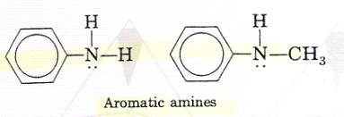
Structure and Classification of Amines
Amines can be considered as derivatives of ammonia, obtained by replacement of one, two or all the three hydrogen atoms by alkyl and/or aryl groups.
Aliphatic amines contain only alkyl groups bonded directly to the nitrogen atom.
Aromatic amines are those in which one or more aryl groups are bonded directly to nitrogen.
Amines are said to be ‘simple’ when all the alkyl or aryl groups are the same, and ‘mixed’ when they are different.

Slide 3
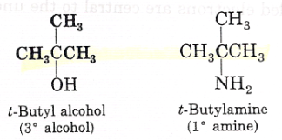
Structure and Classification of Amines
Amines are classified as primary (1º), secondary (2º) and tertiary (3º) depending upon the number of hydrogen atoms replaced by alkyl or aryl groups in ammonia molecule.
NOTE
t-butyl alcohol is a tertiary alcohol (because three carbons are attached to the carbinol carbon),
t-butyl amine is a primary alcohol (because only one carbon is attached directly to the nitrogen atom),

Slide 4
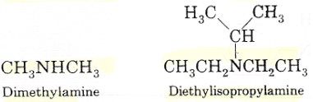
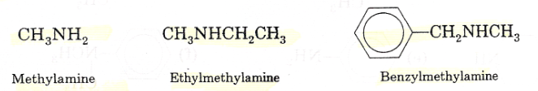
Nomenclature of Amines
A) Common names
An aliphatic amine is named by prefixing alkyl group to amine, i.e., alkylamine as one word.
In secondary and tertiary amines, when two or more groups are the same, the prefix di or tri is appended before the name of alkyl group.

Slide 5
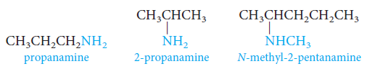
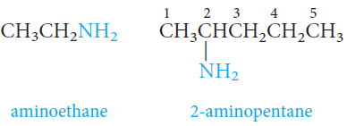
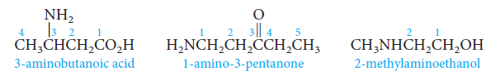
Nomenclature of Amines
B) IUPAC System
Amines are named as “alkanamine”, derived by replacement of ‘e’ of alkane by the word amine.
For example, CH₃NH₂ is named as methanamine.
The amino group, -NH₂, is named as a substituent.
When other functional groups are present, the amino group, -NH₂, is named as a substituent.

Slide 6
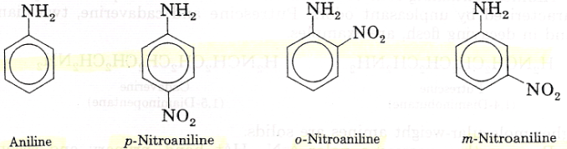
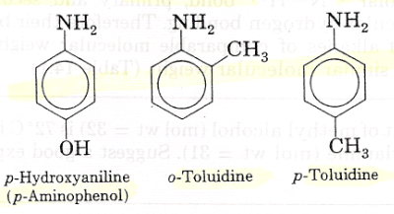
Nomenclature of Amines
B) IUPAC System
In arylamines, –NH₂ group is directly attached to the benzene ring.
C₆H₅NH₂ is the simplest example of arylamine; In common system, it is known as aniline and is also an accepted IUPAC name.
While naming arylamines according to IUPAC system, suffix ‘e’ of arene is replaced by ‘amine’.
Thus in IUPAC system, C₆H₅NH₂ is named as benzenamine.

Slide 7
Nomenclature of Amines
Nomenclature of Some Alkylamines and Arylamines

Slide 8
Nomenclature of Amines

Slide 9
Physical Properties of Amines
Physical State
The lower aliphatic amines are gases with fishy odor.
Primary amines with three or more carbon atoms are liquid and still higher ones are solid.
Aniline and other arylamines are usually colorless but get colored on storage due to atmospheric oxidation.
Solubility in Water
Lower aliphatic amines are soluble in water because they can form hydrogen bonds with water molecules.
Solubility decreases with increase in molar mass of amines due to increase in size of the hydrophobic alkyl part.
Higher amines are essentially insoluble in water.
Amines are soluble in organic solvents like alcohol, ether and benzene.

Slide 10
Physical Properties of Amines
Boiling Points
You may remember that alcohols are more polar than amines and form stronger intermolecular hydrogen bonds than amines.
Primary and secondary amines are engaged in intermolecular association due to hydrogen bonding between nitrogen of one and hydrogen of another molecule.
Tertiary amines do not have intermolecular association due to the absence of hydrogen atom available for hydrogen bond formation.
Therefore, the order of boiling points of isomeric amines is as follows: Primary > Secondary > Tertiary
Intermolecular hydrogen bonding in primary amines

Slide 11
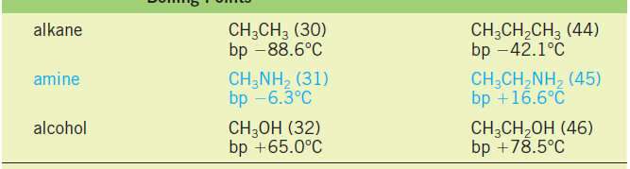
Physical Properties of Amines
Boiling Points
Primary amines boil well above alkanes with comparable molecular weights, but below comparable alcohols.
Intermolecular N-H· · ·N hydrogen bonds are important and raise the boiling points of primary and secondary amines but are not as strong as the O-H · · · · O bonds of alcohols.
The reason for this is that nitrogen is not as electronegative as oxygen.

Slide 12
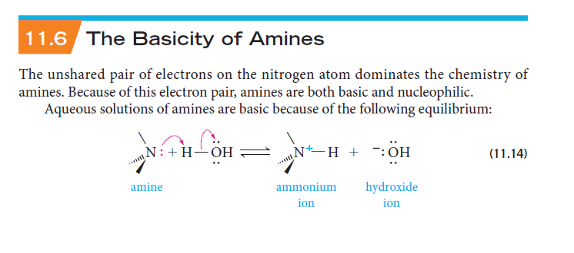

The Basicity of Amines
The unshared pair of electrons on the nitrogen atom dominates the chemistry of amines.
Because of this electron pair, amines are both basic and nucleophilic.
Aqueous solutions of amines are basic because of the following equilibrium:
Electron-donating groups increase the basicity of amines.
Electron-withdrawing groups decrease their basicity.
Alkylamines are stronger bases than ammonia.
Thus, the basic nature of aliphatic amines should increase with increase in the number of alkyl groups.
The order of basicity of amines follows the expected order:
tertiary amine > secondary amine > primary amine > NH₃.

Slide 13
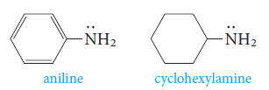
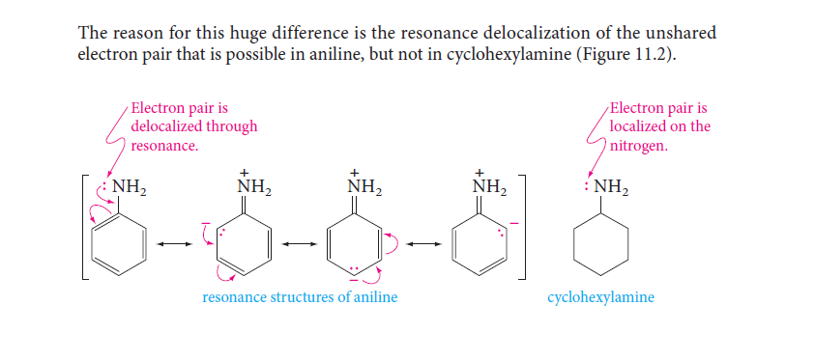
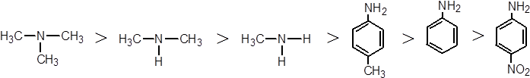
The Basicity of Amines
Aromatic amines are much weaker than aliphatic amines or ammonia.
Example: aniline is less basic than cyclohexylamine.
The reason is the resonance delocalization of the unshared electron pair that is possible in aniline, but not in cyclohexylamine:

Slide 14

Preparation of Amines
1. Reduction of Nitro compounds
Nitro compounds are reduced to amines by passing hydrogen gas in the presence of finely divided nickel, palladium or platinum and also by reduction with metals in acidic medium.
Nitroalkanes can also be similarly reduced to the corresponding alkanamines.

Slide 15



Preparation of Amines
2. Reduction of Nitriles
Nitriles on reduction with lithium aluminum hydride (LiAlH₄) or catalytic hydrogenation produce primary amines. This reaction is used for preparation of amines containing one carbon atom more than the starting amine.
3. Reduction of Amides
The amides on reduction with lithium aluminium hydride yield amines.

Slide 16
Preparation of Amines
4. Ammonolysis of alkyl halides
Alkyl or benzyl halide on reaction with an ethanolic solution of ammonia undergoes nucleophilic substitution reaction in which the halogen atom is replaced by an amino (–NH₂) group.
This process of cleavage of the C–X bond by ammonia molecule is known as ammonolysis.
Treatment of the alkylammonium salt with a strong base (NaOH) liberates the free amine.
Ammonolysis has the disadvantage of yielding a mixture of primary, secondary and tertiary amines and also a quaternary ammonium salt.

Slide 17
Preparation of Amines

Slide 18
Chemical Reactions of Amines
1. Basic character of amines
Amines, being basic in nature, react with acids to form salts.
Amine salts on treatment with a base like NaOH, regenerate the parent amine.
Amines have an unshared pair of electrons on nitrogen atom due to which they behave as Lewis base.

Slide 19
Chemical Reactions of Amines
2. Acylation
Aliphatic and aromatic primary and secondary amines react with acid chlorides, anhydrides and esters by nucleophilic substitution reaction.
The products obtained by acylation reaction are known as amides.

Slide 20
Chemical Reactions of Amines
2. Acylation
Amines also react with benzoyl chloride (C₆H₅COCl). This reaction is known as benzoylation.
What do you think is the product of the reaction of amines with carboxylic acids ?
They form salts with amines at room temperature.
3. Carbylamine reaction
Aliphatic and aromatic primary amines on heating with chloroform and ethanolic potassium hydroxide form isocyanides or carbylamines which are foul smelling substances.
Secondary and tertiary amines do not show this reaction.

Slide 21
Chemical Reactions of Amines
4. Reaction with nitrous acid
Primary aliphatic amines react with nitrous acid to form aliphatic diazonium salts which being unstable, liberate nitrogen gas quantitatively and alcohols.
Quantitative evolution of nitrogen is used in estimation of amino acids and proteins.
(b) Aromatic amines react with nitrous acid at low temperatures (273-278 K) to form diazonium salts, a very important class of compounds used for synthesis of a variety of aromatic compounds.

Slide 22
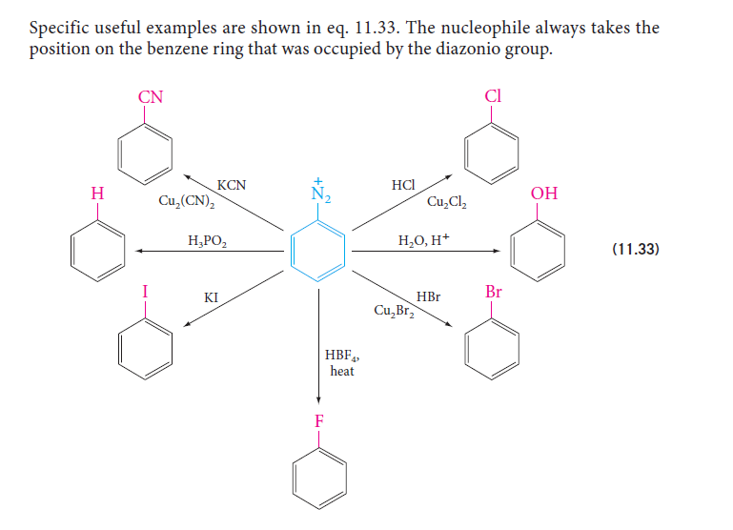
Chemical Reactions of Amines
4. Reaction with nitrous acid
They are useful in synthesis because the diazonio groum (-N₂⁺) can be replaced by nucleophiles; the other product is nitrogen gas.

Slide 23
Chemical Reactions of Amines
4. Reaction with nitrous acid
Reactions involving retention of diazo group coupling reactions
Benzene diazonium chloride reacts with phenol in which the phenol molecule at its para position is coupled with the diazonium salt to form p-hydroxyazobenzene.
Similarly, the reaction of diazonium salt with aniline yields p-aminoazobenzene.

Slide 24
Chemical Reactions of Amines
5. Electrophilic substitution
Bromination:
Aniline reacts with bromine water at room temperature to give a white precipitate of 2,4,6-tribromoaniline.
If we have to prepare monosubstituted aniline derivative, how can the activating effect of –NH₂ group be controlled ? This can be done by protecting the -NH₂ group by acetylation with acetic anhydride, then carrying out the desired substitution followed by hydrolysis of the substituted amide to the substituted amine.

Slide 25
Chemical Reactions of Amines
5. Electrophilic substitution
(b) Nitration:
In the strongly acidic medium, aniline is protonated to form the anilinium ion which is meta directing.
That is why besides the ortho and para derivatives, significant amount of meta derivative is also formed.
However, by protecting the –NH₂ group by acetylation reaction with acetic anhydride, the nitration reaction can be controlled and the p-nitro derivative can be obtained as the major product.

Slide 26
Chemical Reactions of Amines
5. Electrophilic substitution
(c) Sulphonation:
Aniline reacts with concentrated sulphuric acid to form anilinium hydrogensulphate which on heating with sulphuric acid at 453-473K produces p-aminobenzene sulphonic acid, commonly known as sulphanilic acid.
(d) Friedel-Crafts reaction (alkylation and acetylation):
Aniline does not undergo Friedel-Crafts reaction (alkylation and acetylation) due to salt formation with aluminium chloride, the Lewis acid, which is used as a catalyst.

Slide 27
Chemical Reactions of Amines

Slide 28
Chemical Reactions of Amines

Slide 29
Uses of Amines
In nature, they occur among proteins, vitamins, alkaloids and hormones.
Synthetic examples include polymers, dyestuffs and drugs.
Two biologically active compounds, namely adrenaline and ephedrine, both containing secondary amino group, are used to increase blood pressure.
Novocain, a synthetic amino compound, is used as an anesthetic in dentistry.
Benadryl, a well known antihistaminic drug also contains tertiary amino group.
Quaternary ammonium salts are used as surfactants.
Diazonium salts are intermediates in the preparation of a variety of aromatic compounds including dyes.

