Slide 1
Strategic Management: Concepts and Cases
Arab World Edition
Fred R. David
Abbas J. Ali
Abdulrahman Y. Al-Aali
Chapter 5:
Competing in the Global
Marketplace
Copyright © 2009 Pearson Education, Inc.
Publishing as Prentice Hall
Ch 5 -2
Copyright © 2011 Pearson Education

Slide 2
Reasons for Arab companies to expand abroad:
1-To expand markets.
2-To obtain advanced technology and access talent globally
3-To have access to lower cost materials or cheap labor
4-To reduce risk by spreading investment
Copyright © 2009 Pearson Education, Inc.
Publishing as Prentice Hall

Slide 3
Internationalization and Globalization
Arab companies vary in their commitment to international expansion and activities
The two strategic focal points for expansion of Arab businesses:
Internationalization
Globalization
Ch 5 -7
Copyright © 2011 Pearson Education
Copyright © 2009 Pearson Education, Inc.
Publishing as Prentice Hall

Slide 4
Internationalization
*This strategy is limited to expansion to a few countries with no interest in operating globally.
*Activities are dictated by cultural and geographic limits or by familiarity with a specific markets.
Copyright © 2009 Pearson Education, Inc.
Publishing as Prentice Hall

Slide 5
Globalization
*The strategy focus considers the global markets as the platform for action.
*Activities and involvement are determined by opportunities.
Copyright © 2009 Pearson Education, Inc.
Publishing as Prentice Hall

Slide 6
Global Expansion and Orientation
As Arab companies expand beyond domestic markets they confronted with various issues ranging from culture to politics and economics.
They have to face these issues and act appropriately
Copyright © 2009 Pearson Education, Inc.
Publishing as Prentice Hall

Slide 7
Global Expansion & Orientations
Four Strategic Orientations:
Ethnocentric
Polycentric
Regiocentric
Geocentric
Ch 5 -8
Copyright © 2011 Pearson Education
Copyright © 2009 Pearson Education, Inc.
Publishing as Prentice Hall

Slide 8
Ethnocentric : project the beliefs and values of the parent company on its offices abroad.
Polycentric: they consider the culture of the host country to guide the operation.
Regiocentric : let the general beliefs and values prevailing in a particular region guide the operations.
Geocentric : Executives are guided by the best practice globally .
Copyright © 2009 Pearson Education, Inc.
Publishing as Prentice Hall

Slide 9
Differences Among Countries:
Regardless of which country a company choses to operate in executives must understand that differences do exist and must be approached with an open mind
Copyright © 2009 Pearson Education, Inc.
Publishing as Prentice Hall

Slide 10
Differences Among Countries
Existing Differences
Cultural
Demographic
Economic
Technological
Ch 5 -11
Copyright © 2011 Pearson Education
Copyright © 2009 Pearson Education, Inc.
Publishing as Prentice Hall

Slide 11
Examples;
In the united states there is a tendency to divide problems into several issues and deal with them separately , on the other hand Chinese like arabs look at the whole issue.
Copyright © 2009 Pearson Education, Inc.
Publishing as Prentice Hall

Slide 12
Selecting Strategic Markets
Global Presence
Arab firms have no choice but to position themselves strategically
There are variety of options to choose from and there are hundreds of markets
so which market they should focus on is a strategic decision and is not a random action or by chance.
Two factors influence a company in determining which market to enter:
The strategic importance of the market
Firm’s ability or willingness to enter the market
Ch 5 -13
Copyright © 2011 Pearson Education
Copyright © 2009 Pearson Education, Inc.
Publishing as Prentice Hall

Slide 13
The first factor (degree of importance) encompasses elements such as current and future market size (dose the population size effect market size?)
learning opportunity ,customers demand and sophistication (what dose demanding and sophisticated customers stimulate?)

Slide 14
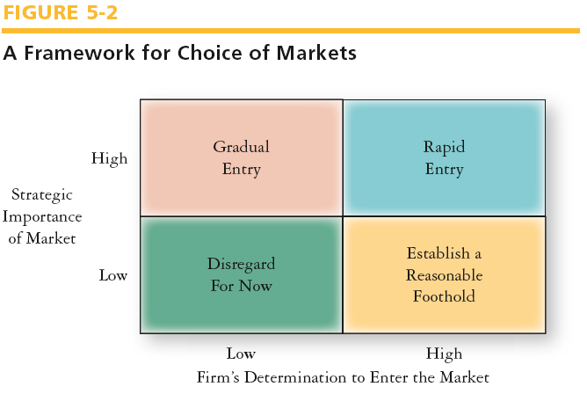
Selecting Strategic Markets
Ch 5 -14
Copyright © 2011 Pearson Education
Copyright © 2009 Pearson Education, Inc.
Publishing as Prentice Hall

Slide 15
*Which one is the Ideal situation?
*Foothold: hope the future of the market will be better.
*Gradual: phased approaches (enter the market in phases..till the firm build its capabilities).
*Companies’ conditions may change so actions will vary accordingly.
*What will happen when a company have a multiproduct or multiple business units?? is the approach apply to all?
various options for the same market

Slide 16
Market Entry Strategies
Strategies differ across industries and target markets.
What mode should be selected is influenced by conditions specific to the firm .

Slide 17
Market Entry Strategies
Influencing conditions on how are we going to enter the market
Executive’s orientations and experience
Resource availability
Type of product or service
Product life-cycle
Market share
Competitive pressures
Ch 5 -15
Copyright © 2011 Pearson Education
Copyright © 2009 Pearson Education, Inc.
Publishing as Prentice Hall

Slide 18
Market Entry Strategies
Entry Modes
Exporting
Contractual approaches
licensing, franchising, management contract, contract manufacturing, and turnkey operations
Investment
Equity participation, joint venture, and wholly-owned subsidiaries, among others
Ch 5 -16
Copyright © 2011 Pearson Education
Copyright © 2009 Pearson Education, Inc.
Publishing as Prentice Hall

Slide 19
Export
is the oldest and least risky approach to foreign markets expansion.
Advantages: low-cost , low-risk ,easy to carry out , no culture issues , full ownership of profits
Disadvantages : difficulties in arranging suitable distribution channels.

Slide 20
Franchising
Agreement involves a firm (franchiser) granting the right to another entity (franchisee) to run its business in a specified manner and provide assistance during the contract duration.
Example : McDonalds.
Advantages : franchiser has a “say” in how the business should operate ,easy method to expand overseas ,avoids the need to invest large capital
Disadvantages : the franchisee may become a competitor.

Slide 21
Turnkey Operations
This usually represents a huge project involving a large investments and is often done for the developing nation’s government.
*when a company constructs an entire project e.g highway
*Advantages : enables the client to have access to hard to get skills and technology.

Slide 22
Joint venture
*this option is popular
*independent entity which is created and owned by 2 or more companies to achieve mutual objectives.
*Advantages : gaining access to new tech or resources ,reducing risk
*Disadvantages: when partners do not share the same goals , slow decision making , conflicts ,

Slide 23
Managing Expansion Effectively
Global Presence of Arab Corporations
There are few very large Arab firms operating globally
Only SABIC appeared on the Fortune 500 list for 2009
Copyright © 2009 Pearson Education, Inc.
_{Publishing as Prentice Hall}
Copyright © 2009 Pearson Education, Inc.
Publishing as Prentice Hall
Ch 5 -30
Copyright © 2011 Pearson Education

Slide 24
Managing Expansion Effectively:
What should Arab corporation change
Arab corporations have to :
*Design and implement effective authorities.
*Rethink the existing portfolio
*Attract the best talents to compete better.
*Separate business and family activities.

Slide 25
Amendments to the syllabus
Submission date will be Dec 9th.

