Slide 2
KINGDOOM OF SAUDI ARABIA
King Saud University
College of Sciences - Department of Botany and Microbiology
Plant nutrition
BIO 572
Dr. Abdulrahman AL-HASHiMi

Slide 3
Course Description
The Plant Physiology course involves:
Course Orientation: Introduction of plant nutrition. Why need to study plant nutrients Water balance in plants
Essential nutrients and their role in plant metabolism Solute transport
Criteria of plant nutrient essentiality
Source of nutrients
Deficiency and toxicity of nutrients in plants

Slide 4
Course Outcomes
At the end of this course the student will be able to:
Explain key-points of essential nutrients and their function in plants .
Describe key-aspects of essential nutrients deficiency and their effect on plant growth and physiology
Outline the principle of mineral and organic nutrition.
Describe key-points of process of nutrient uptake and transported and assimilated by plants.

Slide 5
References
Required Textbook:
Taiz L. and Zeiger E. (2002). Plant Physiology, 3rd Edition, Sinauer Associates, Inc. Publishers, Sunderland, MA.
ISBN: 978-0-87893-823-0.
Taiz L. and Zeiger E. (2010). Plant Physiology, 5th Edition, Sinauer Associates, Inc. Publishers, Sunderland, MA.
ISBN: 978-0-87893-866-7.

Slide 6
Exams & Grading System
Midterm 1: 6th or 7th week.
Midterm 2: 11th or 12th week.
Final Exam Lab: 16th week.
Quizzes & Homework: During the semester.
Final Exam: 16th week.
Midterm 1: 10 % | Midterm 2: 10 % | Final Exam: 40 % | Final Lab Exam:30%
Quizzes, Homework, Attendance & Participation: 10 %

Slide 7
Lectures Topics
Lecture 1: Introduction of plant nutrition
Lecture 2: Essential nutrients and their role in plant metabolism
Lecture 3: Source of nutrients
Lecture 4: Deficiency and toxicity of nutrients in plants
Lecture 5: Method to studying nutrients requirement of plants
Lecture 6: (heavy metals) are toxic to pants
Lecture 7: Plant water relation

Slide 8
Lectures Topics
Lecture 8: Transpiration
Lecture 9: Uptake and transport of plant nutrients
Lecture 10: Phloem transport: flow from source to sink
Lecture 11: Means of transport i.e. passive and active
Lecture 12: Student Oral Presentations

Slide 9
Lecture 1
Mineral Nutrition
1- Essential elements
2- Nutrient deficiency
3- Soil, Root and Microbes

Slide 10
Introduction
Plants are capable of making all necessary organic compounds from inorganic compounds and elements in the environment (autotrophic).
MINERAL NUTRIENTS ARE ELEMENTS acquired primarily in the form of inorganic ions from the soil.
“Mineral”: An inorganic element (acquired mostly in the form of inorganic ions from the soil).
“Nutrient”: A substance needed to survive or necessary for the synthesis of organic compounds.

Slide 11
Introduction
They enter the biosphere predominantly through the root systems of plants.
After being absorbed by the roots, the mineral elements are translocated to the various parts of the plant, where they are utilized in numerous biological functions.
The study of how plants obtain, distribute, metabolize, and utilize mineral nutrients is called Mineral nutrition.
Hydrogen, carbon, and oxygen are not considered mineral nutrients because they are obtained primarily from water (H2O) or carbon dioxide (CO₂).

Slide 12
1- Essential elements
Essentiality of mineral nutrients
Essential: Universal for all plants
Absence prevents completion of life cycle
Absence leads to deficiency
Required for some aspect of mineral nutrition
Beneficial: Often limited to a few species
Stimulates growth and development
May be required in some species

Slide 13
1- Essential elements
An essential element is defined as one whose absence prevents a plant from completing its life cycle.
If plants are given these essential elements, as well as energy from sunlight, they can synthesize all the compounds they need for normal growth.
Essential mineral elements are usually classified as macronutrients or micronutrients, according to their relative concentration in plant tissue.
Many elements often are present in concentrations greater than the plant’s minimum requirements.

Slide 14
1- Essential elements
Adequate tissue levels of elements that may be required by plants
The values for the nonmineral elements (H, C, O) and the macronutrients are percentages. The values for micronutrients are expressed in parts per million (ppm).

Slide 15
1- Essential elements
Adequate tissue levels of elements that may be required by plants
The values for the nonmineral elements (H, C, O) and the macronutrients are percentages. The values for micronutrients are expressed in parts per million (ppm).

Slide 16
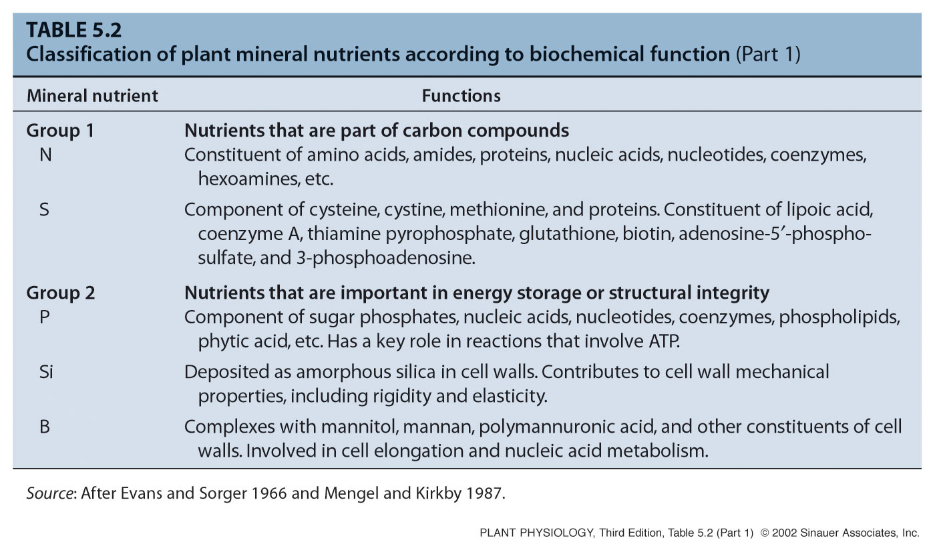
Classification of plant mineral nutrients
according to biochemical function

Slide 17
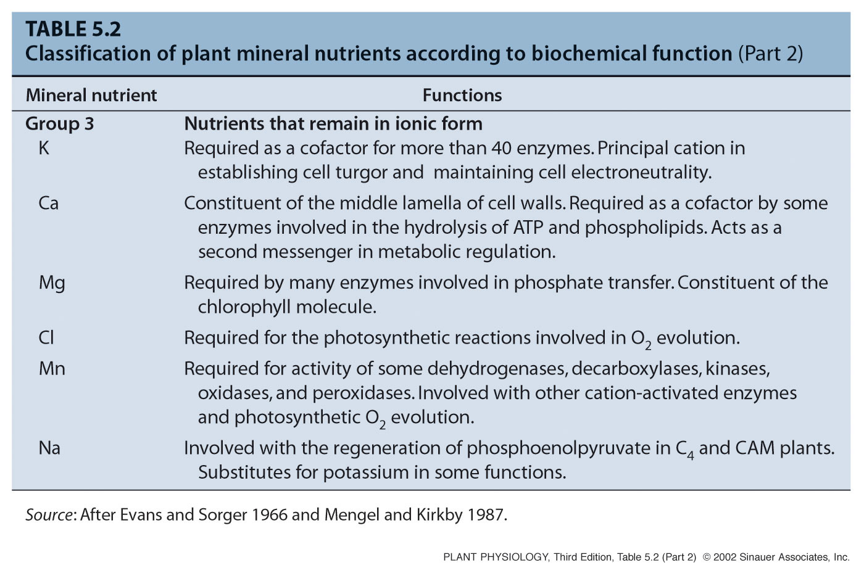
Classification of plant mineral nutrients
according to biochemical function

Slide 18
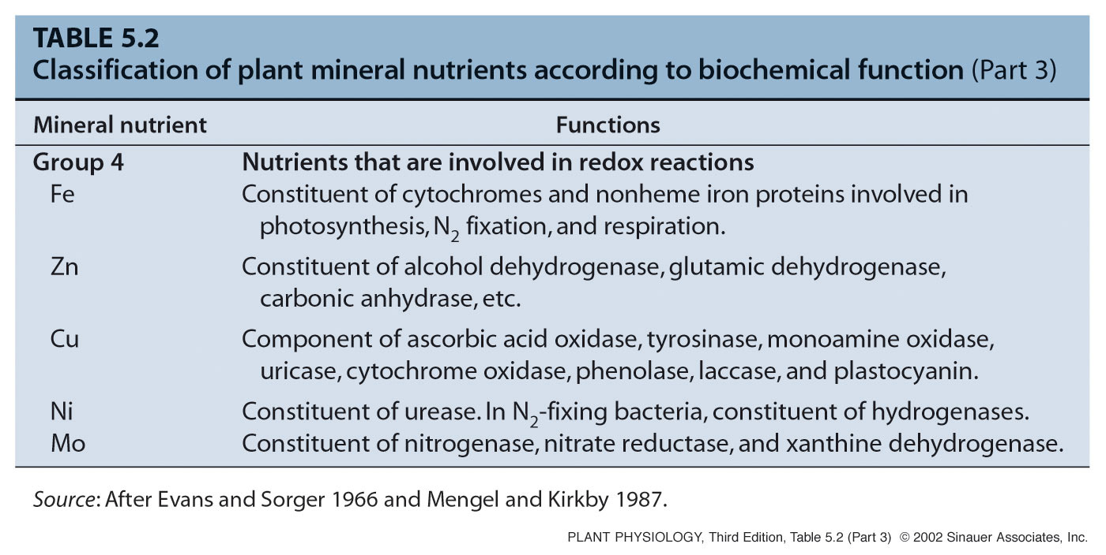
Classification of plant mineral nutrients
according to biochemical function

Slide 19
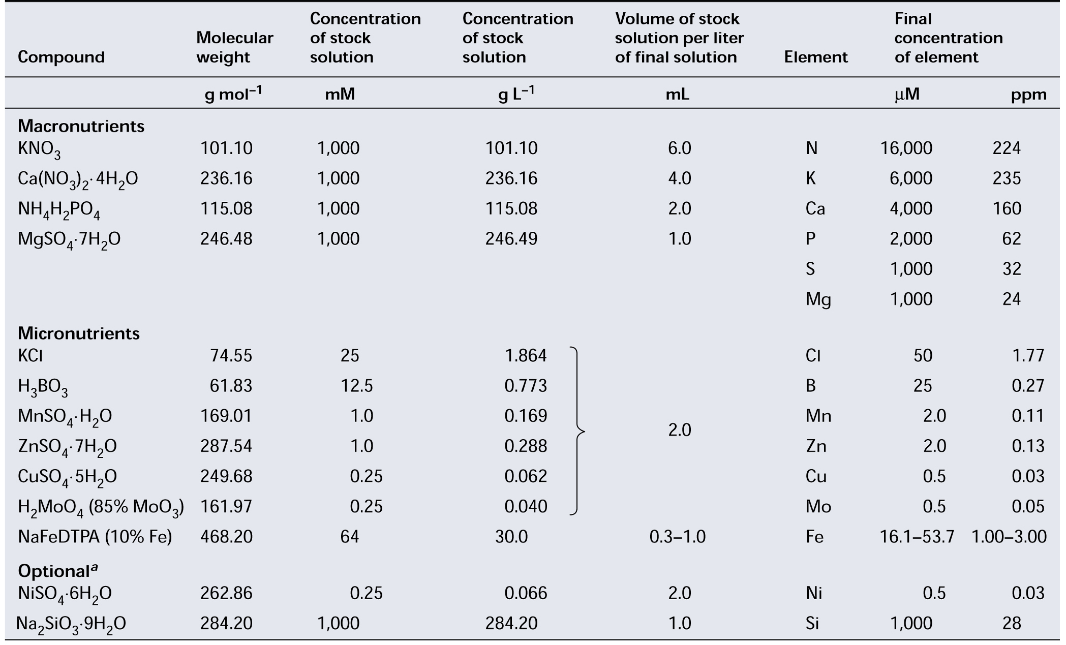
Composition of a modified Hoagland
nutrient solution for growing plants

Slide 20
Techniques used to study plant nutrition
Hydroponic and aeroponic systems for growing plants in nutrient solutions in which composition and pH can be automatically controlled.
Hydroponic system, the roots are immersed in the nutrient
solution, and air is bubbled through the solution.

Slide 21
Techniques used to study plant nutrition
Hydroponic and aeroponic systems for growing plants in nutrient solutions in which composition and pH can be automatically controlled.
An alternative hydroponic system, often used in commercial production. The nutrient solution is pumped as a thin film down a shallow trough surrounding the plant roots.

Slide 22
Techniques used to study plant nutrition
Hydroponic and aeroponic systems for growing plants in nutrient solutions in which composition and pH can be automatically controlled.
Aeroponic system, the roots are suspended over the nutrient solution, which is whipped into a mist by a motor-driven rotor.

Slide 23
2- Nutrient deficiency
Mineral Deficiencies Disrupt Plant Metabolism and Function
Mineral nutrient deficiencies occur when the concentration of a nutrient decreases below the typical range.
Both chronic and acute deficiencies of several elements may occur simultaneously.
Deficiencies or excessive amounts of one element may induce deficiencies or excessive accumulations of another.
Nutrient deficiency symptoms in a plant are the expression of metabolic disorders resulting from the insufficient supply of an essential element.

Slide 24
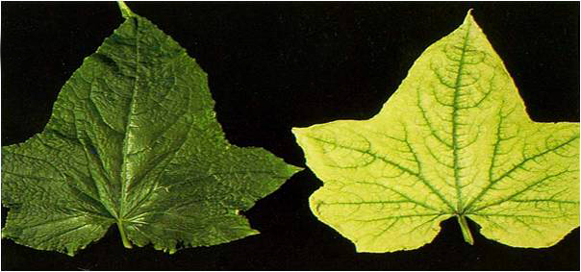
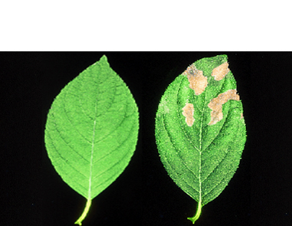
2- Nutrient deficiency
Deficiencies of specific nutrients lead to specific visual, often characteristic, symptoms reflective of the role of that nutrient in plant metabolism.
These symptoms can be used as diagnostic for the deficiency.
Some virus-induced plant diseases may produce symptoms similar to those of nutrient deficiencies.
Chlorosis, Nitrogen deficiency
Necrosis, Potassium deficiency

Slide 25
2- Nutrient deficiency
When relating acute deficiency symptoms to a particular essential element, such element can be recycled (redistributed) from old to young leaves.
Nitrogen, Phosphorus, and Potassium, can readily move from leaf to leaf (mobile). Boron, Iron, and Calcium, are relatively immobile in most plant species.
Mobile, symptoms tend to appear first in old leaves.
Immobile, symptoms tend to appear first in young leaves.

Slide 26
2- Nutrient deficiency
Remobilization of nutrients from old to young leaves
Older leaves on celery turning yellow while
the growing points in the center remain green

Slide 27
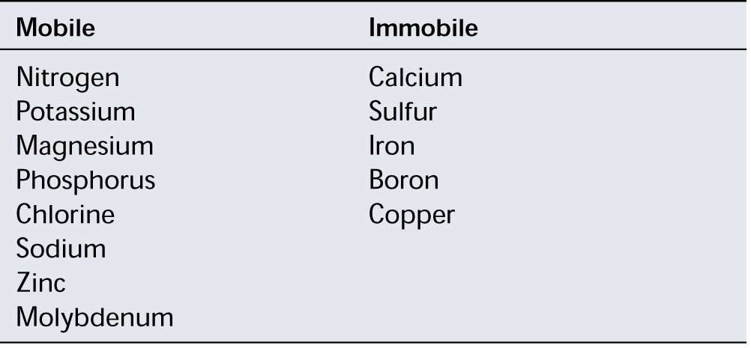
2- Nutrient deficiency
Mineral elements classified on the basis of their mobility within a plant and their tendency to retranslocate during deficiencies
Elements are listed in the order of their abundance in the plant

