Slide 1
KINGDOOM OF SAUDI ARABIA
King Saud University
College of Sciences - Department of Botany and Micorobiology
Mineral Nutrition in the plant
BIO 572
Dr. Abdulrahman Al-hashimi

Slide 2
Assimilation of Mineral Nutrients
Nitrate assimilation
Ammonium assimilation
Biological nitrogen fixation
Sulfur assimilation
Phosphate assimilation
Cation assimilation
Oxygen assimilation

Slide 3
Introduction
Higher plants are autotrophic organisms that can synthesize their organic molecular components from inorganic nutrients obtained from their surroundings.
For many mineral nutrients, this process involves absorption from the soil by the roots and incorporation into the organic compounds that are essential for growth and development.
This incorporation of mineral nutrients into organic substances such as pigments, enzyme cofactors, lipids, nucleic acids, and amino acids is termed Nutrient Assimilation.

Slide 4
Introduction
Assimilation of some nutrients, particularly nitrogen and sulfur, requires a complex series of biochemical reactions that are among the most energy-requiring reactions.
Assimilation of other nutrients, especially the macronutrient and micronutrient cations, involves the formation of complexes with organic compounds.
For example, Mg²⁺ associates with chlorophyll pigments
These complexes are highly stable, and removal of the nutrient from the complex may result in total loss of function.

Slide 5
Nitrogen in the environment
Present in many forms :
78% of atmosphere is N₂ gas.
Most of this is NOT available to living organisms.
Getting N₂ form the atmosphere requires breaking the triple bond between N₂ gas to produce:
Ammonia (NH₃)
Nitrate (NO₃⁻)
These reactions, known as nitrogen fixation.

Slide 6
Nitrogen fixation
Nitrogen fixation can be achieved by both industrial and natural processes.
Nitrogen fixation by industrial processes :
Under high temperature (about 200°C) and high pressure (200 atmospheres), N₂ combines with hydrogen to form ammonia.
This nitrogen fixation reaction, known as Haber–Bosch process, is an artificial nitrogen fixation process and is the main industrial procedure for the production of ammonia.

Slide 7
Nitrogen fixation
Nitrogen fixation by natural processes include :
Lightning:
Lightning is responsible for about 8% of the nitrogen fixed.
Lightning converts water vapor (H₂O) and oxygen (O₂) into free hydrogen atoms (H), and free oxygen atoms (O) that attack the nitrogen (N₂) to form nitric acid (HNO₃).
This nitric acid subsequently falls to Earth with rain.

Slide 8
Nitrogen fixation
Photochemical reactions:
Approximately 2% of the nitrogen fixed derives from photochemical reactions between the nitric oxide gas (NO) and ozone (O₃) that produce nitric acid (HNO₃).
Biological nitrogen fixation:
The remaining 90% results from biological nitrogen fixation, in which bacteria or blue-green algae (cyanobacteria) fix N₂ into ammonium (NH4⁺).

Slide 9
Nitrogen fixation
Once fixed in ammonium or nitrate :
N₂ enters biochemical cycle,
Passes through several organic or inorganic forms before it returns to molecular nitrogen,
The ammonium (NH₄⁺) and nitrate (NO₃⁻) ions generated via fixation are the object of strong competition between plants and microorganisms
To remain competitive, plants have developed mechanisms to get these ions from the soil solution as fast as possible.

Slide 10
Nitrate assimilation
Plants assimilate most of the nitrate absorbed by their roots into organic nitrogen compounds.
The first step of the process is the reduction of nitrate (NO₃⁻) to nitrite (NO₂⁻) in the cytosol by nitrate reductase enzyme.
The nitrite (NO₂⁻) is a highly reactive and potentially toxic ion.
Plant cells immediately transport the nitrite from the cytosol into chloroplasts in leaves and plastids in roots.
In these organelles, the enzyme nitrite reductase reduces the nitrite (NO₂⁻) to ammonium (NH₄⁺).

Slide 11
Ammonium assimilation
High levels of ammonium are toxic, thus, the plant cells avoid the ammonium toxicity by rapidly converting the ammonium generated from nitrate assimilation into amino acids.
This requires the action of two enzymes ;
Glutamine synthetase, combines the ammonium with glutamate to form glutamine.
Glutamate synthase, transfers the amino group of glutamine to an intermediate, yielding two molecules of glutamate.

Slide 12
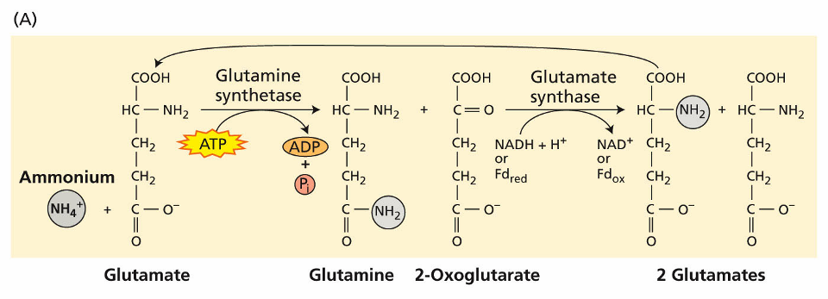
Ammonium assimilation
Structure and pathways of compounds
involved in ammonium metabolism

Slide 13
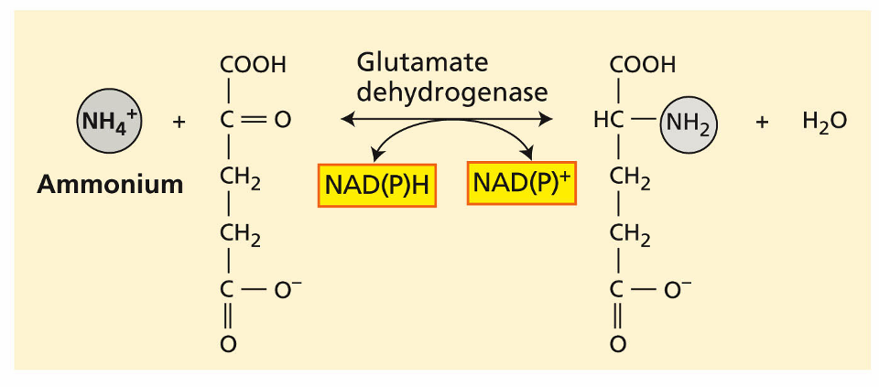
Ammonium assimilation
Ammonium can be assimilated via an alternative pathway
(using the enzyme Glutamate dehydrogenase)

Slide 14
Transamination reactions
Once assimilated into glutamine and glutamate,
nitrogen is incorporated into other amino acids via transamination reactions.
The enzymes involved in these reactions are known as aminotransferases (for example, aspartate aminotransferase).
All transamination reactions require pyridoxal phosphate (vitamin B₆) as a cofactor.
Aminotransferases are found in the cytoplasm, chloroplasts, mitochondria, glyoxysomes, and peroxisomes.

Slide 15
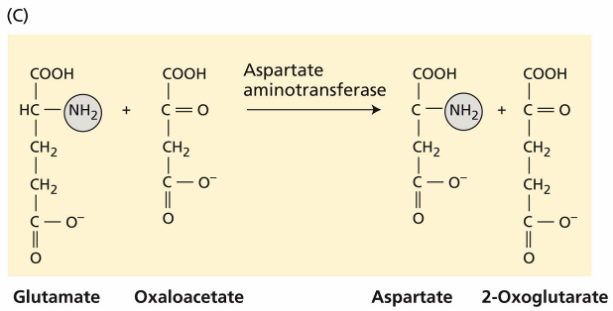
Transamination reactions
An example of aminotransferase

Slide 16
Biological nitrogen fixation
Biological nitrogen fixation accounts for most of the fixation of atmospheric N₂ into ammonium.
Two major types of nitrogen fixation :
Prokaryotes that are free-living in soil, lake, and ocean.
Symbiotic bacteria.
Most of nitrogen-fixing prokaryotes are free living in the soil.
A few of them form symbiotic associations with higher plants,
where the prokaryote directly provides the host plant with fixed nitrogen in exchange for other nutrients and carbohydrates.

Slide 17
Biological nitrogen fixation
The most common type of symbiosis occurs between members of the plant family Leguminosae and soil bacteria of the genera Azorhizobium, Bradyrhizobium, Photorhizobium, Rhizobium, and Sinorhizobium (collectively called rhizobia).
Nitrogen fixation requires anaerobic conditions,
Therefore each of the nitrogen-fixing organisms either functions under natural anaerobic conditions or can create an internal anaerobic environment in the presence of oxygen.
In cyanobacteria, anaerobic conditions are created in specialized cells called heterocysts.

Slide 18
Biological nitrogen fixation
Examples of organisms that can fix nitrogen

Slide 19
Biological nitrogen fixation
Examples of organisms that can fix nitrogen
(Non-symbiotic N₂ fixation)

Slide 20
Biological nitrogen fixation
Symbiotic N₂ fixation :
Rhizobia – Legume
Unicellular
Rhizobial symbiosis
Actinomycetes – Nonleguminous plants
Filamentous bacteria
Live freely in soil, but fix nitrogen in symbiotic association with host.
Actinorhizal symbiosis

Slide 21
Biological nitrogen fixation
Non-symbiotic N₂ fixation :
Cyanobacteria (Blue-green algae)
Other bacteria :
Aerobic : Azotobacter, Beijerinckia, Derxia, etc.
Facultative : Bacillus, Klebsiella, etc.
Anaerobic :
Non-photosynthetic : Clostridium, Methanococcus
Photosynthetic : Rhodospirillum, Chromatium

Slide 22
Biological nitrogen fixation
Symbiotic N₂ Fixation occurs in specialized structures
Symbiotic nitrogen-fixing prokaryotes live within nodules,
the nodules are special organs of the plant host that enclose the nitrogen-fixing bacteria.
In the case of legumes and actinorhizal plants, the nitrogen-fixing bacteria induce the plant to form root nodules.
Vascular connections between the host and microorganism provide the exchange of carbon and nitrogen.

Slide 23
Biological nitrogen fixation
Both legumes and actinorhizal plants regulate gas permeability in their root nodules,
for maintaining a level of oxygen within the nodule that can support cellular respiration for the bacteria.
The nodules ;
Contain an oxygen binding heme protein (leghemoglobin)
Leghemoglobin produces a pink color and helps transport oxygen to the respiring symbiotic bacteria cells in a manner analogous to hemoglobin transporting oxygen to respiring tissues in animals.

Slide 24
Biological nitrogen fixation
Grasses can also develop symbiotic relationships with nitrogen-fixing organisms, but these associations do not lead to the formation of root nodules
Nitrogen-fixing bacteria seem to colonize plant tissues or anchor to the root surface, mainly around the elongation zone and the root hairs.
Known as actinorhizal plants.

Slide 25
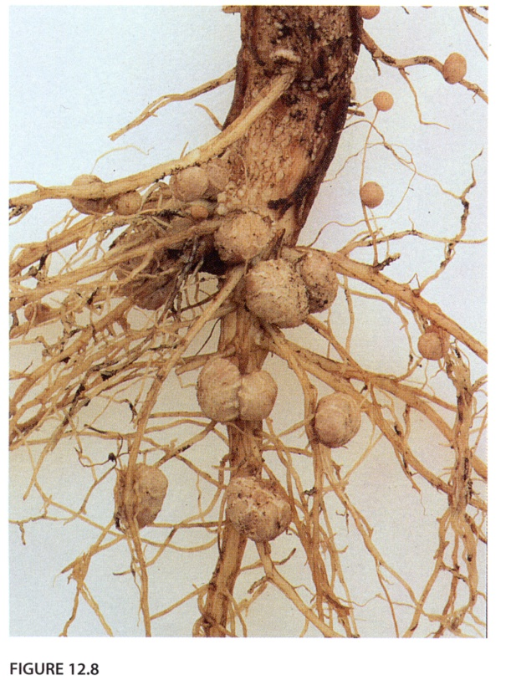
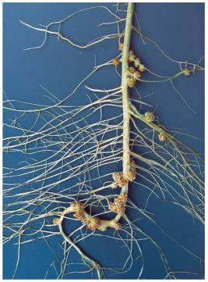
Root nodules on soybean
Biological nitrogen fixation

Slide 26
Biological nitrogen fixation
Symbiosis
The symbiosis between legumes and the rhizobia is not obligatory.
Legumes seedlings germinate without any association to the rhizobia,
Rhizobia also occur as free-living organisms in the soil.
Under nitrogen limiting conditions, the plant and bacteria seek each other out by an elaborate exchange of signals.

Slide 27
Biological nitrogen fixation
Plant genes specific to nodules are called nodulin (nod) genes.
Rhizobial genes that participate in nodule formation are called nodulation (nod) genes
The nod genes are classified as :
Common nod genes :
nodA, nodB, and nodC , found in all rhizobial strains
Host specific non genes :
nodP, nodQ, nodH, nodE, and nodF , differ among rhizobial species and determine the host range.

Slide 28
Biological nitrogen fixation
Nodule formation
The first stage of the association is the migration of the bacteria through the soil towards the host plant.
During root nodule formation, two process occur simultaneously; Infection and Nodule Organogenesis.

Slide 29
Biological nitrogen fixation
Nodule formation
Rhizobia attach to the root hairs and release nod factors that produce a pronounced curling of the root hair cell.
Rhizobia get caught and curl, degrade the root hair cell wall allowing the bacterial cells direct access to the outer surface of the plant plasma membrane.

Slide 30
Biological nitrogen fixation
Nodule formation
Golgi depositing material at the tip at the site of infection. Local degradation of root hair cell wall also occurs.
Infection thread reaches end of the cell, and thread plasma membrane fuses with plasma membrane of root hair cell,
bacterial cells are then released into fused plasma membranes.

Slide 31
Biological nitrogen fixation
Nodule formation
Rhizobia are released into the apoplast and enter the middle lamella, This leads to the formation of a new infection thread, which forms an open channel with the first
Infection thread expands and branches until it reaches target cells, Vesicles composed of plant membrane enclose bacterial cells and they are released into the cytoplasm.

Slide 32
Nitrogen fixation by the nitrogenase enzyme complex
Biological nitrogen fixation
Biological nitrogen fixation, like industrial nitrogen fixation, produces ammonia from molecular nitrogen.
The nitrogenase enzyme complex catalyzes this reaction.
Only prokaryotes have this enzyme.
Because the oxygen inactivates the nitrogenase enzymes, the nitrogen must be fixed under anaerobic conditions.
N₂ + 8H⁺ + 16ATP -----------> 2NH₃ + H₂ + 16ADP + 16Pi
Nitrogenase

Slide 33
Sulfur assimilation
Importance of sulfur in cells
Confer disulfide bridge in proteins.
Participate in Fe-S clusters for electron transport.
Several enzymes need sulfur.
Some secondary metabolites contain sulfur.

Slide 34
Sulfur assimilation
Most of the sulfur in higher plants derives from sulfate (SO4⁻²) absorbed from the soil solution via an H⁺-SO₄⁻² symporter.
The first step in the synthesis of sulfur-containing organic compounds is the reduction of sulfate to cysteine.
The enzymes involved in cysteine synthesis have been found in the cytosol, plastids and mitochondria.
Sulfate assimilation occurs mainly in leaves.
Sulfur assimilated in leaves is exported as glutathione via the phloem to sites of protein synthesis.

Slide 35
Phosphate assimilation
Plant roots absorb phosphate (H₂PO₄⁻) via H⁺-H₂PO₄⁻ symporter from the soil.
The main entry of phosphate into assimilatory pathway is ATP.
The phosphate is subsequently incorporated into a variety of organic compounds, including ;
sugar phosphates
Phospholipids
nucleotides.

Slide 36
Cation assimilation
Plants assimilate macronutrient cations (P, Mg, and Ca) and micronutrient cations (Cu, Fe, Mn, Co, Na, and Zn).
Cations taken up by plant cells form complexes with organic compounds.
Cations form coordination bonds and electrostatic bonds with carbon compounds.
Most of the iron in the plant is found in the heme molecule of cytochromes within the chloroplasts and mitochondria.
In addition, iron also exists in iron-sulfur proteins (ferredoxin).

Slide 37
Oxygen assimilation
Respiration accounts for the bulk (about 90%) of the oxygen (O₂) assimilated by plant cells.
Another major pathway for the assimilation of O₂ into organic compounds involves the incorporation of O₂ from water.
A small proportion of oxygen can be directly assimilated into organic compounds in the process of oxygen fixation.
In oxygen fixation, molecular oxygen is added directly to an organic compound in reactions by the enzymes oxygenases.

Slide 38
The energetics of nutrient assimilation
Nutrient assimilation generally requires large amounts of energy to convert stable, low-energy inorganic compounds into high-energy organic compounds.
A plant may use 25% of its energy to assimilate nitrogen.
Many of assimilatory reactions occur in stroma of chloroplasts,
Plants use energy from photosynthesis to assimilate inorganic compounds in a process called photoassimilation.

Slide 39
Any
QUESTIONS ?

