Slide 2
KINGDOOM OF SAUDI ARABIA
King Saud University
College of Sciences - Department Botany & Microbiology
Plant Physiology
BIO 323
Dr. Abdulrahman Al-hashimi

Slide 3
Lecture 5
Solute Transport
1- Passive and active transport
2- Membrane permeability
3- Membrane transport processes
4- Ion transport in roots

Slide 4
Introduction
Plant cells separated from their environment by a thin plasma membrane (and cell wall). This thin layer separates a relatively constant internal environment from highly variable external surroundings.
The membrane must facilitate and regulate the inward and outward traffic of selected molecules and ions as the cell;
Takes up nutrients
Exports wastes
Regulates its turgor pressure
Send chemical signals to other cells

Slide 5
Introduction
Molecular and ionic movement from one location to another is known as transport.
Local transport of solutes into or within cells is regulated mainly by membranes.
Larger-scale transport between plant and environment, or between leaves and roots, is also controlled by membranes.
For example, the transport of the sucrose from the leaf to the root through the phloem (known as translocation) is regulated by membranes.

Slide 6
1- Passive and active transport
Passive or active transport depends on the gradient in the chemical potential of a solute on either side of a membrane.
The chemical potential has 2 parts;
Concentration
Charge (Electrical)
The two parts together dictate the electrochemical potential for a compartment of a cell.

Slide 7
1- Passive and active transport
Passive transport
The spontaneous “downhill” movement of molecules.
At equilibrium, no further net movements of solute can occur without the application of a driving force.
No energy is required.
Active transport
The movement of substances against or up a gradient of chemical potential (e.g., to a higher concentration).
It is not spontaneous, and it requires that work be done on the system by the application of cellular energy.

Slide 8
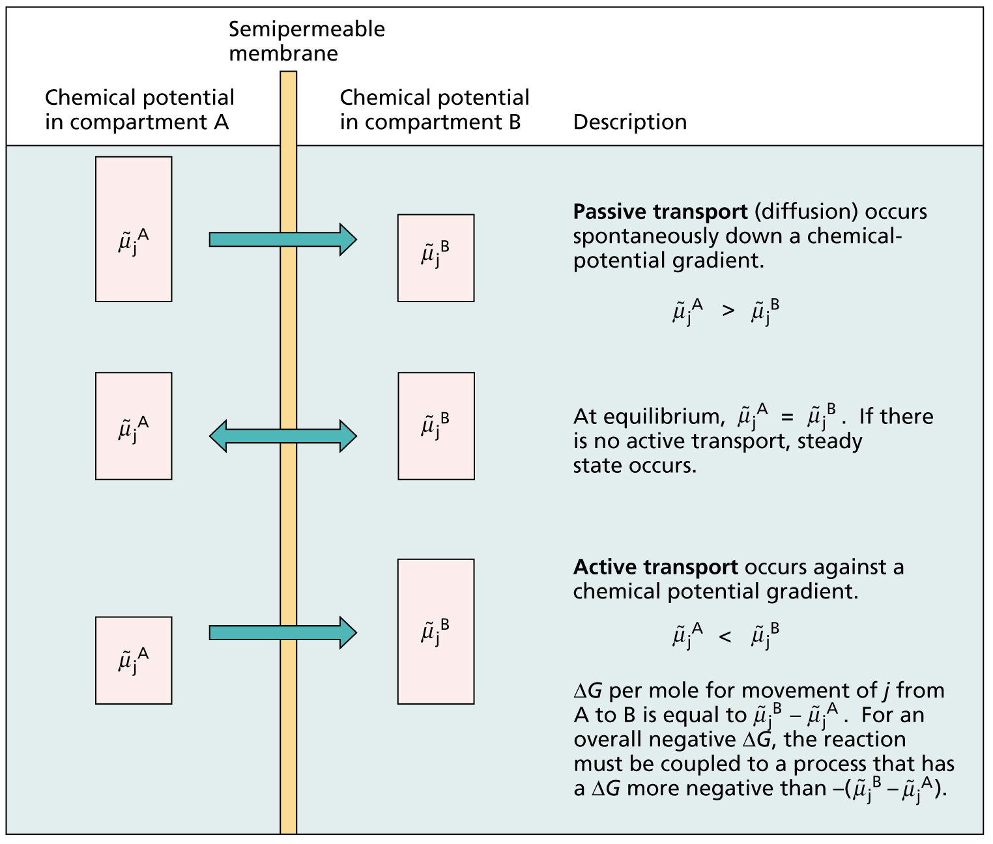
1- Passive and active transport
Relationship between the chemical potential and the transport

Slide 9
Simple diffusion as a passive transport
Movement down the gradient in electrochemical potential
Movement between phospholipid bilayer components
Bidirectional if gradient changes
Slow process

Slide 10
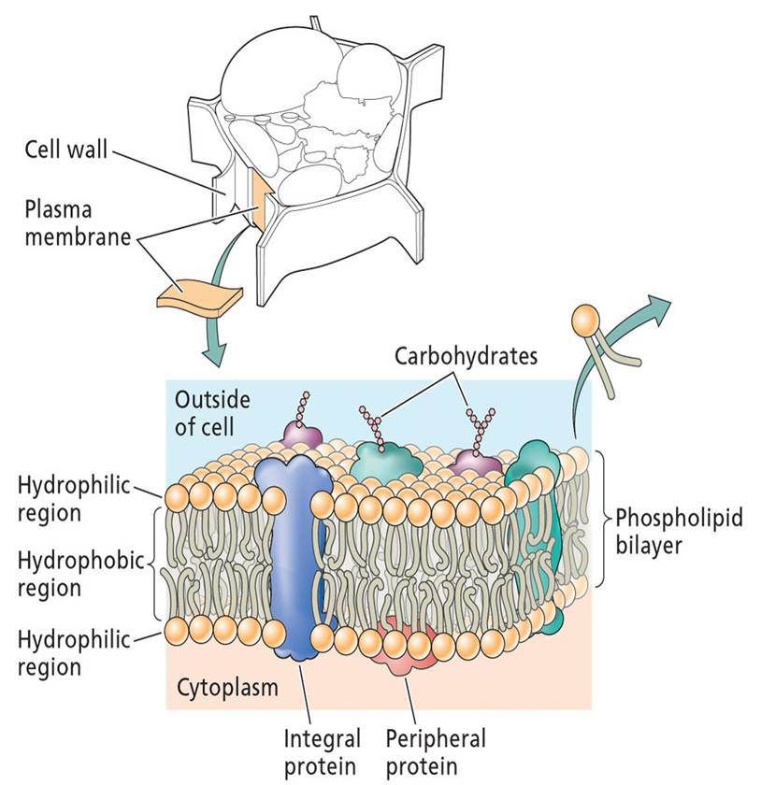
2- Membrane permeability
Structure of the cell membrane
Composed of a phospholipid bilayer (Lipid+Phosphate group) and proteins.
The phospholipid sets up the bilayer structure.
Phospholipids have hydrophilic heads and fatty acid tails.
Such organization makes plasma membrane selectively permeable to ions and molecules.

Slide 11
2- Membrane permeability
The extent to which a membrane permits the movement of a substance is called membrane permeability.
The permeability depends on:
The composition of the membrane.
The chemical nature of the solute.
The permeability is influenced by the ability of a substance to enter the membrane.
When salts diffuse across a membrane, an electric membrane potential (voltage) can develop.

Slide 12
2- Membrane permeability
Development of a diffusion potential
Membrane potential is the difference in electrical potential between the interior and the exterior of a cell.
Create a driving force for ionic transport.
KCl Solution example
K+ and Cl- ions diffuse at different rates across the membranes
Membranes are more permeable to K+ than to Cl-
Initially diffuse at different rates unless they achieve equilibrium

Slide 13
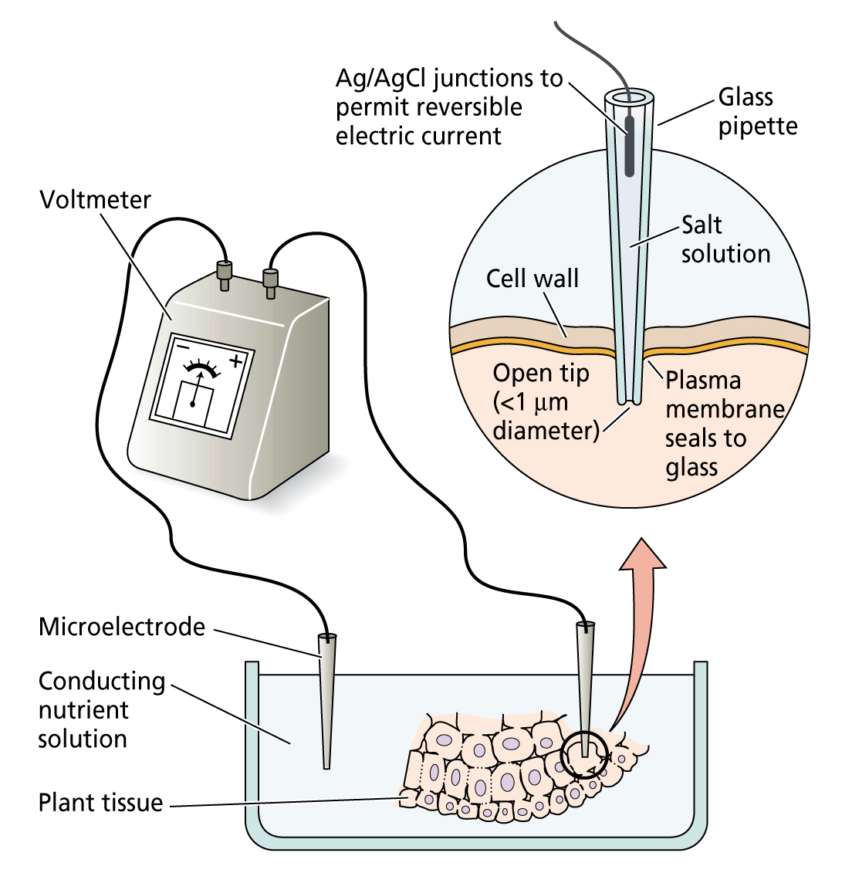
2- Membrane permeability
Measuring membrane potential by microelectrodes
A pair of microelectrodes, one is inserted into the cell compartment under study (usually the vacuole or the cytoplasm), while the other is kept in an electrolytic solution that serves as a reference.
The method is based on measuring the voltage difference between the inside of the cell and the external bathing medium

Slide 14
Ion homeostasis within plant cells
Plant cells segregate ions based upon:
Function or role
Potential toxicity
This segregation creates a balance.
Creating and maintaining the balance may require energy.

Slide 15
Ion homeostasis within plant cells
Ion concentrations in cytosol and vacuole are controlled by passive (dashed) and active (solid) transport processes.
In most plant cells vacuole takes up 90% of the cell volume.
(Contains bulk of cells solutes)
Control of cytosol ion concs is important for the regulations of enzyme activity.
Cell wall is not a permeability barrier.
(It is NOT a factor in solute transport)

Slide 16
3- Membrane transport processes
Three types of membrane transporters enhance the movement of solutes across membranes:
Channels
Carriers
Pumps

Slide 17
3- Membrane transport processes
1- Channels
Transmembrane proteins that work as selective pores.
Transport through channels is always passive.
The size of the pore determines its transport specifity.
Movement down the gradient in electrochemical potential.
Limited to ions and water.

Slide 18
3- Membrane transport processes
1- Channels
Unidirectional.
Very fast transport.
Not open all the time.
Channel proteins have structures called gates that open and close the pore inresponse to external signals.

Slide 19
3- Membrane transport processes
2- Carriers
Do not have pores that extend completely across membrane.
Substance being transported is initially bound to a specific site on the carrier protein.
Uni-directional
Specialized to carry a specific organic compound.

Slide 20
3- Membrane transport processes
2- Carriers
Binding of a molecule causes the carrier protein to change shape, this exposes the molecule to the solution on the other side of the membrane.
Transport complete after dissociation of molecule and carrier protein.

Slide 21
3- Membrane transport processes
2- Carriers
Moderate speed.
Slower than in a channel
100-1000 ions or molecules/second
Binding to carrier protein is like enzyme binding site action.
Can be either active or passive.
Passive action is sometimes called facilitated diffusion.

Slide 22
3- Membrane transport processes
3- Pumps
To carry out active transport, the membrane transporter must couple the uphill transport of a molecule with an energy releasing event,
This is called Primary active transport,
Energy source can be;
The electron transport chain of mitochondria
The electron transport chain of chloroplasts
Absorption of light by the membrane transporter
Such membrane transporters are called Pumps.

Slide 23
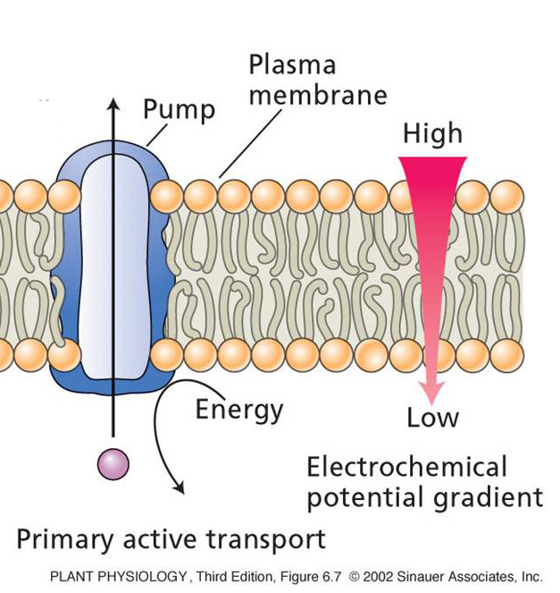
3- Membrane transport processes
Primary active transport - Pumps
Movement against the electrochemical gradient
Unidirectional
Very slow
Direct energy expenditure
e.g. ATP is hydrolyzed as transporter moves a solute across membrane.

Slide 24
3- Membrane transport processes
Secondary active transport - Pumps
Involves the coupling of the uphill transport of a molecule with the downhill transport of another
(A) the initial conformation allows a proton (Hydrogen ion, H⁺) from outside to bind to pump protein.
(B) Proton binding alters the shape of the protein to allow the molecule (S) to bind.

Slide 25
3- Membrane transport processes
Secondary active transport
(C) The binding of the molecule [S] again alters the shape of the pump protein. This exposes the both binding sites, and the proton and molecule [S] to the inside of the cell.
(D) This release restores both pump proteins to their original conformation and the cycle begins again.

Slide 26
3- Membrane transport processes
Types of secondary active transport
(A) Symport: (the protein involved is called symporter), both substances move in the same direction across the membrane.
(B) Antiport: (the protein involved is called antiporter), coupled transport in which the downhill movement of protons drives the active (uphill) movement of a molecule.
Notes:
What are the Symport and Antiport?

Slide 27
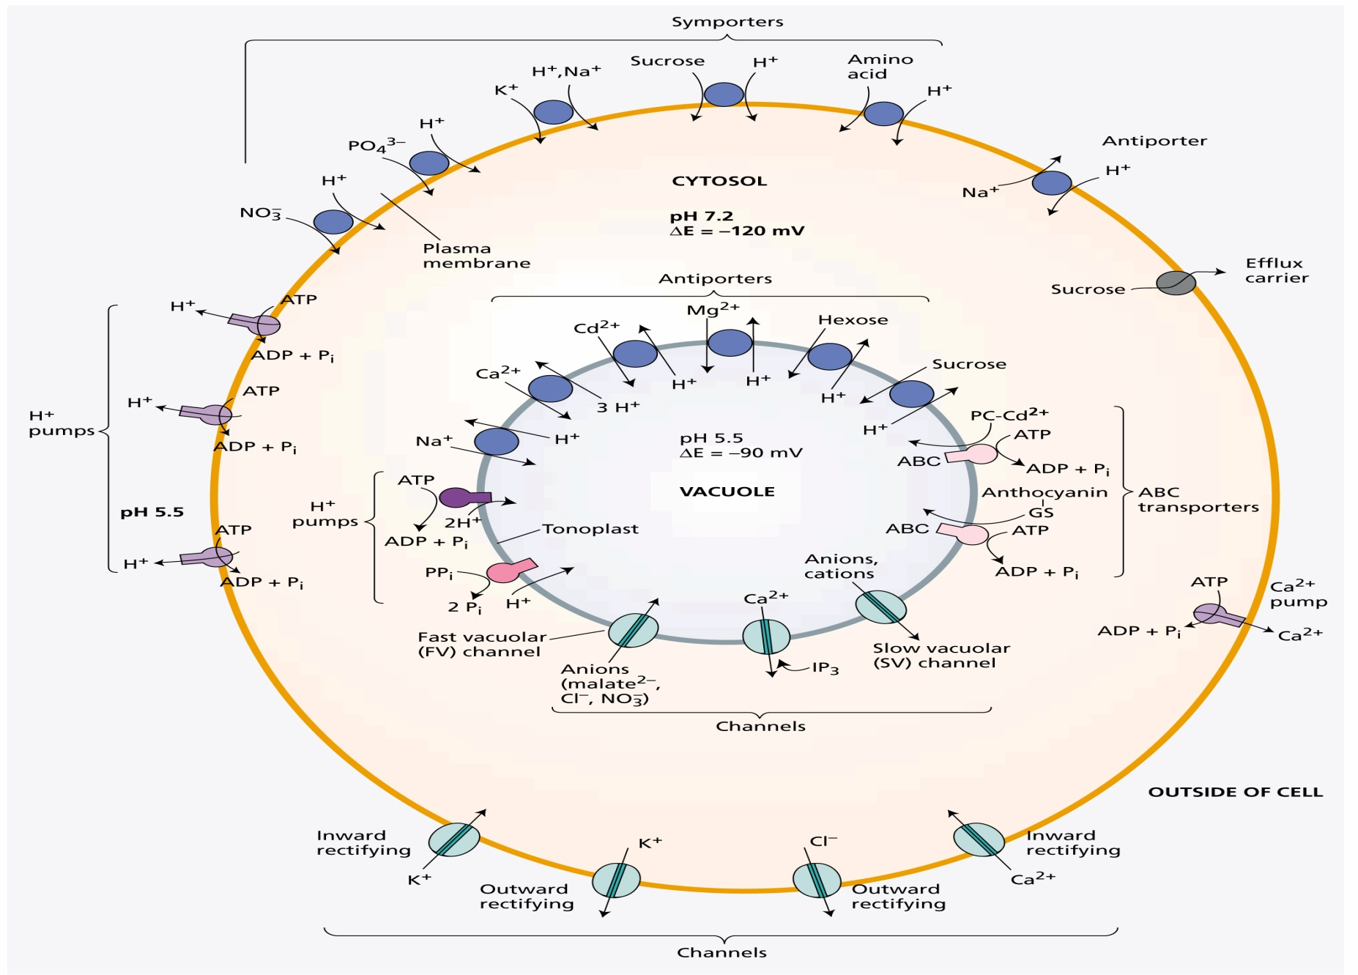
3- Membrane transport processes
Overview of the various transport processes

Slide 28
Summary of membrane transport
Facilitate the passage of ions and other polar molecules
Three types of membrane transporters enhance the movement of solutes across plant cell membranes
Channels – passive transport
Carriers – passive/active transport
Pumps- active transport
Notes:
Draw the passive and active transport?

Slide 29
4- Ion transport in roots
Ion transport across the root obeys the same biophysical laws that govern cellular transport.
However, the anatomy of roots imposes some special constraints on the pathway of ion movement.
In terms of the transport of small molecules, the cell wall is an open lattice of polysaccharides through which mineral nutrients diffuse readily.

Slide 30
4- Ion transport in roots
As all plant cells are surrounded by a cell wall, Ions can be carried through the cell wall space without entering an actual cell,
The apoplast
Just as the cell walls form a continuous space, so do the cytoplasms of neighboring cells,
The symplast

Slide 31
4- Ion transport in roots
In tissues where significant amounts of intercellular transport occur, neighboring cells contain large numbers of plasmodesmata,
(as in cells of the root tip)
Ion absorption in the root is more pronounced in the root hair zone than other parts of the root.
Plasmodesmata

Slide 32
4- Ion transport in roots
An Ion can either enter the root apoplast or symplast but is finally forced into the symplast by the casparian strip.
Once the Ion is in the symplast of the root, it must exit the symplast and enter the xylem, called Xylem Loading.
Ions are taken up into the root by an active transport process.
Ions are transported into the xylem by passive diffusion.

Slide 33
Summary
The movement of molecules and Ions from one location to another is known as transport.
Plants exchange solutes and water with their environment and among tissues and organs.
Both local and long distance transport are controlled by cellular membranes.
Forces that drive biological transport include concentration gradients, electric-potential gradients, and hydrostatic pressures.

Slide 34
Summary
Transport of solutes down a chemical gradient (e.g., by diffusion) is known as passive transport.
Movement of solutes against a chemical potential gradient is known as active transport and requires energy input.
Membranes contain specialized proteins (channels, carriers, and pumps) that facilitate solute transport.
The extent to which a membrane permits or restricts the movement of a substance is called membrane permeability.
Solutes move between cells either through extracellular spaces (Apoplast) or from cytoplasm to cytoplasm (Symplast).

Slide 35
Any
QUESTIONS ?

