Slide 2
KINGDOOM OF SAUDI ARABIA
King Saud University
College of Sciences - Department of Botany and Microbiology
Plant nutrition
BIO 572
Dr. Abdulrahman AL-HASHiMi

Slide 3
Lecture 2
Mineral Nutrition
1- Nutrient deficiency
2- Soil, Root and Microbes

Slide 4
2- Nutrient deficiency
The relationship between plant growth (or yield)
and the mineral concentration of plant tissue
The transition between the deficiency and adequate zones
of the curve reveals the critical concentration of the nutrient

Slide 5
Treating nutritional deficiencies
Addition of Chemical Fertilizers: contain inorganic salts of the macronutrients; nitrogen, phosphorus, and potassium.
Straight fertilizers: contain one mineral nutrient.
Compound or mixed fertilizers: contain two or more.
Foliar application: (uptake through plant leaves).
Iron
Copper
Manganese

Slide 6
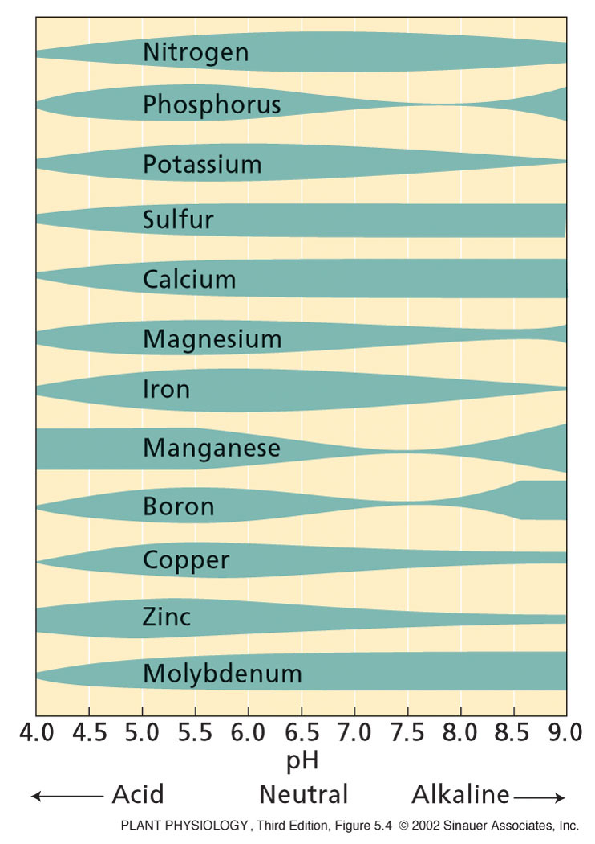
Treating nutritional deficiencies
The soil pH affects the growth of plant roots and soil microbes.
Acidic conditions weathers rock and releases potassium, magnesium, calcium, and manganese.
The decomposition of organic material lowers soil pH.
Chemicals may also be applied to the soil to modify soil pH.

Slide 7
Treating nutritional deficiencies
Addition of Organic Fertilizers: originate from residues of plant or animal life or from natural rock deposits.
- Before crop plants can acquire the nutrient elements from these residues, the organic compounds must be broken down, usually by the action of soil microorganisms through a process called Mineralization.
- The Mineralization depends on:
1- Temperature, water and oxygen availability.
2- Type and number of microorganisms present in the soil.

Slide 8
3- Soil, Root and Microbes
The soil is a complex physical, chemical, and biological substrate.
It is a heterogeneous material containing solid, liquid, and gaseous phases. All of these phases interact with mineral elements.
The inorganic particles of the solid phase provide a reservoir of potassium, calcium, magnesium, and iron.
Also associated with this solid phase are organic compounds containing nitrogen, phosphorus, and sulfur.

Slide 9
3- Soil, Root and Microbes
The liquid phase of the soil constitutes the soil solution, which contains dissolved mineral ions and serves as the medium for ion movement to the root surface.
Gases such as oxygen, carbon dioxide, and nitrogen are dissolved in the soil solution.
In roots gases are exchanged predominantly through the air gaps between soil particles.
Soil constitutes a diverse ecosystem in which plant roots and microorganisms compete strongly for mineral nutrients.
Roots and microorganisms can form alliances for their mutual benefit (symbioses, singular symbiosis).

Slide 10
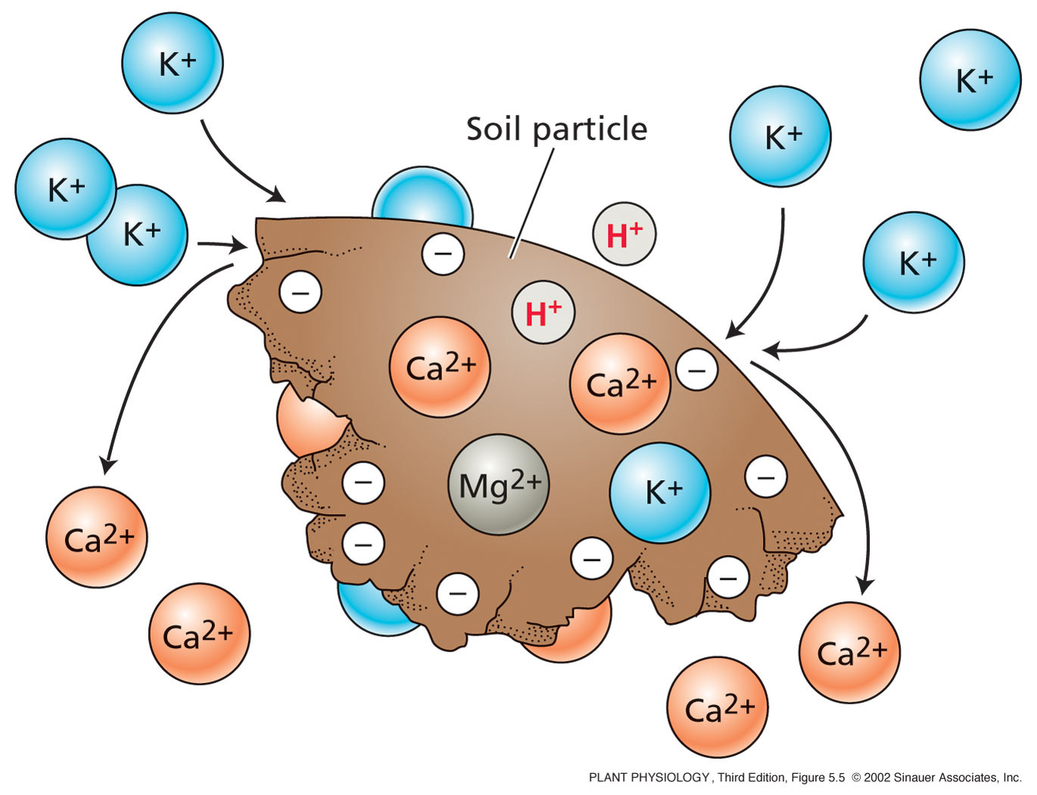
The soil affects nutrient absorption
Negatively charged soil particles affect the absorption of mineral nutrients.
Cation exchange occurs on the surface of the soil particle.
Cations (+ve charged ions) bind to soil as it is (–ve charded).
If potassium binds to the soil,
it can displace calcium from the soil particle and make it available for uptake by the root

Slide 11
Soil pH affects soil microbes and root growth
Root growth favored in slightly acidic soils (pH, 5.5 - 6.5).
Fungi generally predominate in acidic soils.
Bacteria become more prevalent in alkaline soils.
Soil pH also determines the availability of soil nutrients.
Acidity promotes the weathering of rocks that releases K⁺, Mg²⁺, Ca²⁺, and Mn²⁺, and increases the solubility of carbonates, sulfates, and phosphates.
Increasing solubility of nutrients facilitates their availability.
The decomposition of organic matter and the amount of rainfall are major factors that lower the soil pH.

Slide 12
Excess minerals in the soil limits plant growth
When excess minerals are present in the soil, the soil is said to be saline, and plant growth may be restricted.
Sodium chloride and sodium sulfate are the most common salts in saline soils.
Excess minerals causes the accumulation of heavy metals (zinc, copper, cobalt, nickel, mercury, lead, cadmium, silver, and chromium) in the soil, which can cause severe toxicity in plants as well as humans.

Slide 13
Excess minerals in the soil limits plant growth
Excess minerals in soils can be a major problem in arid and semiarid regions because rainfall is insufficient to leach the mineral ions from the soil layers near the surface.
Irrigated agriculture fosters soil salinization if insufficient water is applied to leach the salt below the rooting zone.
To prevent toxic buildup of mineral ions in the cytosol, many plants may sequester them in the cell vacuole.

Slide 14
Soil
Plants obtain inorganic elements from the soil, which serves as a natural medium for land plants.
Soil is the outer loose layer that covers the surface of Earth.
Soil quality is a major determinant, along with climate, of plant distribution and growth. Soil quality depends on the chemical composition of the soil, the topography (regional surface features) and the presence of living organisms.

Slide 15
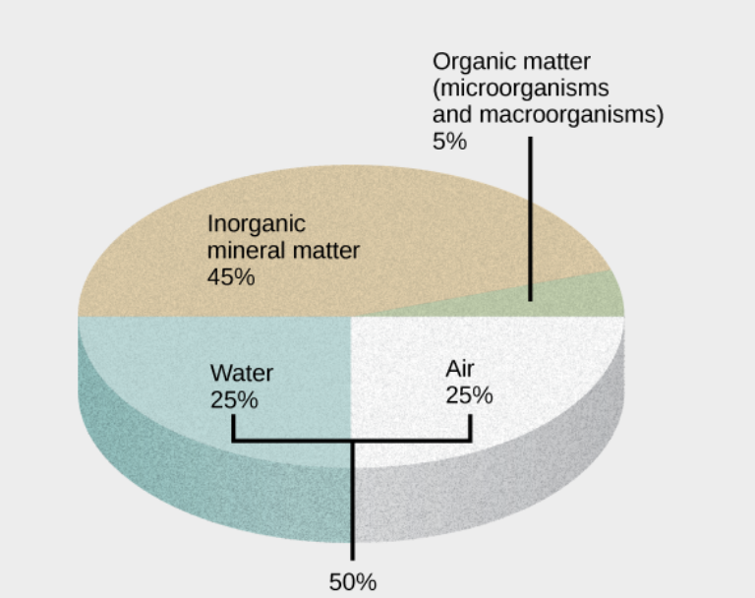
Soil Composition
Soil consists of these major components:
inorganic mineral matter, about 40 to 45 percent of the soil volume
organic matter, about 5 percent of the soil volume
water and air, about 50 percent of the soil volume

Slide 16
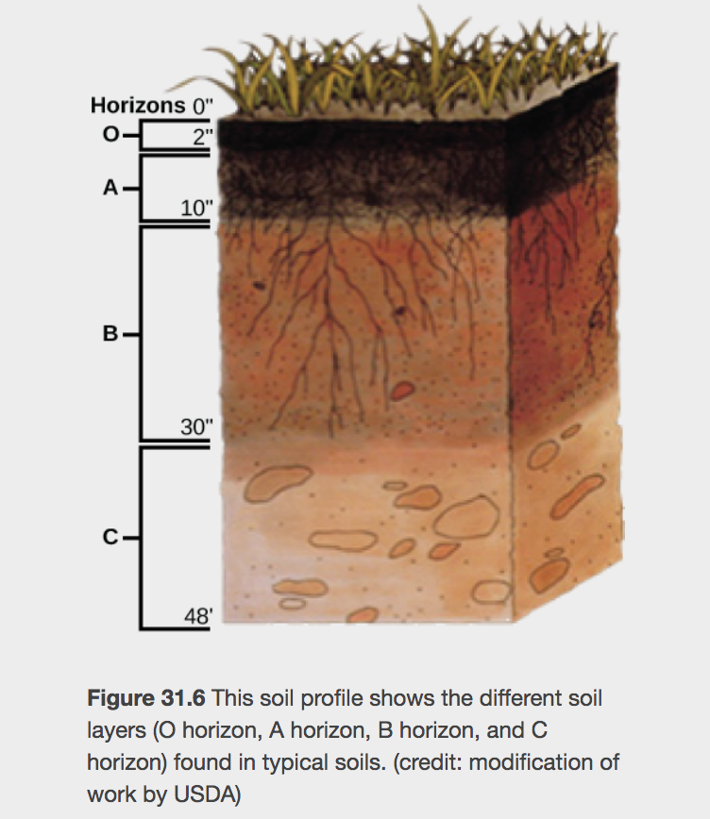
The organic material of soil, called humus, is made up of microorganisms (dead and alive), and dead animals and plants in varying stages of decay.
Humus improves soil structure and provides plants with water and minerals.
The inorganic material of soil consists of rock, slowly broken down into smaller particles that vary in size.

Slide 17
Parent Material
The organic and inorganic material in which soils form is the parent material.
Mineral soils form directly from the weathering of bedrock, the solid rock that lies beneath the soil, and therefore, they have a similar composition to the original rock.
Other soils form in materials that came from elsewhere, such as sand and glacial drift. Materials located in the depth of the soil are relatively unchanged compared with the deposited material.

Slide 18
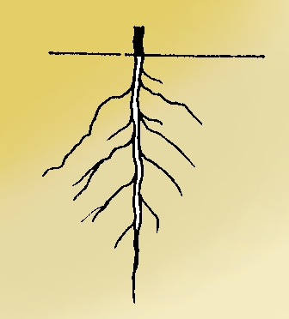
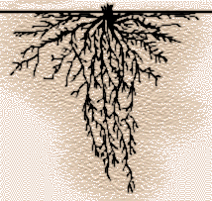
Plant roots
Root systems differ in form but are based on common structures
Tap Root Fibrous Root
Dicots Monocots

Slide 19
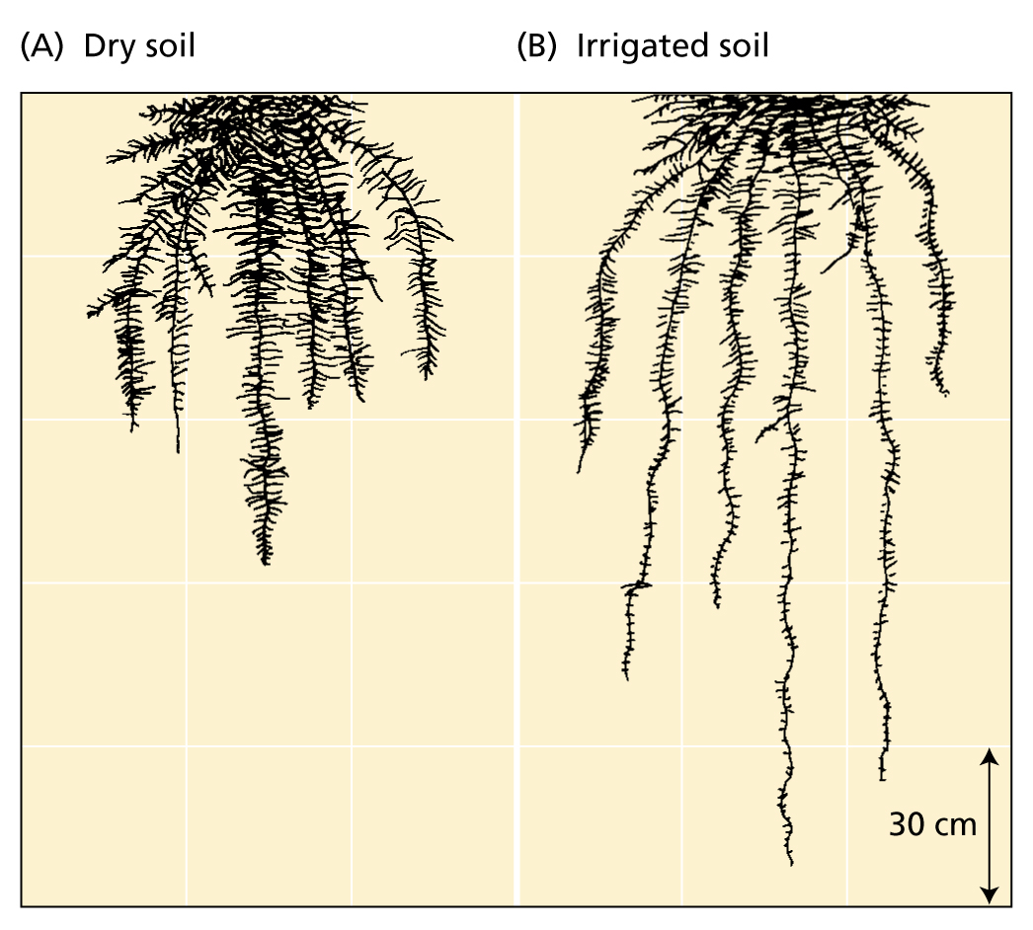
Plant roots
Plants develop extensive root systems
to obtain both water and mineral nutrients from the soil
The rhizosphere is the narrow region of the soil around the root.
If the rhizosphere is poor in nutrients or too dry, root growth is slow.
If the rhizosphere conditions is improved, root growth increases.
If fertilization and irrigation provide abundant nutrients and water, root growth may not keep pace with
shoot growth.
Fibrous root systems of wheat

Slide 20
Plant roots
Meristematic zone
Cells divide both in direction of root base to form cells that will become the functional root and in the direction of the root apex to form the root cap
Elongation zone
Cells elongate rapidly, undergo final round of divisions to form the endodermis. Some cells thicken to form casparian strip.
Maturation zone
Fully formed root with xylem and phloem – root hairs first appear here.
The apical region of the root

Slide 21
Plant roots
Different areas of the root absorb different mineral Ions
Calcium
Apical region
Iron
Apical region (barley)
Or entire root (corn)
Potassium, nitrate, ammonium, and phosphate
All locations of root surface
In corn, elongation zone has max K accumulation and nitrate absorption
In corn and rice, root apex absorbs ammonium faster than the elongation zone does
In several species, root hairs are the most active phosphate absorbers

Slide 22
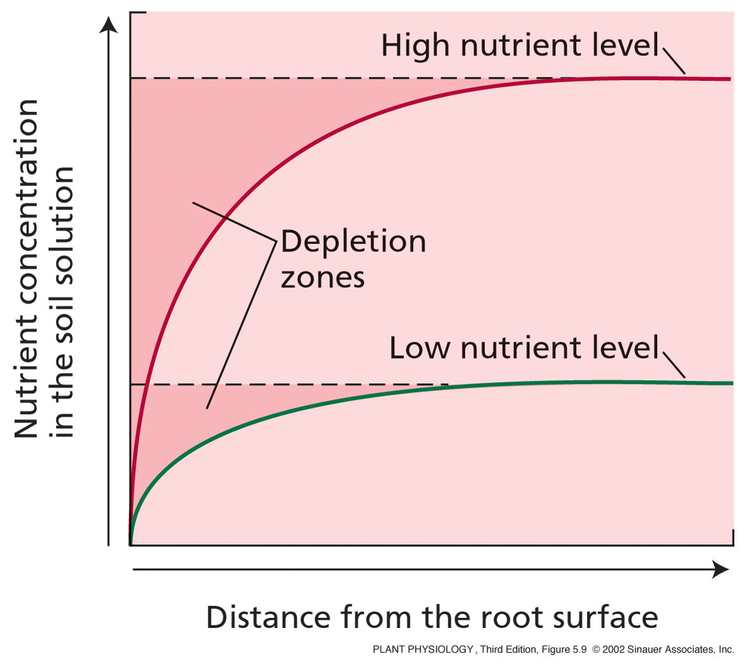
Plant roots
Formation of a nutrient depletion zone in the region of the soil near the plant root.
Forms when rate of nutrient uptake exceeds rate of replacement in soil by diffusion in the water column.
Root associations with Mycorrhizal fungi help the plant overcome this problem.

Slide 23
Mycorrhizal Fungi
Mycorrhizal fungi facilitate nutrient uptake by roots
Ectotrophic Mycorrhizal fungi
Form a thick sheath around root. Some mycelium penetrates the cortex cells of the root.
Root cortex cells are not penetrated, surrounded by a zone of hyphae called Hartig net.
The capacity of the root system to absorb nutrients improved by this association – the fungal hyphae are finer than root hairs and can reach beyond nutrient-depleted zones in the soil near the root.

Slide 24
Mycorrhizal Fungi
Vesicular arbuscular mycorrhizal fungi
Hyphae grow in dense arrangement , both within the root itself and extending out from the root into the soil.
After entering root, either by root hair or through epidermis hyphae move through regions between cells and penetrate individual cortex cells.
Within cells form oval structures – vesicles – and branched structures – arbuscules (site of nutrient transfer)
P, Cu, & Zn absorption improved by hyphae reaching beyond the nutrient-depleted zones in the soil near the root

Slide 25
Mycorrhizal Fungi
Nutrients move from mycorrhizal fungi to the root cells
Ectotrophic Mycorrhizal
Occurs by simple diffusion from the hyphae in the hartig net to the root cells.
Vesicular arbuscular mycorrhizal fungi
Occurs by simple diffusion from arbuscules to the root cells.
The nutrients may be released directly into the host cell.

Slide 26
Any
QUESTIONS ?

