Slide 1
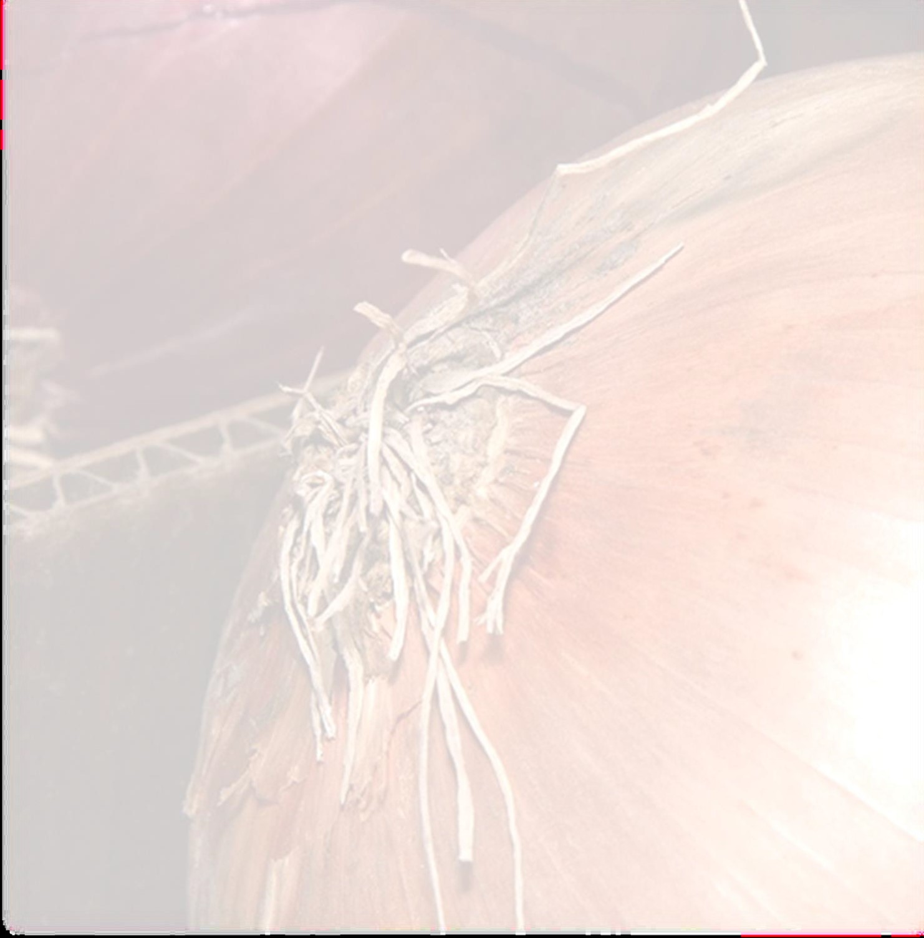
Mitosis in the root tips of Onion
Squash method

Slide 3
In this experiment ,We used the onion root to tip to better understand process of mitosis and visualize all the stages of mitosis.

Slide 4
Materials
1- Developing the summit of the roots of the onion.
2- Anatomy instruments (forceps- scalpel-scissors).
3- Slides and covers.
4- Tubes.
5- Distilled water.
6- Carnoy fixative.
7- 70% alcohol.
8- Dilute hydrochloric acid.
9- A water bath at 60°.
10- Aceto-orcein stain dye.
11- Optical microscope.

Slide 5
Method
1- Onion is placed in water for several days in order to give it roots within the length of 2-3 cm.
2- Using scissors, cut 2 roots tips about 3 cm long, and transfer them into a plastic tube (One of the roots will be an extra one).

Slide 6
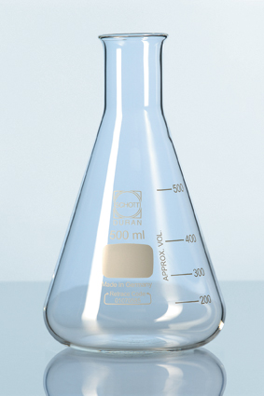
3- Using forceps, carefully transfer the root tips to a tube containing the Carnoy fixative for 8 min.
What is Carnoy fixative?
Consists of :
60% ethanol, 30% chloroform and 10% glacial acetic acid
The aim of the use:
Fixation of the cells on their final shape

Slide 7

4- Remove Carnoy’s fixative using a dropper, and wash the roots with distilled water.
5- After removing the excess water, add 5 ml of 1N HCL to the tube containing the roots, transfer them to a and allow the roots to incubate for 7 minutes.
6- Remove the 1N HCL using a dropper, and wash with distilled water 3 times.

Slide 8
7 - Wash 2 slides with 70 % alcohol.
8 - place the roots in a clean slide and add a drop or two drops of aceto-orcein stain and leave for 5 minutes.
9 - Transfer the roots to a clean slide, cut the root tip and remove the rest.

Slide 9
10 – Cover the root tip with a cover slip, and then carefully push down on the cover slide with the wooden end of a dissecting probe. Push hard, but don’t twist or push the cover slide sideways. The root tip should spread out to diameter about 0.5 - 1cm.
11 – Examine Onion cells in different phases of the cell cycle under the microscope

Slide 11

How to write a laboratory report?
Your report must start with the experiment name as a headline.
Don’t forget to write down these information on the first page of your report :
      Practical Weekly report
      Zoo 556 Lab report number (---)
      Done by : (your name)
      Submitted to : ( your teacher’s name).

Slide 12
How to write a laboratory report?
Your report must include the following :
  Introduction.
  Aim of work.
  Materials and methods.
  Results.
  What you have learned from this lab.

