Slide 1
Barr Body

Slide 2
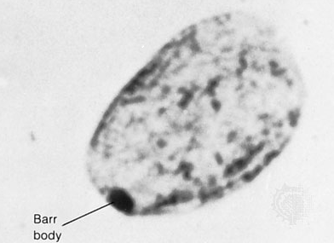
Barr Body:
Also known as sex chromatin.
is the inactive X chromosome in a female somatic cells.
Discover by Murray Barr as small, darkly staining body adjacent to the nucleolus or nuclear membrane in most of the nuclei of neurons of female cats.

Slide 3
Characteristic of female cells ( absent from male cells).
Normal male : one X chromosome ,No Barr Body
Normal female : two X chromosome, one Barr Body
Female with trisomy X chromosome , three X chromosome , two Barr Body.

Slide 4
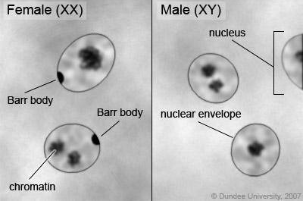

Slide 5
Aim:
Demonstrating sex chromatin (Barr body) in squamous epithelial cells of human oral smear

Slide 6
Materials:
Light microscope
Paper towel
Glass slide
Dropper pipette
Cover slip
Water
Flat toothpick
Methylene blue (0.3%)

Slide 7
Procedure
  Obtain a clean glass microscope slide.
  Place a drop of water in the center of the slide.
  Gently scrape the inside of your cheek with the flat edge of a toothpick.
  Spread cells in the drop of water.
  Place cover slip on top of specimen.
  Apply one drop of methylene blue along one side of the cover slip.
  Along the opposite edge of the cover slip, gently touch with a piece of paper towel. This will draw the methylene blue under the cover slip to stain the cells.
  Observe, diagram, label, and record magnification.

Slide 8
