Slide 1
The digestive system

Slide 2
The digestive system consists of:
The digestive tract
The associated glands
which include:
which include:
oral cavity
salivary glands
pharynx
liver
esophagus
pancreas
stomach
small and large intestines
rectum

Slide 3
General Structure of the digestive tract
A- the tract is a hollow tube having a lumen of variable diameter.
B- the tube wall is made up of 4 principle layers:
1- the mucosa.
2- the submucosa.
3- the muscularis externa.
4- the serosa.

Slide 4
The 4 principle layers
serosa
muscularis externa
submucosa
mucosa
composed of loose connective tissue supplied with many blood and lymph vessels and a submucosal nerve plexus. It may also contain glands and lymphoid tissue in some specialized parts of the digestive tract
The innermost layer, is composed of
A thin layer composed of
Consists mainly of smooth muscle cells arranged in two layers:
An epithelial lining
An internal layer (close to the lumen) of circular muscle
A lamina propria of loose connective tissue rich in blood and lymph vessels and smooth muscle cells, sometimes also containing glands and lymphoid tissues
An external layer mostly of longitudinal muscles
* In between the two layers is a layer of connective tissue supplied with a nerve plexus and blood and lymphatic vessels
Simple squamous covering epithelium (mesothelium)
A layer of muscularis mucosae, usually consisting of an inner circular and an outer longitudinal layer of smooth muscle cells separating the mucosa from the submucosa
Loose connective tissue rich in blood and lymph vessels in addition to adipose tissue

Slide 5
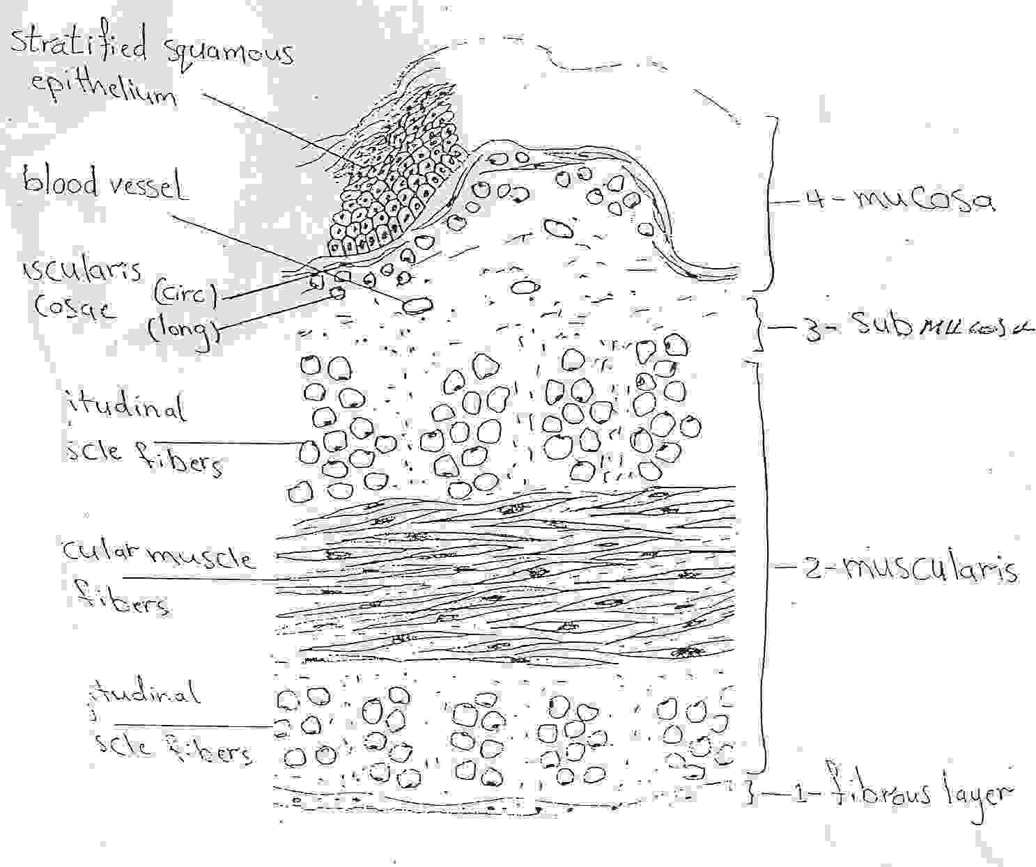
Structure of the Oesophagus of the rabbit
It is a muscular tube which transport food from the mouth to the stomach, it consists of 4 principle layers:

Slide 6
The layer | Content
The serosa | A thin layer composed of : Simple squamous covering epithelium (mesothelium). Loose connective tissue rich in blood and lymph vessels in addition to adipose tissue. Only the part of the esophagus in the peritoneal cavity (below the diaphragm) is covered by serosa. The rest of the esophagus is covered by a layer of fibrous connective tissue (adventitia) which blends into surrounding neck tissue.
The muscula-ris externa | Consists mainly of smooth muscle cells arranged in two layers: An internal layer (close to the lumen) of circular muscle. An external layer mostly of longitudinal muscles. In between the two layers is a layer of connective tissue supplied with a nerve plexus and blood and lymphatic vessels.
In the proximal end of the esophagus (near the pharynx) the muscularis layer consists of only striated (skeletal) muscle cells.
At the distal end (near the stomach), this layer consists only smooth muscle cells.
A mixture of striated (skeletal) and smooth muscle cells are present in the mid portion of the esophagus.
The muscularis consists of 3 layers, an inner and an outer longitudinal muscle layers and a middle circular muscle layer.
The thickest layer.

Slide 7
The submucosa | composed of loose connective tissue supplied with many blood and lymph vessels and a submucosal nerve plexus. It may also contain glands and lymphoid tissue in some specialized parts of the digestive tract.
The mucosa | The innermost layer, is composed of: An epithelial lining. A lamina propria of loose connective tissue rich in blood and lymph vessels and smooth muscle cells, sometimes also containing glands and lymphoid tissues. A layer of muscularis mucosae, usually consisting of an inner circular and an outer longitudinal layer of smooth muscle cells separating the mucosa from the submucosa. The mucosa is formed of a non-keratinized, stratified squamous epithelium.

Slide 8
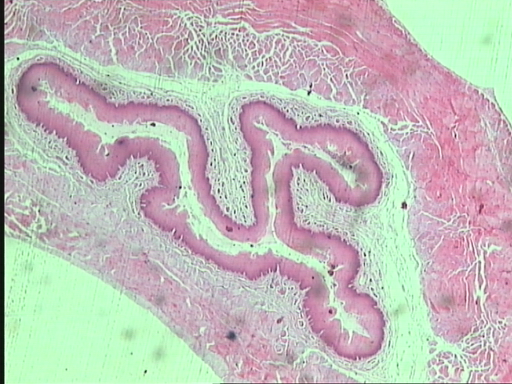
T.S of Oesophagus
3
4
1
6
2
7
5
Fibrous layer 5. Submucosa
Outer Longitudinal muscle fibers 6. Muscularis mucosa
Circular muscle fibers 7. Mucosa
Inner Longitudinal muscle fibers

Slide 9
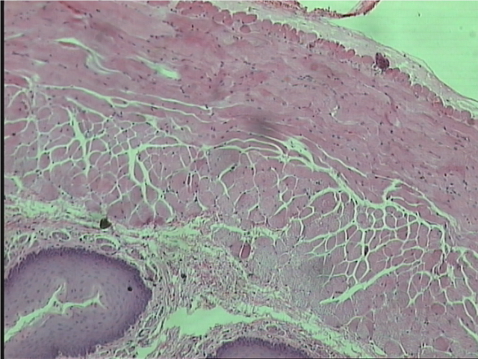
T.S of Oesophagus
2
1
3
4
6
5
7

Slide 10
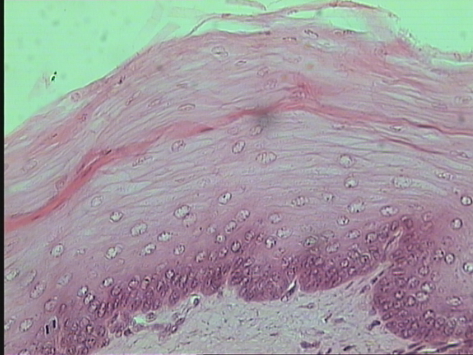
Stratified Squamous Epithelium
Polygonal cells
Wavy basement membrane
Submucosa

Slide 11
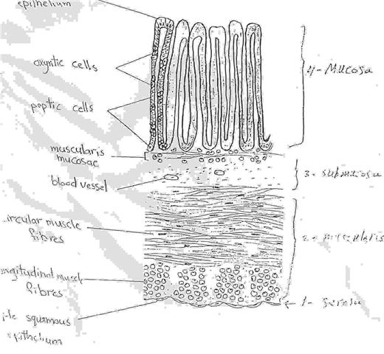
Structure of the Stomach of the rabbit
It is dilated segment of the digestive tract, it consists of 4 principle layers:

Slide 12
The layer | Content
The serosa | A thin layer composed of : Simple squamous covering epithelium (mesothelium). Loose connective tissue rich in blood and lymph vessels in addition to adipose tissue.
The muscularis externa | Consists mainly of smooth muscle cells arranged in two layers: An internal layer (close to the lumen) of circular muscle. An external layer mostly of longitudinal muscles. In between the two layers is a layer of connective tissue supplied with a nerve plexus and blood and lymphatic vessels.

Slide 13
The submu-cosa | composed of loose connective tissue supplied with many blood and lymph vessels and a submucosal nerve plexus. It may also contain glands and lymphoid tissue in some specialized parts of the digestive tract.
The mucos-a | The innermost layer and the thickest layer, composed of: An epithelial lining, a layer of simple columnar epithelium rich in mucus secreting cells, and the parallel tubular gastric glands which open onto the epithelium. The epithelial lining folds, forming depressions called gasytric pits. At the bottom of these gastric pits open the gastric glands. A lamina propria of loose connective tissue rich in blood and lymph vessels and smooth muscle cells, sometimes also containing glands and lymphoid tissues.

Slide 14
A layer of muscularis mucosae, usually consisting of an inner circular and an outer longitudinal layer of smooth muscle cells separating the mucosa from the submucosa.
The gastric glands contain 4 types of cells, which 2 types are well distinguished:
Peptic or central (Chief zymogenic) cells, which predominate in the lower region of the glands.
- They are polygonal, basophilic and contain granules in the cytoplasm.
- They secrete (inactive) pepsinogen which is activated in the acid environment of the stomach lumen to pepsin.
b) parietal (oxyntic) cells, which abound the luminal part of the gastric glands.

Slide 15
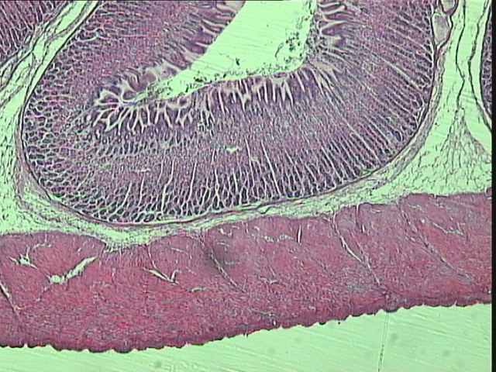
T.S of Stomach
6
4
5
3
Fibrous layer 4. Submucosa
Outer Longitudinal muscle fibers 5. Muscularis mucosa
Inner Circular muscle fibers 6. Mucosa
2
1

Slide 16
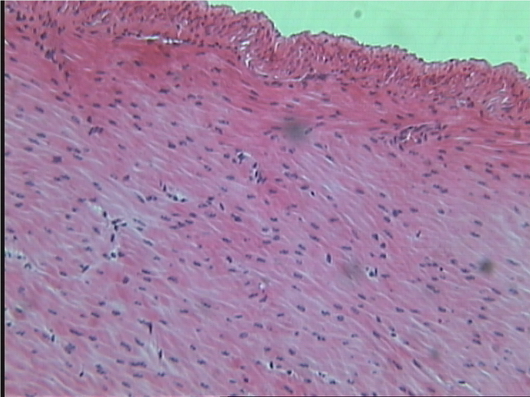
The Muscularis of Stomach
Outer Longitudinal muscle fibers
Circular muscle fibers

Slide 17
T.S of Stomach

Slide 18
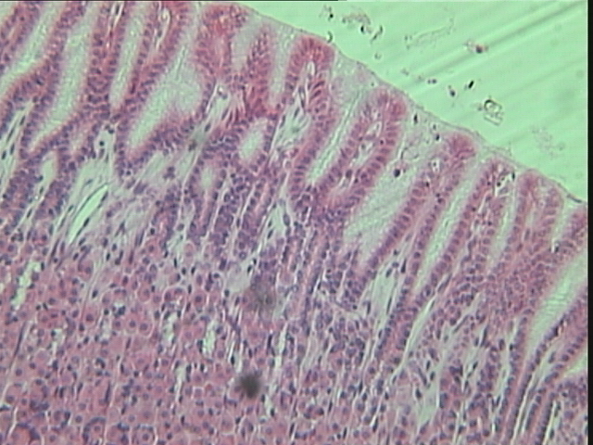
Magnified Part of The Mucosa of Stomach
Simple Columnar Epithelium
Tubular glands
Oxyntic & Peptic cells

Slide 19
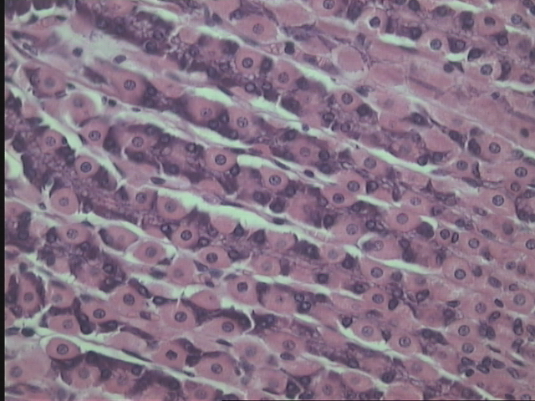
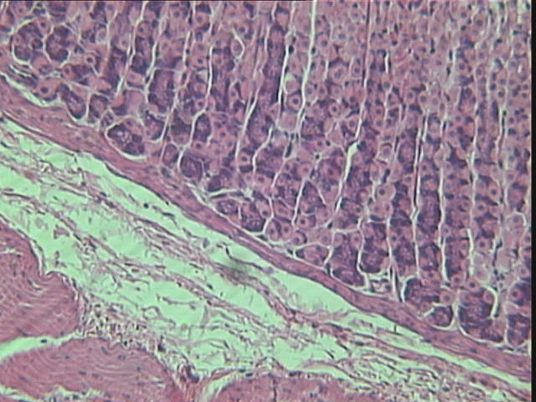
Oxyntic
Peptic cells

