Slide 1
CLS 223

Slide 2
Lecture # 5
Immune Response

Slide 3
Cellular response to stress
Cellular response to stress may be adaptive or non adaptive.
Adaptive | Non-adaptive (cell injury-----cell death)
hypertrophy | Dysplasia
hyperplasia | neoplasia
Atrophy | Degeneration
Metaplasia | Necrosis, apoptosis & gangrene
Reversible | Reversible* / Irreversible
1) Change in cell number, size, type
2) Inflammation and repair
3) Immune response
*to a certain limit

Slide 4
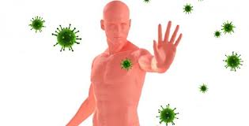
Immune response
Immunity: is the ability of an organism to recognize and defend itself against specific pathogens or antigens.

Slide 5
Protection against invading pathogens:
First line of defense: non-specific natural barrier which restrict entry of pathogen. E.g.: Skin and mucus membranes
Second line of defense: non- specific Innate immune defense provide rapid local response to pathogen after it has entered the host. E.g.: inflammatory response, WBC Phagocytes (macrophages, neutrophils).
Third line of defense: Antigen specific immune response, specifically target and attack invaders that get past first two lines of defense. E.g.: Antibodies and lymphocytes.
Notes:
Neutrophils (early in infection).
natural=innate

Slide 6
Immunity
Non specific defense mechanism |  | Specific defense mechanism (immune system)
1st line of defense | 2nd line of defense | 3rd line of defense
Skin Mucus membrane | Inflammation Phagocytic WBC | Lymphocytes Abs
Natural, innate, non specific
Examples?
Acquired, specific, adaptive
Notes:
Get me more examples for next lecture on natural innate non specific immunity
Skin: keratin (physical barrier), low PH 3-5 (chemical barrier)
Mucus membrane: lines the gastrointestinal and respiratpry tract.: secrete mucus (organisms stick, get trapped)
Other examples: vaginal low ph, cillia in the upper respiratory tract, gastric juice very acidic.

Slide 7
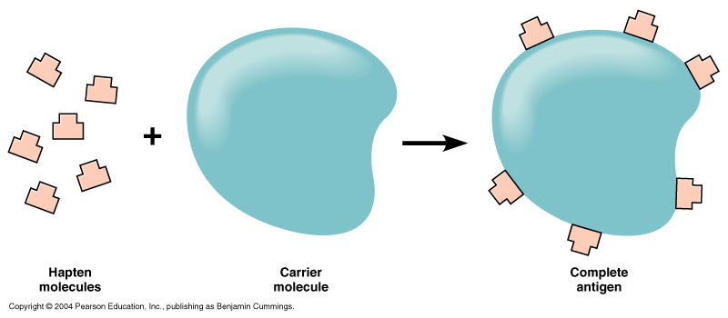
Antigen
Antigen (immunogen): is a substance recognized by the immune system stimulating an immune response.
Hapten: a small molecule that can not induce an immune response (non- immunogenic) unless attached to a large carrier such as protein
Notes:
Examples on antigens: organism, a molecule, part of a molecule/ simple, complex,
Hapten: non- immunogenic by itself. yet when attached to a protein it becomes antigenic. Needs help to induce an immune response.

Slide 8
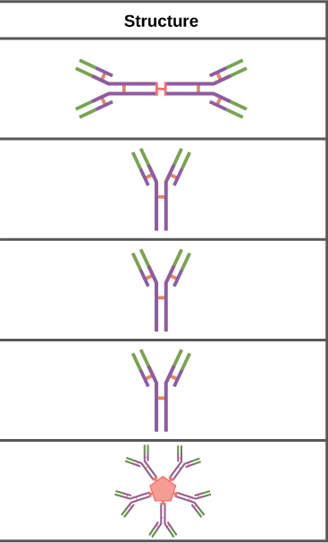
Antibodies
(immunoglobulins, Igs): They are formed by the plasma cells which are derived from B-lymphocytes.
There are 5 types of Igs:
IgA- in secretions; saliva, tears, mucous, breast milk → Localized protection of mucosal surfaces.
→ immunity to infant digestive tract.
IgD- function not well understood.
IgE- it releases the histamine from the Mast cells and Basophils. Protects against parasitic warms and allergic reactions.
IgG- most versatile in function, released after IgM, can cross placenta.
IgM- it is the primary response against infection.
Notes:
Igm: first antibody produced during infection (responsible for early stages of immunity)

Slide 9
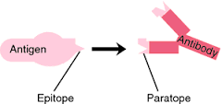
epitope
They are the antigenic determinants. The smallest part of the Ag recognized by the Ab.

Slide 10
Specific, acquired Immunity
It is divided into:
1) Active immunity: B- cells of the subject himself will be stimulated to produce his own antibodies.
-Active immunity can be naturally or artificially acquired.
2) Passive immunity: Antibodies were prepared in other subject or animal and then will be given to the subject needed to be immunized.
-Passive immunity can be naturally and artificially acquired.

Slide 11
Immunity
Acquired, specific,
Natural, innate, non specific
Naturally acquired
Artificially acquired
Active
Infection* (contact with pathogen)
passive
Ab pass from mother to fetus via placenta or to infant in milk
Active
Vaccine* -dead -live attenuated -toxoid
passive
Injection of immune serum (gamma globulin)

Slide 12
Infection*
Infection gives either:
1)Long-life immunity:
Some infections when occur produce long life immunity against this infection and not to others. E.g. Infection by small-pox produces long-life immunity against the small pox only and not any other infection.
2)Short-life immunity:
as in common cold, influenza,,,

Slide 13
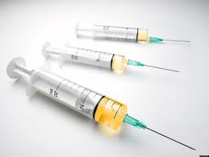
Vaccine*
The vaccine may be:
-Inactivated/Killed: made of micro-organisms that have been destroyed with chemicals, heat, radioactivity, or antibiotics as in hepatitis A.
-Live attenuated: made of active viruses that have been cultivated under conditions that disable their virulent properties as in small pox, measles, rubella, yellow fever, influenza.
-Toxoids (inactivated toxin): made from inactivated toxic compounds rather than the micro-organism itself as in diphtheria, tetanus.

Slide 14
Types of adaptive immune response:
Humoral immune response:
the responsible cells are B-lymphocytes → produce plasma cells → form the Igs.
2) Cell mediated immune response: the responsible cells are the T-lymphocytes.
Stimulated T lymphocytes affect the antigen by direct cytotoxic affect; producing cytotoxic factors that directly kills the antigen.

Slide 15
Humoral immune response
B lymphocytes has membrane bound antibodies that will bind to specific antigens.
The binding event activates the B lymphocyte to produce large number of clones (replicates) → primary humoral response.
Most B cells become plasma cells that produce specific Abs that bind to Ag (Ag-Ab complex) destroy that specific Ag. Or phagocytic cells recognize the Ab-Ag complex and engulf it.
Some B cells become long-lived memory cells → secondary humoral response)
Notes:
Clones (replicate), then become mostly plasma cells and memorly memory cells (differentiate)

Slide 16
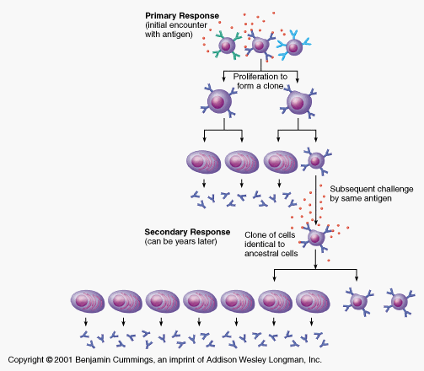
Immune response my be primary or secondary
Notes:
Antigen in the body, 2-recognition by B-cell 3- binding 4- activation of b cell 5- proliferation 6- differentiation into plasma cell and memory cells (primary immune response)
Secnd exposure to the same Ag, cloning of the b cell (memory cell) into more memory cells and much more plasma cells (secondary immune response that is larger and faster.

Slide 17
Primary immune response
When there is an attack with an antigen for the first time, activation of B-lymphocytes occur resulting in production of low amount of antibodies leading to destruction of the antigen.
This immune response takes time to develop. The body gets specific immune state which may last for years (y?).
Notes:
Low number of antibodies compaired to the secondary immune resonse)
Specific immune state (due to production of memory cells

Slide 18
Secondary immune response
When there is a second contact with the same antigen, there is a rapid activation of immune response and there is production of high amount of antibodies.
Rapid destruction of antigen occurs with no disease production.
Notes:
Rapid activation of immune response because of the memory cells present

Slide 19
https://www.khanacademy.org/science/biology/immunology/v/types-of-immune-responses-innate-and-adaptive-humoral-vs-cell-mediated
https://www.khanacademy.org/science/biology/immunology/v/b-lymphocytes-b-cells

