Slide 1


chapter 4
LECTURE
4
Protein and Exercise
Protein and Exercise
Dr Iftikhar Alam
Author name here for Edited books

Slide 2
Function & Classifications of Protein

Slide 3
Functional Roles of Protein
The three-dimensional shape and sequence of amino acids determine the functional role of a protein within the body
Proteins have many exercise-related roles:
  Building materials for bone, ligaments, tendons, muscles, and organs
  Enzymes that facilitate reactions associated with energy production & fuel utilization, as well as the building & repair of body tissues (esp. muscle)
  Hormones involved with energy metabolism

Slide 4
Functional Roles of Protein
Proteins have many exercise-related roles:
  Maintain fluid & electrolyte balance
  Maintain acid-base balance
  Transport proteins carry a number of substances such as micronutrients, drugs, and oxygen within the body and move nutrients into cells
  Can provide energy during and following exercise (esp. in low CHO and energy situations)

Slide 5
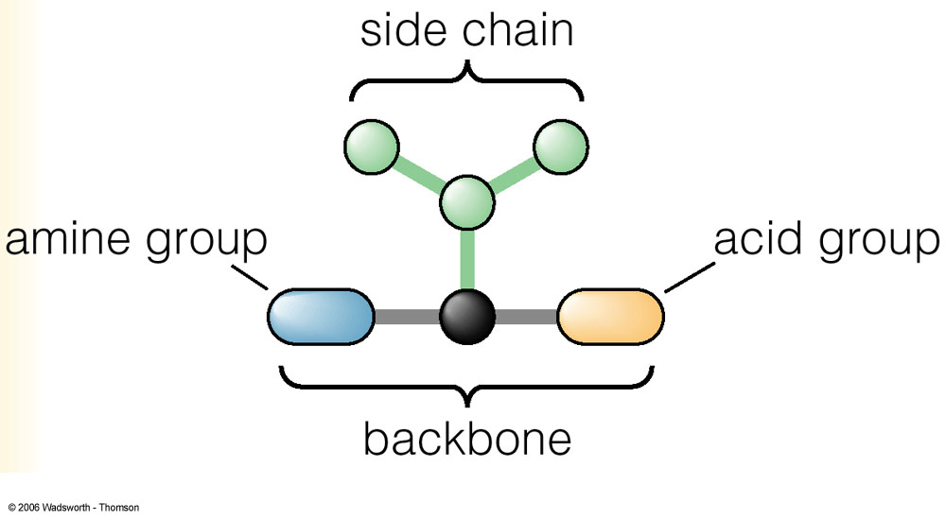
Special Characteristics of Protein
Proteins:
  C, H, O, N
  strands of amino acids
Breakdown of protein:
  Yields CO₂ + H₂O + N
The body does not store extra protein

Slide 6
Essential vs. Non-Essential Amino Acids
Essential (indispensable) amino acids:
  Must be consumed in the diet (9 total):
    Histidine
    Isoleucine
    Leucine
    Lysine
    Methionine
    Phenlalanine
    Threonine
    Tryptophan
    Valine

Slide 7
Essential vs. Non-Essential Amino Acids
Non-essential (dispensable) amino acids:
  Can be synthesized by the body (11 total):
    Alanine
    Arginine
    Asparagine
    Aspartic acid
    Cysteine
    Glutamic acid
    Glutamine
    Glycine
    Proline
    Serine
    Tyrosine

Slide 8
Nitrogen Balance
Nitrogen intake:
  Dietary protein: total protein intake (g/day) divided by 6.25 → grams of nitrogen/day
Nitrogen excretion:
  Urine: N-containing compounds (i.e. urea, creatine, ammonia, uric acid)
  Feces: undigested proteins, sloughed-off cells, bacteria within the gut
  Skin & Misc.: exfoliated dermal cells, nitrogen losses in blood, sweat, nails, hair, and semen

Slide 9
Dietary Sources of Protein

Slide 10
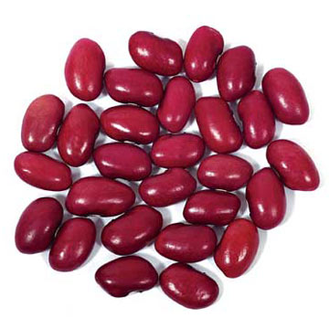
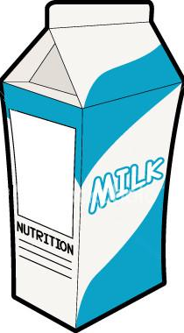


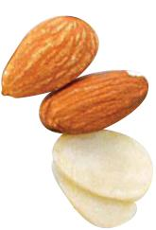
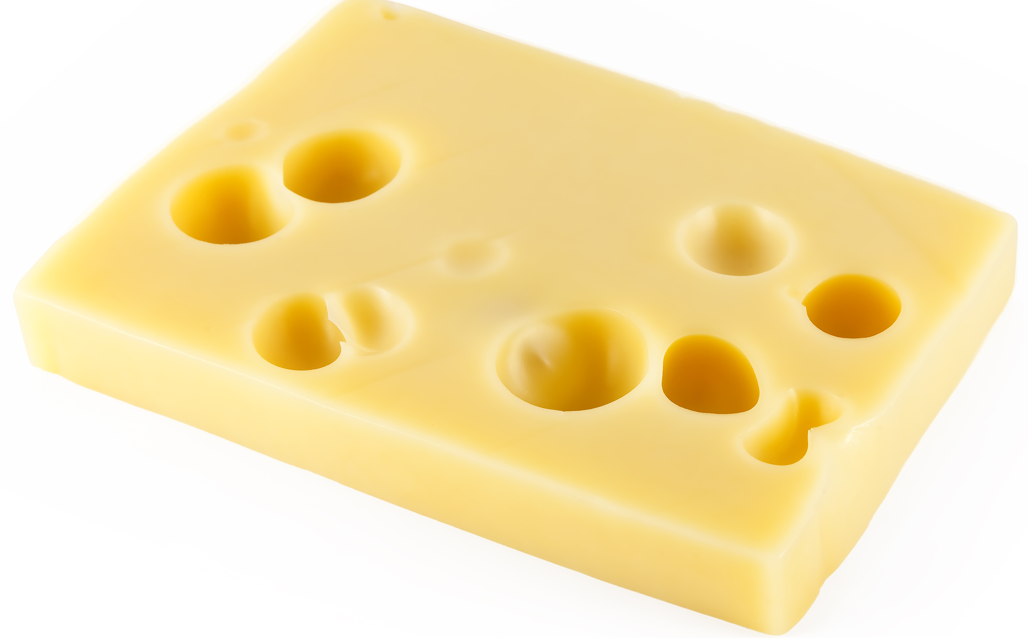
Dietary Sources of Protein
Protein is abundant in the Canadian diet
  Meat & dairy products contain high levels of protein
  Significant amount of dietary protein also comes from cereals, grains, nuts, and legumes

Slide 11
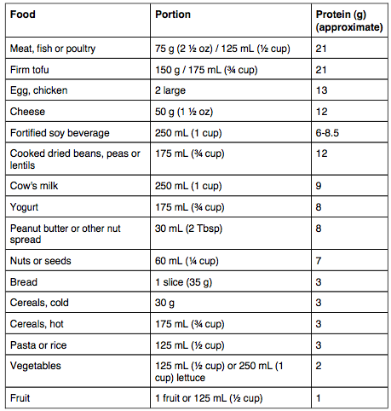

Dietary Sources of Protein

Slide 12
Protein Requirements & Protein Quality
Protein RDA: 0.8 g/kg for healthy adults
  Recommended that people who do not eat meat or dairy products consume more protein daily (0.9 g/kg)
Protein AMDR: 10-35% of kcal (IOM, 2005)
Protein quality: determined by both the amino acid content and the digestibility of the protein
  Proteins derived from plant foods are ~85% digestible
  Proteins from a mixed diet (meats, dairy, grains) are ~95% digestible

Slide 13
Protein Quality
Complete protein: “high quality proteins”
  A protein containing all of the essential amino acids in the correct quantity and ratio for humans, found only in a few animal foods
Incomplete protein: “lesser quality proteins”
  Any protein lacking one or more essential amino acids in correct proportions as necessary for good nutrition and health, true of many plant foods
    Grains: tend to lack lysine
    Legumes: tend to lack methionine

Slide 14
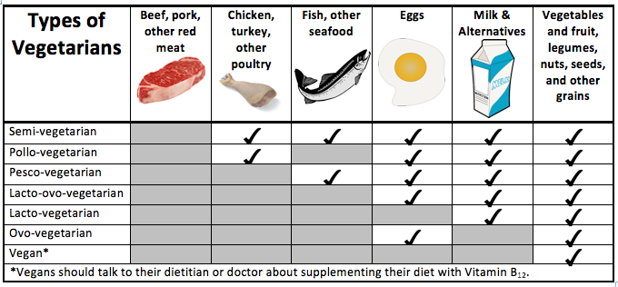
Vegetarian Athletes

Slide 15
Dietary Protein Recommendations for Active Individuals

Slide 16

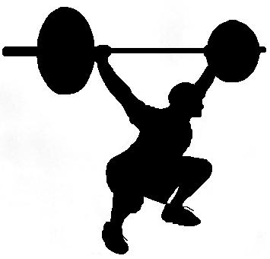
Protein Recommendations for Athletes
Endurance Athletes:
  1.2-1.4 g/kg BW per day
  Represents 1.5 to 1.75 times
  the current RDA
Strength Athletes:
  1.6-1.7 g/kg BW per day
  Represents 2.0 to 2.1 times
  the current RDA

Slide 17
Protein Intake of
Active People

Slide 18
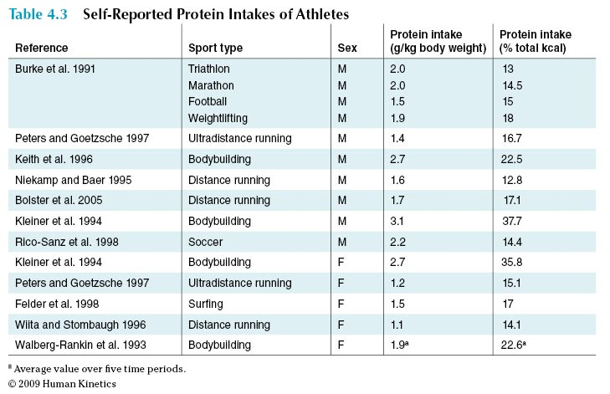
Table 4.3

Slide 19
Athletes at Risk for Low Protein Intake
Those athletes at risk for insufficient protein intake include:
  Female gymnasts
  Distance runners
  Figure skaters
  Dieting wrestlers
These athletes may compromise their protein intakes by consistently consuming too little energy (kcal)

Slide 20
Potential Adverse Effects of High Protein Diets
Excessively high protein diets may cause:
  Renal damage
  Increased urinary calcium excretion
  Increased serum lipoprotein levels and higher risk for heart disease
  Dehydration
  Possible toxicity from large doses of individual amino acids

Slide 21
Metabolism of Protein During & After Exercise

Slide 22
Protein Metabolism
During & After Exercise
Factors influencing protein metabolism:
  Exercise intensity
  Carbohydrate availability
  Type of exercise
  Energy intake
  Gender
  Training level
  Age

Slide 23
Type of Activity & Protein Metabolism
Resistance and endurance exercise rely on different energy systems for fuel
Resistance training:
  ATP & CP
  Anaerobic glycolysis
  Fatty acids & amino acids are not typical fuel sources
Endurance training: aerobic mechanisms to generate ATP
  Fuel sources include stored energy (CHO, fat, and to a lesser extent, protein)

Slide 24
Resistance Exercise
Strength training:
  For muscle to grow, rate of protein synthesis must exceed that of breakdown (anabolism)
  Resistance exercise provides the stimulus for muscle growth, due to the increase in muscle protein synthesis post-exercise
    Can last up to 48 hr after a resistance training session
  N balance studies suggest that strength athletes do require higher protein intakes to maintain N balance
  Recommended protein intake: 1.6-1.7 g/kg per day
    No further increase in protein synthesis occurs at protein intakes higher than 2.0 g/kg per day

Slide 25
Endurance Exercise
Endurance training:
  Protein oxidation increases during endurance exercise
  Protein contributes to energy production during & after exercise in the following ways:
    aa’s can become substrates for gluconeogenesis
    aa’s can be converted to Krebs cycle intermediates and contribute to acetyl-CoA oxidation
    aa’s can be oxidized directly in the muscles for energy
  Additional protein may also be required to repair any muscle damage caused by intense endurance training
  N balance studies suggest endurance athletes require 1.2 to 1.4 g/kg per day to support N balance

Slide 26

Energy & Carbohydrate Availability
When energy intake is not sufficient, there is an increase in the use of protein for energy-yielding functions rather than for the more preferred functional and structural roles of protein
CHO / glycogen availability directly relates to protein utilization during exercise
  Glycogen depletion (limited CHO
  stores): increase in the oxidation
  of amino acids for fuel during
  exercise

Slide 27

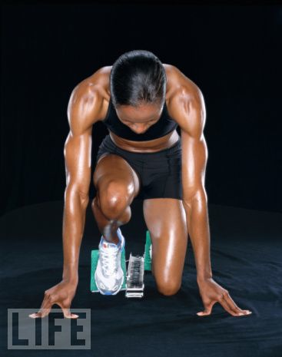
Gender Effects on Protein Metabolism
Majority of exercise studies
on protein utilization have
used male subjects
Evidence of gender differences in protein utilization in response to exercise
  Females rely to a greater extent on fat for fuel during exercise while oxidizing fewer amino acids and excreting less nitrogen than males

