Slide 1
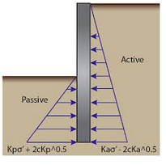
Geotechnical Engineering II
CE 481
5. Lateral Earth Pressure
Chapter 13
Omitted sections: 13.11, 13.13, 13.14

Slide 2
Topics
Introduction
Coefficient of Lateral Earth Pressure
Types and Conditions of Lateral Earth Pressures
Lateral Earth pressure Theories
Rankine’s Lateral Earth Pressure Theory
Lateral Earth Pressure Distribution – Cohesionless Soils
Lateral Earth Pressure Distribution – C – φ Soils
Coulomb’s Lateral Earth Pressure Theory

Slide 3
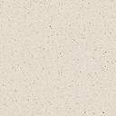

Introduction
Proper design and construction of many structures such as:
Retaining walls (basements walls, highways and railroads, platforms, landscaping, and erosion controls)
Braced excavations
Anchored bulkheads
Grain pressure on silo walls and bins
require a thorough knowledge of the lateral forces that act between the retaining structures and the soil masses being retained.
Tie rod
Anchor
Sheet pile
Cantilever retaining wall
Braced excavation
Anchored sheet pile

Slide 4
These lateral forces are caused by lateral earth pressure.
We have to estimate the lateral soil pressures acting on these structures, to be able to design them.
The magnitude and distribution of lateral earth pressure depends on many factors, such as:
The shear strength parameters of the soil being retained,
The inclination of the surface of the backfill,
The height and inclination of the retaining wall at the wall–backfill interface,
The nature of wall movement under lateral pressure,
The adhesion and friction angle at the wall–backfill interface.

Slide 5
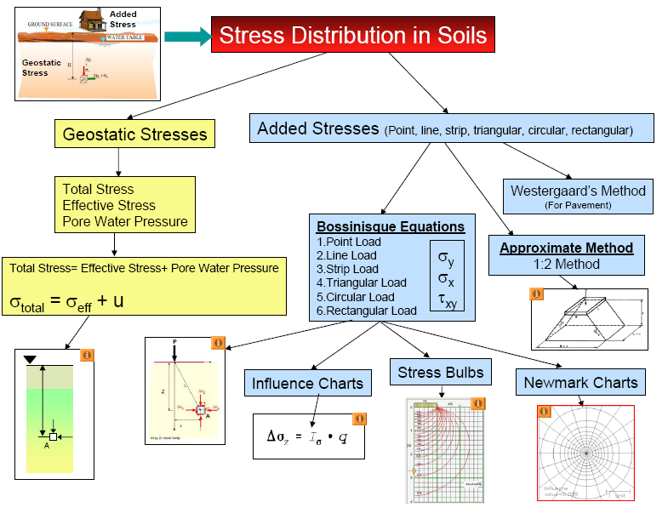
Extra

Slide 6
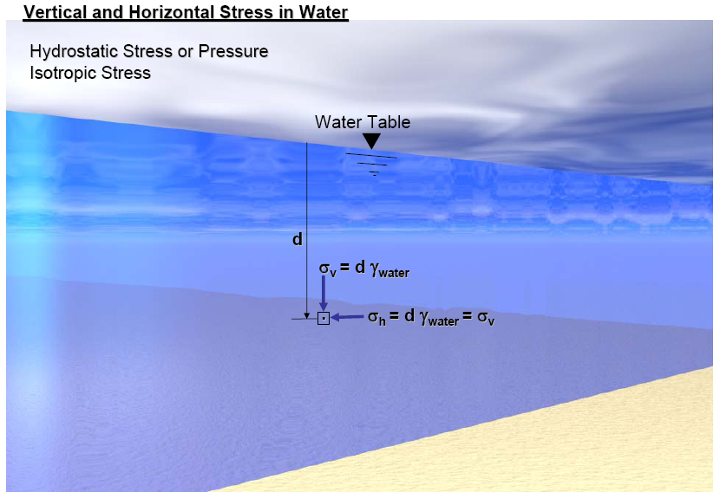

Slide 7
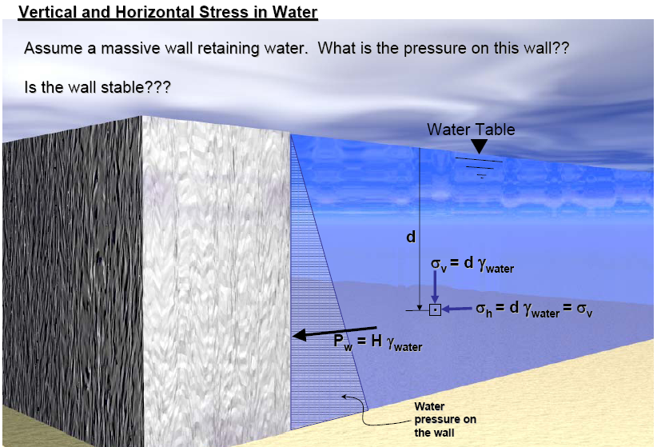

Slide 8
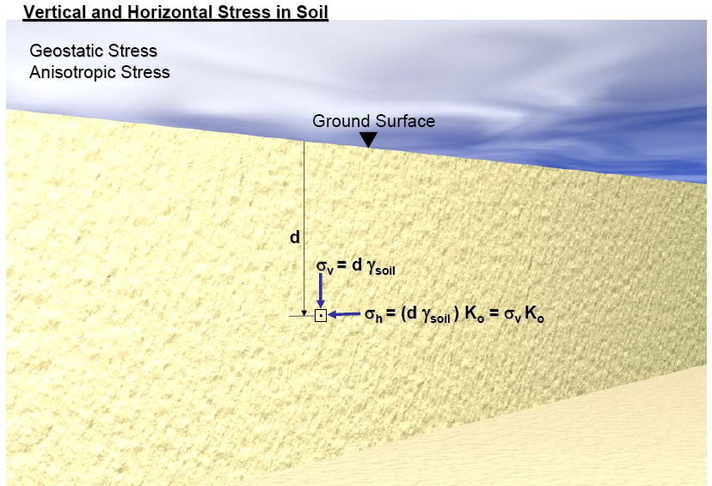
σ_{h} = K (d γ_{soil}) = K σ_{v}
Coefficient of lateral earth pressure

Slide 9
Topics
Introduction
Coefficient of Lateral Earth Pressure
Types and Conditions of Lateral Earth Pressures
Lateral Earth pressure Theories
Rankine’s Lateral Earth Pressure Theory
Lateral Earth Pressure Distribution – Cohesionless Soils
Lateral Earth Pressure Distribution – C – φ Soils
Coulomb’s Lateral Earth Pressure Theory

Slide 10
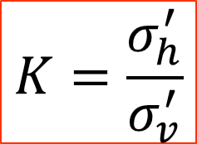
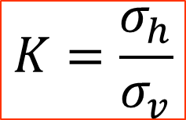
Coefficient of Lateral Earth Pressure
In a homogeneous natural soil deposit,
GL
σ’_{v}
σ’_{h}
X
The ratio σ_{h}’/σ_{v}’ is a constant known as coefficient of lateral earth pressure.
In other words, it is the ratio of the effective horizontal stress (σ_{h}’) to the effective vertical stress (σ_{v}’); then
$$K=\frac{σ_{h}^{′}}{σ_{v}^{′}}$$
$$K=\frac{σ_{h}}{σ_{v}}$$
Or in terms of total stresses
All in subsequent derivation we use total stress, in the text book the effective stress, treatment is the same.

Slide 11
Topics
Introduction
Coefficient of Lateral Earth Pressure
Types and Conditions of Lateral Earth Pressures
Lateral Earth pressure Theories
Rankine’s Lateral Earth Pressure Theory
Lateral Earth Pressure Distribution – Cohesionless Soils
Lateral Earth Pressure Distribution – C – φ Soils
Coulomb’s Lateral Earth Pressure Theory

Slide 12

CASES OF LATERAL EARTH PRESSURE
Three possible cases may arise concerning the retaining wall; they are described as follows:
Case 1 If the wall AB is static—that is, if it does not move either to the right or to the left of its initial position—the soil mass will be in a state of static equilibrium. In that case, σ_{h} is referred to as the at-rest earth pressure.
This is also the case before construction. The soil in the field by itself with no external loads.
A
Unit weight of soil = γ
Ratio of horizontal stress to vertical stress is called coefficient of earth pressure at-rest, K_{o}, or
z
σ_{v}
σ_{h} = K_{o} σ_{v}
AB is a frictionless
wall that extends to an infinite depth
B
where Ko at-rest earth pressure coefficient.
Earth pressure at-rest

Slide 13
Coefficient of lateral earth pressure at-rest, K₀
K₀ = 1 – sin φ’ (Jaky formula)
Gives good results when the backfill is loose sand.
For a dense, compacted sand backfill, may grossly underestimate the lateral earth pressure at rest.
For normally consolidated clays, K₀ = 0.95 – sin φ’
From elastic analysis,
Fine-grained soils

Slide 14
Distribution of Lateral Earth Pressure at Rest on a Wall
The total force per unit length of the wall, Po
P₀ for Partially Submerged Soil
=
+

Slide 15
Example 13.1
32.92
4.5
7.58
5.69
92.75

Slide 16
Case 2: If the frictionless wall rotates sufficiently about its bottom to a position of A’B, then a triangular soil mass ABC’ adjacent to the wall will reach a state of plastic equilibrium and will fail sliding down the plane BC’.
Equally if wall AB is allowed to move away from the soil mass gradually, horizontal stress will decrease, and the shearing resistance of the soil is mobilized.
In this case the soil is the ACTUATING ELEMENT
Plastic equilibrium in soil refers to the condition where every point in a soil mass is on the verge of failure.
A
Unit weight of soil = γ
z
σ_{v}
σ_{h}
Rotation
Translation
K_{a} = Coefficient of active earth pressure
B

Slide 17
Case 3 :If the frictionless wall rotates sufficiently about its bottom to a position of A’B’’ then a triangular soil mass ABC’’ adjacent to the wall will reach a state of plastic equilibrium and will fail sliding upward the plane BC’’.
If the wall is pushed into the soil mass, σ_{h} will increase and the shearing resistance of the soil is mobilized.
In this case the retaining wall is the ACTUATING ELEMENT and the soil provided the resistance for maintaining stability
The lateral earth pressure, σ_{h,} is called passive earth pressure
A
K_{p} = coefficient of passive earth pressure
z
σ_{v}
σ_{h}
Translation
Unit weight of soil = γ
Rotation
B

Slide 18
CASES
At-Rest
Active
Passive

Slide 19
Note on Active and Passive
If the lateral strain in the soil is ZERO the corresponding lateral pressure is called the earth pressure at-rest. This is the case before construction.
In the case of active case the soil is the actuating element and in the case of passive the wall is the actuating element.
For either the active or passive states to develop, the wall must MOVE. If the wall does not move, an intermediate stress state exists called earth pressure at rest. (i.e. zero lateral strain).
For greatest economy, retaining structures are designed only sufficiently strong to resist ACTIVE PRESSURE. They therefore must be allowed to move.
It may at first seem unlikely that a wall ever would be built to PUSH into the soil and mobilize passive earth pressure.

Slide 20
Active
Wedge
Passive
Wedge
Typically passive earth pressure is developed by anchor plates or blocks, embedded in the soil and where the anchor rod or cable tension pulls the anchor into/against the soil to develop passive resistance. Walls are seldom designed for passive pressure.
In most retaining walls of limited height, movement may occur by simple translation or, more frequently, by rotation about the bottom.

Slide 21
Variation of the Magnitude of Lateral Earth Pressure with Wall Tilt
For the active and passive (Rankine cases), a sufficient yielding of the wall is necessary for a state of plastic equilibrium to exist.
ΔL_{a}
ΔL_{p}
H
Earth Pressure, σ_{h}
Passive earth pressure, σ_{p}
Passive state
Movement could be either rotation or also occur by simple translation.
Active state
K₀ state
active earth pressure, σ_{a}
ΔL_{a}/H
ΔL_{p}/H
Wall Tilt

Slide 22
Notes
Active or passive condition will only be reached if the wall is allowed to yield sufficiently. The amount of wall necessary depends on:-
Soil type (sand vs. clay)
Soil density (Loose vs. dense)
Pressure (Active vs. passive)

Slide 23
Topics
Introduction
Coefficient of Lateral Earth Pressure
Types and Conditions of Lateral Earth Pressures
Lateral Earth pressure Theories
Rankine’s Lateral Earth Pressure Theory
Lateral Earth Pressure Distribution – Cohesionless Soils
Lateral Earth Pressure Distribution – C – φ Soils
Coulomb’s Lateral Earth Pressure Theory

Slide 24
Lateral Earth Pressure Theories
Since late 17th century many theories of earth of earth pressure have been proposed by various investigators. Of the theories the following two are the most popular and used for computation of active and passive earth pressures:.
Rankine’s Theory (No wall friction)
Coulomb’s Theory (With wall friction)
Those are usually called the classical lateral earth pressure theories.
In both theories it is required that the soil mass, or at least certain parts of the mass, is in a state of PLASTIC EQUILIBRIUM. The soil mass is on verge of failure. Failure here is defined to be the state of stress which satisfies the Mohr-Coulomb criterion.

Slide 25
Topics
Introduction
Coefficient of Lateral Earth Pressure
Types and Conditions of Lateral Earth Pressures
Lateral Earth pressure Theories
Rankine’s Lateral Earth Pressure Theory
Lateral Earth Pressure Distribution – Cohesionless Soils
Lateral Earth Pressure Distribution – C – φ Soils
Coulomb’s Lateral Earth Pressure Theory

Slide 26
Rankine’s Earth Pressure Theory
Rankine (1857) investigated the stress condition in a soil at a state of PLASTIC EQUILIBRIUM.
Developed based on semi infinite “loose granular” soil mass for which the soil movement is uniform.
Used stress states of soil mass to determine lateral pressures on a frictionless wall
Assumptions:
Vertical wall
Smooth retaining wall
Horizontal ground surface
Homogeneous soil

Slide 27
Active vs. Passive Earth Pressures
Wall moves away from soil
A
Wall moves towards soil
B
smooth wall
Let’s look at the soil elements A and B during the wall movement.
In most retaining walls of limited height, movement may occur by simple translation or, more frequently, by rotation about the bottom.

Slide 28
Granular soils (C = 0)
I. Active earth pressure
σ_{v} = γz
Initially, there is no lateral movement.
∴σ_{h} = K₀ σ_{v} = K₀ γz
As the wall moves away from the soil,
σ_{v} remains the same; and
Active state
σ_{h} decreases till failure occurs.
σ_{a}
σ_{h}
σ_{v}
z
σ_{h}
K₀ state
σ_{h}
A
Active state
wall movement

Slide 29

As the wall moves away from the soil,
τ
failure envelope
Initially (K₀ state)
Failure (Active state)
σ_{a}
σ_{v}
σ
active earth pressure
Decreasing σ_{h}
At-rest earth pressure
$$σ_{a}={K_{a}σ}_{v}$$

Slide 30





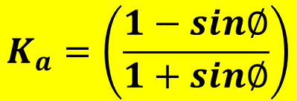
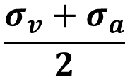

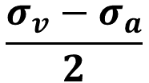
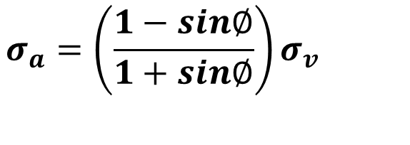
How do we get the expression for K_{a} ?
$$\frac{σ_{v}−σ_{a}}{2}$$
$$Sin ∅=$$
$$\frac{σ_{v}+σ_{a}}{2}$$
τ
Mohr Circle at failure
$$σ_{a}={\left(\frac{1−sin∅}{1+sin∅}\right)σ}_{v}$$
failure envelope
$$σ_{a}={K_{a}σ}_{v}$$
$$K_{a}=\left(\frac{1−sin∅}{1+sin∅}\right)$$
$$\frac{σ_{v}−σ_{a}}{2}$$
φ
$$σ_{a}$$
$$σ_{v}$$
σ
$$\frac{σ_{a}+σ_{v}}{2}$$
Rankine’s coefficient of active earth pressure

Slide 31


Failure plane
τ
Failure plane is at
45 + φ/2 to horizontal
σ_{v}
failure envelope
σ_{a}
45 + ϕ/2
A
φ
45+ϕ/2
$$σ_{a}$$
σ
$$σ_{v}$$

Slide 32
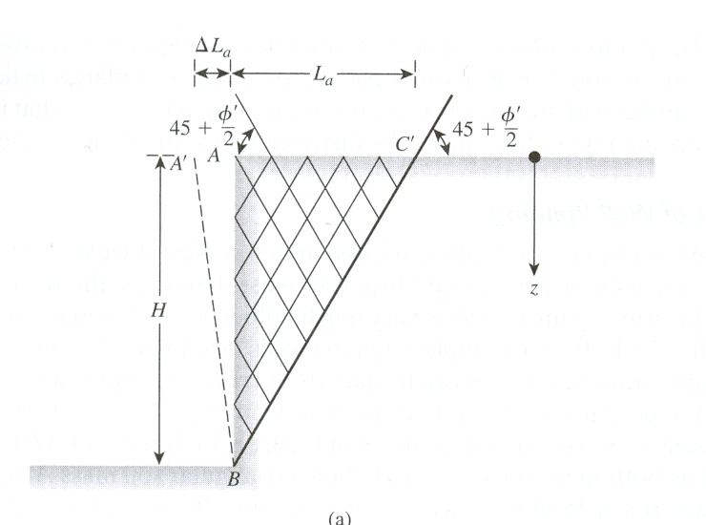
Orientation of Failure Planes
From Mohr Circle the failure planes in the soil make ± (45 + φ/2)-degree angles with the direction of the major principal plane—that is, the horizontal.
These are called potential slip planes.
The distribution of slip planes in the soil mass.
Sliding surface
(45 + φ/2)
Because the slip planes make angles of (45 + φ/2) degrees with the major principal plane, the soil mass in the state of plastic equilibrium is bounded by the plane BC’. The soil inside the zone ABC’ undergoes the same unit deformation in the horizontal direction everywhere, which is equal to ΔL_{a}/L_{a}.

Slide 33
Why two sets of failure planes?

Slide 34
Granular soils (C = 0)
II. Passive earth pressure
Initially, soil is in K₀ state.
As the wall moves towards (pushed into) the soil mass,
σ_{v} remains the same, and
Passive state
σ_{h} increases till failure occurs.
σ_{p}
σ_{h}
σ_{h}
Passive state
σ_{v}
σ_{h}
B
K₀ state
wall movement

Slide 35
As the wall moves towards the soil,
τ
Initially (K₀ state)
Failure (Passive state)
Rankine’s passive state
failure envelope
σ_{v}
σ_{p}
σ
At-rest earth pressure
increasing σ_{h}
passive earth pressure

Slide 36


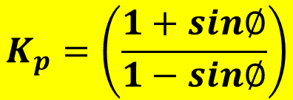
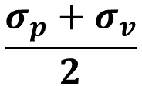

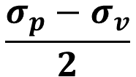
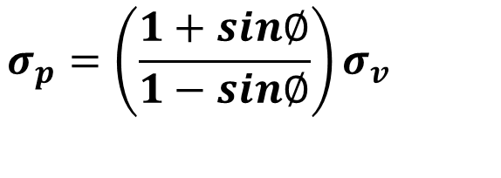


How do we get the expression for K_{P} ????
$$\frac{σ_{p}−σ_{v}}{2}$$
$$Sin ∅=$$
$$\frac{σ_{p}+σ_{v}}{2}$$
τ
$$σ_{p}={\left(\frac{1+sin∅}{1−sin∅}\right)σ}_{v}$$
failure envelope
$$σ_{p}={K_{p}σ}_{v}$$
$$\frac{σ_{p}−σ_{v}}{2}$$
$$K_{p}=\left(\frac{1+sin∅}{1−sin∅}\right)$$
φ
$$σ_{v}$$
$$σ_{p}$$
σ
$$\frac{σ_{p}+σ_{v}}{2}$$
Rankine’s coefficient of passive earth pressure

Slide 37
Failure plane
τ
Failure plane is at
45 - φ/2 to horizontal
σ_{v}
failure envelope
σ_{p}
45 - φ/2
B
φ
90+φ
σ_{v}
σ_{p}
σ

Slide 38
Orientation of Failure Planes
From Mohr Circle the failure planes in the soil make ± (45 - φ/2)-degree angles with the direction of the major principal plane—that is, the horizontal.
These are called potential slip planes.
(45 - φ/2)
Because the slip planes make angles of (45 - φ/2) degrees with the major principal plane, the soil mass in the state of plastic equilibrium is bounded by the plane BC’. The soil inside the zone ABC’’ undergoes the same unit deformation in the horizontal direction everywhere, which is equal to ΔL_{p}/L_{’p}.

Slide 39






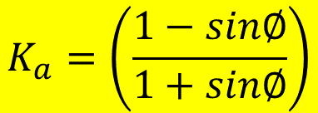







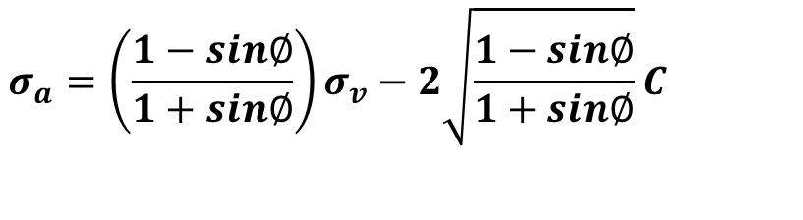
C – φ Soils
I. Active earth pressure
τ
τ
failure envelope
$$\frac{σ_{v}−σ_{h}}{2}$$
$$σ_{a}$$
$$σ_{h}$$
$$σ_{v}$$
φ
C
$$σ_{a}$$
$$σ_{v}$$
σ
$$\frac{σ_{v}+σ_{a}}{2}$$
σ
Active earth pressure
At-rest earth pressure
$$C.Cot ∅$$
$$\frac{σ_{v}−σ_{a}}{2}$$
$$Sin ∅=$$
$C.Cot ∅$ +
$$\frac{σ_{v}+σ_{a}}{2}$$
$$σ_{a}={\left(\frac{1−sin∅}{1+sin∅}\right)σ}_{v}−2\sqrt{\frac{1−sin∅}{1+sin∅}}C$$
$$σ_{a}={K_{a}σ}_{v}−2\sqrt{K_{a}}C$$
$$K_{a}=\left(\frac{1−sin∅}{1+sin∅}\right)$$

Slide 40



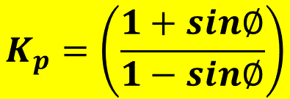

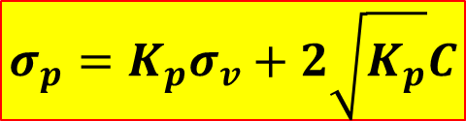


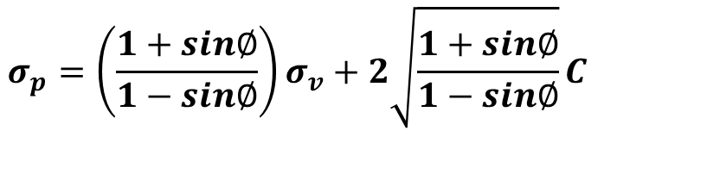


C – φ Soils
τ
II. Passive earth pressure
failure envelope
τ
Initially (K₀ state)
Failure (Active state)
$$\frac{σ_{p}−σ_{v}}{2}$$
failure envelope
φ
C
$$σ_{v}$$
$$σ_{p}$$
σ
$$\frac{σ_{p}+σ_{v}}{2}$$
$$C.Cot ∅$$
$$\frac{σ_{p}−σ_{v}}{2}$$
σ_{p}
$$Sin ∅=$$
$C.Cot ∅$ +
$$\frac{σ_{p}+σ_{v}}{2}$$
σ_{v}
σ
At-rest earth pressure
increasing σ_{h}
$$σ_{p}={\left(\frac{1+sin∅}{1−sin∅}\right)σ}_{v}+2\sqrt{\frac{1+sin∅}{1−sin∅}}C$$
passive earth pressure
$$σ_{p}={K_{p}σ}_{v}+2\sqrt{K_{p}}C$$
$$K_{p}=\left(\frac{1+sin∅}{1−sin∅}\right)$$

Slide 41
Notes
Expression for K_{a} and K_{p} are found theoretically using Rankine’s theory or as we see later from Coulomb Theory. However, K₀ is evaluated only empirically. Therefore, the difficulty for at rest is in the evaluation of K₀.
For active and passive the soil has reached limit state and we apply the failure theory. However, at-rest we could not figure out what exactly is the case of the soil.
Since the at-rest condition does not involve failure of the soil (it represents a state of elastic equilibrium) the Mohr circle representing the vertical and horizontal stresses does not touch the failure envelope and the horizontal stress cannot be evaluated.

Slide 42
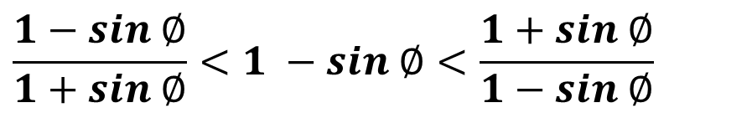
Notes (cont)
What also complicate at-rest condition is the fact that K₀ is not constant but rather change with time.
K₀ is very sensitive to the geologic and engineering stress history. It can be as low as 0.4 or 0.5 for sedimentary deposits that have never been preloaded or up to 3.0 or greater for some very heavily preloaded deposits.
K_{a} and K_{p} are function only of φ. C has no effect on them.
K_{a} < K₀ < K_{p}
$$\frac{1−sin ∅}{1+sin ∅}<1 −sin ∅<\frac{1+sin ∅}{1−sin ∅}$$

Slide 43
Topics
Introduction
Coefficient of Lateral Earth Pressure
Types and Conditions of Lateral Earth Pressures
Lateral Earth pressure Theories
Rankine’s Lateral Earth Pressure Theory
Lateral Earth Pressure Distribution – Cohesionless Soils
Lateral Earth Pressure Distribution – C – φ Soils
Coulomb’s Lateral Earth Pressure Theory

Slide 44
Earth Pressure Distribution
I. Cohesionless soils (C=0)
1. Horizontal Ground Surface
1
Active Case:
The total Lateral Earth Active force per unit length of the wall (P_{a} )
= Area of Earth pressure diagram
= ½ x K_{a} x γ x H²
Point of application of P_{a}
H/3 from the base
σ_{v}
Η
σ_{h}
P_{a}
H/3
2
K_{a} γ H

Slide 45
1. Horizontal Ground Surface
1
Passive Case:
The total Lateral Earth Passive force per unit length of the wall (P_{p} )
= Area of Earth pressure diagram
= ½ x K_{p} x γ x H²
Point of application of P_{p}
H/3 from the base
σ_{v}
γ
_{φ}
Η
σ_{h}
P_{p}
H/3
2
K_{p} γ H
The total lateral passive force per unit length of the wall is the area of the diagram

Slide 46
2. Effect of Surcharge
Active Case:
P_{a1} = ½ x K_{a} x γ x H²
P_{a2} = K_{a} x q x H
The resultant Force acting on the wall
R_{a} = P_{a1} + P_{a2}
Point of application of Resultant
q (kN/m²)
1
σ_{v}
P_{a2}
Η
Ra
H/2
P_{a1}
H/3
Z
2
Ka(q+ γ H)

Slide 47
2. Effect of Surcharge
Passive Case:
Pp₁ = ½ x K_{p} x γ x H²
Pp₂ = K_{p} x q x H
The resultant Force acting on the wall
R_{p} = P_{p1} + P_{p2}
Point of application of Resultant
q (kN/m²)
2
σ_{v}
Pp₂
Η
R_{p}
H/2
Pp₁
H/3
Z
2
K_{p} (q + γ H)

Slide 48
3. Effect of G.W.T
Active Case:
P_{a1} = ½ x K_{a} x γ x H₁²
P_{a2} = K_{a} x γ x H₁ x H₂
P_{a3} = ½ x K_{a} x γ_{sub} x H₂²
P_{w} = ½ x γ_{w} x H₂²
The resultant Force acting on the wall
R_{a} = P_{a1} + P_{a2} + P_{a3} + P_{w}
Η₁
γ
_{φ ’}
Pa₁
K_{a} γ H₁
H₁/3
GWT
Ra
Η₂
γ_{sat}
_{φ ’}
Pa₂
Z
Pa₃
P_{w}
H₂/3
K_{a}(γ H₁ + γ_{sub} H₂)
γ_{w}H₂
Point of application of Resultant
The presence of water will have two effects:
The use of effective unit weight when calculating the lateral pressure for the given submerged soil.
In addition to the lateral force for the soil we add P_{w}.
The effect of water is the same for at-rest, active, or passive.

Slide 49
3. Effect of G.W.T
Passive Case:
Same as before except K_{a} is replaced with K_{p}
Η₁
γ
_{φ ’}
Pp₁
K_{p} γ H₁
H₁/3
GWT
R_{p}
γ_{sat}
_{φ ’}
Η₂
Pp₂
Z
Pp₃
P_{w}
H₂/3
K_{p}(γ H₁ + γ_{sub} H₂)
γ_{water} H₂

Slide 50
4. Layered Profile
Active Case:
Because of different φ, the upper and lower layer will have different lateral earth coefficients.
P_{a1} = ½ x K_{a1} x γ₁ x H₁²
P_{a2} = K_{a2} x γ₁ x H₁ X H₂
P_{a3} = ½ x K_{a2} x γ₂ x H₂²
The Resultant Force acting on the wall
R_{a} = P_{a1} + P_{a2} + P_{a3}
Η₁
Pa₁
γ₁
φ₁ ’
K_{a1} γ₁ H₁
K_{a2} γ₁ H₁
γ₂
φ₂ ’
Η₂
Pa₂
Pa₃
K_{a2} (γ₁ H₁ + γ₂ H₂)

Slide 51
4. Layered Profile
Passive Case:
Same as before except K_{a} is replaced with K_{p}
Η₁
Pp₁
γ₁
φ₁ ’
K_{p1} γ₁ H₁
K_{p2} γ₁ H₁
γ₂
φ₂ ’
Η₂
Pp₂
Pp₃
K_{p2}(γ₁ H₁ + γ₂ H₂)

Slide 52
5. Combination of all these cases
Surcharge + Layered profile
Surcharge + G.W.T
Layered profile + G.W.T
Etc.
Surcharge + Layered profile + G.W.T.
Add P_{w}
Use γ’
Constant with depth
Interface

Slide 53
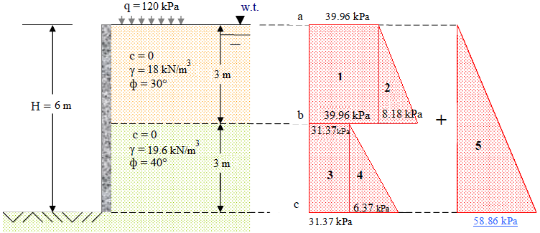
Example 1:
Draw the pressure diagram on the wall in an active pressure condition, and find the total resultant F on the wall and its location with respect to the bottom of the wall.
=(39.96+8.18)/0.333x0.217
=0.333x(18-9.81)x3
K_{a1} = 0.333
=0.217x(19.6-9.81)x3
K_{a2} = 0.217

Slide 54
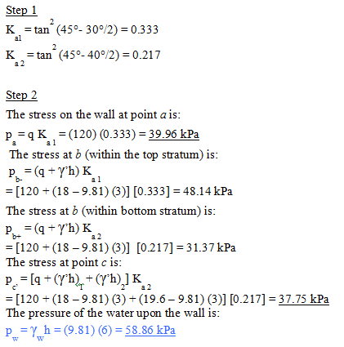

Slide 55
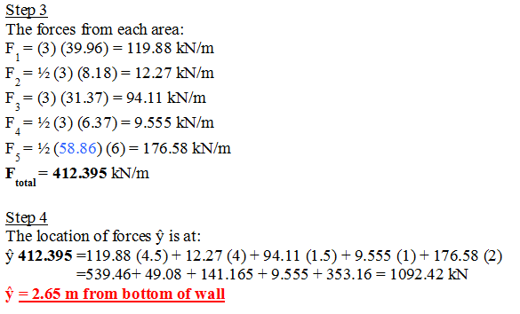

Slide 56
Notes
The distribution of lateral pressure will be one triangle (no bends) if:
K is the same for all layers behind the wall.
No water or water is at the surface.
The same γ
If we have K₀ (or even K_{a} and K_{p}) different, then we calculate the lateral pressure at the interface of the two layers twice. First we use K of the upper layer then K of the lower layer. In both we have the same s_{v}, but since K is different we will have two different lateral pressures.
Since there can be no lateral transfer of weight if the surface is horizontal no shear stresses exist on horizontal and vertical planes. The vertical and horizontal stresses, therefore are principal stresses.
Rankine’s theory overestimates active pressure and underestimates passive pressure because it assumes frictionless wall.

Slide 57
Topics
Introduction
Coefficient of Lateral Earth Pressure
Types and Conditions of Lateral Earth Pressures
Lateral Earth pressure Theories
Rankine’s Lateral Earth Pressure Theory
Lateral Earth Pressure Distribution – Cohesionless Soils
Lateral Earth Pressure Distribution – C – φ Soils
Coulomb’s Lateral Earth Pressure Theory

Slide 58



ii. C- φ Soils
Earth Pressure Distribution
Active Case:
z_{o} = depth of tension crack
= it is the depth at which active lateral earth pressure is zero
Earth Pressure force (P_{a} )
= Area of Earth pressure diagram
For φ = 0 K_{a} = 1
Point of application of P_{a}
(H-z_{o})/3 from the base
1. Horizontal Ground Surface
z_{o}
Η
P_{a} = $\frac{1}{2}{\left(Kaγ\text{H} \text{−}2C\sqrt{K_{a}}\right)(H−z0)}_{}$
H-z_{o}
P_{a}
P_{a} = $\frac{1}{2}{\left(γ\text{H} \text{−}2C\right)(H−z0)}_{}$
2
$$\left(Kaγ\text{H}\text{−}2C\sqrt{K_{a}}\right)$$

Slide 59
For calculation of the total active force, common practice is to take the tensile cracks into account. However, if it is not taken then:
-
=

Slide 60
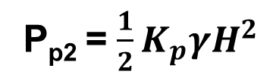
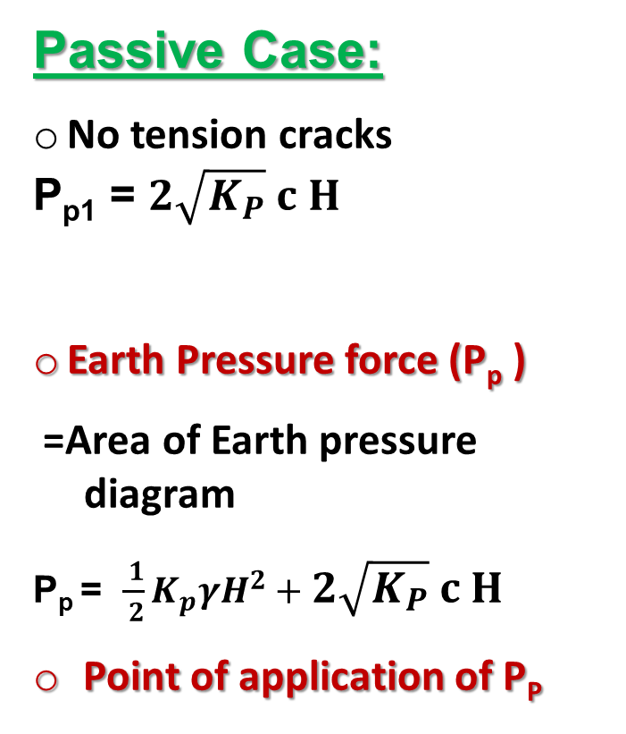
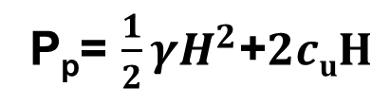
Passive Case:
No tension cracks
P_{p1} = $2\sqrt{K_{P}} c H$
Earth Pressure force (P_{p} )
=Area of Earth pressure diagram
P_{p} = $\frac{ 1}{ 2}K_{p}γH^{2}+2\sqrt{K_{P}} c H$
Point of application of P_{P}
2. Horizontal Ground Surface
P_{p2} = $\frac{1}{2}K_{p}γH^{2}$
P_{p1}
Η
P_{p2}
As done before take moment at the base
For φ = 0, K_{p} = 1, c =c_{u}
P_{p}= $\frac{1}{2}γH^{2}$+$2cuH$

Slide 61

Example 3: 2nd Midterm Exam-Fall 36-37 QUESTION #3
The soil conditions adjacent to a sheet pile wall are given in Fig. 1 below. A surcharge pressure of 50 kN/m² being carried on the surface behind the wall. For soil 1, a sand above the water table, c′ = 0 kN/m² and φ′ = 38º and ɣ = 18 KN/m³. For soil 2, a saturated clay, c′ = 10 kN/m² and φ′ = 28º and ɣ_{sat} = 20 KN/m³.
Calculate K_{a} and K_{p} for each of soils (1) and (2).
Complete the given table for the Rankine active pressure at 6 and 9 m depth behind the behind the wall shown in Fig.1.
Complete the given table for the Rankine passive pressure at 1.5 and 4.5 m depth in front of the wall shown in Fig.1.
q= 50 kN/m² kN/m²
SOLUTION
Soil 1: K_{a} = (1-sin 38)/(1+sin 38) = 0.24
K_{p} = 1/K_{a} = 4.17
Soil (1)
6.0 m
Soil 2: K_{a} = (1-sin 28)/1+sin 28) = 0.36
K_{p} = 1/K_{a} = 2.78
1.5 m
W.T
Soil (2)
3.0 m
Passive
Fig.1
Active

Slide 62
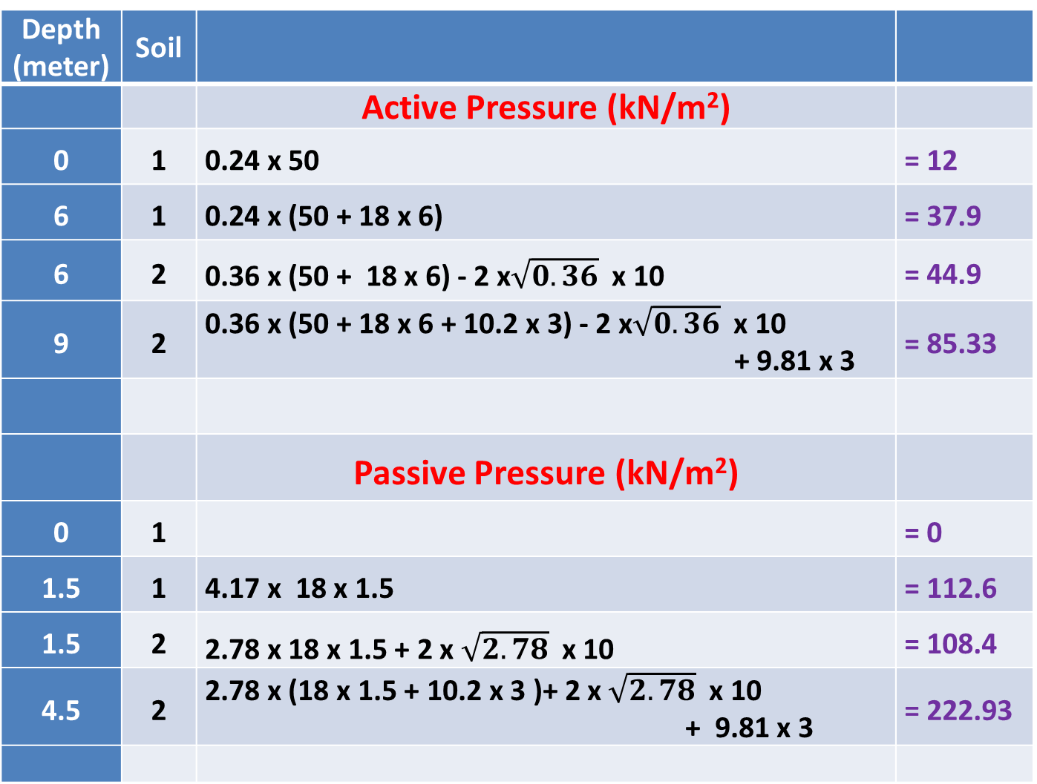
Table 1. Active and passive earth pressures on sheet pile wall shown in Fig. 1.
Depth (meter) | Soil
 |  | Active Pressure (kN/m²)
0 | 1 | 0.24 x 50 | = 12
6 | 1 | 0.24 x (50 + 18 x 6) | = 37.9
6 | 2 | 0.36 x (50 + 18 x 6) - 2 x$\sqrt{0.36}$x 10 | = 44.9
9 | 2 | 0.36 x (50 + 18 x 6 + 10.2 x 3) - 2 x$\sqrt{0.36}$x 10 + 9.81 x 3 | = 85.33
 |  | Passive Pressure (kN/m²)
0 | 1 |  | = 0
1.5 | 1 | 4.17 x 18 x 1.5 | = 112.6
1.5 | 2 | 2.78 x 18 x 1.5 + 2 x $\sqrt{2.78}$x 10 | = 108.4
4.5 | 2 | 2.78 x (18 x 1.5 + 10.2 x 3 )+ 2 x$\sqrt{2.78}$x 10 + 9.81 x 3 | = 222.93

Slide 63
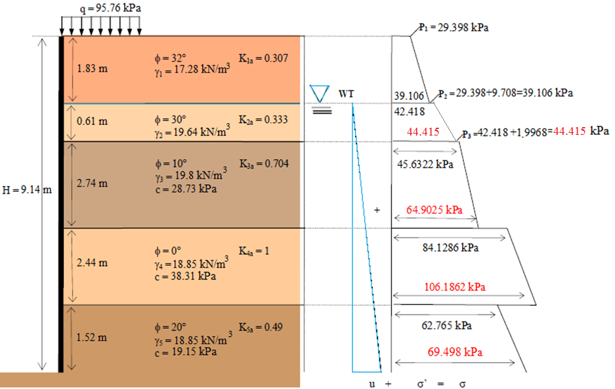
Example 3:
Plot the Rankine pressure diagram and find the resultant force F and its location under an active pressure condition.

Slide 64
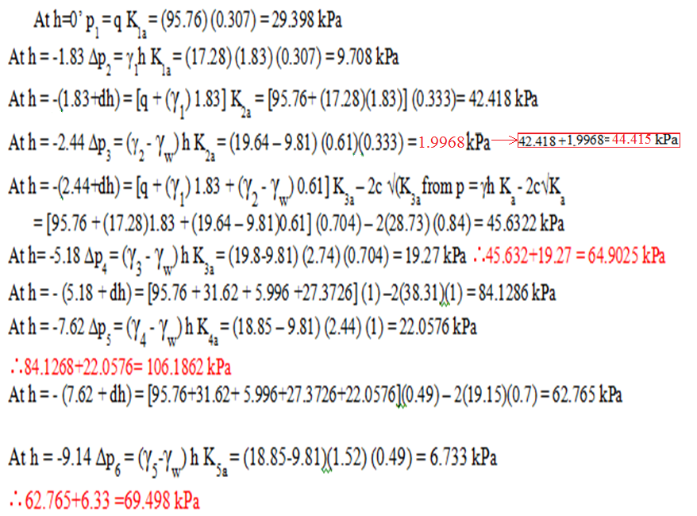

Slide 66
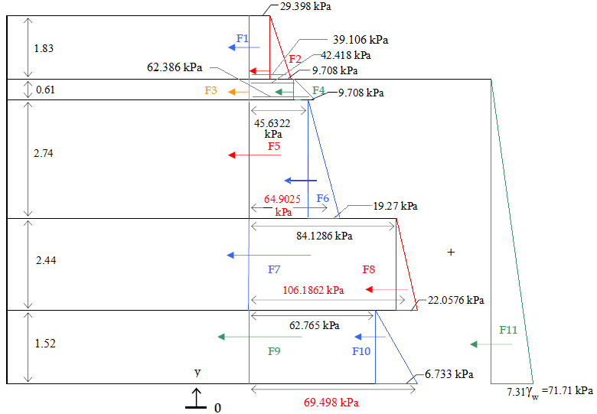

Slide 67
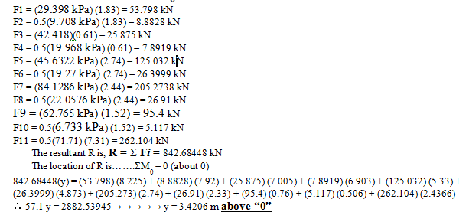

Slide 68
Recommended Procedure
Calculate the appropriate k for each soil
Calculate σ_{V} at a specified depth
Add q if any
Multiply the sum of σ_{V +} q by the appropriate k (for upper and lower soil) and subtract (or add for passive) cohesion part if exists.
Calculate water pressure
Divide each trapezoidal area into a rectangle and a triangle
Calculate areas and that give the lateral forces
Locate point of application for each force
Find the resultant force
Take moments about the base of the wall and find location of the resultant

Slide 69
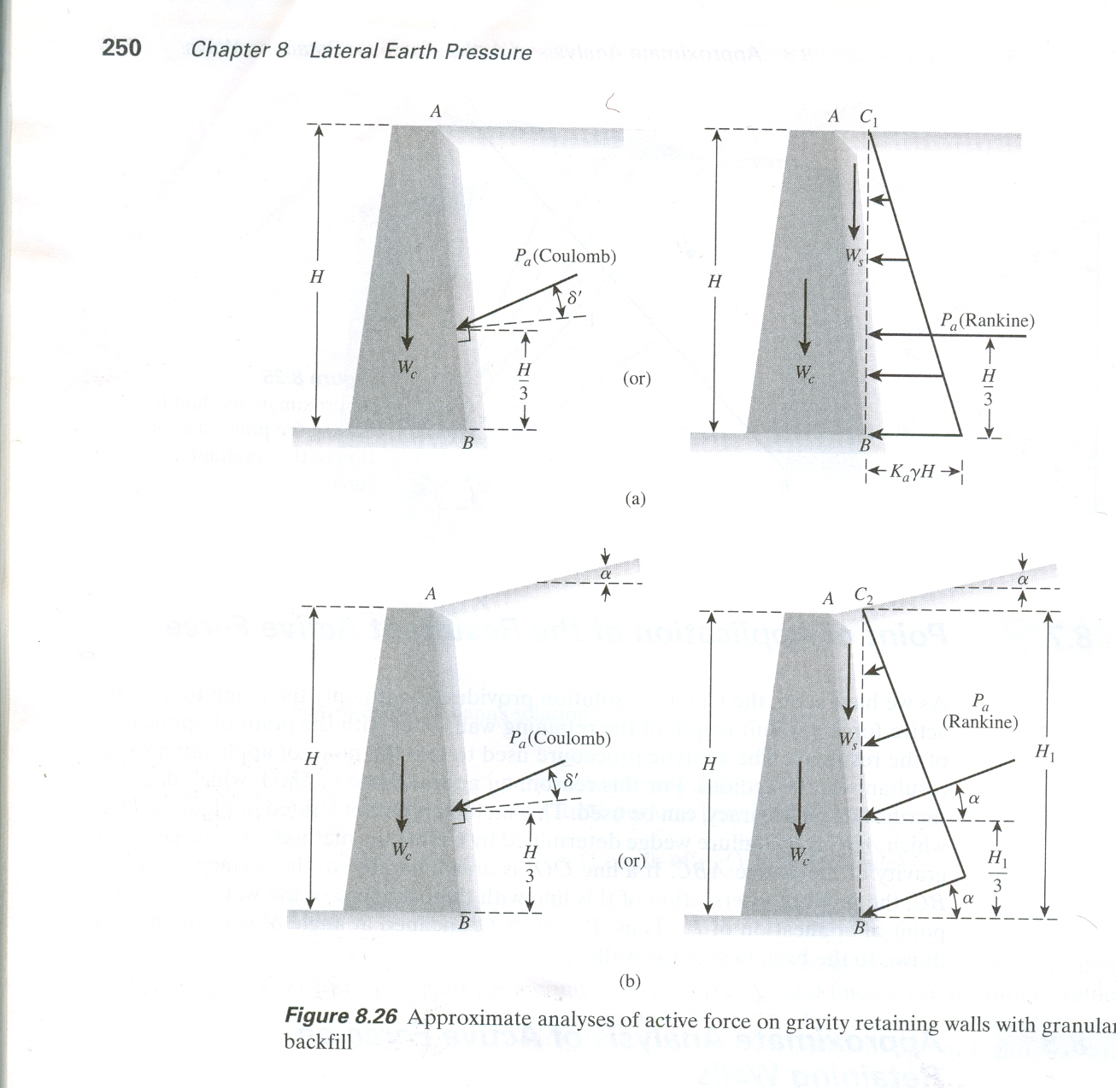
Rankine’s Earth Pressure Theory- Special Cases
I. Horizontal Ground & Inclined Wall Back
No lower bound (Mohr’s Circle) solution is available for this case.
Assume an imaginary vertical wall BC₁
The weight of the wedge of soil (W_{s}) is added vectorally to the earth pressure force for stability analysis.
θ
Notes
W_{c}
Same as vertical wall only we consider W_{s} in addition to P_{a} when analysing the stability of the wall.
This is only approximate solution.
Only active case is provided (It is more practical).
W_{s} = 1/2.γ.H².tan θ

Slide 70
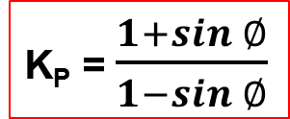
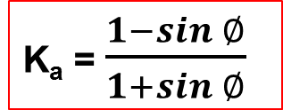
II. Inclined Ground & Vertical Wall Back
In this case, the direction of Rankine’s active or passive pressures are no longer horizontal. Rather, they are inclined at an angle α with the horizontal.
If the backfill is a granular soil with a friction angle φ, and C = 0,
For horizontal ground surface α = 0
K_{a} = $\frac{1−sin ∅}{1+sin ∅}$
K_{P} = $\frac{1+sin ∅}{1−sin ∅}$
The line of action of the resultant acts at a distance of H/3 measured from the bottom of the wall.

Slide 71

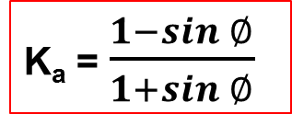
III. Inclined Ground & Inclined Wall Back – Approximate Solution
Assume an imaginary vertical wall BC₂
The weight of the wedge of soil (W_{s}) is added vectorally to the earth pressure force for stability analysis.
For horizontal ground surface α = 0
K_{a} = $\frac{1−sin ∅}{1+sin ∅}$
K_{P} = $\frac{1+sin ∅}{1−sin ∅}$

Slide 72
Remarks
P_{a} acts parallel to the ground surface
For stability analysis W_{s} is vectorally added to P_{a}
Plane BC₂ is not the minor principal plane.
This is only an approximate solution. No available lower bound (Mohr Circle) solution for this case.
Upper bound solution (kinematic) for this case is given by Coulomb.
Rankine kinematic upper bound solutions are special cases or approximation to Coulomb solution and Coulomb solution is a generalization of Rankine solution. (Rankine 1857, Coulomb 1776).
Wall inclination affects the value of H₁ and W_{s}. For vertical wall, H₁ = H, W_{s} = 0.

Slide 73
III. Inclined Ground & Inclined Wall Back – Rigorous Solution (Chu, 1991).
We discussed the Rankine active and passive pressure cases for a frictionless wall with a vertical back and a horizontal backfill of granular soil.
This can be extended to general cases of frictionless wall with inclined back and inclined backfill (granular soil).
Active Case
Passive Case

Slide 74
passive
For walls with vertical back face, θ = 0,

Slide 75
Topics
Introduction
Coefficient of Lateral Earth Pressure
Types and Conditions of Lateral Earth Pressures
Lateral Earth pressure Theories
Rankine’s Lateral Earth Pressure Theory
Lateral Earth Pressure Distribution – Cohesionless Soils
Lateral Earth Pressure Distribution – C – φ Soils
Coulomb’s Lateral Earth Pressure Theory

Slide 76
COULOMB’S EARTH PRESSURE THEORY
In Rankine’s theory one major assumption was that the wall is frictionless (i.e. δ =0). If friction is to be considered, stress state approach cannot be adopted anymore.
We instead go to kinematic approach, i.e. assuming failure plane and then use limit equilibrium.
Coulomb (1776) presented a theory for active and passive earth pressures against retaining walls.
The method is based on the assumption of a failure wedge ( or failure mechanism).

Slide 77
Assumptions
  Soil is isotropic and homogeneous and has internal friction (c = 0).
  The rupture surface is a plane surface and the backfill surface is planar (it may slope but is not irregularly shaped).
  The friction resistance is distributed uniformly along the rupture surface and the soil-to soil friction coefficient τ = tan φ.
  The failure wedge is a rigid body undergoing translation.
  There is wall friction, i.e., as the failure wedge moves with respect to the back face of the wall a friction force develops between soil and wall. This friction angle is usually termed δ.
  Failure is a plane strain problem—that is, consider a unit interior slice from an infinitely long wall.

Slide 78
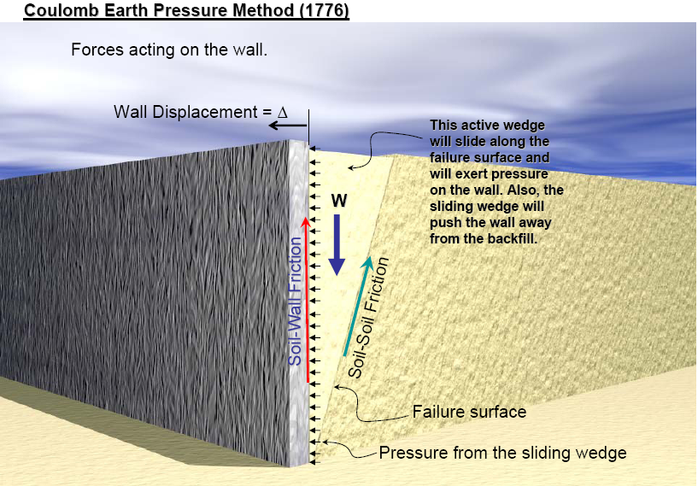

Slide 79
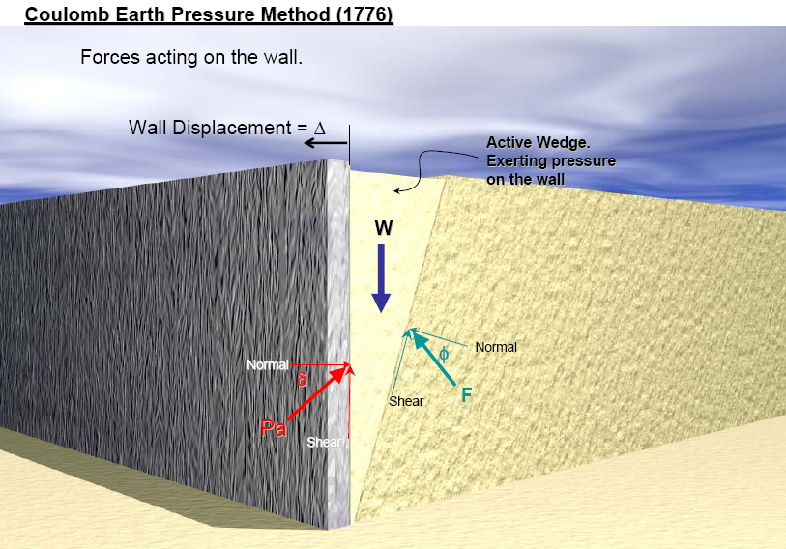

Slide 80
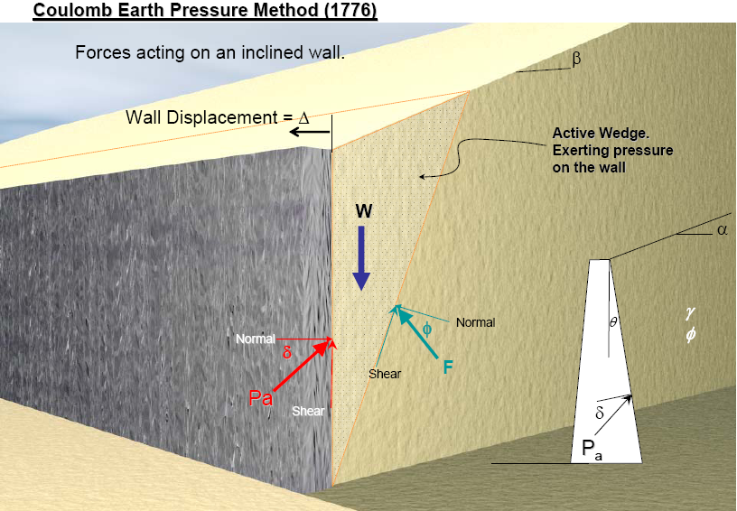

Slide 81
I. ACTIVE CASE - Granular Backfill
α
W = weight of soil wedge.
F = reaction from supporting soil.
P_{a} = maximum reaction from wall required for equilibrium.
Recall Chap. 2
β
δ
θ
p_{a}
W

Slide 83
II. PASSIVE CASE – Granular Backfill
W = weight of soil wedge.
F = reaction from supporting soil forces.
P_{p} = minimum reaction from wall required for equilibrium
P_{p} = ½ x K_{p} x γ x H²

Slide 84
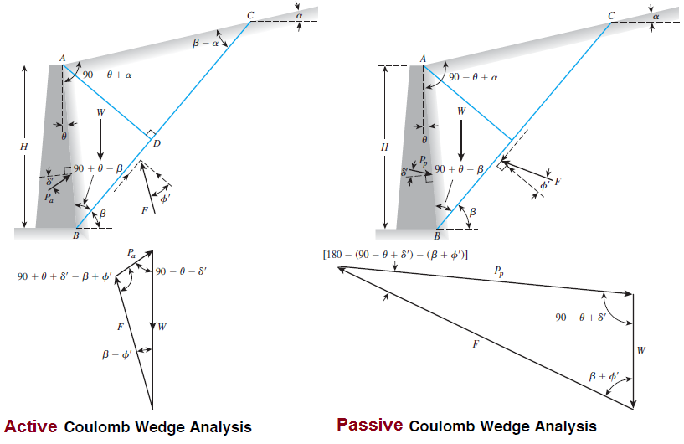
Active Vs Passive

Slide 85
REMARKS ON COULOMB’s THEORY
δ can be determined in the laboratory by means of direct shear test.
Due to wall friction the shape of the failure surface is curved near the bottom of the wall in both the active and passive cases but Coulomb theory assumes plane surface. In the active case the curvature is light and the error involved in assuming plane surface is relatively small. This is also true in the passive case for value of δ < φ/3, but for higher value of δ the error becomes relatively large.
The Coulomb theory is an upper bound plasticity solution. In general the theory underestimates the active pressure and overestimates the passive pressure. (Opposite of Rankine’s Theory)

Slide 86
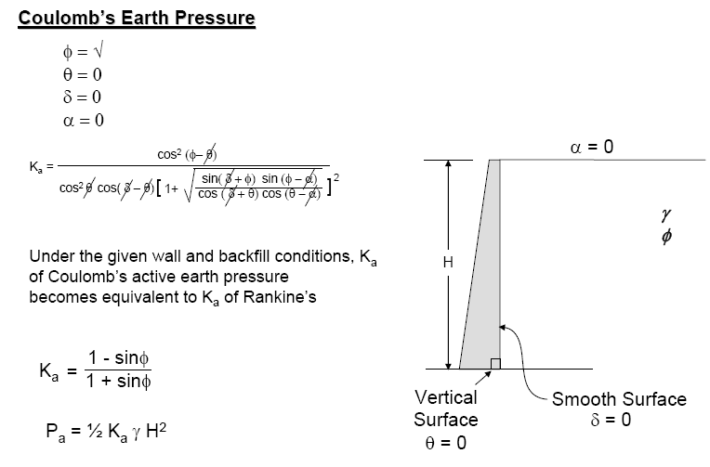
When δ = 0, θ =0, and α =0, Coulomb theory gives results identical to those of the Rankine theory. Thus the solution in this case is exact because the lower and upper bound results coincide.
The point of application of the total active thrust is not given by the Coulomb theory but is assumed to act at a distance of H/3 above the base of the wall.
In Coulomb solution wall inclination (angle θ) enters in K_{a} and K_{p}. In Rankine’s approximate solution θ is included into H₁ and W_{s}.

Slide 87
For inclined ground surface we use H in Coulomb. However, Rankine’s approximate solution uses H₁. Therefore, in Coulomb kinematic solution the effect of ground inclination enters only in K_{a} and K_{p}. In Rankine approximate solution it enters not only in K_{a} and K_{p} but also in H₁ and W_{s}.
H
H₁
P_{a} Coulomb at angle δ to the normal to the wall (δ = angle of friction between the wall and the backfill). In Rankine’s approximate solution P_{a} acts parallel to the slope of the backfill.
In Coulomb solution wall inclination (angle θ) affects the direction of P_{a} and P_{p}. In Rankine’s approximate kinematic solution wall inclination has no effect on the direction of the lateral force.

Slide 88
THE END

