Slide 1
Modelling Input Data
Chapter5

Slide 2
Introduction
When we use the collected data as an input to the simulation model, it is easy to consider the average as a representation of the data.
However, average values will not represent the actual behavior of the data and hence will give a misleading results
The size of data points is categorized into three categories:
Less than 20
20+
200+

Slide 3
Less than 20 data points: Estimation
If the system has not been built yet or there is no enough data for whatever reasons.
Too small to fit a theoretical distribution with statistical confidence
The mean could be a good estimate OR
Knowledge and statistical theory could help to chose a theoretical distribution. Example could include:
If the mean value is not very large, inter-arrival time is exponentially distributed
The availability of the maximum and the minimum values (even as a percentage variability from the mean) can be used to simulate service time as a uniform or symmetric triangular distribution.
Normal distribution could also be used

Slide 4
20+ data points: Deriving theoretical distribution
For a data size of over 20, a theoretical distribution could be derived and the steps used are as follows:
1- Construct a histogram:
It is a frequency distribution where the number of class groupings depend on the data size.
2- Compare histogram with theoretical distributions:
This is used to provide candidate matches by visual inspection. Examples of some theoretical distributions are as follows:

Slide 5
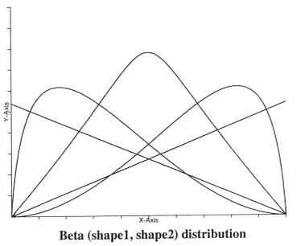
20+ data points: Deriving theoretical distribution: continuous distributions

Slide 6
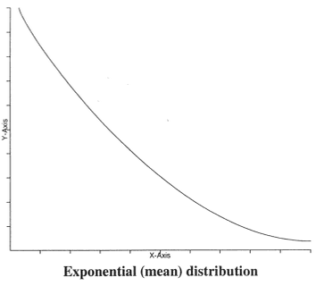
20+ data points: Deriving theoretical distribution: continuous distributions

Slide 7
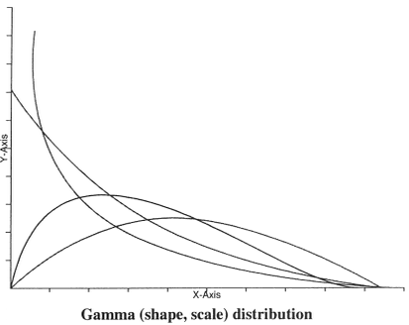
20+ data points: Deriving theoretical distribution: continuous distributions

Slide 8
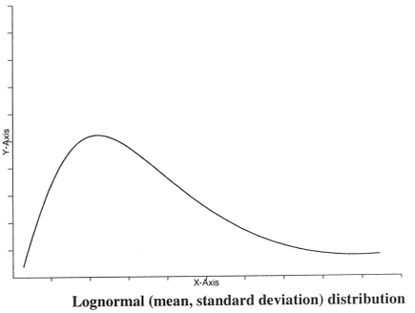
20+ data points: Deriving theoretical distribution: continuous distributions

Slide 9
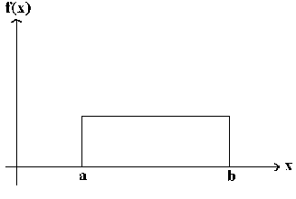
20+ data points: Deriving theoretical distribution: continuous distributions
Figure 5.8:Uniform (minimum, maximum) distribution

Slide 10
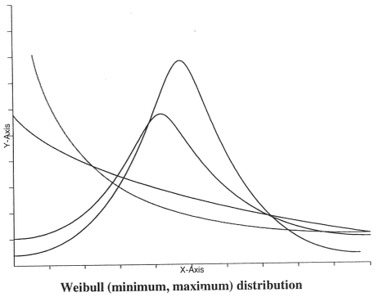
20+ data points: Deriving theoretical distribution: continuous distributions

Slide 11
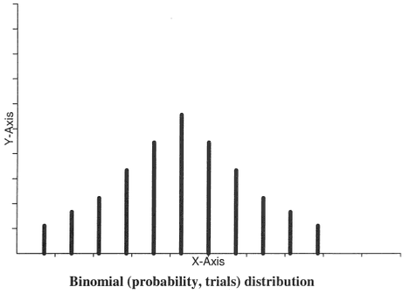
20+ data points: Deriving theoretical distribution: discrete distributions

Slide 12
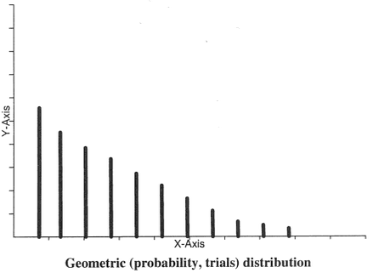
20+ data points: Deriving theoretical distribution: discrete distributions

Slide 13
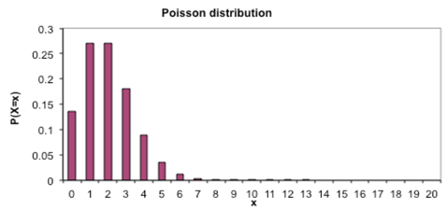
20+ data points: Deriving theoretical distribution: discrete distributions

Slide 14
20+ data points: Deriving theoretical distribution
3- Estimate the parameters:
Method of Maximum Likelihood Estimators (MLEs)
Usually, the simulation software will estimate these parameters for you.
4- Determine the Goodness of Fit:
Statistical tests are used to determine how good the fit is
The Chi-Square test
Kolmogorov-Smirnov (K-S) test – continuous distributions only

Slide 15
200+ data points: Constructing an empirical distribution
If a reasonable theoretical distribution fit cannot be made with the available data, an empirical distribution is the chosen distribution.
An empirical distribution is a distribution that is constructed from the sample data (a frequency distribution).
Simulation software usually have the functionality to fit the empirical distribution and other distributions as well.

Slide 16
Historical data points
Called a trace-driven simulation.
Use actual data such as actual arrival times and actual service time.
Cannot use what-if analysis
Does not consider the fact that conditions of the system and it surrounding environment could be changed and hence the simulation will not be useful then.
Good for validation

