Slide 1
Gel Filtration Chromatography.
Lab# 5
BCH 333 [practical]

Slide 2
Objectives:
The objective of this experiment is for students to learn the principles of gel filtration chromatography by separating of two substance according to the molecular weights.
2. Importance of gel filtration chromatography and procedures in purification.

Slide 3
3-Gel filtration chromatography:
Also called "Molecular Sieve“ or "Size or gel Exclusion’’.
-Well suited for biomolecules that:
Very sensitive to the changes in pH and harsh environmental factors.
-If the protein is relatively large (over 100 KDa), gel filtration could be used as an initial step in the purification.

Slide 4
Gel filtration chromatography
Mobile phase:
buffer.
Stationary phase:
(column matrix)
"beads" of hydrated, porous polymer.

Slide 5
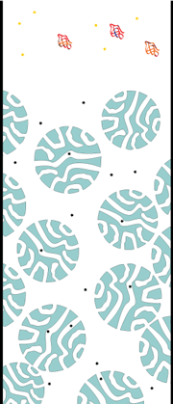
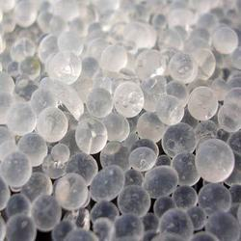

Slide 6
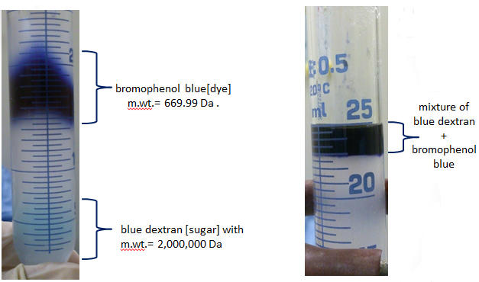
After few mins.
At the beginning

Slide 7
Principle:
-Gel filtration chromatography separates proteins according to their size. And the molecules are "filtered" through the porous beads.
-The gel filtration matrix[stationary phase] contains pores which permit the buffer, small and medium sized molecules to pass through them.
-Large molecules, can’t get through any pores in the beads and move more rapidly
through the column, emerging (eluting) sooner.[elute from the column before the smaller proteins].
- Medium-sized molecules, can enter the larger size pores in the matrix, and so they reach the end of the column later.
-Small molecules, can enter through all pores of the beads and they have the
largest volume to pass through before emerging from the column last. → elute last.

Slide 8
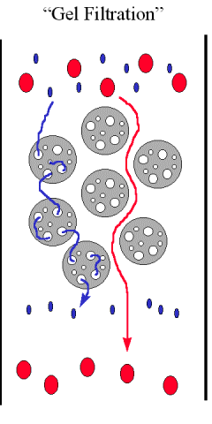

Slide 9
The principle of gel filtration chromatography
(Figure has been taken from-
(http://mortada8.maktoobblog.com/category/instrumental-analysis-studies/chromatographystudies/)

Slide 10
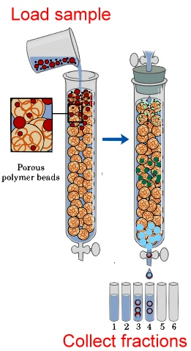

Slide 11
Stationary phase [beads]….info.:
-The gels used as molecular sieves consist of cross-liked polymers that are generally inert, do not bind or react with the material being analyzed, and are uncharged.
Mobile phase:
Is the liquid fills the space inside the beads and between the bead particles and this liquid occupies most of the bed volume.

Slide 12
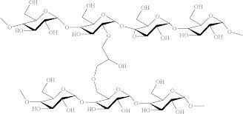
Gel Filtration Resins
Dextran [e.g. Sephadex]:
-is a polysaccharide composed of glucose residues.
-prepared with various degrees of cross-linking to control pores size.
-supplied in the form of dry beads that swell when water is added.
-It is mainly used for separation of small peptides and globular proteins with small to average molecular mass.

Slide 13
Dextran: polysaccharide composed of glucose residues.

Slide 14
General information:
-Gel beads come in various sizes: large, medium, fine, and superfine.
-All consist of semi-permeable, porous gels of cross linked polymers with a range of pore sizes.
-The degree of cross linking is controlled to yield a series of gels having different pore sizes.

Slide 15
NOTES:
-The larger the beads, the more rapid the flow rate and the poorer the resolution.
[because as the flow rate increases, the time available for the molecules to equilibrate between the mobile phase and the pore space in the stationary phase decreases.]
When it is used???
The larger beads are for very large preparation in which resolution is less important than time.
-Super fine, is used if maximum resolution is required and the time is less important.

Slide 16
Notes:
It is the best method for separation of molecules differing in molecular weight because:
1. It doesn’t depend on temperature, pH, ionic strength and buffer composition, so, separation can be carried out under any conditions.
2. There is less zonal spreading than in other techniques.
3. The elution volume is related to the molecular weight.
4. Important method in protein purification.
5.This separation method is unique in fractionating without requiring protein binding, thus significantly reducing the risk of protein loss.

Slide 17
The most common application of gel filtration in biochemistry are:
-Molecular weight determination.
-Fractionation of macromolecules.
-purification.

Slide 18
To estimate the molecular weight for a protein:
1. Several proteins with known molecular weights
are run on the column and their elution volumes determined.
2. The elution volumes are then
plotted against the log molecular weight of the corresponding proteins.
3. A straight line is obtained for the separation range of the gel being used.
4. The elution volume of a protein of unknown molecular weight is then found,
[it can be compared to the calibration curve and the molecular weight determined.]

Slide 19
elution volume, V_{e} is proportional to log of molecular weight.
For high molecular weight less elution volume is needed, and for small molecular weight the large elution volume is needed to elute the sample.

Slide 20
For every column, three volumes should be distinguished:
The void volume, V_{o}:
- The volume of the mobile phase in the space between the beads . [which is the volume external to the beads].
-Can be determined by the elution of High MW molecules which can not enter any pores .
2. The total volume, Vt (bed volume):
-The total volume of material in the column (both solid and liquid).
[can be calculated from the dimension of the column.]
3. The elution volume, Ve, of molecules:
- the amount of liquid( mobile phase) that must be added to produce a peak of
a particular solute in the effluent.
Or the volume required for completely eluting the solute from column.

Slide 21
-Loading the sample :
small volume of sample is placed on the stationary phase and allowed to enter the column.
-Packing the column: Preparation of the gel and loading it in the column.

Slide 22
Gel Filtration Chromatography.

Slide 23
Cautions must be taken:
It is important that the gel should be:
Homogenous.
Free from bubbles.
Free from cracks.
Free from spaces between the walls.
And it should be covered by the liquid "mobile phase" all the time.

Slide 24
Practical Considerations
-Gels of various pore size are available → choose the one with the best fractionation range for your sample
-Good separation usually require long columns and slow flow rate.
-Gel filtration is NOT recommended for separating proteins with only a small difference in molecular weight .

Slide 25
Practical part

Slide 26
The gel filtration material that will be used in the experiment is called Sephadex G-100 and it will separate molecules with molecular weights from 4,000 to 150,000 Da.
So, Those molecules which are with molecular weight larger than 150,000 Da will be excluded from the beads, because of their huge size they can not get through the pores of the beads, and elute first.
In your experiment:
you will separate a mixture of blue dextran [sugar] with m.wt.= 2,000,000 Da and bromophenol blue[dye] m.wt.= 669.99 Da .

Slide 27
1. Remove the excess buffer, then add 1 ml of your sample
2. Collect the fractions, 3ml each.
3. Read the absorbance for each fraction.
4. Draw the curve.(absorbance Vs fraction number)

Slide 28
After few mins.
At the beginning

Slide 29
Diffusion

