Slide 1
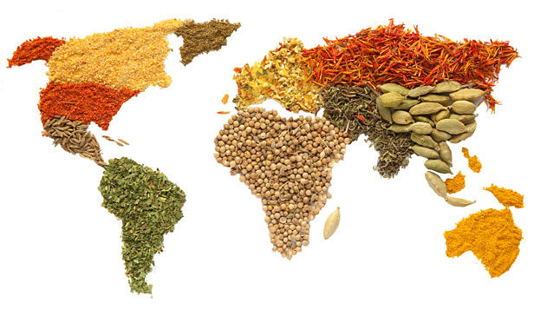
Food
Lecture 5

Slide 2
Objectives
Define food
Define food safety
Define food contamination
Identify the determinants of safe food
Identify sources of food contaminants and their effects on human health
Identify methods to prevent food contamination

Slide 3

Introduction
What is food?
Any substance (solid or liquid) consumed by living organisms for the purpose of nutrition and survival, and that their bodies use to derive the elements necessary for growth and development.
Expectation of food to be good for you:
Provide nourishment and
Be free of any materials that can be harmful to health.

Slide 4
Food Contamination
Food contaminants
Food contamination
Substances that have not been intentionally added to food.
May be the result of environmental contamination or may be introduced in foods during production, packaging, transport or holding.
In raw food or in cooked food improperly handled, heated or stored; cross-contamination from raw foods to cook foods, improper hand washing, pests.
Negative impact on the quality of food and a risk to human health.
Food Contaminants. http://ec.europa.eu/food/food/chemicalsafety/contaminants/index_en.htm

Slide 5
Categories of Food Contaminants
Food hazards
Biological
Microorganisms - Bacteria, viruses, parasites, and fungi.
Food allergens.
Physical
Stones, animal bones, pieces of glass or metal, other solid foreign materials.
Chemical
Pesticides, herbicides, fertilizers
Heavy metals, other chemical substances.
Toxins – plants, animals.
Nutritional
Inadequate amounts (excessive or deficient) of nutrients that can lead to disease.
Food Contaminants. http://ec.europa.eu/food/food/chemicalsafety/contaminants/index_en.htm

Slide 6
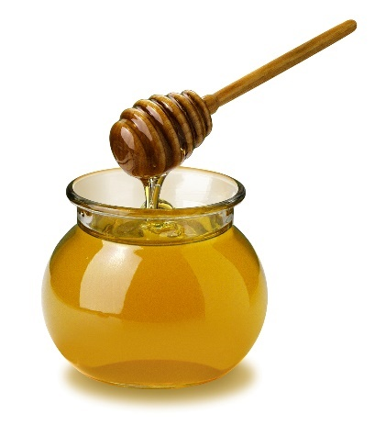
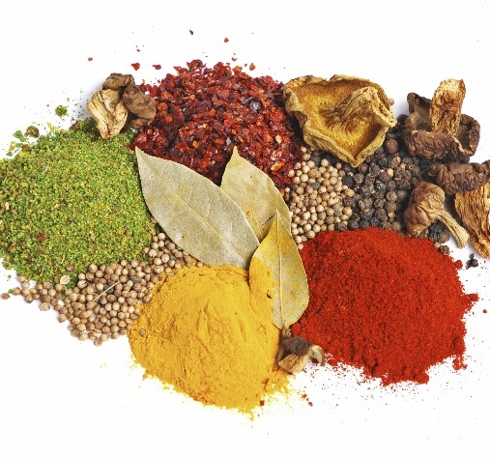
Biological Hazards
Clostridium perfringens - meat dishes stored after cooking with insufficient cooling and reheating (stored at 5-60ºC long enough to facilitate bacterial growth).
Bacillus cereus – pasteurized milk contaminated during processing.
Clostridium botulinum – unpasteurized (raw) honey containing spores as a risk for infants under 1 year of age.
Infant botulism and spores in soil and dust.
Bacteria
Spore-forming bacteria – able to survive temperature extremes and for long periods.
Found in vegetables, spices, honey, meat and milk of animals that ate the spores.

Slide 7
Biological Hazards
Bacteria
Non-spore-forming bacteria
Destroyed by heat – cooking, pasteurization.
E. coli
Fecal contamination.
Undercooked beef, raw vegetables (in contact with manure), improper hand washing.
Kidney hemorrhage as a complication – possibly death.
Listeria
Manure-contaminated soil and water.
Meats raw and cooked, cold cuts, vegetables, milk, cheese.
Contaminated processing equipment and different foods.

Slide 8
Biological Hazards
Bacteria
Non-spore-forming bacteria
Salmonella
Raw poultry and eggs, raw meat and milk.
Other foods during handling or processing.
At higher risk are pregnant and nursing women, infants, elderly, immunocompromised.

Slide 9
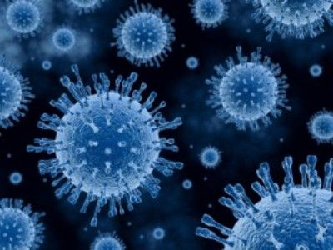
Biological Hazards
Viruses
Need living cells to survive.
Animal or human cells.
Small amounts can cause illness in susceptible individuals.
Norovirus – gastroenteritis.
Droplet, air-borne, fecal-oral transmission.
Severe dehydration in the very young, elderly, and the immunocompromised.
Highly contagious – up to two weeks after recovery.
Hepatitis A virus – infectious hepatitis.
Complications in people with liver disease.
Fecal-oral contamination.
Poor hand-washing and contaminated food/water.
Manure-contaminated water and raw vegetables.

Slide 10
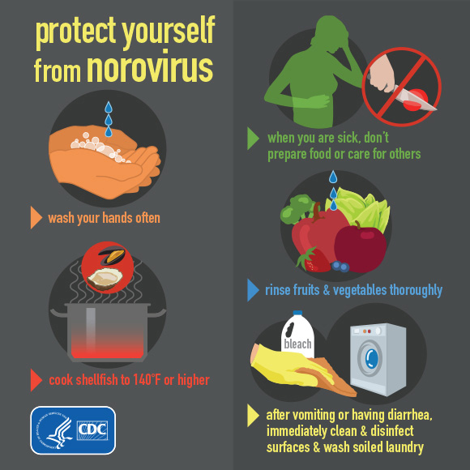
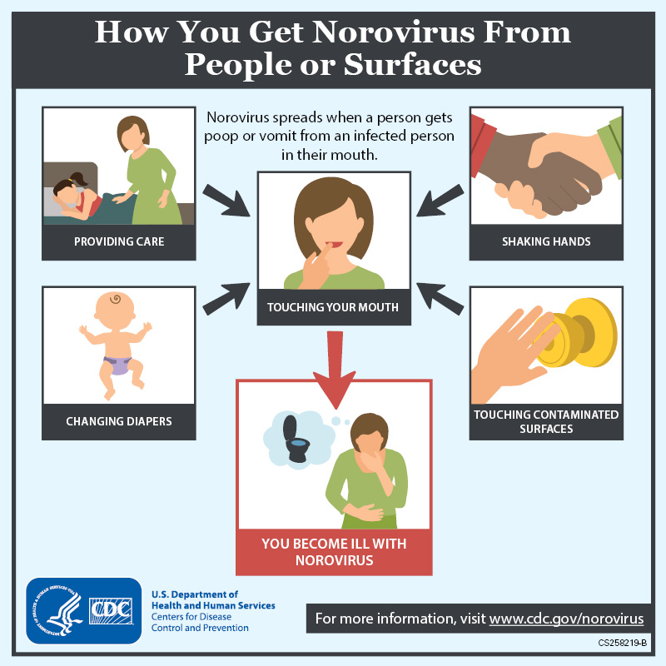

Slide 11
Biological Hazards
Parasites
Small animals that live in or on a living host.
Fecal-oral contamination.
Roundworms in fish.
Can attach to the throat, stomach or intestines.
Cyclospora in fruits and vegetables.

Slide 12
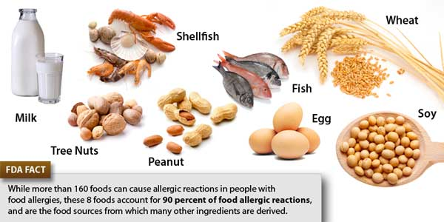
Biological Hazards
Food allergens
Major food allergens
Substances in food that can cause the immune system of sensitive people to overreact.
Very small amounts are enough.
Usually proteins.
Symptoms occur shortly after consumption.
Life-threatening reaction – anaphylaxis.
Read food labels and avoid cross-contamination.

Slide 13
Chemical Hazards
Intentional or accidental presence in foods.
Toxins
Natural – plants and animals
Pesticides, herbicides, veterinary drugs, antibiotics in animal feed, food additives, industrial byproducts, heavy metals.
Pesticides and herbicides
Fruits and vegetables.
Children at greater risk.
Antibiotics and other drugs
Meat, milk, chicken, eggs.
Antibiotic-resistant microbes.
Organic vs. conventional foods
Food additives
Substances added to food to achieve a specific purpose.
Risk to consumers if in excess, or in cases of food sensitivities or allergies.
Colors, flavor enhancers, preservatives.

Slide 14
Chemical Hazards
Bisphenol A (BPA)
Phthalates
Plastic used in baby bottles, water bottles, liner for metal food cans, plastic food storage containers.
Links to cardiovascular disease, type 2 diabetes, liver enzyme abnormalities, endocrine disruptor.
Reduce exposure by
Eating less canned foods.
Using BPA-free baby bottles and plastic containers.
Make plastics flexible.
Found in fatty foods, milk, fish, meat and oils.
Exposure by ingestion, inhalation and skin absorption.
Metabolized and excreted in urine and feces.
Bioaccumulation in humans not clear.
Affect the developing fetus.
Reproductive issues in males.
Brain development issues in females.

Slide 15
Chemical Hazards
Toxins from fish and shellfish
Amnesic shellfish poisoning – GI and neurological symptoms, short-term memory loss.
Ciguatera fish poisoning –caused by biomagnification of toxins produced by microscopic sea plants called dinoflagellates. GI, neurological and CV symptoms.
Not destroyed by heat.
Algae and plankton toxins passed onto seafood.
Types of poisonings:
Paralytic shellfish poisoning – muscles, respiratory and CV symptoms.
Diarrheic shellfish poisoning – GI symptoms.
Neurotoxic shellfish poisoning – nervous symptoms.

Slide 16
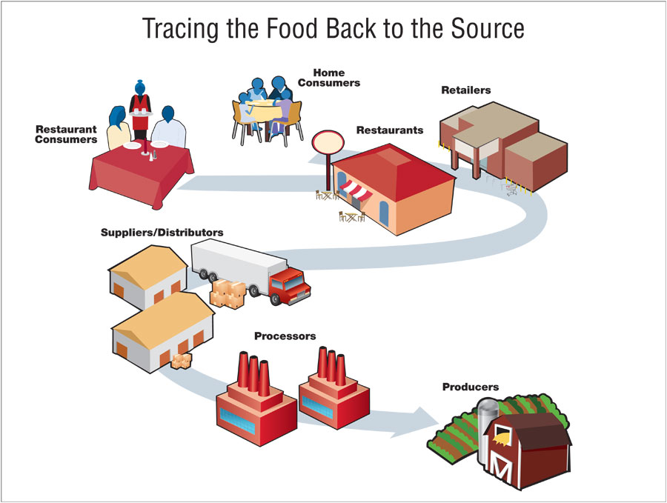
Points of contamination
Growing
Polluted soil, water, air.
Harvesting, holding/storage
Transport
Processing
Packaging
Distribution
Preparation
Consumption

Slide 17
Foodborne diseases
Common symptoms
Illnesses caused by consuming contaminated food or drink.
The food may be contaminated by microorganisms, their toxins, or chemical or physical substances.
Oral route of entry into the gastrointestinal tract.
First symptoms usually GI.
Some severe cases involve organs other than the GIT.
Nausea, vomiting, diarrhea, abdominal pain.
Headache, fever, dehydration.
No or mild flu-like symptoms in healthy adults.

Slide 18
Foodborne diseases
Most at risk
Factors affecting the symptoms
Infants, young children, the elderly, pregnant and nursing women.
Immunocompromised patients – life-threatening.
HIV, cancer, or on immune suppressors (organ transplant).
Can become violently ill with smaller amounts of pathogens.
1. Type of contaminant – biological, chemical, physical.
2. Amount of contaminant in the food consumed.
3. Amount of food consumed.
4.Individual health status.

Slide 19
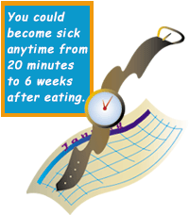
Foodborne diseases
Onset time
Amount of time between eating the contaminated food and the first symptoms of illness.
Factors
Age.
Health status.
Weight.
Amount of contaminant.
Type of contaminant.

Slide 20

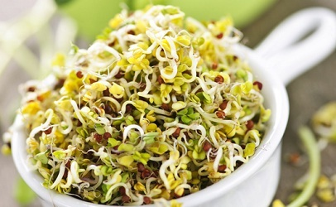
Foodborne diseases
Potentially hazardous foods
Foods that can support the rapid growth of pathogenic microorganisms.
Examples:
High protein, low acid, high moisture, protein-rich foods provide an ideal environment for pathogenic bacteria.
Bacteria need nutrients to survive.
Proper handling and storage is needed.
Cooking time/temperature.
Examples of foods:
Meat, poultry, milk, fish and seafood.
Plant foods that have been heat-treated.
Raw seed sprouts.

Slide 21
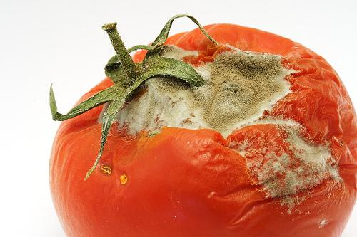

Food contamination and spoilage
Contamination vs. Spoilage
In both, there are pathogens in the food.
Depending on the pathogen, the appearance, smell or taste of the food may not change.
Contaminated food may not appear dangerous to eat.
Spoiled food will show changes in the smell, appearance and/or taste, indicating that the food is not safe to eat.
Contaminated food may not show signs of spoilage.
Fruits – fungi.
Vegetables – bacteria and fungi.

Slide 22
Preventing food contamination
No zero risk.
Food can never be entirely safe.
Pathogens may contaminate food at any time.
Common sources of contamination (Air, water and soil).
Some man-made pollutants are common in the environment and difficult to avoid or to determine source of contamination.
Foodborne disease prevention and education provided to:
Food growers, handlers and consumers.
Main factors contributing to foodborne outbreaks:
Improper storage/holding temperatures.
Improper preparation/cooking time or temperature.
Improper personal hygiene in food handlers.
Contaminated equipment.

Slide 23

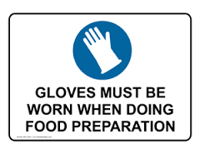
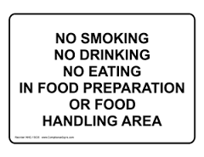

Preventing foodborne diseases

Slide 24
Preventing foodborne diseases
People in charge of food preparation must be in good health.
Clean food preparation area surfaces and implements to avoid cross-contamination.
Transfer of pathogens between clean and contaminated surfaces, foods, utensils during storage or preparation.
Raw to cooked foods.
Cutting boards or utensils.
Soiled hands or counters.
Hand washing – simplest, most effective way to prevent diseases.
Hand washing with soap and water.
Hand sanitizers are not a substitute for hand washing.
Clothing, gloves and hair nets.
No eating, smoking or drinking in food preparation areas.

Slide 25
Preventing foodborne diseases
Frumkin H. Environmental Health: From Global to Local. 2nd Edition. 2010. Jossey-Bass.

Slide 26
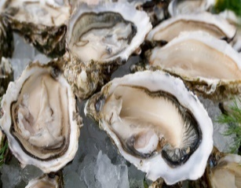

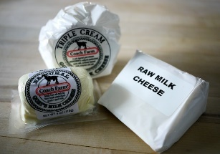
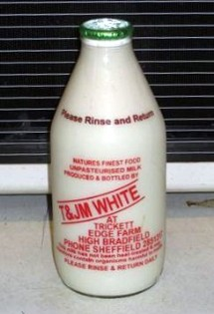
Preventing foodborne diseases
*Braising is roasting or simmering less-tender meats with a small amount of liquid in a tightly covered pan.
Cooking Temperature
Food sources to avoid
Cook food thoroughly.
Avoid consuming raw animal foods.
Cook chicken to internal temperature of 75ºC/15 seconds.
Cook ground beef to internal temperature of 72ºC.
Shellfish and fish from polluted waters.
Agricultural products and polluted soil or water.
Foods prepared from raw animal products – milk or meat.
Foods improperly handled or stored.
Food safety. http://www.foodsafety.gov/keep/types/meat/ USDA. Beef from farm to table.

Slide 27
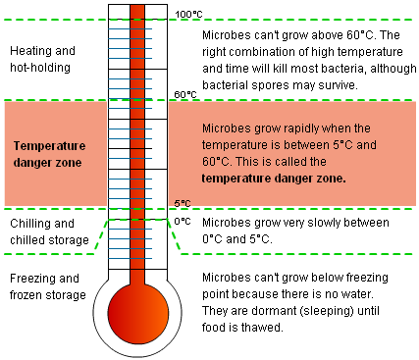
Preventing foodborne diseases
Holding temperatures
Temperature danger zone: 5-60ºC.
Keep hot foods hot and cold foods cold or do not keep it.
Hot foods > 60ºC.
Cold foods < 5ºC.
During heating or cooling of foods minimize the time the food spends in the temperature danger zone.
Chill or heat quickly.
Avoid repeated cycles of heating and chilling.
Do not thaw food at room temperature.

Slide 28

Preventing foodborne diseases
Food irradiation
Most of the radiation passes through the food without being absorbed.
The amount that is absorbed destroys any pathogenic organisms and slows down fruit and vegetable ripening.
Use of ionizing radiation to destroy pathogenic bacteria, insects, parasites, and fungi.
Extends shelf-life and improves safety of foods.
Not a substitute for food hygiene practices.
Viruses resist irradiation at the levels approved.
www.fda.gov/Food/ResourcesForYou/Consumers/ucm261680.htm

Slide 29
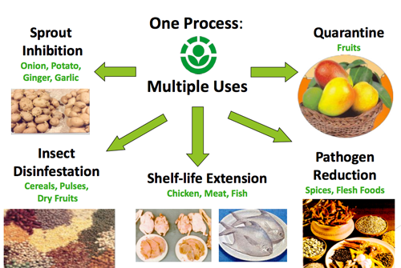
Preventing foodborne diseases
Food irradiation
FDA approved foods for irradiation in the USA
Beef, seafood (lobster, shrimp, and crab), fresh fruits and vegetables, lettuce and spinach, shellfish (oysters, clams, mussels, and scallops), poultry, seeds for sprouting shell eggs, spices and seasonings.
www.fda.gov/Food/ResourcesForYou/Consumers/ucm261680.htm

Slide 30
Factors that contribute to the spread of foodborne diseases
There is an increased number of emerging pathogens because of changes in how food is produced and distributed.
Mass production, food imports.
Pathogens spreading to places far away from their origin.
Increased antibiotic resistance.
Lack of rules, regulations, surveillance and monitoring systems or food safety or poor implementation of them.
Lack of educational programs to increase awareness among consumers.

Slide 31
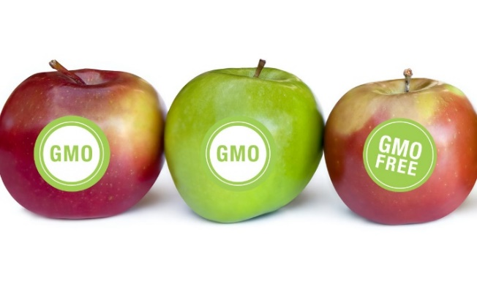
Genetically modified foods (GMOs)
Genetically-engineered, transgenic foods.
Bacterial genes – corn, potatoes, and cotton.
Herbicide-tolerant genes – soy and corn.
Increased use of specific herbicides or pesticides.
Harm to humans and environment biodiversity.
Genetically modified organisms can escape into natural ecosystems and disrupt biodiversity.
Unexpected changes in nutrients.
Rice modified to have less glutelin resulted in high levels of a protein with high allergenicity and lower nutritional value.
Rice modified to have β-carotene resulted with high levels of other carotenoids instead.
Will GMOs solve world food problems?
Poor countries – war, lack of infrastructure.
Genetically Modified Foods. http://www.chgeharvard.org/topic/genetically-modified-foods

Slide 32
Organic vs. conventional foods
Nutritionally
Organic plant foods had lower nitrate content and higher phosphorus content.
Nitrates and increased risk of gastrointestinal cancer, and methemoglobinemia in infants.
No consistent differences seen in nutrient content.
Varies with food type.
Higher vitamin C concentrations in organic leafy vegetables, such as spinach, lettuce.
No difference in protein or fat content of milk.
Organic milk may contain higher levels of antioxidants and omega-3 fatty acids.

Slide 33
Organic vs. conventional foods
Environmentally
Organic foods and lower risk of pesticide, herbicide or synthetic fertilizers contamination.
Lower levels of pesticide residues in children’s urine.
But not pesticide-free.
Organically raised animals and reduced use of drugs.
Antibiotics, hormones, steroids.
Reduced exposure to antibiotic-resistant bacteria.
Increases nutrient recycling and enhances and protects biodiversity.
Crop rotation.
No synthetic fertilizers, pesticides or herbicides.

Slide 34
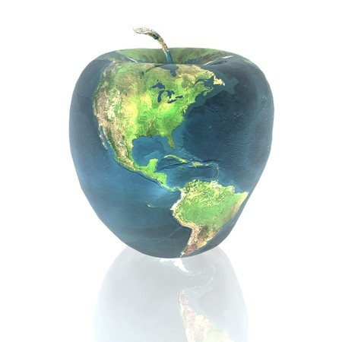
Food production and the environment
What and how much we eat impacts our health and the health of the environment.
Changing diets, obesity and related diseases.
Excess of animal protein consumption.
Cattle growing, overfishing.
Less biodiversity.
Rice, corn and wheat as main staples.
Biodiversity
Soil health
Water resources
Food miles
Growing,
Harvesting,
Distribution and
the range of foods
available

Slide 35
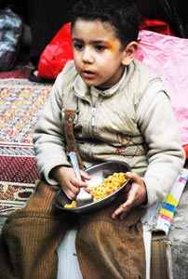
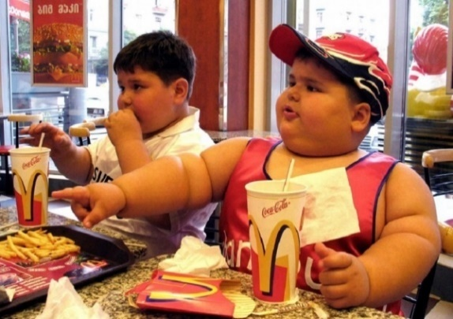
Food production and the environment
Malnutrition is caused by nutrient imbalance even if the caloric content in the diet is adequate.
Nutrient imbalance occurs because of inadequate diet or because of a health condition that interferes with digestion or absorption of nutrients.
Obesity is a form of malnutrition called ‘overnutrition.’
Undernourishment is caused by insufficient food and nutrients, leading to diseases associated with nutritional and calorie deficiencies.
Too little food to provide the necessary nutrients for normal growth and development.

Slide 36
References
Frumkin H. Environmental Health: From Global to Local. Second Edition. 2010. Jossey-Bass. John Wiley and Sons, Inc.
Middlecamp C et al. Chemistry in Context: Applying Chemistry to Society. Seventh Edition. A Project of the American Chemical Society. 2012. McGraw-Hill Publishers.
Genetically Modified Foods. http://www.chgeharvard.org/topic/genetically-modified-foods
Tuomisto, H.L. et al. 2012. Does organic farming reduce environmental impacts? – A meta-analysis of European research. http://www.sciencedirect.com/science/article/pii/S0301479712004264
American Academy of Pediatrics. 2012. CLINICAL REPORT Organic Foods: Health and Environmental Advantages and Disadvantages. http://pediatrics.aappublications.org/content/130/5/e1406.full.pdf
Open Learn Works. Hygiene and Environmental Health Module: 8. Food Contamination and Spoilage. The Open University. Accessed on 2-27-16. http://www.open.edu/openlearnworks/mod/oucontent/view.php?id=194

Slide 37
Additional reading
Benbrook, C. Nutrition Action Health Letter. October 2012. CSPI. Going Organic: What's the payoff? http://www.cspinet.org/nah/articles/going-organic.html

