Slide 1
Introduction to Work Measurement
Sections:
Time Standards and How They Are Determined – part 1
Prerequisites for Valid Time – part 2
Allowances in Time – part 2

Slide 2
Introduction – Some Definitions
Time Study, Work Measurement:
often used interchangeably
meaning: time to complete a unit of work
Notes:
* Note, don’t confuse work study and work measurement
* Also note, book differentiates slightly bet. Time study and work measurement, “time study has a slightly broader meaning; work measurement is generally focused on human work effort; time study refers to all of the ways in which time is investigated and analyzed in work situations, whether the work is accomplished by human workers or automated systems.; time study also covers learning curve phenomenon (not covered by work measurement)”

Slide 3
Introduction – Some Definitions
Work Measurement:
4 techniques to evaluate task i.t.o. time allowed for average worker to perform that task:
direct time study (DTS)
predetermined motion time systems (PMTS)
standard data systems (SDS), and
work sampling
task that is measured: usu. repetitive work cycle
objective of work measurement techniques:
determine standard time ($Tstd$) for task

Slide 4
Introduction to Work Measurement
Time Standards and How They Are Determined

Slide 5
Time Standards and How They Are Determined
standard time for given task:
amount of time allowed for average worker,
to process 1 work unit
using standard method
and working at normal pace
includes also additional time: allowance,
worker’s personal needs
worker fatigue,
and unavoidable delays during the shift
⇒ std. time aka allowed time
Notes:
* “allowed time, because it indicates how much time is allowed the worker to process each work unit so that by the end of the shift a fair day’s workload has been accomplished, despite the various interruptions that may occur”

Slide 6
Time Standards and How They Are Determined
Applications in which time standards are useful:
Low productivity: need for improvement
Repeat orders
set time standard for 1st order
⇒ same standard used for successive orders
Long production runs
time to set standard: divided over more parts
⇒ average cost of work measurement ↓
Repetitive work cycles: justifies work measurement
Short cycle times (work cycles): require less time to set standards

Slide 7
Time Standards and How They Are Determined
Functions/advantages of time standards :
Determine a “fair day’s work”:
i.e. number of hrs in shift (e.g. 8 hrs) should = # of completed work units * respective $Tstd$
Converting workload into manpower and equipment resources to accomplish workload
Objective way to compare alternative methods for accomplishing same task
Evaluating worker performance
Functions that depend on task time data:
Production planning, scheduling cost estimating, material requirements planning

Slide 8
Methods to Determine Time Standards

Slide 9
Methods to Determine Time Standards
Methods (vary i.t.o. accuracy and reliability):
Estimation:
department foreman determines time that should be allowed for given task
⇒ least accurate of techniques (subjective)
Historical records of previous production runs:
records of previous identical/similar job orders used to determine time standards
average time/part calculated from worker “time cards”
disadvantage: don’t indicate work efficiency
Work measurement techniques: most acc. (next)
Notes:
Foreman: رئيس العمال
“time cards”: indicate the time spent on orders or jobs and the quantities of parts turned in against that time.

Slide 10
Methods to Determine Time Standards
Cont. Methods (see figure 1)
Work measurement techniques
Work sampling:
different from other 3 techniques
determines proportions of time spent in various categories of work activity
uses randomized observations of subjects
Other 3 techniques (DTS, PMTS, SDS):
establish time/engineering standards:
based on time values adjusted for worker performance
effort needed to find best method
Notes:
i.e. involves design and optimization

Slide 11
Work Measurement Techniques

Slide 12
Work Measurement Techniques
Direct Time Study (DTS):
direct observation of task
using stopwatch/chronometric device
records time taken to accomplish task
task usu. divided into work elements
each work element is timed separately
time study analyst (while observing worker):
evaluates worker’s performance (pace)
records pace to each work element time
this’s called performance rating
Notes:
Chronometric: ميقاتي
Note, how the term “performance rating “ combines both the important issues of efficiency and speed (not only one of those terms); term is discussed in detail later

Slide 13
Work Measurement Techniques
Cont. Direct Time Study (DTS):
$T_{n}=T_{obs} (PR)$
$T_{n}$: normal time for element/task* (time req. by worker working @ 100% pace for 1 cycle), min
$T_{obs}$: observed time, min
$PR$: performance rating of worker’s pace
observed by analyst
usu. recorded as %ge during observation
applied as decimal fraction in equation
If task is repetitive,
several work cycles observed,
$T$-values avg. to improve statistical accuracy
Notes:
Note, Sometimes study analysts attach an overall performance rating to the entire task; others prefer to rate the worker’s performance during each work element

Slide 14
Work Measurement Techniques
cont. Direct Time Study (DTS):
$T_{std}=T_{n} (1+A_{pfd})$
$T_{std}$: standard time, min.
$T_{n}$: normal time
$A_{pfd}$: allowance for
personal time,
fatigue,
delays
Notes:
A_{pfd}: described later in detail

Slide 15
Work Measurement Techniques
Predetermined Motion Time Systems (PMTS):
relies: database of basic motion elements
e.g. reach, grasp, move, other therbligs
with each motion element:
set of $T_{n}$’s,
values of $T_{n}$’s depend on conditions under which motion element was performed
e.g. $T_{n}$ for move depends on :
distance reached
longer distances ⇒ more time
also on weight of moved object

Slide 16
Work Measurement Techniques
Predetermined Motion Time Systems (PMTS):
analyst activities:
analyst lists all BME’s for task (& conditions)
retrieves $T_{n}$ (each BME) from database
$T_{n}$(task) $= \sum{T_{n}}$(BME’s)
$T_{std}=T_{n} (1+A_{pfd})$ (i.e. same as in DTS)
advantages of PMTS:
performance rating: not required,
can be applied to find $T_{std}$(task) before production

Slide 17
Work Measurement Techniques
Standard Data Systems (SDS):
compilation of $T_{n}$’s for work elements,
used in tasks performed in given facility
used to find $T_{std}$’s
tasks composed of work elements,
similar to those in database
advantage of SDS:
$T_{std}$ can be set before job is in production
$T_{n}$’s obtained from:
previous DTS’s, or PMTS data, or WS data
or even historical time records
large data amounts req. to build database
Notes:
Note the difference between PMTS (database of basic motion elements) and SDS (database of work elements)

Slide 18
Work Measurement Techniques
cont. Standard Data Systems (SDS):
analyst activities:
identifies:
work elements that make up task &
values of work variables for each element
retrieves $T_{n}$ (each WE*) from database
$T_{n}$(task) $= \sum{T_{n}}$(WE’s)
$T_{std}=T_{n} (1+A_{pfd})$ (i.e. same as in DTS, PMTS)
Notes:
As we will see later: “normal time for a given element is a function of the work variable(s), and this functionality must be included in the database in the form of tables, charts, or mathematical equations.”

Slide 19
Work Measurement Techniques
Work Sampling:
uses random sampling techniques to study work situations
⇒ proportions of time spent in different activities: estimated with defined deg. of stat. accuracy
e.g. setting up for production, producing parts, machine idle
advantage of work sampling:
can include multiple subjects (e.g. workers, machines)
DTS, PMTS: limited to 1 worker/study

Slide 20
Work Measurement Techniques
Work Sampling:
to achieve desired level of statistical accuracy:
large # of observations
over long period of time
observations must be made @ random times (⇒ minimize bias)
objectives in work sampling study (e.g.’s):
measure machine utilization in plant
appropriate allowance factor for use in setting $T_{std}$ in DTS (i.e. not always finding $T_{std}$)
Disadvantage of work sampling:
$T_{std}$ in WS: less acc. than other techniques*
Notes:
* reason: statistical errors inherent in the sampling procedure

Slide 21
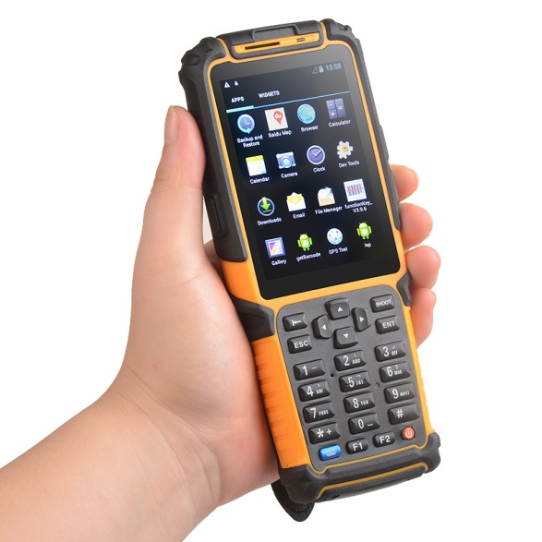
Work Measurement Techniques
Computerized Work Measurement:
Software/hardware products:
improve productivity of analysts (performing work measurement)
reduce time req. by analyst to set $T_{std}$
developed for all 4 work measurement techniques: DTS, PMTS, SDS, WS
used with
PC’s
PDA’s (portable digital assistants)

Slide 22
Work Measurement Techniques
Computerized Work Measurement:
advantages:
facilitate collecting data at work site (DTS, WS)
perform routine computations (instead of analyst)
organizing $T_{std}$files & databases
retrieving data from databases (PMTS, SDS)
documentation req. in work measurement (e.g. methods descriptions, reports)

Slide 23
Work Measurement Techniques
Useful videos to watch on work measurement:
https://youtu.be/QzZKXC5KJrI
https://youtu.be/hzYXtZn1MMw
https://youtu.be/cWrsDCIWRgc
Useful video to watch on time motion study:
https://youtu.be/IUu9CNuKGYY
https://youtu.be/O77elB7-CYE (second half)
Notes:
Last video will be helpful in DTS chapter

