Slide 1
Principles of Birth Control Activities

Slide 2
Objectives:
By the end of this session, students will be able to:
Discuss what is done in initial visit for family planning.
Recognize basis for choice of contraceptive method.
Identify steps of family planning counseling.
Recognize how to be a good counseler.
Explain the approach “GATHER”
Differentiate between initial and return visits.

Slide 3
Introduction
Counseling is a key component of family planning services.
The time dedicated to talking with clients can help ensure correct use and satisfaction with a chosen contraceptive method.
The counseling provided by an FP program plays a key role in FP uptake and continuation and is essential for ensuring informed and voluntary decision.
Counseling traditionally focuses on addressing the needs of new clients.
In their effort to provide information, many providers end up giving clients too much information.
Clients are not prepared for what side effects to expect or for what to do when those side effects occur.

Slide 4
A) Initial visit
1- Preliminary health examination:
History:
Existing medical problems
Regular medication
Family history
Menstrual history
Obstetric history
Previous contraceptive use

Slide 5
Examination:
Physical general examination.
Gynecological examination.
These examinations are important for selecting the proper safe contraceptive and avoiding complications.

Slide 6
2- Choice of the method:
Issues regarding choice
Age
Efficacy required
Ease of use
The choice of the method best suited for a particular couple depends on several criteria namely: safety, effectiveness and acceptability.

Slide 7
Topics to cover for each method
Efficacy
Individual suitability
Absolute contra-indications
Side effects
Advantages other than contraception
Mode of use
Onset of action
Follow-up arrangements
Timing of return to fertility
Protection against sexually transmitted disease

Slide 8
a) Safety:
Before recommending a method for human usage, it must have undergone laboratory & clinical testing.
However, all contraceptives involve some risks to the user e.g., infection , pain , bleeding .
Some women are more likely than others to encounter problems with a specific method of birth control, so exclusion of contraindications to methods are important safety elements to be considered during choice of the method.

Slide 9
b) Effectiveness (prevention of conception)
Effectiveness is defined as the relative effectiveness of any given method in preventing conception.
Contraceptive methods vary markedly in their effectiveness even the best one.
Effectiveness is classified into:

Slide 10
Cont.
Theoretical Effectiveness: It expresses effectiveness of the method when it is perfectly invariably applied by the users.
Use Effectiveness: It gives the observed effectiveness of a method and includes errors by users due to faulty application, omission or discontinuation.
Program Effectiveness: It expresses the success of a method when recommended to a large group. This depends on the factors of acceptability

Slide 11
c) Acceptability:
It is defined as a state of mind and belief of value of the method.
It has two aspects:
Initial acceptability and
Continual acceptability (continuation of use).

Slide 12
Initial acceptability:
may be defined as the willingness of the client at least to try the proposed method. It is measured by the acceptance rate =
Number of clients accepts using the proposed contraceptive method × 100
Number of clients to whom the contraceptive method is proposed
Initial acceptability depends on: the persuasiveness of the providers, client's motivation as well as suitability of the proposed method to cultural and socio-economic conditions

Slide 13
Continual acceptability:
Continuation of use is the acceptability after the method has been tried. It is measured by: continuation and discontinuation rates.
Continuation of use depends on: characteristics of the method itself (e.g. side effects, availability …etc), and its appropriateness in a given cultural and economic setting. The continuation rate of contraceptive method is one of the most sensitive indices for evaluation of acceptability. Sterilization has the best continuation of any method; Norplant sub-dermal implants come next, and the IUDs follow.

Slide 14
Factors favoring acceptance of a contraceptive method
Being inexpensive.
Independent of coitus.
Requiring minimal responsibility from the users and minimal intervention from the medical profession.
Absence of side effects.
Being reversible.

Slide 15
3- Counseling:
Counseling is crucial because it helps clients make their own choices of FP methods based on accurate, useful information.
Good counseling makes couples more satisfied because of their free choice
It helps clients to use FP more successfully and for longer periods

Slide 16
What does every user of family planning services have the right to expect?
Information: to understand the advantages and availability of family planning
Access: to be able to obtain services, regardless of race, social status or lifestyle
Choice: to make decisions freely regarding family planning and contraceptive methods
Safety: to practice safe and effective family planning
Privacy: access to a private space for receiving counseling and services
Comfort: to feel comfortable when receiving services
Continuity: to receive family planning services and supplies at the times when they are necessary
Opinion: to express points of view regarding the services being offered

Slide 17
What should family planning counselors be able to do?
Create a comfortable atmosphere for family planning users.
Have respect for the values and attitudes of users.
Present information clearly.
Encourage the formulation of questions.
Listen and observe attentively.
Be impartial or neutral.
Ask questions in a manner that encourages clients to share information and feelings.
Facilitate effective counselor-user interaction.
Speak the language of the client.

Slide 18
GATHER approach
Greet your client respectfully.
Ask and assess needs.
Tell information.
Help choose.
Explain and demonstrate.
Return and reinforce, refer.

Slide 19
Return visits
This is done for:
Renewal of the supplies (pills, condoms,).
Encouragement to continue.
Health education.
Periodic checkup examination to detect complication early.
Evaluation of the clinic's success.

Slide 20
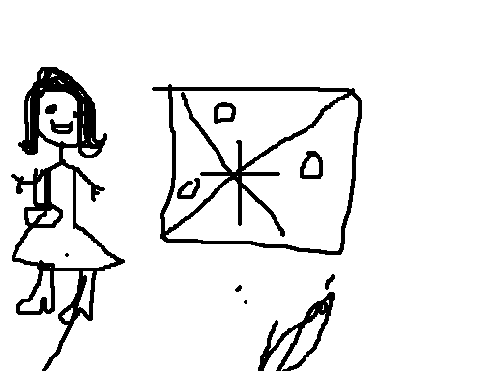
Thank you

