Slide 1
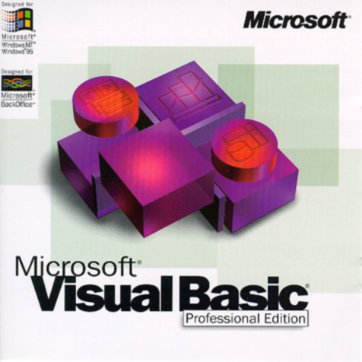
String Manipulation
Reference:
Lecturer Reham O. Al-Abdul Jabba lectures for cap211 [Binhadba update]
Notes:
1

Slide 2
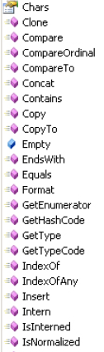
Strings have their own properties and methods, just like a textbox or label or form does.

Slide 3
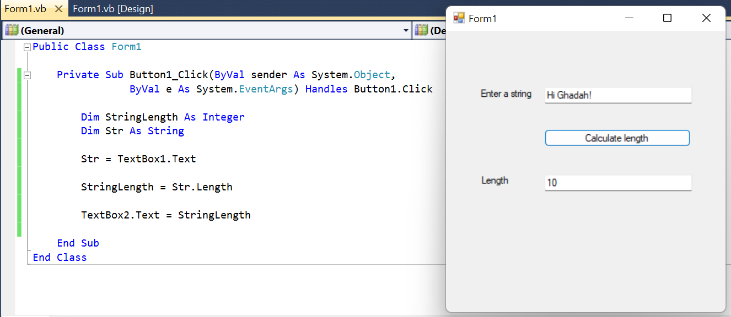
Length
Notice that the name of the variable you want to do something with comes first. Then, after the full stop(dot), you add the name of the method.
To get the length of a string:
Dim TextLength As Integer
TextLength = FirstName.Length

Slide 4
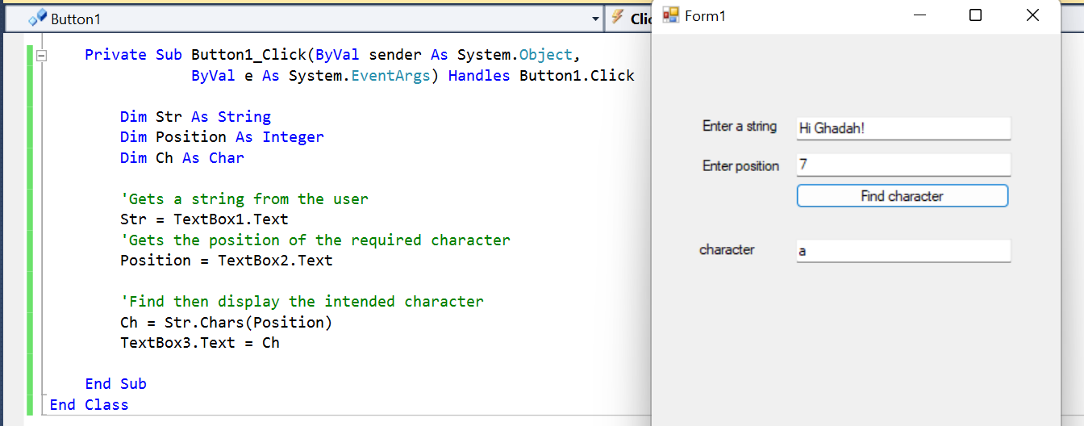
Chars
To get the character at a specified position.
Dim Ch As Char
…
Ch= Str.Chars(Position)

Slide 5
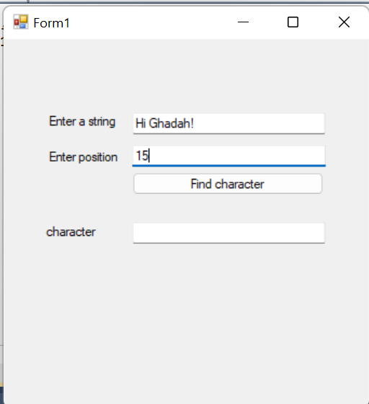
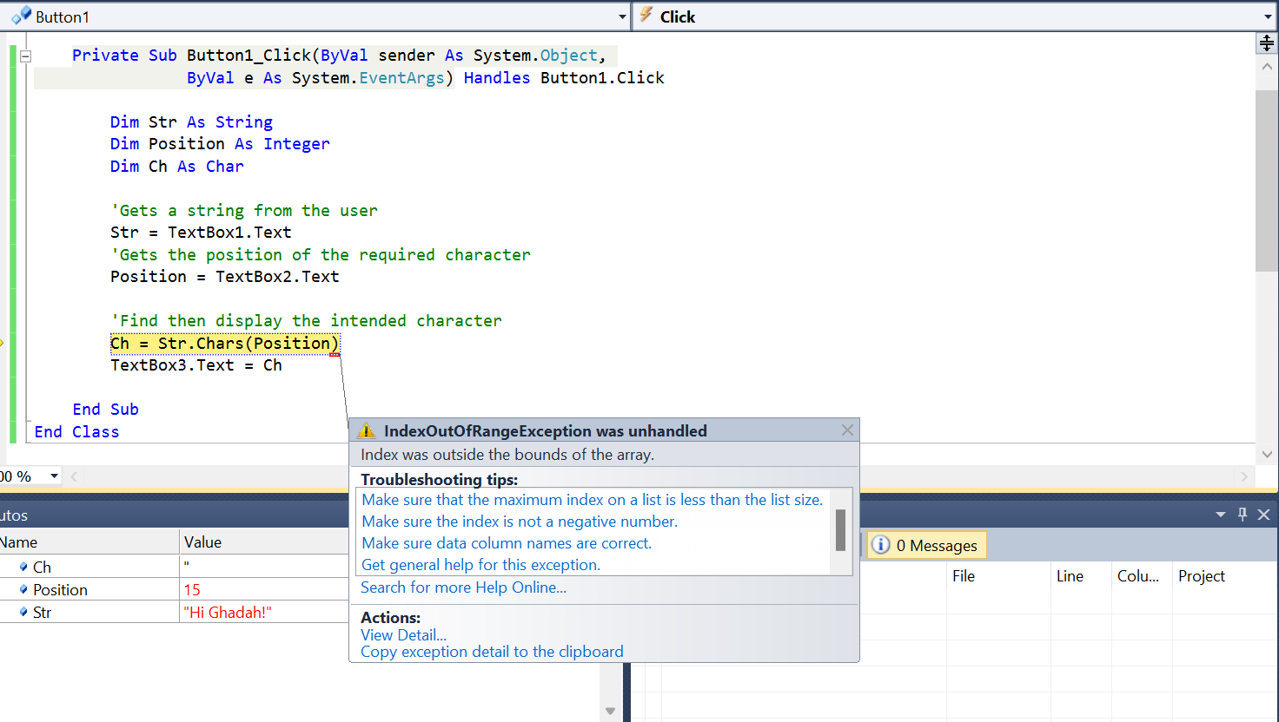

Chars
Note that: the entered Position should be any value between 0 and Str.length-1, As entering a value that exceeds its length will lead to a runtime error.

Slide 6
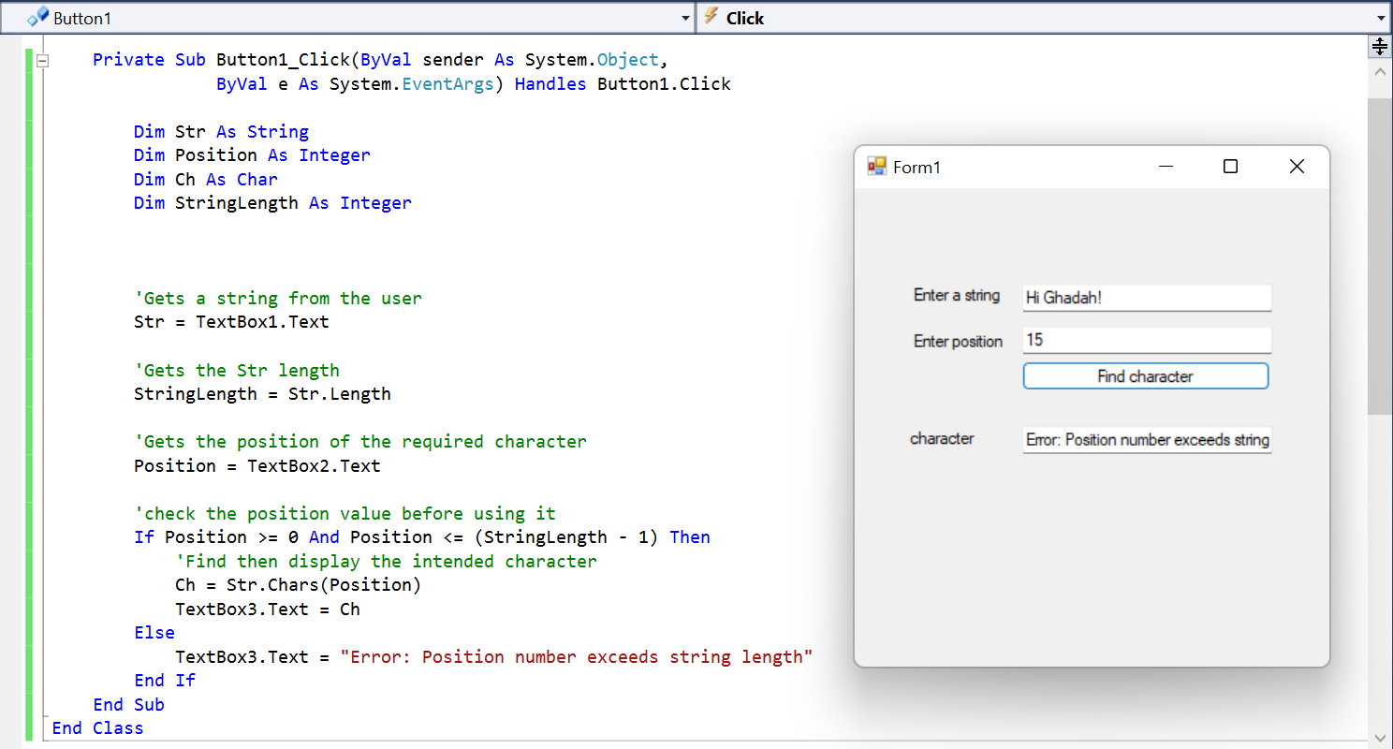
Chars
To avoid this from happening: check the value of position before using it using a condition statement (see below)

Slide 7
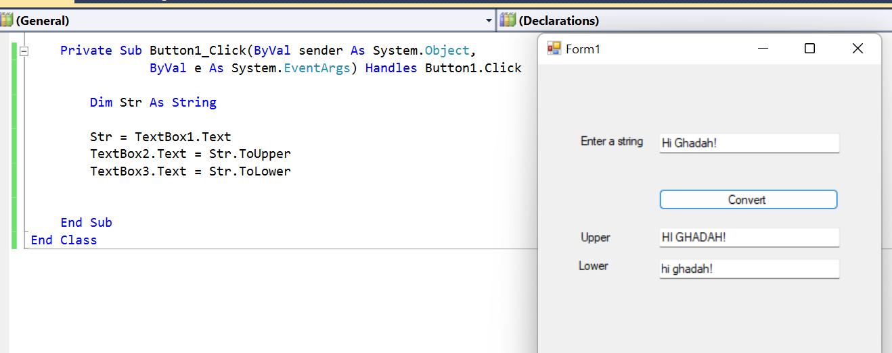
ToUpper, ToLower
Dim str As String
str = TextBox1.Text
TextBox2.Text = str.ToUpper
TextBox3.Text = str.ToLower

Slide 8
Trim
One of the methods on our list is Trim. What this does is to trim any leading or trailing blank spaces from a string.
So if the string was “ Text ”, then Trim would delete those spaces for you, leaving just “Text”.
You use it in your code like this:
  FirstName = FirstName.Trim

Slide 9
InStr( )
The InStr( ) method of string variables tells you what the position of one string is inside another.
For example, if your string was “me@me.com” and you wanted to know if the string contained the @ symbol, you could use InStr( ) Method.
You would use it like this:
  FirstString = “me@me.com”
  SecondString = “@”
  position = InStr(FirstString, SecondString)

Slide 10
InStr( )
The variable FirstString is the string we want to search; SecondString is what we want to search for.
You can specify a starting position for the search to begin. If you do, this number goes at the start (the default is zero):
position = InStr(1, FirstString, SecondString)
In the code above, position would have a value of 3. That’s because the @ symbols starts at the third letter of “me@me.com”.

Slide 11
InStr( )
Note: the InStr() Method starts counting at 1, and not zero like Chars(), which is very confusing!
If the string you’re searching for is not found, then the value placed inside of your integer variable (position in our case) is zero. That enables you to code something like this:
If position = 0 Then
MsgBox (“Not a Valid email address: There was No @ Sign”)
End If

Slide 12
Substring
This allows you to grab one string within another. (For example, if you wanted to grab the “.com” from the email address “me@me.com.”)
In between the round brackets of Substring( ), you specify a starting position and then how many characters you want to grab (the count starts at zero again). Like this:
Dim Email as String
Dim DotCom as String
Email = “me@me.com”
DotCom = Email.Substring(5, 4)
MsgBox(DotCom)

Slide 13
Substring
You could also do a check to see if the email address ended in “.com” like this. Here’s some code to do the job:
Dim Email As String
Dim DotCom As String
Email = "me@me.com"
DotCom = Email.Substring(Email.Length - 4, 4)
If DotCom = ".com" Then
MsgBox("Ends in Dot Com")
Else
MsgBox("Doesn't End in Dot Com")
End If

Slide 14
Substring
Substring method could do the same function as Chars() method and the result would be the same. Like this:
Ch= Str.Chars(Position)
Ch=Str. Substring(Position, 1)

Slide 15
Substring
Note: if you omit the number of characters you want to get, Substring will return the characters from the specified position until the end of the string.
Example
Dim s As String = "Welcome to the world"
s = s.Substring(8) ' “to the world ”
Dim r As String = "Welcome to the world"
r = r.SubString(8, 6) ' “to the”

Slide 16
Replace
You can replace text in one string with some other text.
Dim OldText As String
Dim NewText As String
OldText = "This is some test"
NewText = OldText.Replace("test", "text")
MsgBox(OldText)
MsgBox(NewText)
When you run the program, the first message box will say "This is some test" and the second box will say "This is some text".

Slide 17
Insert
You can also insert some new text into an string.
    Dim SomeText As String
    Dim NewText As String
    SomeText = "This some text"
    NewText = SomeText.Insert(5, "is ")
    MsgBox(SomeText)
    MsgBox(NewText)
The 5 in round brackets means start at position 5 in the string variable SomeText (the count starts at zero). You then type the text that you want inserted.
The first message box ➔ This some text
The second message box ➔ This is some text

Slide 18
Split and Join
Split allows you to split a line of text and put each element (word or phrase) into an array;
Join allows you to join elements of an array into one line of text.

Slide 19
Split
You can read the text file line by line, and each line might be something like this:
“UserName1, Password1, UserName2, Password2, UserName3, Password3”
The programming problem is to separate each word. You can use Split for this.
Each word would then be separated, ready for you to place into an array.

Slide 20
Split
Dim LineOfText As String
Dim i As Integer
Dim aryTextFile() As String
LineOfText = "UserName1, Password1, UserName2, Password2"
aryTextFile = LineOfText.Split(",")
For i = 0 To UBound(aryTextFile)
MsgBox(aryTextFile(i))
Next I
When VB finishes the splitting, it fills up your array. Each element will occupy one slot in your array.
So in our example, aryTextFile(0) will hold a value of UserName1, aryTextFile(1) will hold a value of Password1, etc.

Slide 21
Join
The Join method is used when you want to join the elements of an array back together again. Here’s some code which does exactly that:
Dim LineOfText As String
Dim i As Integer
Dim aryTextFile(3) As String
aryTextFile(0) = "UserName1"
aryTextFile(1) = "Password1"
aryTextFile(2) = "UserName2"
aryTextFile(3) = "Password2"
LineOfText = LineOfText.Join("-", aryTextFile)
MsgBox(LineOfText)
you first type what you want to use as a separator. Here, we’re using an hyphen as a separator. Next, you put the name of your array. The variable LineOfText will hold the following:
"UserName1-Password1-UserName2-Password2"

Slide 22

ToCharArray
Dim string1 As String = "hello"
Dim charArray() As Char = string1.ToCharArray()
Dim i As Integer
Textbox1. AppendText("string1 = " & string1&vbCrLf)
Textbox1. AppendText("string1 as an array of character =")
For i = 0 To charArray.Length - 1
Textbox1. AppendText(" " & charArray(i))
Next
string1 = hello
string1 as an array of character = h e l l o

Slide 23
Equals
In code previously, we had this:
If DotCom = ".com" Then
MsgBox("Ends in Dot Com")
Else
MsgBox("Doesn't End in Dot Com")
End If
You can use the Equals method of string variables in the first line, instead of an equals sign:
If DotCom.Equals(“.com”) Then
…

Slide 24
Equals
Str1.Equals(Str2)
variable
String.Equals(Str1,Str2)
namespace
Both returns true or false

Slide 25
CompareTo
Str1.compareTo (str2)
Returns:
  0 if equal
  -1 if str1 < str2 …. ASCII codes
  1 if str1 > str2

Slide 26
Dim a As String = "Ahmad"
Dim b As String = "Ali"
If (a.CompareTo(b) = 0) Then
Label1.Text = "equals"
End If
If (a.CompareTo(b) = -1) Then
Label1.Text = "ahmad <ali"
End If
If (a.CompareTo(b) = 1) Then
Label1.Text = "ahmad>ali"
End If

Slide 27
StrReverse
If you wish to flip around the front and back end of a string, then the StrReverse(string) is for you.
It is used in the following way. This would pop up a message saying ‘looc si 112pac’
MsgBox(StrReverse(“cap211 is cool"))

Slide 28
String Methods
Chr (65) → A
Asc (“Apple”) → 65
Asc(“Ahmad”) → 65
“32” & chr(176) & “Fahrenheit” ➔
32°Fahrenheit

Slide 29
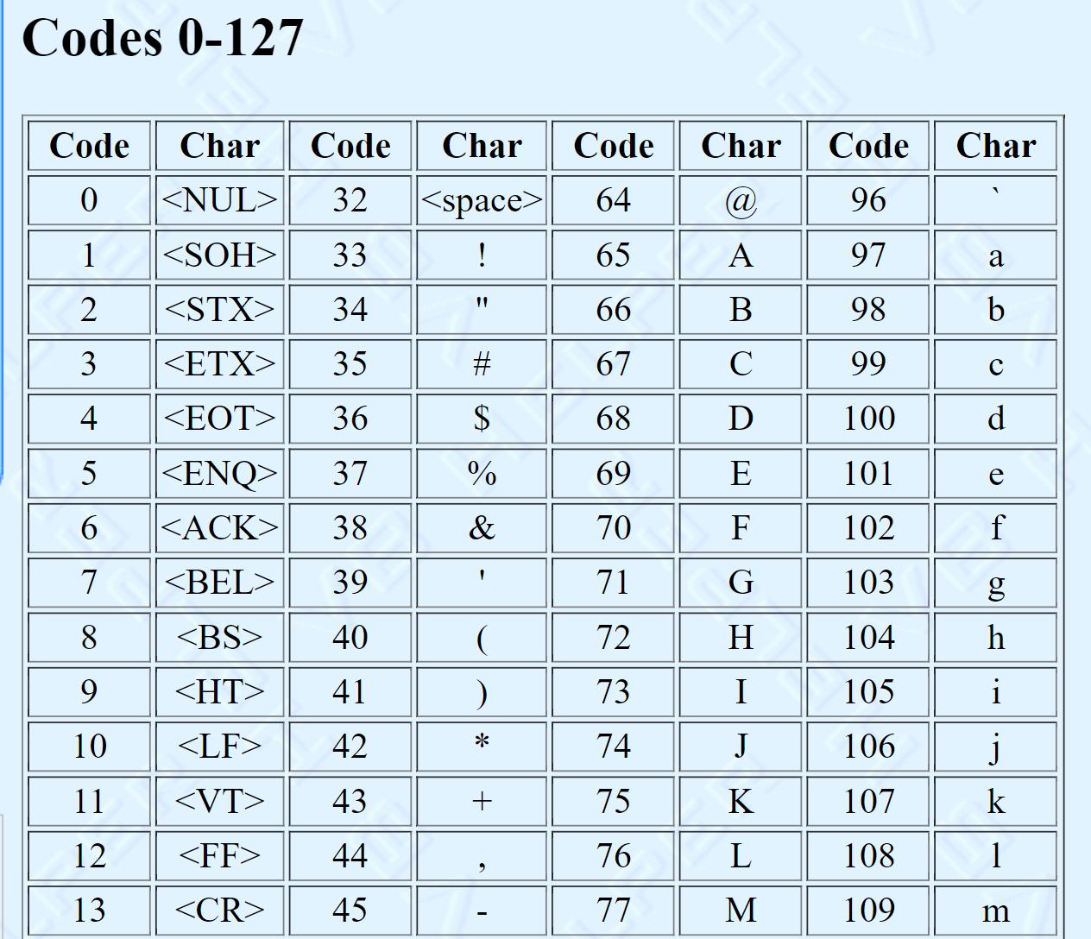
See full table here:
*VB Helper: Tutorial: ASCII Codes (vb-helper.com)

Slide 30


Char Methods
Test characters to determine whether they are of specific character type and that perform case conversions on characters.
IsDigit
IsLetter
IsLetterOrDigit
IsLower
IsUpper
ToUpper
ToLower
Returns Boolean value (True or False)
Returns a converted character

Slide 31
Char Methods
Dim ch As Char = textbox1.text
If Char.IsDigit( ch ) then
MsgBox (“Digit”)
Else
MsgBox (“Not Digit”)
End If

Slide 32
IndexOf Method
Let str1 and str2 be strings.
str1.IndexOf(str2)
is the position of the first occurrence of str2 in str1.
(Note: Has value -1 if str2 is not a substring of str1.)
"Visual Basic".IndexOf("is") is 1.
"Visual Basic".IndexOf("si") is 9.
"Visual Basic".IndexOf("ab") is -1.

Slide 33
Initial Value of a String Variable
By default the initial value is the keyword Nothing
Strings can be given a different initial value as follows:
Dim name As String = "Fred"

Slide 34
What is msgBox?

Slide 35
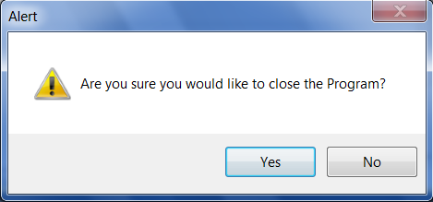



Msgbox
Dialog title
Icon
PromptText
Buttons

Slide 36




Msgbox -Parameters
The message box function takes 3 main parameters:
Msgbox (Prompt Text, Buttons+Icon, DialogTitle)
[ Prompt : a Text which contains the message. ]
Button Constant
vbOKOnly
vbOkCancel
vbYesNo
vbYesNoCancel
vbAbortRetryIgnore
vbRetryCancel
Icon Constant | Icon
vbQuestion
vbInformation
vbExclamation
vbCritical

Slide 37
Msgbox -Example
MsgBox("Are you sure you would like to close the Program?", vbYesNo + vbExclamation, "Alert")

