Slide 1

Fundamentals of Organic Chemistry
CHEM 108
King Saud University
College of Science, Chemistry Department
CHAPTER 4. ALCOHOLS, PHENOLS AND ETHERS
CHEM 108

Slide 2
Alcohols, Phenols and Ethers
Alcohols, ethers and phenols have a common functional group, the hydroxyl group, -OH.
Ph-O-H Phenol | R-O-R Ethers | R-OH Alcohol | H-O-H Water
Alcohols are compounds whose molecules have a hydroxyl group attached to a saturated carbon atom.
Phenols are compounds that have a hydroxyl group attached directly to a benzene ring .
Ethers are compounds whose molecules have an oxygen atom bonded to two carbon atom.

Slide 3
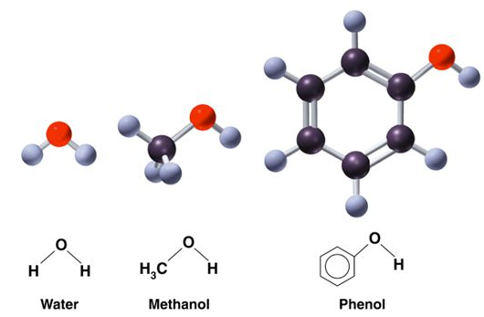
Alcohols and Phenols
Alcohols and phenols may be viewed as organic derivatives of water.
Alcohols have the general formula R-OH, and structurally similar to water, but with one of the hydrogens replaced by an alkyl group.
Phenols have a hydroxyl group attached directly to an aromatic ring.

Slide 4
Alcohols
Alcohols can be viewed in two ways structurally:
as hydroxyl derivatives of alkanes
and (2) as alkyl derivatives of water.

Slide 5
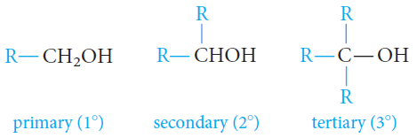
Classification of Alcohols
Alcohols are classified as primary (1°), secondary (2°), or tertiary (3°), depending on whether one, two, or three organic groups are connected to the hydroxyl-bearing carbon atom.
Methyl alcohol, which is not strictly covered by this classification, is usually grouped with the primary alcohols.

Slide 6
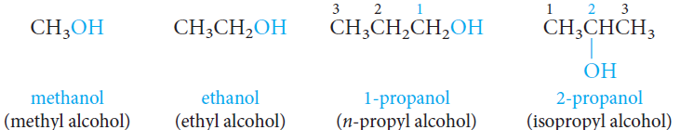
Nomenclature of Alcohols
The common names for the simplest alcohols consist of alkyl group attached to the hydroxyl function followed by the word alcohol: Alkyl alcohol .
In the IUPAC system, alcohols are named according to the following rules.
1. Select the longest continuous carbon chain that contains the -OH group.
Drop the –e ending of the parent alkane and replace it by the suffix -ol: Alkanol
2. When isomers are possible, the chain is numbered so as to give the functional group (-OH) the lowest possible number.

Slide 7
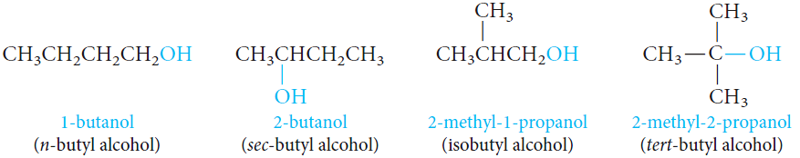
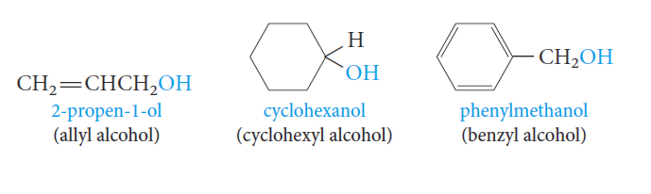
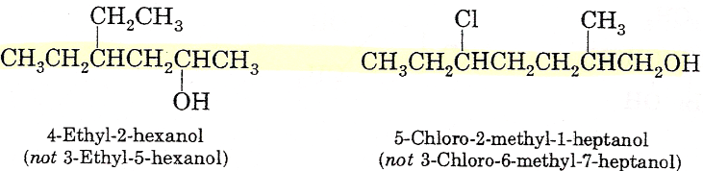
Nomenclature of Alcohols
3. When alkyl side chains or other groups are present, they are named alphabetically and their positions are indicated by a number.
The position of the functional group (-OH) is always given the lowest possible number at the end of the name.

Slide 8
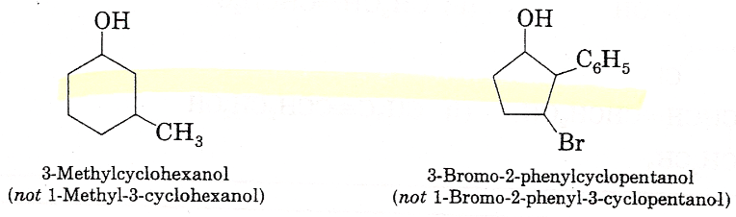
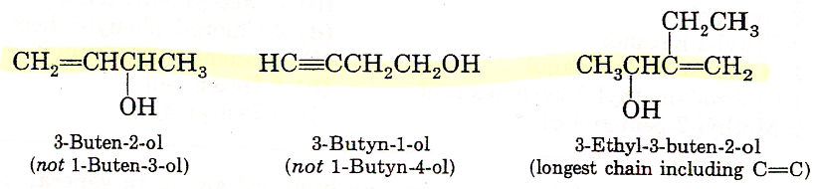
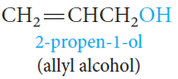
Nomenclature of Alcohols
For cyclic alcohols, numbering always starts from the carbon bearing the -OH group.
4. With Unsaturated Alcohols; If a molecule contains both an -OH group and a C=C or C-C triple bond, the -OH group takes preference before the double or triple bonds in getting the lower number.
The name should include (if possible) both the hydroxyl and the unsaturated groups, even if this does not make the longest chain the parent hydrocarbon.

Slide 9
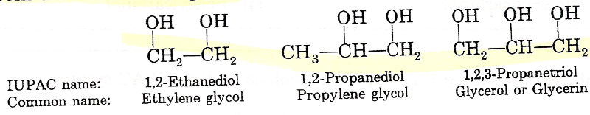
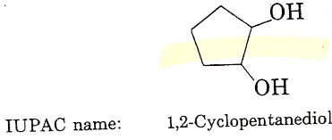
Nomenclature of Alcohols
Alcohols with More Than One Hydroxyl Group
Compounds with two adjacent alcohol groups are called glycols.
The most important example is ethylene glycol.
Compounds with more than two hydroxyl groups are also known, and several, such as glycerol and sorbitol, are important commercial chemicals.
Ethylene glycol is used as the “permanent” antifreeze in automobile radiators and as a raw material in the manufacture of polyester fiber: Dacron.
Ethylene glycol is completely miscible with water.
Glycerol is a syrupy, colorless, water-soluble, high-boiling liquid with a distinctly sweet taste. Its soothing qualities make it useful in shaving and toilet soaps and in cough drops and syrups.

Slide 10
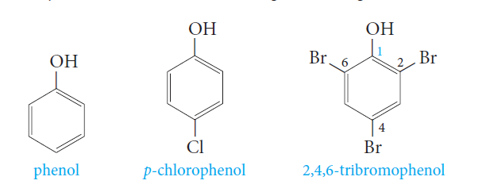
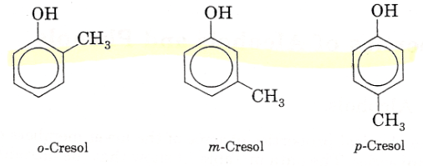
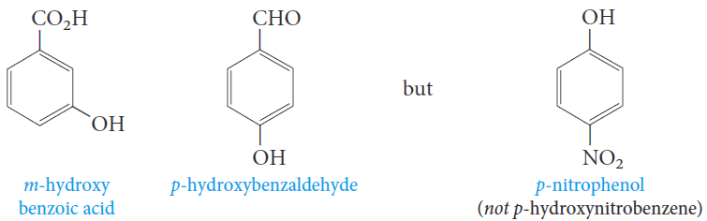
Nomenclature of Phenols
Phenols are usually named as derivatives of the parent compounds.
The hydroxyl group is named as a substituent when it occurs in the same molecule with carboxylic acid, aldehyde, or ketone functionalities, which have priority in naming.

Slide 11
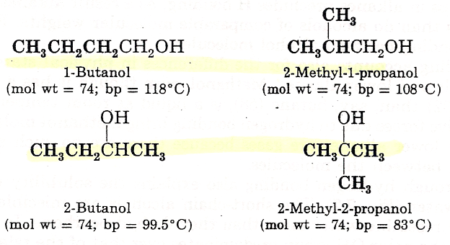
Physical Properties of Alcohols
Physical State
The simplest alcohol, methanol, is a liquid at room temperature.
In contrast, alkanes from methane to butane are gases.
Solubility
The lower alcohols are completely miscible with water.
As the number of carbons in the alcohol increases, the solubility in water decreases.
Boiling Points
Series of normal alcohols; The boiling points increase with increase in molecular weights.
A comparison of boiling points among isomeric alcohols; The boiling points decrease as the number of alkyl branches from the carbinol group increases.

Slide 12

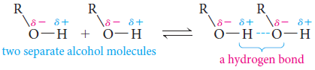
Hydrogen Bonding in Alcohols
The boiling points (bp,s) of alcohols are much higher than those of ethers or hydrocarbons with similar molecular weights.
Why? Because alcohols form hydrogen bonds with one another.
The O-H bond is polarized by the high electronegativity of the oxygen atom and places a partial positive charge on the hydrogen atom and a partial negative charge on the oxygen atom.
Two or more alcohol molecules thus become loosely bonded to one another through hydrogen bonds.

Slide 13
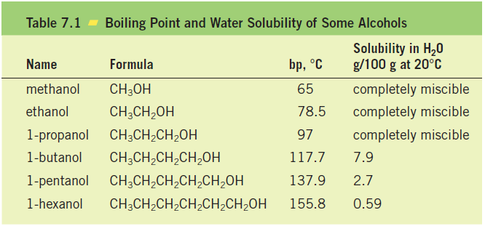
Hydrogen Bonding in Alcohols
Consequently, alcohols have relatively high boiling points because they must supply enough heat to break the hydrogen bonds before each molecule.
Hydrogen bonds are weaker than ordinary covalent bonds.
Water, of course, is also a hydrogen-bonded liquid.
The lower molecular-weight alcohols can readily replace water molecules in the hydrogen bonded network.
This accounts for the complete miscibility of the lower alcohols with water.
However, as the organic chain lengthens and the alcohol becomes relatively more hydrocarbon like, its water solubility decreases.

Slide 14
Physical Properties of Phenols
Phenol is a colorless, crystalline, low-melting solid, with a high boiling point, that is moderately soluble in water.
Most other phenols also are solids, with slight solubility in water and high boiling points.
The most significant physical property that distinguishes alcohols from phenols is the acidity of phenols.

Slide 15
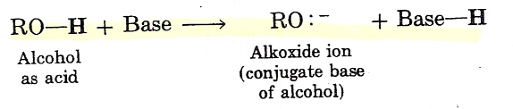
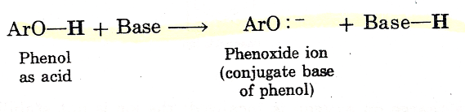
The Acidity of Alcohols and Phenols
Like water, alcohols and phenols are weak acids.
The hydroxyl group can act as a proton donor, and dissociation occurs in a manner similar to that for water

Slide 16
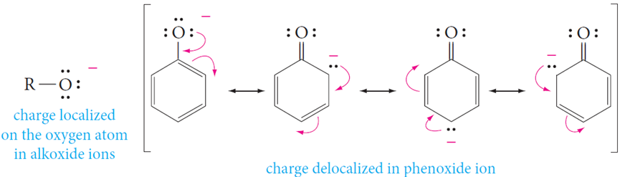
The Acidity of Alcohols and Phenols
Phenols are stronger acids than alcohols mainly because the corresponding phenoxide ions are stabilized by resonance.
The negative charge of an alkoxide ion is concentrated on the oxygen atom, but the negative charge on a phenoxide ion can be delocalized to the ortho and para ring positions through resonance.
Because phenoxide ions are stabilized in this way, the equilibrium for their formation is more favorable than that for alkoxide ions

Slide 17
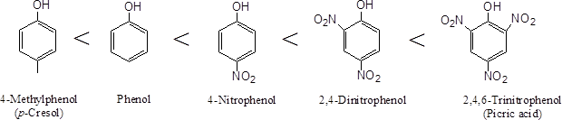

The Acidity of Alcohols and Phenols
All electron-withdrawing groups increase acidity by stabilizing the conjugate base. Electron-donating groups decrease acidity because they destabilize the conjugate base.

Slide 18
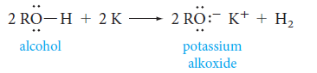
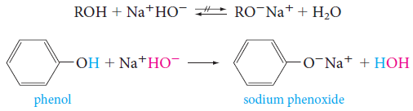
The Acidity of Alcohols and Phenols
Alkoxides, the conjugate bases of alcohols, can be prepared by the reaction of an alcohol with sodium or potassium metal.
Treatment of alcohols with sodium hydroxide does not convert them to their alkoxides.
This is because alkoxides are stronger bases than hydroxide ion, so the reaction goes in the reverse direction.
Since alcohols are weaker acids than water, it is not possible to form the salt of an alcohol in aqueous alkaline solutions.
Treatment of phenols with sodium hydroxide converts them to phenoxide ions.

Slide 19
Preparation of Alcohols
From Alkenes
A. Acid-Catalyzed Hydration of Alkenes
1. Addition of water to a double bond in the presence of an acid catalyst, H⁺.
It is not possible to prepare primary alcohols except Ethanol.

Slide 20
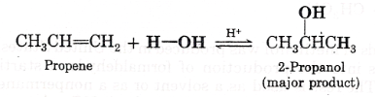
2. The addition follows Markovnikov’s rule.
Mechanism : Water adds to alkenes in the presence of an acid catalyst following Markovnikov’s rule, the reaction is reversible.

Slide 21
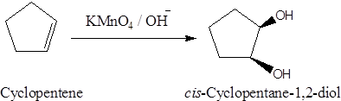
Preparation of Alcohols
From Alkenes
B. Oxidation of Alkenes and Cycloalkenes
Alkenes react with alkaline potassium permanganate to form glycols (compounds with two adjacent hydroxyl groups).

Slide 22
Preparation of Alcohols
Nucleophilic Substitution of Alkyl Halide
Reduction of Ketones, and Aldehydes using LiAlH₄ or NaBH₄

Slide 23
Reduction of Ketones, and Aldehydes
Aldehydes and ketones are easily reduced to primary and secondary alcohols, respectively.

Slide 24
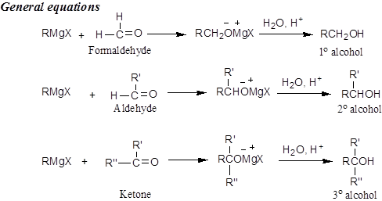
Preparation of Alcohols
Addition of Grignard’s Reagent to Aldehydes and Ketones

Slide 25
Reactions of Alcohols and Phenols
Alcohols undergo two kinds of reactions:
Those that involve the breaking of the oxygen-hydrogen bond (CO-H).
Those that involve the rupture of the carbon-oxygen bond (C-OH).
Phenols do not participate in reactions where the C-OH bond is broken.

Slide 26
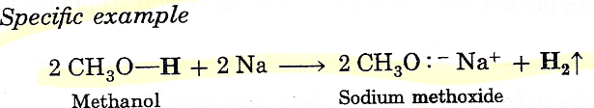
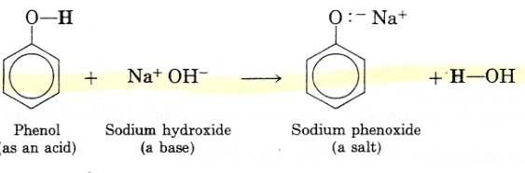
Reactions of Alcohols
A) Those that involve the breaking of the oxygen-hydrogen bond (CO-H).
1) Reactions of Alcohols and Phenols as Acids: Salt Formation.

Slide 27

Reactions of Alcohols
B) Those that involve the rupture of the carbon-oxygen bond (C-OH).
1) The Reaction of Alcohols with Hydrogen Halides: Alkyl Halides
Alcohols react with hydrogen halides (HCl, HBr and HI) to give alkyl halides.
Reaction of Primary Alcohols with Hydrogen Halides: The S_{N}2 Mechanism:
Methyl and primary carbocations are the least stable, and they are not likely to be intermediates in reaction mechanism:
RH₂C-OH + H-X RH₂C-X + HOH

Slide 28
Reactivity of the alcohol:
Reactivity of the H-X : parallels the acidity of HX
HF < HCl < HBr < HI

Slide 29

2) Dehydration of Alcohols: Formation of Alkenes
Alcohols can be dehydrated by heating them with strong acid.

Slide 30
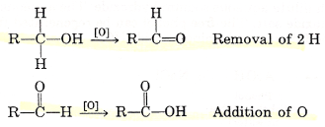
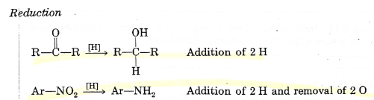
Reactions of Alcohols
C) Oxidation Reactions
Oxidation is the removal of H from a compound and/or the addition of O to a compound.
An oxidizing agent is the chemical reagent that does the oxidation.
Reduction is the addition of H to a compound and/or the removal of O from a compound.
A reducing agent is a substance that does the reduction.

Slide 31
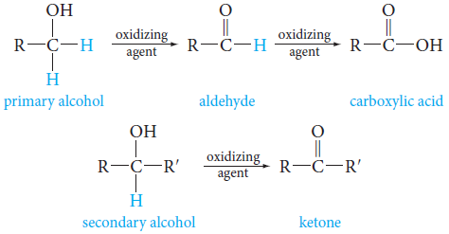
Reactions of Alcohols
C) Oxidation Reactions
Alcohols with at least one hydrogen attached to the hydroxyl-bearing carbon can be oxidized to carbonyl compounds.
Primary alcohols give aldehydes, which may be further oxidized to carboxylic acids.
Secondary alcohols give ketones.
Tertiary alcohols, having no hydrogen atom on hydroxyl-bearing carbon, do not undergo oxidation.

Slide 32
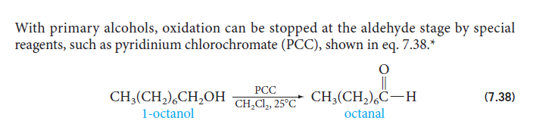
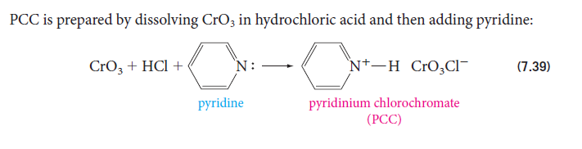
Reactions of Alcohols
C) Oxidation Reactions
Primary alcohols, oxidation can be stopped at aldehyde stage by special reagents, such as “pyridinium chlorochromate (PCC)”.

Slide 33
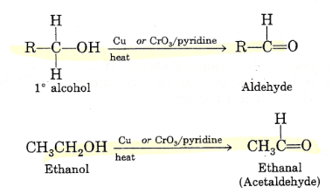
Reactions of Alcohols
C) Oxidation Reactions
Primary alcohols yield aldehydes when treated with mild oxidizing agents such as hot metallic copper or CrO₃ in pyridine.

Slide 34
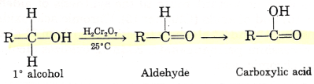
Reactions of Alcohols
C) Oxidation Reactions
Primary alcohols yield aldehydes when treated with stronger oxidizing agents, such as chromic acid, H₂Cr₂O₇, or neutral potassium permanganate, KMnO₄, the intermediate aldehydes formed initially are oxidized further to carboxylic acids.

Slide 35
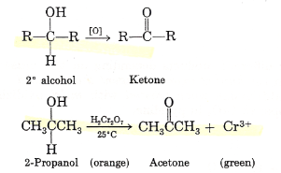
Reactions of Alcohols
C) Oxidation Reactions
Secondary alcohols, when treated with any of the oxidizing agents mentioned previously, yield ketones.

Slide 36
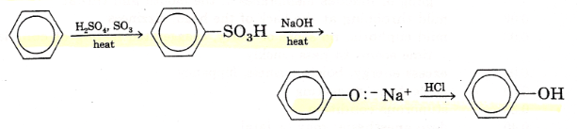
Preparation of Phenols
The Alkali Fusion of Sulfonates
The alkali fusion of sulfonates involves the following steps;
1. Sulfonation of an aromatic ring.
2. Melting (fusion) of the aromatic sulfonic acid with sodium hydroxide to give a phenoxide salt.
3. Acidification of the phenoxide with HCl to produce the phenol.

Slide 37
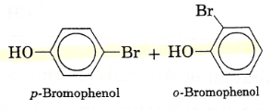
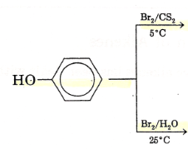
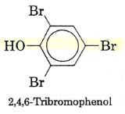
Reactions of Phenols
Halogenation takes place without catalyst.
The products depend on the solvent used.
In aprotic solvents (solvents that do not release protons) (CCl₄, CS₂)-bromination gives a mixture of o- and p-bromophenol.
In protic solvents (solvents that can release protons) (H₂O)-halogenation gives a trisubstituted phenol is produced.

Slide 38
Ethers

Slide 39
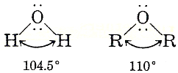
Structure of Ethers
All ethers are compounds in which two organic groups are connected to a single oxygen atom.
The general formula for an ether is R-O-R’, where R and R’ may be identical or different, and they may be alkyl or aryl groups
R—O—R, Ar—O—R, or Ar—O—Ar
The geometry of simple ethers is similar to that of water.

Slide 40
Structure of Ethers
The ether is classified as
Symmetrical ethers;
When the organic groups attached to the oxygen are identical.
Unsymmetrical ethers (mixed ethers);
When the organic groups attached to the oxygen are different.

Slide 41
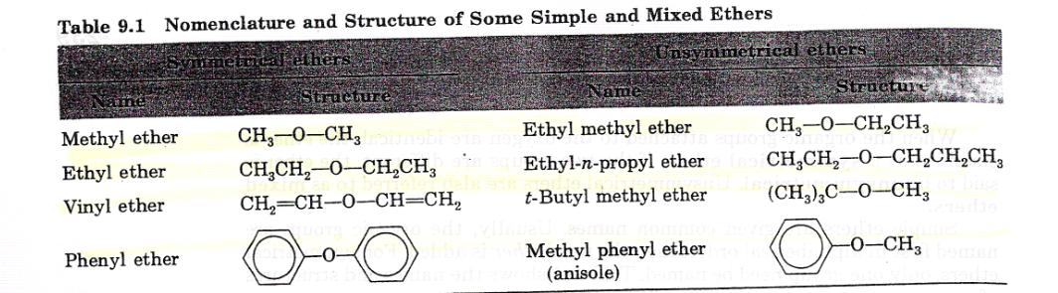
Nomenclature of Ethers
Common Names
Ethers are usually named by giving the name of each alkyl or aryl group, in alphabetical order, followed by the word ether.

Slide 42
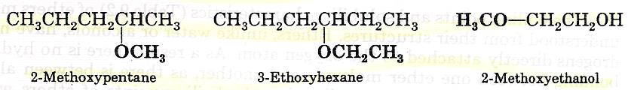
Nomenclature of Ethers
IUPAC System
For ethers with more complex structures, it may be necessary to name the -OR group as an alkoxy group. In the IUPAC system, the smaller alkoxy group is named as a substituent.

Slide 43
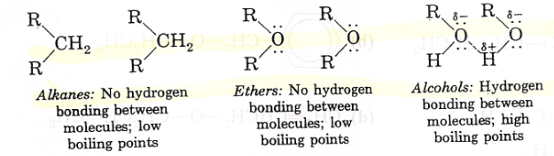
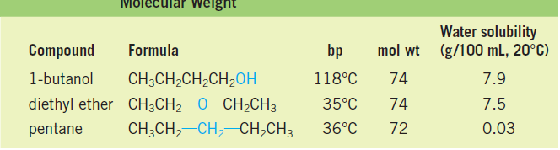
Physical Properties of Ethers
Physical State
Ethers are colorless compounds with characteristic, relatively pleasant odors.
Boiling Points
They have lower boiling points (bp,s) than alcohols with an equal number of carbon atoms.
In fact, an ether has nearly the same bp as the corresponding hydrocarbon in which a -CH₂- group replaces the ether’s oxygen.
Because of their structures (no O-H bonds), ether molecules cannot form hydrogen bonds with one another.

Slide 44
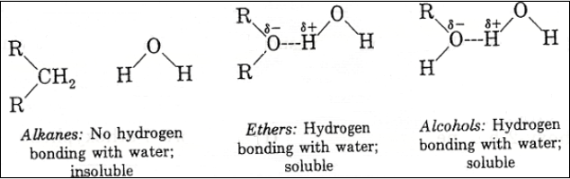
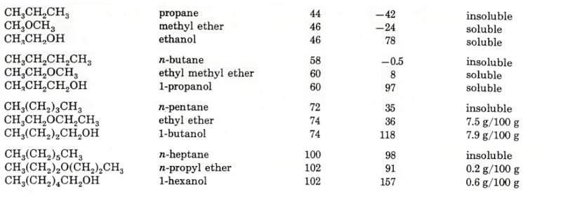
Physical Properties of Ethers
Solubility
Low-molecular-weight ethers, such as dimethyl ether, are quite soluble in water.
Ether molecules can form hydrogen bonds to water.

Slide 45
Preparation of Ethers
There are two general methods for synthesizing ethers.
1) Dehydration of alcohols
It is used commercially and in the laboratory to make certain symmetrical ethers.
2) Williamson synthesis
General laboratory method used to prepare all kinds of ethers, symmetrical and unsymmetrical.

Slide 46
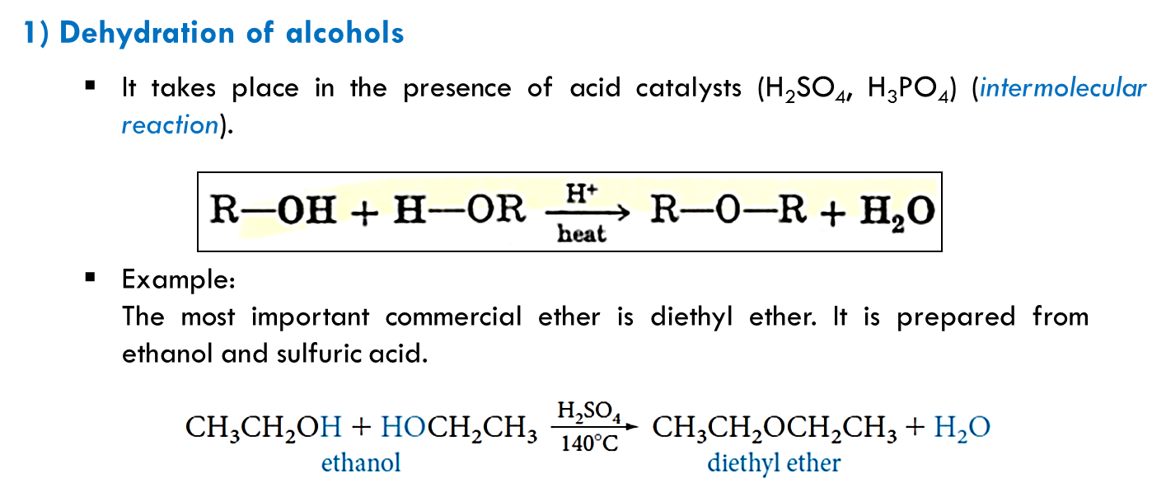
Preparation of Ethers
1) Dehydration of Alcohols
It takes place in the presence of acid catalysts (H₂SO₄, H₃PO₄) (intermolecular reaction)
Example;
The most important commercial ether is diethyl ether. It is prepared from ethanol and sulfuric acid.

Slide 47


Preparation of Ethers
Scope and Limitations
When ethyl alcohol is dehydrated by sulfuric acid at 180° C, the dominant product is ethylene.
To prepare ethyl ether
Dissolve ethyl alcohol in sulfuric acid at ambient temperature.
Heat the solution to 140°C while adding more alcohol.

Slide 48
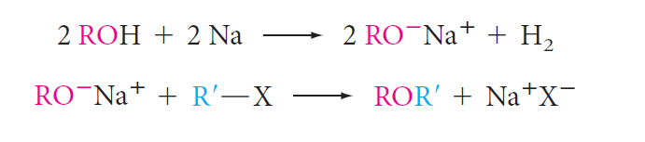
Preparation of Ethers
2) Williamson Synthesis
This method has two steps;
1) An alcohol is converted to its alkoxide by treatment with a reactive metal (sodium or potassium).
2) Displacement is carried out between the alkoxide and an alkyl halide.
To obtain the best yields of mixed dialkyl ethers, we select a 1° rather than a 2°or 3°alkyl halide and react it with a sodium alkoxide
To prepare an alkyl aryl ether, we must be careful not to pick a combination in which one of the reagents has a halogen directly attached to an aromatic ring.

Slide 49
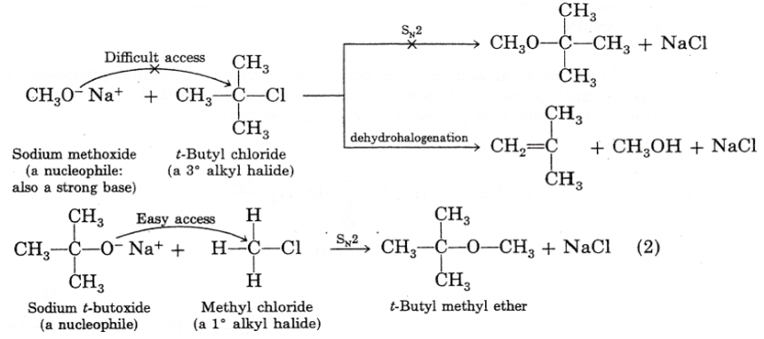
Preparation of Ethers
2) Williamson Synthesis
Example 1; Preparation of t-butyl methyl ether, (CH₃)₃C-O-CH₃.
In theory, this could be done by either of two reactions.
1. You could react sodium methoxide, CH₃O⁻Na⁺, with t-butyl chloride, (CH₃)₃C-Cl.
This combination leads to dehydrohalogenation to an alkene, an elimination reaction.
2. You could react sodium t-butoxide, (CH₃)₃C-O⁻Na⁺, with methyl chloride, CH₃Cl.
This route gives the desired ether by substitution.

Slide 50


Preparation of Ethers
2) Williamson Synthesis
Example 2; Assume you need to synthesize methyl phenyl ether (anisole), CH₃-O-C₆H₅, by the Williamson method.
In theory, you could obtain anisole in either of two ways.

Slide 51
Reactions of Ethers
Ethers are quite stable compounds.
The ether linkage does not react with bases, reducing agents, oxidizing agents, or active metals.
Ethers react only under strongly acidic conditions.

Slide 52


Preparation of Ethers
Cleavage of Ethers by Hot Concentrated Acids
When ethers are heated in concentrated acid solutions, the ether linkage is broken.
The acids most often used in this reaction are HI, HBr, and HCl.
If an excess of acid is present, the alcohol initially produced is converted into an alkyl halide by the reaction.

Slide 53


Cyclic Ethers
It is possible to obtain cyclic ethers by an intramolecular reaction.

THF is so named because it is related to the unsaturated cyclic ether furan.

Slide 54

Cyclic Ethers

When 1,5-pentanediol is heated in acid, the six-membered ring ether tetrahydropyran is obtained.

Tetrahydropyran is so called because it is related to the unsaturated ether pyran.

Slide 55
Uses of Ethers
Ether is used as a mild anesthetic and as a solvent in industries
It is used as an antiseptic to prevent infection when an injection is administered.
Dimethyl ether is used as refrigerant and as solvent at low temperature.
Diethyl ether is a common ingredient as an anesthetic in surgery.
Diethyl ether is common solvent for oils, gums, resins, etc….
We use phenyl ether as a heat transfer medium because of its high boiling point.

Slide 56

Epoxides
Epoxides are cyclic ethers in which the ether oxygen is part of a three membered ring.

The simplest and most important epoxide is ethylene oxide.

Ethylene oxide is prepared commercially by air oxidation of ethylene.

