Slide 1
Equilibrium constant

Slide 2
Equilibrium constant
Many reactions that occur in nature are reversible and do not proceed to completion.
They come to an equilibrium where the net velocity = 0
The velocity of forward reaction is equal to the reverse reaction.
The position of equilibrium is described by equilibrium constant, K_{eq}.

Slide 3
Equilibrium constant cont’ed
Example: dissociation of a weak acid:
HA H⁺ + A⁻
The forward velocity, is proportional to the [HA]
V_{f} α [HA]
V_{f} = k₁ [HA]
K₁ is proportional to the constant rate
V_{r} α [H⁺] and V_{r} α [A⁻]
V_{r} α [H⁺][A⁻]
V_{r} = k₋₁ [H⁺][A⁻]
K₁
K-₁

Slide 4
Equilibrium constant cont’ed
At equilibrium: V_{f} = V_{r}
Or k₁ [HA] = k₋₁ [H⁺][A⁻]
k₁ [H⁺][A⁻]
k₋₁ [HA]
=
k₁
k₋₁
K_{eq}
=
[H⁺][A⁻]
[HA]
K_{eq}
=

Slide 5
Acids and Bases

Slide 6
Acids and Bases
Acid: is a substance that can donate protons (hydrogen ions).
Base: is a substance that can accept protons.
Bronsted concept:
HA + B⁻ A⁻ + HB
Acid
Base
Conjugated Base
Conjugated Acid

Slide 7
Acids and Bases
The fundamental concept of Brønsted –Lowry theory:
Is that when an acid and a base react with each other, the acid forms its conjugate base, and the base forms its conjugate acid
by exchange of a proton (the hydrogen
cation, or H+).

Slide 8
Ionization of strong acids and bases
A strong acid is a substance that ionizes 100% in aqueous solutions.
HCl + H₂O H₃O⁺ + Cl⁻
A strong base is a substance that ionizes totally in solution to produce OH⁻ ions.
KOH K⁺ + OH⁻
^{Hydronium}

Slide 9
Ionization of Water
K₁
H₂O H⁺ + OH⁻
The equilibrium arrows, , mean that H₂O molecules are dissociating at exactly the same rate as H⁺ and OH⁻ ions are combining, and this is the reason it is called a dynamic equilibrium
Water is amphoteric it can accept and donate protons.
In pure water 1 mole of [H⁺] produces
1 mole of [OH⁻], ie. [H⁺] = [OH⁻]
The pH of water = 7
Then: [H⁺] = [OH⁻] = 10⁻⁷ M
K-₁
K_{eq}
[H⁺] [OH⁻]
[H₂O]
=

Slide 10

The equilibrium constant for the reversible ionization of water is
K_{eq} = [H⁺] [OH⁻] / [H₂O].
K_{eq} [H₂O] = [H⁺][OH⁻]
In pure water at 25˚C, the concentration of H₂O is 55.5 M.
Water concentration
Mw of water = 18g/mol
1L of water = 1000g
Number of mole= 1000g/18g/mol
n= 55.56 mol
M=n=55.56
If we go back to the equation
K_{eq} [H₂O]= [H⁺][OH⁻]

Slide 11
(K_{eq}) (55.6 M) = [H⁺] [OH⁻] = K_{W}
where K_{W} designates the product (55.6 M) (K_{eq}) and is the ion product of water.
Since the value of K_{eq}, determined by electrical conductivity measurements is 1.8 x 10⁻¹⁶ M, the equation becomes
K_{W} = [H⁺] [OH⁻] = (55.6 M) ( 1.8 x 10⁻¹⁶ M)
K_{W} = [H⁺] [OH⁻] = 1.0 x 10⁻¹⁴ .
The above calculations indicate that the product [H⁺] [OH⁻] in aqueous solution at 25˚C always equals 1 x 10⁻¹⁴ M.
Thus, when the concentrations of H⁺ and OH⁻ in solution are equal (a neutral solution at neutral pH, see below)
[H⁺] = [OH⁻] = 1 x 10⁻⁷ M.

Slide 12
The 10⁻⁷ is very small it can be neglected
• Since the concentration of the water is constant
thus Keq of water can be written as follows:
Keq = [H⁺] [OH⁻]
Kw = [H⁺] [OH⁻]
Kw = 10⁻⁷ X 10⁻⁷
Kw = 10⁻¹⁴
pKw = - log 10⁻¹⁴
pKw = 14

Slide 13
Potential of Hydrogen (pH)
Although the concentration of both OH⁻ and H⁺ are very effective in reactions, it’s usually the concentration of the [H⁺] ions in solutions that is measured.
The concentration of [H⁺] ions in solutions is usually very low; thus it’s expressed as pH where: pH= -Log [H⁺]

Slide 14
pH and pOH
pH is a shorthand way of designating the hydrogen ion activity of a solution.
pH is the negative logarithm of hydrogen ion activity.
pOH is the negative logarithm of the hydroxyl ion activity.

Slide 15
In dilute solutions of acids and bases and in pure water, the activities of H⁺ and OH⁻ may be considered to be the same as their concentrations.
pH= -log[H⁺] = log1/ [H⁺]
pOH= -log[OH⁻]= log1/ [OH⁻]
In all aqueous solutions the equilibrium for the ionization of water must be satisfied, that is, [H⁺][OH⁻]= K_{w} =10⁻¹⁴.
Thus, if [H⁺] is known, we can easily calculate [OH⁻]. Furthermore, we can derive the following relationship between pH and pOH:
[H⁺][OH⁻]= K_{w}

Slide 16
Taking the logarithm:
log [H⁺] + log[OH⁻]= log K_{w}
-log [H⁺] - log[OH⁻]= -log K_{w}
-log [H⁺]=pH ; - log[OH⁻]=pOH ; -log K_{w} =pK_{w}
pH + pOH = pK_{w}
K_{w} = 10⁻¹⁴
pK_{w} = -log10⁻¹⁴= +14
pH + pOH = 14

Slide 17
Example 1
pOH | pH | [OH-] | [H+]
 |  |  | 1x10⁻¹²
 |  | 1x10⁻⁶
 | 8
5
2
12
1x10⁻²
6
8
1x10⁻⁸
6
1x10⁻⁶
1x10⁻⁸
9
1x10⁻⁵
1x10⁻⁹
[H⁺][OH⁻]=10⁻¹⁴
pH + pOH= 14

Slide 18
pH
Determine the solution if it is acidic or basic?
pOH | pH | [OH-] | [H+]
 |  |  | 1x10⁻¹²
 |  | 1x10⁻⁶
 | 8
5
2
12
1x10⁻²
basic
6
8
1x10⁻⁸
basic
6
basic
1x10⁻⁶
1x10⁻⁸
9
1x10⁻⁵
1x10⁻⁹
basic
pH
0
7
14
Acidic
Basic
Neutral

Slide 19
Example 2
Calculate the pH of 0.10 M sodium hydroxide solution?
The formula of sodium hydroxide is NaOH and this compound is completely soluble.
Therefore [OH–] ion in solution = 0.10 M.
As [H⁺] [OH–] = 1 x10^{–14},
then [H⁺] = 1x10^{–14} / [OH–]
[H+] = 1x10^{–13} M
pH = –log[H+]
= –log(1 x10^{–13})
= –(–13.00)
= 13.00

Slide 20
Example 3
Calculate the pH of 0.010 M sodium hydroxide solution?
NaOH is completely soluble in water,
[OH–] in solution = 0.010 M.
As [H⁺] [OH–] = 1 x10^{–14}
then [H⁺] = 1x 10^{–14} / [OH–]
[H⁺] = 1x 10^{–14}
= 1 x 10^{–12} M
and pH = –log[H+]
= –log(1 x 10^{–12})
= 12.00
Notice how the pH of basic solutions approaches 7 from above as the base is diluted.

Slide 21
Example 4
What are the:
H⁺ ion concentration.
pH.
OH⁻ ion concentration.
pOH.
of a 0.001 M solution of HCl ?

Slide 22
A. HCl is a strong inorganic acid; it is 100% ionized in dilute solution.
So when 0.001 mole of HCl is introduced into a litre of H₂O, it immediately dissociates into 0.001 M H⁺ and 0.001 M Cl⁻.
The ionization of water in neglected.
B. pH= -log[H⁺]
= -log10⁻³
=-(-3)= +3

Slide 23
C. [H⁺][OH⁻]= K_{w} [OH⁻]= K_{w} /[H⁺]
[OH⁻]= (1 x 10⁻¹⁴ )/(1 X 10⁻³)
[OH⁻]= 1 x 10⁻¹¹
pOH= -log[OH⁻]
= -log(10⁻¹¹)
= -(-11)
pOH= 11
OR:
pH + pOH =14 pOH= 14 – pH
pH = 14 – 3 = 11

Slide 24
Example 5
What are the:
[H⁺].
[OH⁻].
pH.
pOH.
Of a 0.002 M solution of HNO₃ (nitric acid ) ?

Slide 25
HNO₃ is a strong inorganic acid.
[H⁺]= 0.002 M = 2 x 10⁻³ M
B. [H⁺][OH⁻]= 1 x 10⁻¹⁴
[OH⁻]= (1 x 10⁻¹⁴)/(2 x 10⁻³) = 0.5 x 10⁻¹¹
[OH⁻]= 5 X 10⁻¹⁴ M
C. pH= log 1/[H⁺]
= log 0.5 x 10³
= log 5 x 10² = 0.699 + 2
pH= 2.699
pH + pOH= 14
pOH= 14.000 – 2.699 = 11.301

Slide 26
Example 6
What is the concentration of HNO₃ in a solution that has a pH of 3.4 ?
[H⁺]= antilog -pH
=10^{-pH}
= 10^{-3.4}
= 10⁻⁴ x 10^{+0.6}
[H⁺]= 3.98 x 10⁻⁴

Slide 27
Example 7
How many: (a) H⁺ ions , (b) OH⁻ ions present in 250 ml of a solution of a pH 3?
pH = 3
[H⁺] = 10⁻³ M (g/L)
1 g/L = 6.023 × 10²³ ion/L
10⁻³ g/L = 6.023 × 10²⁰ ion/L
6.023 × 10²⁰
4
= 1.506 × 10²⁰ ion/250 ml
250 ml is 1/4th1000ml (1L)

Slide 28
OR
10⁻³ 1000
? 250ml
= 2.5x10⁻⁴
= 2.5x10⁻⁴ x (6.024x10²³)
= 1.506 × 10²⁰ ion/250 ml

Slide 29
B)
pH + pOH = 14
3 + pOH = 14
pOH = 14 – 3 = 11
[OH⁻] = 10⁻¹¹
1 g/L = 6.023 × 10²³ ion/L
10⁻¹¹ g/L = 6.023 × 10¹² ion/L
6.023 × 10¹²
4
= 1.506 × 10¹² ion/250 ml

Slide 30
Ionization of weak acids
Weak acids have a weak affinity towards their proton
CH₃COOH + H₂O CH₃COO ⁻ + H₃O⁺
K_{a} =
The concentration of water is not considered since it is a constant
HA H⁺ + A⁻
K_{a} =
[H₃O⁺] [CH₃COO⁻]
[CH₃COOH]
[H⁺] [A⁻]
[HA]

Slide 31
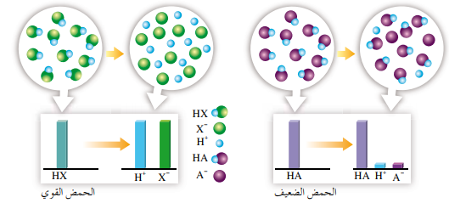
Ionization of weak acids cont’ed
Since weak acids ionize partially only thus their K_{a} value will always be less than one because the concentration of [HA] is always higher than the concentration of both [H⁺] and [A⁻]
Between weak acids the higher the K_{a} the stronger the acid.

Slide 32
Dissociation Constants of Weak Acids and Bases
Unlike strong acids (HCl, H₂SO₄) and strong bases (NaOH, KOH), weak acids and bases (e.g., acetic acid (CH₃COOH) and amino acids) are not completely ionized when dissolved in water.
Each weak acid has a characteristic tendency to lose its proton in aqueous solution.
The stronger the acid, the greater the tendency to ionize.

Slide 33
Dissociation Constants of Weak Acids and Bases
The tendency of any weak acid (HA) to lose a proton and form its conjugate base (A⁻) is defined by the equilibrium constant (K_{eq}) for the reversible reaction
HA  H⁺ + A⁻
For which K_{eq} = [H⁺][A⁻]/[HA] = K_{a}.
Equilibrium constants for ionization reactions are usually called acid dissociation constants, K.

Slide 34
Ionization of Weak Bases
Weak bases have a weak affinity towards their proton.
NH₄OH NH₄ ⁺ + OH⁻
K_{b} =
There are two types of bases:
Inorganic bases that ionize to release OH⁻ ions.
Organic bases, these bases don’t contain OH⁻ ions to release.
R- NH₂ + H₂O R-NH₃ ⁺ OH ⁻ R-NH₃⁺ + OH⁻
[NH₄ ⁺] [OH⁻]
[NH₄OH]

Slide 35
Ionization of Weak Bases
Organic bases will react with water accepting a proton and eventually OH⁻ will be released.
K_{b}= [R-NH₃⁺][OH⁻]
[R-NH₂]

Slide 36
In the case of strong acid, there is an equality between the concentration of acid used and the concentration of hydrogen ions resulting.
Most weak acids barely dissociate in solution.

Slide 37
pH of Solutions of Weak Acids
The dissociation of a weak monoprotic acid, HA, yields, H⁺ and A⁻ in equal concentration.
If K_{a} and the initial concentration of HA are known, H⁺ can be calculated easily:
K_{a} = =
[H⁺] ² =K_{a} [HA]
[H⁺] =√ K_{a} [HA]
Log[H⁺] = ½ Log K_{a} [HA]
[H⁺] [A⁻]
[H⁺] ²
[HA]
[HA]

Slide 38
pH of Solutions of Weak Acids Cont’ed
Multiply by -1
- Log[H⁺] = ½ (-Log K_{a} - Log [HA])
pH = ½ ( pK_{a} + p [HA]) →To calculate pH of weak acid
A similar relationship can be derived for weak bases:
[OH⁻] =√ K_{b} [A⁻]
pOH = ½ ( pK_{b} + p [A⁻]) →To calculate pH of weak base

Slide 39
Example 1
Estimate the pH of a 0.20 M solution of acetic acid, K_{a} = 1.8 × 10^{–5}.
[H⁺] =√ K_{a} [HA]
= (0.20 × 1.8E–5)^{½}
= 1.9E-3 M
The pH of the solution is
–log (1.9E–3) = 2.7

Slide 40
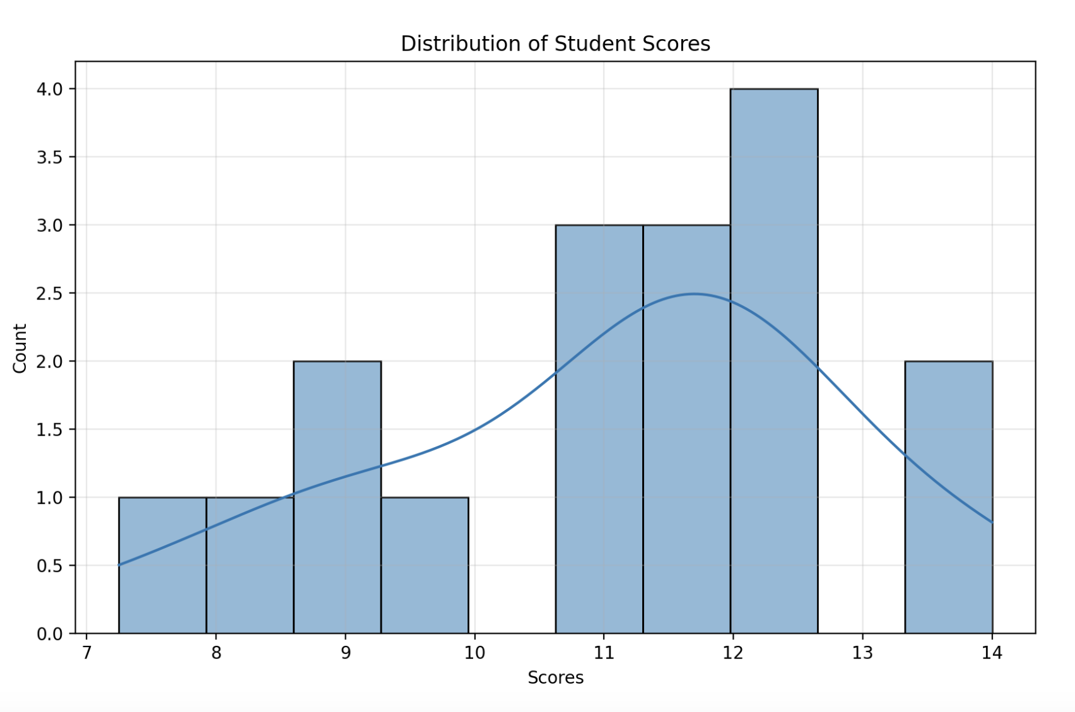

Slide 41
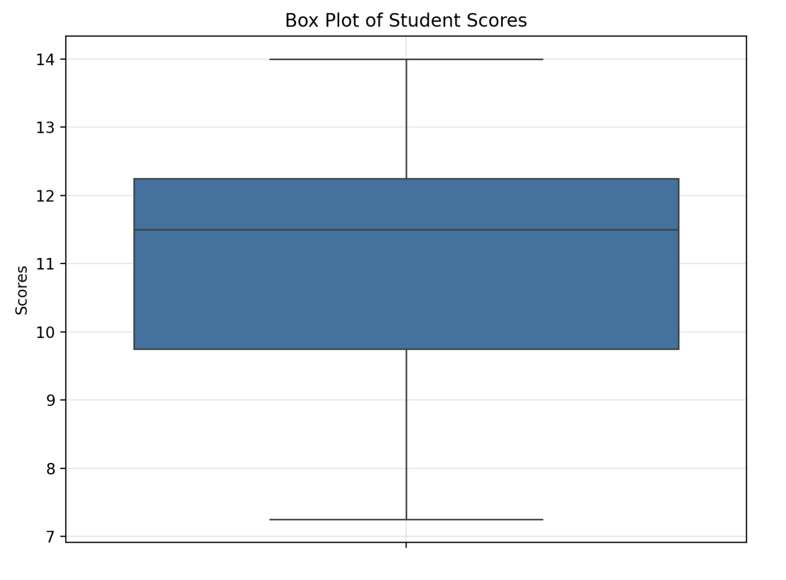
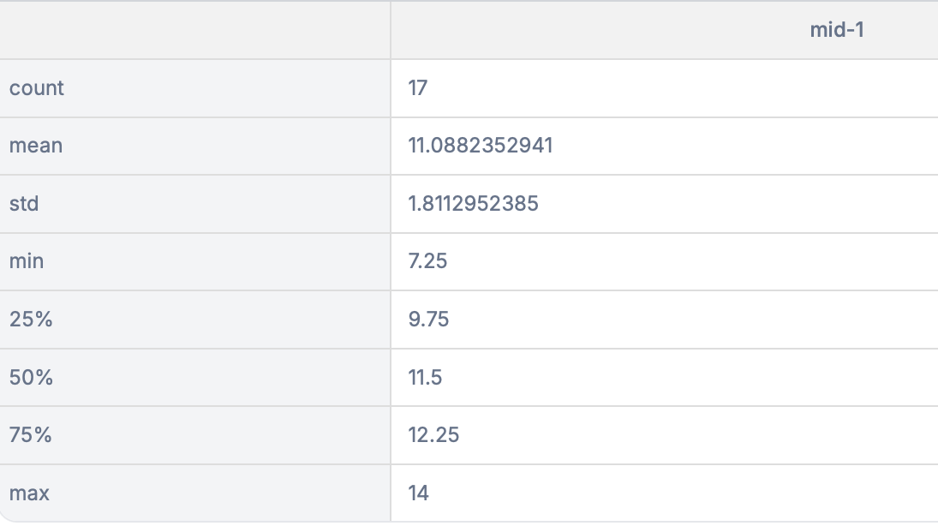

Slide 42
Neutralization
Of strong acids and bases

Slide 43
Neutralization of strong acids and bases
To answer any question related to neutralization , follow the steps below:
1-Know that to neutralize an acid or a base and form salt +water (pH=7)
no. of moles /equivalents of H+ = no. of moles /equivalents of OH-
2-Choose either moles /equivalents depending on the (n) if it is for both acid and base:
•same -------- then moles
•Different -------- then equivalents
3-finally, calculate according to what is ordered in the Q.

Slide 44
Example1
1- How many ml of 0.025 M H₂SO₄ are required to neutralize exactly 525 ml of 0.06 M KOH?
2- What is the pH of the neutralized solution?
No. of moles (equivalents) of H⁺ required = no. of moles (equivalents) of OH⁻ present
V (in L)_{acid} × N_{acid} = no. of equivalents
V (in L)_{acid} × N_{acid} = V (in L)_{base} × N_{base}
0.025 M H2SO4
V=? (ml)
0.06 M KOH
V= 525ml = 0.525 L
Note : No of equivalents is calculated instead of moles , since H2SO4release 2 H⁺ and KOH release 1 OH⁻ (i.e. different (n) number)

Slide 45
Cont’ed
N_{acid}= M x n= 0.025 M x 2 = 0.05 N
N_{base}= M x n= 0.06 M x 1 = 0.06 N
V (in L)_{acid}×0.05 = 0.525 ×0.06
V (in L)_{acid}= (0.525 ×0.06) / 0.05
= 0.63 L =630 ml
The neutralized solution contains only K₂SO₄ “a salt” of a strong acid and strong base has no effect on pH
pH =7

Slide 46
Example 2
How many ml of 0.05 N HCl are required to neutralize exactly 8g of NaOH?
At the equivalent point:
The no. of moles H+ added = no. of moles OH-present
V (in L)_{acid}× M_{acid}= no. of moles of H+ added
M=N/n 0.05/1 = 0.05M
wt_{NaOH}/ Mwt_{NaOH}= no. of moles of OH⁻present
0.05 N HCl
V=? (ml)
8g NaOH
Mwt= 23+16+1 = 40 g\mol
Note : No of moles is calculated, since HCl release 1 H⁺ and NaOH release 1 OH⁻ (i.e. same (n) number)

Slide 47
Cont’ed
V (in L)_{HCl} × M_{HCl.} = wt_{NaOH}/ Mwt_{NaOH}
V (in L)_{HCl}×0.05 = 8 / 40
V (in L)_{HCl}= 0.2/ 0.05 = 4 L or 4000 ml

Slide 48
Relationship between K_{a} and K_{b} for weak acids and bases
Weak acids (HA) dissociates in water:
HA H⁺ + A⁻
K_{a} =
If we start with conjugated base A⁻ and dissolve it water, it ionizes as a typical base:
A⁻ + HOH HA + OH⁻
K_{b} =
[H⁺] [A⁻]
[HA]
[HA] [OH⁻]
[A⁻]

Slide 49
[H⁺] =
[OH⁻] =
[H⁺] [OH⁻] = K_{w}
= K_{w}
K_{a} × K_{b} = K_{w}
Log K_{a} + Log K_{b} = Log K_{w}
- Log K_{a} - Log K_{b} = - Log K_{w}
pk_{a} + pK_{b} = pK_{w}
14 = pK_{w}
pk_{a} + pK_{b} = 14
[HA] K_{a}
[A⁻]
[A⁻] K_{b}
[HA]
[HA] K_{a}
[A⁻] K_{b}
×
[A⁻]
[HA]

Slide 50
The K_{a} for a weak acid, is 1.6 ×10⁻⁶. The molarity of acid is 10⁻³ M. What are the:
A) pH.
B) Calculate pK_{a} and pK_{b.}
A) pH = ½ ( pK_{a} + p [HA])
pK_{a} = - log K_{a}
pK_{a} = - log K_{a} = - log 1.6 ×10⁻⁶
pK_{a} = 5.796

Slide 51
P [HA] = - log [HA] = - log 10⁻³
P [HA] = 3
pH = ½ ( pK_{a} + p [HA])
pH = ½ (5.79 + 3)
pH = 4.398
B) pK_{a} = - log K_{a}
pK_{a} = - log K_{a} = - log 1.6 ×10⁻⁶
pK_{a} = 5.796
pK_{a} + pK_{b} = 14
pK_{b} = 14 - pK_{a} = 14 – 5.796
pK_{b} = 8.204

Slide 52
Example 3
A weak acid HA, is 0.1% ionized (dissociated) in a 0.2 M solution.
What is the equilibrium constant of the acid K_{a}?
What is the pH of the solution?
How much weaker is the active acidity of the HA solution compared to a 0.2 M solution of HCl?
How many ml of 0.1 N KOH would be required to neutralize completely 500 ml of 0.2 M HA solution?

Slide 53
A)First, calculate the dissociation fraction by multiplying the starting conc (0.2M) with the dissociation % to find the conc. of both ions at equilibrium.
The dissociation fraction= (0.1/100) ×0.2 = 2×10⁻⁴M
HA H⁺. + A⁻
Start: 0.2 M 0 + 0
Equilibrium: 0.2 _ 2×10⁻⁴M 2×10⁻⁴M + 2×10⁻⁴M
Ka= =
[H⁺] [A⁻]
(2×10⁻⁴) ×(2×10⁻⁴)
0.2 _ 2×10⁻⁴
[HA]
When the amount of HA that has dissociated is small, 10% or less the Ka is simplified by ignoring the subtraction from [HA]

Slide 54
K_{a} = ((2×10⁻⁴) × (2×10⁻⁴)) / 0.2
K_{a} = 4×10⁻⁸ / 2×10⁻¹
K_{a} = 2×10⁻⁷
B) pH = - Log [H⁺]
pH = - Log 2×10⁻⁴
pH = 3.7
C) A 0.2 M HCl would be 100% ionized and yields 0.2 M H⁺
pH = - Log [H⁺]
pH = - Log 0.2
pH = 0.7
The weak acid is 3 pH units less than HCl but this is a log scale, actually HA is 1000 times weaker than HCL

Slide 55
Example Continue
D) No. of moles of OH⁻ required = no. of moles of H⁺ present
V (in L)_{base}× M_{base} = V (in L)_{acid} × M_{acid}
N _{base}= M _{base}( n= 1)
V (in L)_{base} × 0.1= 0.5 × 0.2
V_{base} = 0.1/ 0.1 = 1 liter = 1000ml
0.1 N KOH
V=? (ml)
0.2 M HA
V=500ml = 0.5 L
Note : No of moles is calculated, since HA release 1 H⁺ and KOH release 1 OH⁻ (i.e. same (n) number)

Slide 56
Do you have questions?

