Slide 1
Motion Study and Work Design
Sections:
Basic Motion Elements and Work Analysis – part 1
Micromotion Analysis – part 1
Principles of Motion Economy and Work Design – part 2

Slide 2
Definitions
Motion study - analysis of the basic hand, arm, and body movements of workers as they perform work
Work design - design of the methods and motions used to perform a task
Includes:
Workplace layout and environment
Tooling and equipment used in the task

Slide 3
Motion Study and Work Design
Basic Motion Elements and Work Analysis

Slide 4
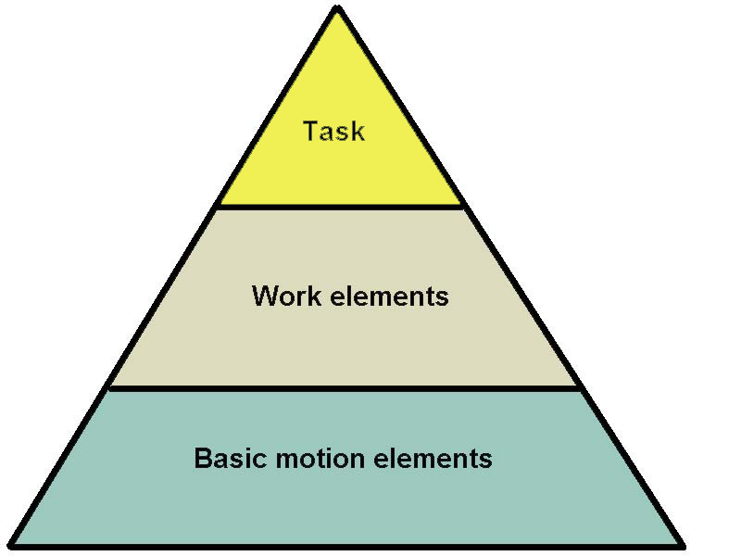
The Pyramidal Structure of Work
Remember?
Work consists of tasks
Tasks consist of work elements
Work elements consist of basic motion elements

Slide 5
Basic Motion Elements
Therbligs* – 17** basic motion elements
Basic building blocks of virtually all manual work performed at a single location
Invented/refined by Frank and Lillian Gilbreth (1908 – 1924): “motion cycles”
Used to
examine smallest of motions
categorize motions
Identify unnecessary / fatigue producing motions
Note, not related to “time study” (only motion)***
Notes:
* Can you guess where the name Therbligs came from? A: -mostly- Gilbreth spelled backwards
* * Anywhere between 15 – 18 elements, depending on classification or textbook (we will stick here with these 17)
MTM stands for: Methods-Time Measurement; MOST: Maynard Operation Sequence Technique; MTM, MOST: modern work measurement systems that utilize Therbligs
* * * Time would be identified later when adding time to Therbligs plotted on a SIMO chart, in order to identify positions of time-wasting motions

Slide 6
Basic Motion Elements
Watch movie “Frank & Lillian Gilbreth” https://youtu.be/ZsQ7KPO6DOw
Reading assignment: “Therbligs: The Keys to Simplifying Work”
http://web.mit.edu/allanmc/www/Therblgs.pdf
Or here:
http://gilbrethnetwork.tripod.com/therbligs.html
Notes:
* Can you guess where the name Therbligs came from? A: -mostly- Gilbreth spelled backwards
* * Anywhere between 15 – 18 elements, depending on classification or textbook (we will stick here with these 17)
MTM stands for: Methods-Time Measurement

Slide 7
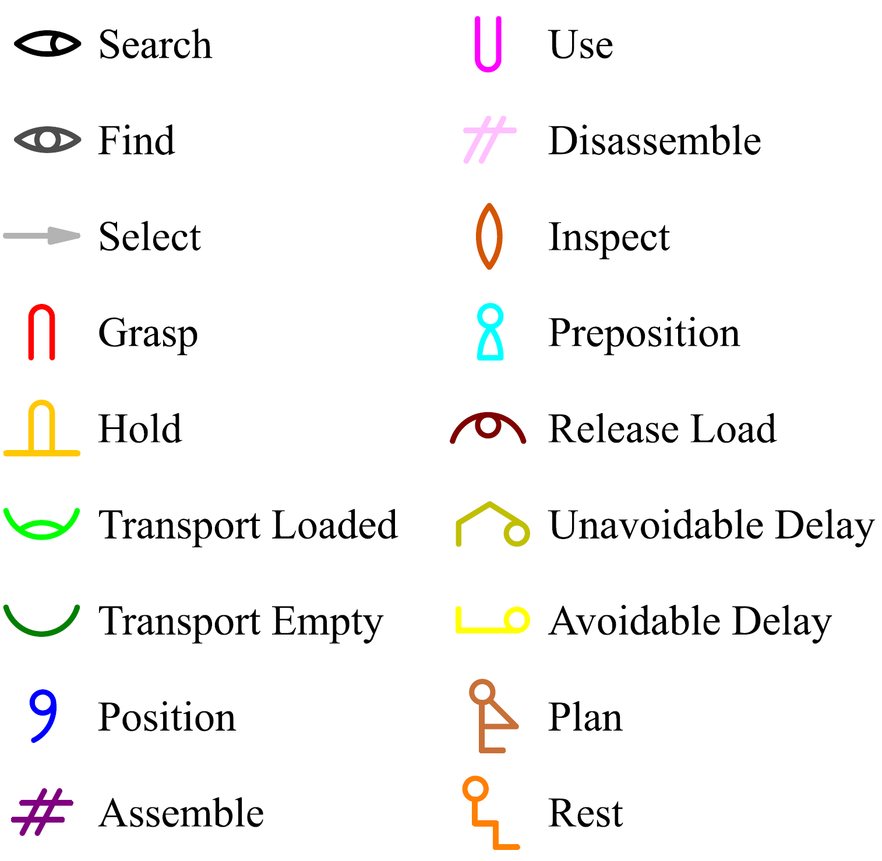
Therbligs
*
Therbligs symbols chart (18)
Notes:
* Find (F) Therblig is non-existent in some textbooks; Read in handout [Therbligs The Keys to Simplifying Work] “Dr. Barnes eliminated this Therblig, explaining that it was a mental reaction, at the end of the Search cycle.” Source: http://web.mit.edu/allanmc/www/Therblgs.pdf
Note how each Therblig has a specific color (to help identify it; see how HFE course was important in specifying this)

Slide 8
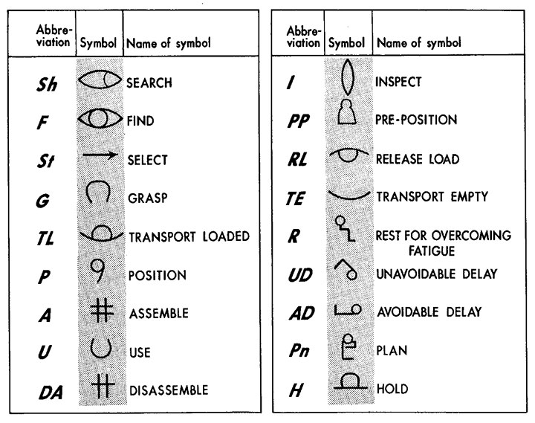
Therbligs
Therbligs symbols chart (18)

Slide 9
Therbligs
Transport empty (TE) – reach for an object
{icon shows an empty hand}
Grasp (G) – grasp an object
{icon suggesting by a hand poised over an object, ready to grasp it}
Transport loaded (TL) – move an object with hand and arm
{icon shows a hand cupped, holding an object}

Slide 10
Therbligs
Hold (H) – hold an object
{icon suggested by a horseshoe magnet holding a bar}
Release load (RL) – release control of an object
{icon suggested by a hand with an object poised to drop}
Use (U) – manipulate a tool
{icon is simple the letter U ---for Use}

Slide 11
Therbligs (continued)
Pre-position (PP) – position object for next operation
{icon suggests a bowling pin being placed into proper position}
Position (P) – position object in defined location
{icon suggests an object, such as a pen, being placed in the hand, ready to Use}
Assemble (A) – join two parts
{icon shows several items (lines) placed together}

Slide 12
Therbligs (continued)
Disassemble (DA) – separate multiple parts that were previously joined
{icon shows Assemble symbol with one part removed}
Search (Sh) – attempt to find an object using eyes or hand
{icon suggested by an eye turned, as if searching}

Slide 13
Therbligs (continued)
Select (St) – choose among several objects in a group
{icon suggested by an arrow aimed at an object, much the same as a computer cursor in form and intent}
Plan (Pn) – decide on an action
{icon shows a worker with fingers on head, thinking}
Inspect (I) – determine quality of object
{icon suggests a magnifying glass}

Slide 14
Therbligs (continued)
Unavoidable delay (UD) – waiting due to factors beyond worker control
{icon suggested by a man bumping his nose unintentionally}
Avoidable delay (AD) – worker waiting
{icon shows a worker intentionally lying down on the job}
Rest (R) – resting to overcome fatigue
{icon shows a person resting in a seated position}

Slide 15
Classification of Therbligs
Effective therbligs:
Transport empty
Grasp
Transport loaded
Release load
Use
Assemble
Disassemble
Inspect
Rest
Ineffective therbligs:
Hold
Pre-position
Position
Search
Select
Plan
Unavoidable delay
Avoidable delay
Notes:
Q: can you identify the reason for each of the effective and ineffective therbligs?

Slide 16
Classification of Therbligs
Types of Therbligs
Motions required for performing an operation
Motions that tend to slow down type 1 motion
Motions that do not perform an operation
Notes:
Note, this is another classification (from another source on the same topic)

Slide 17
Classification of Therbligs
Types of Therbligs
Motions required for performing an operation:
Transport empty
Grasp
Transport loaded (carry)
Position
Use
Assemble
Disassemble
Release load
Inspect

Slide 18
Classification of Therbligs
Types of Therbligs
Motions that tend to slow down type 1 motion :
Search
Find*
Select
Plan (person thinking)
Pre-position (set up)
Notes:
* Find (F) Therblig is non-existent in some textbooks; Read in handout [Therbligs The Keys to Simplifying Work] “Dr. Barnes eliminated this Therblig, explaining that it was a mental reaction, at the end of the Search cycle.” Source: http://web.mit.edu/allanmc/www/Therblgs.pdf

Slide 19
Classification of Therbligs
Types of Therbligs
Motions that do not perform an operation :
Hold
Unavoidable delay
Avoidable delay (standby)
Rest

Slide 20
Benefits of Classification
Use motions which are easy and effective,
Discard motions which are awkward, fatiguing and ineffective
People who accomplish the most do not necessarily work hardest
Watch video on application of therbligs on a simple task: https://youtu.be/z2EYyPA2Gik
Notes:
Here is another very good (detailed) video on therbligs: https://youtu.be/O77elB7-CYE (watch first part only for now: motion study; time study later)

Slide 21
Benefits of Classification
Identifying/solving avoidable delay
e.g. person selecting parts for assembly
exclusively with one hand
while the other remains idle
Effects:
work is slowed down, also
hand being used is becoming more fatigued
Solution: use of both hands
How? encouraging workers to become more “ambidextrous”
Notes:
Ambidextrous: the ability to use both hands for work

Slide 22
Motion Study and Work Design
Micromotion Analysis

Slide 23
Micromotion Analysis
Activities of two or more workers on group work
Relationship: operator’s activities and machine
Timing operation
Obtain time-motion data for time standards
Permanent record of method and time
Research (motion and time study)

Slide 24
Micromotion Analysis
Main objectives:
Finding the preferred method of doing work
Training individuals to understand the meaning of motion study
Analysis of therbligs that make up a repetitive task

Slide 25
Micromotion Analysis
Detailed objectives:
Eliminate ineffective therbligs if possible
Avoid holding objects with hand – Use workholder
Combine therbligs – Perform right-hand and left-hand motions simultaneously
Simplify overall method
Reduce time for a motion, e.g., shorten distance

Slide 26
Micromotion Analysis – Technique
Filming operation
Analyzing the film
Charting the results
Developing an improved method
Reading assignment 2: “Micromotion Analysis Checklist for Possible Improvements” (course website)

Slide 27
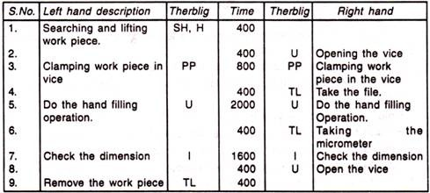
Micromotion Analysis – Example
Part of “Micromotion study analysis sheet” (aka left-right hand chart)
Operation: Finish hand filing copper work piece
Notes:
Note how this greatly resembles the “two handed process chart”, but of course the intention here is different, here we want to show/emphasize basic motion elements (not flow of processes)
Source: http://www.yourarticlelibrary.com/ergonomics/simo-simultaneous-motion-cycle-chart-meaning-method-to-improve-and-construction/34465/
Note, chart above must also include the following info: Micro motion Study
Dept……………………………………………. Film No……………….
Analysis Sheet
Operation: Finish hand fillings
Charted By……………….
Date……………………………………………………………………………….. Operator…………………

Slide 28
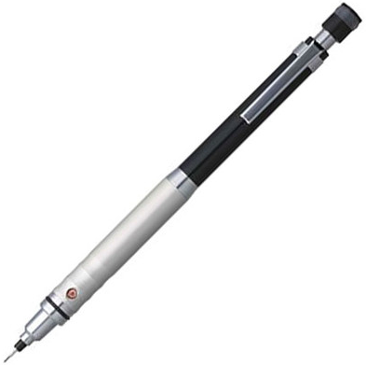
Micromotion Analysis – Exercise
Sitting at her desk, the writer reached for the mechanical pencil, picked it up, positioned it, and then began to write on notepad of paper. After finishing one sentence, she lifted the pencil, and read the sentence. She then put the pencil aside and reached for the rectangular eraser nearby. Grasping and positioning it, she erased one of the words in the sentence.
Write a list of the therbligs that comprise this motion sequence and label each basic motion with a brief description.

