Slide 1

CHEM 344 (REQUIRED COURSE)
ORGANIC REACTION MECHANISM
FOR CHEMISTRY’ STUDENTS, COLLEGE OF SCIENCE
Pre-requisites Course; CHEM 241
Credit Hours: 2(2+0)
Prof. Mohamed El-Newehy
Chemistry Department, College of Science, King Saud University
https://faculty.ksu.edu.sa/en/melnewehy
Prof. Zainab Almarhoon
Chemistry Department, College of Science, King Saud University
https://faculty.ksu.edu.sa/en/zalmarhoon

Slide 2
Addition to Carbon–Carbon Double Bond
Electrophilic Addition Reactions

Slide 3
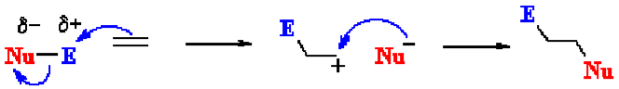
Electrophilic Addition Reaction
Electrophilic addition reactions are an important class of reactions that allow the interconversion of C=C and C≡C into a range of important functional groups. .
Conceptually, addition is the reverse of elimination
What does the term "electrophilic addition" imply ?
An electrophile, E⁺ , is an electron poor species that will react with an electron rich species (C=C)
An addition implies that two systems combine to a single entity.
Electrophilic addition reaction involves two major steps:
Addition of the electrophile to the nucleophilic π bond to give carbocation intermediate,
Reaction of the carbocation with a nucleophile.
Simultaneous formation of the two σ bonds

Slide 4
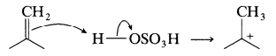
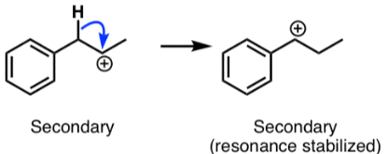
Electrophilic Addition Reaction; Formation and Stability of Carbocation
Protonation of an olefin; Intermediate cations are often produced by addition of a proton or a Lewis acid to a π bond.
Carbocation rearranges to another carbocation of equal or greater stability.
1,2-Hydride Shift
1,2-methyl shift

Slide 5
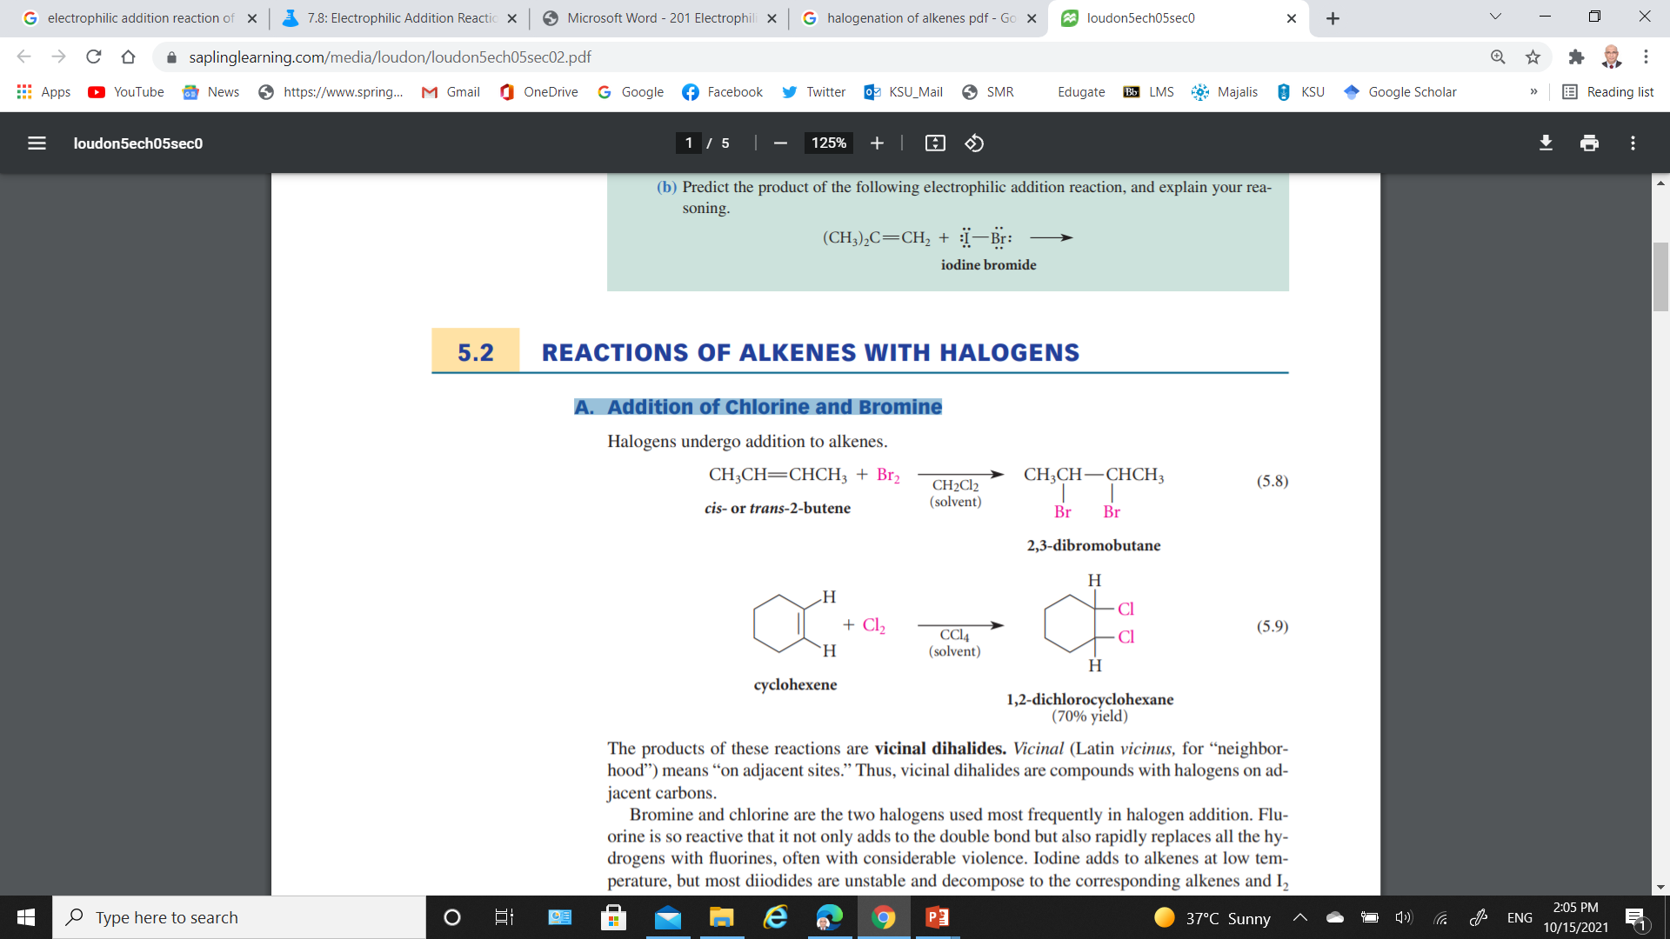
A) Halogenation of Alkenes
The products of these reactions are vicinal dihalides “compounds with halogens on adjacent carbons”.
These reaction run at low temperature, and Dark (Avoid Radicals).
Inert solvents such as methylene chloride (CH₂Cl₂) or carbon tetrachloride (CCl₄) are used as these solvents dissolve both halogens and alkenes.
Bromine and chlorine are the two halogens used mostly in halogen addition.
Fluorine is so reactive that it not only adds to the double bond but also rapidly replaces all the hydrogens with fluorenes, often with considerable violence.
Diiodides are unstable and decompose to the corresponding alkenes and I₂.
In fact, this discharge of color is a useful qualitative test for alkenes.

Slide 6
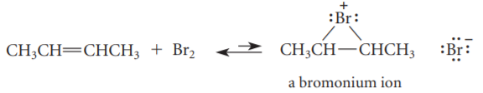
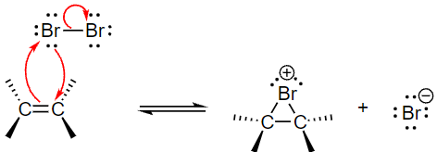

A) Halogenation of Alkenes; Mechanism
Addition of bromine to alkene involves a reactive intermediate called a bromonium ion.
Carbocations are not actual intermediates in most halogen additions.
Step 1,
Heterolytic cleavage of polarized Br-Br bond occurs and Br with the positive charge forms a cyclic intermediate “bromonium ion” with the two carbons from the alkene.
Step 2,
Bromide anion attacks carbon of the bridged bromonium ion from the back side of the ring.
The ring opening with the two halogens on opposite sides as each other.

Slide 7
A) Halogenation of Alkenes; Mechanism
Anti stereochemistry;
The two bromine atoms come from opposite faces of the double bond.
The product is that the bromines add on trans to each other.
The halide ion can attack any carbon from the opposite side of the ring it creates a mixture of steric products.
Optically inactive starting material produce optically inactive achiral products; a racemic mixture.

Slide 8
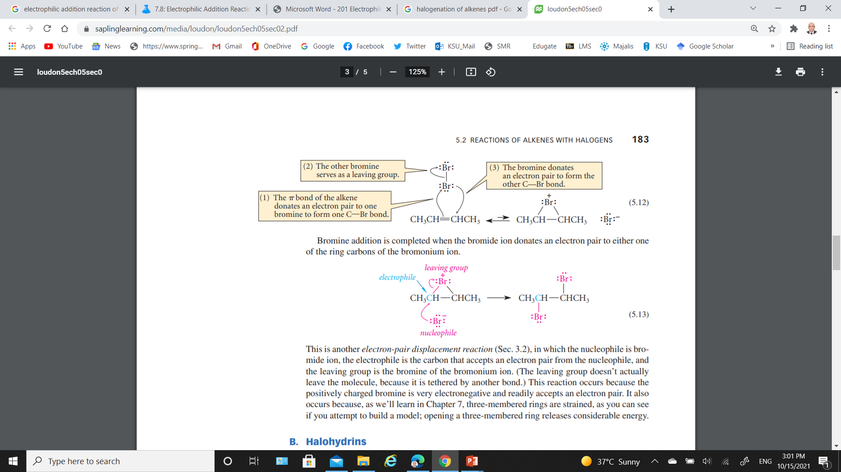
A) Halogenation of Alkenes; Example 1
Step 1,
The electrons of the π-bond are donated to one of the bromines,
The other bromine acts as a leaving group, and a carbocation is formed.
Step 2,
The carbocation undergoes a Lewis acid–base association reaction with the neighboring bromine. (intramolecular (internal) Lewis's acid–base association reaction)

Slide 9
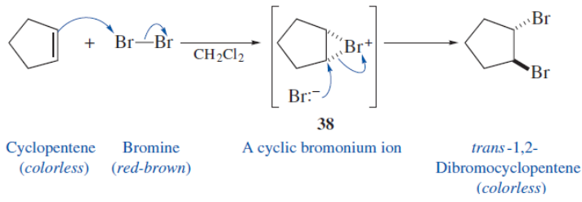
A) Halogenation of Alkenes; Example 2
The reaction of bromine with cyclopentene is stereospecific and proceeds by anti addition.

Slide 10
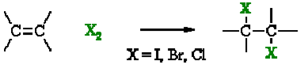
A) Halogenation of Alkenes; Summary
Overall transformation: C=C to X-C-C-X.
Reagent: normally the halogen (e.g. Br₂) in an inert solvent like methylene chloride, CH₂Cl₂.
Regioselectivity: not relevant since both new bonds are the same, C-X.
Reaction proceeds via cyclic halonium ion.
Stereoselectivity: anti since the two C-X bonds form in separate steps one from X₂ the other X⁻.

Slide 11
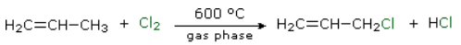
Electrophilic Addition vs. Free‐Radical Substitution
The propylene molecule has two sites where the halogen can attack, the double bond and the methyl group.
Alkanes undergo substitution by halogen at high temperatures and generally in the gas phase conditions favor to form free radicals.
Alkenes undergo addition of halogen at low temperatures and generally in liquid phase conditions favor to form heterolytic reactions.

Slide 12
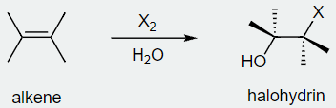
B) Halohydrin Formation; Mechanism
The addition of hypohalous acid (HO-X) such as hypobromous acid, HO-Br, or hypochlorous acid, HO-Cl to an alkene to give a 1,2-halo alcohol, called a halohydrin.
Mechanism
1) Reaction of the alkene with Br₂ yields a bromonium ion intermediate.
2) Water acts as a nucleophile, using a lone pair of electrons to open the bromonium ion ring and form a bond to carbon.
Since oxygen donates its electrons in this step, it now has the positive charge.
3) Loss of a proton from oxygen then gives H₃O⁺ and the neutral bromohydrin addition product.
Nucleophilic Solvents (H₂O) can open Bromonium ion

Slide 13
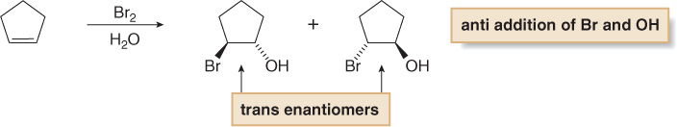
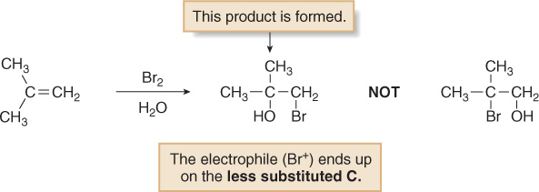
B) Halohydrin Formation; Examples
Symmetric alkene; anti addition of Br and OH
Unsymmetric alkene; The reaction is highly Regioselective.
The reaction of water with the bromonium ion can give two possible products.

Slide 14
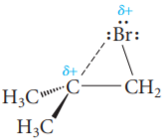

B) Halohydrin Formation; Examples
The bond between this carbon and the bromine is so long and weak that this species is essentially a carbocation containing a weak carbon–bromine interaction.
Water reacts with the bromonium ion at the tertiary carbon, and the weaker bond to the leaving group is broken, to give the observed regioselectivity.

Slide 15
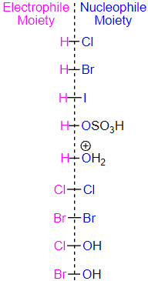
B) Halohydrin Formation; Mechanism
Water is available at a higher concentration than the bromine ion,
Water is also a better nucleophile than the bromine ion.
The better a nucleophile, the more likely it is to attack.

Slide 16
C) Addition of HX to Alkene
All the halides (HI > HBr > HCl > HF) can participate in this reaction with different rates due to the H-X bond getting weaker as X gets larger (poor overlap of orbitals)s.
This reaction works well with HBr and HCl.
HI can also but used by reacting potassium iodide (KI) with phosphoric acid (H₃PO₄).
Overall reaction;
The π-bond of the alkene is broken to form two single, σ-bonds.
π Bond (Nucleophile) Protonate → Carbocation Intermediate.
Carbocation Captured by Br¯ (Nucleophile) → HBr Added.
HBr (or other HX) Addition in Two Overall Steps.

Slide 17
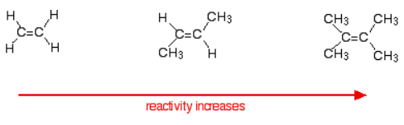
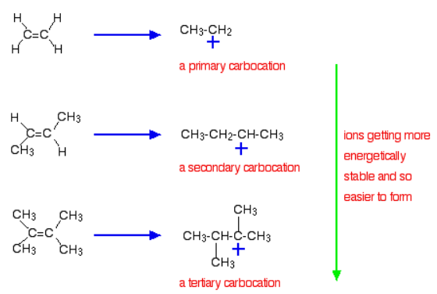
C) Addition of HX to Alkene; Reaction Rate
Variation of rates when you change the alkene
The more important reason, is the stability of the intermediate ion formed during the reaction.
Two-step electrophilic addition mechanism
The first step of the mechanism is the rate-determining step.
This electrophilic addition is a second order reaction.
Rate = k[Alkene][HX]

Slide 18
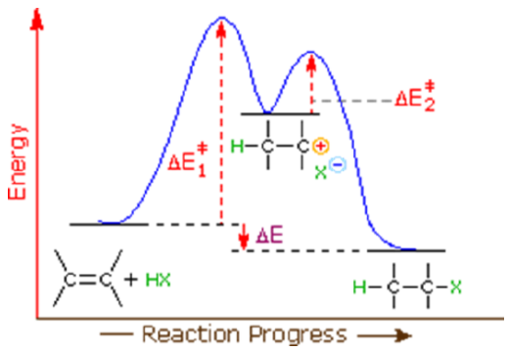
C) Addition of HX to Alkene; Reaction Energy Diagram

Slide 19
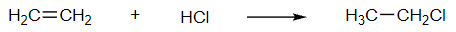
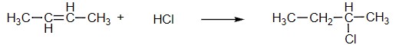
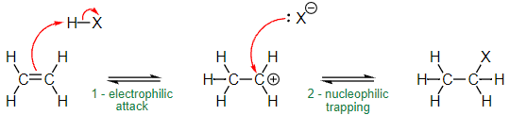
C) Addition of HX to Alkene; Addition to Symmetrical Alkenes
With ethene and hydrogen chloride, you get chloroethane.
With but-2-ene you get 2-chlorobutane:
Mechanism
Step 1) Electrophilic Attack
The 2π electrons from the double bond attack the H (electrophile) in the HX makes one of the carbons become an electron deficient “carbocation intermediate (sp² hybridized carbon) ”.
Step 2: Nucleophilic attack by halide anion
The formed carbocation now can act as an electrophile and accept an electron pair from the nucleophilic halide anion.

Slide 20
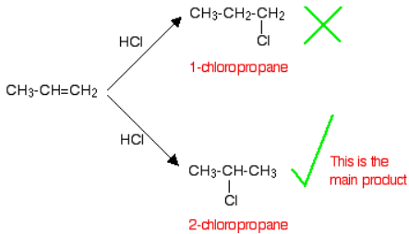
C) Addition of HX to Alkene; Addition to Unsymmetrical Alkenes
Regioselectivity of HX Addition: Markovnikov's Rule
If HCl adds to an unsymmetrical alkene like propene; there are two possible ways it could add.
However, in practice, there is only one major product according to Markovnikov's Rule;
“When a compound HX is added to an unsymmetrical alkene, the hydrogen becomes attached to the carbon with the most hydrogens attached to it already.”

Slide 21
C) Addition of HX to Alkene; Addition to Unsymmetrical Alkenes
Regioselectivity of HX Addition: Markovnikov's Rule
Mechanism for Markovnikov's Rule; Stability of Carbocation
Protonation of double bond occurs in direction that gives the more stable of two possible carbocations.

Slide 22
C) Addition of HX to Alkene; Addition to Unsymmetrical Alkenes
Regioselectivity of HX Addition: Markovnikov's Rule
Mechanism for Markovnikov's Rule; Stability of Carbocation
Protonation of double bond occurs in direction that gives the more stable of two possible carbocations.

Slide 23
C) Addition of HX to Alkene; Addition to Unsymmetrical Alkenes
Regioselectivity of HX Addition: Markovnikov's Rule
Carbocation Rearrangements in Hydrogen Halide Addition to Alkenes
1,2-Hydride Shift
H₂C
CHCH(CH₃)₂
HCl, 0°C
H
+
+
CH₃CHCH(CH₃)₂
CH₃CHC(CH₃)₂
2º
3º More Stable
CH₃CHCH(CH₃)₂
CH₃CH₂C(CH₃)₂
Cl
(40%)
Cl
(60%)

Slide 24
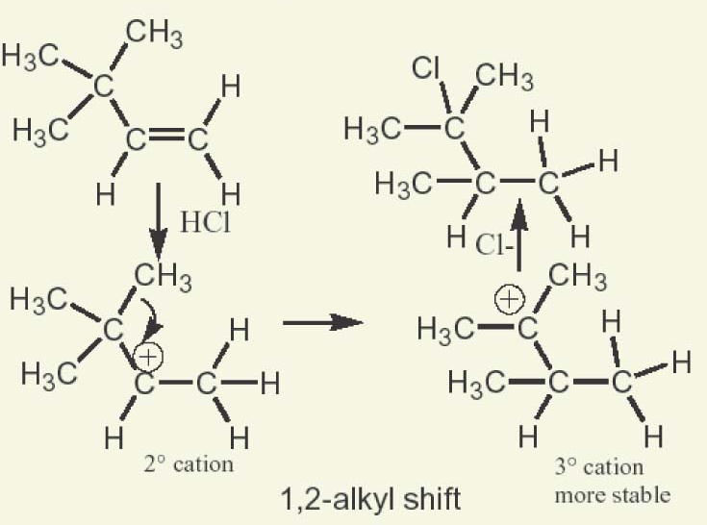
C) Addition of HX to Alkene; Addition to Unsymmetrical Alkenes
Regioselectivity of HX Addition: Markovnikov's Rule
Carbocation Rearrangements in Hydrogen Halide Addition to Alkenes
1,2- Methyl Shift

Slide 25
C) Addition of HX to Alkene; Stereochemistry in Ionic Additions
Just as We Saw in S_{N}¹: C⁺ Has TWO FACES
Top and Bottom Attack Give Two Stereochemical Products
R and S Enantiomers Formed as a Racemic Mixture (50:50)

Slide 26
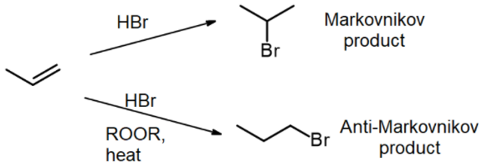
C) Addition of HX to Alkene; Anti-Markovnikov HBr Addition
Free Radical Addition
HBr adds to an unsymmetrical alkene to form an alkyl halide forming “Markovnikov product”
When HBr heated in the presence of a dialkyl peroxide (often written as ROOR), a radical mechanism takes over forming “anti-Markovnikov product”- due to the so-called “peroxide effect”.

Slide 27
C) Addition of HX to Alkene; Anti-Markovnikov HBr Addition
Free Radical Addition

Slide 28
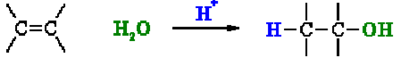
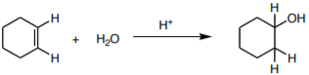
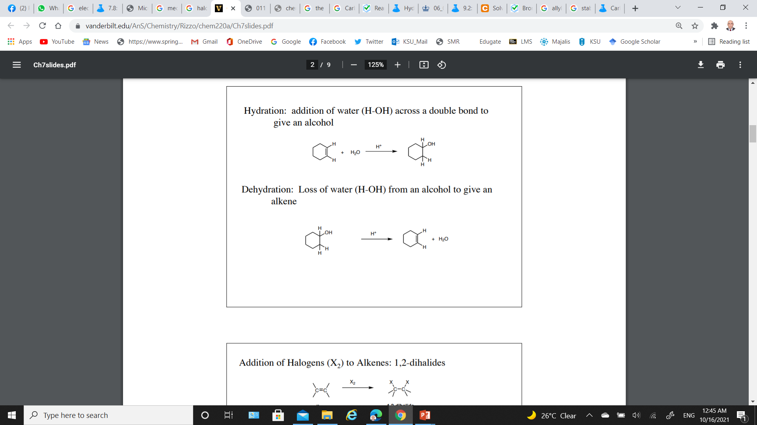
D) Addition of H₂O to Alkene (Hydration of Alkenes)
Addition of water (H-OH) across a double bond to give an alcohol
1) Acid catalyzed hydration- Markovnikov addition of H-OH
Acid catalysts are used in high temperature industrial processes: ethylene is converted to ethanol.
Carbocation Rearrangements.
Similar Reaction: Acid Catalyzed Dehydration

Slide 29
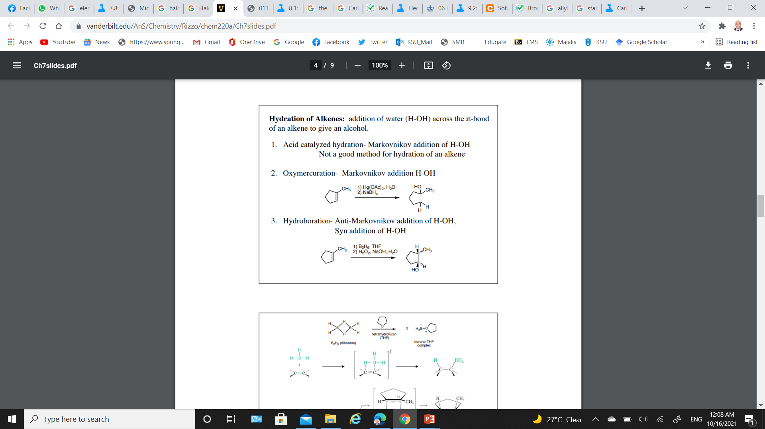
D) Addition of H₂O to Alkene (Hydration of Alkenes)
2) Oxymercuration- Markovnikov addition H-OH
No Carbocation Rearrangements.
3) Hydroboration- Anti-Markovnikov addition of H-OH, Syn addition of H-OH

Slide 30
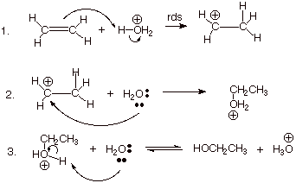
D) Addition of H₂O to Alkene; Acid Catalyzed Hydration
Step 1:
An acid/base reaction; Protonation of the alkene to generate the more stable carbocation.
The π electrons act pairs as a Lewis base.
Step 2:
Attack of the nucleophilic (H₂O) on the electrophilic carbocation creates an oxonium ion.
Step 3:
An acid/base reaction; Deprotonation by a base generates the alcohol and regenerates the acid catalyst

Slide 31
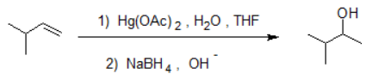
D) Addition of H₂O to Alkene; Oxymercuration-Demercuration
Addition of water follows Markovnikov’s rule with no rearrangement for the carbon carbocation due to the formation of cyclic intermediate
Net Reaction: Markovnikov Addition of H₂O to Alkene.
Both Reactions Quite Rapid; Alcohol Yields Usually > 90%.
Strong acids are not required
Carbocation rearrangements are avoided because no discreet carbocation intermediate forms.

Slide 32
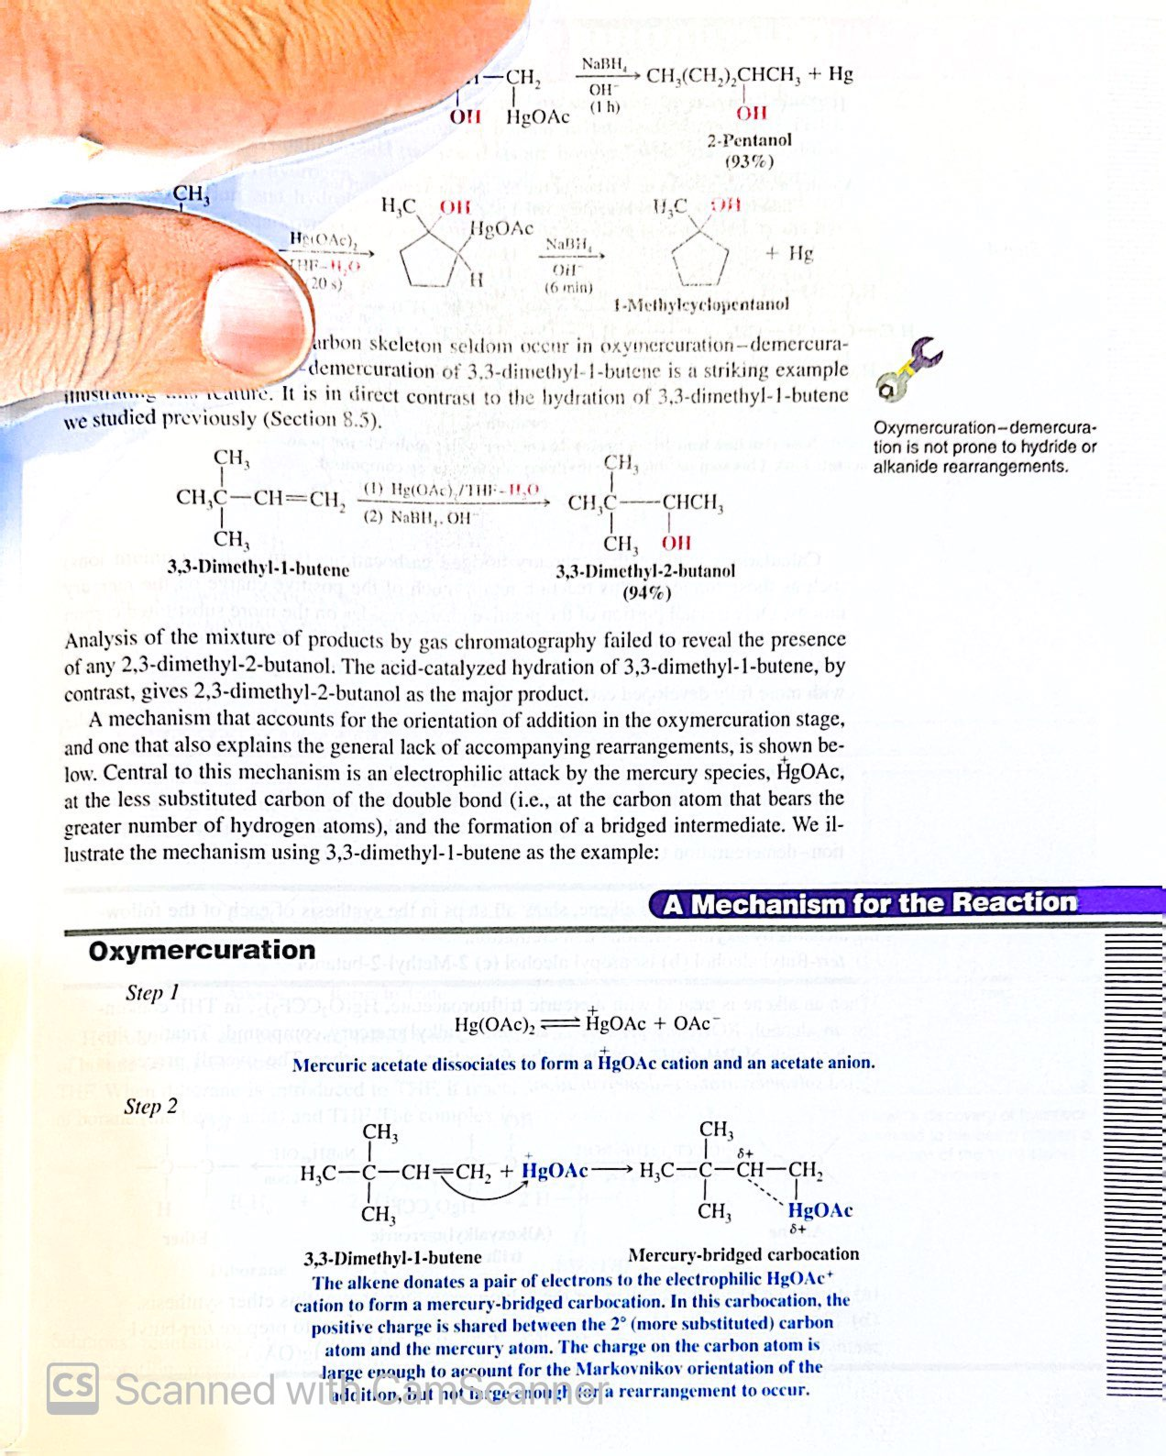
D) Addition of H₂O to Alkene; Oxymercuration-Demercuration
Oxymercuration

Slide 33
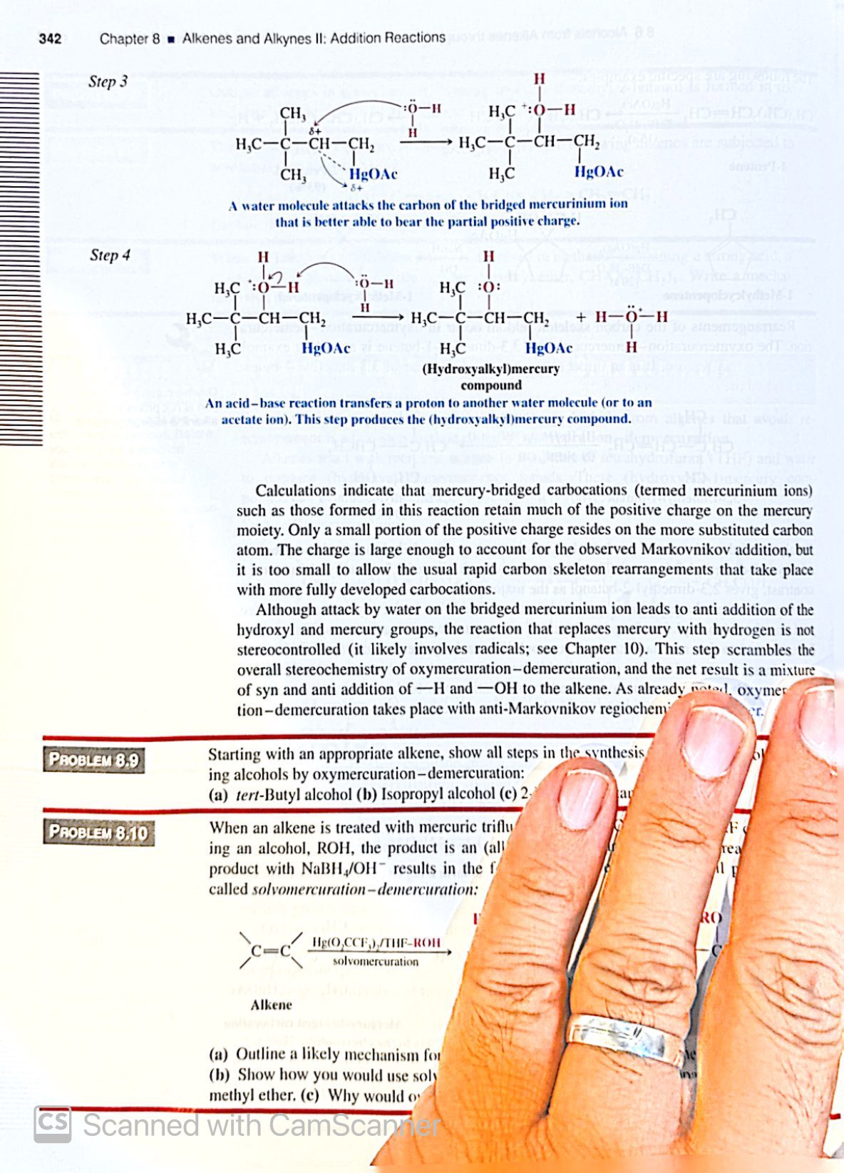
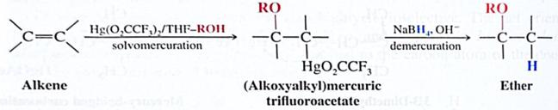
D) Addition of H₂O to Alkene; Oxymercuration-Demercuration
Oxymercuration
Demercuration

Slide 34
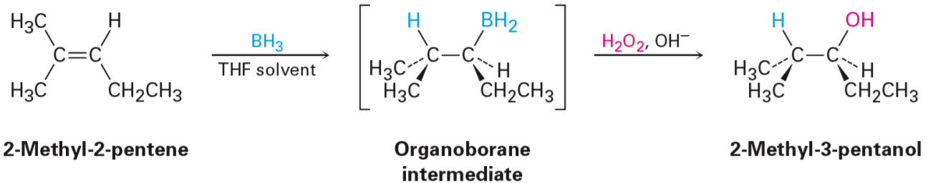
D) Addition of H₂O to Alkene; Hydroboration-Oxidation
The reaction proceeds in an Anti-Markovnikov manner; (Good for 1° Alcohols).
In the alkene double bond;
Hydrogen (from BH₃ or BHR₂) attaches to the more substituted carbon.
Boron attaches to the least substituted carbon.
This process does not require any activation by a catalyst.
Oxidation: H₂O₂, NaOH Oxidize to Trialkylborate Ester.

Slide 35
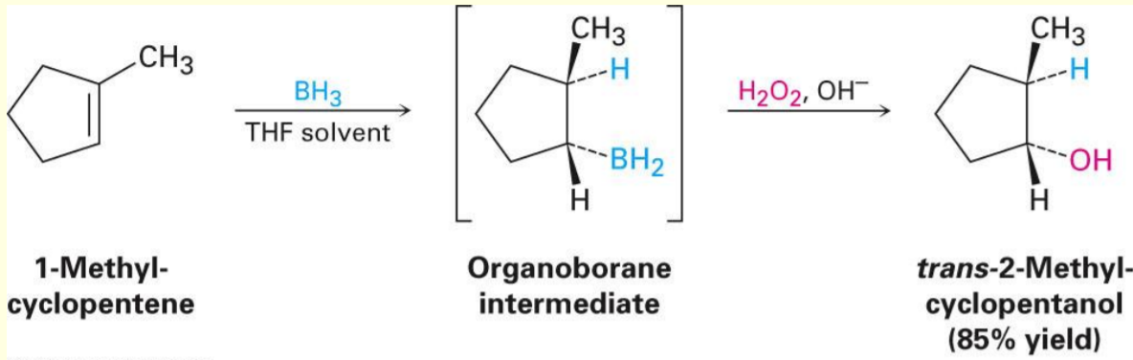
D) Addition of H₂O to Alkene; Hydroboration-Oxidation
Regiochemistry is opposite to Markovnikov orientation
OH is added to carbon with most H’s
H and OH add with syn stereochemistry, to the same face of the alkene (opposite of anti addition),
Stereospecific.

Slide 36
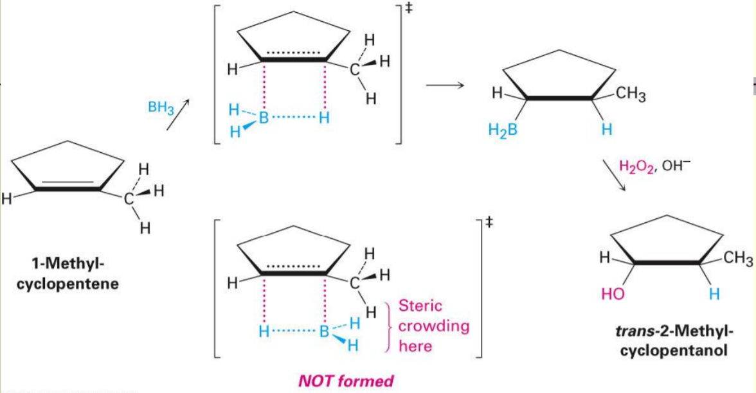
D) Addition of H₂O to Alkene; Hydroboration-Oxidation
Borane (BH₃) is electron deficient and is a Lewis acid and Alkene is Lewis's base
Transition state involves anionic development on B
The components of BH₃ are added across C=C
More stable carbocation is also consistent with steric preferences

Slide 37
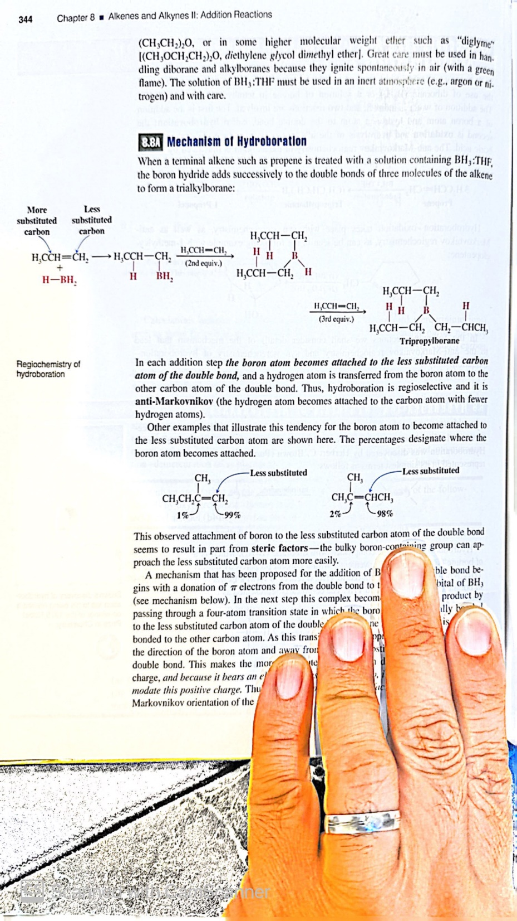
D) Addition of H₂O to Alkene; Hydroboration-Oxidation
Step 1: Hydroboration of alkene
In this first step the addition of the borane to the alkene is initiated and proceeds as a concerted reaction because bond breaking and bond formation occurs at the same time.
The boron atom becomes attached to the less substituted carbon atom of the double bond.

Slide 38
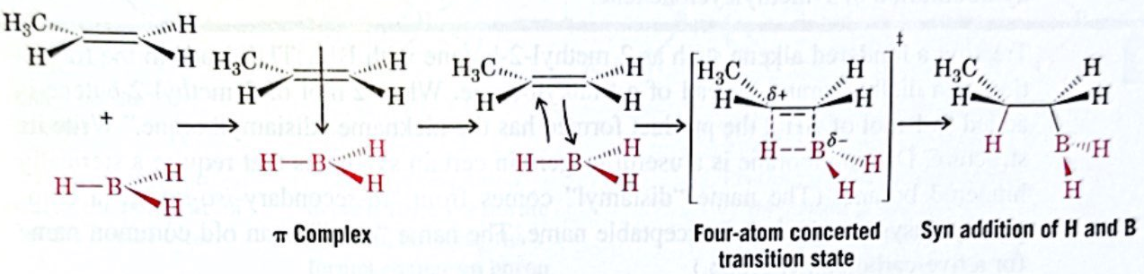
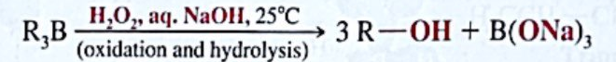
D) Addition of H₂O to Alkene; Hydroboration-Oxidation
Both electronic and steric factors account for the anti-markovinkov orientation of the addition.
Step 2: Oxidation and hydrolysis of trialkylborane.

Slide 39
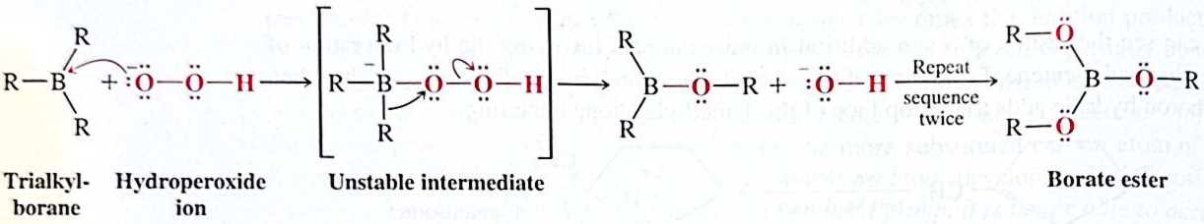
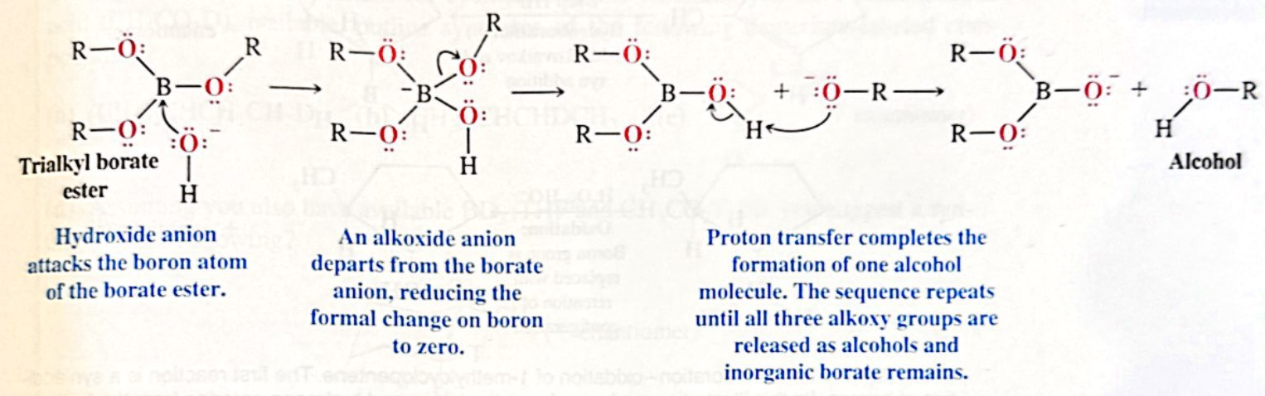
D) Addition of H₂O to Alkene; Hydroboration-Oxidation

Slide 40
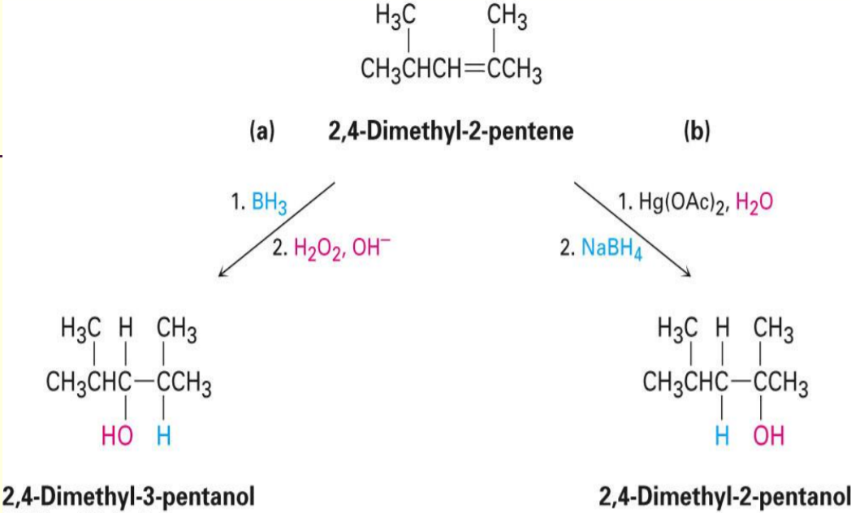
D) Addition of H₂O to Alkene; Hydroboration-Oxidation & Oxymercuration
Hydroboration/oxidation occurs with syn stereochemistry and gives the anti Markovnikov addition product
Oxymercuration gives the Markovnikov product .

Slide 41
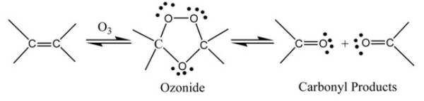
E) Ozonolysis; Alkene Cleavage
Ozonolysis is a method of oxidative cleaving alkenes using ozone (O₃).
The process allows for carbon-carbon double bonds to be replaced by double bonds with oxygen.
This reaction is often used to identify the structure of unknown alkenes by breaking them down into smaller, more easily identifiable pieces.
Zn
CH₃COOH
H₂O
-78ºC
CH₂Cl₂

Slide 42
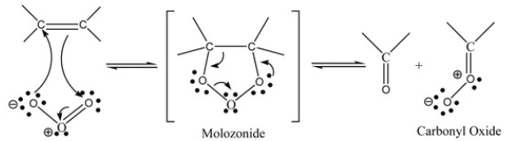

E) Ozonolysis; Mechanism
Step 1:
Initial electrophilic addition of ozone to the Carbon-Carbon double bond forming the unstable molozonide intermediate, which breaks apart to form a carbonyl and a carbonyl oxide molecule.
O₃
-78ºC
CH₂Cl₂
Step 2:
The carbonyl and the carbonyl oxide rearranges and reforms to create the stable ozonide intermediate.
A reductive workup could be performed to convert the ozonide molecule into the desired carbonyl products.

Slide 43
E) Ozonolysis; examples

Slide 44
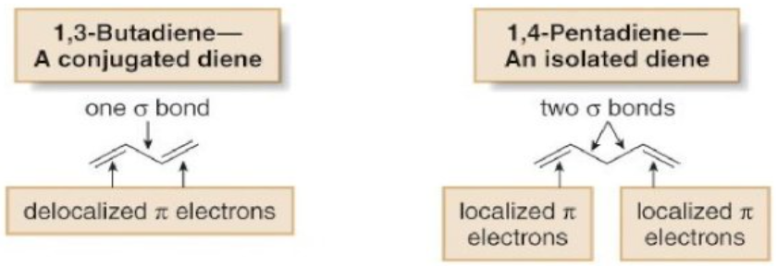
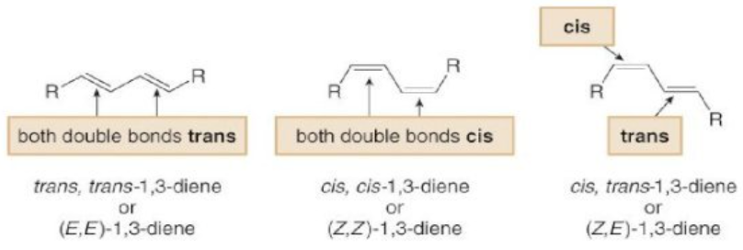
Conjugated Dienes
Compounds have more than one double bond.
If they are separated by only one single bond they are conjugated.
The conjugated diene 1,3-butadiene has properties that are very different from those of the nonconjugated diene, 1,5-pentadiene.
Three stereoisomers are possible for 1,3-dienes with alkyl groups bonded to each end carbon of the diene.

Slide 45
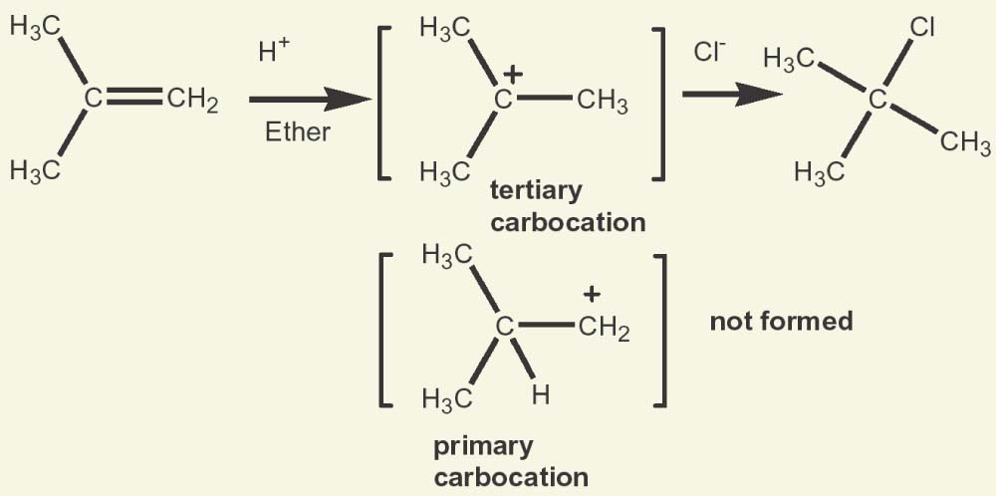
Conjugated Dienes; Allylic Carbocations
The allyl carbocation is another example of conjugated system.
Conjugation stabilizes the allyl carbocation and making it more stable than a normal primary carbocation.
With conjugated dienes the allylic carbocation intermediately generated has different resonance forms.

Slide 46
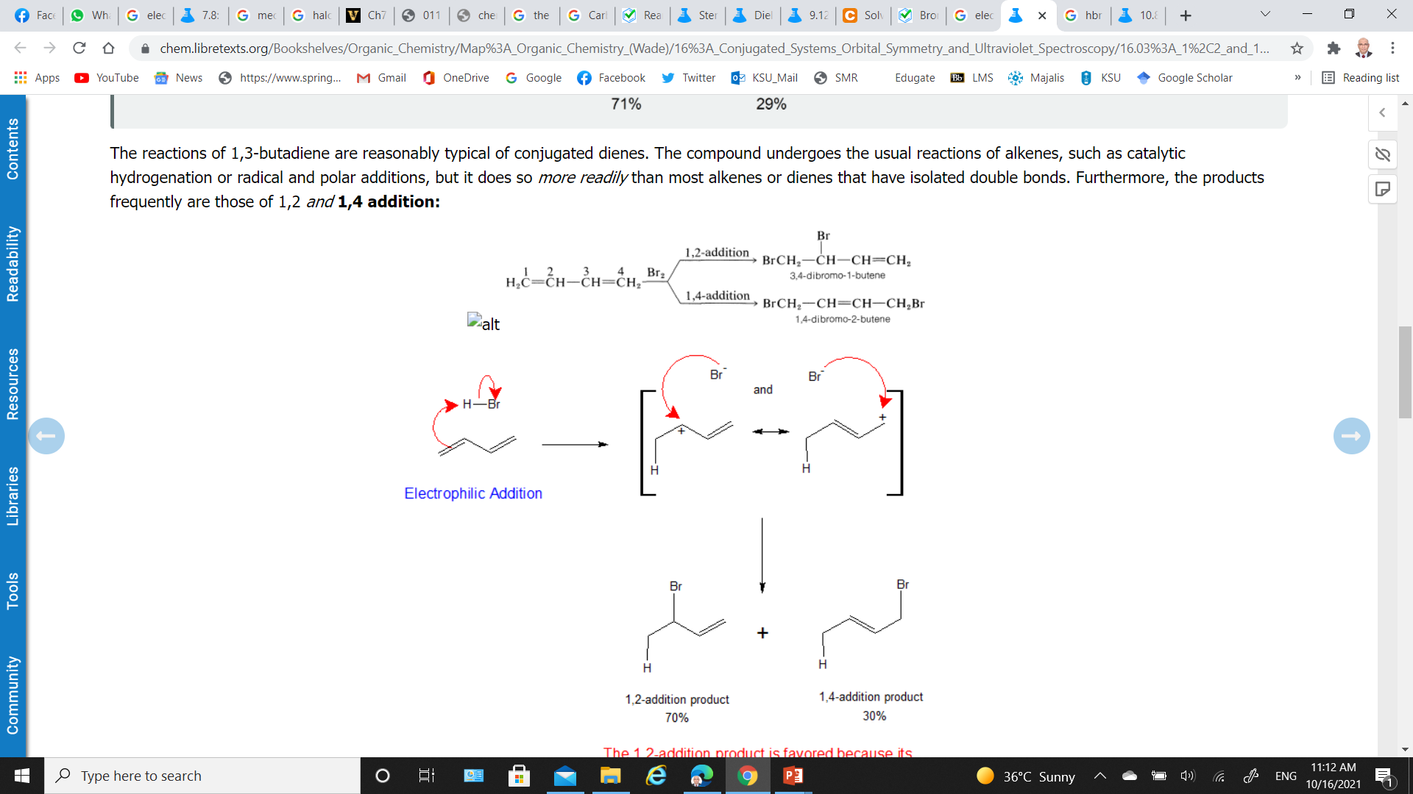
Conjugated Dienes; Example
Addition of HBr to 1,3-butadiene: 1,2-addition & 1,4-addition

Slide 47
Conjugated Dienes; Example
Addition of Br₂ to 1,3-butadiene:
The 1,2-addition product is favored because its secondary allylic carbocation intermediate is more stable

Slide 48
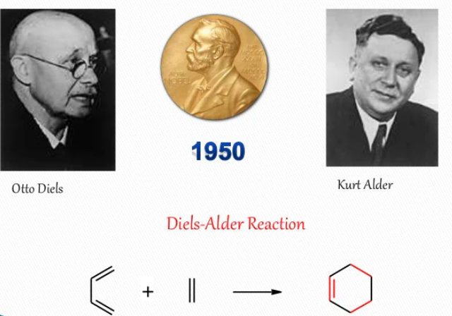
Cycloaddition to Conjugated Dienes; The Diels–Alder Reaction
Polyenes (including dienes) can undergo a variety of pericyclic reactions “the π-electrons rearrange to form new bonds”.
In a cycloaddition, one π-system is “added across” another π-system (often on a different molecule), creating a ring.
1930

Slide 49
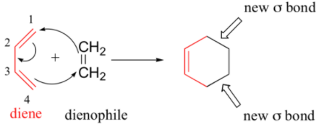
Cycloaddition to Conjugated Dienes; The Diels–Alder Reaction
Diels-Alder reaction is one of the most important pericyclic reaction and is a type of cycloaddition.
This is a [4+2] cycloaddition;
meaning that one reactant contributes 4 π–electrons while the other contributes 2 π–electrons.
A Diels-Alder reaction must involve a diene and dienophile “alkene (or alkyne)”.
A Diels-Alder adduct (addition product) contains formation of cyclohexene ring by addition of the dienophile to the diene.
The formation of the ring involves no intermediate (concerted formation of two bonds)
Two π-bonds are converted to two sigma-bonds.
Six-membered ring is formed
Adduct

Slide 50


Cycloaddition to Conjugated Dienes; The Diels–Alder Reaction, Mechanism
A conjugated diene reacts with a double-bonded dienophile.
Dienes are electron-rich; dienophiles are electron poor.

Slide 51
Cycloaddition to Conjugated Dienes; The Diels–Alder Reaction, Mechanism
  Reaction is facilitated by a combination of electron-withdrawing substituents on one reactant and electron-releasing substituents on the other.

