Slide 1

CHEM 342 (REQUIRED COURSE)
POLYMERS AND PETROCHEMICALS
FOR CHEMISTRY’ STUDENTS, COLLEGE OF SCIENCE
Pre-requisites Course; CHEM 241
Credit Hours: 2(2+0)
Prof. Mohamed El-Newehy
Chemistry Department, College of Science, King Saud University
http://fac.ksu.edu.sa/melnewehy/home

Slide 2
Copolymerization

Slide 3
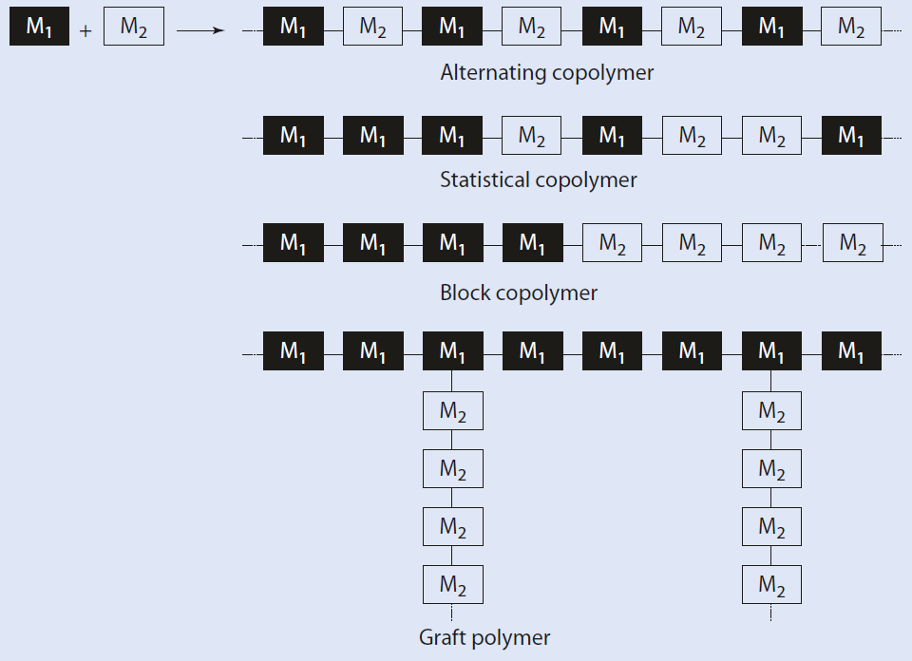
Copolymerization
If two different monomers, M₁ and M₂, are polymerized together,
The following nomenclature has emerged:
Statistical (Random) copolymer:
Poly(M₁-stat-M₂)
Alternating copolymer:
Poly(M₁-alt-M₂)
Block copolymer:
Poly(M₁-block-M₂)
Graft copolymer:
Poly(M₁-graft-M₂)
If it is not intended to distinguish the specific copolymer architecture, the general term is poly(M₁-co-M₂).
Structures of alternating, statistical, block, and graft copolymers
Random and alternating copolymers: one phase
Block and Graft copolymers: two phase

Slide 4
Copolymerization
Copolymer: two or more polymers are combined to each other by chemical bonds.
Copolymerization has the great advantage that the attributes of the homopolymers can be combined.
Example;
Polystyrene (PS); which is brittle and hard and has only moderate solvent resistance,
High Impact PS [Poly(styrene-co-acrylonitrile), (SAN or nitrile plastic)]; copolymers with styrene as comonomer can be
Improved impact resistance
Improved solvent resistance
Poly(styrene-co-butadiene) (SBR) rubber;
Styrene copolymerized with 1,3-butadiene (25%S +75%BD)
Automobile res – Hoses – Molded goods – Shoe soles – Electrical insulation
Poly(styrene-block-butadiene-block-styrene) (SBS); copolymers with styrene as comonomer can be elastomers.
SBR blended with SAN Or S copolymerized with AN in the presence of PB =ABS plastics
Used in – Piping – Cars and other vehicles – Sporting goods so on

Slide 5
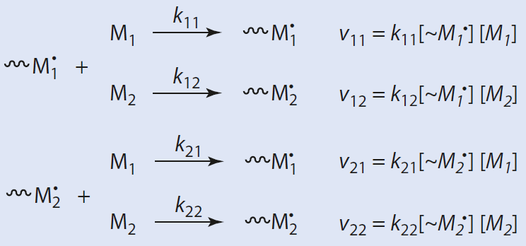
Copolymerization Equation; Mayo-Lewis’s Equation of Copolymerization
The compositions of statistical copolymers are determined by the monomer composition and the relative reactivity of the comonomers.
Mayo–Lewis's equation or copolymer equation in polymer chemistry describes the distribution of monomers in a copolymer.
If radical polymerization is initiated in the presence of two different monomers, M₁ and M₂,
The polymerization is initiated, the primary radical reacts with the monomer (M₁ or M₂),
In the case of copolymerization, four different phases of growth,
Chain growth during a radical polymerization of two monomers M₁ and M₂

Slide 6
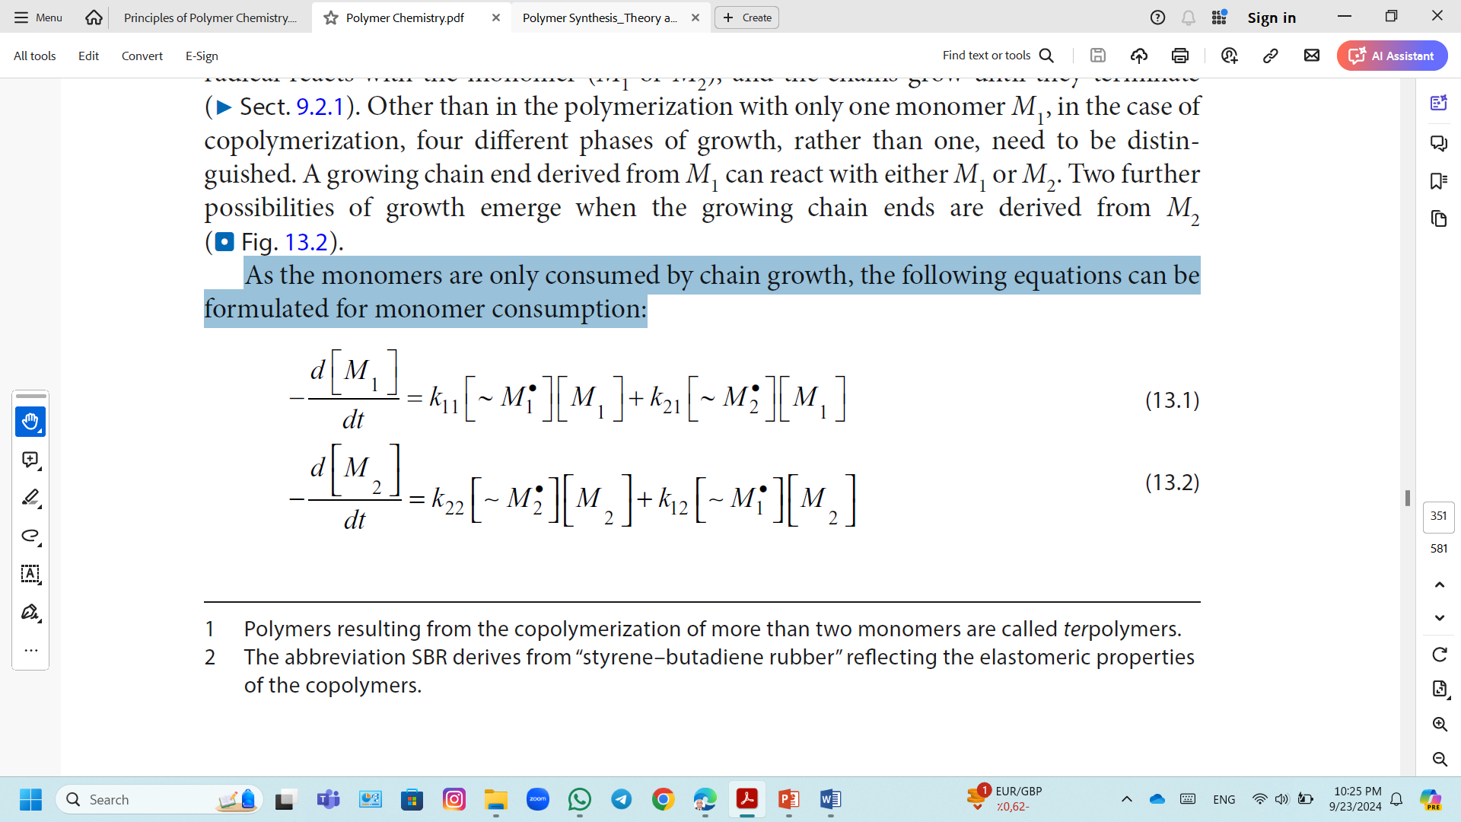
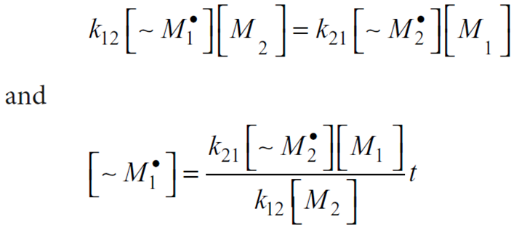
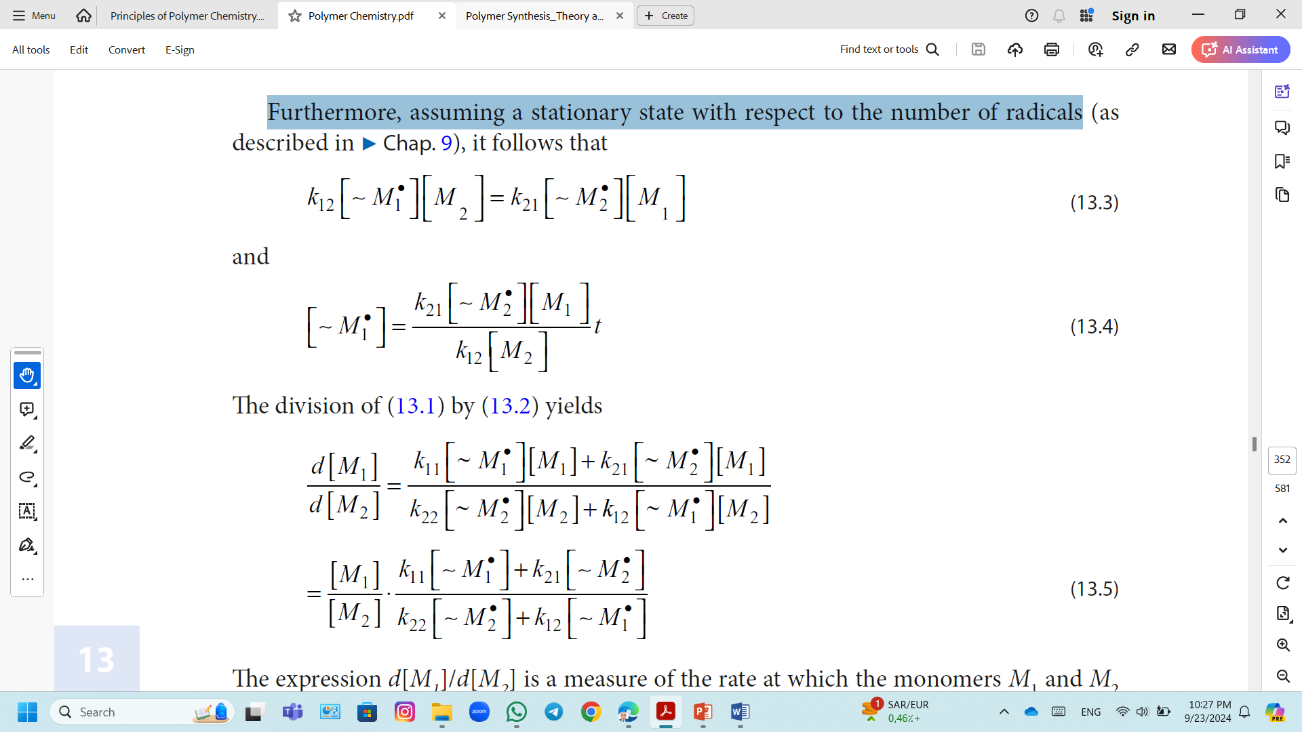
Copolymerization Equation; Mayo-Lewis's Equation of Copolymerization
As the monomers are only consumed by chain growth, the following equations can be formulated for monomer consumption:
(1)
(2)
Furthermore, assuming a stationary state with respect to the number of radicals
(3)
(4)
The division of equation (1) by (2) yields
(5)

Slide 7
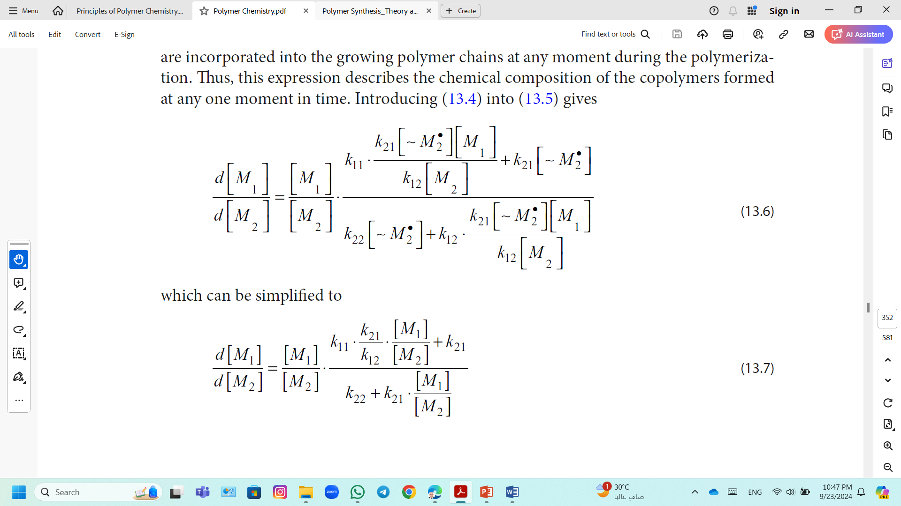
Copolymerization Equation; Mayo-Lewis's Equation of Copolymerization
The expression d[M₁]/d[M₂] is a measure of the rate at which the monomers M₁ and M₂ are incorporated into the growing polymer chains at any moment during the polymerization.
Thus, d[M₁]/d[M₂] describes the chemical composition of the copolymers formed at any one moment in time.
Introducing equation (4) into equation (5)
(6)
Which can be simplified to
(7)

Slide 8
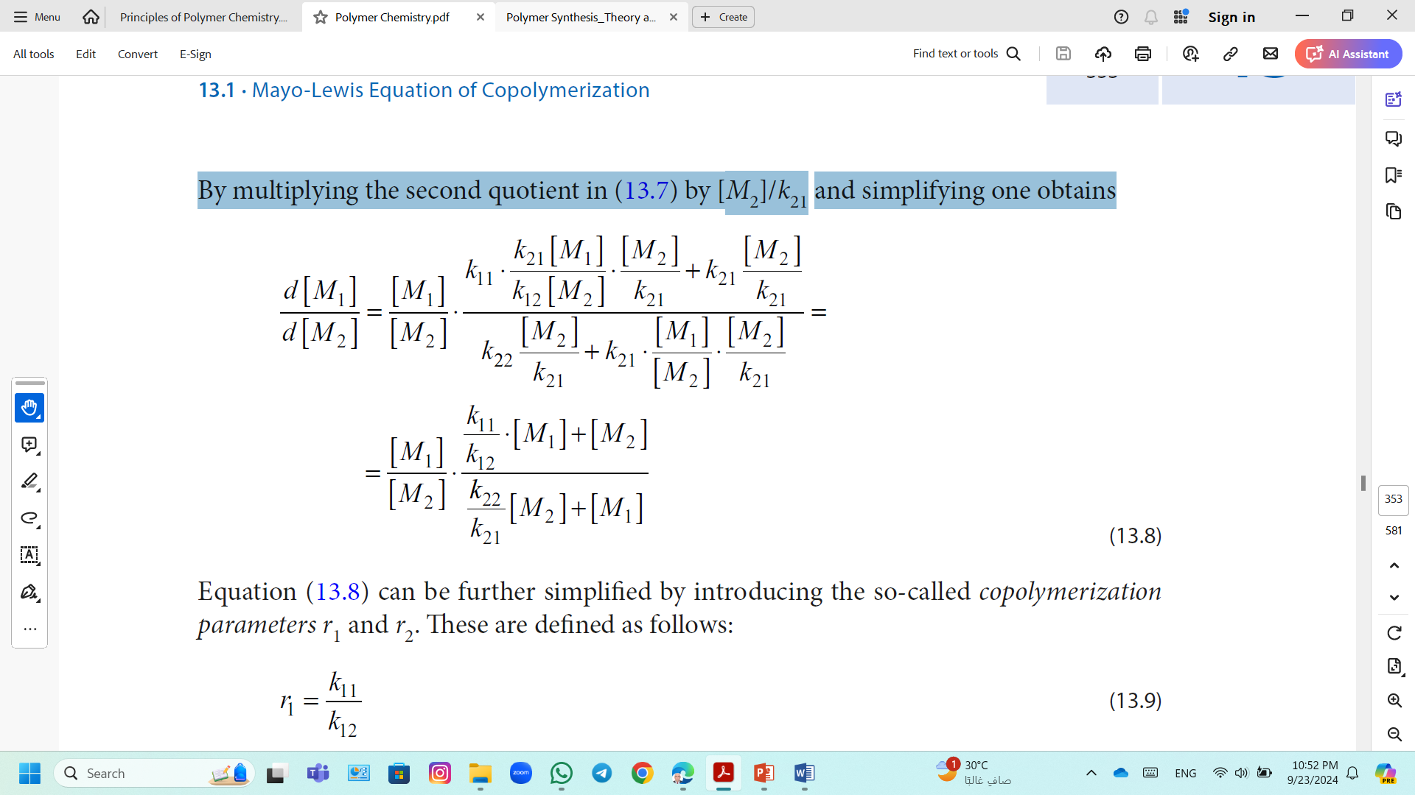
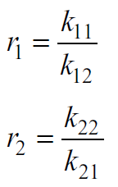
Copolymerization Equation; Mayo-Lewis's Equation of Copolymerization
By multiplying the second quotient in (7) by [M₂]/k₂₁ and simplifying one obtains
(8)
Equation (8) can be further simplified by introducing the so-called copolymerization parameters r₁ and r₂, the reactivity ratios r₁ and r₂, These are defined as follows:
(9)
(10)
The reactivity ratios r₁ and r₂, describe the relative reactivity of the radicals towards the monomers M₁ and M₂.

Slide 9
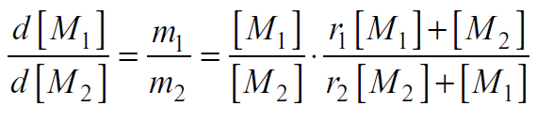
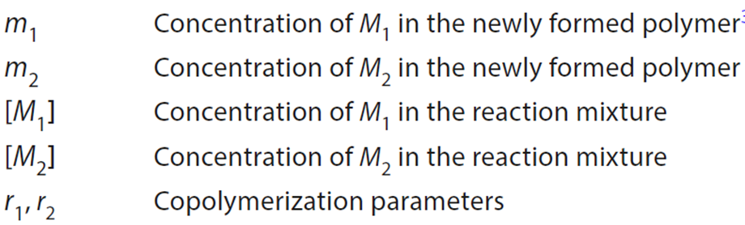
Copolymerization Equation; Mayo-Lewis's Equation of Copolymerization
By inserting the parameters r₁ and r₂ into (8) one obtains the Mayo–Lewis's copolymerization equation:
(11)
Equation (11) describes the composition of the polymer formed at any one time as a function of the monomer composition at that time.
During most copolymerization, as the reaction progresses, and depending on the reactivity of the individual comonomers, the proportion of comonomers in the reaction mixture occurs.
If copolymerization is allowed to continue to complete conversion, the average composition of all the polymer chains naturally corresponds to the initial monomer composition.

Slide 10
Copolymerization Equation; Mayo-Lewis's Equation of Copolymerization
Ideal Copolymers;
r₁ < 1, r₂ > 1 (or reversed) and r₁ x r₂ = 1
Both type of propagating species show the same preference for both monomers.
Mostly encountered in ionic polymerizations.
Random Copolymers (A variation of ideal copolymerization);
r₁ = r₂ = 1
Two monomers show equal reactivities toward both monomers
Copolymer composition = comonomer feed
Random order of two monomers along the copolymer chain
r₁ > 1 and r₂ < 1 or r₁ < 1 and r₂ > 1
Copolymer richer in the more reactive monomer.

Slide 11
Copolymerization Equation; Mayo-Lewis's Equation of Copolymerization
Block Copolymers;
Both r₁ and r₂ > 1 and r₁ x r₂ > 1 .
Block copolymers with perfect controlled structure are commonly synthesized by living polymerization with sequential monomer addition technique.
M₁M₁M₁M₁M₁M₁M₁M₁M₁M₁M₁M₁M₁M₁M₂M₂M₂M₂M₂M₂M₂M₂M₂M₂M₂M₂M₂M₂
Alternating Copolymers
r₁ = r₂ = 0 or both r₁ and r₂ are very small, close to 0.
Each propagating species prefers to add the other monomer.
Copolymerization lie in between the ideal and the alternating extremes
homopolymerization
r₁ >> r₂ , r₁ >> 1 and r₂ << 1

Slide 12
Copolymerization Equation
Factors Affecting Free Radical copolymerization
Factors may influence not only the rate of polymerization but also the properties of the resulting polymers, particularly the degree of polymerization are
The nature of the solvent (polarity, dielectric constant etc.),
pH,
Addition of complexing agents and surfactants,
Temperature,
The nature of initiator,
Concentration of monomer

Slide 13
Copolymerization Equation
Factors Affecting Free Radical copolymerization
Effect of Reaction Conditions
  Effect Reaction Medium
Free radical copolymerization are neither affected by the initiation step whatever the starters types (thermal or photoinitiators) nor the termination species. but they are affected by reaction high temperature & pressure.
Effect of Reaction Temperature
Reaction temperature has low effect on the monomers ratio and polymer composition; it is found that styrene (M₁) and methyl methacrylate (M₂) at different reaction temperatures will have very similar values of r₁ & r₂.
r₁ = 0.52
r₁ = 0.54
r₂ = 0.46
r₂ = 0.59
at 60°C
at 131°C
The increase of reaction temperature decreases the copolymerization selectivity, as r reactivity ratios is getting close to unity.

Slide 14
Copolymerization Equation
Factors Affecting Free Radical copolymerization
  Effect of Pressure
The reaction pressure has similar effect as reaction temperature
The higher the pressure, the less selectivity of the joint polymerization by converting a value of ratios to achieve towards the ideal co polymerization.
Example: polymerization of methyl methacrylate acrylonitrile
r₁r₂ = 0.16
r₁r₂ = 0.54
r₁r₂ = 0.91
at 1 atm
at 100 atm
at 1000 atm
Note that; changing reaction pressure will affect the free radical species not the monomer

Slide 15
Copolymerization Equation
Factors Affecting Free Radical copolymerization
Effect of Resonance
Reactivity of monomers towards free radicals increases with the stability of resonance structures formed.
The following substituted groups increases the monomer reactivities in the order illustrated below.
-C₆H₅,
C CH₂ H
> -CN, -COR > -COOH
-COOR
> -Cl
> -OR , H
>
> -OCOR
Effect of Steric Hindrance
Monomers reactivity decreases by steric effect.
Example; The polymerization of styrene with

Slide 16
Copolymerization Equation
Factors Affecting Free Radical copolymerization
Effect of Polarity
Increasing the difference between the monomer's polarity leads to the formation of an alternating copolymer.
Example: acrylonitrile polymerization with butadiene where r₁r₂ = 0
When monocular polarity converges, an ideal copolymer is formed.
Example: acrylonitrile polymerization with methyl phenyl ketone where r₁r₂ = 1.

