Slide 1

Chemistry Department, College of Science, King Saud University
CHEM 241
Organic Chemistry II
FOR CHEMISTRY’ STUDENTS, COLLEGE OF SCIENCE
PRE-REQUISITES COURSE; CHEM 240
CREDIT HOURS; 2 (2+0)
Carbonyl Compounds; Carboxylic Acids Based on NCERT

Slide 2
Carboxylic Acids
Carbon compounds containing a carboxyl functional group, –COOH are called carboxylic acids.
The carboxyl group, consists of a carbonyl group attached to a hydroxyl group, hence its name carboxyl.
Depending on the group, alkyl or aryl, attached to carboxylic carbon, carboxylic acids may be
Aliphatic (R-COOH) or
Aromatic (Ar-COOH).
Fatty acids, some higher members of aliphatic carboxylic acids (C12 – C18), occur in natural fats as esters of glycerol.
Carboxylic acids serve as starting material for several other important organic compounds such as anhydrides, esters, acid chlorides, amides, etc.

Slide 3
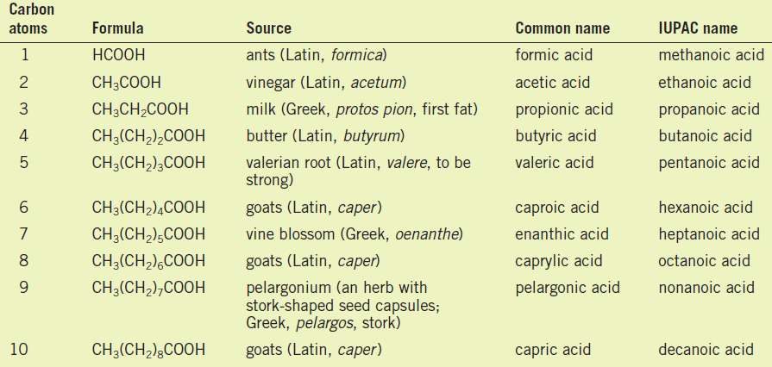
Nomenclature of Carboxylic Acids
A) Common Names
The common names of carboxylic acids all end in -ic acid.
These names usually come from some Latin or Greek word that indicates the original source of the acid.
Common name, substituents are located with Greek letters, beginning with the α–carbon atom.

Slide 4
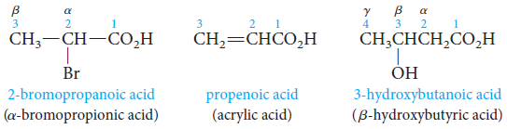
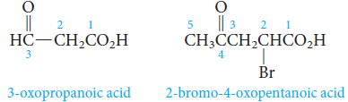

Nomenclature of Carboxylic Acids
B) IUPAC System
We replace the final e in the name of the corresponding alkane with the suffix -oic and add the word acid.
Alkane- e + oic acid = Alkanoic acid
IUPAC system, the chain is numbered beginning with the carboxyl carbon atom, and substituents are located in the usual way.
The carboxyl group has priority over alcohol, aldehyde, or ketone functionality in naming.
The prefix oxo- is used to locate the carbonyl group of the aldehyde or ketone.

Slide 5

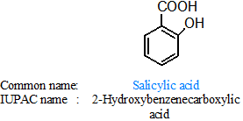
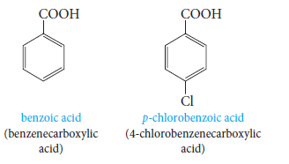
Nomenclature of Carboxylic Acids
Cycloalkane carboxylic acid
When the carboxyl group is attached to a ring, the ending -carboxylic acid is added to the name of the parent cycloalkane. (i.e. Cycloalkanecarboxylic acid)
Aromatic Acids
Aromatic acids are named by attaching the suffix -oic acid or -ic acid to an appropriate prefix derived from the aromatic hydrocarbon.

Slide 6
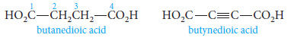
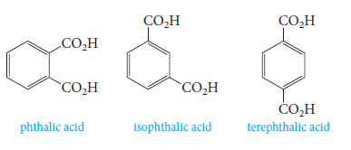
Nomenclature of Carboxylic Acids
Dicarboxylic acids (acids that contain two carboxyl groups) are known almost exclusively by their common names.
Aliphatic dicarboxylic acids are given the suffix -dioic acid in the IUPAC system.
The three benzenedicarboxylic acids are generally known by their common names.
Common name:
IUPAC name:
Benzene-1,2-
dicarboxylic acid
Benzene-1,3-
dicarboxylic acid
Benzene-1,4-
dicarboxylic acid

Slide 7
Questions

Slide 8
Structure of Carboxyl Group
In carboxylic acids, the bonds to the carboxyl carbon lie in one plane and are separated by about 120°.
The carboxylic carbon is less electrophilic than carbonyl carbon because of the possible resonance structure.
Carboxylic acids dissociate in water to give resonance stabilized carboxylate anions and hydronium ion.
Acidity
Acid Strength and Structure

Slide 9
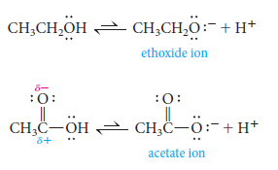
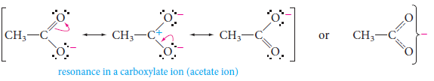
Acid Strength and Structure
Why carboxylic acids are more acidic than alcohols?
In ethoxide ion, the negative charge is localized on a single oxygen atom.
In acetate ion, on the other hand, the negative charge can be delocalized through resonance.

Slide 10
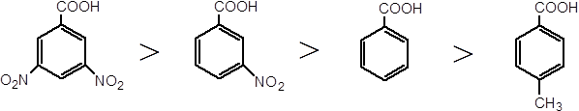

Acid Strength and Structure
Effect of Structure on Acidity; the Inductive Effect
Acidities can vary depending on what other groups are attached to the molecule.
Recall that electron-withdrawing groups (-I) enhance acidity, and electron-releasing groups (+I) reduce acidity.
This effect relays charge through bonds, by displacing bonding electrons toward electronegative atoms, or away from electropositive atoms.
Formic acid is a substantially stronger acid than acetic acid.
This suggests that the methyl group is more electron-releasing (hence anion-destabilizing and acidity-reducing) than hydrogen.

Slide 11
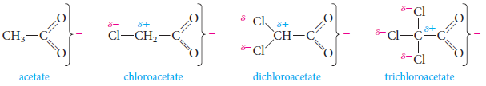

Acid Strength and Structure
Effect of Structure on Acidity; the Inductive Effect
Example: acetic acid with those of mono-, di-, and trichloroacetic acids.
Comparison of acid strengths of acetic Acid and chlorinated acetic acids
The more chlorines, the greater the effect and the greater the strength of the acid.
Comparison of acid strengths of butyric acid and the monochlorinated acids.

Slide 12
Physical Properties of Carboxylic Acids
Physical State
Aliphatic carboxylic acids up to nine carbon atoms are colorless liquids at room temperature with unpleasant odors.
The higher acids are wax like solids and are practically odorless due to their low volatility.
Boiling Points
Carboxylic acids are higher boiling liquids than aldehydes, ketones and even alcohols of comparable molecular masses.
This is due to more extensive association of carboxylic acid molecules through intermolecular hydrogen bonding.
The hydrogen bonds are not broken completely even in the vapor phase.
In fact, most carboxylic acids exist as dimer in the vapor phase or in the aprotic solvents.

Slide 13
Physical Properties of Carboxylic Acids
Solubility in Water
Simple aliphatic carboxylic acids having up to four carbon atoms are miscible in water due to the formation of hydrogen bonds with water.
The solubility decreases with increasing number of carbon atoms.
Higher carboxylic acids are practically insoluble in water due to the increased hydrophobic interaction of hydrocarbon part.
Benzoic acid, the simplest aromatic carboxylic acid is nearly insoluble in cold water.
Carboxylic acids are also soluble in less polar organic solvents like benzene, ether, alcohol, chloroform, etc.
Solubility in H₂O at 25°C | b.p. °C | Mol. Wt. | Name | Structure
Very soluble Very soluble | 100 78 | 46 46 | Formic acid Ethyl alcohol | HCOOH CH₃CH₂OH
Very soluble Very soluble | 118 97 | 60 60 | Acetic acid n-Propyl alcohol | CH₃COOH CH₃CH₂CH₂OH
4.0 g/100 g H₂O 0.6 g/100 g H₂O | 187 156 | 102 102 | Valeric acid n-Hexyl alcohol | CH₃(CH₂)₃COOH CH₃(CH₂)₄CH2OH
Insoluble Insoluble | 250 250 | 122 122 | Benzoic acid 3-Phenylethanol | Ph-COOH Ph-CH₂CH₂OH

Slide 14
Preparation of Carboxylic Acids
1. From Primary Alcohols and Aldehydes
Primary alcohols are readily oxidized to carboxylic acids with common oxidizing agents such as potassium permanganate (KMnO₄) in neutral, acidic or alkaline media or by potassium dichromate (K₂Cr₂O₇) and chromium trioxide (CrO₃) in acidic media (Jones reagent).
Carboxylic acids are also prepared from aldehydes by the use of mild oxidizing agents

Slide 15
Preparation of Carboxylic Acids
2. From Alkylbenzenes
Aromatic carboxylic acids can be prepared by vigorous oxidation of alkyl benzenes with chromic acid or acidic or alkaline potassium permanganate.
3. From Nitriles and Amides
Nitriles are hydrolyzed to amides and then to acids in the presence of H⁺ or HO⁻ as catalyst.

Slide 16
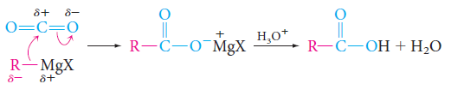
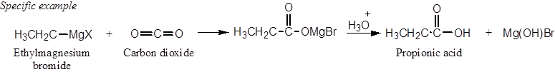
Preparation of Carboxylic Acids
4. From Grignard Reagents
Grignard reagents react with carbon dioxide (dry ice) to form salts of carboxylic acids which in turn give corresponding carboxylic acids after acidification with mineral acid.
Note: the Grignard reagents and nitriles can be prepared from alkyl halides.

Slide 17
Preparation of Carboxylic Acids
5. From Acyl Halides, Anhydrides and Esters
Acid chlorides when hydrolyzed with water give carboxylic acids or more readily hydrolyzed with aqueous base to give carboxylate ions which on acidification provide corresponding carboxylic acids.
Anhydrides on the other hand are hydrolyzed to corresponding acid(s) with water.
Acidic hydrolysis of esters gives directly carboxylic acids while basic hydrolysis gives carboxylates, which on acidification give corresponding carboxylic acids.

Slide 18
Questions

Slide 20
Questions

Slide 21
Chemical Reactions of Carboxylic Acids
Reactions Involving Cleavage of O–H Bond
(i) Acidity: Reactions with Metals and Alkalies
The carboxylic acids like alcohols evolve hydrogen with electropositive metals and form salts with alkalies similar to phenols.
However, unlike phenols they react with weaker bases such as carbonates and hydrogencarbonates to evolve carbon dioxide (detection of the presence of carboxyl group in an organic compound).

Slide 22
Chemical Reactions of Carboxylic Acids
Reactions Involving Cleavage of C–OH Bond
1. Formation of Anhydride
Carboxylic acids on heating with mineral acids such as H₂SO₄ or with P₂O₅ give corresponding anhydride.
2. Esterification
Carboxylic acids are esterified with alcohols or phenols in the presence of a mineral acid such as concentrated H₂SO₄ or HCl gas as a catalyst.

Slide 23
Chemical Reactions of Carboxylic Acids
Reactions Involving Cleavage of C–OH Bond
Mechanism of Esterification of Carboxylic Acids: Nucleophilic Acyl Substitution
Protonation of the carbonyl oxygen activates the carbonyl group towards nucleophilic addition of the alcohol.
Proton transfer in the tetrahedral intermediate converts the hydroxyl group into –⁺OH₂ group, which, being a better leaving group, is eliminated as neutral water molecule.
The protonated ester so formed finally loses a proton to give the ester.

Slide 24
Chemical Reactions of Carboxylic Acids
Reactions Involving Cleavage of C–OH Bond
3. Reactions with PCl₅, PCl₃ and SOCl₂
The hydroxyl group of carboxylic acids, behaves like that of alcohols and is easily replaced by chlorine atom on treating with PCl₅, PCl₃ or SOCl₂.
4. Reaction with Ammonia
Carboxylic acids react with ammonia to give ammonium salt which on further heating at high temperature give amides.

Slide 25
Chemical Reactions of Carboxylic Acids
Reactions Involving –COOH Group
1. Reduction
Carboxylic acids are reduced to primary alcohols by lithium aluminum hydride or better with diborane.
2. Decarboxylation
Carboxylic acids lose carbon dioxide to form hydrocarbons when their sodium salts are heated with sodalime (NaOH and CaO in the ratio of 3 : 1).

Slide 26
Chemical Reactions of Carboxylic Acids
Substitution Reactions in the Hydrocarbon Part
1. Halogenation (Hell-Volhard-Zelinsky reaction)
Carboxylic acids having an α-hydrogen are halogenated at the α-position on treatment with chlorine or bromine in the presence of small amount of red phosphorus to give α-halocarboxylic acids.
2. Ring Substitution
Aromatic carboxylic acids undergo electrophilic substitution reactions in which the carboxyl group acts as a deactivating and meta-directing group.

Slide 27
Questions

Slide 28

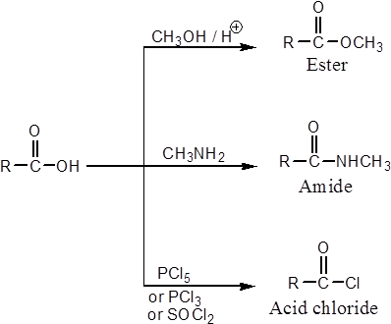
Carboxylic Acid Derivatives

Slide 29

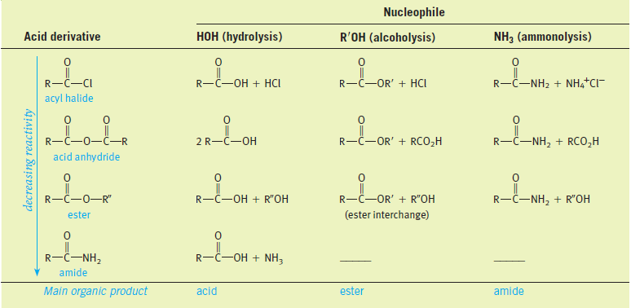
Carboxylic Acid Derivatives
Carboxylic acid derivatives are compounds in which the hydroxyl part of the carboxyl group is replaced by various other groups.
All acid derivatives can be hydrolyzed to the corresponding carboxylic acid.

Slide 30


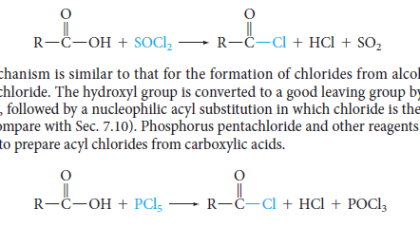
Carboxylic Acid Derivatives
Acid Chloride
Acyl chlorides have the general formula RCOCl.
Acyl chlorides are more common and less expensive than bromides or iodides.
Nomenclature:
Acyl chlorides, or acid chlorides, are named by replacing the -ic acid ending of the parent acid by -yl chloride.
Preparation:
They can be prepared from acids by reaction with thionyl chloride or phosphorous pentachloride.

Slide 31
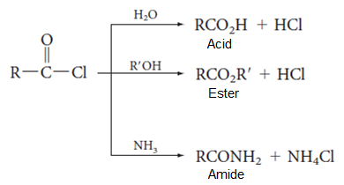

Carboxylic Acid Derivatives
Acid Chloride
Reactions: They can react rapidly with most nucleophile.
Examples:

Slide 32
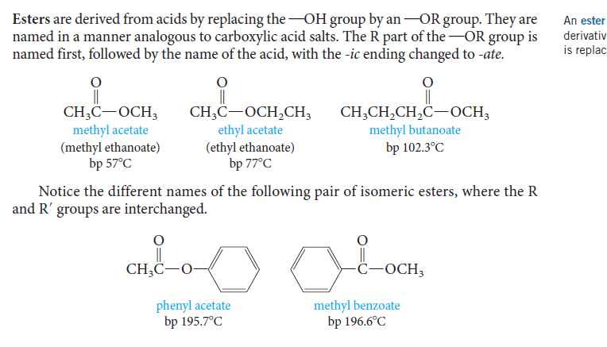
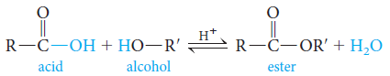
Carboxylic Acid Derivatives
Esters
Esters are derived from acids by replacing the –OH group by an –OR group and have the general formula R/COOR.
Nomenclature:
They are named in a manner analogous to carboxylic acid salts.
The R part of the –OR group is name first, followed by the name of the acid, with the –ic acid ending changed to –ate.
Preparation:
When a carboxylic acid and an alcohol are heated in the presence of an acid catalyst (HCl or H₂SO₄), an equilibrium is established with the ester and water.

Slide 33
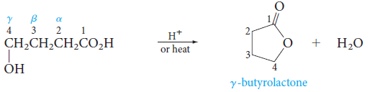
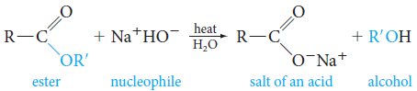
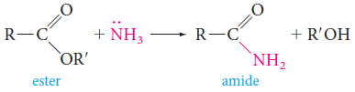
Carboxylic Acid Derivatives
Esters
Reactions
Cyclic esters (lactones) can be prepared from hydroxy acids if these groups can come in contact through bending of the chain.
Saponification; esters are commonly hydrolyzed with base.
Ammonia converts esters to amides.

Slide 34
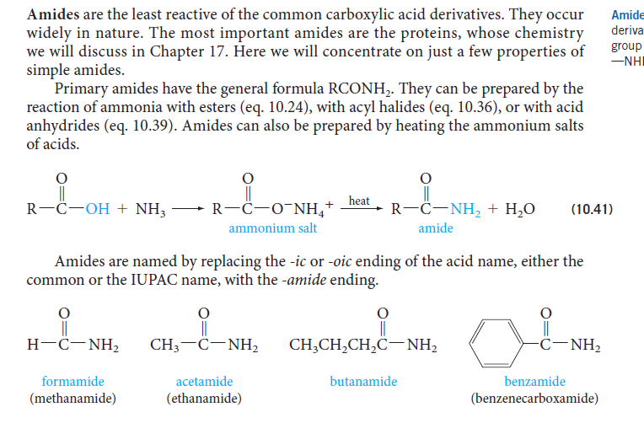

Carboxylic Acid Derivatives
Amides
Amides are the least reactive of the common carboxylic acid derivatives.
Primary amides have general formula RCONH₂.
Nomenclature:
Amides are named by replacing the –ic or –oic acid ending of the acid name, either the common or the IUPAC name, with the –amide ending.

Slide 35
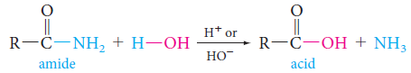
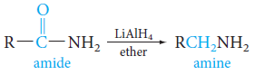
Carboxylic Acid Derivatives
Amides
Preparation:
They can be prepared by the reaction of ammonia with esters, with acyl halides, or with acid anhydrides.
Amides can also prepared by heating the ammonium salts of acids.
Reactions
Amides react with nucleophiles and they can be hydrolyzed by water.
Amides can be reduced by lithium aluminums hydride to give amines.

Slide 36
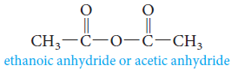
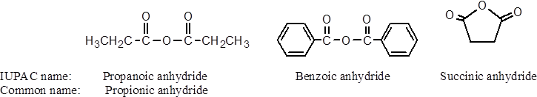
Carboxylic Acid Derivatives
Acid Anhydrides
Acid anhydrides have general formula RCOOCOR.
Nomenclature:
The name of an anhydrides is obtained by naming the acid from which is derived and replacing the word acid with anhydride.

Slide 37
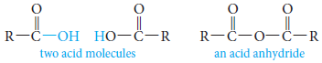

Carboxylic Acid Derivatives
Acid Anhydrides
Preparation
Acid anhydrides are derived from acids by removing water from two carboxyl groups and connecting the fragments.
Anhydrides can also be prepared from acid chlorides and carboxylate salts.
This method is used for preparing anhydrides derived from two different carboxylic acids (mixed anhydrides).

Slide 38
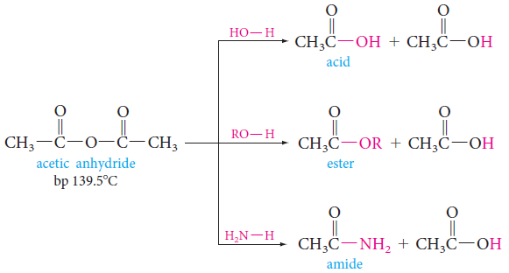
Carboxylic Acid Derivatives
Acid Anhydrides
Reactions
Anhydrides undergo nucleophilic acyl substitution reactions (They are more reactive than esters, but less reactive than acyl halides).

Slide 39
Uses of Carboxylic Acids
Hexanedioic acid is used in the manufacture of nylon-6, 6.
Esters of benzoic acid are used in perfumery.
Sodium benzoate is used as a food preservative.
Higher fatty acids are used for the manufacture of soaps and detergents.

