Slide 1
IE 469 Manufacturing Systems
469 صنع نظم التصنيع
Expert Systems
Part 2

Slide 2
Uncertainty in Rule Bases
Uncertainty in KBS can be caused by the problem with the data.
Data might be missing or unavailable.
Data might be present but unreliable or ambiguous due to measurement errors
The representation of the data may be imprecise or inconsistent.
Data may just be user’s best guess.
Data may be based on default and the defaults may have exception
Uncertainty may caused by the represented knowledge since it might be
Represent best guesses of the experts that are based on plausible or statistical associations they have observed.
Not be appropriate in all situations (may have indeterminate applicability)

Slide 3
Four approaches
Bayesian approach, Certainty factor, Dempster-Sharper theory of evidence, Fuzzy Sets and Fuzzy logics
Certainty Factor Varies slightly in its implementation
Certainty factor c ∈ (0, 1)
The formulas for calculating certainty factors
Rule 1
IF EVIDENCE
THEN HYPOTHESYS(CF)
IF A₁ AND B₁ THEN D₁
CF(A₁)=C_{A1,} CF(B₁)=C_{B1}
CF(D₁)=CF(R₁)=CF(A₁ AND B₁)
= min{C_{A1}, C_{B1}}

Slide 4
Rule2
Rule 3
IF A₂ OR B₂ THEN D₂
CF(D₂)=CF(R₂)=CF(A₂ OR B₂)
= max{C_{A2}, C_{B2}}
IF A₁ AND B₁ THEN D₁ CF=c
CF(D₁)= min{C_{A1}, C_{B1}} c

Slide 5
Rule 4
Two production rules:
IF A₂ OR B₂ THEN D₂ CF=c
CF(D₂)= max{C_{A2}, C_{B2}} c
Rule 1: IF A₁ AND B₁ THEN D₁ CF=c1
Rule 2: IF A₂ OR B₂ THEN D₂ CF=c2
CF(R1, R2)= c1+c2-c1*c2
= c1+c2(1-c1)

Slide 6
Three production rules:
CF(R1, R2, R3)= CF(R1, R2) + CF(R3) [1-CF(R1, R3)]

Slide 7
Knowledge-Based Systems (Knowledge Consistency)

Slide 8
Requirement
Why is the knowledge consistency needed?
Elicitation of production rules is a difficult step in building a knowledge-based system
Errors associated with knowledge elicitation result in various inconsistencies and redundancies among production rules. This is especially likely to happen while developing large knowledge bases, in particular when the knowledge is elicited form multiple sources

Slide 9
Production Rule
A rule base consists of a number of production rules R_{i}
IF C(R_{i}) THEN A(R_{i})
C(R_{i}) = condition clause of production rule
A(R_{i}) = action part of a production rule
Example
< Production rule R₁ >
IF machine M₁ is available AND tool t₄ is loaded in tool magazine T₃
THEN release part p₆ for processing on machine M₁
C(R₁)
A(R₁)

Slide 10
Knowledge Anomalies
Static anomalies
Detected without inferenceing rules
Inference (dynamic) anomalies
Identified during the inference process
- Liebowitz and Desalvo[1989]

Slide 11
Static Anomalies
Type 1 (Potential Conflict)
Two rules with different conditions results identical actions
C(R_{i}) ≠ C(R_{j}) , A(R_{i}) = A(R_{j})
Type 2 (Potential Conflict)
Two rules with identical conditions results different actions
C(R_{i}) = C(R_{j}) , A(R_{i}) ≠ A(R_{j})
Type 3 (Redundancy)
Two rules with identical conditions results identical actions
C(R_{i}) = C(R_{j}) , A(R_{i}) = A(R_{j})
Type 4 (Subsumption)
Two rules with identical conditions, but one contains additional elements in the actions clauses
C(R_{i}) = C(R_{j}) , A(R_{i}) ⊂ A(R_{j})

Slide 12
Inference Anomalies
Type 5 (Cycle)
Set of production rules forms a cycle
A(R₁)⊆C(R₂)⊆A(R₃) …⊆A(R_{n}) ⊆ C(R₁)
Type 6 (Unreachable Action)
In the backward inferencing, the action of a rule is neither a part of the possible query nor a part of the condition of another rule.
Type 7 (Dead-End-Query)
In the backward inferencing, the query does not match an action of one of the rules in the rule base
Type 8 (Dead-End-Condition)
To satisfy the condition of a rule in the backward inferencing, the condition must be askable or matched by a conclusion of one of the rules in the rule base

Slide 13
Detection of Static Anomaly
Detection with Simple Action Clause
Detection with Compound Condition & Action Clauses

Slide 14
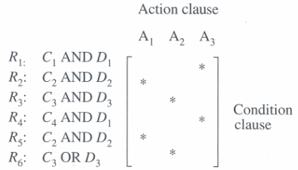
Incidence Matrix
6 production rules R1, …, R6 representation
Bipartite graph
Incidence Matrix
‘*’ Indicates the incidence of a condition-action clause
More suitable for computer applications, especially for large-scale knowledge bases

Slide 15
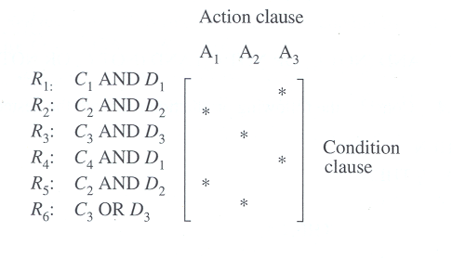
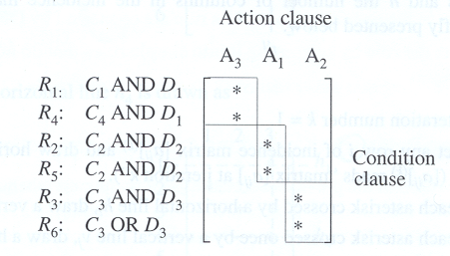
Detection with Simple Action Clause (1)
CI algorithm
R2, R5 : type3 redundancy (identical)
R3, R6 : type1 anomaly (different conditions, identical actions)
R1, R4 : type1 anomaly (different conditions, identical actions)

Slide 16
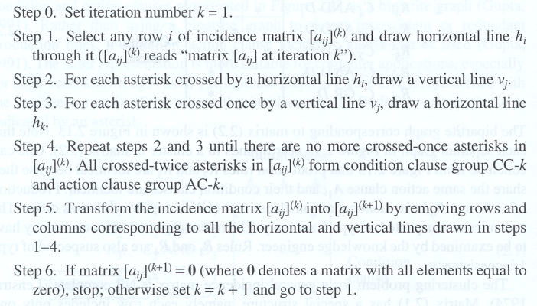
Detection with Simple Action Clause (2)
CI (Clustering identification) Algorithm

Slide 17
Detection with Simple Action Clause (3)
CI algorithm example
0. Set iteration number
1. Select any row i of incidence matrix and
draw horizontal line h_{i} through it
Iteration 1
2. For each asterisk crossed by a horizontal line h_{i},
draw a vertical line v_{j}
 |  | 1 | 2 | 3 | 4 | 5 | 6 | 7 | 8
1 |  |  | * | * |  | *
2 |  | * |  |  |  |  | *
3 |  |  |  |  | * |  |  | *
4 |  | * |  |  |  |  | *
5 |  |  |  | * |  | *
6 |  |  |  |  | *
7 |  |  | * | * |  | * |  |  | *
3. For each asterisk crossed once by a vertical
line v_{i}, draw a horizontal line v_{j}
4. Repeat 2, 3 until there are no more crossed-
once asterisks, all crossed-twice asterisks form
condition & action clause group
5. Transform the matrix by removing rows and
columns corresponding to the group in 4
CC-1 = {1, 5, 7}
AC-1 = {2, 3, 5, 8}

Slide 18
Detection with Simple Action Clause (4)
6. If matrix = 0, stop;
otherwise set k=k+1 and goto step 1
 |  | 1 | 4 | 6 | 7
2 |  | * |  | *
3 |  |  | * |  | *
4 |  | * |  | *
6 |  |  | *
 |  | 4 | 7
3 |  | *
6 |  | * | *
 |  | 2 | 3 | 5 | 8 | 1 | 6 | 4 | 7
1 |  | * | * | *
5 |  |  | * | * | *
7 |  | * | * | * | *
2 |  |  |  |  |  | * | *
4 |  |  |  |  |  | * | *
3 |  |  |  |  |  |  |  | * | *
6 |  |  |  |  |  |  |  | *
Iteration 2
Iteration 3
Final decomposition result

Slide 19
Detection with Compound Condition & Action Clauses (1)
More than one element linked by AND and/or OR connector
A Incidence Matrix is defined as follows ;
* for the first element in clause j of rule i
AND² for the second AND element in clause j of rule i
OR² for the second OR element in clause j of rule i
AND³ for the third AND element in clause j of rule i
OR³ for the third OR element in clause j of rule i
.
.
AND^{k} for the k^{th} AND element in clause j of rule i
OR^{k} for the k^{th} OR element in clause j of rule i
a _{ij}=
R1 : IF C1 AND D1 THEN A5 AND A1
R2 : IF C2 AND D2 THEN A3 AND A7 AND A6
R3 : IF C3 AND D3 THEN A2 AND A4

Slide 20
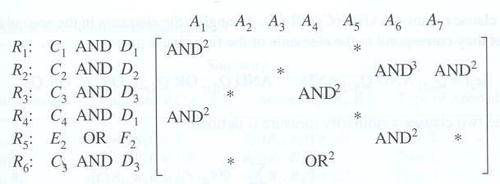
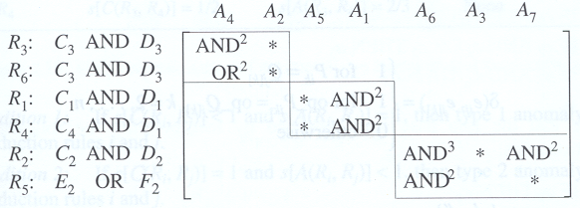
Detection with Compound Condition & Action Clauses (2)
CI algorithm
R3, R6 : type2 anomaly (identical conditions, different actions)
R1, R4 : type1 anomaly (different conditions, identical actions)
R2, R5 : type1 anomaly (different conditions, similar actions)

Slide 21
Detection with Compound Condition & Action Clauses (3)
Similarity measure
The alternative approach of CI algorithm
When an ideal decomposition (block diagonal structure) of an incidence matrix does not occur
e_{i} = P_{i1} AND P_{i2} AND … AND P_{if} AND P_{i,f+1} AND … AND P_{in’}
e_{j} = Q_{j1} AND Q_{j2} AND … AND Q_{ig} AND Q_{i,g+1} OR … OR Q_{jn’’}
Arranging the elements in the second clause
e_{i} = P_{i1} AND P_{i2} AND … AND P_{if} AND P_{i,f+1} AND … AND P_{in’}
[e_{j}] = Q_{j[1]} AND Q_{j[2]} AND … AND Q_{i[g]} AND Q_{i,[g+1]} OR … OR Q_{j[n’’]}

Slide 22
Detection with Compound Condition & Action Clauses (4)
n
∑ δ (e_{ik} , e_{j[k]})
S (e_{i}, e_{j}) =
K=1
n
1 for P_{ik} = Q_{j[k]}
δ (e_{ik} , e_{j[k]})
=
1 for op_P_{ik} = op_Q_{j[k]}, k=2, …, n
0 otherwise
n = max {n’, n’’}
e_{ik} = k_{th} element of clause e_{i}
e_{j[k]} = k_{th} element of clause [e_{j}]
op_P_{ik} = logical operator and element that follows that operator

Slide 23
Detection with Compound Condition & Action Clauses (5)
Similarity measure example
e₁ = A₁ AND A₂ AND A₃ OR A₄ OR A₅ OR A₆ OR A₇
e₂ = A₃ AND A₁ AND A₂ AND A₅ OR B₁ AND A₈ AND A₇
e₁ = A₁ AND A₂ AND A₃ OR A₄ OR A₅ OR A₆ OR A₇
[e₂] = A₁ AND A₂ AND A₃ AND A₅ OR B₁ AND A₇ AND A₈
1 + 1 + 1 + 0 + 0 + 0 + 0
3
s (e₁, e₂) =
=
7
7

Slide 24
Detection with Compound Condition & Action Clauses (6)
Similarity measure and anomaly detection
If s [C(R_{i}, R_{j})] < 1 and s [A(R_{i}, R_{j})] = 1, then type 1 anomaly exists
( different conditions, identical actions )
If s [C(R_{i}, R_{j})] = 1 and s [A(R_{i}, R_{j})] < 1, then type 2 anomaly exists
( identical conditions, different actions )
If s [C(R_{i}, R_{j})] = 1 and s [A(R_{i}, R_{j})] = 1, then type 3 anomaly exists
( identical conditions, identical actions )
Similarity measure pro & con
Pro : can also be used to detect other types of anomalies
Con : consider only two rules at a time, cf) clustering approach

Slide 25
Detection of Inference Anomaly
AND/OR Graph
Adjacency matrix

Slide 26
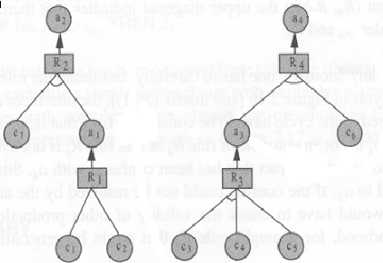
AND/OR Graph
R1 : IF c1 OR c2 THEN a1
R2 : IF c7 AND a1 THEN A2
R3 : IF c3 AND c4 OR c5 THEN a3
R4 : IF a3 AND c6 THEN a4
R1 : IF c1 OR c2 THEN a1
R2 : IF c7 AND a1 THEN A2
R3 : IF c3 AND c4 OR c5 THEN a3
R4 : IF a3 AND c6 THEN a4
+
R5 : IF a2 THEN c4
R6 : IF a4 AND c6 THEN a3

Slide 27
Adjacency Matrix
b_{ij} =
+ : if A(R_{i}) ⊆ C(R_{j})
0 : no relationship between rules R_{i} and R_{j} exists
Example

Slide 28
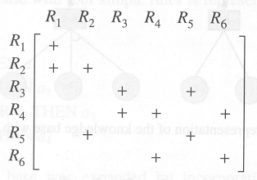
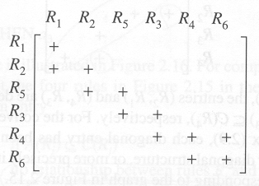
Inference (Dynamic) Anomalies
Triangularization algorithm
The order in which the production rules can be fired is R1, R2, R5, R3, R4
The element (R4, R6) in the upper diagonal indicates that there exists a cycle between rules R4 and R6

