Slide 1
Petri Nets
IE 469 Manufacturing Systems
469 صنع نظم التصنيع

Slide 2
Outline
Petri nets
  Introduction
  Examples
  Properties
  Analysis techniques
Notes:
Outline

Slide 3
Petri net models and graphical representation
A Petri net (PN) is defined as a directed bipartite graph having a structure, C, and a marking, M.
we use the definition C = (P, T, I, O), where:
P = a set of places. P = {pl, p2, p3,... pn}
T = a set of transitions. T = {t 1, t2, t3 ... tm}
I = a mapping from places to transitions. (PXT) →N
O= a mapping from transitions to places. (PXT) →N
Each of these concepts has a graphical representation. The place is represented by a circle, the transition by a bar, and the input and output mapping by a set of directed arcs.

Slide 4
In this illustration there are four places, P = {p 1, p2, p3, p4}, and three transitions, T = {t 1, t2, t3}. There are also eight directed arcs which define I and O
Tokens: black dots
p2
t2
2
p1
t1
p4
3
t3
p3

Slide 5
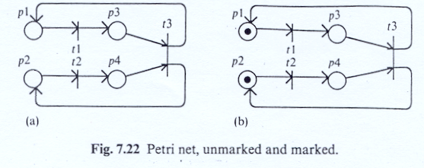
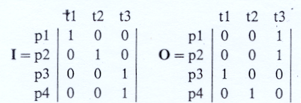
Petri net, unmarked and marked.
mappings can be described in matrix form as follows:

Slide 6
Petri Net
A PN (N,M0) is a Petri Net Graph N
  places: represent distributed state by holding tokens (Activities)
    marking (state) M is an n-vector (m1,m2,m3…), where mi is the non-negative number of tokens in place pi.
    initial marking (M₀) is initial state
  transitions: represent actions/events
    enabled transition: enough tokens in predecessors
    firing transition: modifies marking
…and an initial marking M0.
p2
t2
t1
2
p1
p4
3
Places/Transition: conditions/events
t3
p3
Notes:
What places and transitions represent.
Places represent state
Transitions actions
See also as condition/event

Slide 7
Transition firing rule
A marking is changed according to the following rules:
  A transition is enabled if there are enough tokens in each input place
  An enabled transition may or may not fire
  The firing of a transition modifies marking by consuming tokens from the input places and producing tokens in the output places
2
2
2
2
3
3
Notes:
Firing rule: only PN rule.
May or may not fire: asynchronicity

Slide 8
Concurrency, causality, choice
t1
t2
t5
t3
t4
t6
Notes:
Concurrency
Sequencing
Conflict

Slide 9
Concurrency, causality, choice
t1
Concurrency
t2
t5
t3
t4
t6

Slide 10
Concurrency, causality, choice
t1
t2
t5
Causality, sequencing
t3
t4
t6

Slide 11
Concurrency, causality, choice
t1
t2
t5
Choice,
conflict
t3
t4
t6

Slide 12
Concurrency, causality, choice
t1
t2
t5
Choice,
conflict
t3
t4
t6

Slide 13
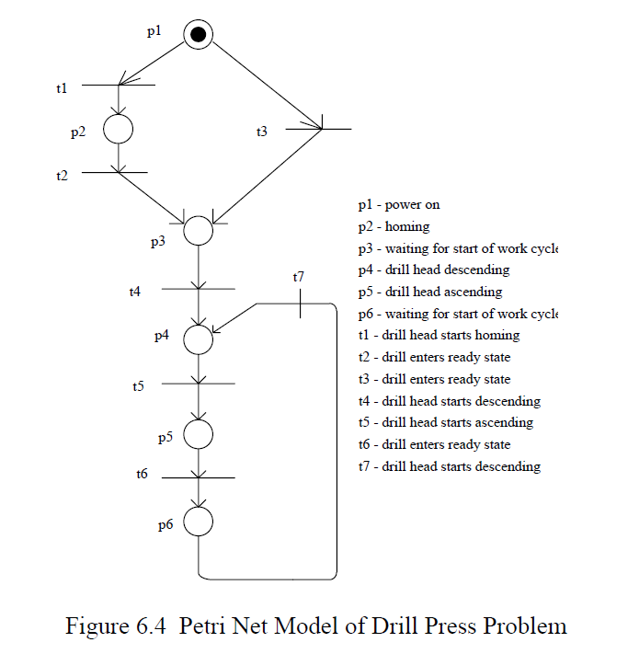
Example

Slide 14
Producer-Consumer Problem
Produce
Buffer
Consume
Notes:
Unbounded channel
PNs are an infinite state model but most properties are decidable with finite time and memory

Slide 15
Producer-Consumer Problem
Produce
Buffer
Consume

Slide 16
Producer-Consumer Problem
Produce
Buffer
Consume

Slide 17
Producer-Consumer Problem
Produce
Buffer
Consume

Slide 18
Producer-Consumer Problem
Produce
Buffer
Consume

Slide 19
Producer-Consumer Problem
Produce
Buffer
Consume

Slide 20
Producer-Consumer Problem
Produce
Buffer
Consume

Slide 21
Producer-Consumer Problem
Produce
Buffer
Consume

Slide 22
Producer-Consumer Problem
Produce
Buffer
Consume
Notes:
Bounded channel with complementary arcs

Slide 23
Producer-Consumer Problem
Produce
Buffer
Consume

Slide 24
Producer-Consumer Problem
Produce
Buffer
Consume

Slide 25
Producer-Consumer Problem
Produce
Buffer
Consume

Slide 26
Producer-Consumer Problem
Produce
Buffer
Consume

Slide 27
Producer-Consumer Problem
Produce
Buffer
Consume

Slide 28
Producer-Consumer with priority
A
Consumer B can
consume only if
buffer A is empty
Inhibitor arcs
B
Notes:
Unbounded channel
PNs are an infinite state model but most properties are decidable with finite time and memory

Slide 29
PN properties
Behavioral: depend on the initial marking (most interesting)
  Reachability
  Boundedness
  Schedulability
  Liveness
  Conservation
Structural: do not depend on the initial marking (often too restrictive)
  Consistency
  Structural boundedness
Notes:
Most interesting properties are behavioral because we know the initial marking of the system and we are interested in analysis that start from there.
Structural properties are properties that hold for any initial marking, therefore they are too restrictive. Usually we know the initial marking of the system we design.

Slide 30
Reachability
Marking M is reachable from marking M0 if there exists a sequence of firings σ = M0 t1 M1 t2 M2… M that transforms M0 to M.
The reachability problem is decidable.
p2
t2
Μ0 = (1,0,1,0)
t3
M1 = (1,0,0,1)
t2
M = (1,1,0,0)
p1
t1
p4
t3
p3
Μ0 = (1,0,1,0)
M = (1,1,0,0)
Notes:
The reachability problem is decidable.

Slide 31
When the transition t_{j} fires it results in a new marking M’, (by removing I(pi, tj) tokens from each of its input places and adding O(pi, tj) tokens to each of its output places. Then, M’ is reachable from M as: M’(pi)=M(pi)+O(pi,tj)-I(pi,tj)
Example: The following figure shows the change in state from M_{k-1} to M_{k} by firing t1.Let u be a firing vector, where u^{T}=[u(t1), u(t2), u(t3)]. Then
M_{k} = M_{k-1}+Ou_{k}-Iu_{k} =M_{k-1}+Au_{k}

Slide 32
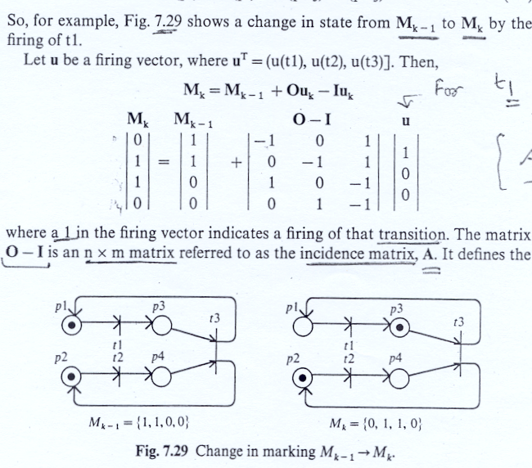

Slide 33
Petri net invariants
An invariant of a PN depends on its topology.
  P-invariant.
  T-invariant.
  If there exists a set of non-negative integers x such that x^{T}A=0, then x is called a P-invariant of the PN.
  Let x be a weighting vector of places x=[w1, w2, w3, …wn].
There are (n-r) minimal P-invariants.
n= number of places. r= the rank of A.

Slide 34
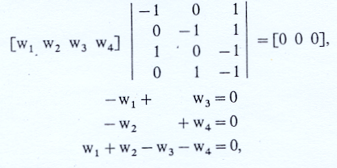
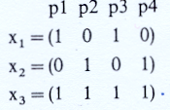
which has the following solutions:

Slide 35
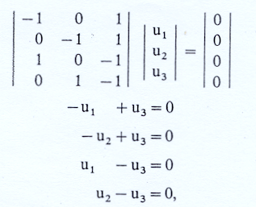
T-invariant
A vector y of non-negative integers is a T-invariant if there exists a marking M and a firing sequence back to M whose firing count vector is y.
A T-invariant is a solution to the equation Ay=0. Let y be a vector y=[u1, u2, u3, …..um].
Which yields the T-invariant y^{T}=(1,1,1).
y defines the number of times each transition must be fire in one complete cycle from M0 back to it self. In general there are (m-r) T-invariants.
m= number of transitions.

Slide 36
Liveness
Liveness: from any marking any transition can become fireable
  Liveness implies deadlock freedom, not viceversa
Not live
Notes:
The transition is not live because it can be fired only once and after that is dead.
The net is not live but it is deadlock free because I can keep firing the two transitions on the right

Slide 37
Liveness
Liveness: from any marking any transition can become fireable
  Liveness implies deadlock freedom, not viceversa
Not live

Slide 38
Liveness
Liveness: from any marking any transition can become fireable
  Liveness implies deadlock freedom, not viceversa
Deadlock-free

Slide 39
Liveness
Liveness: from any marking any transition can become fireable
  Liveness implies deadlock freedom, not viceversa
Deadlock-free

Slide 40
Boundedness
Boundedness: the number of tokens in any place cannot grow indefinitely
  (1-bounded also called safe)
  Application: places represent buffers and registers (check there is no overflow)
Unbounded
Notes:
Finite number of token can accumulate

Slide 41
Boundedness
Boundedness: the number of tokens in any place cannot grow indefinitely
  (1-bounded also called safe)
  Application: places represent buffers and registers (check there is no overflow)
Unbounded

Slide 42
Boundedness
Boundedness: the number of tokens in any place cannot grow indefinitely
  (1-bounded also called safe)
  Application: places represent buffers and registers (check there is no overflow)
Unbounded

Slide 43
Boundedness
Boundedness: the number of tokens in any place cannot grow indefinitely
  (1-bounded also called safe)
  Application: places represent buffers and registers (check there is no overflow)
Unbounded

Slide 44
Boundedness
Boundedness: the number of tokens in any place cannot grow indefinitely
  (1-bounded also called safe)
  Application: places represent buffers and registers (check there is no overflow)
Unbounded

Slide 45
Conservation
Conservation: the total number of tokens in the net is constant
Not conservative

Slide 46
Conservation
Conservation: the total number of tokens in the net is constant
Not conservative
Notes:
This net is not coservative

Slide 47
Conservation
Conservation: the total number of tokens in the net is constant
Conservative
2
2
Notes:
This is conservative

Slide 48
Analysis techniques
Structural analysis techniques
  Incidence matrix
  T- and P- Invariants
State Space Analysis techniques
  Coverability Tree
  Reachability Graph
Notes:
Let us consider now analysis techniques.
They are of two types.
Structural: incidence matrix and algebraic techniques.
PNs firing rules have links to linear algebra.
State-based: Reachability tree
State-based are exhaustive but expensive.

Slide 49
Incidence Matrix
t2
p1
t1
p2
p3
t1
t2
t3
t3
-1 0 0
1 1 -1
0 -1 1
p1
A=
p2
p3
Necessary condition for marking M to be reachable from initial marking M₀:
there exists firing vector v s.t.:
M = M₀ + A v
Notes:
Build an incidence matrix that gives info about the PN structure: I/O relationship between nodes.
Necessary condition is that exists a solution. Not sufficient!

Slide 50
State equations
E.g. reachability of M =|0 0 1|^{T} from M₀ = |1 0 0|^{T}
t2
p1
t1
p2
p3
-1 0 0
1 1 -1
0 -1 1
A=
t3
1
0
1
0
0
1
1
0
0
-1 0 0
1 1 -1
0 -1 1
1
0
1
v1 =
=
+
Notes:
The solution is one of the vectors

Slide 51
Reachability
x^{T}M’ = x^{T}M₀
Example:
Show that M=(0 0 1 1) is reachable from M₀ but M =(1 0 1 0) is not reachable from M₀.
Testing: M=(0 0 1 1)

Slide 52
Testing M=(1 0 1 0)

Slide 53
Reachability graph
t2
p1
t1
p2
p3
100
t3
For bounded nets the Coverability Tree is called Reachability Tree since it contains all possible reachable markings

Slide 54
Reachability graph
t2
p1
t1
p2
p3
100
t1
010
t3
For bounded nets the Coverability Tree is called Reachability Tree since it contains all possible reachable markings

Slide 55
Reachability graph
t2
p1
t1
p2
p3
100
t1
010
t3
t3
001
For bounded nets the Coverability Tree is called Reachability Tree since it contains all possible reachable markings

Slide 56
Reachability graph
t2
p1
t1
p2
p3
100
t1
010
t3
t2
t3
001
For bounded nets the Coverability Tree is called Reachability Tree since it contains all possible reachable markings

Slide 57
Coverability Tree
Build a (finite) tree representation of the markings
Karp-Miller algorithm
Label initial marking M0 as the root of the tree and tag it as new
While new markings exist do:
  select a new marking M
  if M is identical to a marking on the path from the root to M, then tag M as old and go to another new marking
  if no transitions are enabled at M, tag M dead-end
  while there exist enabled transitions at M do:
    obtain the marking M’ that results from firing t at M
    on the path from the root to M if there exists a marking M’’ such that M’(p)>=M’’(p) for each place p and M’ is different from M’’, then replace M’(p) by ω for each p such that M’(p) >M’’(p)
    introduce M’ as a node, draw an arc with label t from M to M’ and tag M’ as new.
Notes:
Build coverability tree starting from initial marking

Slide 58
Coverability Tree
Boundedness is decidable
with coverability tree
1000
t2
p1
t1
p2
p3
p4
t3
Notes:
Build coverability tree starting from initial marking

Slide 59
Coverability Tree
Boundedness is decidable
with coverability tree
1000
t1
0100
t2
p1
t1
p2
p3
p4
t3

Slide 60
Coverability Tree
Boundedness is decidable
with coverability tree
1000
t1
0100
t2
p1
t1
p2
p3
t3
0011
p4
t3

Slide 61
Coverability Tree
Boundedness is decidable
with coverability tree
1000
t1
0100
t2
p1
t1
p2
p3
t3
0011
t2
p4
0101
t3

Slide 62
Coverability Tree
Boundedness is decidable
with coverability tree
1000
t1
0100
t2
p1
t1
p2
p3
t3
0011
t2
p4
010_{ω}
t3
Notes:
Introduce the omega symbol that means infinite accumulation of tokens.
It cannot solve reachability problems

Slide 63
Petri Net extensions
Add interpretation to tokens and transitions
  Colored nets (tokens have value)
Add time
  Time/timed Petri Nets (deterministic delay)
    type (duration, delay)
    where (place, transition)
  Stochastic PNs (probabilistic delay)
  Generalized Stochastic PNs (timed and immediate transitions)
Add hierarchy
  Place Charts Nets
Notes:
Stochastic PNs have exponentially distributed random variable expressing the delay between the enabling and the firing of a transition.
GSPNs have immediate transitions that take negligible amount of time.
Place Charts Nets: exponential reduction in size. Good for preemption.

