Slide 1
IDEF 1X
IE 469 Manufacturing Systems
469 صنع نظم التصنيع
Data Modeling

Slide 2
Components of Information
Information
Data
Meanings
Facts

Slide 3
From ER to IDEF1X
Selling
Customer
M
M
Product
Customer
Product
Selling

Slide 4
IDEF 1X
Useful in determining when information voids are the cause of a problem
Consistent, extensible, and transformable
Provides consistent mapping and definition of enterprise data

Slide 5
Benefits of IDEF1X Analysis
Separate Facts from Folklore
Discover underlying cause for problems
Use directly as requirements
Implement results with policy or procedure change
Designed for the domain expert

Slide 6
Why Develop an IDEF1X Model?
Determine information resource management needs and requirements
Depict what information is collected, stored, and managed
Depict the rules governing the management of information
Validate the concepts in the associated IDEF0 model
Leverage information to achieve a competitive advantage

Slide 7
What is an IDEF1X Model?
A Graphic / Textual Depiction of “What Must I Know to Do What I Do?”
Automated and
Non-Automated
Objects
  People
  Filing Cabinets
  Telephones
ABC Mailbox / 6
Sale / 2
ABC ID
Sale #
Receives
Decreases
Invoices
Count of
from
P
Vendor / 5
Shipment / 4
Item on Shipment / 7
Item / 1
Vendor #
Vendor # (FK)
Vendor # (FK)
1
Item #
Prepares
P
Shipment #
Contains
P
Shipment #(FK)
Increases Count of
Vendor # (FK)
P
Owns
1
Vendor Mailbox / 3
Vendor # (FK)
Receives count of

Slide 8
What is a Data Model?
A Representation of the Data Elements and the Relationships among those Elements in an Existing or Planned System.

Slide 9
Data Modeling Focus
Things inside the computer/software system
Representation & structure of DATA
Use for
  logical design of databases
  logical design of applications
  physical design of database implementation

Slide 10
Information Modeling Focus
Information collected, stored, and managed by the organization
Rules within the organization about that information
Logical relationships within the organization reflected in the information
Basis for information system design
Use for
  Problem Identification
  Requirements Definition

Slide 11
Knowledge Modeling Focus
Terminology used in the domain to represent concepts, physical objects, behavior or knowledge that people use to do their job
Concepts people use to do their job
Perceived relationships within the organization
  Physical (Nomic) Constraints
  Conventional (Nominative) Constraints
  Conditional Constraints
Map of language use on the real world
The flow of knowledge between situated agents in the environment

Slide 12
Information Modeling Use
Information System Audit
  systems
  machines & software
Document Flow Analysis
  Which organizations generate
  Which organizations use
Data Life-Cycle Definition
Data Flow Modeling

Slide 13
IDEF1X - Data Modeling
Intended as a method to facilitate the logical design of a relational database, IDEF1X provides:
a foundation for a data dictionary.
a definition of the information and data structure of the enterprise.
a model that can be used in actual database implementation.
SQL code generated through commercial product support.

Slide 14
IDEF1X As A Standard
Federal Information Processing Standards Publication (FIPS PUB) 184 - Integration Definition for Information Modeling (IDEF1X)
  Published December 1993
DoD 8020.1-M established IDEF1X as the DoD standard methodology used for data modeling

Slide 15
"Real World" Connections
The Real World
Information
Model
Business
Rules
VENDOR
Any individual
vendor may receive
many purchase
orders.
Information
about
Vendors
Connection
Information
about
Purchase
Orders
Any individual
purchase order
is issued to only
one vendor.
Purchase
Order

Slide 16
Entity
A generic name of a person, place, or thing that is within the scope of the model and has a unique identifier.
  Employee is an entity and has a unique identifier (employee number).

Slide 17
Entities
Instances of entities
Dick Schwartz
John Jones
Employee
Entity

Slide 18
What Makes a Set of Things an Entity?
Can it be described?
Are there several instances?
Can one instance be separated or distinguished from another?
Does it refer to or describe something? (If YES, then it may be an attribute of an entity.)

Slide 19
Attribute
A type of characteristic or property associated with a set of real or abstract things (people, objects, events, etc.).
Attribute Instance
  Is a specific characteristic of an entity.
  Is defined by both the types of a characteristic and its value.
  Has a unique name (noun/noun phrase), and the same meaning must always apply to the same name.
  May be inherited by an entity through a specific connection or categorization relationship in which it is a child or category entity.

Slide 20
Attributes: An Example
Entity Instance of an Attributes
(employee) Attribute
No. 1:
NAME: Smith
JOB: Operator
Employee
No.
No. 2:
NAME: Jones
JOB: Supervisor
Employee
Name
No. 3:
NAME: Starbuck
JOB: Pilot
Employee
Job

Slide 21
Attributes
Hair Color
Gender
Employee Number
16482 F Brn 25
13258 M Red 18
Employee Number
Gender
Hair Color
Age
Age
Employee

Slide 22
Entities and Attributes
Vendor/1
P.O./2
vendor_name
vendor_number
contact_number
address
phone_number
po_total
po_number
P
Account Item/3
status
due_date
invoice_date
invoice_number

Slide 23
Keys
Primary Key Attribute whose value uniquely identifies every instance of the entity.
Alternate Key Attribute whose value uniquely identifies the entity, but is not the primary key. There can be more than one.
Foreign Key Attribute that appears in a dependent entity, having migrated from the primary key of its parent entity.

Slide 24
Primary Key
Attribute and Primary Key Syntax
Entity-name/Entity-number
}
Primary Key
Attributes
}
Other Attributes
Owned or Inherited

Slide 25
Primary Key
Vendor/1
P.O./2
vendor_number
po_number
vendor_name
contact_number
address
phone_number
po_total
P
Account Item/3
status
due_date
invoice_date
invoice_number

Slide 26
Alternate Key
Every entity must have a unique key formed from one or more attributes.
If more than one unique key exists only one is the primary key, the others are alternate keys.
A primary key may serve as part of an alternate key.
Example:
Employee/2
Primary Key
Alternate Key #1
Alternate Key #2
Employee-No
SSN (AK1)
Name (AK2)
Birth Date (AK2)

Slide 27
Foreign Keys
Vendor/1
P.O./2
vendor_number
po_number
vendor_name
contact_number
po_total
address
phone_number
P
Account Item/3
po_number (FK)
vendor_number (FK)
status
due_date
invoice_date
invoice_number

Slide 28
Relationships
A meaningful association or connection between two entities.
A business rule.

Slide 29
IDEF1X Relationships
All decisions are determined in pairs!
Entity
Classes
Related
Pairs

Slide 30
IDEF1X Component Relations
Relations show the association and dependency between Entity Classes. Each relationship is labeled with a verb phrase.
  Examples—
    “is assigned to” “is contained in”
    “has” “performs”
The dependency between two entity classes determines the syntax of the label and the way it is depicted

Slide 31
Types of Relationships in IDEF1X
Non-specific Relationships
Categorization Relationships
Entity 1
Entity 2
Complete Categorization
Generic Entity
Discriminator
Specific Relationships
Entity 1
Entity 2
Identifying Relationship
Entity 1
Entity 2
Incomplete Categorization
Generic Entity
Non-Identifying Relationships
Entity 1
Entity 2
Discriminator
Entity 1
Entity 2

Slide 32
IDEF1X Component Relations
An entity class which can not meaningfully exist without the existence of another entity class is said to be dependent.
  Example: a Purchase Order can not exist without a Purchaser.
Relations are depicted and labeled from the independent entity class towards the dependent entity class.
Often non-specific dependencies must be shown and resolved later. These are always given “bi-directional” labels.

Slide 33
Non-Specific Relationship
Many-to-Many relationship between two and only two entities.
Cardinality is expressed in both directions.
The relationship is named in both directions.
RELATIONSHIP OF A TO B
Entity A/1
Entity B/2
Relationship Name/
Relationship Name
RELATIONSHIP OF B TO A

Slide 34
Specific Relationship
Parent-child or Existence-dependency.
One parent exists for zero, one, or more instances of the child.
Each instance of a child entity can exist only if an associated instance of the parent entity exits.
Relationships may be identifying or non-identifying.

Slide 35
Key Class Migration
Refers to the “inheritance” of key class attributes from an independent entity class to a related, dependent entity class.
Stabilizes “functional dependency.”
Causes refinement of model to next lower level of detail.

Slide 36
Key Class Migration
Requires resolution of “Non-Specific” Relation Class syntax first
Migrates from “Independent” to “Dependent” Entity Class
Occurs once for each Relation Class shared by an Entity Class “pair”
Non-Key Attribute Classes NEVER Migrate.

Slide 37
Identifying Relationship
The unique identification of an instance of the child depends upon knowing the identity of the associated instance of the parent.
The child entity in an identifying relationship is always an identifier-dependent entity.
PARENT ENTITY
RELATIONSHIP NAME
FROM PARENT TO CHILD
CHILD ENTITY
Entity A/1
Entity B/2
Key-Attribute-A
Key-Attribute-B
Relationship Name
Key-Attribute-A (FK)
IDENTIFYING RELATIONSHIP
INDICATOR

Slide 38
Non-Identifying Relationship
The unique identification of the instance of the child does not depend upon knowing the identity of the parent instance.
The child entity will be an identifier-dependent entity unless it is also a child entity in an identifying relationship with some other entity.
RELATIONSHIP NAME
FROM PARENT TO CHILD
CHILD ENTITY
PARENT ENTITY
Entity A/1
Entity B/2
Key-Attribute-A
Relationship Name
Key-Attribute-B
Key-Attribute-A (FK)
NON-IDENTIFYING RELATIONSHIP
INDICATOR

Slide 39
Cardinality of Relationships
Identifying Relationships Non-Identifying Relationships
One To Zero or More
One To Zero or More
One To One or More
One To One or More
P
P
One To Zero or One
One To Zero or One
Z
Z
One To Exactly N
One To Exactly N
N
N

Slide 40
Cardinality
P.O./2
Vendor/1
P
Account Item/3

Slide 41
Complete Categorization
Generic
Entity
The generic entity may
be identifier-independent or
identifier-dependent.
Discriminator
Category entities are always
identifier-dependent.
Category
Entities

Slide 42
Incomplete Categorization
Discriminator

Slide 43
Categorization Migration
Account Item/3
po_number(FK)
vendor_number (FK)
due_date
invoice_number
invoice_date
status
status
Billed/8
Overdue/7
Paid/6
po_number (FK)
po_number (FK)
po_number (FK)
vendor_number (FK)
vendor_number (FK)
vendor_number (FK)
overcharge_due
date_received
check_number

Slide 44
IDEF1X Glossary
In IDEF1X, a glossary of entities, attributes, and sometimes relations must be documented.
A diagram tells only half the story—textual content tells the other half.
  Why does the department have access or use of employees instead of assigning them to a department for that department’s exclusive use?

Slide 45
IDEF1X Project Members
Project Manager
Modeler (Author)
Expert Source
Expert Reviewer
Librarian

Slide 46
Getting Started
Establish Viewpoint, Purpose, & Context
  Context is most important
Five-phase process
  Designed as a discovery process
  Not sequential in phase application
  Designed to be tolerant of error
Phases are really skill categories

Slide 47
IDEF1X Phased Approach
Phase 0 - Context Definition
Phase 1 - Entity Class Definition
Phase 2 - Relation Class Definition
Phase 3 - Key Class Definition
Phase 4 - Attribute Class Population

Slide 48
Phase 0
Align Information Model Purpose
  Supplements and balances other aspects of the project
Organize Team (modelers, experts, stakeholders)
Determine data collection techniques to be used and develop Data Collection Plan
Identify and maintain Source Data List (SDL)
Establish Model conventions

Slide 49
Phase 0 Example
1. Purpose: Identify information that no longer needs to be maintained due to organizational changes.
2. Data Collection Plan: Specify approach to obtain and model data, including data collection techniques (interviews, documentation reviews, etc.).
3. Source Data List: Data List Report.
4. Conventions: Entity & Attributes will be capitalized and hyphenated.

Slide 50
Phase I: Identify Entities
Identify candidate entity classes
  Examine physical documents, interview results, associated IDEF0 Activity Models; and/or IDEF3 Process Models
Assign entity class ID number
Define glossary for entity classes
Identify & define Entity Class synonyms
Separate candidate entities from model entities relative to the project purpose

Slide 51
Identify Entities
Candidate Entity List Employee, Computer, Agency, Dept, Product, Directive
Employee A person who works in a department of the agency
Synonyms: Person, Supervisor, Worker, Manager
Computer A combination typewriter & calculator usually not used to its full potential
Synonyms: PC, idiot box, that stupid machine
Agency A unit of the Federal Government
Dept A sub-unit of an agency
Product A paper document Congress says is needed but nobody ever asks for
Directive A requirement to produce for a product

Slide 52
Phase II: Identify Relations
Identify relations between entity classes
  Focus Diagrams
  Views
  Entities/Relations Matrix
Define each relation in the Glossary
Create first diagrams of information model
  Create a diagram for each “row” in the matrix; or
  Pick an important entity class and group related entity classes around it
Identify dependencies between entity classes
Labeling some relations may not be possible until Attribute Classes have been identified and defined.

Slide 53
Entity Relations Matrix
Establish relations using the Entity-Relation Matrix...

Slide 54
Phase II: Example
ABC Mailbox / 6
Sale / 2
...create the first diagrams...
P
Vendor / 5
Shipment / 4
Item on Shipment / 7
Item / 1
P
P
1
P
1
Vendor Mailbox / 3

Slide 55
Phase II: Example
ABC Mailbox / 6
Sale / 2
...identify the dependencies...
Receives
Decreases
Invoices
Count of
from
P
Vendor / 5
Shipment / 4
Item on Shipment / 7
Item / 1
Prepares
P
Contains
P
Increases Count of
1
P
Owns
1
Vendor Mailbox / 3
Receives count of

Slide 56
Phase III: Key Class Identification
Identify how members of a single entity class are identified through the use of key classes.
Form compound key classes if necessary.
Migrate key classes to other entity classes where they are used but not as key classes.

Slide 57
Key Class Migration
Stabilizes “Functional Dependency”
Causes Refinement of Model to Next Lower Level of Detail

Slide 58
Six Basic Rules
Trace ALL model claims to facts
No nulls
No repeats
Only one owner of an attribute class
Relation only if key class migrates
No non-decreasing cycles

Slide 59
Phase III: Example
ABC Mailbox / 6
Sale / 2
ABC ID
Sale #
...identify the key classes...
Receives
Decreases
Invoices
Count of
from
P
Vendor / 5
Shipment / 4
Item on Shipment / 7
Item / 1
Vendor #
1
Item #
Prepares
P
Shipment #
Contains
P
Increases Count of
P
Owns
1
Vendor Mailbox / 3
Receives count of

Slide 60
Phase III: Example
ABC Mailbox / 6
Sale / 2
ABC ID
Sale #
...migrate the key classes...
Receives
Decreases
Invoices
Count of
from
P
Vendor / 5
Shipment / 4
Item on Shipment / 7
Item / 1
Vendor #
Vendor # (FK)
Vendor # (FK)
Item #
Prepares
P
Shipment #
Contains
P
Shipment #(FK)
Increases Count of
1
Vendor # (FK)
P
Owns
1
Vendor Mailbox / 3
Vendor # (FK)
Receives count of

Slide 61
Phase III & IV: Example
ABC Mailbox / 6
Sale / 2
ABC ID
Sale #
...resolve non-specific relations and check migration...
Receives
Decreases
Invoices
Count of
from
P
Vendor / 5
Shipment / 4
Item on Shipment / 7
Item / 1
Vendor #
Vendor # (FK)
Vendor # (FK)
Item #
Prepares
P
Shipment #
Contains
P
Shipment #(FK)
Increases Count of
1
Vendor # (FK)
P
Owns
1
Vendor Mailbox / 3
Vendor # (FK)
Receives count of

Slide 62
Phase IV: Attribute Class Definition
Identify attribute classes
Define attribute classes in the Glossary
Determine attribute class “owners,” the entity class that controls the occurrence of the attribute class
Change non-specific relations to specific relations through the creation of associative entity classes

Slide 63
Phase IV: Example
ABC Mailbox / 6
Sale / 2
ABC ID
Sale #
...identify and assign attribute classes.
Receives
Decreases
Invoices
Count of
from
P
Vendor / 5
Shipment / 4
Item on Shipment / 7
Item / 1
Vendor #
Vendor # (FK)
Vendor # (FK)
Item #
Prepares
P
Shipment #
Contains
P
Shipment #(FK)
Increases Count of
1
Vendor # (FK)
P
Owns
1
Vendor Mailbox / 3
Vendor # (FK)
Receives count of

Slide 64
Complete and Stable IDEF1X Model
1. Each Entity Class has exactly one meaning.
2. No two Entity Classes have the same meaning.
3. All members of an Entity Class always contain exactly the same Attribute Class. (No Null Rule)
4. Each Attribute Class Represents only one fact. (No Repeat Rule)
5. No two Attribute Classes have the same meaning.
6. Each Attribute Class is “owned” by (originates in) exactly one Entity Class.

Slide 65
Complete and Stable IDEF1X Model
7. Members of an Entity Class are distinguishable from one another only by the Entire Entity Key, the whole Key, and nothing but the Key.
7A. No Non-Key Attribute Class within an Entity Class represents a fact that is identifiable by anything less than the Entire Entity Class Key.
7B. No Non-Key Attribute Class within an Entity Class represents a fact about (is a Descriptor of) another Non-Key fact.

Slide 66
Complete and Stable IDEF1X Model
8. Each business rule describing the Relationship Class between any pair of Entity Classes is always completely true.
9. In any related pair of Entity Classes, one is always Independent and the other always Dependent.
10. All Attribute Classes comprising the Key of an Independent Entity Class are inherited by each related Dependent Entity Class exactly once for each Relationship Class between the pair.

Slide 67
Complete and Stable IDEF1X Model
11. No Non-Key Attribute Class in an Entity Class, whether inherited or owned by the Entity Class, migrates to any other Entity Classes.
12. None of the Attribute Classes in an Entity Class (Key or Non-Key) will ever be multi-valued (have multiple values) in an Entity Class occurrence.
13. None of the Attribute Classes in an Entity Class (Key or Non-Key) will ever be logically “Null” in an Entity Type occurrence.

Slide 68
Data modeling with IDEF1x
A case study

Slide 69
Phase 0
The IDEF1x data model must be defined in terms of its goals and limitations. These objectives include:
(1) Project definition: a general statement of what has to be done, why, and how it will get done.
(2) Source material: a plan for the acquisition of source material, including indexing and filing.
(3) Author conventions: a fundamental declaration of the conventions by which the author chooses to make and manage the model

Slide 70
Phase 1 involves determining the entities to be modeled
Suppose that it is desired to model a machine shop:
The modeling objective might read: The IDEF1x model of the machine shop will concentrate on the relationships between the machines and what they produce in the machine shop.
This will be an ``AS-IS’’ model’.
Potential entities include: Machine, Tool, Part,
and Product.

Slide 71
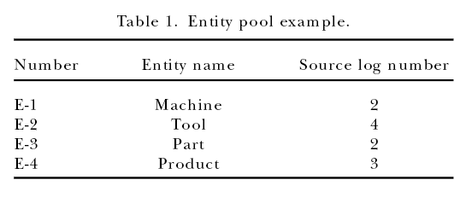

Slide 73
Phase 2 is concerned with the identification and definition of relationships between entities.
The first step in Phase 2 is to identify the relationships between entities. This is commonly done using a relationship matrix as shown in the following Figure. This matrix has the entities placed along each axis. An X placed in location (A,B) signifies that there is a relationship between entity A and entity B.

Slide 74
Identification of related entities.

Slide 75
Relationship definition.

Slide 76
Entity level diagram construction.

Slide 77
In Phase 3 the non-specific relationships are refined, key attributes are defined for each entity, primary keys are migrated to form foreign keys in child entities, and relationships and keys are validated.
Non-specific relationship resolution.

Slide 78
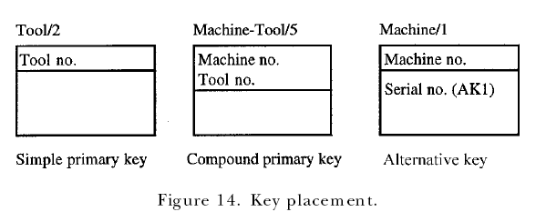
Key attribute identification.

Slide 79
Key migration.

Slide 80
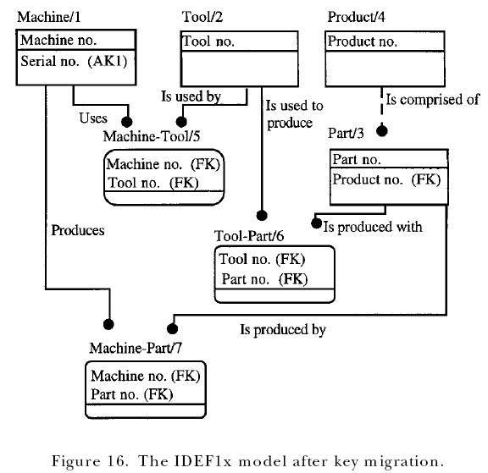

Slide 83
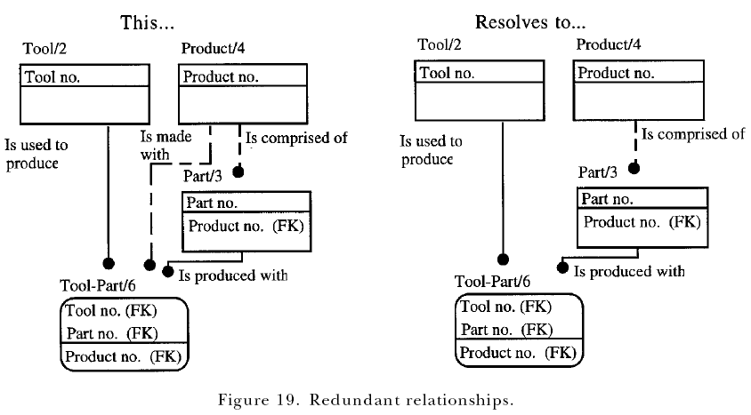

Slide 84
`O’ =owner, `K’ =primary key, and `I’ =inherited.

Slide 85
A Phase 3 function view should be accompanied by its entity documentation sets
These sets include:
(1) a definition of the entity;
(2) a list of primary, alternative, and foreign key attributes;
(3) a definition for owned key attributes;
(4) a list of relationships in which the entity is a generic entity;
(5) a list of relationships in which the entity is a category entity;
(6) a list of identifying relationships in which the entity is a parent;
(7) a list of identifying relationships in which the entity is a child;
(8) a list of non-identifying relationships in which the entity is a parent;
(9) a list of non-identifying relationships in which the entity is a child.
(10) a definition of dual path assertions (if appropriate);
(11) an individual entity diagram following the same approach as the entity diagram in Phase 2 (optional);
(12) a cross-reference to the associated entities, as well as a cross-reference to the owned and shared attributes (optional but helpful).

Slide 87
Phase 4
Phase 4 is the final stage of the modeling procedure. The objectives of Phase 4 include:
(1) development of an attribute pool;
(2) establishment of attribute ownership;
(3) definition of non-key attributes;
(4) validation and refinement of the data structure.

Slide 88
Non-key attribute identification.

Slide 89
Model refinement.

Slide 90
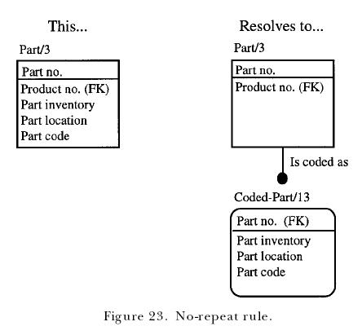

Slide 91
Phase 4 results
At the conclusion of Phase 4, the function view diagrams can be updated to display the refinement of the model.
The entity document set should now contain:
(1) a definition of each entity;
(2) a list of primary, alternative, and foreign key attributes;
(3) a definition of each owned attribute (key and non-key);
(4) a list of relationships in which the entity is a parent (generic entity, identifying and non-identifying parent relationships);
(5) a list of relationships in which the entity is a child (category entity, identifying and non-identifying child relationships);
(6) a definition of any dual path assertions;
(7) individual entity diagrams expanded to show non-key attributes (optional);
(8) cross-reference of relationships to participating entities;
(9) cross-reference of key and non-key attributes to their entities.

Slide 92
