Slide 1
Copyright © 2009 Pearson Education, Inc.
_{Publishing as Prentice Hall}
Ch 4 -1
Copyright © 2011 Pearson Education

Slide 2
Strategic Management: Concepts and Cases
Arab World Edition
Fred R. David
Abbas J. Ali
Abdulrahman Y. Al-Aali
Chapter 4:
The Internal Assessment
Copyright © 2009 Pearson Education, Inc.
_{Publishing as Prentice Hall}
Ch 4 -2
Copyright © 2011 Pearson Education

Slide 3
Nature of an Internal Assessment
All organizations have strengths and weaknesses in Functional Areas of Business:
No Company is equally strong or weak in all areas.
Ch 4 -4
Copyright © 2011 Pearson Education
Copyright © 2009 Pearson Education, Inc.
_{Publishing as Prentice Hall}

Slide 4
Nature of an Internal Assessment
Basis for Objectives & Strategies
Internal strengths/weaknesses
External opportunities/threats
Clear statement of mission
Objectives and strategies are established with the intention of capitalizing upon internal strength and minimizing weaknesses.
Ch 4 -6
Copyright © 2011 Pearson Education
Copyright © 2009 Pearson Education, Inc.
_{Publishing as Prentice Hall}

Slide 5
Key Internal Forces
Functional Business Areas
Vary by organization
In large organizations, divisions may have different strengths & weaknesses
Copyright © 2009 Pearson Education, Inc.
_{Publishing as Prentice Hall}
Ch 4 -7
Copyright © 2011 Pearson Education

Slide 6
Performing an Internal Assessment
Collecting Information from functional areas:
Management
Marketing
Finance/accounting
Production/operations
Research & development
Management information systems
Ch 4 -10
Copyright © 2011 Pearson Education
Copyright © 2009 Pearson Education, Inc.
_{Publishing as Prentice Hall}

Slide 7
Performing an Internal Assessment
Performing an internal strategic-management assessment provides a vehicle for understanding the nature and effect of decisions in other functional business areas of the firm.
Internal analysis is a forum for communication.
Copyright © 2009 Pearson Education, Inc.
_{Publishing as Prentice Hall}
Copyright © 2009 Pearson Education, Inc.
_{Publishing as Prentice Hall}
Ch 4 -11
Copyright © 2011 Pearson Education

Slide 8
Performing an Internal Assessment
The key to organizational success is coordination & understanding among managers from all functional areas
Participant in internal analysis understand how their jobs and departments fit in the whole org.
and that will improve their performance.
Copyright © 2009 Pearson Education, Inc.
_{Publishing as Prentice Hall}
Ch 4 -12
Copyright © 2011 Pearson Education

Slide 9
Performing an Internal Assessment
Functional Relationships
Number and complexity increases relative to organization size
Copyright © 2009 Pearson Education, Inc.
_{Publishing as Prentice Hall}
Copyright © 2009 Pearson Education, Inc.
_{Publishing as Prentice Hall}
Ch 4 -13
Copyright © 2011 Pearson Education

Slide 10
Resource Based View (RBV)
Approach to Competitive Advantage
Internal resources are more important than external factors
Ch 4 -15
Copyright © 2011 Pearson Education
Copyright © 2009 Pearson Education, Inc.
_{Publishing as Prentice Hall}

Slide 11
Resource Based View (RBV)
key points of the theory are:
Identify the firm’s potential key resources.
What is resource ?
Resources are the inputs or the factors available to a company which helps to perform its operations or carry out its activities

Slide 12
Resource Based View (RBV)
Three All-Encompassing Categories
Physical resources (ex plants and equipment)
Human resources (ex employees and skills)
Organizational resources( ex.firm structure , trademarks)
Ch 4 -16
Copyright © 2011 Pearson Education
Copyright © 2009 Pearson Education, Inc.
_{Publishing as Prentice Hall}

Slide 13
Resource Based View (RBV)
Empirical Indicators
2.Evaluate whether these resources fulfil the following criteria :
For a resource to be valuable, it must be:
Rare
Hard to imitate
Not easily substitutable
Ch 4 -17
Copyright © 2011 Pearson Education
Copyright © 2009 Pearson Education, Inc.
_{Publishing as Prentice Hall}

Slide 14
Resource Based View (RBV)
3.Care for and protect resources that possess these evaluations, because doing so can improve organizational performance.

Slide 15
Evaluating Capabilities and Competitive Position
Assessment of resource capabilities, and strengths and weaknesses
A realistic map of the company’s future
Three common methods of assessment
Strength-Weaknesses-Opportunities-Threats (SWOT) analysis
Value Chain Analysis (VCA)
Internal Factor Evaluation (IFE)
Ch 4 -24
Copyright © 2011 Pearson Education
Copyright © 2009 Pearson Education, Inc.
_{Publishing as Prentice Hall}

Slide 16
Identifying Strengths, Weaknesses, Opportunities and Threats
Part of SWOT analysis
Provides useful insights on the company’s strategic position
Ch 4 -25
Copyright © 2011 Pearson Education
Copyright © 2009 Pearson Education, Inc.
_{Publishing as Prentice Hall}

Slide 17
SWOT Analysis
Strengths
Resources
Capabilities
Ch 4 -26
Copyright © 2011 Pearson Education
Copyright © 2009 Pearson Education, Inc.
_{Publishing as Prentice Hall}

Slide 18
SWOT Analysis
Disadvantages of a company relative to its competitors
Weaknesses
Ch 4 -27
Copyright © 2011 Pearson Education
Copyright © 2009 Pearson Education, Inc.
_{Publishing as Prentice Hall}

Slide 19
SWOT Analysis
Induced by various factors and changing conditions in the external environment
Opportunities
Ch 4 -28
Copyright © 2011 Pearson Education
Copyright © 2009 Pearson Education, Inc.
_{Publishing as Prentice Hall}

Slide 20
SWOT Analysis
Any factor in the external environment which negatively impacts a firm
Threats
Ch 4 -29
Copyright © 2011 Pearson Education
Copyright © 2009 Pearson Education, Inc.
_{Publishing as Prentice Hall}

Slide 21
The Value of SWOT Analysis
After the SWOT Analysis, executives must engage in two more processes:
Developing and understanding the company’s position(
Devising strategies compatible with the company’s internal and external situations
Ch 4 -30
Copyright © 2011 Pearson Education
Copyright © 2009 Pearson Education, Inc.
_{Publishing as Prentice Hall}

Slide 22
The Value of SWOT Analysis
These three processes (SWOT identification, examining the firm’s position, and developing strategies) are interrelated and require careful attention.
understanding the limitation requires a sound alignment or fit between internal capabilities and existing opportunities and threats.
These help ensure the company is embarking on a course of action that is practical and will lead to optimal outcomes.
Ch 4 -31
Copyright © 2011 Pearson Education
Copyright © 2009 Pearson Education, Inc.
_{Publishing as Prentice Hall}

Slide 23
The Internal Factor Evaluation (IFE) Matrix
An internal strategic-management analysis
Evaluation of strengths and weaknesses
Basis for identifying and evaluating relationships
Intuitive judgments are required
In a multidivisional companies each division should construct an IFE matrix then divisional matrices then can be integrated to develop an overall corporate IFE matrix.
Ch 4 -36
Copyright © 2011 Pearson Education
Copyright © 2009 Pearson Education, Inc.
_{Publishing as Prentice Hall}

Slide 24
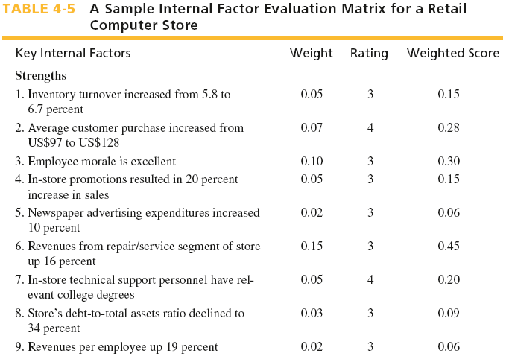
Ch 4 -37
Copyright © 2011 Pearson Education
Copyright © 2009 Pearson Education, Inc.
_{Publishing as Prentice Hall}

Slide 25
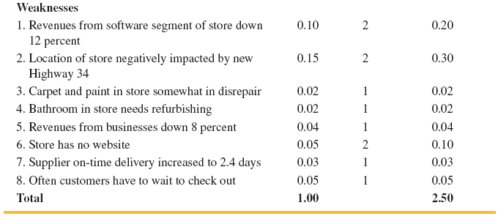
Ch 4 -38
Copyright © 2011 Pearson Education
Copyright © 2009 Pearson Education, Inc.
_{Publishing as Prentice Hall}

Slide 26
Factors considered to have the greatest effect on organizational performance should be assigned the highest weights.
The sum of all weights must equal 1.
weights are industry based.

Slide 27
Ratings from 1-4.
factor that represents a major weakness (rating =1)
a minor weakness (rating =2)
a minor strength (rating =3)
a major strength (rating =4)
Note that strengths must receive a 3 or 4 rating only
and weaknesses must receive a 1 or 2 only.
Ratings are company based.

Slide 28
Average weighted score is 2.5
Total weighted score well below 2.5 means org is weak internally
= = = significantly above 2.5 means a strong internal position
when a factor is a strength and weakness it should be listed twice (in S and W) and a weight and rating should be assigned.
ex. experience employees (S).
their high salaries (W).

Slide 29
The IFE matrix provides important information for strategy formulation.
In our example:
This retail computer store might want to hire another checkout person (W8)
Also may want to increase advertising for its repair services (S6)

