Slide 1
King Saud University College of Engineering IE – 462: “Industrial Information Systems” Fall – 2018 (1st Sem. 1439-40H)
Chapter 3
Data Modeling and Design – p1 – Introduction
Prepared by: Ahmed M. El-Sherbeeny, PhD

Slide 2
Lesson Overview
Introduction – (p1)
E-R Diagram – (p2)
Case Studies – (p3)

Slide 3
Lesson Overview
Introduction – (p1)
Introduction
Databases and DBMS
DBMS Classes
Database Structures
DBMS Architecture
Conceptual Data Modeling Process
Gathering Information for Conceptual Data Modeling

Slide 4
Introduction

Slide 5
Introduction
Remember DFD:
Technique shows how, where, and when data are used or changed in an information system
But does not show definition, structure, and relationships within the data
Data modeling
Fills this crucial gap in the system
System developers believe this to be most important part of the statement of IS requirements

Slide 6
Introduction
Importance of Data Modeling:
Necessary to capture characteristics of data in the design of databases, programs
e.g. customer name is limited to a specified set of values
e.g. product can be in only 1 product line at a time
Data, not processes, are the most complex aspects of many modern IS
e.g. validating data in transaction processing, sales tracking

Slide 7
Introduction
Importance of Data Modeling (cont.):
Characteristics about data should have common features for the same applications in different organizations
Structural information about data is essential for automatic program generation
e.g. automatic design of a computer screen for entry of customer order

Slide 8
Databases and DBMS

Slide 9
Databases
A database is a computerized filing cabinet that stores data (i.e. collection of records) defined and “filed” by users within the organization
The database system has both hardware and software components
Hardware is the physical storage medium for the data (hard disk, CD, tape, etc.)
Software is the medium through which the user accesses the physically stored data
This software is called the DataBase Management System (DBMS)

Slide 10
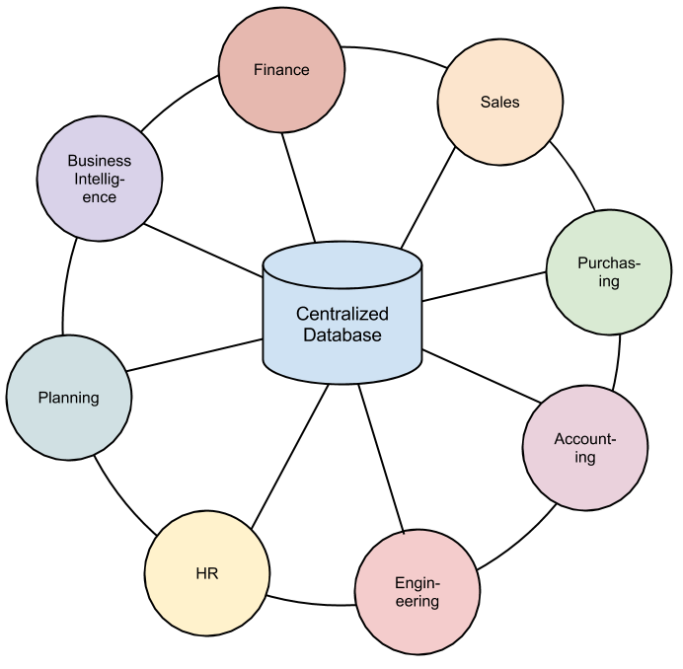
Database and Information Systems
Databases are an essential component of any information system
Notes:
This is a diagram of an ERP system

Slide 11
DBMS
Database Management Systems (DBMS):
Create, control, manage, and provide use of the database (i.e. managing the database records)
Allows the user to store, retrieve, and update data

Slide 12
Database Classification
We discuss several ways to classify/view databases:
Classes of database systems
Database structures
Database architecture

Slide 13
DBMS Classes

Slide 14
DBMS Classes
There are three classes of database systems with different levels of complexity:
Enterprise databases
Workstation databases
Personal databases

Slide 15
DBMS Classes (cont.)
1. Enterprise Database
A large database that runs on one or more servers and may have several remote client users
It must be capable of handling a large quantity of transactions and the execution must be in real-time
e.g. a transaction involving an ATM debit recorded in seconds
DBMS like Oracle (Oracle Corporation) and DB2 (IBM) are typically used for these applications

Slide 16
DBMS Classes (cont.)
2. Workstation/Workgroup Database
Runs on one server and distributes information to several client machines running on the same local area network (LAN)
DBMS must be capable of:
handling multiple clients who are independently generating transactions, thus:
changing the contents of one or more databases running concurrently on the DBMS
Microsoft’s SQL Server, which supports client-server architecture, is a popular choice for workgroup applications

Slide 17
DBMS Classes (cont.)
3. Personal Database
A personal database runs on a single personal computer (PC)
Access DBMS is a good example of a personal database

Slide 18
Database Structures

Slide 19
Database Structures
There are 4 types of database system structures:
Hierarchical
Network
Object-oriented
Relational
Notes:
Further reading: “Types of Database Management Systems” https://www.c-sharpcorner.com/UploadFile/65fc13/types-of-database-management-systems/

Slide 20
Database Structures (cont.)
1. Hierarchical Database
Records contain information about parent/child relationships, just like a tree structure
Data can be accessed and updated rapidly
Each child in the tree may have only one parent, and relationships/linkages between children are not permitted

Slide 21
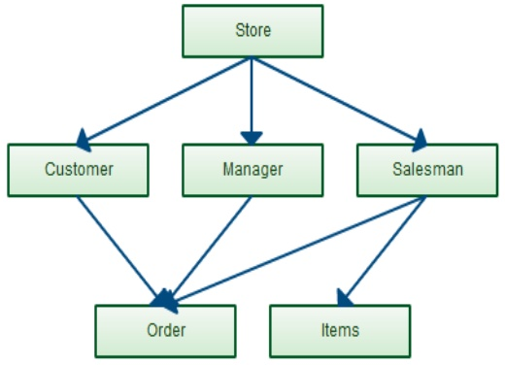
Database Structures (cont.)
2. Network Database
Network databases are mainly used on large digital computers
Also has a hierarchical structure (cobweb or interconnected network of records)
Each child can have more than one parent (i.e. suitable for many-to-many relationships in data)

Slide 22
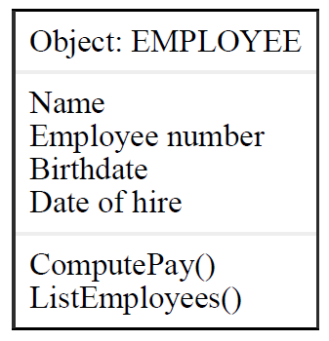
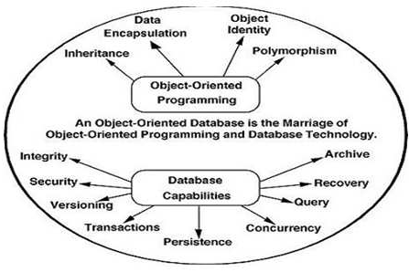
Database Structures (cont.)
3. Object-Oriented Database
Information is represented in the form of objects (which are themselves stored in the OO database)
Each object consists of two elements:
Data (e.g., sound, video, text, or graphics)
Instructions for what to do with the data
More expensive to develop, but provide powerful multimedia capability

Slide 23
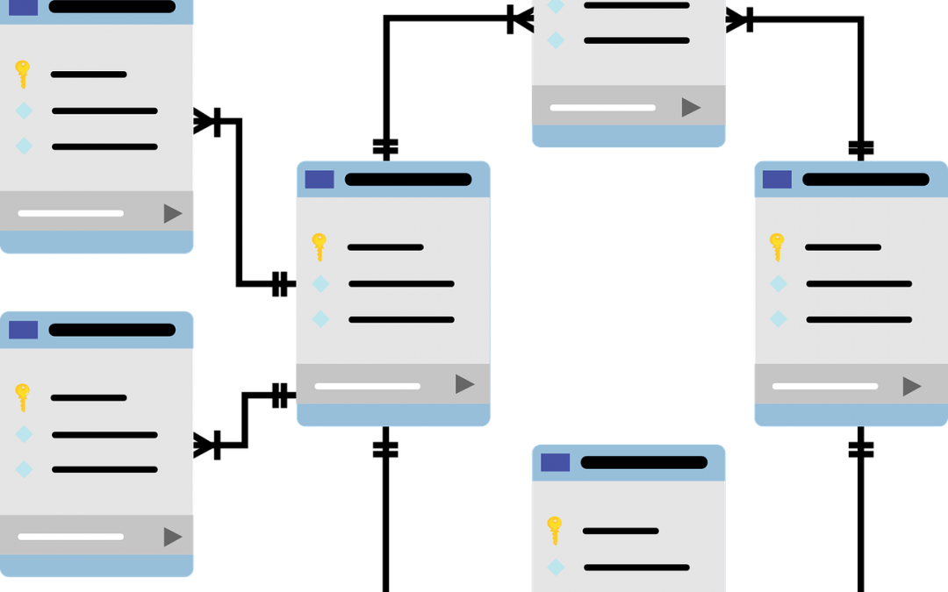
Database Structures (cont.)
4. Relational Database
Data is stored in tables, each having a key field that identifies each row
This model is more reliable than either the hierarchical or network database structures
It can be used with little or no training
It is the foundation of modern DBMS; we will discuss this model in detail in this chapter

Slide 24
DBMS Architecture

Slide 25
DBMS Architecture
Data representation should be done independent of how data are stored & manipulated in the computer
General architecture for data representation:
Developed in 1975 by ANSI/SPARC (Standards Planning and Requirements Committee of the American National Standards Institute)
3-level architecture based on 3 views of the data in the database:
External level
Conceptual level
Internal level

Slide 26
DBMS Architecture

Slide 27
DBMS Architecture
1. External Level
External level addresses the way in which different users view the database
Includes entities & attributes that the user sees and interacts with
Implementation at the external level involves user interfaces (“forms”, “reports”, summary statistics, etc.) used to interact with the database
Notes:
Note, there may be other entities and attributes that the user does not see and that are not part of the external level.

Slide 28
DBMS Architecture
3. Internal Level
Internal level addresses data structures and the ﬁle organization used to store data within the computer
Properties of internal level:
defines how data are stored*
i.e. includes data compression, data encryption, use of indexes, and other details
dependent on operating system and physical components of computer system on which the database resides
Notes:
compare to conceptual level

Slide 29
DBMS Architecture
2. Conceptual Level
Conceptual level is a holistic (i.e. complete system / “big picture”) view of the database
Properties of conceptual level:
deﬁnes entities, their attributes, and their relationships (to be discussed in E-R diagram lesson in detail)
describes what data are stored in the database but not how they are stored
i.e. it’s a logical description of the database without saying anything about its implementation
independent of speciﬁc hardware/software platform

Slide 30
DBMS Architecture
2. Conceptual Level (cont.)
We focus on this conceptual/logical design of the database, aka design of a data model
Design of a data model provides representation of:
entities in the enterprise
attributes of those entities, and
relationships that exist among entities

Slide 31
DBMS Architecture
2. Conceptual Level (cont.)
Conceptual data model:
a detailed data model
captures overall structure of organizational data
shows rules about the meaning and interrelationships among data
independent of any DBMS, implementation considerations, how data is stored in memory
usually, a subset of the project development team concentrates on data modeling while other team members focus attention on process modeling

Slide 32
DBMS Architecture
2. Conceptual Level (cont.)
Conceptual data model (cont.):
work of all team members is coordinated and shared through the project repository
repository is maintained by a common CASE or data modeling software tool
process and data model descriptions of system must be consistent/complete since they describe different, but complementary, views of the same IS
e.g. names of data stores on primitive level DFDs should correspond to names of data entities in E-R diagrams
Notes:
Remember: CASE = Computer-Aided Software Engineering; repository is explained in a later part of this chapter

Slide 33
DBMS Architecture
2. Conceptual Level (cont.)
Conceptual data modeling techniques (originated by Peter Chen in the late 1970s) include:
Entity-relationship (E-R) modeling; most commonly used technique/format
Class diagramming; similar format to E-R modeling, used with object-oriented analysis & design methods
Integrated Computer-Aided Manufacturing Deﬁnition 1, extended (IDEF1X); speciﬁcally designed for manufacturing applications
Notes:
IDEF1X are discussed in Chapter 5 of the textbook (Design of Industrial Information Systems. Thomas Boucher, and Ali Yalcin. Academic Press. First Ed. 2006.)

Slide 34
Conceptual Data Modeling Process

Slide 35
Conceptual Data Modeling Process
Conceptual Data Modeling Steps
Process begins with developing a conceptual data model for system being replaced (if system already exists)
Then new conceptual data model is built including all of the data requirements for the new system
Modeling is iterative process with many checkpoints; uses rapid development methodologies
Conceptual modeling methods are suitable for the planning and analysis phases of the development life cycle (SDLC) (see next slide)
Notes:
Note how similar this is to what we did with DFDs

Slide 36
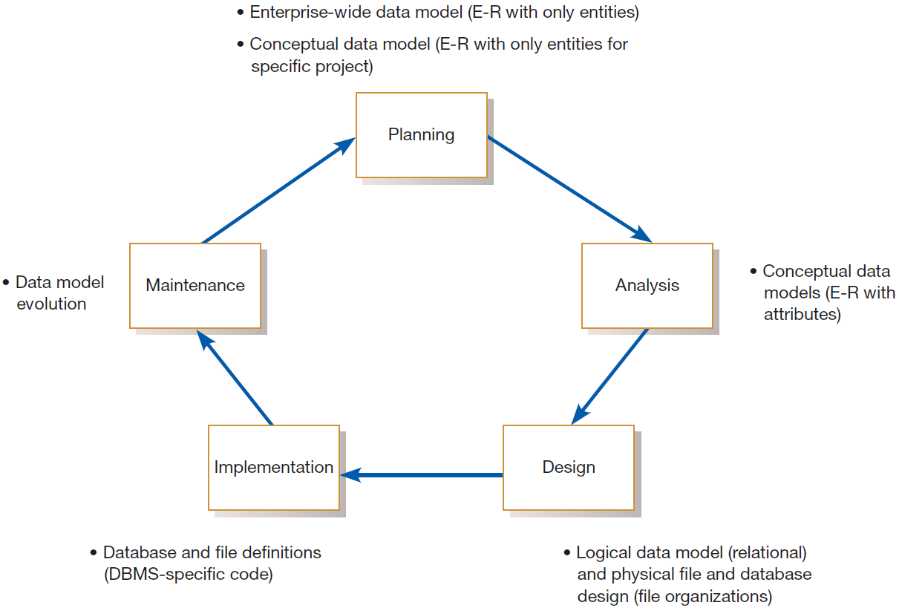
Conceptual Data Modeling Process
Notes:
Note how similar this is to what we did with DFDs

Slide 37
Conceptual Data Modeling Process
Deliverables and Outcomes
Deliverable 1:
Primary deliverable from conceptual data modeling step (analysis phase) is an E-R diagram
E-R diagram shows(next slide):
major categories of data (rectangles on diagram)
business relationships between them (lines connecting rectangles)

Slide 38
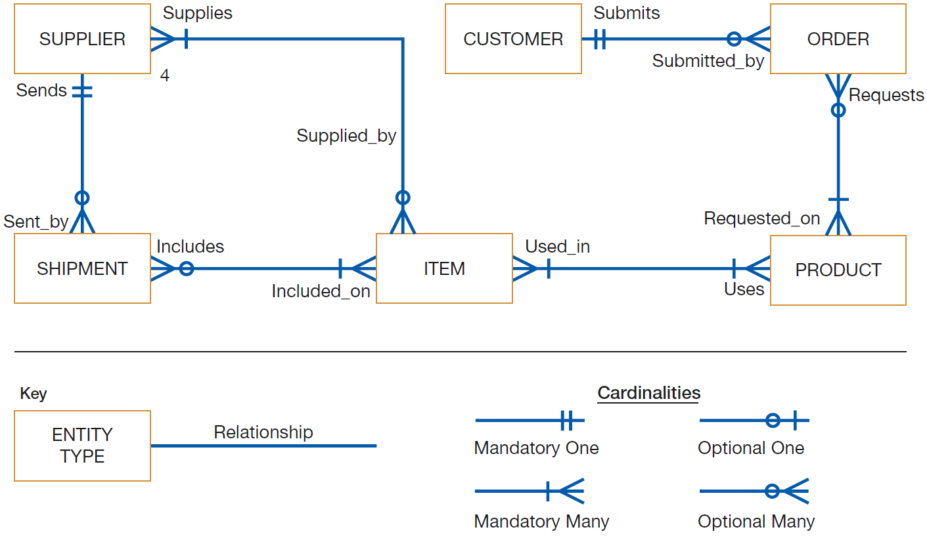
Conceptual Data Modeling Process
Notes:
thus, three main components of a data model:
- entity type / categories of data (e.g. customer)
- relationship (e.g. requests items)
- cardinality (e.g. mandatory one -symbol) - عدد العلاقات (number of elements in a given mathematical set)

Slide 39
Conceptual Data Modeling Process
Deliverables and Outcomes (cont.)
Deliverable 1 (cont.):
Example from diagram:
a SUPPLIER sometimes Supplies ITEMs to company (company wants to keep track of some suppliers without designating what they can supply)
ITEM is always Supplied by one to four SUPPLIERS
Diagram includes on each line,
two names (so that a relationship can be read in either direction) –test it!
note, some standards include only 1 name/line

Slide 40
Conceptual Data Modeling Process
Deliverables and Outcomes (cont.)
Deliverable 2:
Deliverable 2: entries about data objects that will be stored in project repository, or data modeling software
Repository is mechanism that links data and process models of an IS (e.g. links between data model & DFD):
Data elements included in data flows also appear in the data model, and vice versa; note, data flows are captured by manual or automated data stores
Each data store in a process model must relate to business objects (aka data entities); e.g. Inventory File data (Hoosier Burger) must correspond to ≥ 1 data objects on a data model

Slide 41
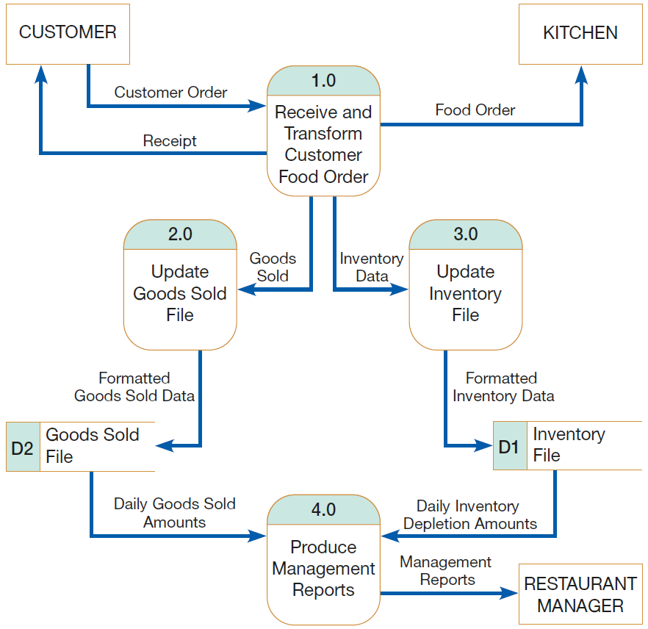
Conceptual Data Modeling Process
Notes:
Note, automated repository can be used to verify these linkages (i.e. through various CASE tools)

Slide 42
Gathering Information for Conceptual Data Modeling

Slide 43
Gathering Info. for Conceptual Data Modeling
During Joint Application Design (JAD) sessions/ interviews you must ask specific Q’s in order to gain the perspective on data you need for the data model
These Q’s relate to:
explaining what the organization does
rules of how work is performed in the organization
not how or when data are processed or used to do data modeling
Ways to gather this information:
Top-down approach
Bottom-up approach

Slide 44
Gathering Info. for Conceptual Data Modeling
1. Top-Down Approach
Top-down approach:
derives business rules for a data model from proper understanding of nature of business
usually used with a purchased data model
Table 8-1:
key Q’s to ask system users & business managers
help to develop accurate & complete data model, for a particular situation
ask these Q’s when you begin data modeling project with a purchased data model
note, don’t use technical terms (in bold); instead, frame your Q’s in business terms for manager

Slide 45
Gathering Info. for Conceptual Data Modeling

Slide 46
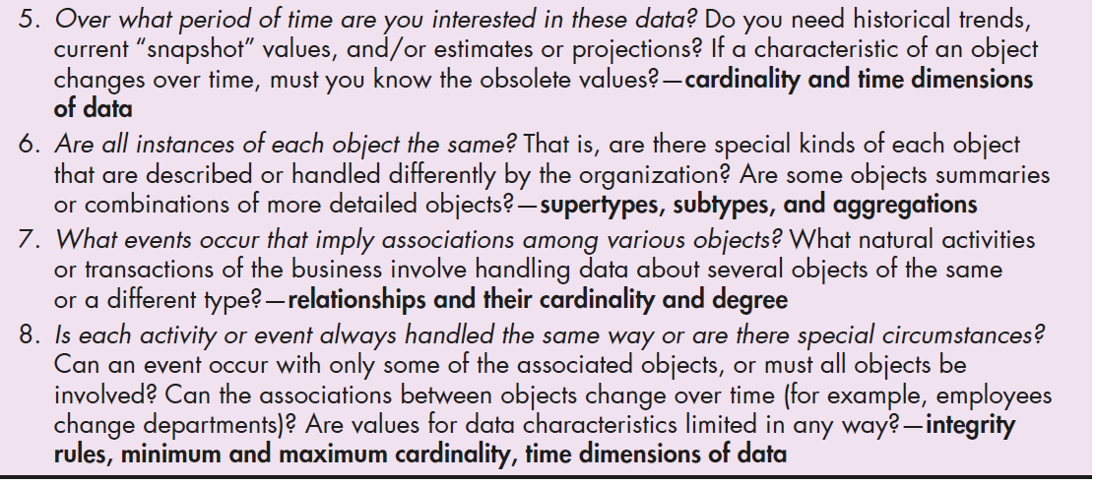
Gathering Info. for Conceptual Data Modeling

Slide 47
Gathering Info. for Conceptual Data Modeling
2. Bottom-Up Approach
You can also gather needed info. for data modeling by reviewing specific business documents used in IS:
computer displays
reports and business forms
This is usually represented as:
data flows on DFDs, and this shows:
data processed by the system ⇒ i.e. data that must be maintained in system’s database

Slide 48
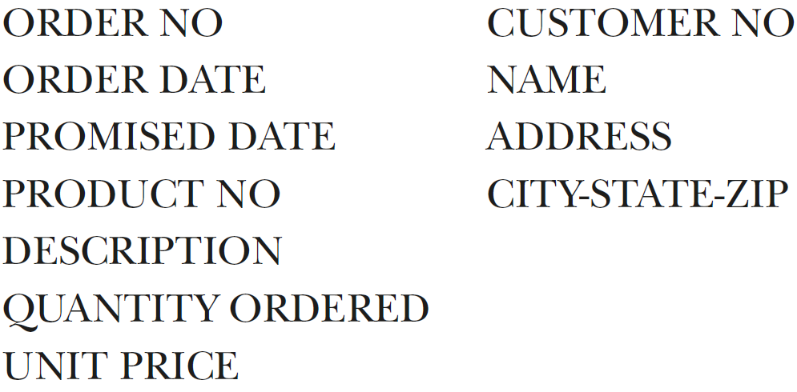
Gathering Info. for Conceptual Data Modeling
2. Bottom-Up Approach (cont.)
Example: customer order form used at Pine Valley Furniture (PVF)
following data must be kept in the database:
We also see important info. needed for data model:
each order is from one customer,
order can have multiple line items, 1 per product
Notes:
i.e. order:customer is a 1:1; items:order is a many:1 relationship

Slide 49
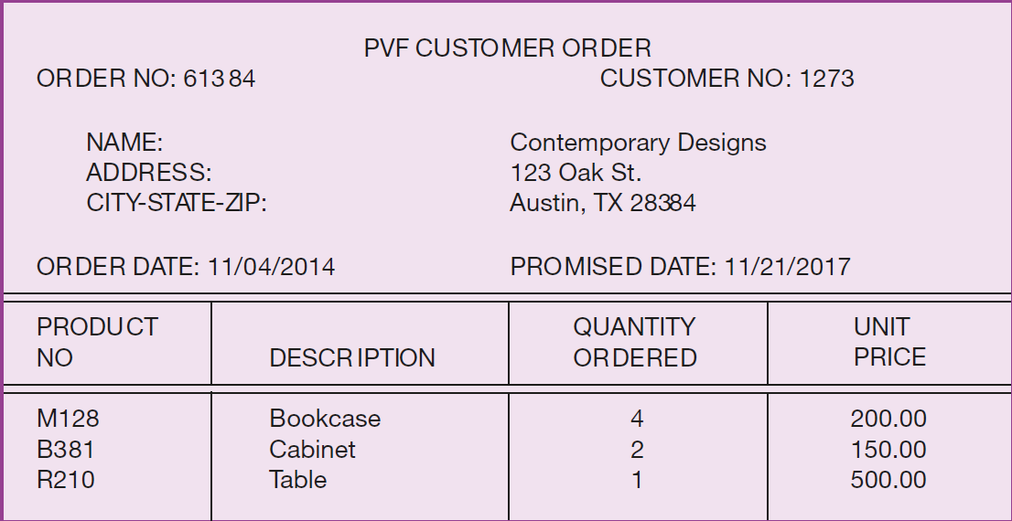
Gathering Info. for Conceptual Data Modeling

Slide 50
Videos to Watch
Entity Relationship Diagram (ERD) Tutorial - Part 1 https://youtu.be/QpdhBUYk7Kk
Entity Relationship Diagram (ERD) Tutorial - Part 2 https://youtu.be/-CuY5ADwn24
Entity-Relationship Diagrams (another system) https://youtu.be/c0_9Y8QAstg
Entity Relationship Diagram (ERD) Training Video https://youtu.be/-fQ-bRllhXc
Notes:
Last video is a detailed video and contains exercises on ERD’s

Slide 51
Sources
“Chapter 3: Database Modeling and Design”; Slides by Dr. Sabeur Kosantini (2017)
“Types of Database Management Systems” (2017) by Arjun Panwar, c-sharpcorner.com; Available at: https://www.c/sharpcorner.com/UploadFile/65fc13/types-of-database-management-systems/
Modern Systems Analysis and Design. Joseph S. Valacich and Joey F. George. Pearson. Eighth Ed. 2017. Chapter 8.
Design of Industrial Information Systems. Thomas Boucher, and Ali Yalcin. Academic Press. First Ed. 2006. Chapter 3.

