Slide 1
King Saud University College of Engineering IE – 341: “Human Factors Engineering” Fall – 2016 (1st Sem. 1437-8H)
Chapter 10. Human Control of Systems
– Tracking (Part 2)
Prepared by: Ahmed M. El-Sherbeeny, PhD

Slide 2
Contents
PART I
Inputs and Outputs in Tracking
Pursuit and Compensatory Displays in Tracking
Control Order of Systems
Control Responses with Various Control Orders
Human Limitations in Tracking Tasks
PART II
Factors that Influence Tracking Performance
Procedures for Facilitating Tracking Performance

Slide 3
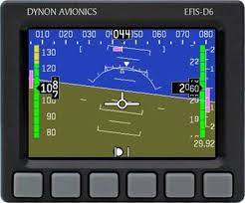
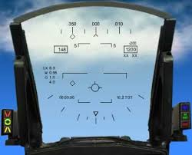

Slide 4
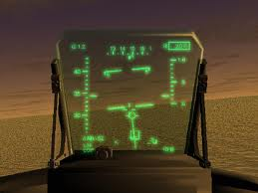
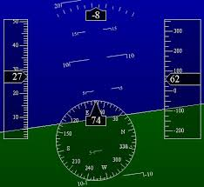
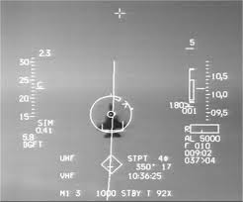

Slide 5
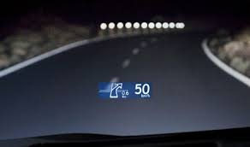

Slide 6
Factors that Influence Tracking Performance
Preview of track ahead
Type of display
Time lag in tracking
Specificity of displayed error in tracking
Paced vs. self-paced tracking

Slide 7
Factors that Influence Tracking Performance
Preview of track ahead
Background
Preview assists operator in tracking task
e.g.: driving on winding road that is visible ahead
Functions of preview
Nature of preview
Nature of task affects possible benefit of preview
Kvälseth (1979):
Preview is best when shows track immediately preceding current position
Better than lagged preview (gap between preview and present)
Duration of preview
It is more important to have some preview than its duration
Kvälseth (1978a):
Performance improves steadily when preview: approx. 0.5 s
For preview > 0.5s: performance doesn’t improve much
Advantages of preview
Enables operator to compensate for time lags
0.5 s preview: offers good response time for higher order control

Slide 8
Factors that Influence Tracking Performance
Type of display
Pursuit vs. compensatory display:
Table 10-2 (Poulton, 1974):
Summarized numerous (79) studies on tracking display
Conclusion: conventional pursuit display (true motion) is preferable to compensatory (relative motion) display
Figure 10-13 (Brigg, 1966): error rate is higher for compensatory
Why pursuit display generally preferred:
Separate effects of target and controlled-element
Operator can see effects of cursor movements on error generated
This makes it easier to predict target’s course
Also makes easier to learn effects of various control actions on movement of controlled element
Greater movement compatibility
When target moves left*:
Pursuit display: shows correct response movement, which is to left to chase target
Compensatory display: displays cursor and error: moving right ⇒ less movement compatibility than in pursuit display
Notes:
* Note, the book does not cover another type of compensatory display: target-moving and cursor fixed (e.g. as in 1st person computer games)

Slide 9
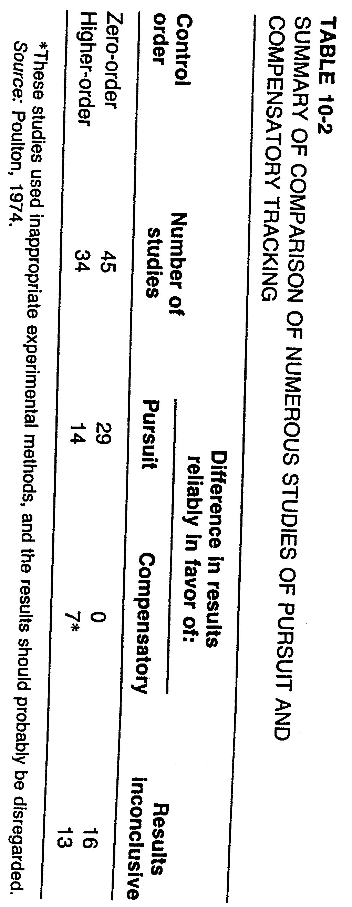
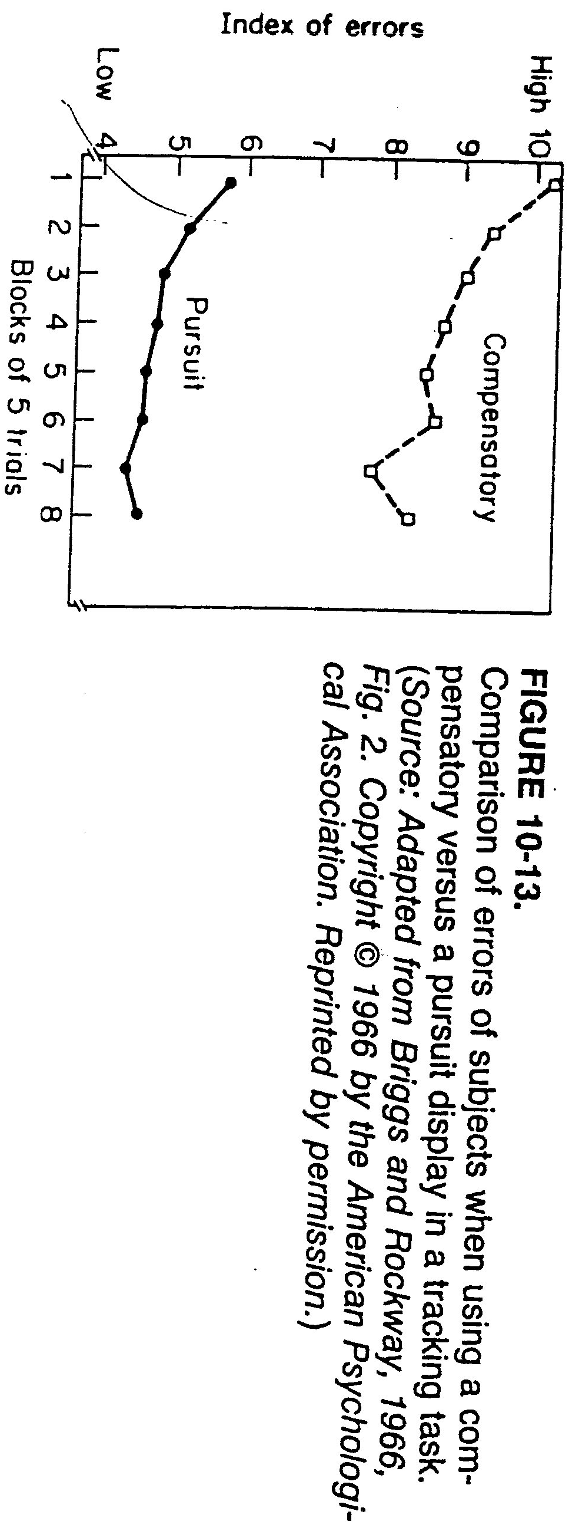

Slide 10
Factors that Influence Tracking Performance
Cot. Type of display
Using digital displays:
Note all previous studies were using analog (continuous) displays
Kvälseth (1978b): using digital displays:
Harder to visualize target course (since only changing numbers)
Here: no difference in performance between two display types
When compensatory display preferred:
May occupy less space on control panels (i.e. practical reason)*
Notes:
* An analogy to this is moving-scale fixed pointer scale used to occupy less space than the generally preferred fixed-scale moving pointer scale (Chapter 5)

Slide 11
Factors that Influence Tracking Performance
Time lag in tracking
Correcting tracking errors:
Step 1: operator chooses and performs corrective response
Step 2: controlled system must respond to control input
Step 3: result must be displayed to operator
Time lag
Above steps all require time, aka time lag in the task
This degrades operator performance
Reason: time lag:
Requires greater demand on working memory
Makes a greater need to anticipate future events (in presence of lags)

Slide 12
Factors that Influence Tracking Performance
Cont. Time lag in tracking
Types of time lags:
Response lag: time taken by operator to make a response to an input
Control-system lag: time between control action of an operator and response of the system under control
e.g. for sluggish higher order systems (such as large ship or plane*)
This’s the major focus of time lag research (Figure 10-14: Poulton, 1974)
Three types of control-system lag:
Transmission time lag: displays the effect of a person’s response; output follows the control response by a constant time interval
Exponential time lag: a situation in which the output is represented by an exponential function following a step input
Sigmoid time lag: is represented by a S-shaped curve (resembles most the human response)
Display-system lag: time between response of the controlled system (e.g. change in target) and display of that change
Notes:
* control-system lag here may be several seconds

Slide 13
Notes:
Input here: target movement (dotted line); output: control or human response (3 types shown)

Slide 14
Factors that Influence Tracking Performance
Cont. Time lag in tracking
Effect of lags on performance
Kao and Smith,1978 (Figure 10-15):
Study of compensatory tracking for control using one-hand (unimanual) vs. two-hands (bimanual)
Result a: as time lags ↑ (≤ 0.8 s) ⇒ performance ↓ for both control types
Result b: for longer display lag (1.5 s) ⇒ bimanual control affected more
Ways to minimize error in tracking
All three types of control lag increase undesirable error in tracking
Suggestions to minimize error:
Poulton (1974): reducing order of a system from acceleration (2nd order) to rate (1st order) control using an exponential lag
Rockway (1954): with long delays: control-response ratio (C/R ratio) can have effect on tracking performance:
C/R ratio: ratio of movement of control vs. movement of display*
Higher ratios (1:3 and 1:6) ⇒ performance ↓ with long lags
Low ratios (1:15 and 1:30) ⇒ performance stays the same or even improves
Notes:
* i.e. control system lag vs. display system lag

Slide 15
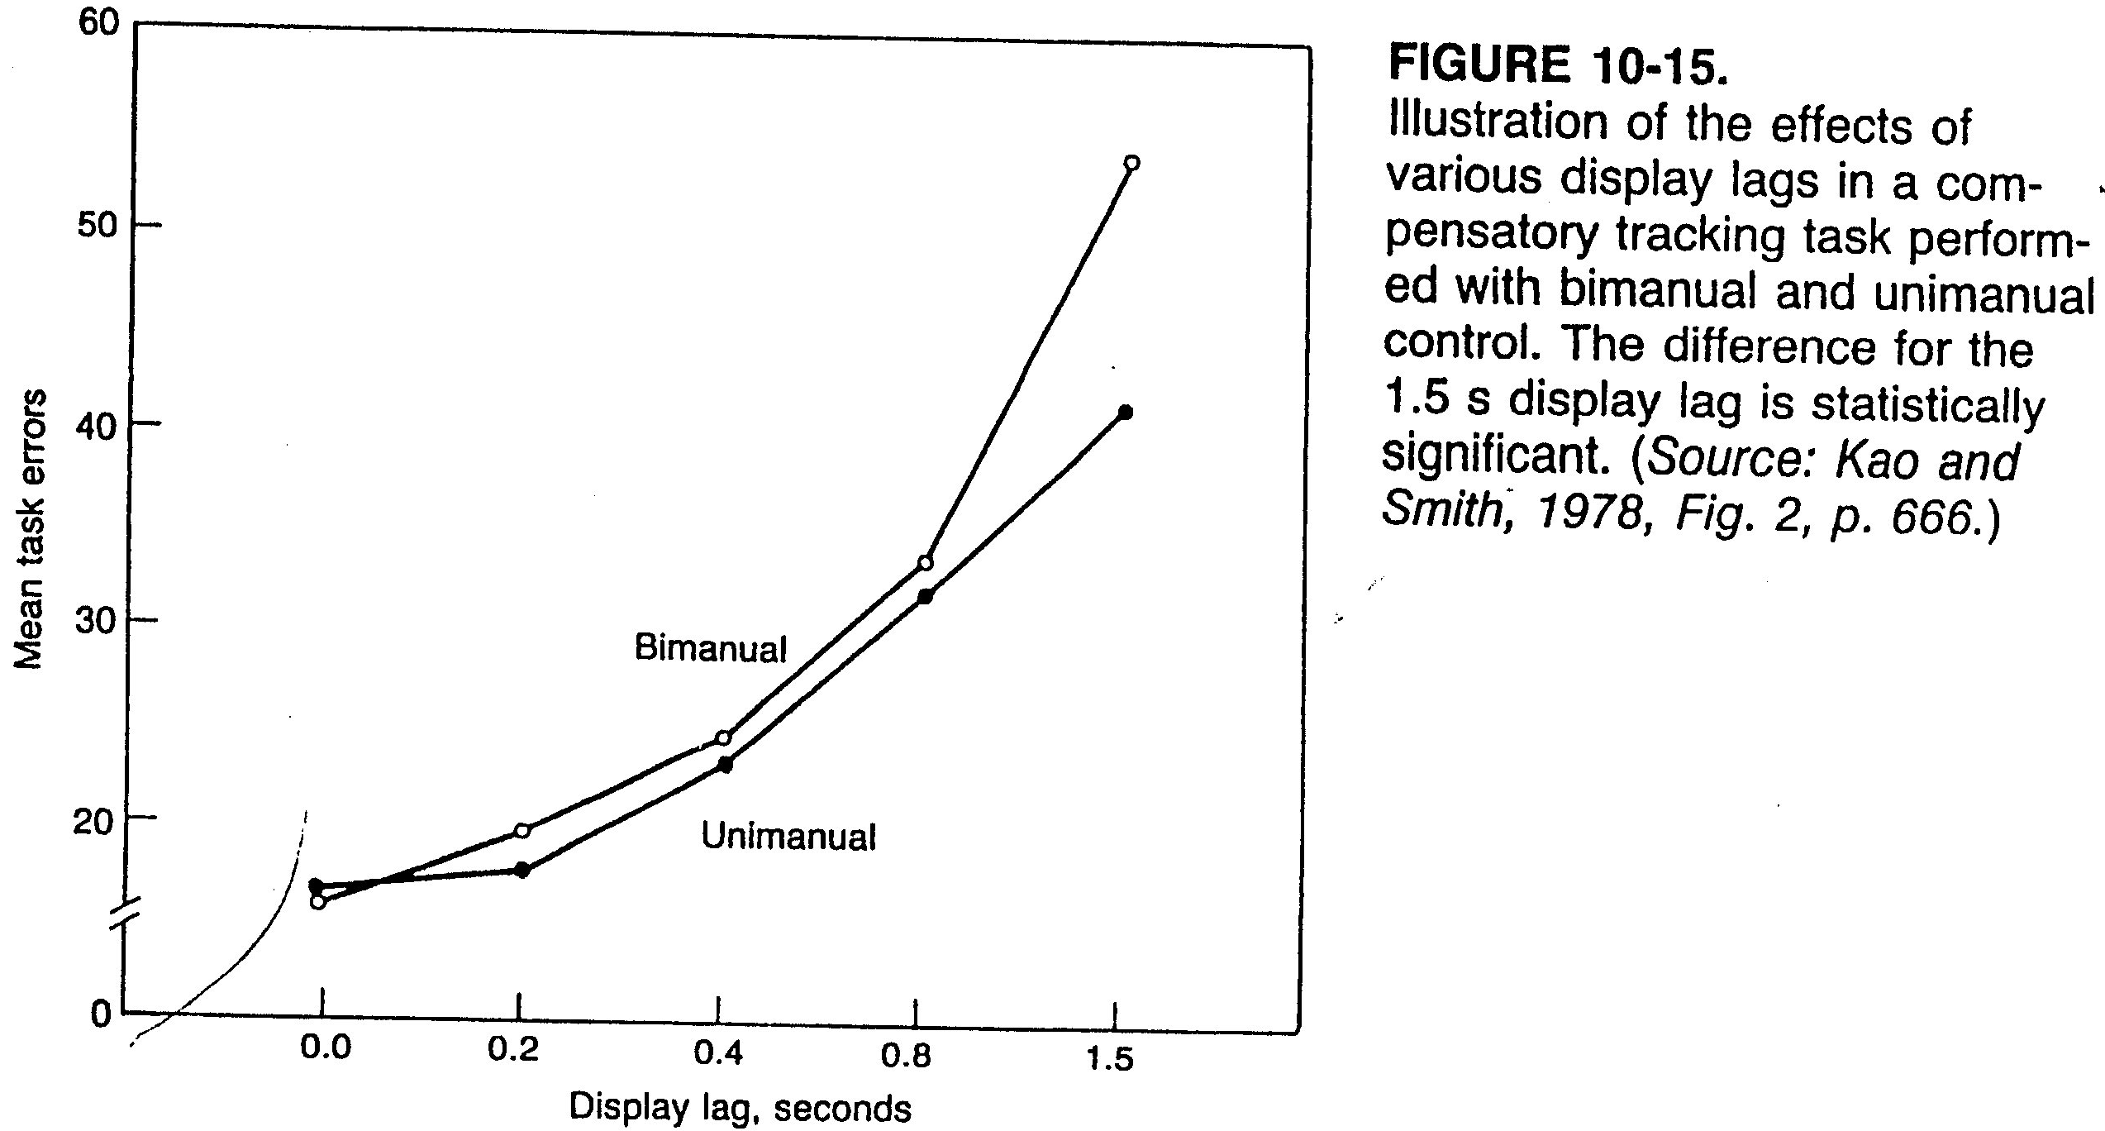

Slide 16
Factors that Influence Tracking Performance
Specificity of displayed error in tracking
Occurs in certain compensatory displays
Error (difference between input and output) presented with various degrees of specificity
Tracking experiment (Hunt, 1961: Figure 10-16) shows such variations:
3 categories of specificity (left, on target, right)
7 categories
13 categories
Continuous (i.e. analog)
Accuracy for tracking performance measure for 2 levels of difficulty
Result: performance ↑ with increased # of categories of info. (i.e. more specificity), especially with continuous feedback (for easy and hard)
Other experiments also show: more specific display info. ⇒ performance ↑
Paced vs. self-paced tracking
Most tracking tasks: self-paced:
Person has control over rate of output (e.g. driving car: selecting speed)
Some tracking tasks: paced tracking (i.e. person has no control)
e.g. Poulton (1974): plane pilot when landing: must keep plane within speed range & keep plane in defined path
Tracking is easiest with self-paced & more difficult as external pacing ↑

Slide 17
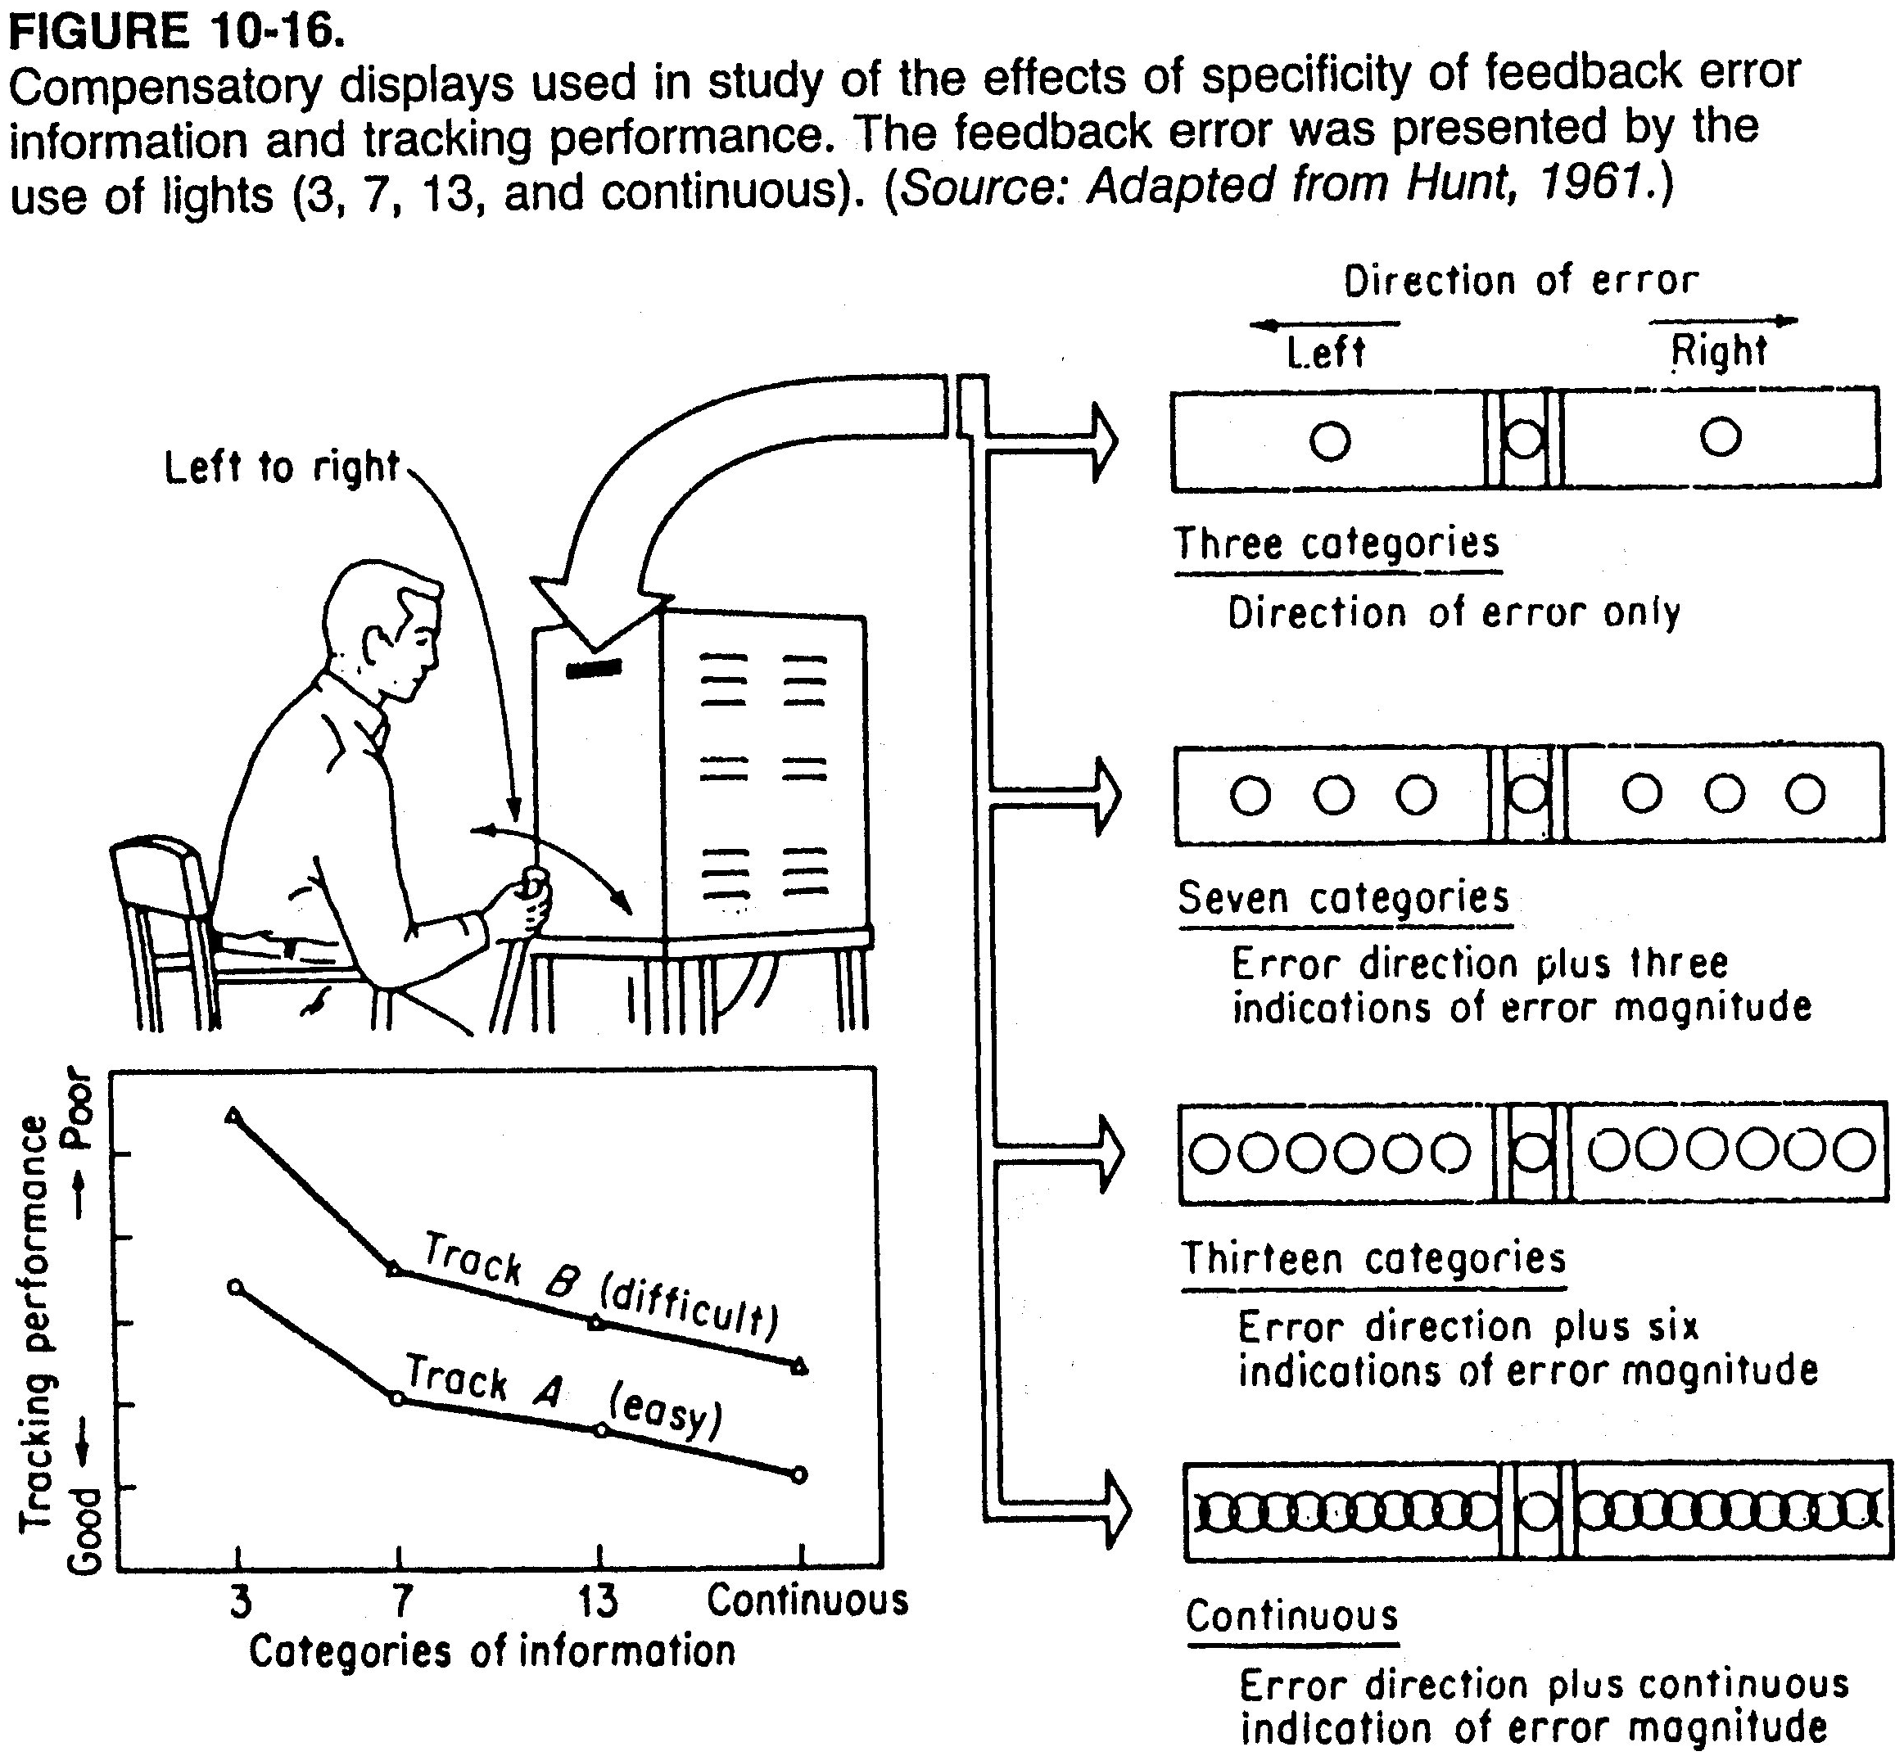

Slide 18
Procedures for Facilitating Tracking Performance
Humans have limitations (as shown in part-1):
Built-in time lags (i.e. processing time)
Limited bandwidth
Poor anticipation of system’s future state
Tracking performance is influenced (i.e. -vely) by;
Control order
Preview
Time lags
Limitations/influences:
Important especially for higher order systems (2nd, 3rd, 4th order)
⇒ often such system characteristics exceed capabilities of operator
Procedures to compensate for these obstacles:
Aiding
Predictor displays
Quickening

Slide 19
Procedures for Facilitating Tracking Performance
Aiding:
Background:
Initially developed for gunnery tracking systems
Also: any application where operator follows target with device
Effect: modify output of control to help tracker
Other types of aiding:
Rate aiding:
Single adjustment of control affects: rate and position of tracking
e.g.: using telescope to track high-flying plane:
If we fall behind ⇒ telescope speeds up (i.e. rate of motion ↑) ⇒ position also ↑
If telescope is ahead of target ⇒ rate ↓ ⇒ position also ↓
This simplifies matching device rate with target rate ⇒ better tracking
Acceleration aiding:
Control movement controls: acceleration, rate, and position
Notes:
* i.e. figuring out how sensitive the device/tracker is

Slide 20
Procedures for Facilitating Tracking Performance
Cont. Aiding:
Operational effects of aiding
It removes operator mental efforts of differentiation/integration/algebra
⇒ operator can focus on amplification (i.e. figuring out ratio of movement of control vs. controlled element*)
Factors affecting aiding:
Nature of the input signal
Control order
System type: pursuit or compensatory
Notes:
* i.e. figuring out how sensitive the device/tracker is

Slide 21
Procedures for Facilitating Tracking Performance
Predictor displays
Another procedure for simplifying control of higher-order systems
e.g.: used with large bodies such as submarines
Procedure:
Uses fast-time model of system to predict future movement of system
Displays this depiction on some device
Function of predictor displays:
Model predicts real system’s future based on assumptions of what the operator will do with the control, e.g.:
Return control to neutral position
Hold it in its place
Move it to another extreme
Predictions: reduce difference bet. predicted and desired output
Display: shows both present and predicted (future) state of system
Examples of predictor display
Figure 10-17: present & predicted path of submarine (10 s)
Figure 10-18: present & predicted path of aircraft (8 s) during landing

Slide 22
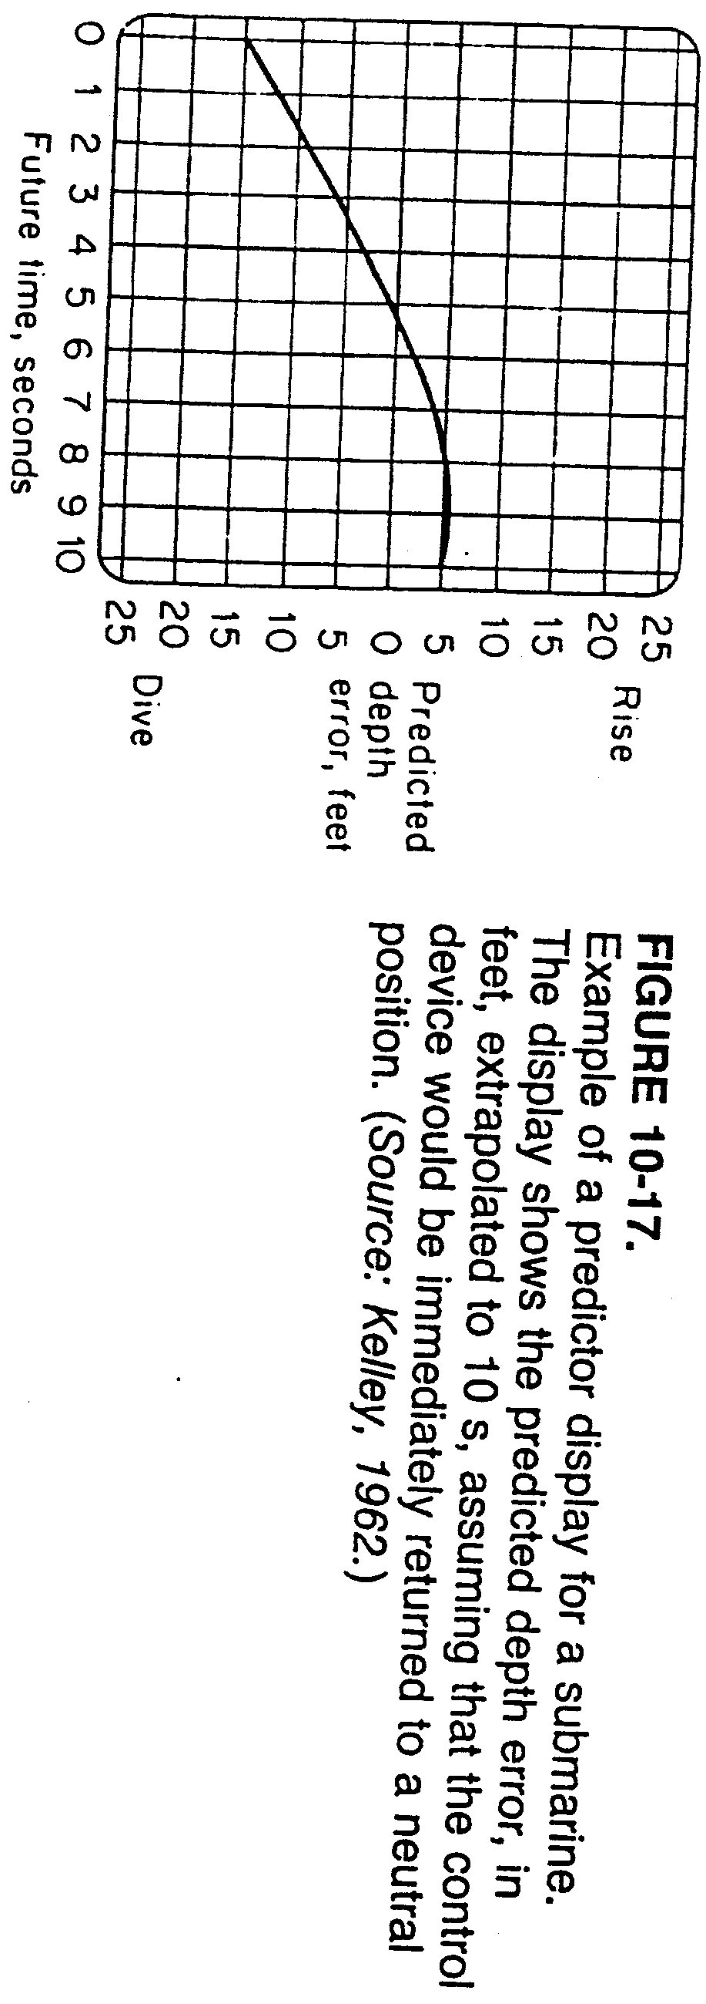
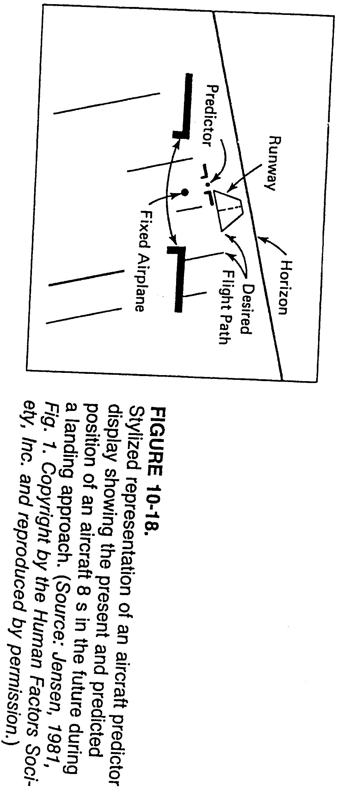
Notes:
Figure 10-18: see how operator is being informed that s/he needs to shift the path to the right (since predictor is to left of runway)

Slide 23
Procedures for Facilitating Tracking Performance
Cont. Predictor displays
Advantages of predictor displays:
Useful with complex control systems where operator needs to anticipate several seconds in advance
e.g. with submarines, aircraft, spacecraft
Experiment by Dey (1972):
Simulated control of VTOL (vertical takeoff and landing)
Index of deviation from desired course:
With predictor display: 2.48
Without predictor display: 7.92
Other experiments: also showed control performance ↑ with predictor display

Slide 24
Procedures for Facilitating Tracking Performance
Quickening:
Closely related to predictor displays
Displays info. about where system will be in future given action by operator
⇒ operator learns quickly (from where name quickening comes) future consequences of control action
Predictor vs. quickening displays:
Predictor displays:
Show current state/position of system
Generally result in better tracking performance
Quickened displays:
Do not show current state/position of system
Look like regular displays
Show what the situation will be in the future
Preferred only in specific conditions
Example of how quickening display may be misleading:
May show that controlled element is on target
This may not necessarily mean controlled element is on target now
Only means it is predicting that element will be on target in future

Slide 25
Procedures for Facilitating Tracking Performance
Discussion
Usefulness of many methods of facilitating tracking performance depend on:
Type of input (step, ramp, sine wave, etc.)
Control order (zero, first, second, etc.)
Type of display (pursuit, compensatory)
Aiding:
Useful in some situations
Has limited general applicability
Combining predictor and quickened displays:
In general pursuit displays (for higher order systems): much easier and safer to use than quickened displays
However, it’s possible to combine both displays in one display ⇒ performance found to possibly improve

Slide 26
References
Human Factors in Engineering and Design. Mark S. Sanders, Ernest J. McCormick. 7th Ed. McGraw: New York, 1993. ISBN: 0-07-112826-3.
Slides by: Dr. Woohyung Park

