Slide 1
Immunology
Lecture 3

Slide 2
Lymphoid tissues
Although lymphocytes are found circulating in the blood, a large proportion of them are found either in discrete clusters or organised in specific tissues. This distribution increases the chance of an antigen meeting a cell that bears a receptor capable of binding it.
lymphoid system is categorised as primary and secondary lymphoid tissue.

Slide 3
Lymphatic system
Lymph is a clear to yellowish fluid which is found throughout the body. It circulates through body tissues picking up unwanted materials such as bacteria, filtering these unwanted materials out through the lymphatic system.

Slide 4
What are the functions of lymphatic system?
The lymphatic system helps to maintain fluid balance
defend the body against microbes and disease
absorb liquids from the intestine and transport them to the blood such as fats .

Slide 5
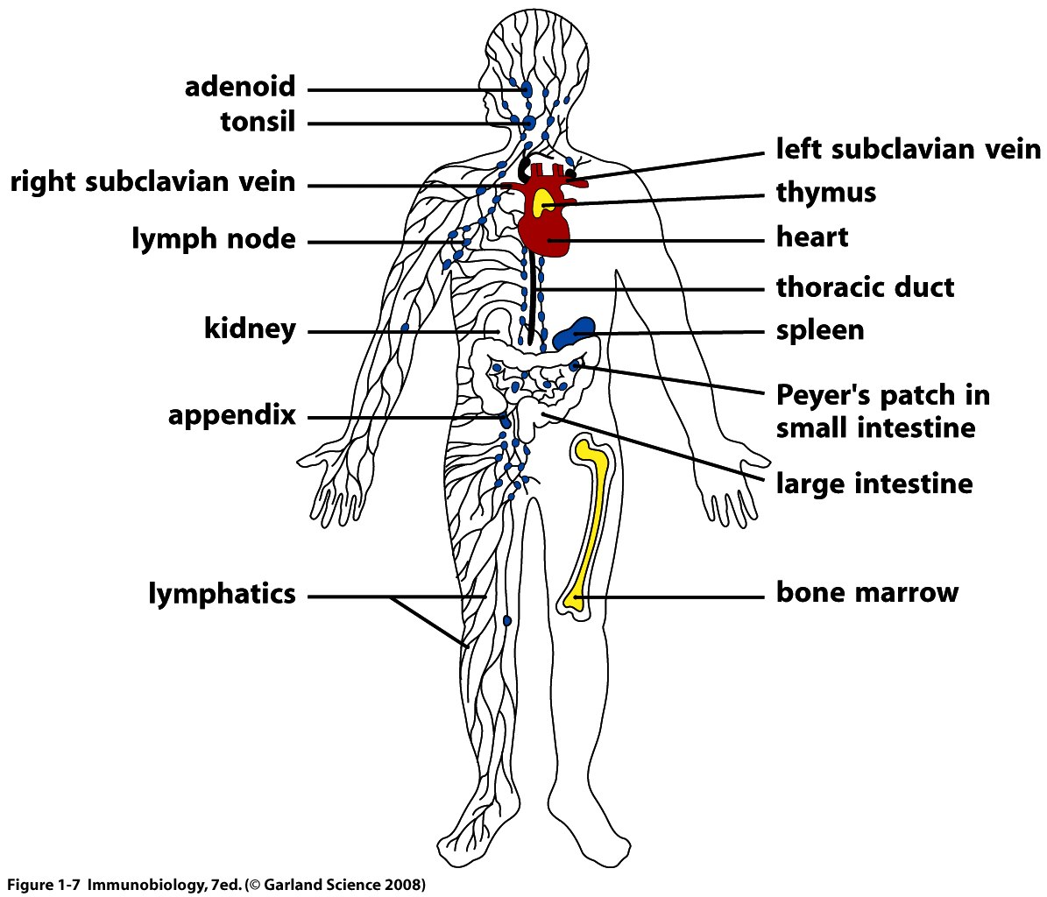
Lymphoid system

Slide 6
Lymphatic system
lymphoid system is categorised to :
1- primary lymphoid tissue.
2- secondary lymphoid tissue.

Slide 7
Primary lymphoid tissue: bone marrow
All lymphocytes develop initially from haemopoietic stem cells in the bone marrow.
T cells migrate to the thymus for further development
immature B cells remain in the bone marrow and develop into mature cells under local influences.

Slide 8
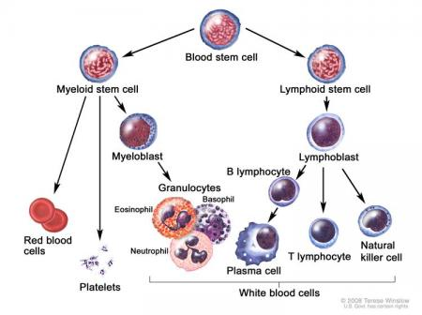
Primary lymphoid tissue: bone marrow

Slide 9
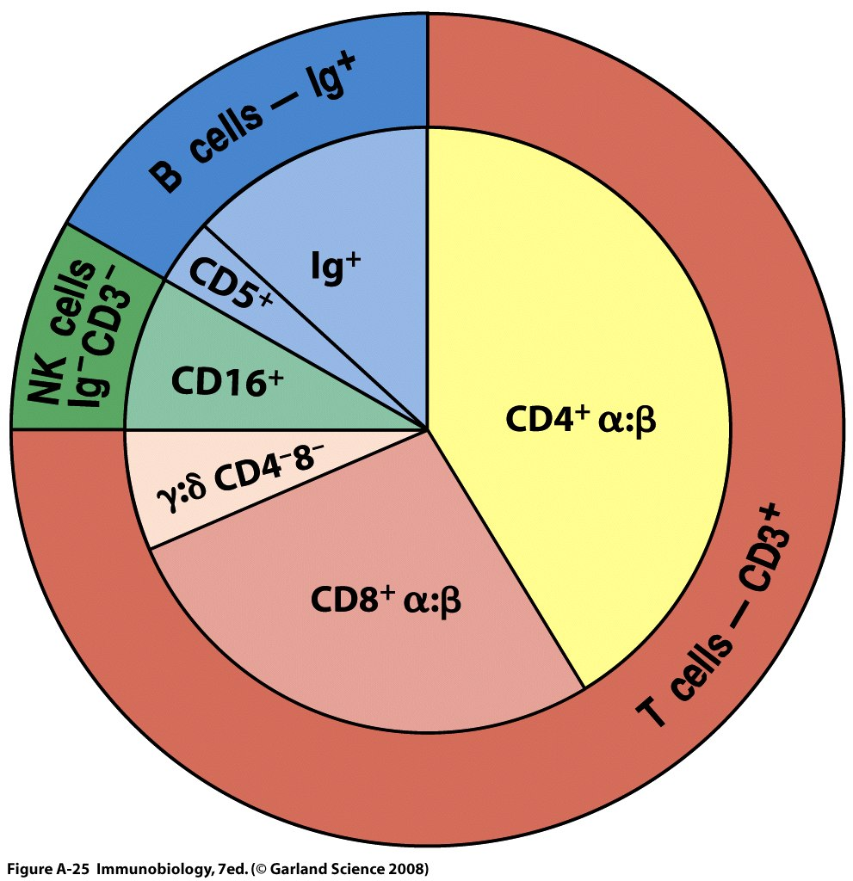

Slide 10
Primary lymphoid tissue: Thymus gland
The thymus gland is located in the upper thorax behind the sternum, but below the thyroid gland.
The thymus is largest and most active during the neonatal and pre-adolescent periods.
During development, the thymus is the first organ to produce lymphocytes and provides an environment for T cell maturation.

Slide 11
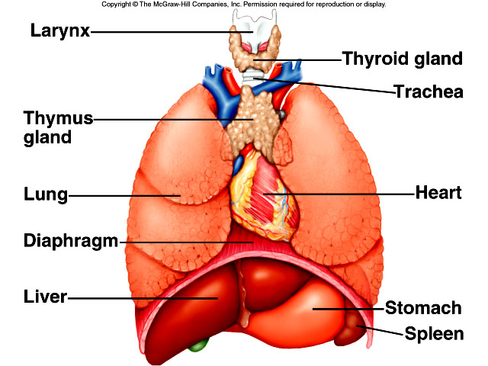
Primary lymphoid tissue: Thymus gland

Slide 12
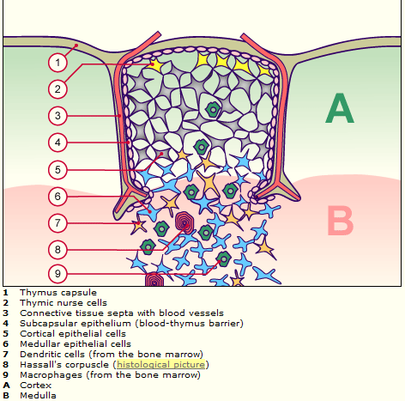
Thymus gland

Slide 13
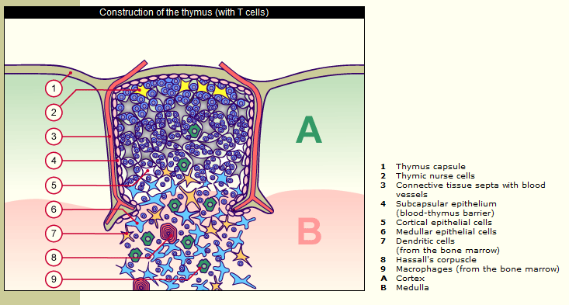
Thymus gland

Slide 14
Secondary lymphoid tissues
Secondary lymphoid tissues are designed to allow the accumulation and presentation of antigen to both virgin and memory lymphocyte populations.
Secondary lymphoid tissues include; lymph nodes, spleen, and mucosal-associated lymphoid tissues (MALT), which includes gut-associated lymphoid tissues (GALT), and bronchial-associated lymphoid tissues (BALT).

Slide 15
Lymph nodes
The lymph nodes are bean-shaped structures usually found at the junction between major lymphatic vessels.
They range between 1 and 25mm in diameter but become much larger during an infection

Slide 16
Lymph nodes functions
Filtration of particles and microorganisms to keep them out of general circulation.
Interaction of circulating antigens in lymph with lymphocytes to initiate immune response.
Activation, proliferation of B lymphocytes and antibody production.
Activation, proliferation of T lymphocytes.

Slide 17
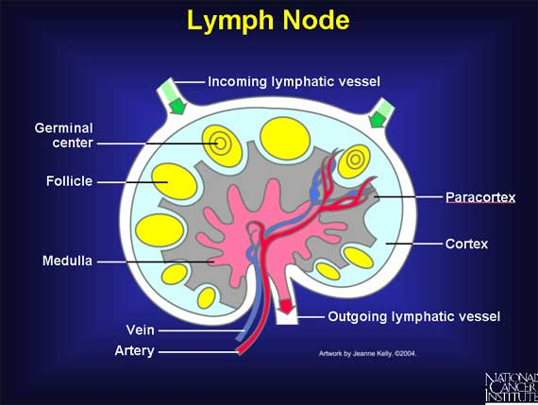
Lymph node

Slide 18
Lymph node
Cortex : B cells
Paracortex: T cells
Medulla: plasma cells and macrophages

Slide 19
Spleen
The spleen is located in the abdominal cavity and acts as a filter for peripheral blood. The spleen consists of two basic types of tissue. The red pulp, which is involved in the degradation of senescent red blood cells. White pulp is scattered throughout the red pulp and this is where the acquired immune response is initiated. The white pulp is organized around central arterioles, which deliver blood (containing lymphocytes and antigen). Like the lymph node, the white pulp of the spleen is organized into T cell-rich regions and B cell-rich areas. Antigenic stimulation induces B cell proliferation.

Slide 20
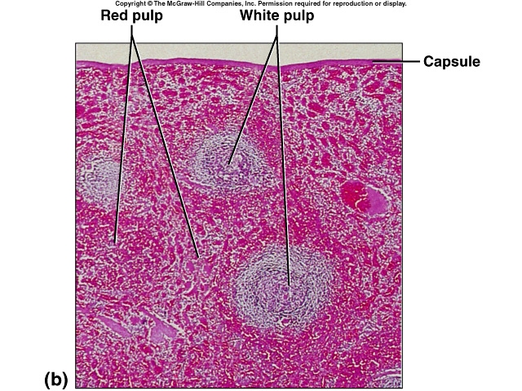
Spleen

Slide 21
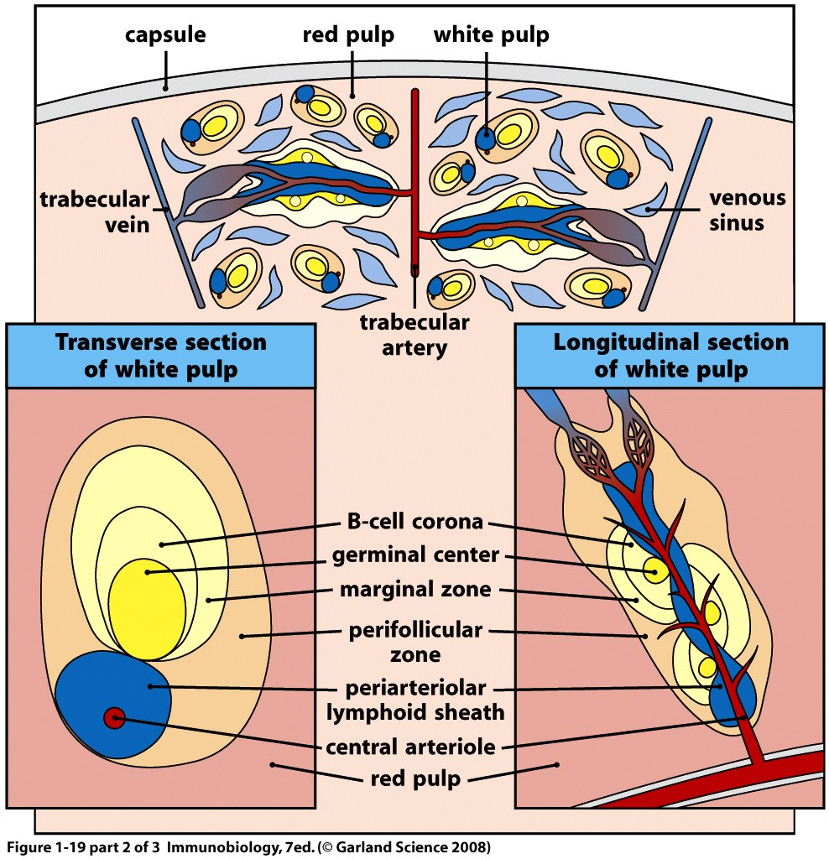
spleen

Slide 22
. Mucosal-Associated Lymphoid Tissues (MALT)
Mucosal-Associated Lymphoid Tissues (MALT):
MALT produce the immune responses against pathogens that invade the mucosa .
Like the spleen and lymph nodes, the MALT contains B cell and distinct T cell-rich regions.
In the intestine we find Peyer's Patches.
Although its organization is similar to the spleen and lymph node, the mucosal immune system is different in several ways: (1) unlike the spleen and lymph node, MALT tissue is not surrounded by a fibrous capsule, (2) IgA is the predominant class of immunoglobulin produced in MALT.

Slide 23
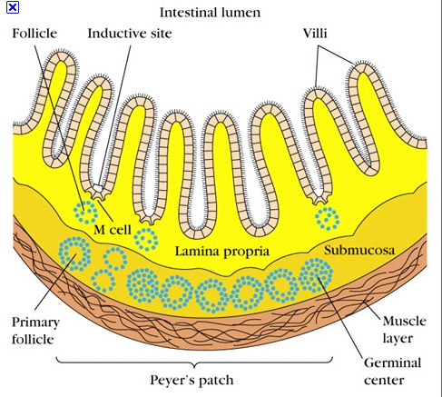
Peyer's Patches

