Slide 1
Immunology
Lecture 2

Slide 2
Innate immune response
Characteristics:
rapid
does not generate immunological memory
dependent upon germline encoded receptors recognizing structures common to many pathogens
The strength of the immune response does not increase with the second infection (same infection).
The cells of innate immunity do not need an activation by other cells

Slide 3
Adaptive or acquired immune response
Characteristics:
Not rapid
does generate immunological memory
The strength of the immune response increases with the second infection (same infection).
The cells of adaptive immunity need an activation by other cells

Slide 4
Innate immune cells
Natural killer (NK) cells
They are generated from the bone marrow
The distribution of NK cells in the human body differs from organ to organ. The percentage of NK cell in the lung is about 25% of all lymphoctes, 35% of all lymphocyte in the liver , 15% in the spleen, 15% of blood mononuclear cells.

Slide 5
Innate immune cells
Natural killer (NK) cells
First identified by having the ability to lytically kill certain tumor cell lines without prior sensitization.
Kill target cell by release of cytotoxic granules containing granzymes and perforin which penetrate target cell membrane and induce programmed cell death.
Can mediate Antibody-Dependent Cellular Cytotoxicity (ADCC).
Kill virally infected cells with missing
MHC class I

Slide 6
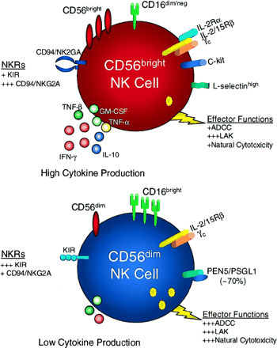
Innate immune cells
Natural killer (NK) cells

Slide 7
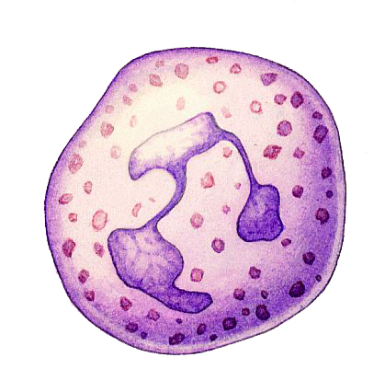
Innate immune cells neutrophil
Neutrophils are the most abundant white blood cells in human, they account for approximately 70% of all white blood cells.
The average lifespan of neutrophils in the circulation is about 3-4 days.
They are generated in bone marrow.

Slide 8
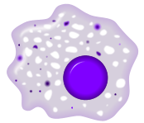
Innate immune cells macrophages
They are generated from bone marrow
They performed an important role in bacterial immunity.
They are found in different tissues with different names, for example kuppfer in liver.

Slide 9
phagocytosis
Phagocytosis
Chemotaxis
Recognition and attachment
Ingestion
killing
Digestion

Slide 10
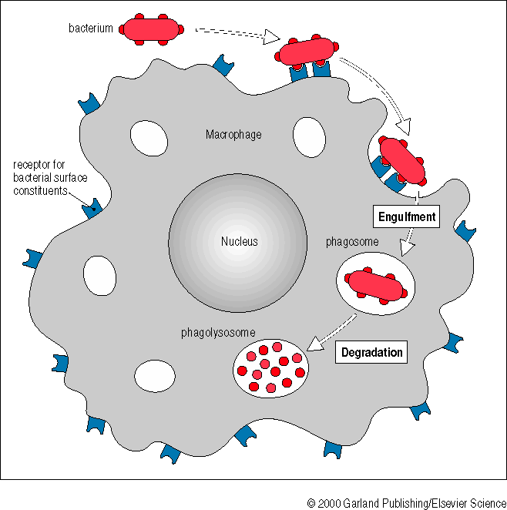
phagosytosis

Slide 11
Pattern-recognition receptors
      1- Endocytic Pattern-Recognition Receptors
mannose receptor
      2- Secreted Pattern-Recognition receptors
Mannan-binding lectin (MBL)
      3- Signalling Pattern-Recognition receptors
Toll-like receptors (TLRs)

Slide 12
Toll-Like Receptors
a family of cellular surface protein receptors which are expressed on many different cells such as macrophages.
TLRs were first described in Drosophila fruit flies.
over thirteen TLRs have been reported in human and mouse.

Slide 13
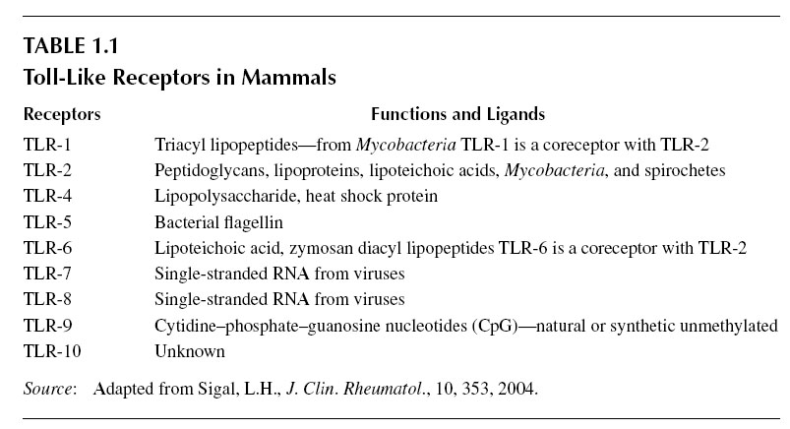
Toll-Like Receptors

Slide 14
Inflammation
  Inflammation
  Triggered by tissue damage due to infection, heat, wound, etc.
  Four Major Symptoms of Inflammation:
  1. Redness
  2. Pain
  3. Heat
  4. Swelling
  May also observe:
  5. Loss of function

Slide 15
Inflammation function
  1. Destroy and remove pathogens
  2. If destruction is not possible, to limit effects by confining the pathogen and its products.
  3. Repair and replace tissue damaged by pathogen and its products.

Slide 16
Stages of inflammation
  1. Vasodilation: Increase in diameter of blood vessels.
  Triggered by chemicals released by damaged cells: histamine, kinins, prostaglandins, and leukotrienes.
  2. Phagocyte Migration and Margination: Margination is the process in which phagocytes stick to lining of blood vessels.
  Diapedesis (Emigration): Phagocytes squeeze between endothelial cells of blood vessels and enter surrounding tissue.

Slide 17
Stages of inflammation
  Phagocytes are attracted to site of infection through chemotaxis.
  Phagocytes destroy microbes, as well as dead and damaged host cells.
  3. Tissue Repair: Dead and damaged cells are replaced.

Slide 18
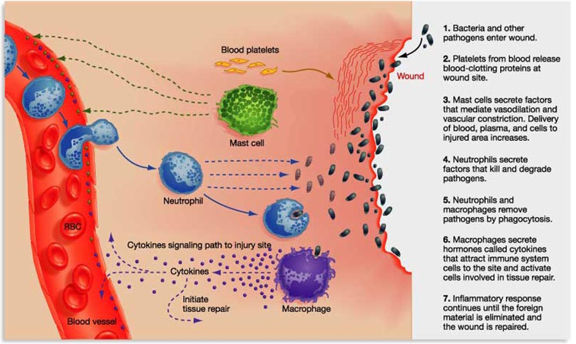
Inflammation

