Slide 1
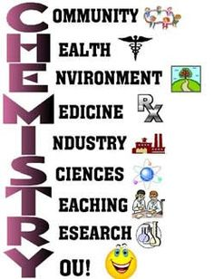
418 Chem.
Bioinorganic Chemistry
Part II. Transport and Storage of Metal Ions
b. Iron
M. H. Al-Qunaibit

Slide 2
Outline- Part II b
The chemistry of iron
The biological role of Fe
Ferritin, the cellular Fe store
Oxygen transport
  Myoglobin
  Hemoglobin

Slide 3
Oxidation states of Fe
Fe, Z=26, 1s²2s²2p⁶3s²3p⁶3d⁶4s²
The chemistry of iron is dominated by the +2 and +3 oxidation states.
They form complex ions with selected ligands, usually of an octahedral shape, and a few tetrahedral iron(III) complexes exist.
FeIII is stabilized by negatively charged ligands.
FeII is favored by neutral ligands which allow some charge delocalization in π-orbitals.

Slide 4
Fe³⁺ complexes
At low pH, hydrolysis occurs (it is a complicated process and mixture, especially in presence of coordinating anions).
FeIII salts dissolve in water producing high acidity, and the hexaquo ion predominates at very low pH ~0 (pale-violet)
At pH 2-3 color becomes yellow due to hydrolyzed species.

Slide 5
Fe³⁺ complexes
At pH > 2-3, colloidal gels form ⇒ reddish-brown precipitate of hydrous iron(III) oxide
FeIII form complexes with a variety of ligands, but has a marked preference to O-donor ligands

Slide 6
Fe²⁺ complexes
[Fe(H₂O)₆]²⁺ ion is pale green
No hydrolysis in acidic solutions
FeII forms complexes with a variety of ligands.
These complexes are less stable than those with FeIII (smaller cationic charge)

Slide 7
The FeIII/FeII couple
Fe³⁺ + e ↔ Fe²⁺
The standard reduction potential E value for the couple involving the simple aquated ions shows that:
The Fe^{II}(aq) is thermodynamically stable with respect to hydrogen.
Fe^{III}(aq) is spontaneously reduced by hydrogen gas.
Fe^{II}(aq) is oxidized to Fe^{III}(aq) by atmospheric oxygen under certain circumstances. Oxidation is slow in acidic solutions

Slide 8
The FeIII/FeII couple
E changes with alkalinity increase and precipitation of Fe(III) species occur.
Fe(II) solutions are not stable with respect to areal oxidation.

Slide 9
Which oxidation state of iron you think will be best utilized in biological systems? Why?

Slide 10
Outline- Part II b
The chemistry of iron
The biological role of Fe
Ferritin, the cellular Fe store
Oxygen transport
  Myoglobin
  Hemoglobin

Slide 11
The Biological role of iron
Iron is an essential element in our diet and is needed for the production of haemoglobin.
The iron atom in the haemoglobin molecule helps coordinate of the oxygen molecule and hence the transportation of oxygen around the body to the cells of all the tissues.
Iron deficiency causes anaemia.
Plants require iron for the synthesis of chlorophyll.

Slide 12
Selective transport and storage of iron
Iron is essential for almost all life forms, and is difficult to obtain.
Any excess presents a serious toxic risk.
Nature has at least two problems in dealing with this element:
The first is the insolubility of Fe(III) (the stable oxidation state found in most minerals). As the pH increases, hydrolysis, polymerization, and precipitation of hydrated forms of the oxide occur.

Slide 13
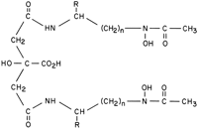
Selective transport and storage of iron
The second problem is the toxicity of ‘free-Fe’ species, particularly through the generation of OH radicals.
In biological systems, Fe:
Uptake into organisms involves
special ligands known as siderophores
(iron carriers/special ligands).
Transport in the circulating fluids of higher organisms requires a protein called transferrin
Is stored as ferritin.
Citrate hydroxamate siderophore
Notes:
Siderophores: "iron carrier") are small, high-affinity iron-chelating compounds secreted by microorganisms such as bacteria and fungi and serving to transport iron across cell membranes Siderophores are amongst the strongest soluble Fe³⁺ binding agents known.

Slide 14
Why does iron uptake into organisms involve special ligands?

Slide 15
Outline- Part II b
The chemistry of iron
The biological role of Fe
Ferritin, the cellular Fe store
Oxygen transport
  Myoglobin
  Hemoglobin

Slide 16
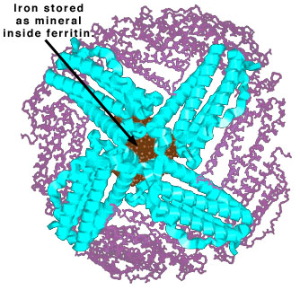
Ferritin
Ferritin is the principal store of non-heam Fe in animals (most Fe is occupied in heamoglobin and myoglobin)
It occurs in all types of organism (in mammals in the spleen and in blood).
Ferritins have two components:
a ‘mineral’ core that contains up to 4500 Fe atoms (mammalian ferritin).
and a protein shell (apoferritin).
Notes:
A water soluble metalloprotein

Slide 17
Ferritin
The mineral core is composed of:
hydrated Fe(III) oxide (ferrihydrite)
varying amounts of phosphate, which helps anchor it to the internal surface.
The structure resembles that of the mineral ferrihydrite, 5Fe₂O₃.9H₂O, which is insoluble and Fe must be mobilized.

Slide 18
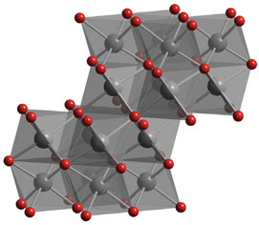
Ferritin
Ferrihydrite: (5Fe₂O₃.9H₂O)
Based on an hcp array of O²⁻ and OH⁻ with Fe(III) layered in both the octahedral and tetrahedral sites.

Slide 19
Ferritin
The proposed mechanism for the reversible incorporation of Fe in ferritin involves:
transport in and out as Fe(II), perhaps as the Fe²⁺ ion, which is soluble at neutral pH, but more likely with some type of ‘chaperone’ complex.

Slide 20
Ferritin
Oxidation to Fe(III) involves:
The coordination of O₂ and inner-sphere electron transfer reaction:
2 FeII + O₂ + 2H⁺ → 2 FeIII + H₂O₂
The mechanism by which Fe is released almost certainly involves its reduction back to the more mobile Fe(II).

Slide 21
Suggest a cycle representing the mobility of iron in and out of storage.

Slide 22
Outline- Part II b
The chemistry of iron
The biological role of Fe
Ferritin, the cellular Fe store
Oxygen transport
  Myoglobin
  Hemoglobin

Slide 23
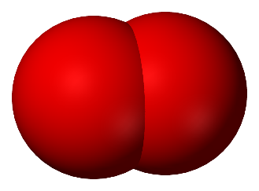
Dioxygen
As the waste product of photosynthesis, O₂ is a biogenic substance, one that comes from solar energy capture by living organisms.
Great thermodynamic advantage of having such a powerful oxidant available led to the evolution of higher organisms that now dominate Earth.
The requirement for O₂ needs special systems for transporting and storing it.

Slide 24
Dioxygen
There is difficulty in supplying O₂ to buried tissue, and achieving sufficiently high concentration in aqueous environments which was overcame by:
Metalloproteins known as O₂ carriers .
In mammals and most other animals and plants, these special proteins (myoglobin and heamoglobin) contain an Fe porphyrin cofactor.

Slide 25
Dioxygen
Some lower invertebrates use an alternative type of Fe protein, heamerythrin, which contains a dinuclear Fe site.
Some primitive animals such (e.g. molluscs and arthropods) use a Cu protein called heamocyanin.
What does the word heam (heme) mean?

Slide 26
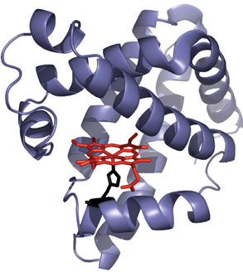
Myoglobin
Is an Fe²⁺ protein that coordinates O₂ reversibly and controls its concentration in tissue.
In mammals, O₂ (by respiration) is:
  carried in the bloodstream by heamoglobin
  and is stored in the tissues in myoglobin.

Slide 27
Myoglobin
Structure:
The molecule contains several regions with the single Fe porphyrin group (heam group) located in a cleft between two helices.

Slide 28
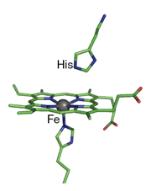
Myoglobin
Fe is coordinated to four N-donor atoms in the porphyrin ring.
The fifth ligand to the Fe is provided by a histidine-N.
The sixth position is the site at which O₂ is coordinated.
Notes:
The Fe(II) centre is in a square-based pyramidal environment when in its ‘rest state’, also referred to as the deoxy-form. When O2 binds to the heam group, it enters trans to the His residue to give an octahedral species

Slide 29
Myoglobin
Deoxymyoglobin is 5-coordinate, high-spin, and Fe²⁺ lies above the ring plane.
When O₂ binds it is coordinated end-on to the Fe atom.
The unbound end of O₂ is fastened by a hydrogen bond to the imidazole-NH.
The coordination of O₂ (a strong-field π-acceptor) causes the Fe(II) to switch from high spin (t_{2g}⁴e_{g}²) to low-spin (t_{2g}⁶)
Notes:
In some cases, a slow auto oxidation reaction releases superoxide and produces Fe(III), which is inactive in binding O₂.
with no d electrons in antibonding orbitals, shrink slightly and move into the plane of the ring.

Slide 30
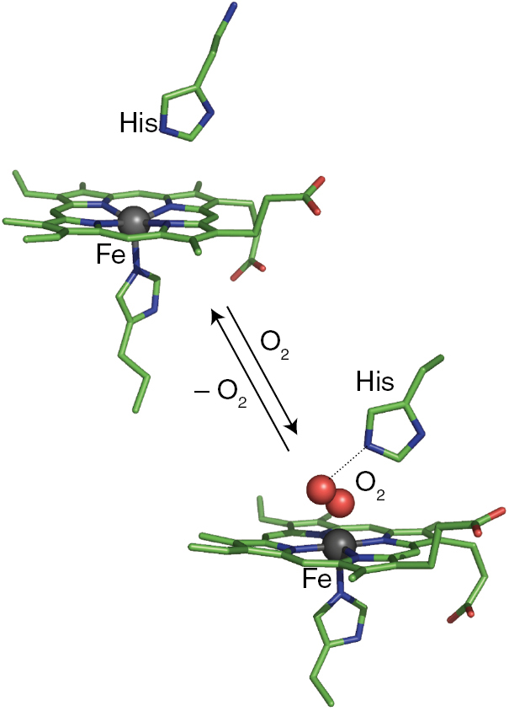
Myoglobin
Coordination by O₂ causes the Fe to:
Become low spin (smaller radius).
Move into the plane of the porphyrin ring accordingly.
Notes:
the heam group in its rest state contains high-spin Fe(II) lying 40pm out of the plane of the N,N’,N’’,N’’’-donor set of the porphyrin group and is drawn towards the His residue; the high-spin Fe(II) centre is apparently too large to ﬁt within the plane of the four N-donor atoms. When O2 enters the sixth coordination site, the iron centre (now low-spin Fe3þ, see below) moves into the plane of the porphyrin ring and pulls the His residue with it

Slide 31
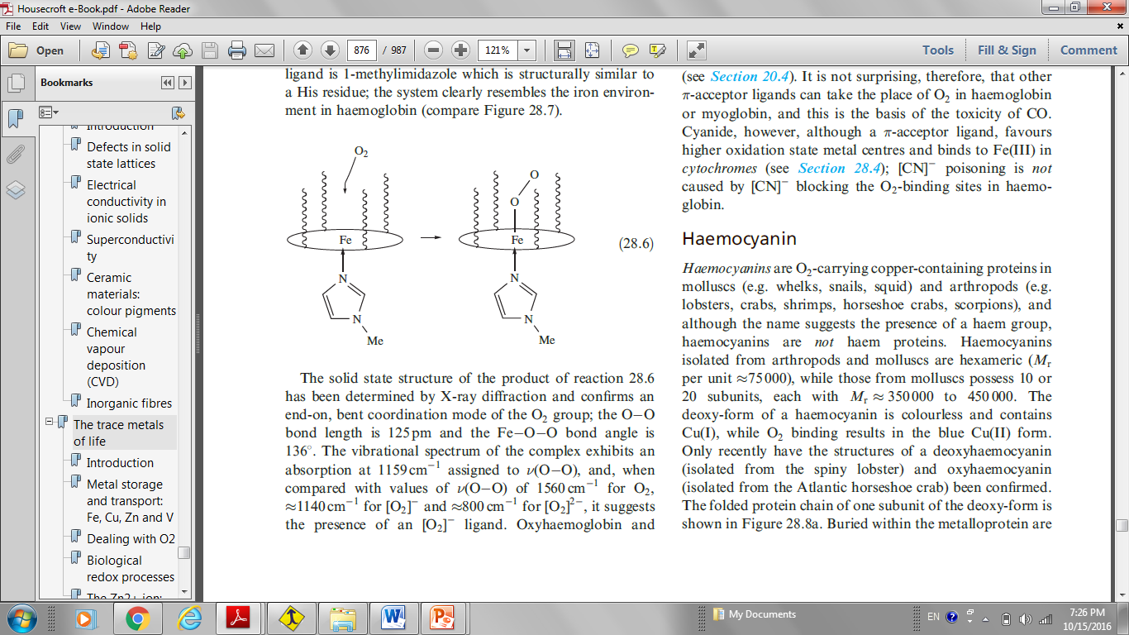
Myoglobin
Interaction between iron centers is prevented by a so-called ‘picket-fence’ porphyrin.

Slide 32
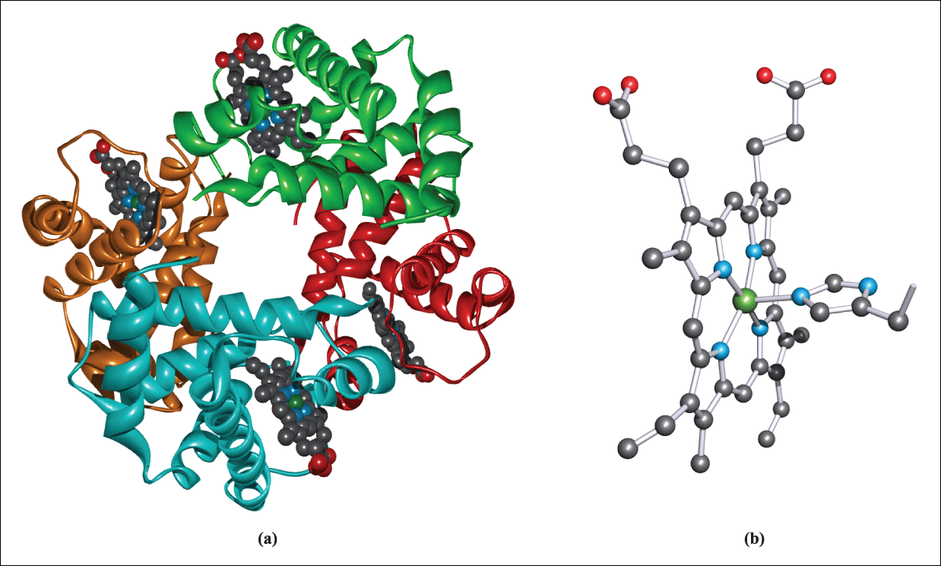
Hemoglobin
Hemoglobin consists of a tetramer of myoglobin-like subunits with four Fe sites that bind O₂ cooperatively.

Slide 33
Hemoglobin
Although each of the four units in heamoglobin contains a heam group, the four groups do not operate independently of each other, and binding (and release) of O₂ is a cooperative process:
As the tetramer binds successive O₂ molecules, the affinity of the ‘vacant’ heam groups for O₂ increases such that the affinity for the fourth site is ~ 300 times that of the first heam unit.
Notes:
the heam group in its rest state contains high-spin Fe(II) lying 40pm out of the plane of the N,N’,N’’,N’’’-donor set of the porphyrin group and is drawn towards the His residue; the high-spin Fe(II) centre is apparently too large to ﬁt within the plane of the four N-donor atoms. When O2 enters the sixth coordination site, the iron centre (now low-spin Fe3þ, see below) moves into the plane of the porphyrin ring and pulls the His residue with it. This in turn perturbs not only the protein chain to which the His group is attached, but also the other three protein subunits, and a cooperative process triggers the other heam units to successively bind O2 more avidly. When O2 is released from heamoglobin to myoglobin, the loss of the ﬁrst O2 molecule triggers the release of the remaining three

Slide 34
Hemoglobin
When O₂ is released from hemoglobin to myoglobin, the loss of the first O₂ molecule triggers the release of the remaining three.
Myoglobin does not exhibit this cooperative effect since it comprises only one protein chain.

Slide 35
Construct a comparison between haemoglobin and myoglobin.

Slide 36
Video links
https://www.youtube.com/watch?v=Zro-MR2Mjak
https://www.youtube.com/watch?v=HdR-U0gMIi4

Slide 37
Toxicity of CO and CN⁻
Carbon monoxide:
CO is small enough to fit into the protein cavity and form such strong bonds with the iron that the process is irreversible.
High concentrations of CO rapidly use up the body's limited supply of hemoglobin molecules, and prevent them from binding to oxygen.
Hemoglobin’s binding affinity for CO is 200 times greater than for O₂.

Slide 38
Toxicity od CO and CN⁻
Cyanide ion:
Once cyanide is taken into the blood stream the majority (92-99%) is found bound to hemoglobin in red blood cells.
Then CN⁻ is taken to the body's tissues where it binds to an enzyme called cytochrome oxidase and stops cells from being able to use oxygen.

Slide 39
Toxicity od CO and CN⁻
Different mechanisms:
Cyanide dissociates from hemoglobin faster than carbon monoxide and much slower than the dissociation rate constants for oxygen.
Because of the extremely low affinity of CN⁻ ligand for the ferrous heam iron, the dissociation occurs.
Why?

