Slide 1
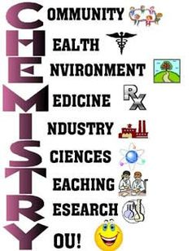
418 Chem.
Bioinorganic Chemistry
Part II. Transport and Storage of Metal Ions
a. Sodium and Potassium
M. H. Al-Qunaibit

Slide 2
Outline- Part II-a
Metal coordination sites
Sodium and potassium transport

Slide 3
Metal binding in Biological Systems
The roles of metal ions reflect their fundamental properties; charge, size, electronic configuration and rates of ligand exchange.
Major binding sites for metal ions are provided by the amino acids that make up protein molecules.
Ligation sites range from backbone peptide carbonyls to the side chains that provide more specific complexation.
What is a peptide?

Slide 4
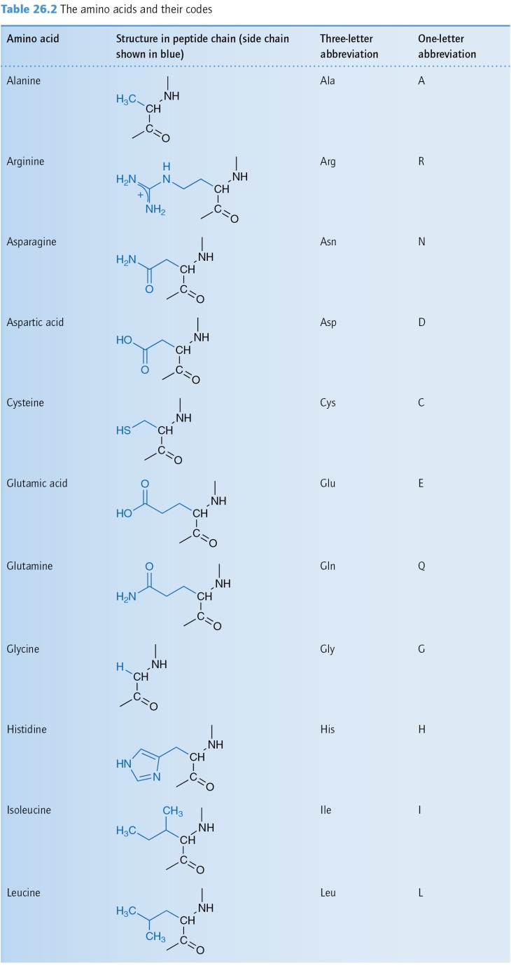
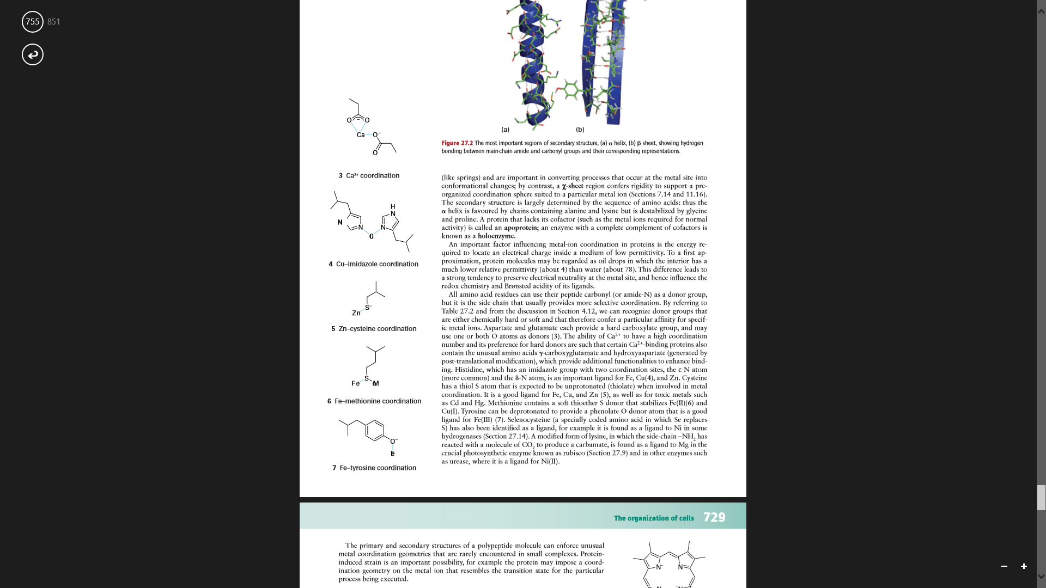

Slide 5
How do:
charge
size
electronic configuration
and rates of ligand exchange
affect the roles of metals?

Slide 6
Metal binding in Biological Systems
Defining metal binding classes:
The s-block metals (Na⁺, K⁺, Mg²⁺, Ca²⁺) interact weakly with ligands due to their poor polarizing power and prefer to bind to oxygen donor ligands.
Are these hard or soft acids?
Notes:
An advantage of using transition metal arises in the study of biological systems that contain such metals, is their electronic properties that help characterize their binding sites, while main group Na+ and K+ for example can be studied using NMR only (mostly)

Slide 7
Metal binding in Biological Systems
The transition metals, with partially filled d- orbitals bind ligands more strongly than the s-block metals.
- 3d metals V- Zn are all essential elements, while Mo appears to be the only essential metal in the second row of transition metals)
- They adopt different coordination numbers and geometries, and so undergo changes in coordination numbers during the redox process.
Notes:
An advantage of using transition metal arises in the study of biological systems that contain such metals, is their electronic properties that help characterize their binding sites, while main group Na+ and K+ for example can be studied using NMR only (mostly)

Slide 8
Why do transition metals bind ligands more strongly than the s-block metals?

Slide 9
Metal binding in Biological Systems
Toxic elements usually:
4d¹⁰, 5d¹⁰ (Cd, Hg)
p-block metals (Th, Sn, Pb, and As),
They are all readily polarized (soft), bind strongly to many ligands, particularly soft ligands, and displace essential metals from their binding sites resulting in conformations .
Why are these metals toxic?
Notes:
Attention is recently drawn to the toxicity of aluminum which results from inhibition of Mg²⁺-dependent enzymes. It can also compete with Fe³⁺ and Ca²⁺ in biological systems

Slide 10
Special ligands
Ligand groups available include:
Negatively charged groups ( e.g. carboxylate, thiolate or phosphate)
Groups such as amine, which coordinate to the metal center through lone pairs of electrons.
Macrocyclic ligands ( e.g. porphyrins).
Bridging sulphide or oxide ligands.
Notes:
Thiolate R-S⁻

Slide 11
Write the chemical formulae for carboxylate, thiolate amine, phosphate and sulphide.

Slide 12
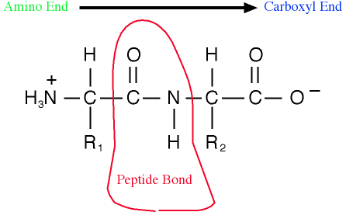
Special ligands
We can categorize ligands accordingly to:
1. Ligand groups on peptides and proteins (present in cell walls) with amine and carboxylate termini, deprotonated peptide links, thiols…

Slide 13
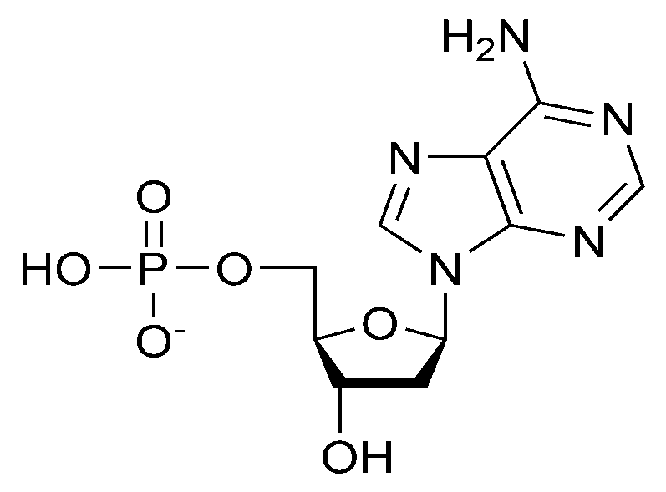
Special ligands
2. Ligand groups on nucleotides and nucleic acids. Here the metal binds to phosphates and nucleotide base moieties and only weakly to sugar groups.
Nucleotide= N base+ pentose + phosphate group
Notes:
The building blocks of nucleic acids, nucleotides are composed of a nitrogenous base, a five-carbon sugar (ribose or deoxyribose), and at least one phosphate group. T

Slide 14
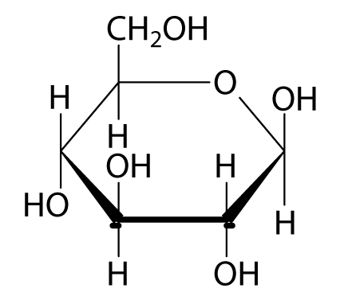
Special ligands
3. Ligand groups on polysaccharides, which are always extremely diverse in their metal binding sites.
Saccharide= made only from H, C, O
Can you guess where can a metal bind?
Notes:
The building blocks of nucleic acids, nucleotides are composed of a nitrogenous base, a five-carbon sugar (ribose or deoxyribose), and at least one phosphate group. T

Slide 15
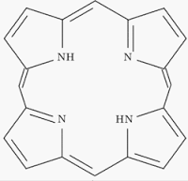
Special ligands
4. Macrocyclic ligands: A range of tetrapyrole ligands are available
to bind metals as Fe
(e.g. porphyrin)
5. Metal clusters with bridging sulphide or oxide (such as Fe-S clusters) found in some proteins where they bind via
cysteine thiolate groups

Slide 16
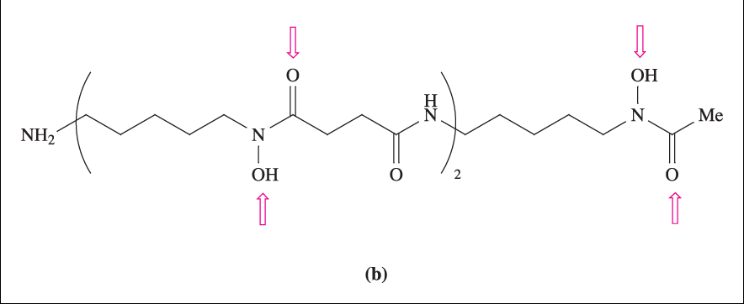
Special ligands
6. Specialized ligands: such as Fe-carriers siderophores.
(All siderophores form very stable chelate complexes with approximately octahedrally coordinated high spin Fe(III))
Example: Desferrioxamine
(OH groups are
deprotonated before
coordination to Fe³⁺.)

Slide 17
Construct a table listing ligand groups in biological systems and the functional metal-binding group in each

Slide 18
Metal-ligand interactions
Metal-ligand interaction is associated with all terms that relate to functions in biology;
Selectivity
Stabilization
Cross-linking
Orientation
Reactivity
Redox potential values
Define each of the above terms.

Slide 19
The strength of metal-ligand interaction
  Is characterized by a formation constant, which is usually measured at fixed temperatures and ionic strengths.
  Metal ions compete with protons for ligands, so they bind less well at lower pH values. Competition for a metal from two ligands could well be determined by the pK_{a} values of the protonated ligands.

Slide 20
1. Define the formation constant for the reaction:
[Fe(OH₂)₆]³⁺(aq) + SCN⁻ (aq) ↔[Fe(SCN)(OH₂)₅]²⁺(aq) + H₂O(l)
2. What is pK_{a} ? Give an example

Slide 21
Metal-ligand interactions
Factors affecting metal-ligand interaction
The complexing power of a metal ion depends upon its polarizing power (charge/radius ratio).
  1. Hard and soft acids and bases
  M^{n+} of biological significance are hard or borderline acids;
  - main cellular constituents (binding groups) are generally hard ligands (with N or O donor atoms).

Slide 22
Metal-ligand interactions
  -Some biological ligands are soft (S containing side chains), they moderate the overall hardness /softness of a metal binding site to control selectivity, and stabilize the lower oxidation states.
  Discuss the above.

Slide 23
Metal-ligand interactions
  2. Chelation and ion exchange
  Molecular models of metal binding are usually either :
  -chelation, in homogenous reactions,
  - or ion exchange in heterogenous reactions.
  3. Back -bonding
  Metal sites in biological systems are involved in binding and activation of small molecules such as gaseous O₂, N₂, CO….

Slide 24
Metal-ligand interactions
  Complex formation here arises from the synergic effect resulting from:
  -sigma (σ) ligand-to-metal and
  - back-bonding metal-to-ligand pi (π) bond
  Example:
  O₂ molecule is activated by binding to Fe(II). Electron transfer to dioxygen takes place via overlap of a metal 3d and the antibonding π molecular orbitals of dioxygen.

Slide 25
Metal-ligand interactions
  Metals and selectivity for binding
  - M^{n+} may be bound selectively by a ligand which possess the appropriate donor atoms, and is able to accommodate the normal geometry of the metal ion.
  -In biological systems, the nature of the groups at the binding sites discriminates immediately between metals.
  How does this relate to HS acids and bases?

Slide 26
Metal-ligand interactions
  Example
  If the binding site is made up of N or S ligands, the binding of the transition metal or zinc is favoured and the group Ι and ΙΙ cations will be excluded.
  Note
  Other factors are important, e g metal ion concentration.
Notes:
Transition metals do not show extreme difference from one another in terms of their preference for particular binding groups. This is shown by a comparison of the formation constants in table 1, which shows as well that Cu (ΙΙ) is by far the strongest Lewis acid. The metal ion concentration is an important factor, and has a marked effect on the outcome of any competition between metal cations for binding sites.
Consequently, biosorption of metal ions proved to occur with relative affinities that are different for different organisms at different sets of conditions [8-12]. Such phenomena suggested that each metal ion ‘prefers’ a certain binding site at certain conditions such as pH, temperature, metal ion concentration and medium of reaction.

Slide 27
Outline- Part II-a
Metal coordination sites
Sodium and potassium transport

Slide 28
Na and K
Sodium and potassium have high natural abundances, occurring widely as salts such as chlorides
Valence electron configuration ns¹.
Chemical properties are those of the Group 1 elements which correlate with the trend in their atomic radii.
Notes:
Charge carriers –Na+, K+, Ca2+

Slide 29
Na and K
The Group 1 element ions are hard Lewis acids and complexes are formed mainly with small, hard donors such as O or N atoms.
Their hardness decreases down the group with increasing ionic radius (hence more covalent character)
Na⁺ and K⁺ are two ions that are very similar except for their radii

Slide 30
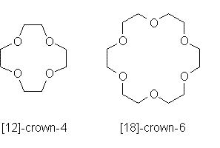
Na and K
Differentiating between these two ions is achieved through their selective complexation by special ligands, such as crown ethers, with dimensions appropriate for coordination to one particular kind of ion.
What is the basis of differentiation?
Notes:
Crown ethers are complex macrocyclic ions with cavities that have different radii and are suitable to specific metal ions

Slide 31
Na⁺ and K⁺ transport
These ions are transported through the membranes by:
1. Ion channels; large membrane- spanning proteins that allow selective transport of K⁺ and Na⁺ (as well as Ca²⁺ and Cl⁻) and are responsible for electrical conduction in the nervous systems as well as in coupled transport of solutes. Passive transport.
Notes:
Passive transport

Slide 32
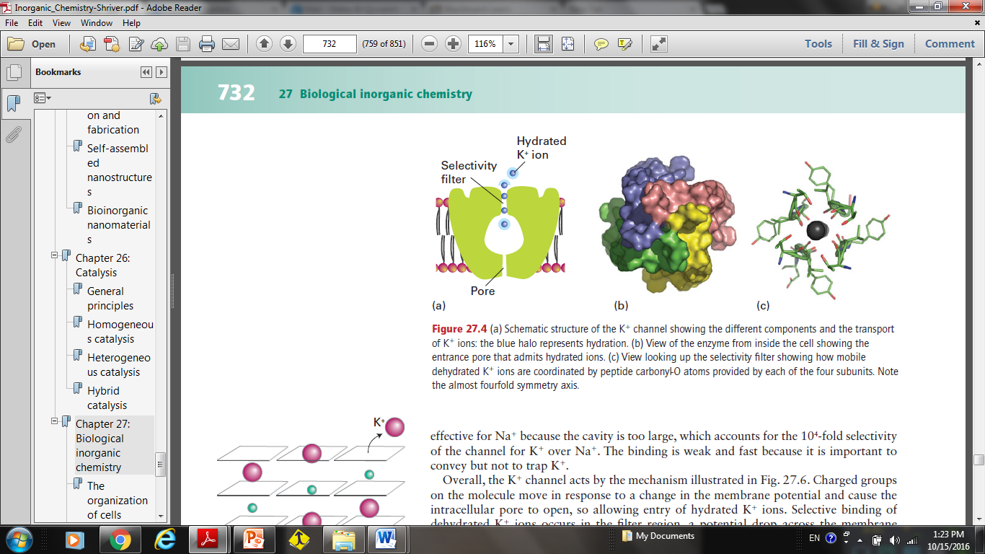
Na⁺ and K⁺ transport
Mechanism:
Moving from the inside surface of the membrane, there is a pore leading into a central cavity about 1 nm diameter; K⁺ ions can remain hydrated.
The binding is weak and fast because it is important to convey but not to trap K⁺.

Slide 33
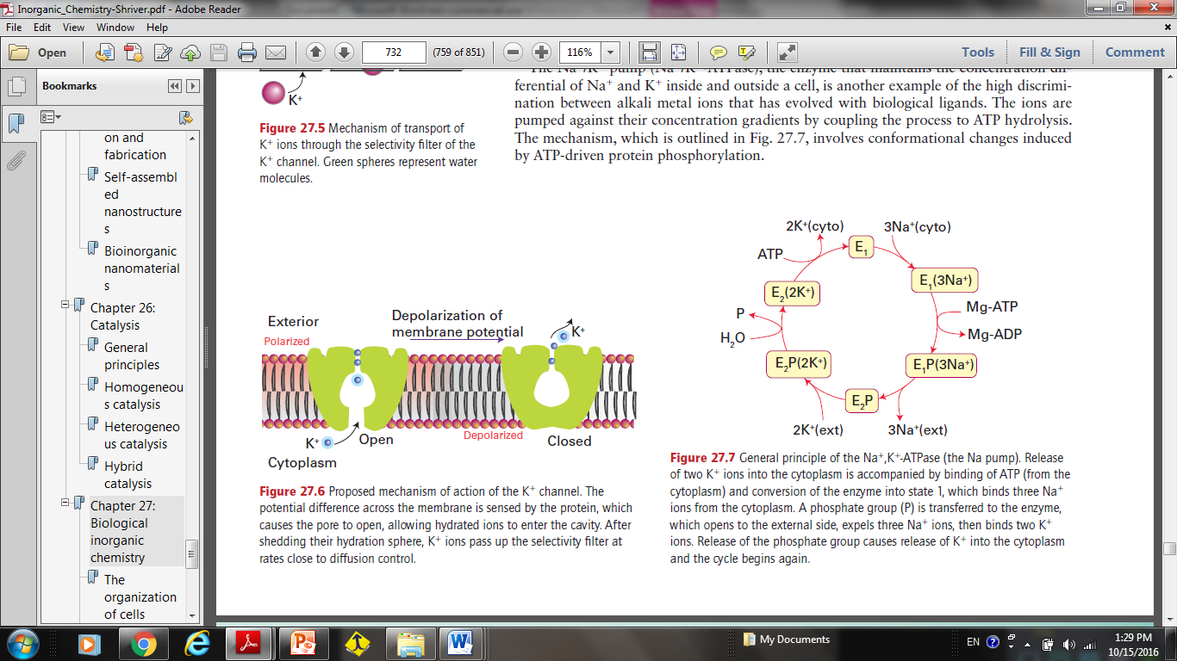
Na⁺ and K⁺ transport
Summary:
The potential difference across the membrane is sensed by the protein, causing the pore to open, allowing hydrated ions to enter the cavity. After shedding the hydration sphere, K⁺ ions pass up the selectivity filter.
Notes:
Charged groups on the molecule move in response to a change in the membrane potential and cause the intracellular pore to open, so allowing entry of hydrated K ions. Selective binding of dehydrated K ions occurs in the filter region, a potential drop across the membrane is sensed, and the cavity closes. At this point the filter opens up to the external surface, where the K concentration is low and the K ions are hydrated and released. This release causes the protein to switch back to the original conformation and K ions again enter the filter.
This is not effective for Na⁺ because the cavity is too large, which accounts for the 10⁴⁻fold selectivity of the channel for K⁺ over Na⁺.

Slide 34
Na⁺ and K⁺ transport
2. The Na/K pump; maintains the concentration differential of Na⁺ and K⁺ inside and outside a cell. The ions are pumped against their concentration gradients by coupling the process to ATP hydrolysis. Active transport.
General principle of the Na, K-ATPase (the Na pump) is shown in the next figure:
Notes:
3 Na+(ic) + 2 K+(ic) + ATP4-+H2O →3 Na+(ec) + 2 K+(ic) + ADP3-+H2PO4
Active transport
•Carboxylategroups (hydrophilic) for binding the active species •Selectivity by formation of E1 and E2 which are produced via (de)phosphorylation •Energy–consuming ion transport mechanism, energy production by hydrolysis of ATP

Slide 35
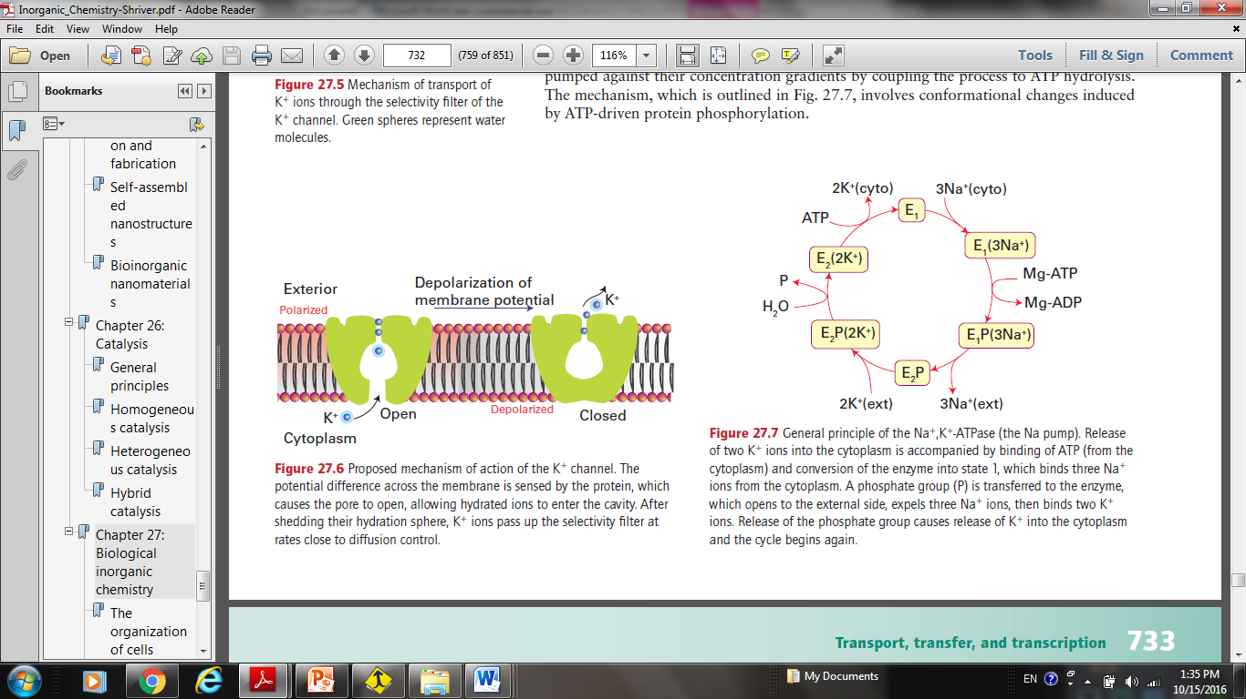
Na⁺ and K⁺ transport
In the cytoplasm
Release of two K⁺ accompanies binding of ATP and conversion of the enzyme, which binds three Na⁺.
A phosphate group (P) is transferred to the enzyme, which opens to the external side, expels three Na⁺ then binds two K⁺.
Release of (P) causes release of K⁺ and the cycle begins again
Notes:
•Symport: simultaneous transport of anions and cations (K+/Cl-) in same direction •
Antiport: transport of ions of the same charge in opposite direction (H+/K+)

Slide 36
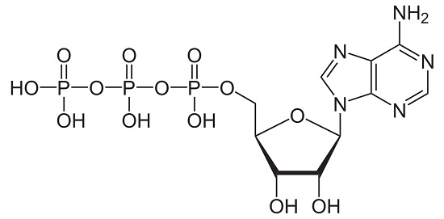
What is ATP?
Adenosine triphosphate
Is considered by biologists to be the energy currency of life.
It is the high-energy molecule that stores the energy we need to do just about everything we do.
It is present in the cytoplasm and nucleoplasm of every cell,
All the physiological mechanisms that require energy for operation obtain it directly from the stored ATP.

Slide 37
Differentiate between ion channels and ion pumps (compare).

