Slide 1
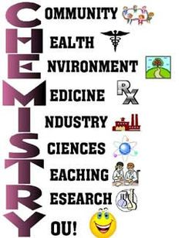
418 Chem.
Bioinorganic Chemistry
Part I : Overview
M. H. Al-Qunaibit

Slide 2
Outline- Part I
Introduction
The inorganic composition of cells
Terminology
The biological functions of elements
Analytical techniques

Slide 3
Bioinorganic Chemistry links Inorganic Chemistry to Biochemistry, where it:
Describes the relationship between these two disciplines.
Discusses the structure and function of inorganic elements, ions, coordination compounds and mineralization in living systems
Covers the use of inorganics in medicinal fields for therapy and diagnosis.

Slide 4
An interdisciplinary science
Organic chemistry: restricted to carbon compounds
Biochemistry: chemical components of living systems
Inorganic chemistry: no covalent carbon components
Bioinorganic chemistry: biochemical function of “inorganic elements”.

Slide 5
Exploitation of chemical properties
Different elements are taken up selectively by different cells and intracellular compartments.
The main focus is on metal ions, where we are interested in:
their interaction with biological ligands.
and the important chemical properties they are able to exhibit and impart to an organism.

Slide 6
These properties include:
  ligand binding
  catalysis
  signaling
  regulation
  sensing
  defense
  structural support.

Slide 7
History
Bulk inorganic elements have long been known to be essential.
Blood known to contain iron since 17th century
Bioinorganic chemistry developed as a field after 1960.
First inorganic biochemistry symposium in 1970
Society of Biological Inorganic Chemistry was formed in 1995

Slide 8
Coordination Chemistry
Revisiting - in context
Central atom is bound to a large number of ligands
Usually discrete species in solution and solid
Properties of central atoms (transition metals):
Large charge/radius ratio
Variable oxidation states

Slide 9
Coordination chemistry
Meta-stable high oxidation states, s-electrons are removed first.
Compounds are often paramagnetic (unpaired electrons).
Formation of colored ions and compounds.
Compounds with profound catalytic activity.
Formation of stable complexes (HSAB theory)
Trend to metal-metal bonding (clusters, not important in biology).

Slide 10
Coordination chemistry
Properties of ligands
  Monodentate
  polydentate
  Ambidentate (nitro-, nitrito)
HSAB theory
The principle of hard and soft acids and bases (HSAB) is used to rationalize observed patterns in complex stability.

Slide 11
HSAB principle
Pearson stated that cations (Lewis acids) and ligands (Lewis bases) were classed as being either ‘hard’ or ‘soft’, hence:
Hard acids (hard metal cations) form more stable complexes with hard bases (hard ligands), while soft acids (soft metal cations) show a preference for soft bases (soft ligands).

Slide 12
Hard vs Soft
The terms ‘hard’ and ‘soft’ acids arise from a description of the polarizabilities of the metal ions.
Hard acids are typically either small monocations with a relatively high charge density or are highly charged, again with a high charge density. These ions are not very polarizable and show a preference for hard ligands.

Slide 13
Hard bases with donor atoms that are also not very polarizable
Soft acids tend to be large monocations with a low charge density, and are very polarizable. They prefer to form coordinate bonds with soft bases.
Soft bases contain donor atoms that are also highly polarizable.
Note the relationships between the classiﬁcations of the ligands and the relative electronegativities of the donor atoms in the series next.

Slide 14
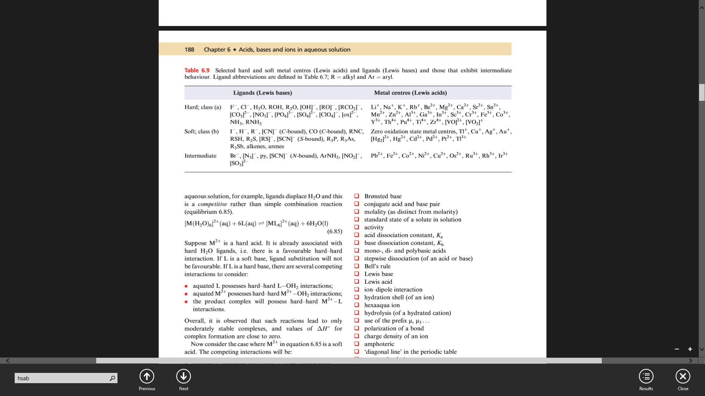

Slide 15
Outline- Part I
Introduction
The inorganic composition of cells
Terminology
The biological functions of elements
Analytical techniques

Slide 16
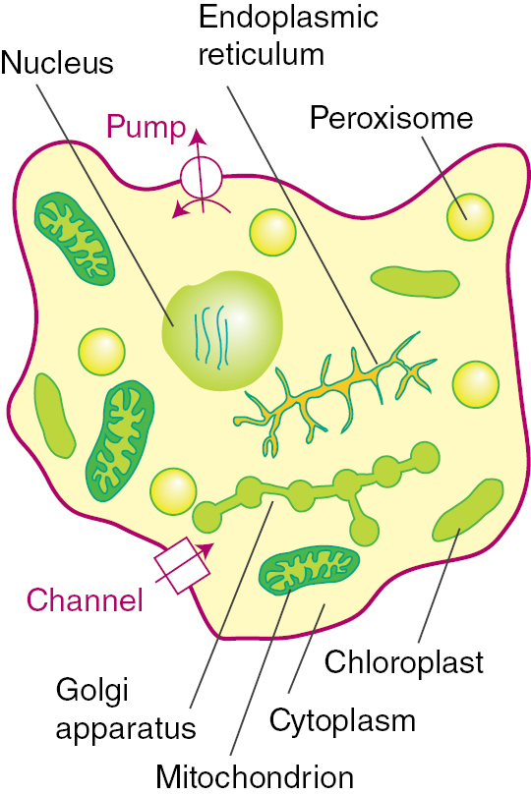
The cell
Living cells and organelles are enclosed by membranes.
The concentrations of specific elements may vary greatly between different compartments.
The biologically essential elements can be classified as trace or essential.

Slide 17
The physical structure of cells
The cell is the basic unit of any living organism (ranges from complex to simple).
It is found in prokaryotes (bacteria and bacteria-like) and much larger and more complex examples found in eukaryotes (includes animals and plants).
Membranes act as barriers to water and ions and manage all mobile species and the electrical currents.

Slide 18
The physical structure of cells
Membranes are lipid bilayers (~ 4 nm thick, in which are embedded protein molecules and other components.
The long hydrocarbon chains of lipids make the membrane interior very hydrophobic and impermeable to ions, which must instead travel through specific channels, pumps, and other receptors.

Slide 19
The physical structure of cells
The structure of a cell also depends on osmotic pressure, which is maintained by high concentrations of solutes, including ions, imported during active transport by pumps.

Slide 20
The Elements of life
Essential Elements
C, H, N O, P and S are the fundamental essential elements that make up the building blocks of biomolecules.
Less abundant, essential elements are Na, K, Cl, Mg and Ca.
Trace elements are V, Cr, Mn, Fe, Co, Ni, Cu, Zn Mo (metals), and B, Si, Se, F, I (non-metals)‏
Notes:
In biological processes: the boundary between inorganic and organic chemistry is blurred.

Slide 21
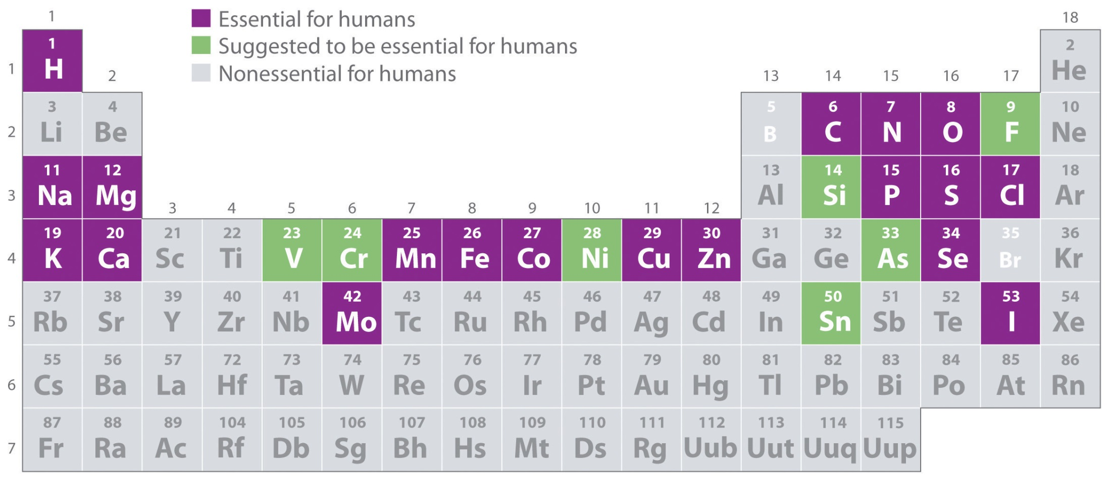
The periodic table of life

Slide 22
Compartmentalization
Is the distribution of elements inside and outside a cell and between different internal compartments.
Different elements are strongly segregated inside and outside a cell and among different internal compartments
The maintenance of constant ion levels in different biological zones is achieved by membranes being barriers to passive ion flow.
Notes:
(e.g. there is a large difference in concentration of K⁺ and Na⁺ ions across cell membranes).

Slide 23
Compartmentalization
Two important issues arise in the context of compartmentalization.
The process requires energy (ions must be pumped against an adverse gradient of chemical potential), and once a concentration difference has been established, there is a difference in electrical potential across the membrane dividing the two regions.

Slide 24
Compartmentalization
2. The selective transport of ions must occur through ion channels built from membrane-spanning proteins:
Some release ions on receipt of an electrical or chemical signal.
Others, the transporters and pumps, transfer ions against the concentration gradient by using energy provided by ATP (energy compound) hydrolysis.

Slide 25
Outline- Part I
Introduction
The inorganic composition of cells
Terminology
The biological functions of elements
Analytical techniques

Slide 26
Some new terms
[GLOSSARY OF TERMS USED IN BIOINORGANIC CHEMISTRY, IUPAC]
Binding site: A specific region (or atom) in a molecular entity capable of entering into a stabilizing interaction with another molecular entity (e.g. an active site in an enzyme with its substrate). Typical forms of interaction are by:
  hydrogen bonding
  coordination
  ion pair formation

Slide 27
Some new terms
Biomass: Material produced by the growth of micro-organisms, plants or animals
Biomineralization: The synthesis of inorganic crystalline or amorphous mineral-like materials by living organisms
Biopolymers: Macromolecules (including proteins, nucleic acids and polysaccharides) formed by living organisms.

Slide 28
Some new terms
Biosensor: A device that uses specific biochemical reactions to detect chemical compounds, usually by electrical, thermal or optical signals.
Chelation therapy: using chelating agents to remove toxic amounts of metal ions from living organisms.
Coenzyme: A low-molecular-weight, non-protein organic compound participating in enzymatic reactions.

Slide 29
Some new terms
Cofactor: An organic molecule or ion (usually a metal ion) that is required by an enzyme for its activity, and may be attached either loosely (coenzyme) or tightly (prosthetic group).
Contrast agent: Paramagnetic (or ferromagnetic) metal complex or particle causing a decrease in the relaxation times of nuclei detected in an image.
Notes:
Prosthetic group
A tightly bound, specific nonpolypeptide unit in a protein determining and involved in its biological
activity. See also cofactor.Prosthetic = of, relating to, or constituting a nonprotein group of a conjugated protein

Slide 30
Some new terms
Cooperativity: The phenomenon that binding of a species to a biological system either enhances or diminishes the binding of a successive molecule, of the same or different kind, to the same system.
Element abundance : a large amount of the element.

Slide 31
Some new terms
Enzyme: A macromolecule that functions as a biocatalyst by increasing the reaction rate, frequently containing or requiring one or more metal ions.
Ion channel: enable ions to flow rapidly through membranes in a thermodynamically downhill direction after an electrical or chemical impulse.

Slide 32
Some new terms
Ion pumps: enable ions to flow through membranes in a thermodynamically uphill direction by the use of an energy source such as ATP or light.
Metalloenzyme: an enzyme that, in the active state, contains one or more metal ions which are essential for its biological function.
Zwitterionic compound: A neutral compound having electrical charges of opposite sign, delocalized or not, on adjacent or nonadjacent atoms

Slide 33
Outline- Part I
Introduction
The inorganic composition of cells
Terminology
The biological functions of elements
Analytical techniques

Slide 34
The roles of elements
The Essential elements
Fundamental essential
(C, H, N and O) make up the building blocks of biomolecules (e.g. amino acids, peptides, carbohydrates, proteins, lipids and nucleic acids),
with P playing its part (e.g., in ATP and DNA)
and S being the key to the coordinating abilities of cysteine residues in proteins.

Slide 35
The roles of elements
2. The less abundant -but essential- elements include:
osmotic control and nerve action (Na, K and Cl),
Mg²⁺‏ in chlorophyll Mg²⁺‏-containing enzymes involved in phosphate hydrolysis,
structural functions of Ca²⁺‏ (e.g. bones, teeth, shells) and triggering actions of Ca^{2‏+} (e.g. in muscles)

Slide 36
The roles of elements
The trace metals
Which are important to life and can be
summarized as follows:
V: Enzymes (nitrogenases, haloperoxidases)
Cr: may be essential in glucose metabolism in higher mammals.
Mn: Enzymes (phosphatase, mitochondrial superoxide dismutase, glycosyl transferase); photoredox activity in Photosystem II
Co: Vitamin B12 coenzyme.

Slide 37
The roles of elements
Fe: Electron-transfer systems; O² storage and transport; Fe storage and transport; in enzymes (e.g. nitrogenases, hydrogenases).
Ni: Enzymes (urease, some hydrogenases).
Cu: Electron transfer systems; O² storage and transport; transport proteins.
Zn: Acts as a Lewis acid (e.g. in hydrolysis processes); structural roles.
Mo: Enzymes (nitrogenases, reductases, hydroxylases)

Slide 38
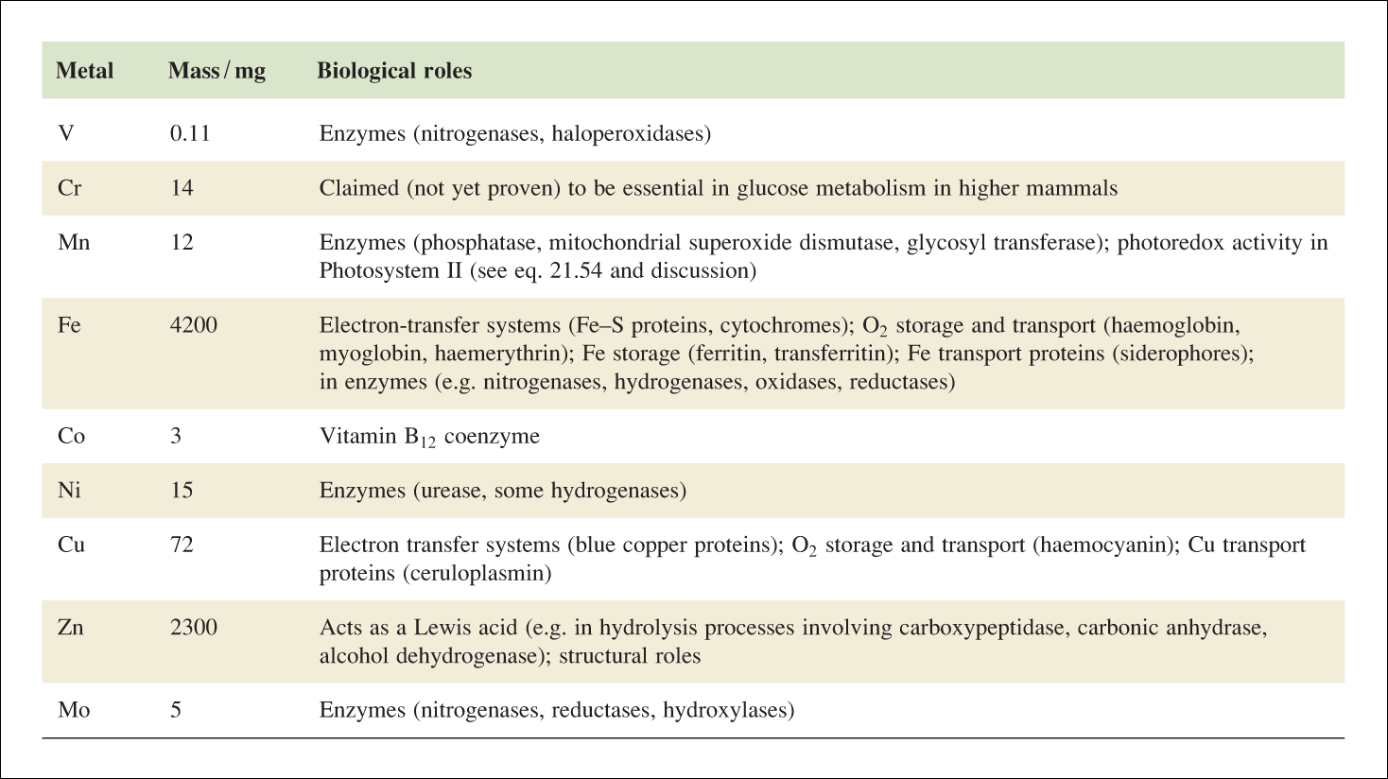
Mass of each trace metal present in an average 70 kg human, and a summary of where the trace metals are found and their biological roles [1]

Slide 39
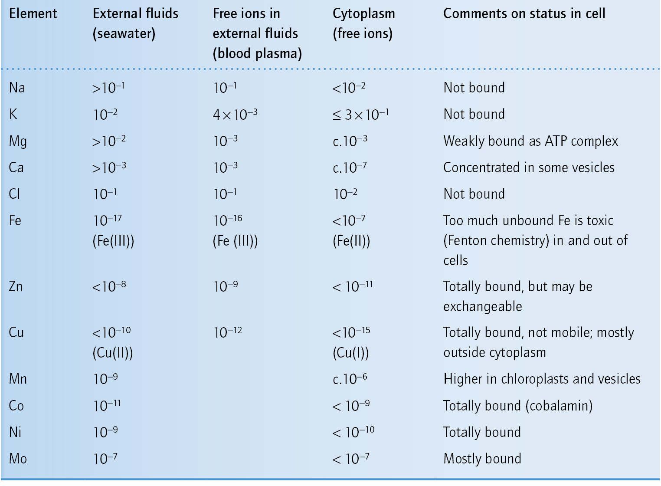
Concentrations of some elements in different biological zones

Slide 40
Outline- Part I
Introduction
The inorganic composition of cells
Terminology
The biological functions of elements
Analytical techniques

Slide 41
Analytical Techniques
Common physical methods adopted in bioinorganic chemistry are:
X‐ray crystallography
X‐ray absorption (XAS)
  Extended X‐ray
  Absorption Fine Structure (EXAFS) X‐ray absorption Near Edge Structure
Magnetic Resonance
  Electron paramagnetic resonance (EPR)
  Nuclear magnetic resonance (NMR)

Slide 42
Analytical techniques
•Mössbauer (MB)
•Optical Spectroscopy:
  Electronic absorption (UV‐vis)
  Circular dichroism (CD)
  Magnetic circular dichroism (MCD)
  Luminescence (fluorescence & phosphorescence)
  Infrared (IR)
  Resonance Raman (RR)
•Electrochemistry

Slide 43
Analytical techniques- What do they tell?
IR and Resonance Raman spectroscopy
Increasingly used in bioinorganic chemistry for characterization and assignment of vibrations directly connected with the species of interest.
Information on functional groups, bond length, binding metal, etc., can be elucidated.

Slide 44
Analytical techniques
Extended X-ray absorption fine structure (EXAFS)
Arise of electron scattering by atoms surroun-ding a particular atom of interest as it absorbs X-rays and emits electrons.
This technique is a probe of the local structure.
Bond lengths and local symmetry, coordination numbers, … may be derived

Slide 45
Analytical techniques
Nuclear magnetic resonance (NMR) spectroscopy
NMR spectroscopy makes it possible to discriminate nuclei, typically protons, in different chemical environments.
Structural information can be obtained about a paramagnetic site in proteins.

Slide 46
Analytical techniques
Magnetic resonance imaging (MRI)
The visualization of the distribution of nuclear spins (usually water) in a body by using a magnetic field gradient.
It is NMR imaging

Slide 47
Analytical techniques
Mössbauer effect
Resonance absorption of gamma radiation by specific nuclei arranged in a crystal lattice in such a way that the recoil momentum is shared by many atoms.
Studies coordinated metal ions; in bioinorganic chemistry mostly studied is ⁵⁷Fe nucleus, and provides information about the oxidation, spin and coordination state of the iron.

