Slide 1
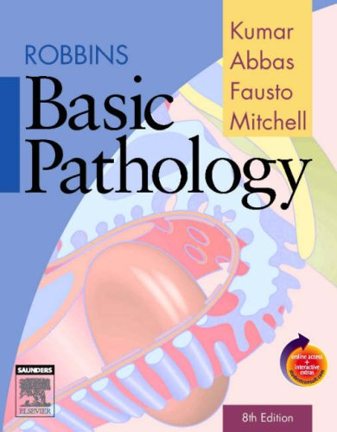
CLS 223

Slide 2
Lecture # 4
Tissue repair

Slide 3
Cellular response to stress
Cellular response to stress may be adaptive or non adaptive.
Adaptive | Non-adaptive (cell injury-----cell death)
hypertrophy | Dysplasia
hyperplasia | neoplasia
Atrophy | Degeneration
Metaplasia | Necrosis, apoptosis & gangrene
Reversible | Reversible* / Irreversible
1) Change in cell number, size, type
2) Inflammation and repair
3) Immune response
*to a certain limit

Slide 4
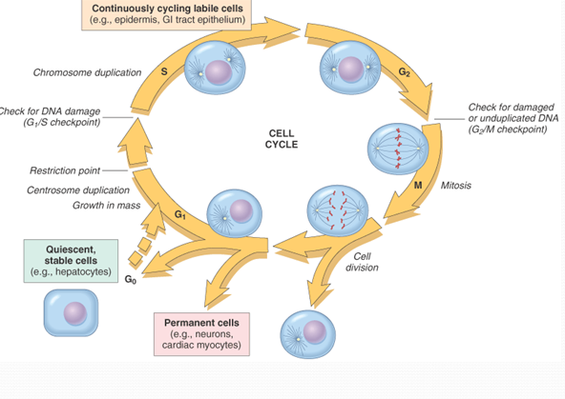
Repair
It is the restoration of tissue architecture and function after an injury.
The ability of tissue to repair is influenced by Local Factors:
- What is the type of this injured cells (based on the ability of a cell to proliferate):
1) Labile: continuously dividing cells. E.g. skin, mucous membrane of the GIT.
Notes:
repair: replacement of damaged tissue by a new healthy one.

Slide 5
2) Stable: Have minimal replacement capacity in normal state. However, they are capable of proliferating in response to injury. E.g. Hepatocytes.
3) Permanent: non-proliferative cells. E.g. Nerves and cardiac muscles cells.
Blood supply: Poor blood supply and ischaemia delays repair.
Infection and presence of foreign bodies delays repair
Severity of tissue damage.

Slide 6
The ability of tissue to repair is influenced by General Factors:
Age: Repair is more rapid and adequate in young age.
Hormonal effect
Protein deficiency, Vitamin deficiency delays repair
Diabetes mellitus
Types of repair:
Cell and tissue regeneration
Repair by connective tissue (fibrosis, scarring)

Slide 7
Regeneration
Definition: Replacement of damaged cells by new cells of the same kind.
Occurs in:
Labile cells → Continue to regenerate throughout life as long as the pool of stem cells is preserved.
Stable cells → Regeneration occurs with small damage to stable cells.
Notes:
Stable cells like liver undergo regeneration incase of a mild injury but once the injury is severe and reached the supporting structures then repair will occur with connective tissue formation

Slide 8
Healing by fibrosis
Definition: Replacement of damaged tissue by granulation tissue which matures to fibrous tissue resulting in scar formation.
Occurs in:
Stable cells → repair by connective tissue occurs with large damage to these cells.
Permanent or fixed cells → cannot undergo regeneration at all.
Notes:
Severity of tissue damage: If the injury is so bad that the tissue is incapable of complete restoration, or if the supporting structure of the tissue are severely damaged, repair occurs by connective (fibrouse) tissue formation (scar).

Slide 9
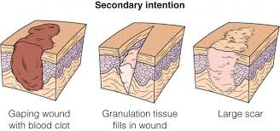
Pathogenesis:
1)The damaged area is invaded by granulation tissue from the surrounding living tissue. It consists of new capillaries and proliferating fibroblasts.
2)The granulation tissue then matures when fibroblasts change to fibrocytes and capillaries undergo atrophy and resorption. The resulting avascular tissue is called scar.

Slide 10
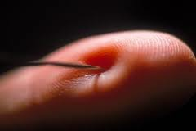
Describe what happens if you get pricked by a needle
Notes:
What is vasoconstriction? Plug formation? Steps of coagulation, clot formation (anatomy and physiology)
Inflammation (take from previous lecture what is the mechanism), what type of inflammation will take place?
Which white blood cells will increase the most?
Repair: will it regenerate or scar?

