Slide 1
The blood vessels
&
The Urinary System

Slide 2
The circulatory system consists of
the blood vascular system
the lymphatic vascular system
composed of
The heart
The arteries
The veins
The capillaries
pumps
the blood
carry oxygenated blood and nutrients to the tissues
carry deoxygenated blood, rich in carbon dioxide and other metabolic products from the tissues to the heart
consists of a diffuse network of thin tubules through which gas exchange between blood and tissues takes place
They becomes thinner as they branch forming arterioles

Slide 3
Structure of the blood vessels
All blood vessels have a number of structural features in common. They are composed of three layers called
1- tunica intima
2- tunica media
3- tunica adventitia

Slide 4
Structure of the blood vessels
Tunica intima
Tunica media
Tunica adventitia
It is an areolar connective tissue layer consisting of longitudinally collagen and elastic fibers
Consists of 2 components
Consists of layers of circular smooth muscle cells with elastic and collagen fibers interposed among them
A layer of squamous endothelial cells lining the vessel interior surface, and rest on a basement membrane called the basal lamina
gradually becomes continuous with the enveloping connective tissue of the organ through which the vessel is running
A subendothelial layer of loose connective tissue that may contain some smooth muscle cells, which tend to be arranged longitudinally

Slide 5
Layer | The artery
Tunica intima | -Consists of 2 components: a) A layer of squamous endothelial cells lining the vessel interior surface, and rest on a basement membrane called the basal lamina. b) A subendothelial layer of loose connective tissue that may contain some smooth muscle cells, which tend to be arranged longitudinally. -Is separated from the media by a well developed layer of elastic connective tissues, called the internal elastic lamina.
Tunica media | -Consists of layers of circular smooth muscle cells with elastic and collagen fibers interposed among them. - The thickest layer of the vessel wall.
Tunica adventitia | -It is an areolar connective tissue layer consisting of longitudinally collagen and elastic fibers. -This layer gradually becomes continuous with the enveloping connective tissue of the organ through which the vessel is running. -Rich in elastic fibers.

Slide 6
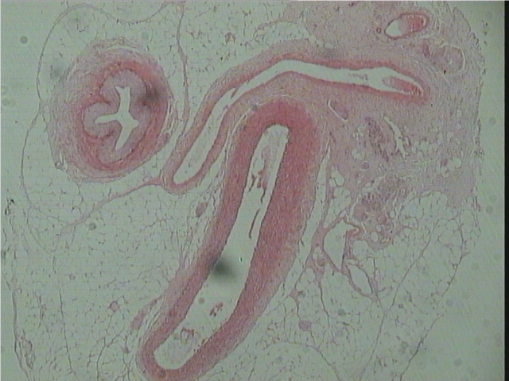
T.S of different Blood Vessels
(Artery and Vein)
Vein
Artery

Slide 7
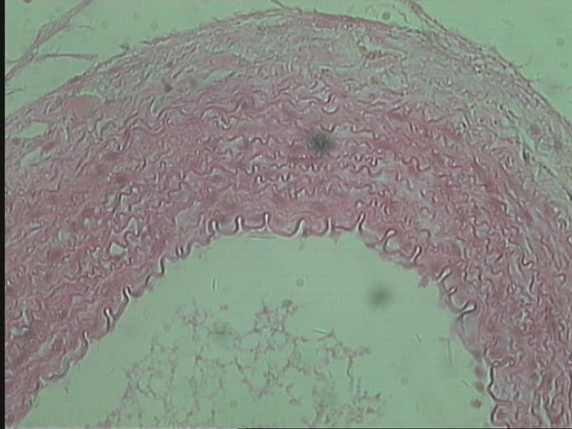
Sector of the wall of an artery
Tunica adventitia
Tunica media
Tunica intima
Lumen

Slide 8
Layer | The vein
Tunica intima | -Consists of 2 components: a) A layer of squamous endothelial cells lining the vessel interior surface, and rest on a basement membrane called the basal lamina. b) A subendothelial layer of loose connective tissue that may contain some smooth muscle cells, which tend to be arranged longitudinally. -Is not separated from the media by the internal elastic lamina.
Tunica media | Consists of layers of circular smooth muscle cells with elastic and collagen fibers interposed among them. -Much thinner than that of the artery.
Tunica adventitia | -It is a connective tissue layer consisting of longitudinally collagen and elastic fibers. -This layer gradually becomes continuous with the enveloping connective tissue of the organ through which the vessel is running. - Rich in collagenous fibers. - The thickest layer of the vessel wall.

Slide 9
T.S of different Blood Vessels
(Artery and Vein)
Vein
Artery

Slide 10
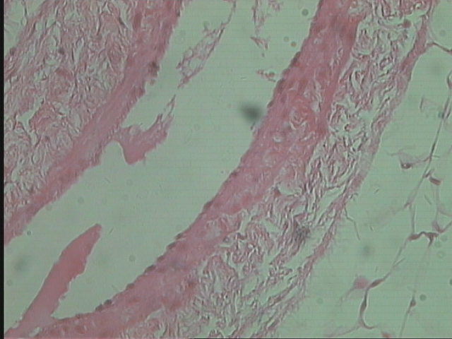
Sector of the wall of a vein
Tunica adventitia
Tunica intima
Tunica media
Lumen

Slide 11
Sector of the wall of an artery
Sector of the wall of a vein

Slide 12
Layer | The artery | The vein
Tunica intima | -Consists of 2 components: a) A layer of squamous endothelial cells lining the vessel interior surface, and rest on a basement membrane called the basal lamina. b) A subendothelial layer of loose connective tissue that may contain some smooth muscle cells, which tend to be arranged longitudinally. -Is separated from the media by a well developed layer of elastic connective tissues, called the internal elastic lamina. | -Consists of 2 components: a) A layer of squamous endothelial cells lining the vessel interior surface, and rest on a basement membrane called the basal lamina. b) A subendothelial layer of loose connective tissue that may contain some smooth muscle cells, which tend to be arranged longitudinally. -Is not separated from the media by the internal elastic lamina.
Tunica media | -Consists of layers of circular smooth muscle cells with elastic and collagen fibers interposed among them. - The thickest layer of the vessel wall. | Consists of layers of circular smooth muscle cells with elastic and collagen fibers interposed among them. -Much thinner than that of the artery.
Tunica adventitia | -It is an areolar connective tissue layer consisting of longitudinally collagen and elastic fibers. -This layer gradually becomes continuous with the enveloping connective tissue of the organ through which the vessel is running. -Rich in elastic fibers. | -It is a connective tissue layer consisting of longitudinally collagen and elastic fibers. -This layer gradually becomes continuous with the enveloping connective tissue of the organ through which the vessel is running. - Rich in collagenous fibers. - The thickest layer of the vessel wall.

Slide 13
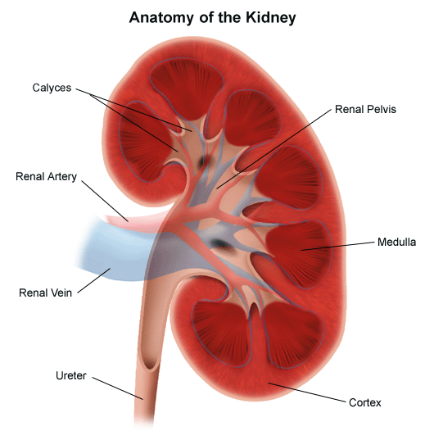
The Urinary System

Slide 14
*The kidney is bean-shaped with a
concave medial border , the hilum
(where nerves enter, blood and lymph
vessels enter and exit and the ureter
exits) and a convex lateral surface.
*The kidney is surrounded by a mass
of adipose tissue.
*The kidney tissue surrounds a cavity,
the renal pelvis. This pelvis is the
expanded upper end of the ureter.
*The functional unit of the kidney is
the uriniferous tubule which consists
of the nephron and the collecting duct
into which the renal tubule empties
its contents.

Slide 15
The kidney tissue can be divided into :
An outer ,
granular appearing
An inner ,
striated appearing
cortex
medulla

Slide 16
cortex
medulla

Slide 17
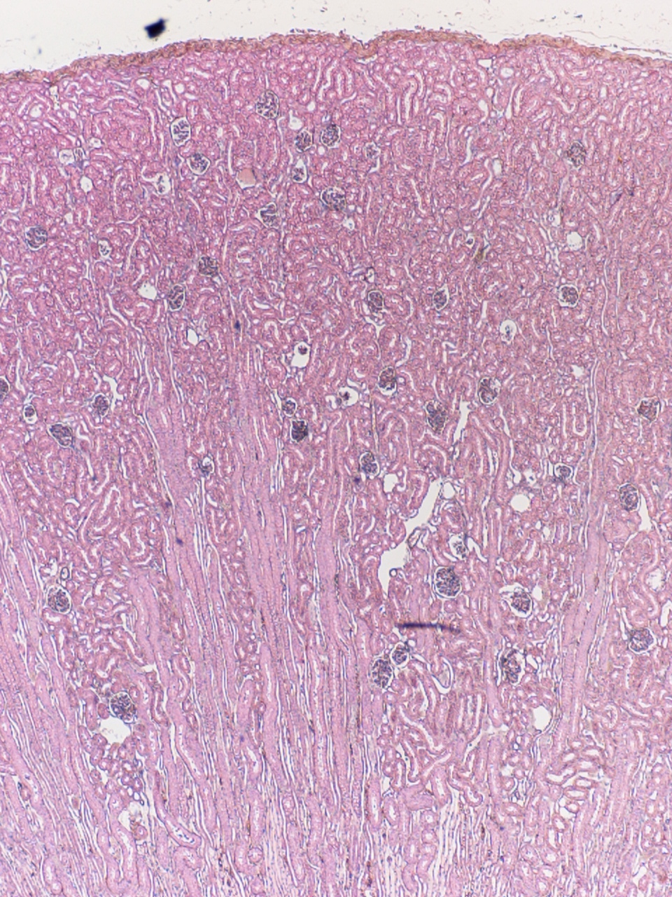
medulla
cortex

Slide 18
The human medulla, has 10-18
medullary pyramids.
The pyramid tips are called the renal
papillae and each is perforated by
10-25 orifices, the opening of the
collecting ducts. From the bases of
each medullary pyramid, parallel
medullary rays penetrate the cortex.
Each ray consists of one or more
collecting tubules together with the
straight portions of several nephrons.
Surrounding each medullary ray in
the cortical region are the renal
corpuscles and convoluted portions
of the nephron.

Slide 19
The Nephron
The Renal (Malpighian) Corpuscle
The renal tubule
The Bowman’s capsule
glomerulus
Proximal convoluted tubule
Distal convoluted tubule
Loops of Henle
Ascending limb
Descending limb

Slide 20
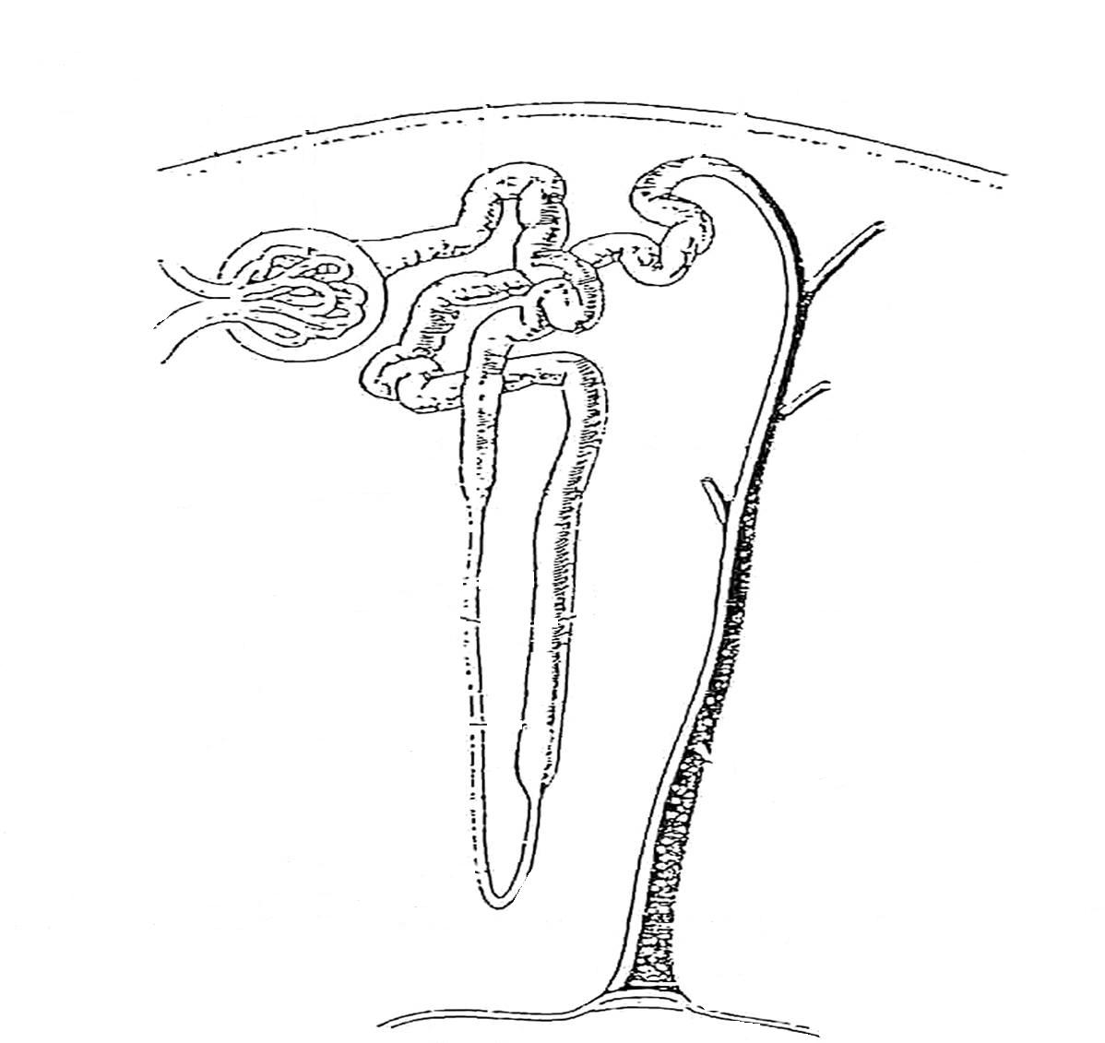
The Renal (Malpighian) Corpuscle
Proximal convoluted tubule
Distal convoluted tubule
Glomerulus
cortex
The Bowman’s capsule
Descending limb
Loop of Henle
medulla
Ascending limb
Collecting duct

Slide 21
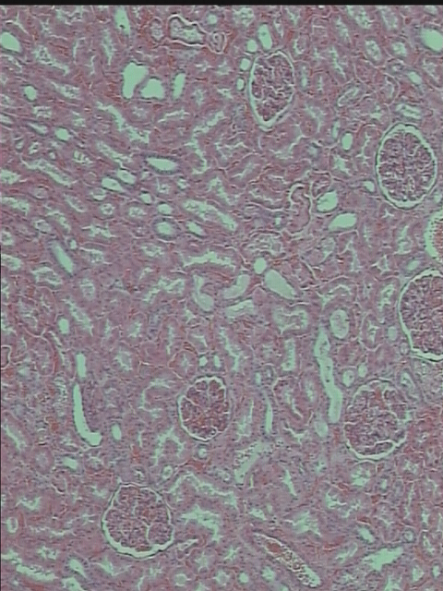
T.S. of The kidney Showing The Renal Corpuscle
The Renal Corpuscle
(Malpighian corpuscle)

Slide 22
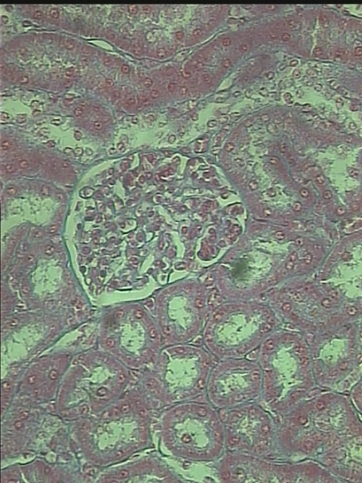
T.S. of The kidney Showing The Renal Corpuscle
The Renal Corpuscle
(Malpighian corpuscle)
Glomerulus
The Bowman’s capsule

Slide 23
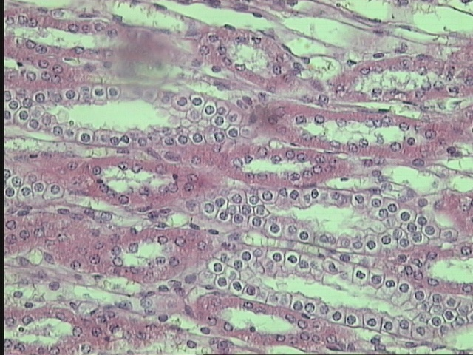
T.S. of The kidney Showing The collecting tubules
collecting tubules

Slide 24


