Slide 1
Preparation of Buffer Solutions by
Different laboratory Ways
BCH 312 [PRACTICAL]

Slide 2
Objective:
  -To learn how to prepare a buffer by different laboratory ways.

Slide 3
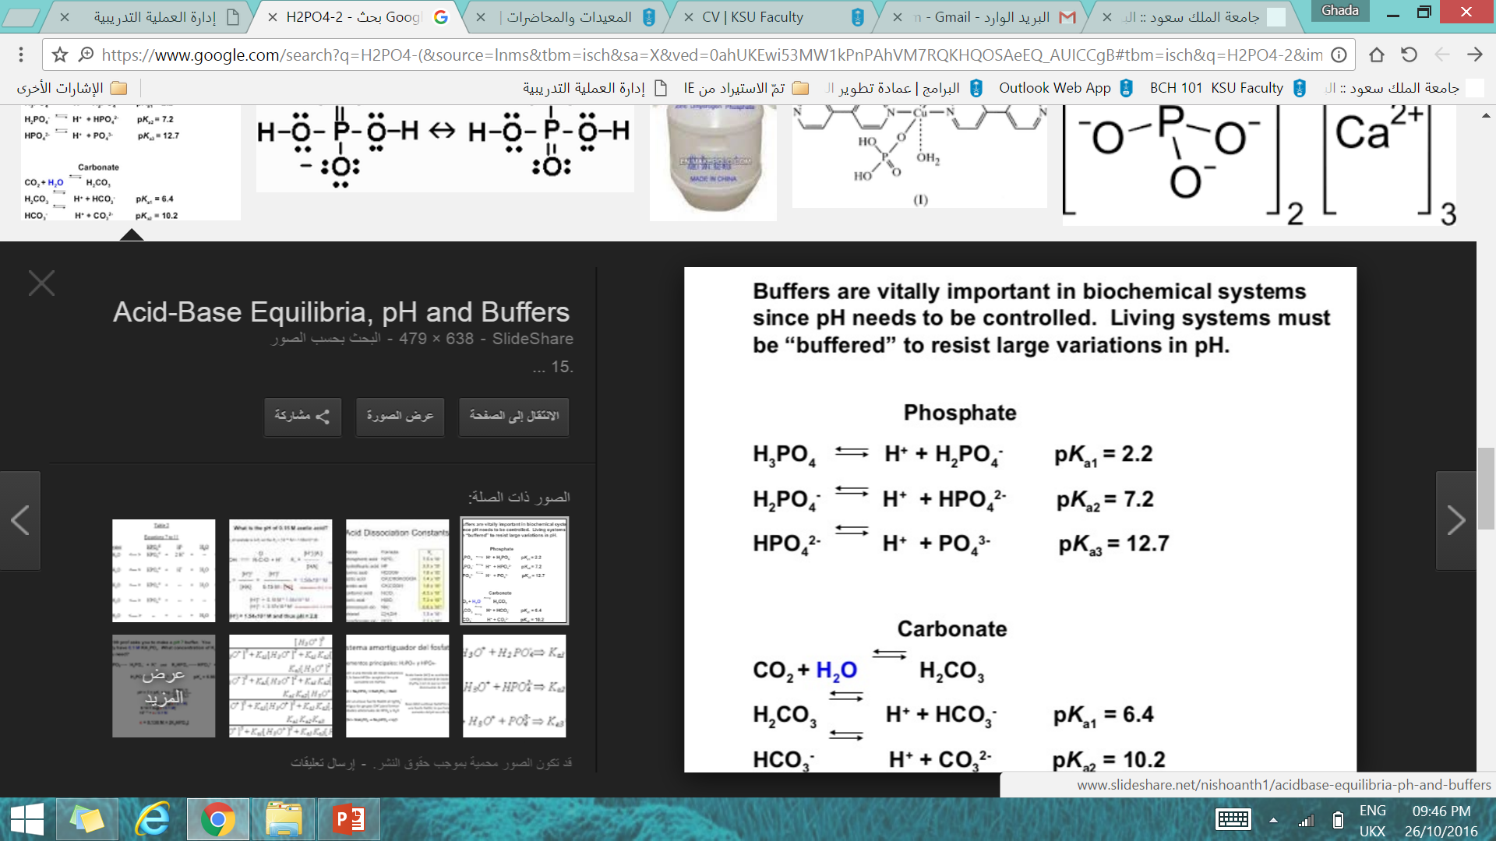
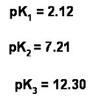
Dissociation of triprotic acid:
Triprotic acid is acid that contain three hydrogens ions.
It dissociates in solution in three steps, with three Ka values.
phosphoric acid is an example of triprotic acid .
It dissociates in solution as following:

Slide 4
The buffer can be prepared in any one of several ways:
For example if you was asked to prepare sodium phosphate buffer
[ e.g. NaH₂PO₄ / Na₂HPO₄ ]: you can by……..
By mixing NaH₂PO₄ (conjugate acid ) and Na₂HPO₄ (conjugate base) in the proper proportions.
By starting with NaH₃PO₄ and converting it to NaH₂PO₄ , plus Na₂HPO₄ by adding the proper amount of NaOH.
By starting with NaH₂PO₄ and converting a portion of it to Na₂HPO₄ by adding NaOH.
By starting with Na₂HPO₄ and converting a portion of it to NaH₂PO₄ by adding a strong acid such as HCl.
By starting with Na₃PO₄ and converting it to Na₂HPO₄ , plus NaH₂PO₄ by adding HCl.
By mixing Na₃PO₄ and NaH₂PO₄ in the proper proportions.

Slide 5
H₃PO₄
H₂PO₄⁻
HPO₄²⁻
PO₄³⁻
HCl
‘donate H⁺’
NaOH
‘accept H⁺’

Slide 6
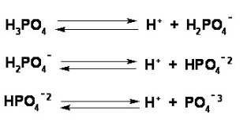
Example:
Prepare 0.1 liters of 0.045 M sodium phosphate buffer, pH=7.5
[pka₁= 2.12, pka₂ = 7.21 and pka₃ = 12.30]
a) From concentrated (15M) NaH₃PO₄ and solution of 1.5 M NaOH .
b) From solid NaH₂PO₄ and solid NaOH.
1st , write the equations of Dissociation of phosphoric acid and the pka of corresponding ones:
Because phosphoric acid [H₃PO₄] has (Triprotenation : it has 3 dissociation phases) so,

Slide 7
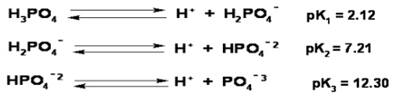
2nd , choose the pka value which is near the pH value of the required buffer, to be able to know the ionic species involved in your buffer:
The pH of the required buffer [pH =7.5] is near the value of pka₂
Consequently , the two major ionic species present are H₂Po₄⁻( conjugate acid ) and HPO₄⁻² (conjugate base ). with the HPO₄⁻² predominating { since the pH of the buffer is slightly basic }

Slide 8
Since the buffer concentration is 0.045M, so assume [A⁻] = y , [HA]= 0.045 – y
  3rd , calculate No. of moles for the two ionic species in the buffer :
  PH =PKa₂ + log [ HPO₄⁻² ] / [H₂PO₄⁻]
  Assume [A⁻] = y , [HA]= 0.045 - y
  7.5 = 7.2 + log ( y / 0.045-y )
  7.5-7.2 = log ( y / 0.045-y )
  0.3= log( y / 0.045-y ) → antilog for both sides:
  2=( y / 0.045-y)
  y= 0.09 - 2 y → 3 y = 0.09
  y= 0.9/3 = 0.03 M →conc. of [ HPO₄⁻² ] = [A⁻] = y
  So, conc. of [H₂PO₄⁻] =[HA] = 0.045 – y = 0.045- 0.03 = 0.015 M
  - No. of moles of = HPO₄⁻² (A⁻ ) = M x V = 0.03 x 0.1 = 0.003 moles.
  - No. of moles of H₂PO₄⁻ (HA)= M x V = 0.015 x 0.1 = 0.0015 moles.
Note that :
[A⁻] = HPO₄⁻²
[HA] = H₂PO₄⁻

Slide 9
  [Note that Total no. of moles of phosphate buffer= M x V= 0.045 x 0.1 = 0.0045 moles].
[Regardless of which method is used , the first step involves calculating number of moles and amounts of the two ionic species in the buffer].
Note: 1- H₂PO₄⁻ ( HA) = (NaH₂PO₄).
2- HPO₄ ⁻² (A⁻) = (Na₂HPO₄).

Slide 10
Now, to prepare the required buffer:
a) From concentrated (15M) NaH₃PO₄ and solution of 1.5 M NaOH .
Calculations:
Start with 0.0045 mole of H₃PO₄ and add 0.0045 moles of NaOH to convert H₃PO₄ completely to H₂PO₄⁻ (HA) (NaH₂PO₄),then add 0.003 moles of NaOH to convert H₂PO₄⁻ to give HPO₄ ⁻² (A⁻):
No. of moles needed of NaOH= 0.0045+0.003= 0.0075 moles
Volume of NaOH needed= no.of moles / M = 0.0075/ 1.5 = 0.005 L = 5 ml
Volume of H₃PO₄ needed =no.of moles / M = 0.0045/ 15 =0.0003 L = 0.3 ml
→ Add 5ml of NaOH to the 0.3 ml of concentrate H₃PO₄, mix ; then add sufficient water to bring the final volume to 0.1 liters (100 ml), and check the pH
Remember that the two ionic species involved in the buffer are:

Slide 11
prepare the required buffer,
a) From concentrated (15M) NaH₃PO₄ and solution of 1.5 M NaOH . CONT,
0.0045 moles
H₃PO ₄
NaOH
H₂PO ₄⁻
0.0045 moles
0.0045 moles
NaOH
HPO ₄ ²⁻
H₂PO ₄⁻
0.003 moles
0.003 moles
0.0015 moles

Slide 12
Remember that the two ionic species involved in the buffer are:
Now, to prepare the required buffer:
b) From solid NaH₂PO₄ and solid NaOH.
Calculations
Start with 0.0045 mole of NaH₂PO₄ (HA) and add 0.003 moles of NaOH to convert NaH₂PO₄ to give Na₂HPO₄ (A⁻):
- Weight in grams of NaH₂PO₄ needed = no. of moles x mwt =0.0045 x 119.98 = 0.54 g
Weight in grams of NaOH needed = no. of moles x mwt = 0.003 x 40 =0.12 g
So, Dissolve the 0.548g of NaH ₂ PO ₄ and 0.12g of NaOH in some water, mix ; then add
sufficient water to bring the final volume to 0.1 liters (100 ml), and check the pH.
Note
Conc.=concentration

Slide 13
prepare the required buffer,
b) From solid NaH₂PO₄ and solid NaOH. CONT,
0.0045 moles
H₂PO ₄⁻
NaOH
HPO ₄ ²⁻
H₂PO ₄⁻
0.003 moles
0.003 moles
0.0015 moles

Slide 14
As in the lab sheet,
Prepare 0.1 liters of 0.045 M sodium phosphate buffer, pH=7.5,
[pKa1= 2.12, pKa2 = 7.21 and pKa3 = 12.30]:
a) From concentrated (15M) H₃PO₄ and solution of 1.5 M NaOH :
Add 5ml of NaOH to the 0.3 ml of concentrate H₃PO₄, mix ; then add sufficient water to bring the final volume to 0.1 liters (100 ml), and check the pH.
b) From solid NaH₂PO₄ and solid NaOH :
Dissolve the 0.548g of NaH ₂PO ₄ and 0.12g of NaOH in some water, mix ; then add sufficient water to bring the final volume to 0.1 liters (100 ml), and check the pH.

Slide 15
Homework:
Prepare 0.1 liters of 0.045 M sodium phosphate buffer, pH=7.5,
[pka1= 2.12, pka2 = 7.21 and pka3 = 12.30]:
c) You are provided with solid Na₂HPO₄ and 2M HCl.
d) You are provided with solid Na₃PO₄ and 2 M HCl .

