Slide 1
Soil
Lecture 4

Slide 2
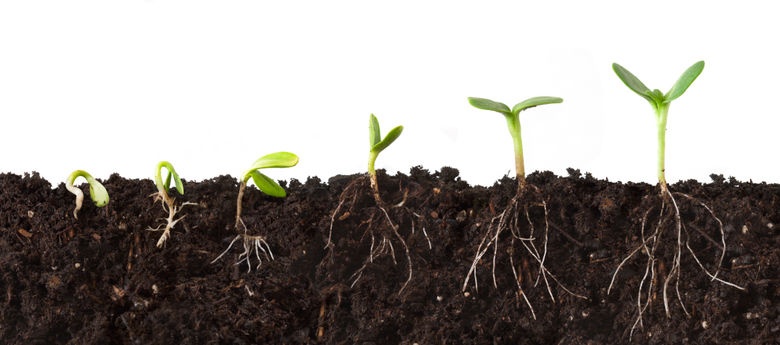
Objectives
Define soil
Define soil contamination
Identify sources of soil contamination
Identify health implications of soil contamination

Slide 3
Introduction
Life under your feet !
What is soil?
It is the outermost layer of the earth’s crust.
~1/3 of earth’s surface is covered by land.
Only 10% of earth’s land is fit for agriculture.
95% of our food comes from the land.
A biologically active mixture of inorganic and organic materials, living organisms, air and water.

Slide 4
Components of Soil
Components | Contents/functions
Organic matter (5%) | Humus – left over dark brown matter, rich in minerals such as nitrogen, that remains after all the organic matter (plant and animal) has decomposed. Provides nutrients to the soil, and helps to hold and drain water, and aerate the soil.
Minerals (45%) | Found in inorganic materials in sand, silt and clay – provides nutrients and texture.
Air (20-30%) | Plant and microorganisms health/respiration – biological processes by which microorganisms release additional nutrients into the soil. In relation to the size of soil particles – important to water drainage.
Water (20-30%) | Essential for living organisms and their biological processes – carries nutrients to plants.
Living organisms | Found on and in the soil – aerate, mix and add nutrients.

Slide 5
Soil forming factors
Climate (rain, wind, sunlight).
The material they are made of.
The organisms that live in it (including human activity).
The topography of the terrain (mountains, valleys).
Time.
The components of the soil constantly change.
Minerals, water, air, organic matter, and living organisms.
ISRIC. World Soil Information. http://www.isric.org/about-soils

Slide 6
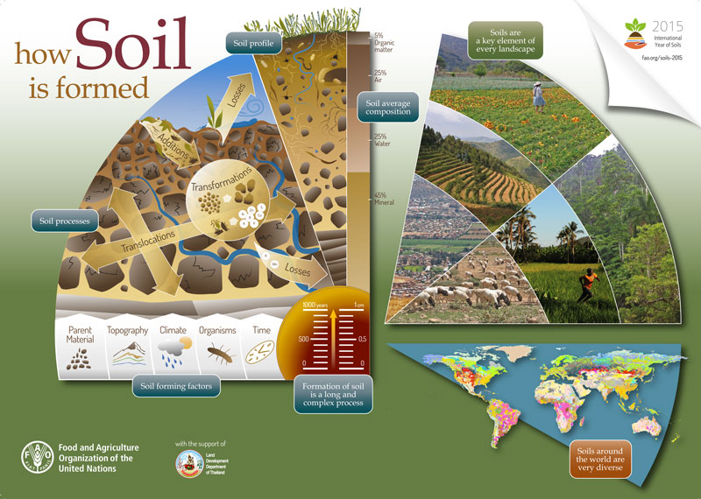
http://www.fao.org/globalsoilpartnership/news-events-archive/news/detail/en/c/284443/

Slide 7
Soil functions
The major functions of a healthy soil include:
1. Sustaining biological activity, diversity, and productivity.
2. Regulating the flow of water and dissolved nutrients.
3. Storing and cycling nutrients and other elements.
4. Supporting plant growth, protecting air and water quality, and ensuring human and animal health.
5. Filtering, buffering, degrading, immobilizing and detoxifying organic and inorganic materials that are potential pollutants.
The physical structure, chemical make-up, and biological components of the soil together determine how well a soil performs these services.

Slide 8
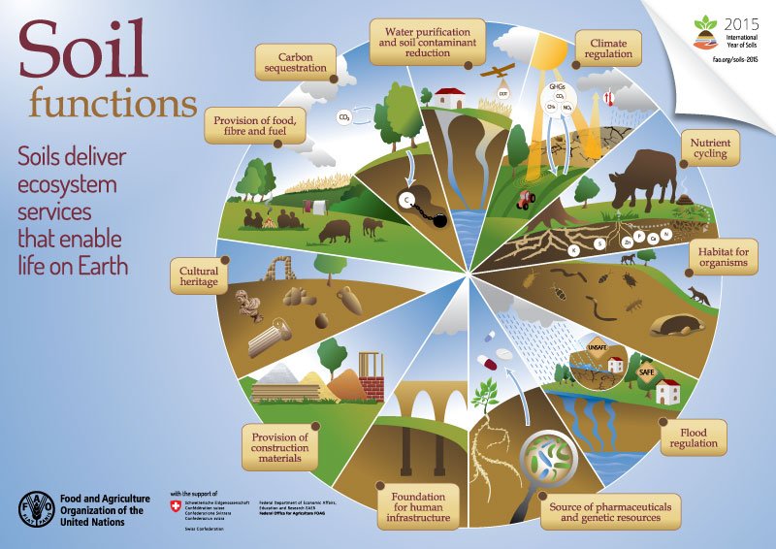
http://www.fao.org/globalsoilpartnership/news-events-archive/news/detail/en/c/284443/

Slide 9
What is soil pollution?
Definition:
The presence of substances that alter the natural soil environment and damage living organisms.
Natural or man-made.
Pollutants in the soil can
Reach the ground water.
Pass down to plants or animals.
Bind tightly to the soil.
Soil pollution can lead to soil deterioration and loss of function.
Pollutants type and amount.
Pollutants have to be “bioavailable” to cause harm to the following:
Cells
Organs
Organisms
Ecosystems
http://esdac.jrc.ec.europa.eu/themes/soil-contamination

Slide 10
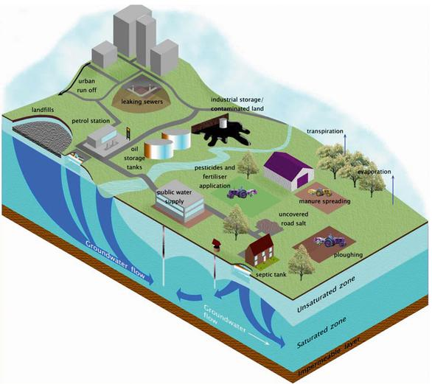
Categories/Types of soil pollutants
Chemical
Insecticides, herbicides, pesticides, antibiotics, fuel spills, petroleum, solvents, heavy metals, radioactive compounds.
Biological
Bacteria, viruses, fungi, protozoa, toxins.
Physical
Solid waste, sewage sludge.

Slide 11
Chemical pollutants
Organic
Inorganic
Fuel hydrocarbons
Polycyclic aromatic hydrocarbons(PAHs)
Polychlorinated biphenyls (PCBs), chlorinated aromatic compounds
Detergents
Pesticides, herbicides
Nitrates
Phosphates
Heavy metals – lead, cadmium, chromium, arsenic.
Inorganic acids
Radioactive materials

Slide 12
Common causes of soil pollution
1. Petrochemicals
Leaking underground storage tanks.
Fuel leakages and spills.
2. Emissions from fossil fuel combustion
Particulate matter
SO_{2 ,} NO_{x}, acid rain
Dry and wet deposition.
3. Agricultural waste
Fertilizers, pesticides and herbicides, antibiotics.
Crop and animal waste.

Slide 13
Common causes of soil pollution
4. Salinization
Improper irrigation, land clearing, fertilizer use, climate, topography.
5. Radioactive fallout
6. Industrial waste.
Chemicals, VOCs, persistent organic pollutants (POPs), heavy metals, radioactive waste.
7. Inadequate urban waste disposal.
Leaching of waste from landfills.
Direct dumping of urban waste.
Sanitary sewage.
Sewage treatment sludge.

Slide 14
Fate of soil pollutants
Changes in chemical structure of pollutants can change their bioavailability to living organisms or how they move within the soil.
Solubilized into water in the soil.
Leaching through the soil into underground water.
Volatilize.
Bind tightly to the soil.
Chemical compounds may degrade or be transformed into compounds of different toxicity.
Soil characteristics that may affect the behavior of pollutants
Soil texture, mineral content, pH, organic matter content, moisture level, temperature, other chemicals, type of living organisms.

Slide 15
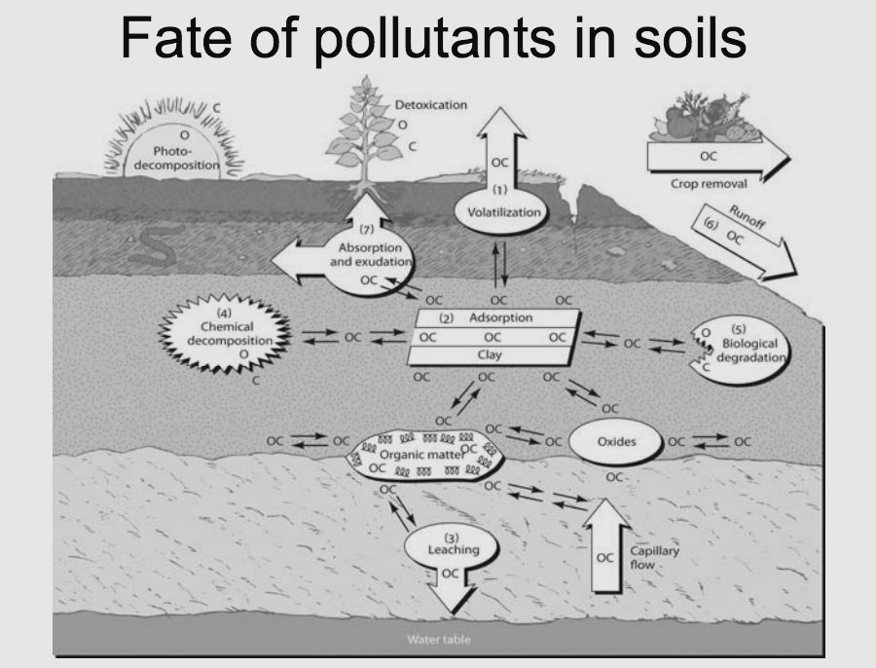

Slide 16
Effects/consequences of soil pollution
Increased salinity.
Reduced soil fertility.
Increased erosion.
Deforestation.
Contamination of vegetation.
Loss of natural nutrients.
Underground and surface water contamination.
Damage natural balance of organisms living in it.
Air contamination.
Release of toxic gases.
Create toxic dust.
Spread of diseases.
Microbes, pests.

Slide 17
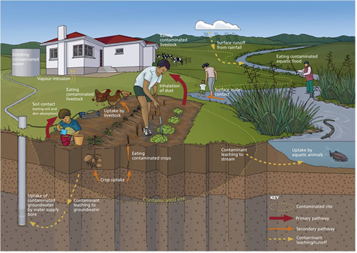
Pathways of exposure to soil pollutants
What is contaminated land? http://www.mfe.govt.nz/land/risks-contaminated-land/about-contaminated-land-new-zealand/what-contaminated-land

Slide 18
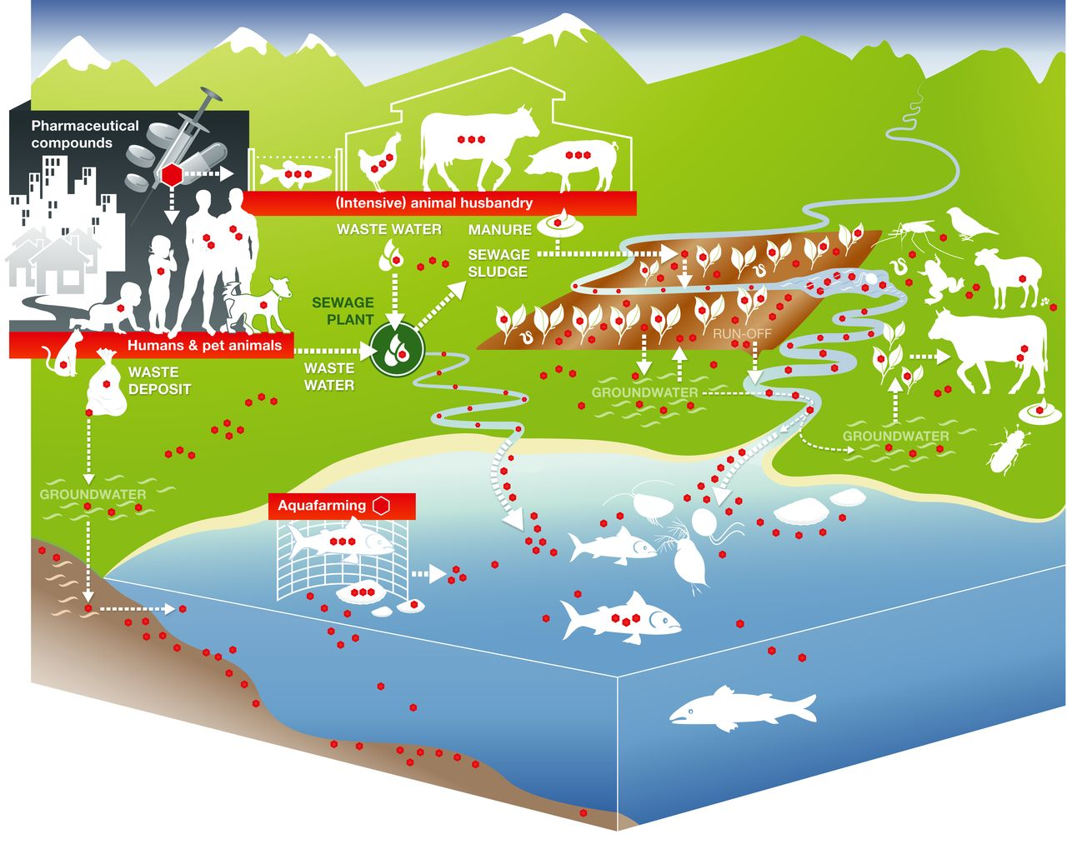
Antibiotic use and environmental contamination

Slide 19
Consequences of soil pollution
Microorganisms
Nutrient pollution, heavy metal contamination and acid rain alter the natural microbial composition of the soil.
Acid rain and heavy metals decrease bacteria and increase fungi in soil.
Microorganisms that metabolize nitrogen are sensitive to the presence of pesticides.

Slide 20
Consequences of soil pollution
Humans
Health effects
Agricultural chemicals
Cancer and reproductive problems.
Heavy metals
Neurological and developmental problems in children, kidney damage and liver toxicity.
Industrial toxins
Birth defects, nervous system disorders, kidney and liver diseases, leukemia.
Exposure and uptake absorption (skin), inhalation (nose/mouth) or ingestion (mouth).
Soil/dust particles, water or food (animals or plants).
https://www.env.go.jp/en/water/soil/contami_cm.pdf

Slide 21
Control of soil pollution
Reduction in the use of pesticides, herbicides and fertilizers.
Reusing and recycling to reduce solid waste.
Reforestation.
Adequate waste treatment and disposal.
Industrial waste
Landfills
Buried waste
Chemical and physical separation of the pollutants.
Using heat to remove chemicals or to destroy pathogens.
Bioremediation
Using living organisms to destroy, transform, or immobilize pollutants.
Microorganisms (bacteria, fungi), plants, earthworms (arthropods).
Soil Contamination, Risk Assessment and Remediation Muhammad Aqeel Ashraf, Mohd. Jamil Maah and Ismail Yusoff http://cdn.intechopen.com/pdfs-wm/46032.pdf

Slide 22
References
Roosk, J., Brookes,P.C. and Baath, E. Contrasting Soil pH Effects on Fungal and Bacterial Growth Suggest Functional Redundancy in Carbon Mineralization. Appl Environ Microbiol. 2009 Mar; 75(6): 1589–1596. doi: 10.1128/AEM.02775-08
USDA.NRCS. Soil Health. http://www.nrcs.usda.gov/wps/portal/nrcs/detailfull/soils/health/biology/?cid=nrcs142p2_053868 Accessed on 02/12/2016
United Nations Environment Programme Division of Technology, Industry and Economics. Phytoremediation: An Environmentally Sound Technology for Pollution Prevention, Control and Remediation. Newsletter and Technical Publications. Freshwater Management Series No. 2. An Introductory Guide To Decision-Makers.
http://www.unep.or.jp/Ietc/Publications/Freshwater/FMS2/2.asp Chong, S. et al. How do soils breathe? http://www.invisiblestructures.com/white_papers/sand/Breathe.pdf
PennState Extension. Earthworms. http://extension.psu.edu/plants/crops/soil-management/soil-quality/earthworms

