Slide 1
parasites
Sahar alhogail

Slide 2
Parasites: An organism living on or in another organism called host that provides it with protection and nourishment.
Host: the animal that harbors a parasites.
Type of parasites:
Obligate parasites : those parasites that cannot exists with out a host.eg: malaria
Facultative parasites: are those parasites that can exist in soil and water independently of their host and when the environmental condition are unsuitable , they parasite the host .
Accidental parasites : are these parasites which enter accidently and can live in a host differ from their normal one.

Slide 3
Parasites can also be divided into:
Endoparasites which lives inside the host.
Ectoparasites : which found attached to the skin of the host.
There are two type of host :
definitive host :
The host in which the parasites achieves its sexual maturity, to the adult stage.
Intermediate host :
The host in which the immature or larva stage of parasites is found.

Slide 4
Vector: Is a host that transmits parasites from one host to another.
Parasitism: is an obligatory relationship in which one organism , the parasite is metabolically dependent on another organism, the host may be harmed by such a relationship.

Slide 5
Symbiosis:.
This is the close association of two organisms, so
That one cannot live without the help of the other. Each one of them called symbiont.
Zoonosis: is the term given to a disease of animals which are transmitted to man.

Slide 6
Mode of transmission :
Ingestion
Active penetration
Arthropod-borne.
Congenital by crossing the placenta.
Blood transfusion.

Slide 7
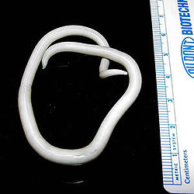
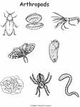
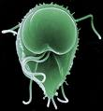
Medically parasite
protozoa
Helminthes
Arthropods

Slide 8
Protozoes
It is single cells cannot see by naked eye.
Live as free state or as parasites.
The protozoa are classified taxonomically by their mode of locomotion into 4 category:
Sarcodina (amebas):
E by extending cytoplasmic projection (pseudopodia) several pseudopodia.
Mastigophora (flagellates):
Move by flagella it ingest food by cytosome.(oral groove)

Slide 9
3.Ciliata (ciliated):
Move by cilia, ingest food by cytosomes.
The only pathogenic for human balantidim coli
Cause balantidiasis disease & it is rare.
4. Sporozoa:
It is obligate intracelllar parasites.
Have non motile adult.

Slide 10
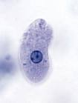
Intestinal disease:
Entamoeba histolytica cause amebic dysentery the pathogenic trophozites secrete lytic enzyme cause necrosis in the epithelial layer of the large intestine it may invase the peritonial layer peritonitis, appendex appendicitis , liver cause liver abscess
May or may not produce manifestation
Abdominal pain passage of blood and mucus in stool.
cause enteritis the pathogenic trophozoites secre

Slide 11
Diagnosis: stool examination for the cyst and trophozoite
Serology test
Mode of transformation:
Polluted water supply
Imperfectly washed raw vegetable.
Contaminated hand by feces usually in cyst passes who are handlers food
contaminated with vomits or excreta of flies which feed on feces.
Using human excreta as fertilizers.

Slide 12
Genus and Species Entamoeba histolytica
Infective stage Tetranucleated cyst (having 4 nuclei) Definitive Host Human
Portal of Entry Mouth
Mode of Transmission Ingestion of mature cyst through contaminated food or water
Habitat Colon and Cecum
Pathogenic Stage Trophozoite
Locomotive apparatus Pseudopodia (“False Foot”) Motility Active, Progressive and Directional Nucleus 'Ring and dot' appearance: peripheral chromatin and central karyosome
Mode of Reproduction Binary Fission
Pathogenesis Lytic necrosis (it looks like “flask-shaped” holes in Gastrointestinal tract sections (GIT)

Slide 13
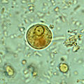

Slide 14

B.Giardia lamblia:
Common in tropical countries
It commonly occur in children
It exist in two form :
cyst trophozoite

Slide 15
Hosts
Giardia infects humans, but is also one of the most common parasites infecting cats, dogs and birds. Mammalian hosts also include cattle, and sheep.
Life cycle
The life cycle begins with a noninfective cyst being excreted with the faeces of an infected individual. The cyst is hardy, providing protection from various degrees of heat and cold, desiccation, and infection from other organisms. A distinguishing characteristic of the cyst is four nuclei and a retracted cytoplasm. Once ingested by a host, the trophozoite emerges to an active state of feeding and motility. After the feeding stage, the trophozoite undergoes asexual replication through longitudinal binary fission. The resulting trophozoites and cysts then pass through the digestive system in the faeces. While the trophozoites may be found in the faeces, only the cysts are capable of surviving outside of the host.

Slide 16
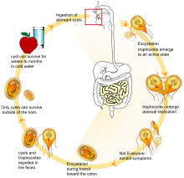

Slide 17
It cause gastroentritis it infect cyst form trophozoite , in the small intestine
cyst that pass through the stool.
Mode of infection:
Contaminated food or drink
By house flies.
Autoinfection.
It cause diarrhea abdominal pain malabsorption.

Slide 18
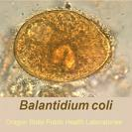
C. balantidium coli( ciliated)
From the genus Balantidium, Balantidium coli is a large ciliated protozoan parasite. Balantidium coli has been known about for over a century, but the process of infection has yet to be discovered. It is the only known ciliated parasite to infect humans. It is responsible for the disease Balantidiasis. Balantidium coli is found world wide but predominately found in the areas where pigs are raised. Humans are usually infected when they ingest contaminated water and food. Fecal to oral transmission is most common. Balantidium coli occur as a trophozoite and a cyst in the colon. The prevalence of this infection is only 1% and have been noted in Latin America, Bolivia, Southeast Asia, the Philippines and New Guinea. The prevalence of Balantidium coli in pigs is reported to be from about 20% to 100%

Slide 19
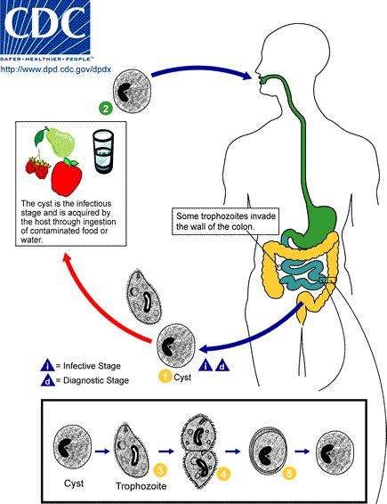

Slide 20
2- Urogenital protozoa
Trichomonas vaginalis is an anaerobic,
flagellated protozoan, a form of microorganism. The parasitic microorganism is the causative agent of trichomoniasis, and is the most common pathogenic protozoan infection of humans in industrialized countries. Infection rates between men and women are the same with women showing symptoms while infections in men are usually asymptomatic. Transmission takes place directly because the trophozoite does not have a cyst. The WHO has estimated that 160 million cases of infection are acquired annually worldwide

Slide 21
Trichomonas vaginalis :
It effect the vagina in female and the urethras in male it cause vaginal discharge and vaginal pruritis.
Transmitted by :
sexual intercourse ( More than 160 million people worldwide are annually infected by this protozoan)
contaminated underwear

Slide 22
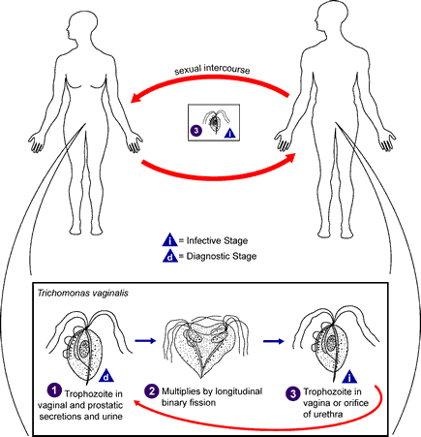
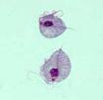
Trichomonas vaginalis

Slide 23
Blood and tissue :
Leshmania:
It effect the body in two way: localized in (cutanouse tissue) or systematic visceral leishmaniasis that can effect different parts of the body mainly liver and spleen
It has two host :
vertebrate host man dog rodents
Invertebrate host snadflies

Slide 24
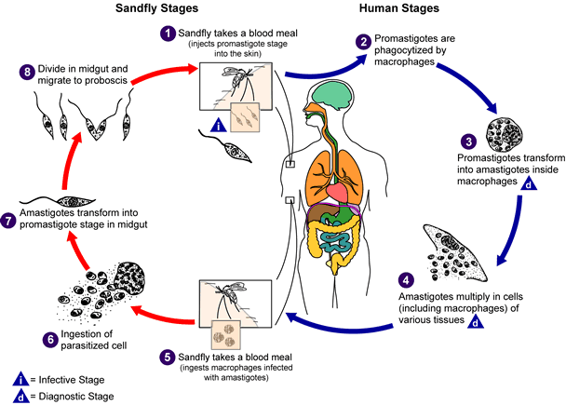
Leshmania life cycle

Slide 25
Malaria :
it is caused by plasmodium spp.
It require two hosts man as intermediate host (asexual )
Anaphlise mosquitoes definitive host sexual stage.

Slide 26
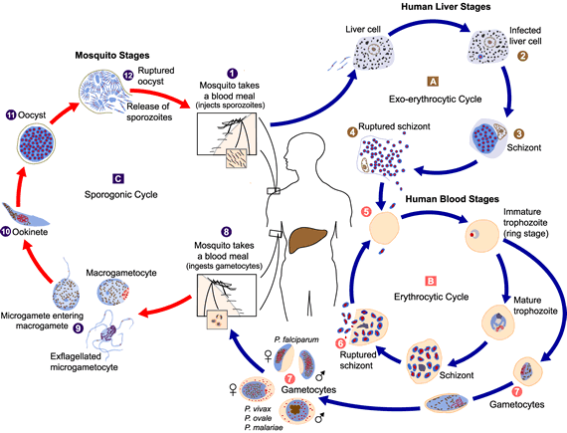
Malaria life cycle

Slide 27

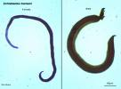
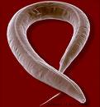
Helminthes:
Nematod cestode trematodes
Round warm tapewarm fluks

Slide 28
Cestode
It is ribbon like segmented worm >
Do not have digestive system
It absorbed soluble material by cuticle
It has hooks and suckers scolex of the worm help to attach the worm to the inner layer of the intestine.
It has body strobild that have many segments called (proglottids).
Each proglottids have sexual organs both male and female that produce the fertilized eggs. It located at the posterior part of the organisms.
Break of the chain
Stool
Example: tenia solium

Slide 29
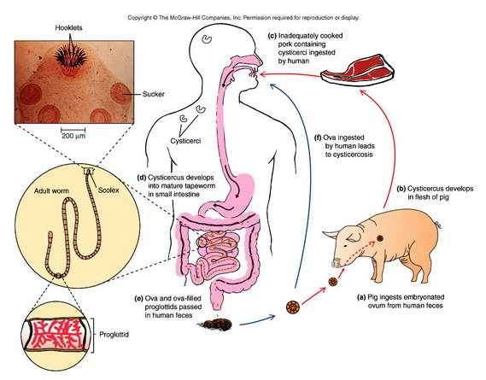

Slide 30
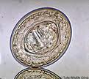
Tenia soluim

Slide 31
Trematodes
It called flukes
Small in size about 1 cm
Infect various organs of human hosts example intestinal veins , urinary bladder, liver and lung.
All the trematodes use fresh water snails as an intermediate host.

Slide 32
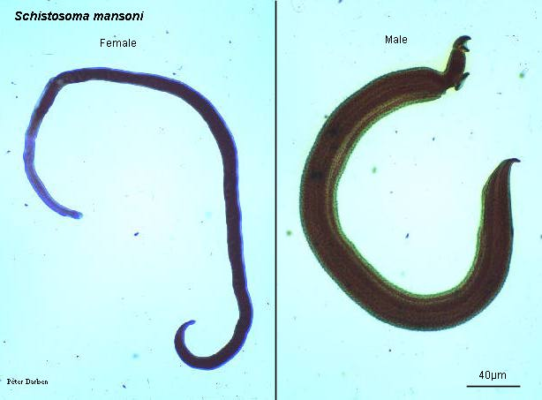
trematodes

Slide 33
Sexual fluckes
Schistosoma cause parasitic disease called schistosomiasis
Although it has a low mortality rate, schistosomiasis often is a chronic illness that can damage internal organs and, in children, impair growth and cognitive development.^{[1]} The urinary form of schistosomiasis is associated with increased risks for bladder cancer in adults. Schistosomiasis is the second most socioeconomically devastating parasitic disease after malaria.

Slide 34
Bilharzia (Schistosomiasis)
Disease of the venous system, acquired by people when they come in contact with contaminated water
Adult Schistosomes take up residence in various abdominal veins, depending on the species; they are, therefore called (Blood Flukes)
Very common among children
Transmission: Direct skin penetration
Fresh water becomes contaminated by Schistosoma eggs when infected people urinate or defecate in the water. The eggs hatch and the parasites grow and develop inside snails.
types of Schistosomiasis:
intestinal Schistosomiasis
Urinary tract Schistosomiasis

Slide 35
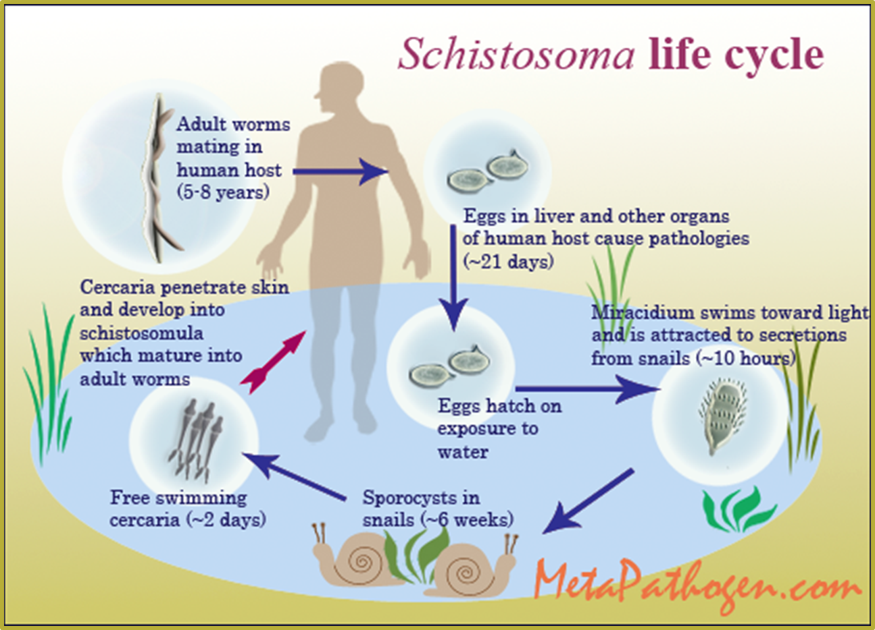

Slide 36



Slide 37
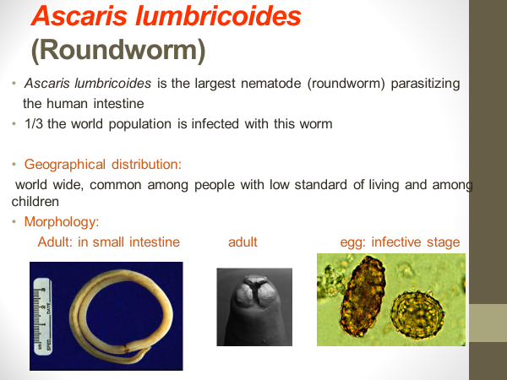

Slide 38
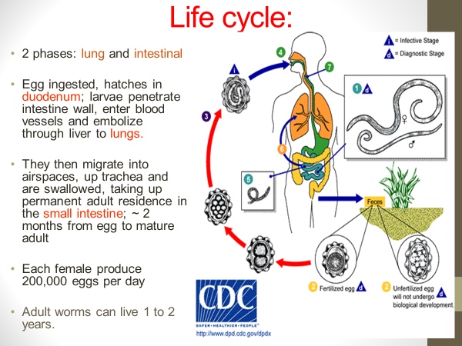

Slide 39
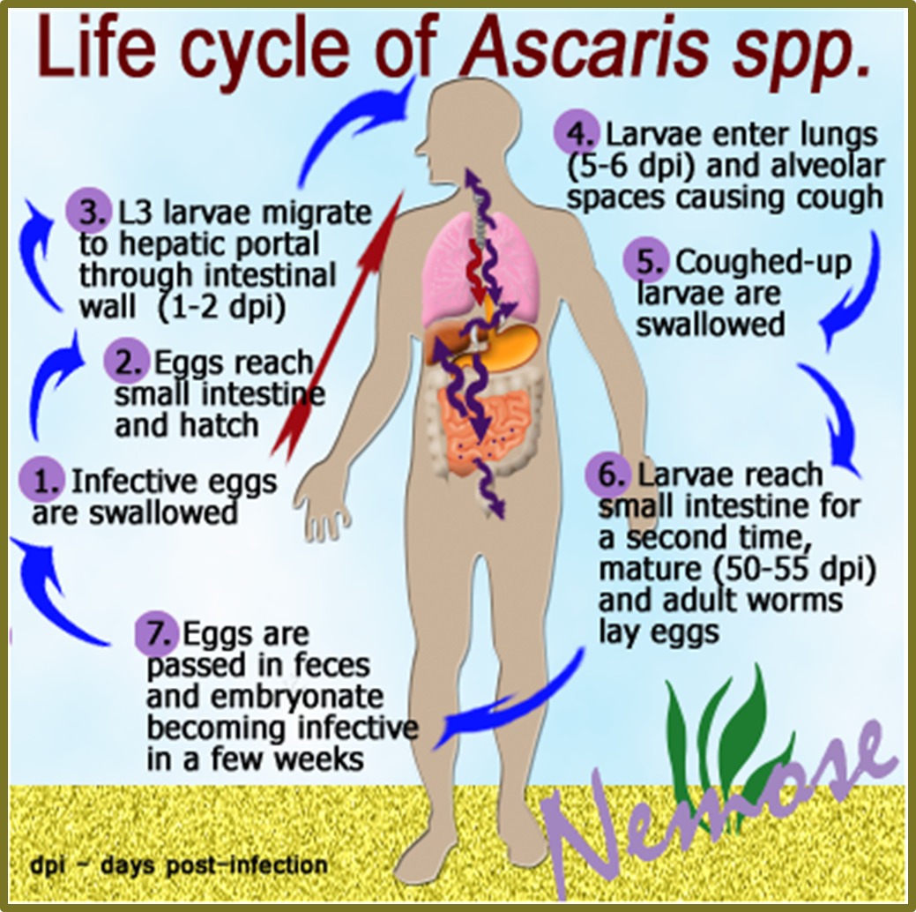

Slide 40
