Slide 1
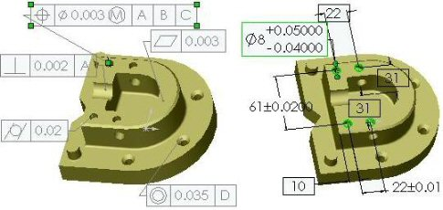
Geometric Tolerances & Dimensioning
MANUFACTURING PROCESSES - 2, IE-352
Ahmed M. El-Sherbeeny, PhD
KING SAUD UNIVERSITY
Spring - 2014

Slide 2
Content
Overview
Form tolerances
Orientation tolerances
Location tolerances
Wrapping up

Slide 3
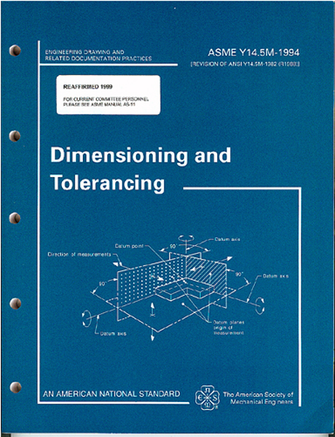
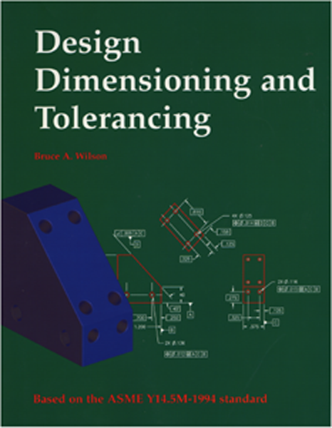
ANSI Y14.5-1994 Standard
This standard establishes uniform practices for defining and interpreting dimensions, and tolerances, and related requirements for use on engineering drawings.
The figures in this presentation
are taken from Bruce Wilson’s
Design Dimensioning and Tolerancing.

Slide 4
Geometric Tolerancing
What is Geometric tolerancing used for?
Geometric Tolerancing is used to specify the shape of features. Things like:
Straightness
Flatness
Circularity
Cylindricity
Angularity
Profiles
Perpendicularity
Parallelism
Concentricity
And More...

Slide 5
Overview of Geometric Tolerances
Geometric tolerances define the shape of a feature as opposed to its size.
We will focus on three basic types of geometric tolerances:
Form tolerances: straightness, circularity, flatness, cylindricity;
Orientation tolerances; perpendicularity, parallelism, angularity;
Location tolerances: position, symmetry, concentricity.

Slide 6
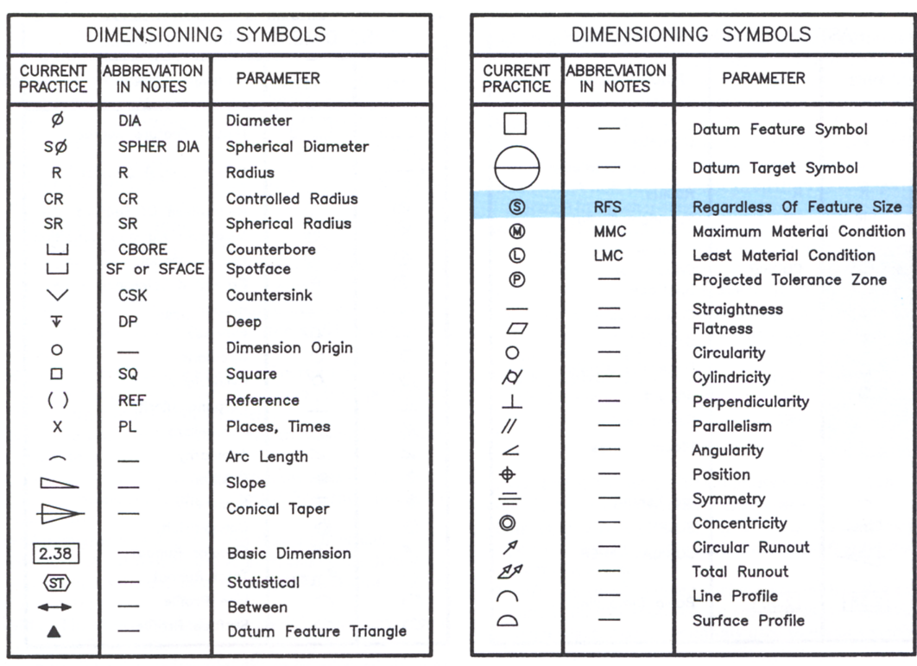
Symbols for Geometric Tolerances
Form
Orientation
Location

Slide 7
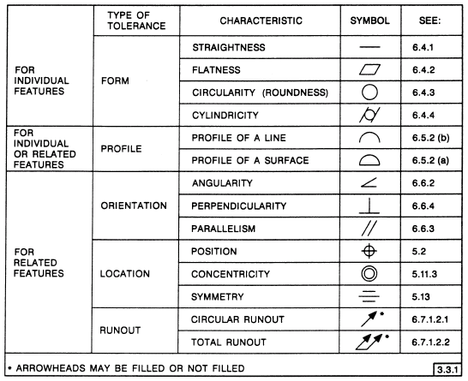
Most Common Symbols

Slide 8
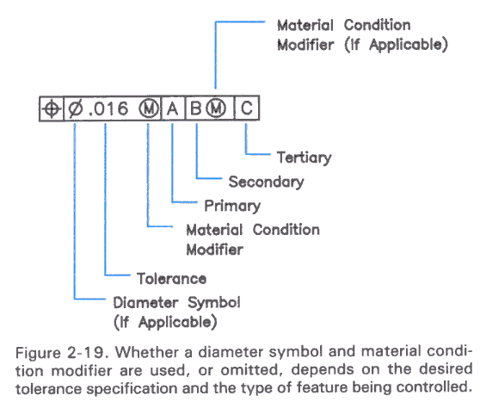
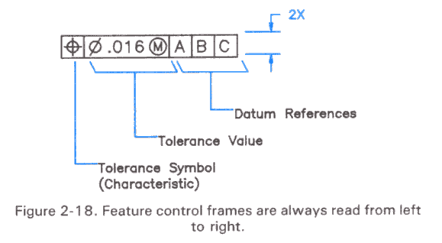
Feature Control Frame
A geometric tolerance is prescribed using a feature control frame.
It has three components:
1. the tolerance symbol,
2. the tolerance value,
3. the datum labels for the reference frame.

Slide 9
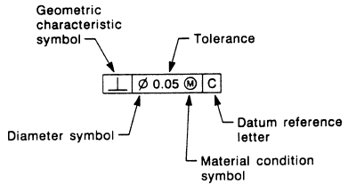
Feature Control Frame
How do you read this feature control frame?
“The specified feature must lie perpendicular within a tolerance zone of 0.05 diameter at the maximum material condition, with respect to datum axis C.”
In other words, this places a limit on the amount of variation in perpendicularity between the feature axis and the datum axis. In a drawing, this feature control frame would accompany dimensional tolerances that control the feature size and position.

Slide 10
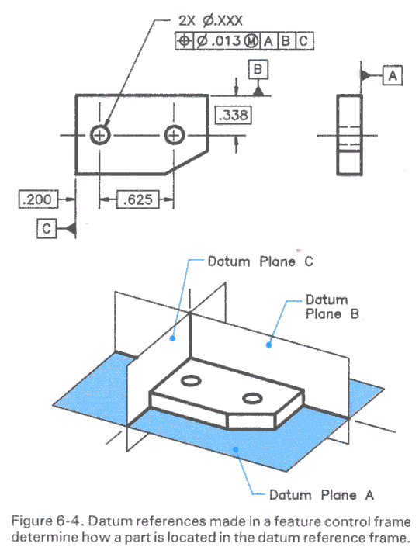
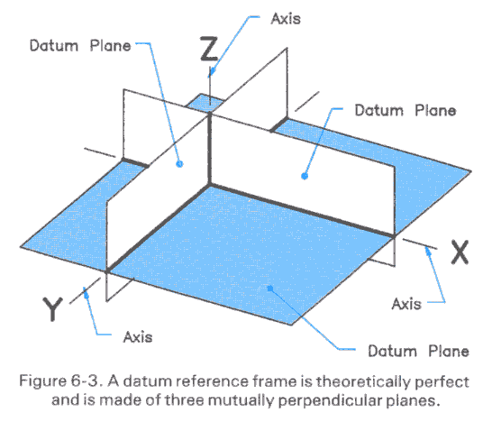
Reference Frame
A reference frame is defined by three perpendicular datum planes.
The left-to-right sequence of datum planes defines their order of precedence.

Slide 11
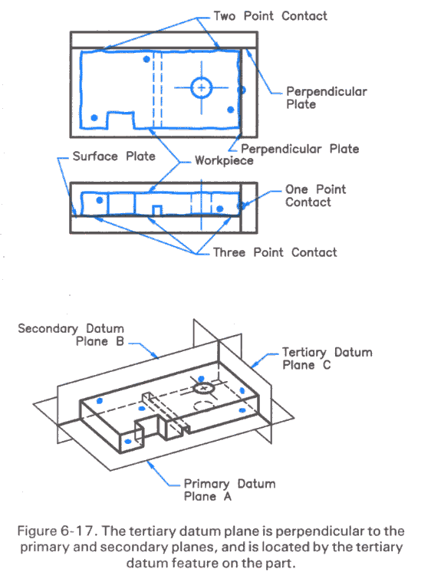
Order of Precedence
The part is aligned with the datum planes of a reference frame using 3-2-1 contact alignment.
3 points of contact align the part to the primary datum plane;
2 points of contact align the part to the secondary datum plane;
1 point of contact aligns the part with the tertiary datum plane

Slide 12
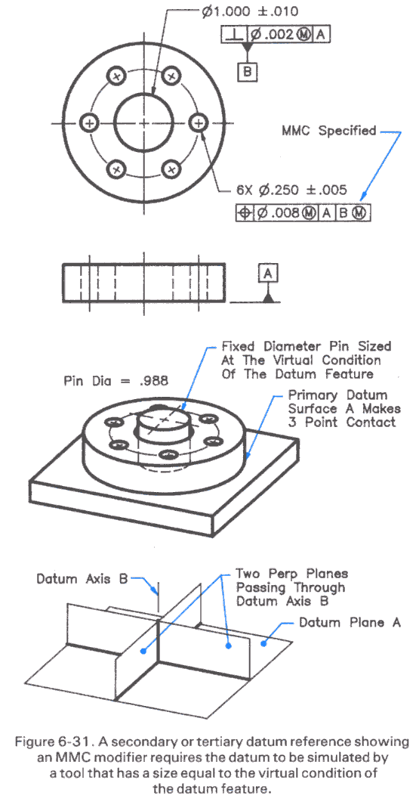
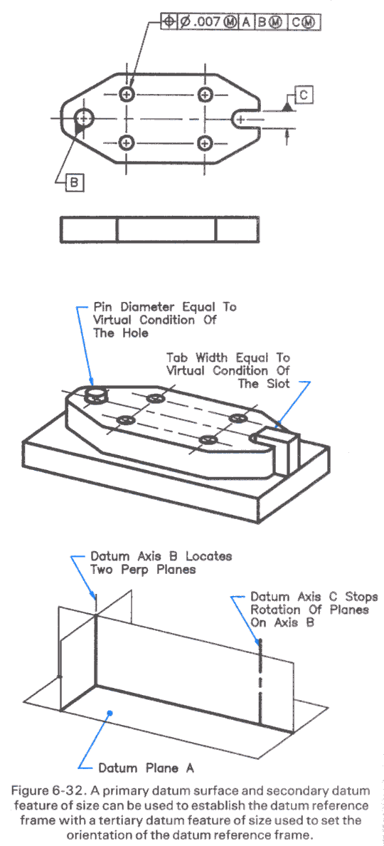
Using a Feature as a Datum
A feature such as a hole, shaft, or slot can be used as a datum.
In this case, the datum is the theoretical axis, centerline, or center plane of the feature.
The “circle M” denotes the datum is defined by the Maximum Material Condition (MMC) given by the tolerance.

Slide 13
Material Conditions
Maximum Material Condition (MMC): The condition in which a feature contains the maximum amount of material within the stated limits. e.g. minimum hole diameter, maximum shaft diameter.
Least Material Condition (LMC): The condition in which a feature contains the least amount of material within the stated limits. e.g. maximum hole diameter, minimum shaft diameter
Regardless of Feature Size (RFS): This is the default condition for all geometric tolerances. No bonus tolerances are allowed and functional gauges may not be used.

Slide 14
Material Conditions
ANSI Y14.5M RULE #1:
A dimensioned feature must have perfect form at its maximum material condition.
This means:
A hole is a perfect cylinder when it is at its smallest permissible diameter,
A shaft is a perfect cylinder when at its largest diameter.
Planes are perfectly parallel when at their maximum distance.
ANSI Y14.5M RULE #2:
If no material condition is specified, then it is “regardless of feature size.”

Slide 15
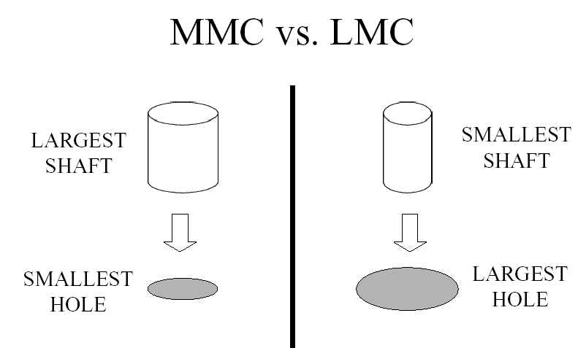
Material Conditions
Which one is which?

Slide 16
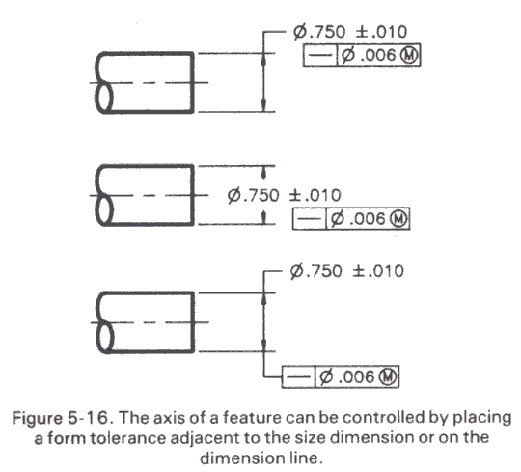
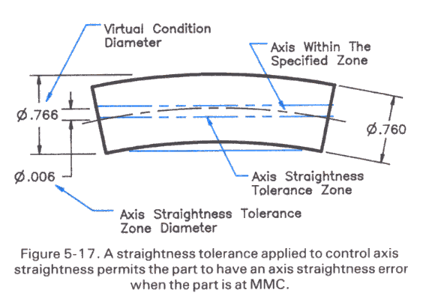
Straightness of a Shaft
A shaft has a size tolerance defined for its fit into a hole. A shaft meets this tolerance if at every point along its length a diameter measurement falls within the specified values.
This allows the shaft to be bent into any shape. A straightness tolerance on the shaft axis specifies the amount of bend allowed.

Slide 17
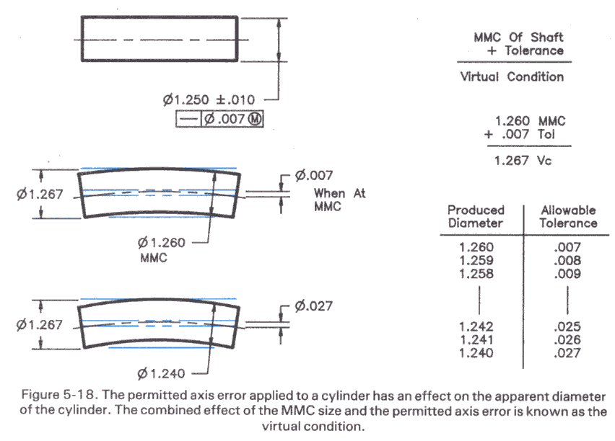
Straightness of a Shaft
Add the straightness tolerance to the maximum shaft size (MMC) to obtain a “virtual condition” Vc, or virtual hole, that the shaft must fit to be acceptable.

Slide 18
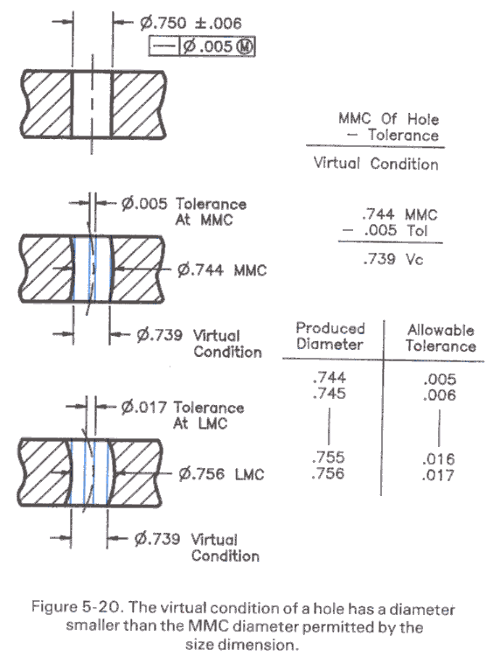
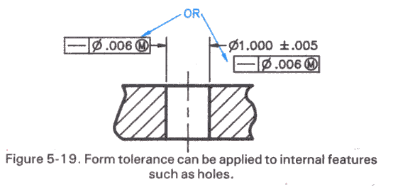
Straightness of a Hole
The size tolerance for a hole defines the range of sizes of its diameter at each point along the centerline. This does not eliminate a curve to the hole.
The straightness tolerance specifies the allowable curve to the hole.
Subtract the straightness tolerance from the smallest hole size (MMC) to define the virtual condition Vc, or virtual shaft, that must fit the hole for it to be acceptable.

Slide 19
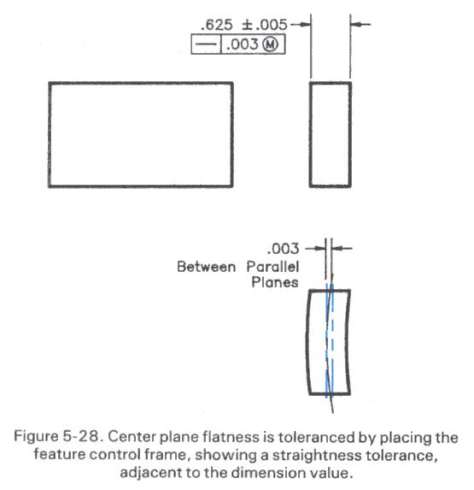
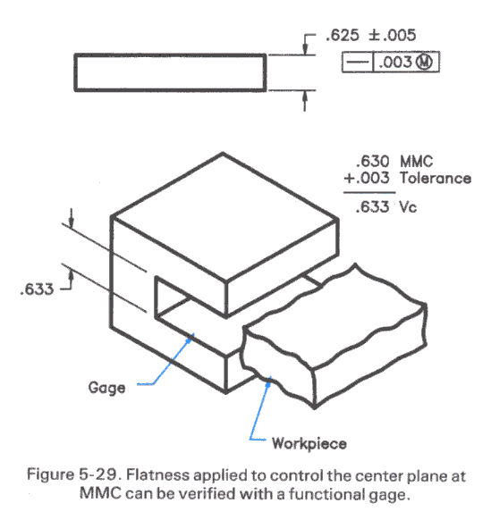
Straightness of a Center Plane
The size dimension of a rectangular part defines the range of sizes at any cross-section.
The straightness tolerance specifies the allowable curve to the entire side.
Add the straightness tolerance to the maximum size (MMC) to define a virtual condition Vc that the part must fit into in order to meet the tolerance.

Slide 20
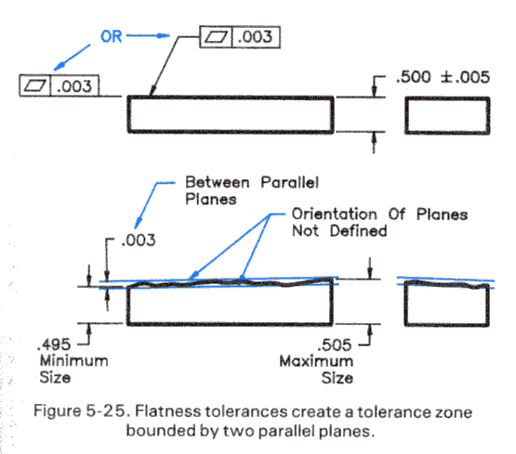
Flatness, Circularity and Cylindricity
The flatness tolerance defines a distance between parallel planes that must contain the highest and lowest points on a face.

Slide 21
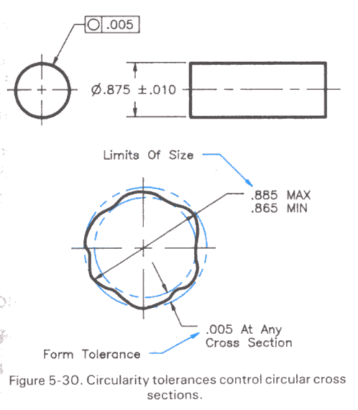
Flatness, Circularity and Cylindricity
The circularity tolerance defines a pair of concentric circles that must contain the maximum and minimum radius points of a circle.

Slide 22
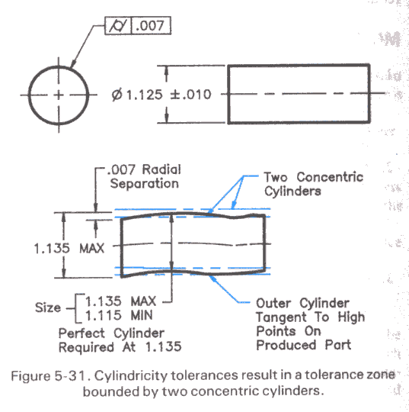
Flatness, Circularity and Cylindricity
The cylindricity tolerance defines a pair of concentric cylinders that must contain the maximum and minimum radius points along a cylinder.

Slide 23
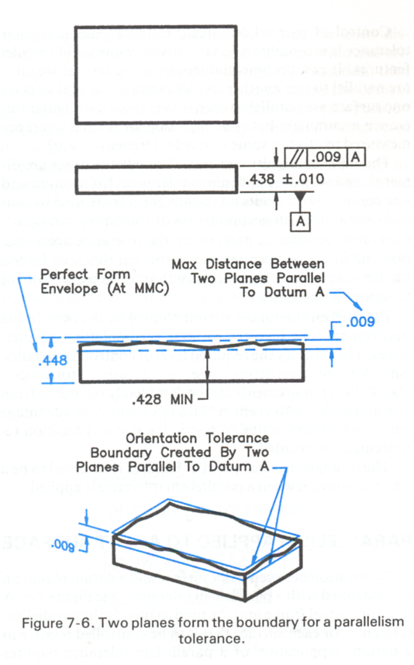
Parallelism Tolerance
A parallelism tolerance is measured relative to a datum specified in the control frame.
If there is no material condition (i.e.. regardless of feature size), then the tolerance defines parallel planes that must contain the maximum and minimum points on the face.

Slide 24
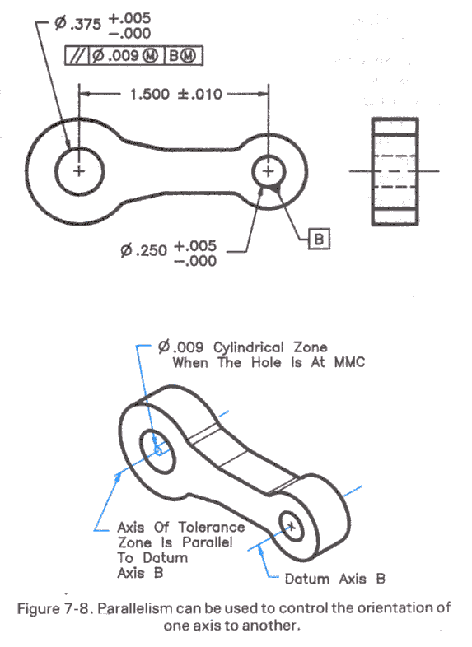
Parallelism Tolerance
If MMC is specified for the tolerance value:
• If it is an external feature, then the tolerance is added to the maximum dimension to define a virtual condition that the part must fit;
• If it is an internal feature, then the tolerance is subtracted to define the maximum dimension that must fit into the part.

Slide 25
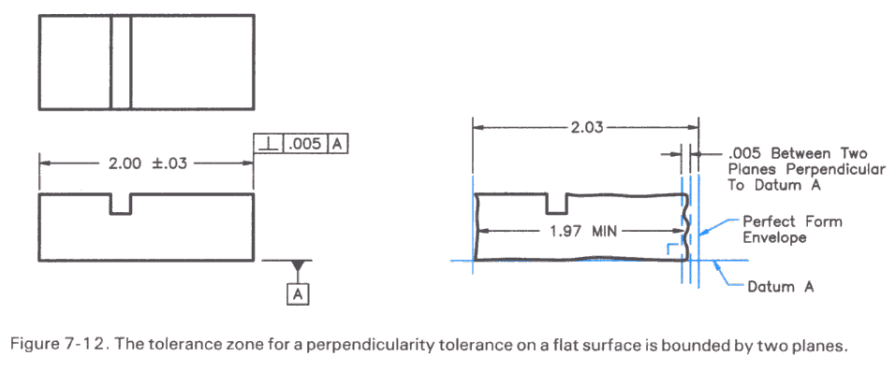
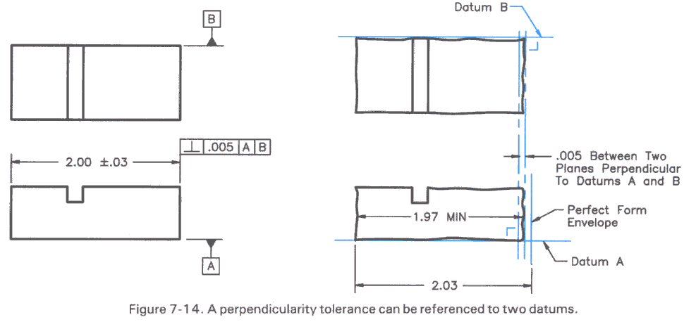
Perpendicularity
A perpendicular tolerance is measured relative to a datum plane.
It defines two planes that must contain all the points of the face.
A second datum can be used to locate where the measurements are taken.

Slide 26
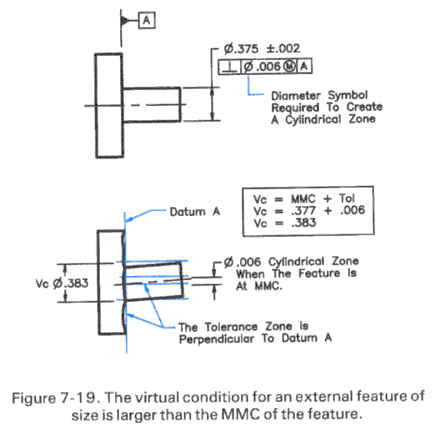
Perpendicular Shaft, Hole, and Center Plane
• Shaft: The maximum shaft size plus the tolerance defines the virtual hole.

Slide 27
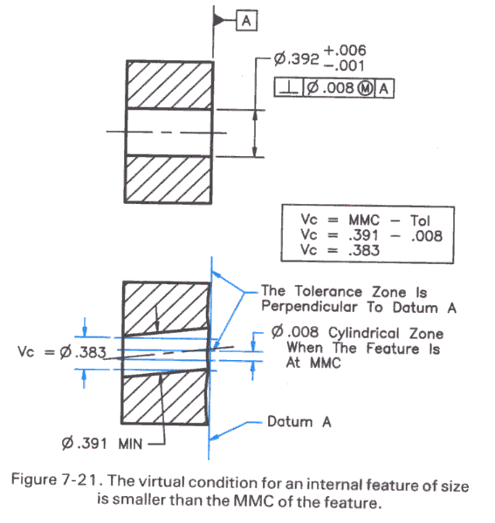
Perpendicular Shaft, Hole, and Center Plane
Hole: The minimum hole size minus the tolerance defines the virtual shaft.

Slide 28
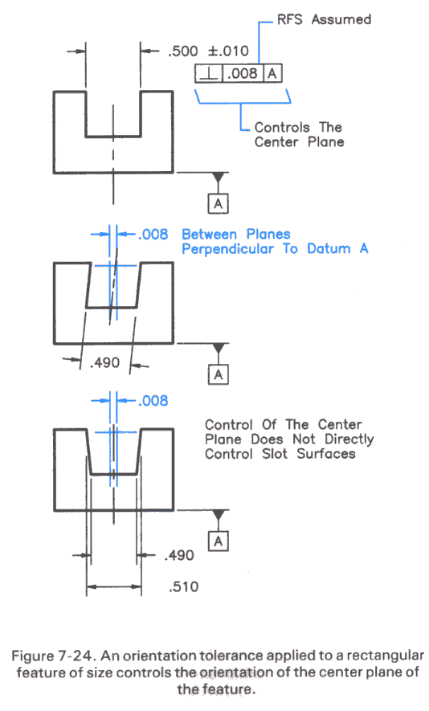
Perpendicular Shaft, Hole, and Center Plane
Plane: The tolerance defines the variation of the location of the center plane.

Slide 29
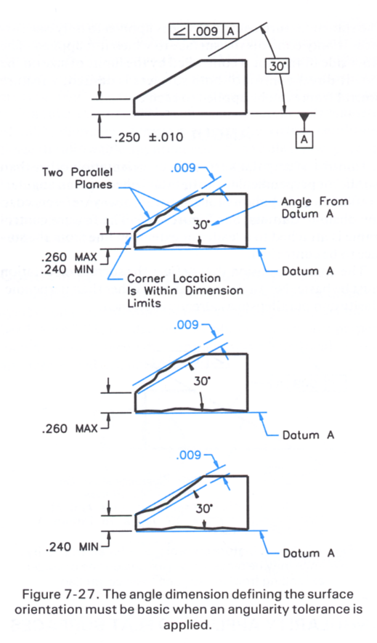
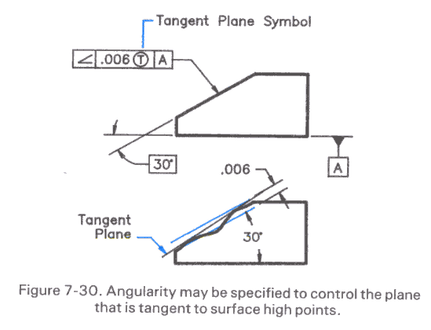
Angularity
An angularity tolerance is measured relative to a datum plane.
It defines a pair of planes that must
contain all the points on the angled face of the part, or
if specified, the plane tangent to the high points of the face.

Slide 30
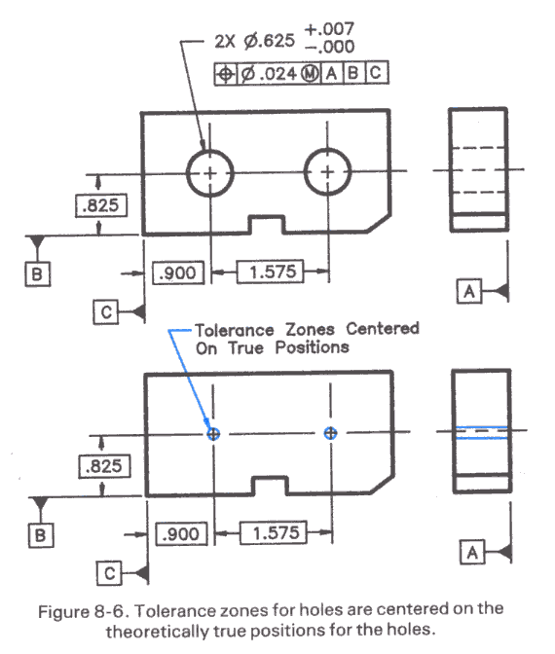
Position Tolerance for a Hole
The position tolerance for a hole defines a zone that has a defined shape, size, location and orientation.
It has the diameter specified by the tolerance and extends the length of the hole.
Basic dimensions locate the theoretically exact center of the hole and the center of the tolerance zone.
Basic dimensions are measured from the datum reference frame.

Slide 31
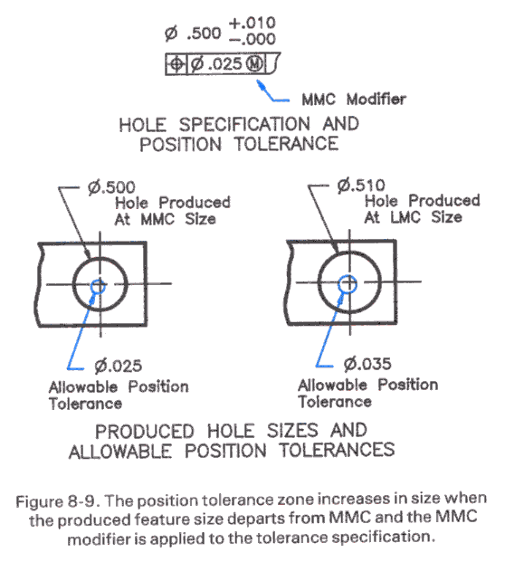
Material Condition Modifiers
MMC:
If the tolerance zone is prescribed for the maximum material condition (smallest hole), then the zone expands by the same amount that the hole is larger in size.
Use MMC for holes used in clearance fits.

Slide 32
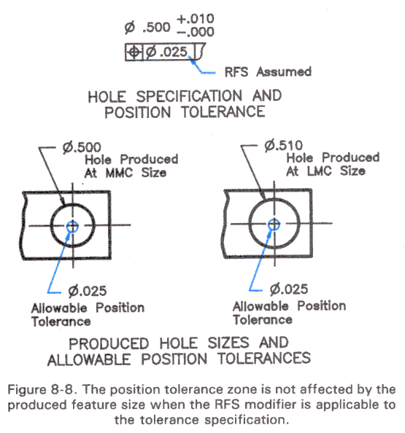
Material Condition Modifiers
RFS:
No material condition modifier means the tolerance is “regardless of feature size.”
Use RFS for holes used in interference or press fits.

Slide 33
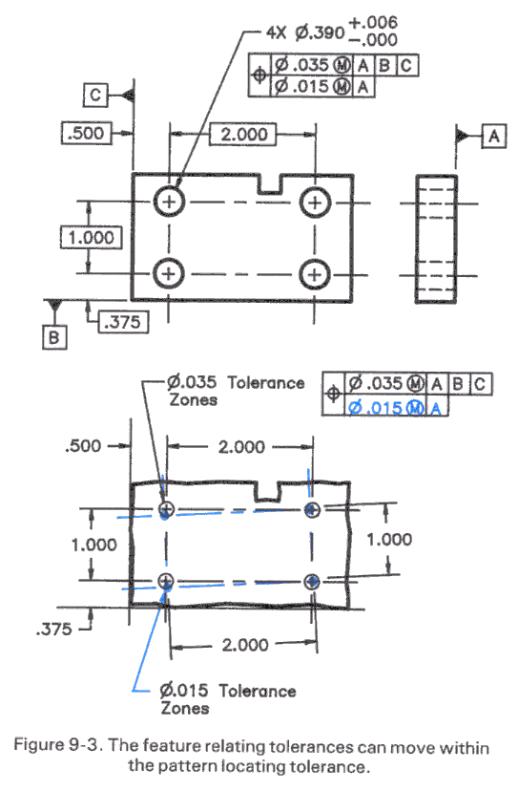
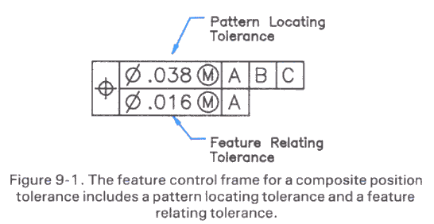
Position Tolerance on a Hole Pattern
A composite control frame signals a tolerance for a pattern of features, such as holes.
The first line defines the position tolerance zone for the holes.
The second line defines the tolerance zone for the pattern, which is generally smaller.
Notes:
This is an advanced (i.e. optional) topic for this chapter

Slide 34
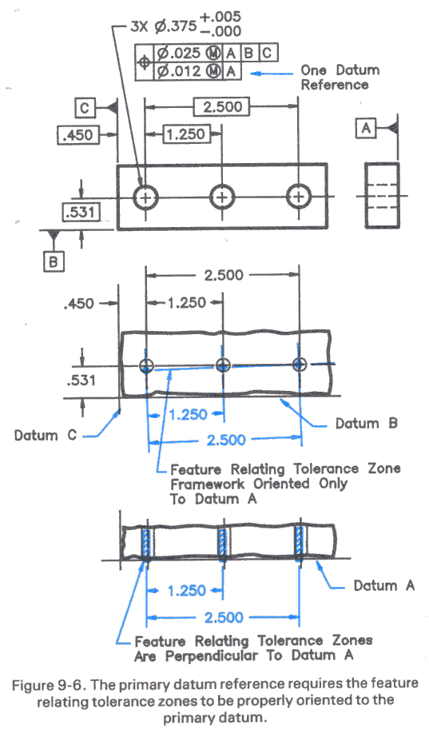
Datum Reference in a Composite Tolerance
A datum specification for the pattern only specifies the orientation of the pattern tolerance zones.
Primary datum specified.

Slide 35
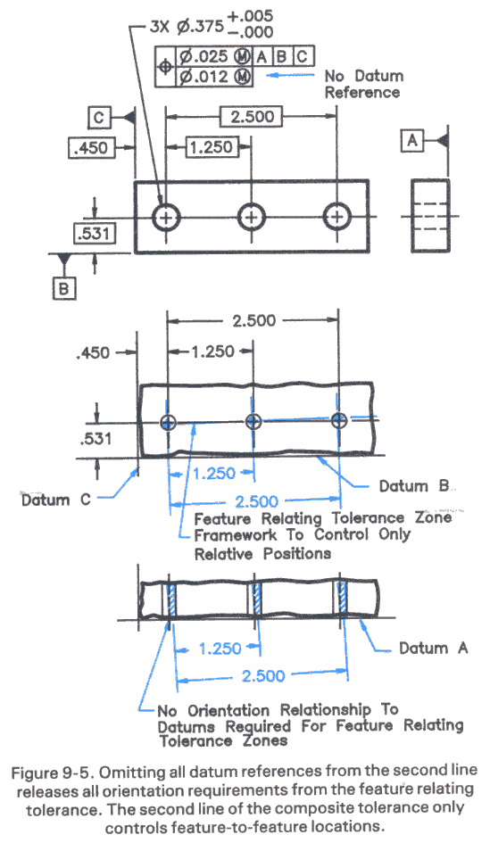
Datum Reference in a Composite Tolerance
No datum for the pattern

Slide 36
Summary
Geometric tolerances are different from the tolerances allowed for the size of feature, they specify the allowable variation of the shape of a feature.
There are three basic types of geometric tolerances: Form, Orientation and Position tolerances.
Geometric tolerances are specified using a control frame consisting of a tolerance symbol, a tolerance value and optional datum planes.
Material condition modifiers define the condition at which the tolerance is to be applied. If the maximum material condition is specified, then there is a “bonus tolerance” associated with a decrease in material.
1. The form of a feature is assumed to be perfect at its maximum material condition.
2. If no material condition is specified, then it is regard less of feature size.

Slide 37
Additional materials
http://www.engineersedge.com/tolerance__calc_menu.shtml
http://www.engineersedge.com/gdt.htm

